Slide 1
CSEP 521 Applied Algorithms
Richard Anderson
Winter 2013
Lecture 1

Slide 2
CSEP 521 Course Introduction
CSEP 521, Applied Algorithms
Monday’s, 6:30-9:20 pm
CSE 305 and Microsoft Building 99
Instructor
Richard Anderson, anderson@cs.washington.edu
Office hours:
CSE 582
Monday, 4:00-5:00 pm or by appointment
Teaching Assistant
Tanvir Aumi, tanvir@cs.washington.edu
Office hours:
TBD

Slide 3
Announcements
It’s on the web.
Homework due at start of class on Mondays
HW 1, Due January 14, 2013
It’s on the web
http://www.cs.washington.edu/education/courses/csep521/13wi/

Slide 4
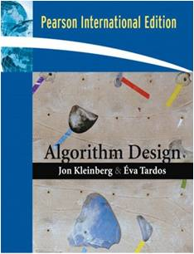
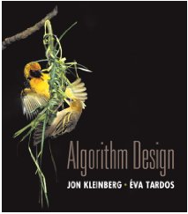
Text book
Algorithm Design
Jon Kleinberg, Eva Tardos
Read Chapters 1 & 2
Expected coverage:
Chapter 1 through 7

Slide 5
Recorded lectures
This is a distance course, so lectures are recorded and will be available on line for later viewing
However, low attendance in the distance PMP course is a concern
Various draconian measures are under discussion
We will make lectures available
Please attend class, and participate
Participation may be a component of the class grade

Slide 6
Lecture schedule
Monday holidays:
Monday, January 21, MLK
Monday, February 18, President’s day
Make up lectures will be scheduled, which will be recorded for offline viewing
Hopefully, some students will attend, so there is a studio audience
First makeup lecture:
Thursday, January 17, 5:00-6:30 pm
Additional makeup lectures to accommodate RJA’s travel schedule

Slide 7
Course Mechanics
Homework
Due Mondays
Textbook problems and programming exercises
Choice of language
Expectation that Algorithmic Code is original
Target: 1 week turnaround on grading
Late Policy: Two assignments may be turned in up to one week late
Exams (In class, tentative)
Midterm, Monday, Feb 11 (60 minutes)
Final, Monday, March 18, 6:30-8:20 pm
Approximate grade weighting
HW: 50, MT: 15, Final: 35

Slide 8
All of Computer Science is the Study of Algorithms

Slide 9
How to study algorithms
Zoology
Mine is faster than yours is
Algorithmic ideas
Where algorithms apply
What makes an algorithm work
Algorithmic thinking

Slide 10
Introductory Problem: Stable Matching
Setting:
Assign TAs to Instructors
Avoid having TAs and Instructors wanting changes
E.g., Prof A. would rather have student X than her current TA, and student X would rather work for Prof A. than his current instructor.
Purpose of the example: new, interesting problem, show how different ideas apply

Slide 11
Formal notions
Perfect matching
Ranked preference lists
Stability
m₁
w₁
m₂
w₂

Slide 12
Example (1 of 3)
m₁: w₁ w₂
m₂: w₂ w₁
w₁: m₁ m₂
w₂: m₂ m₁
m₁
w₁
m₂
w₂

Slide 13
Example (2 of 3)
m₁: w₁ w₂
m₂: w₁ w₂
w₁: m₁ m₂
w₂: m₁ m₂
m₁
w₁
m₂
w₂

Slide 14
Example (3 of 3)
m₁: w₁ w₂
m₂: w₂ w₁
w₁: m₂ m₁
w₂: m₁ m₂
m₁
w₁
m₂
w₂

Slide 15
Formal Problem
Input
Preference lists for m₁, m₂, …, m_{n}
Preference lists for w₁, w₂, …, w_{n}
Output
Perfect matching M satisfying stability property:
∀ m’, w’’, (m’, w’’) is NOT an instability
If (m’, w’) ∈ M and (m’’, w’’) ∈ M then
(m’ prefers w’ to w’’) or (w’’ prefers m’’ to m’)

Slide 16
Idea for an Algorithm
m proposes to w
If w is unmatched, w accepts
If w is matched to m₂
If w prefers m to m₂ w accepts m, dumping m₂
If w prefers m₂ to m, w rejects m
Unmatched m proposes to the highest w on its preference list that it has not already proposed to

Slide 17
Algorithm
Initially all m in M and w in W are free
While there is a free m
w highest on m’s list that m has not proposed to
if w is free, then match (m, w)
else
suppose (m₂, w) is matched
if w prefers m to m₂
unmatch (m₂, w)
match (m, w)

Slide 18
Example
m₁: w₁ w₂ w₃
m₂: w₁ w₃ w₂
m₃: w₁ w₂ w₃
w₁: m₂ m₃ m₁
w₂: m₃ m₁ m₂
w₃: m₃ m₁ m₂
m₁
w₁
m₂
w₂
m₃
w₃
Order: m₁, m₂, m₃, m₁, m₃, m₁

Slide 19
Does this work?
Does it terminate?
Is the result a stable matching?
Begin by identifying invariants and measures of progress
m’s proposals get worse (have higher m-rank)
Once w is matched, w stays matched
w’s partners get better (have lower w-rank)

Slide 20
Claim: The algorithm stops in at most n² steps
Each m asks each w at most once

Slide 21
When the algorithms halts, every w is matched
Why?
Hence, the algorithm finds a perfect matching
Invariant: partial matching
What happens when some m reaches its last choice?
exactly n-1 w’s much be matched
last choice must be available

Slide 22
The resulting matching is stable
Suppose
(m₁, w₁) ∈ M, (m₂, w₂) ∈ M
m₁ prefers w₂ to w₁
How could this happen?
m₁
w₁
m₂
w₂
m₁ proposed to w₂ before w₁
w₂ rejected m₁ for m₃
w₂ prefers m₃ to m₁
w₂ prefers m₂ to m₃

Slide 23
Result
Simple, O(n²) algorithm to compute a stable matching
Corollary
A stable matching always exists

Slide 24
A closer look
Stable matchings are not necessarily fair
m₁
w₁
m₁: w₁ w₂ w₃
m₂: w₂ w₃ w₁
m₃: w₃ w₁ w₂
w₁: m₂ m₃ m₁
w₂: m₃ m₁ m₂
w₃: m₁ m₂ m₃
m₂
w₂
m₃
w₃
How many stable matchings can you find?

Slide 25
Algorithm under specified
Many different ways of picking m’s to propose
Surprising result
All orderings of picking free m’s give the same result
Proving this type of result
Reordering argument
Prove algorithm is computing something mores specific
Show property of the solution – so it computes a specific stable matching

Slide 26
Proposal Algorithm finds the best possible solution for M
Formalize the notion of best possible solution:
(m, w) is valid if (m, w) is in some stable matching
best(m): the highest ranked w for m such that (m, w) is valid
S* = {(m, best(m)}
Every execution of the proposal algorithm computes S*

Slide 27
Proof
See the text book – pages 9 – 12
Related result: Proposal algorithm is the worst case for W
Algorithm is the M-optimal algorithm
Proposal algorithms where w’s propose is W-Optimal

Slide 28
Best choices for one side may be bad for the other
Design a configuration for problem of size 4:
M proposal algorithm:
All m’s get first choice, all w’s get last choice
W proposal algorithm:
All w’s get first choice, all m’s get last choice
m₁:
m₂:
m₃:
m₄:
w₁:
w₂:
w₃:
w₄:
M’s:
1342
2341
3124
4123
W’s:
2341
1342
4123
3124

Slide 29
But there is a stable second choice
Design a configuration for problem of size 4:
M proposal algorithm:
All m’s get first choice, all w’s get last choice
W proposal algorithm:
All w’s get first choice, all m’s get last choice
There is a stable matching where everyone gets their second choice
m₁:
m₂:
m₃:
m₄:
w₁:
w₂:
w₃:
w₄:
M’s:
1342
2431
3214
4123
W’s:
2431
1342
4123
3214

Slide 30
Suppose there are n m’s, and n w’s
What is the minimum possible M-rank?
What is the maximum possible M-rank?
Suppose each m is matched with a random w, what is the expected M-rank?

Slide 31
Random Preferences
Suppose that the preferences are completely random
m₁: w₈ w₃ w₁ w₅ w₉ w₂ w₄ w₆ w₇ w₁₀
m₂: w₇ w₁₀ w₁ w₉ w₃ w₄ w₈ w₂ w₅ w₆
…
w₁: m₁ m₄ m₉ m₅ m₁₀ m₃ m₂ m₆ m₈ m₇
w₂: m₅ m₈ m₁ m₃ m₂ m₇ m₉ m₁₀ m₄ m₆
…
If there are n m’s and n w’s, what is the expected
value of the M-rank and the W-rank when the
proposal algorithm computes a stable matching?

Slide 32
What is the run time of the Stable Matching Algorithm?
Initially all m in M and w in W are free
While there is a free m
w highest on m’s list that m has not proposed to
if w is free, then match (m, w)
else
suppose (m₂, w) is matched
if w prefers m to m₂
unmatch (m₂, w)
match (m, w)
Executed at most n² times

Slide 33
O(1) time per iteration
Find free m
Find next available w
If w is matched, determine m₂
Test if w prefers m to m₂
Update matching

Slide 34
What does it mean for an algorithm to be efficient?

Slide 35
Key ideas
Formalizing real world problem
Model: graph and preference lists
Mechanism: stability condition
Specification of algorithm with a natural operation
Proposal
Establishing termination of process through invariants and progress measure
Under specification of algorithm
Establishing uniqueness of solution

Slide 36
Five Problems

Slide 37
Theory of Algorithms
What is expertise?
How do experts differ from novices?
Point of slide – experts have a
Structure of knowledge

Slide 38
Introduction of five problems
Show the types of problems we will be considering in the class
Examples of important types of problems
Similar looking problems with very different characteristics
Problems
Scheduling
Weighted Scheduling
Bipartite Matching
Maximum Independent Set
Competitive Facility Location

Slide 39
What is a problem?
Example: Minimum Spanning Tree
Instance
Solution
Constraints on solution
Measure of value
Graph
Set of edges
Tree constraints
Edge costs

Slide 40
Problem: Scheduling
Suppose that you own a banquet hall
You have a series of requests for use of the hall: (s₁, f₁), (s₂, f₂), . . .
Find a set of requests as large as possible with no overlap

Slide 41
What is the largest solution?

Slide 42
Greedy Algorithm
Test elements one at a time if they can be members of the solution
If an element is not ruled out by earlier choices, add it to the solution
Many possible choices for ordering (length, start time, end time)
For this problem, considering the jobs by increasing end time works

Slide 43
Suppose we add values?
(s_{i}, f_{i}, v_{i}), start time, finish time, payment
Maximize value of elements in the solution
5
2
1
1
2
4
1
3
1
6

Slide 44
Greedy Algorithms
1
Earliest finish time
Maximum value
Give counter examples to show these algorithms don’t find the maximum value solution
2
2
2
3

Slide 45
Dynamic Programming
Requests R₁, R₂, R₃, . . .
Assume requests are in increasing order of finish time (f₁ < f₂ < f₃ . . .)
Opt_{i} is the maximum value solution of {R₁, R₂, . . ., R_{i}} containing R_{i}
Opt_{i} = Max{ j | f_{j} < s_{i} }[Opt_{j} + v_{i}]

Slide 46
Matching
Given a bipartite graph G=(U,V,E), find a subset of the edges M of maximum size with no common endpoints.
Application:
U: Professors
V: Courses
(u,v) in E if Prof. u can teach course v

Slide 47
Find a maximum matching

Slide 48
Augmenting Path Algorithm
s
t
Trace path from s to t to
show augmenting path

Slide 49
Reduction to network flow
More general problem
Send flow from source to sink
Flow subject to capacities at edges
Flow conserved at vertices
Can solve matching as a flow problem

Slide 50
Maximum Independent Set
Given an undirected graph G=(V,E), find a set I of vertices such that there are no edges between vertices of I
Find a set I as large as possible

Slide 51
Find a Maximum Independent Set
A
C
D
B
E
F
G
H
K
J
L
O
S
I
N
T
M
R
Q
U
P

Slide 52
Verification: Prove the graph has an independent set of size 10

Slide 53
Key characteristic
Hard to find a solution
Easy to verify a solution once you have one
Other problems like this
Hamiltonian circuit
Clique
Subset sum
Graph coloring

Slide 54
NP-Completeness
Theory of Hard Problems
A large number of problems are known to be equivalent
Very elegant theory

Slide 55
Are there even harder problems?
Simple game:
Players alternating selecting nodes in a graph
Score points associated with node
Remove nodes neighbors
When neither can move, player with most points wins
4
3
2
6
5
2
3
4
1
6

Slide 56
5
6
4
6
5
5
6
4
1
6
2
1
4
2
5
8
7
8
5
4
4
5
4
3
4

Slide 57
Competitive Facility Location
Choose location for a facility
Value associated with placement
Restriction on placing facilities too close together
Competitive
Different companies place facilities
E.g., KFC and McDonald’s

Slide 58
Complexity theory
These problems are P-Space complete instead of NP-Complete
Appear to be much harder
No obvious certificate
G has a Maximum Independent Set of size 10
Player 1 wins by at least 10 points

Slide 59
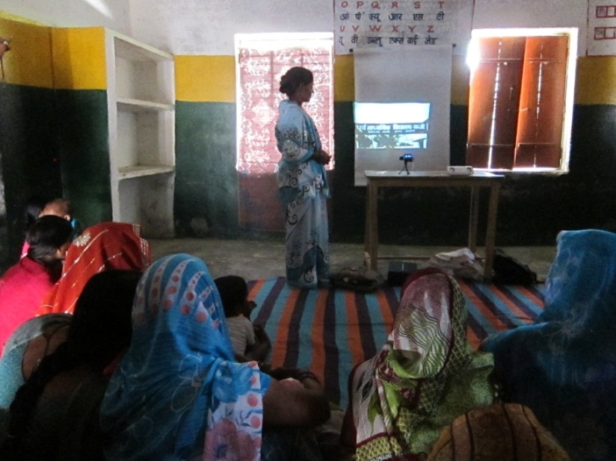
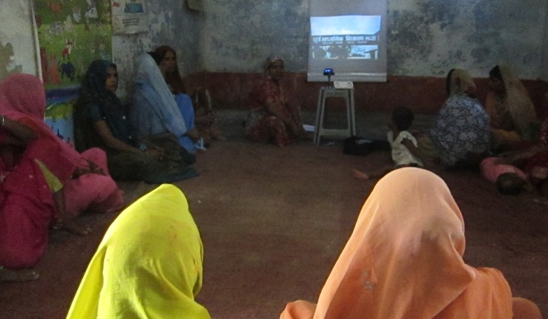
An NP-Complete problem from Digital Public Health
ASHAs use Pico projectors to show health videos to Mothers’ groups
Limited number of Pico projectors, so ASHAs must travel to where the Pico projector is stored
Identify storage locations for k Pico projectors to minimize the maximum distance an ASHA must travel

Slide 60
Summary
Scheduling
Weighted Scheduling
Bipartite Matching
Maximum Independent Set
Competitive Scheduling

