Slide 1
Catch A Ride
Ashwini, Keith, Jarret

Slide 2

Overall Problem and Solution
Ridesharing Problems
Vanpool: complicated initial startup
Craigslist: unreliable, unsafe, difficult to find rideshares, minimal driver profile info
Catch-A-Ride Solution
Semistructured smartphone application including strong user profiles and advanced search functionality

Slide 3
Presentation Overview
CI informed our project
Participant interviews
Main tasks
Early sketches
Current selected design

Slide 4


Contextual Inquiry - Participants
Steph
Took our rideshare to Olympia
Leon
HR manager that runs the employee
carpool program at the Summit at
Snoqualmie
Leslie - Vanpools at Microsoft

Slide 5
Contextual Inquiry - Description
Research Covered
Available programs (government, employer, craigslist)
Typical user profile (demographics, smartphone owner)

Slide 6
Contextual Inquiry - Results
Focused on Craigslist after Inquiry
Vanpool - great program after complicated initial setup
Craigslist - main concerns included safety, reliability, …
Our users - 18 to 30 years old, own smart phones

Slide 7
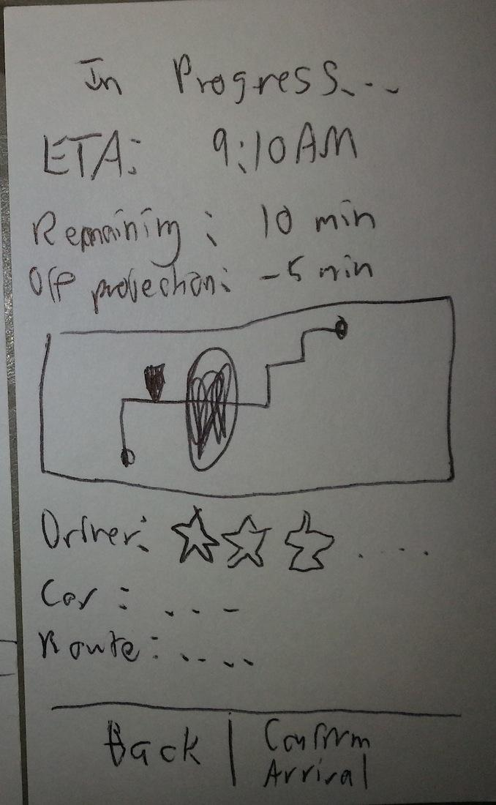
Representative Task - Easy
Reviewing a Driver
Maintaining long-lived user profiles allows us to prompt for rider feedback during the rideshare
A map displays realtime location information during the ride
Riders touch 0 to 5 stars to rate the driver, car, and route

Slide 8
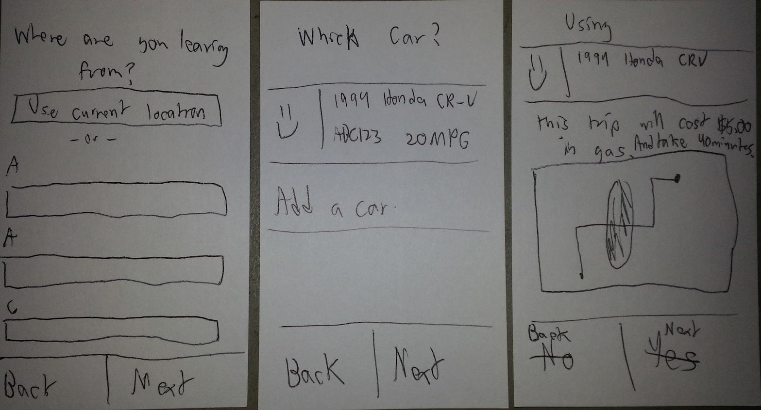
Representative Task - Medium
Posting a Ride Offer
Wizard reconfirms driver input and provides a route map

Slide 9
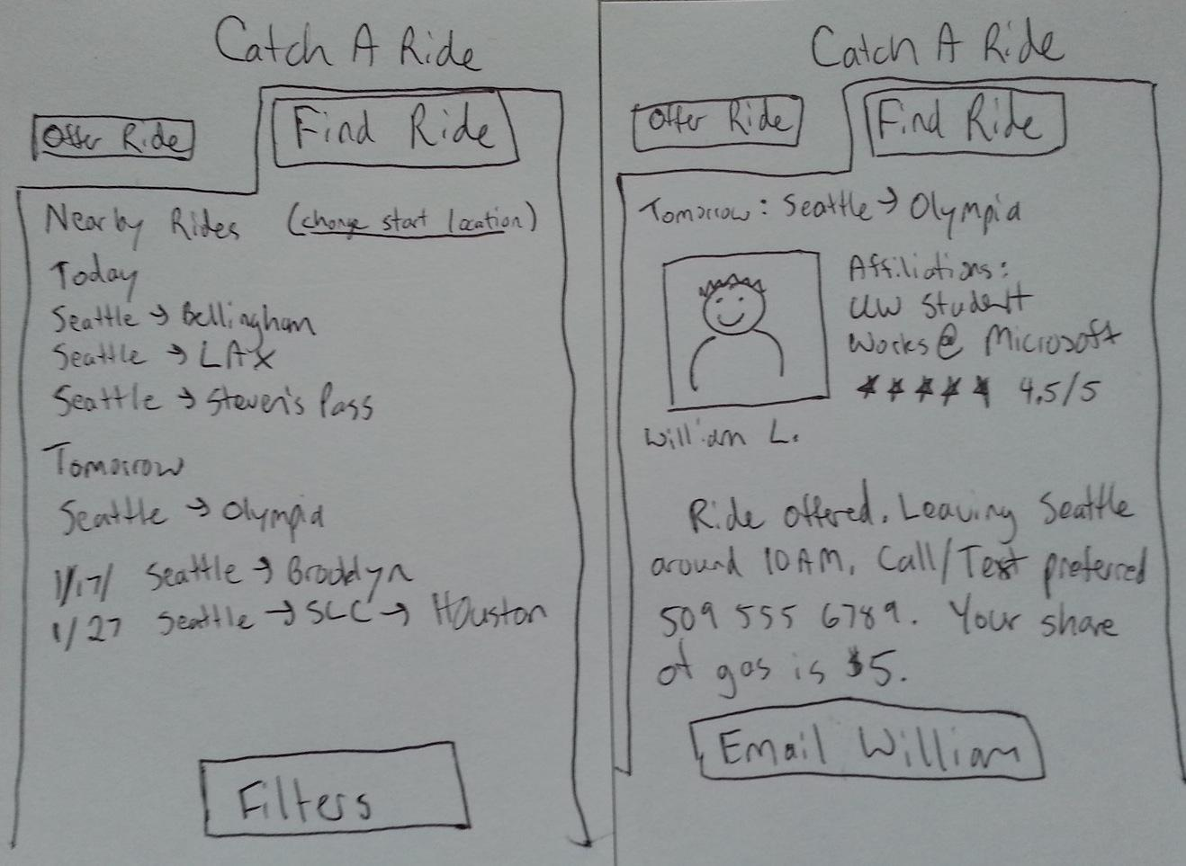
Representative Task - Hard
Finding a Rideshare
Available rides sorted by departure time
Rich user profiles on rideshare descriptions instill trust in the driver
Many advanced filters (pets, smoking)

Slide 10
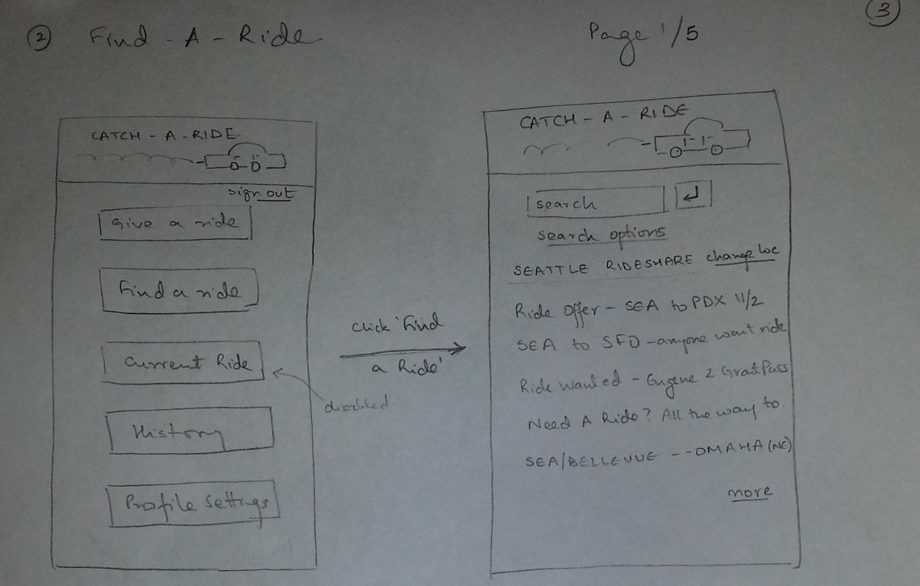
Early Sketches - Version A
Learned that sorting ride offers by creation date could be improved.
Home menu used basic buttons.

Slide 11
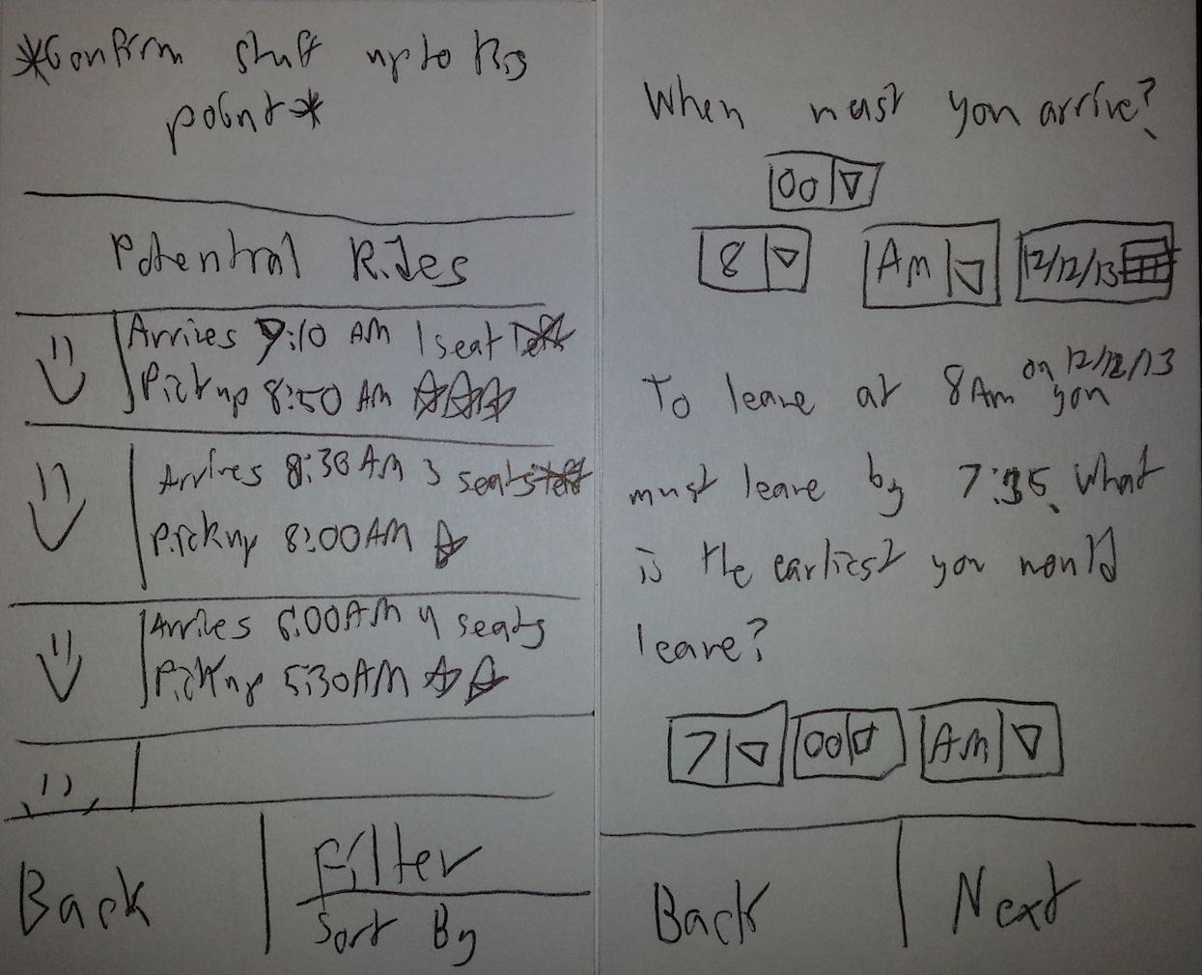
Early Sketches - Version B
Since passengers typically have flexibility in departure time, we needed to simplify our eHarmony-like matching engine.

Slide 12
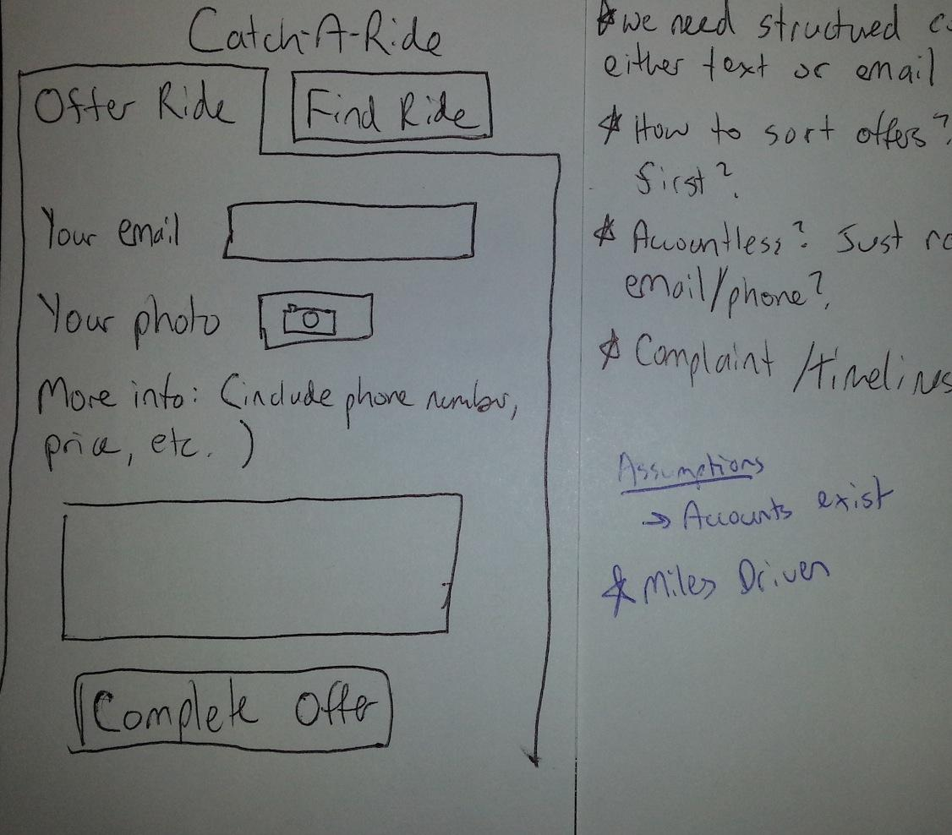
Early Sketches - Version C
Decided to assume that external accounts must exist; we needed a persistent place for contact info and reviews.

Slide 13
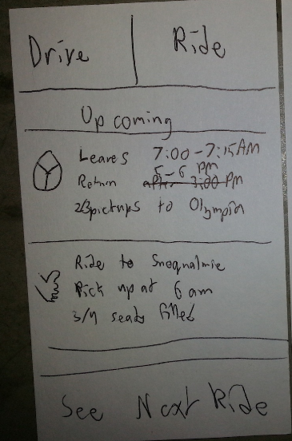
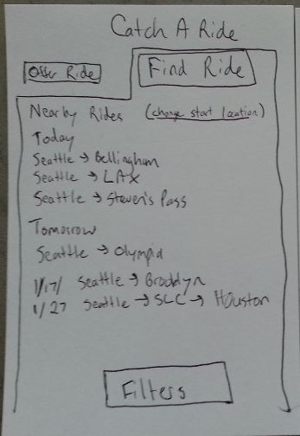
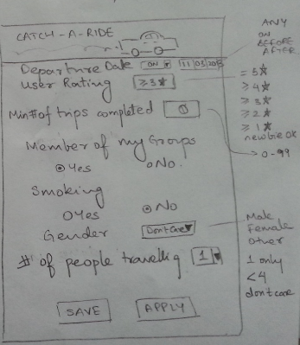
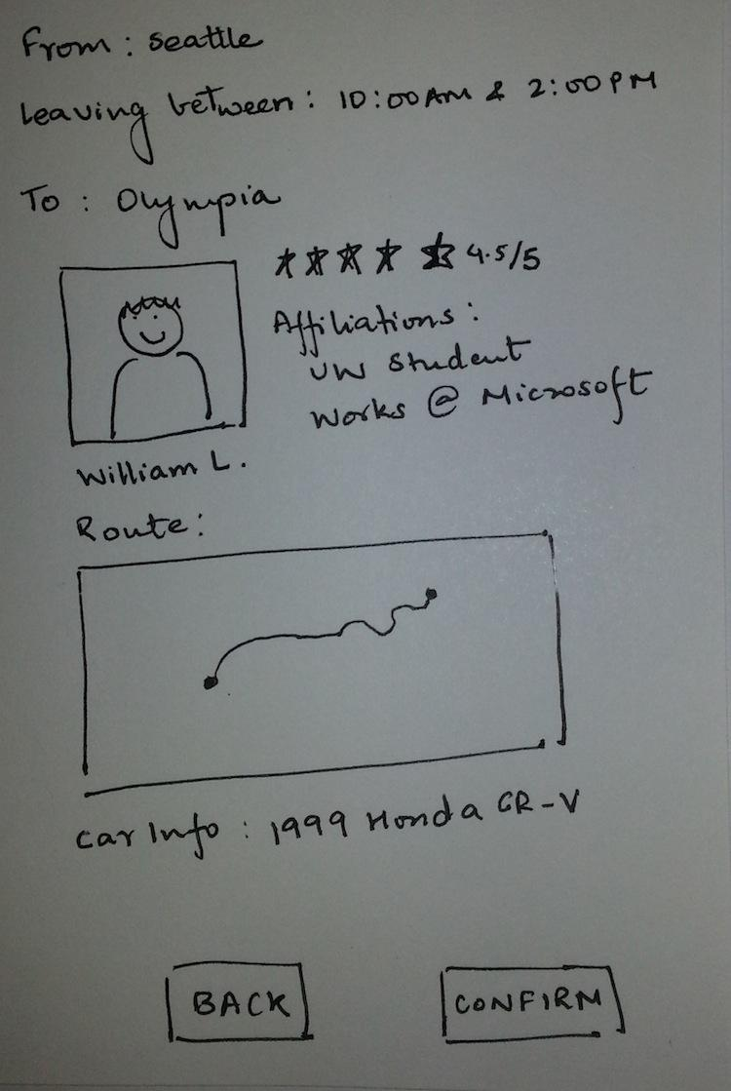
Selected Design - Find a Ride
Workflow includes main menu, list of available rides, filtering, and details for each rideshare

Slide 14
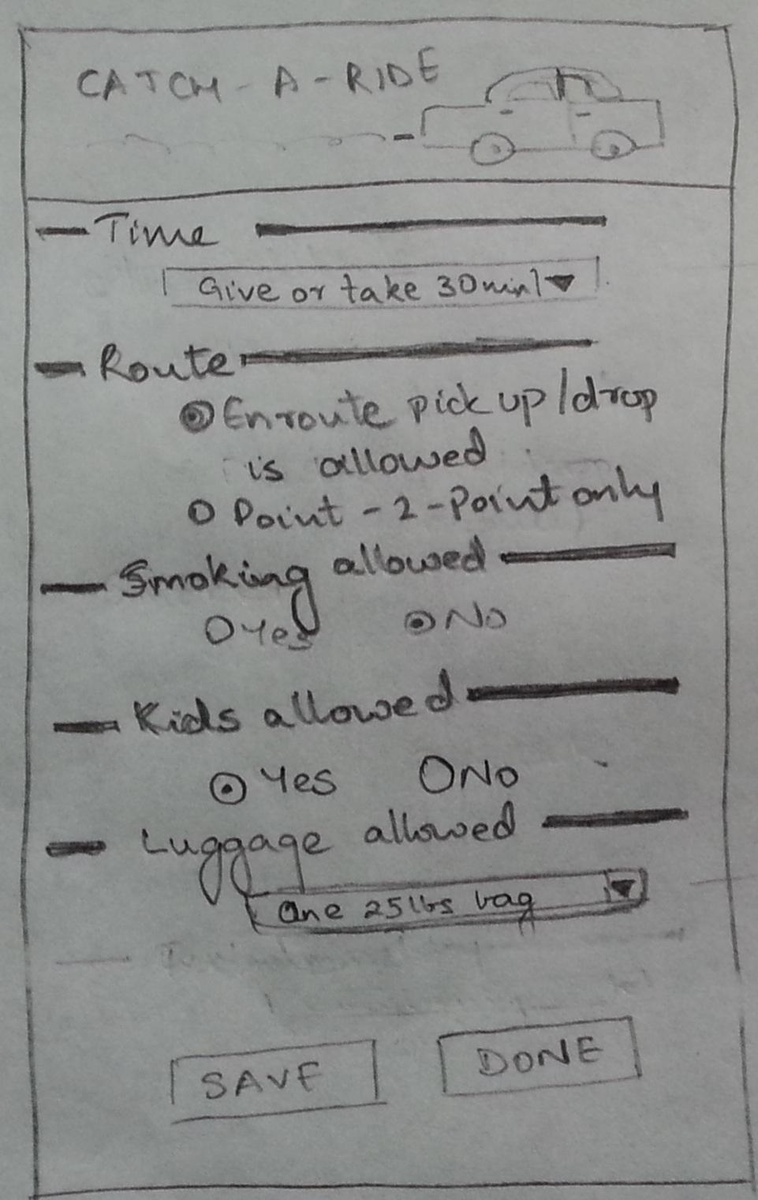
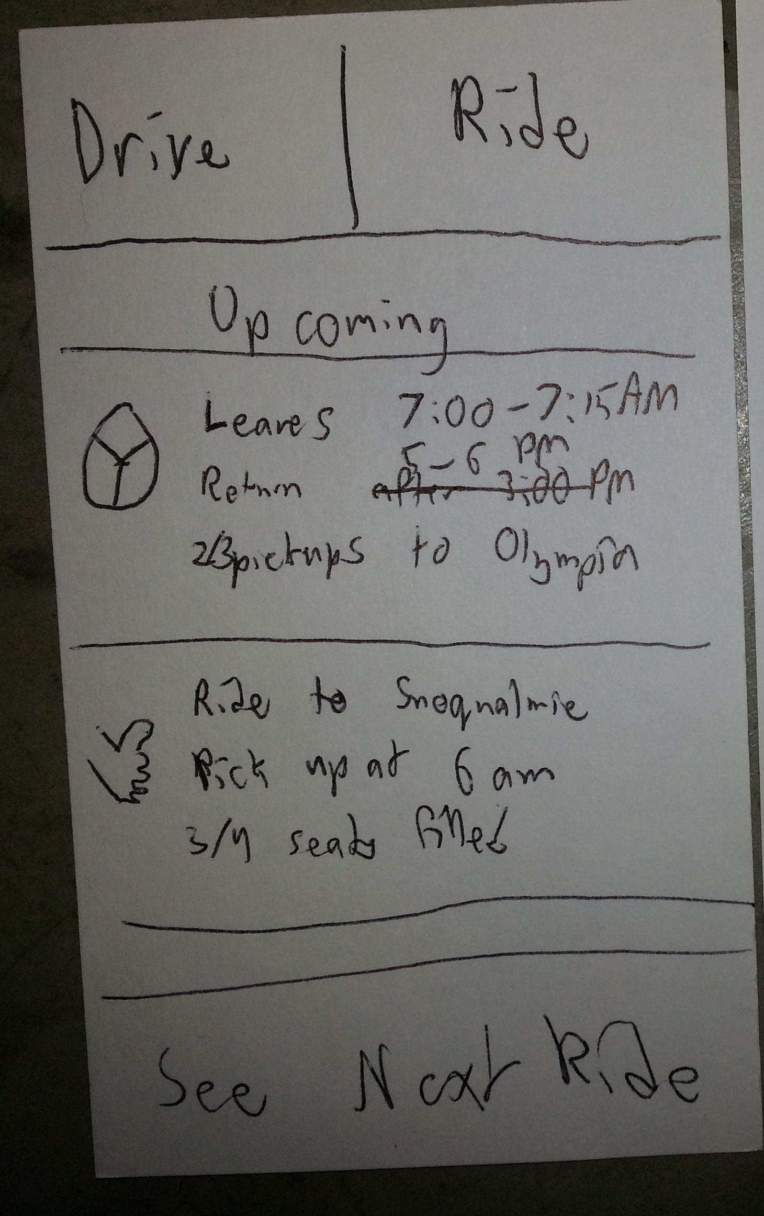
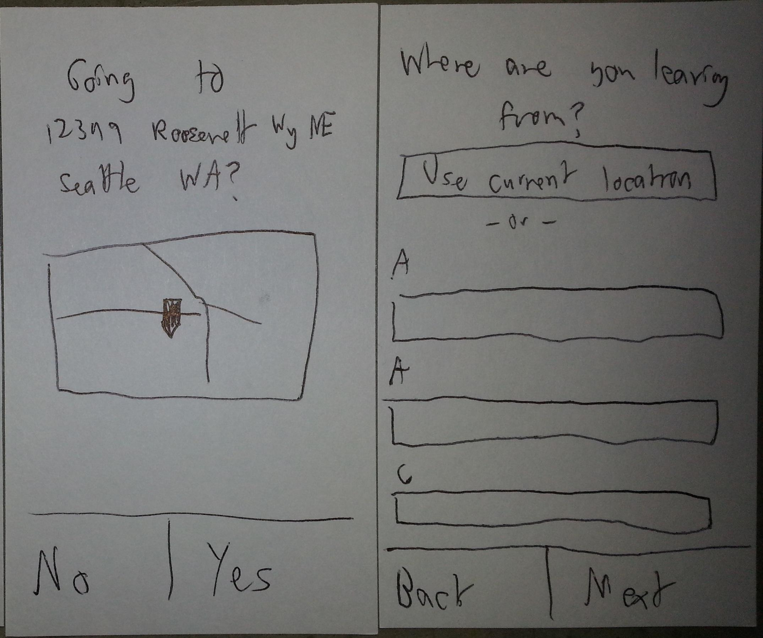
Selected Design - List a Ride
Workflow includes main menu, destination and starting location prompts, and trip options (smoking, luggage allowed, etc)

Slide 15
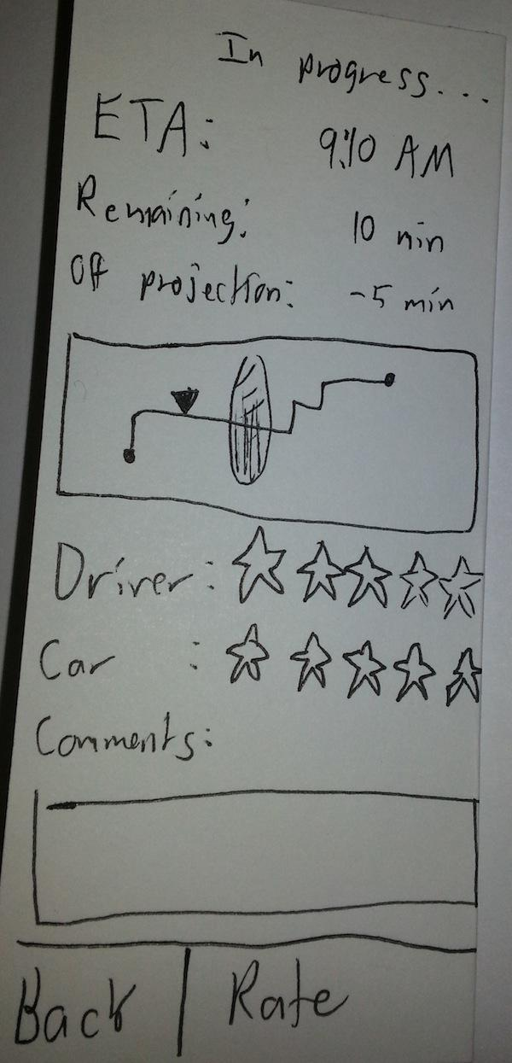
Selected Design - Review a Driver
Accessed within an in-progress rideshare summary screen.
Added freeform text comments
after reviewing prototypes
Easy task, valuable info for users

Slide 16
Catch-A-Ride Summary
Semistructured mobile app for rideshares
Users want safe, reliable ad-hoc rideshare
Tasks include posting, searching, and reviewing
Vanpool requires complicated setup
Craigslist lacks user profiles
Any Questions?

