Slide 1
CSE P 501 – Compilers
Inlining and Devirtualization
Hal Perkins
Autumn 2009

Slide 2
References
Adaptive Online Context-Sensitive Inlining Hazelwood and Grove, ICG 2003
A Study of Devirtualization Techniques for a Java JIT Compiler Ishizaki, et al, OOPSLA 2000
Slides by Vijay Menon, CSE 501, Sp09

Slide 3
Inlining
long res;
void foo(long x)
{
res = 2 * x;
}
void bar() {
foo(5);
}
long res;
void foo(long x)
{
res = 2 * x;
}
void bar() {
res = 2 * 5;
}
long res;
void foo(long x)
{
res = 2 * x;
}
void bar() {
res = 10;
}

Slide 4
Benefits
Reduction on function invocation overhead
No marshalling / unmarshalling parameters and return values
Better instruction cache locality
Expanded optimization opportunities
CSE, constant propagation, unreachable code elimination, ...
Poor man’s interprocedural optimization

Slide 5
Costs
Code size
Typically expands overall program size
Can hurt icache
Compilation time
Larger methods can lead to more expensive compilation, more complex control flow

Slide 6
Language / runtime aspects
What is the cost of a function call?
C: cheap, Java: moderate, Python: expensive
Are targets resolved at compile time or run time?
C: compile time; Java, Python: run time
Is the whole program available for analysis?
Is profile information available?

Slide 7
When to inline?
Jikes RVM (with Hazelwood/Grove adaptations):
Call Inst. Sequence (CIS) = # of Inst to make call
Tiny (function size < 2x call size) : Always inline
Small (2-5x) : Inline subject to space constr.
Medium (5-25x) : Inline if hot (sub. to space)
Large : Never inline

Slide 8
Gathering profile info
Counter-based: Instrument edges in CFG
Entry + loop back edges
Enough edges (e.g., Ball / Larus)
Expensive - typically removed in opt. code
Call stack sampling
Periodically walk stack
Interrupt-based or instrumentation-based

Slide 9
Object-oriented languages
OO encourages lots of small methods
getters, setters, ...
Inlining a requirement for performance
High call overhead wrt total execution
Limited scope for compiler optimizations
For Java, if you’re going to anything, do this!
But ... virtual methods a challenge

Slide 10
Virtual methods
class A {
int foo() { return 0; }
int bar() { return 1; }
}
class B extends A {
int foo() { return 2; }
}
void baz(A x) {
y = x.foo();
z = x.bar();
}
In general, we cannot determine the target until runtime
Some languages (e.g., Java) allow dynamic class loading: all subclasses of A may not be visible until runtime

Slide 11
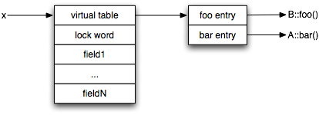
Virtual tables
Object layout in a JVM:

Slide 12
Virtual method dispatch
t1 = ldvtable x
t2 = ldvirtfunaddr t1, A::foo
t3 = call [t2] (x)
t4 = ldvtable x
t5 = ldvirtfunaddr t4, A::bar
t6 = call [t4] (x)
x is receiver object
For a receiver object with a runtime type of B, t2 will refer to B::foo.

Slide 13
Devirtualization
Compiler converts virtual calls to static calls
Benefits: enables inlining, lowers call overhead, better branch prediction on calls
Often optimistic:
Make guess at compile time
Test guess at run time
Fall back to virtual call if necessary

Slide 14
Guarded devirtualization
Guess receiver type is B (e.g, based on profile).
Call to B::foo is statically known - can be inlined.
Guard inhibits optimization
t1 = ldvtable x
t7 = getvtable B
if t1 == t7
t3 = call B::foo(x)
else
t2 = ldvirtfunaddr t1, A::foo
t3 = call [t2] (x)
...

Slide 15
Guarded by method test
t1 = ldvtable x
t2 = ldvirtfunaddr t1
t7 = getfunaddr B::foo
if t2 == t7
t3 = call B::foo(x)
else
t2 = ldvirtfunaddr t1, A::foo
t3 = call [t2] (x)
...
Guess that method is B:foo
More robust, but more overhead
Harder to optimize redundant guards

Slide 16
How to guess receiver?
Profile information
Record call site targets and / or frequently executed methods at run time
Class hierarchy analysis
Walk class hierarchy at compile time
Type analysis
Intra / interprocedural data flow analysis

Slide 17
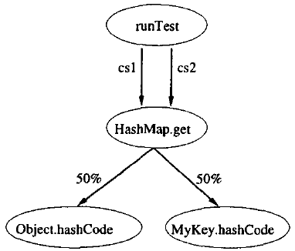
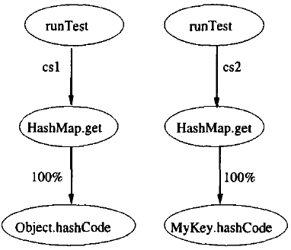
Profiling
Context-insensitive
Context-sensitive

Slide 18
Class hierarchy analysis
Walk class hierarchy at compilation time
If only one implementation of a method (i.e., in the base class), devirtualize to that target
Not guaranteed in the presence of class loading
Still need runtime test / fallback

Slide 19
Flow sensitive type analysis
Perform a forward dataflow analysis propagating type information.
At each use site, compute the possible set of types.
At call sites, use type information of receiver to narrow targets.
A a1 = new B();
a1.foo();
if (a2 instanceof C)
a2.bar();

Slide 20
Alternatives to guarding
Guarding impose overheads
run-time test on every call, merge points impede optimization
Often “know” only one target is invoked
call site is monomorphic
Alternative: compile without guards
recover as assumption is violated (e.g, class load)
cheaper runtime test vs more costly recovery

Slide 21
Recompilation approach
Optimistically assume current class hierarchy will never change wrt a call
Devirtualize/inline call sites without guard
On violating class load, recompile caller method
Recompiled code installed before new class
New invocations will call de-optimized code
What about current invocations?

Slide 22
Preexistence analysis
Idea: if the receiver object pre-existed the caller method invocation, then the call site is only affected by a class load in future invocations.
If new class C is loaded during execution of baz, x cannot have type C:
void baz(A x) {
...
// C loaded here
x.bar();
}

Slide 23
Code-patching
Pre-generate fallback virtual call out of line
On invalidating class load, overwrite direct call / inlined code with a jump to the fallback code
Must do thread-safe!
On x86, single write within a cache line is atomic
No recompilation necessary

Slide 24
Patching
t3 = 2 // B::foo
next:
...
fallback:
t2 = ldvirtfunaddr t1, A::foo
t3 = call [t2] (x)
goto next
goto fallback

Slide 25
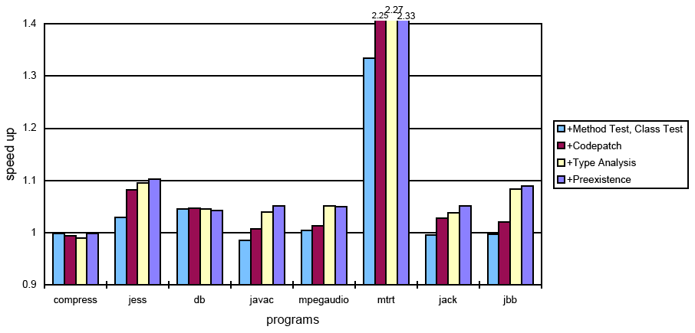
Performance

