Slide 1
Automated program verification
Bryan Parno
A Systems-Security View
of Verification
With material borrowed from: Chris Hawblitzel, Rustan Leino, and Emina Torlak

Slide 2
Plan
Overview
Z3: SAT/SMT
Boogie: Hoare logic
Dafny: Advanced tips and tricks
Reminder: Hw 2 due Monday night. Start early! Questions?
Office hours Thursday morning

Slide 3
Automated program verification
Automated
Tools try to fill in low-level proof steps
Program
Focused on verifying the correctness of programs, not necessarily proofs
Verification
Sound, but not complete
Examples
Dafny: Imperative, OO
F*: ML-like with dependent types

Slide 4
Dafny
Object-based language
generic classes, no subclassing
object references, dynamic allocation
sequential control
Built-in specifications
pre- and postconditions
framing
loop invariants, inline assertions
termination
Specification support
Sets, sequences, algebraic datatypes, coinductive types, integer subset types
User-defined functions; higher-order functions
Ghost variables
Rustan Leino

Slide 5
Types of program verification
functional correctness
Dafny
traditional mechanical program verification
extended static checking
limited checking
automatic
decision
procedures
interactive proof assistants

Slide 6
Exercise: Max frequency
method find_max_frequency(elts:seq<int>)
returns (max_elt:int, count:int)
ensures count_occurrences(elts, max_elt) == count;
ensures forall elt ::
elt in elts ==> count_occurrences(elts, elt) <= count;

Slide 7
Dafny’s architecture
Dafny code
Desired properties
How much of this is trusted?
Implementation
Dafny
Proof
DafnyCC
Dafny
C# code
Boogie code
Boogie code
BoogieX86
Boogie
Boogie
BoogieAsm
Boogie
SMT formulas
SMT formulas
Asm
Z3
Z3
SAT, UNSAT, or Timeout
SAT, UNSAT, or Timeout

Slide 8
Plan
Overview
Z3: SAT/SMT
Boogie: Hoare logic
Dafny: Advanced tips and tricks

Slide 9
Syntax of propositional logic
From CSE 507 by Emina Torlak

Slide 10
Satisfiability & validity of propositional formulas
F is satisfiable iff there exists an assignment for which F is true
F is valid iff F is true for all assignments
From CSE 507 by Emina Torlak

Slide 11
Satisfiability & validity of propositional formulas
F is satisfiable iff there exists an assignment for which F is true
F is valid iff F is true for all assignments
Duality of satisfiability and validity:
F is valid iff ¬F is unsatisfiable.
From CSE 507 by Emina Torlak

Slide 12
Satisfiability & validity of propositional formulas
F is satisfiable iff there exists an assignment for which F is true
F is valid iff F is true for all assignments
If we have a procedure for checking satisfiability, then we can also check validity of propositional formulas, and vice versa.
Duality of satisfiability and validity:
F is valid iff ¬F is unsatisfiable.
From CSE 507 by Emina Torlak

Slide 13
A brief review of DPLL
(DPLL = Davis, Putnam, Logemann, Loveland)
// Returns true if the CNF formula F is
// satisfiable; otherwise returns false.
DPLL(F)
G ← BCP(F)
if G = ⟙ then return true
if G = ⟘ then return false
p ← choose(vars(G))
return DPLL(G{p ↦ ⟙}) = “SAT” ||
DPLL(G{p ↦ ⟘})
From CSE 507 by Emina Torlak
3

Slide 14
A brief review of DPLL
(DPLL = Davis, Putnam, Logemann, Loveland)
// Returns true if the CNF formula F is
// satisfiable; otherwise returns false.
DPLL(F)
G ← BCP(F)
if G = ⟙ then return true
if G = ⟘ then return false
p ← choose(vars(G))
return DPLL(G{p ↦ ⟙}) = “SAT” ||
DPLL(G{p ↦ ⟘})
Boolean constraint propagation applies unit resolution until fixed point:
lit clause[¬lit] clause[⟘]
From CSE 507 by Emina Torlak
3

Slide 15
A brief review of DPLL
(DPLL = Davis, Putnam, Logemann, Loveland)
// Returns true if the CNF formula F is
// satisfiable; otherwise returns false.
DPLL(F)
G ← BCP(F)
if G = ⟙ then return true
if G = ⟘ then return false
p ← choose(vars(G))
return DPLL(G{p ↦ ⟙}) = “SAT” ||
DPLL(G{p ↦ ⟘})
Okay for randomly generated CNFs, but not on practical ones. Why?
From CSE 507 by Emina Torlak
3

Slide 16
A brief review of DPLL
(DPLL = Davis, Putnam, Logemann, Loveland)
No learning: throws away all the
work performed to conclude that the current partial assignment (PA) is bad. Revisits bad PAs that lead to conflict due to the same root cause.
// Returns true if the CNF formula F is
// satisfiable; otherwise returns false.
DPLL(F)
G ← BCP(F)
if G = ⟙ then return true
if G = ⟘ then return false
p ← choose(vars(G))
return DPLL(G{p ↦ ⟙}) = “SAT” ||
DPLL(G{p ↦ ⟘})
From CSE 507 by Emina Torlak
3

Slide 17
A brief review of DPLL
(DPLL = Davis, Putnam, Logemann, Loveland)
No learning: throws away all the
work performed to conclude that the current partial assignment (PA) is bad. Revisits bad PAs that lead to conflict due to the same root cause.
// Returns true if the CNF formula F is
// satisfiable; otherwise returns false.
DPLL(F)
G ← BCP(F)
if G = ⟙ then return true
if G = ⟘ then return false
p ← choose(vars(G))
return DPLL(G{p ↦ ⟙}) = “SAT” ||
DPLL(G{p ↦ ⟘})
Chronological backtracking: backtracks one level, even if it can be deduced that the current PA became doomed at a lower level.
From CSE 507 by Emina Torlak
3

Slide 18
A brief review of DPLL
(DPLL = Davis, Putnam, Logemann, Loveland)
No learning: throws away all the
work performed to conclude that the current partial assignment (PA) is bad. Revisits bad PAs that lead to conflict due to the same root cause.
// Returns true if the CNF formula F is
// satisfiable; otherwise returns false.
DPLL(F)
G ← BCP(F)
if G = ⟙ then return true
if G = ⟘ then return false
p ← choose(vars(G))
return DPLL(G{p ↦ ⟙}) = “SAT” ||
DPLL(G{p ↦ ⟘})
Naive decisions: picks an arbitrary variable and assumes it is true. Fails to consider the state of the search to make heuristically better decisions.
Chronological backtracking: backtracks one level, even if it can be deduced that the current PA became doomed at a lower level.
From CSE 507 by Emina Torlak
3

Slide 19
From CSE 507 by Emina Torlak

Slide 20
From CSE 507 by Emina Torlak

Slide 21
From CSE 507 by Emina Torlak

Slide 22
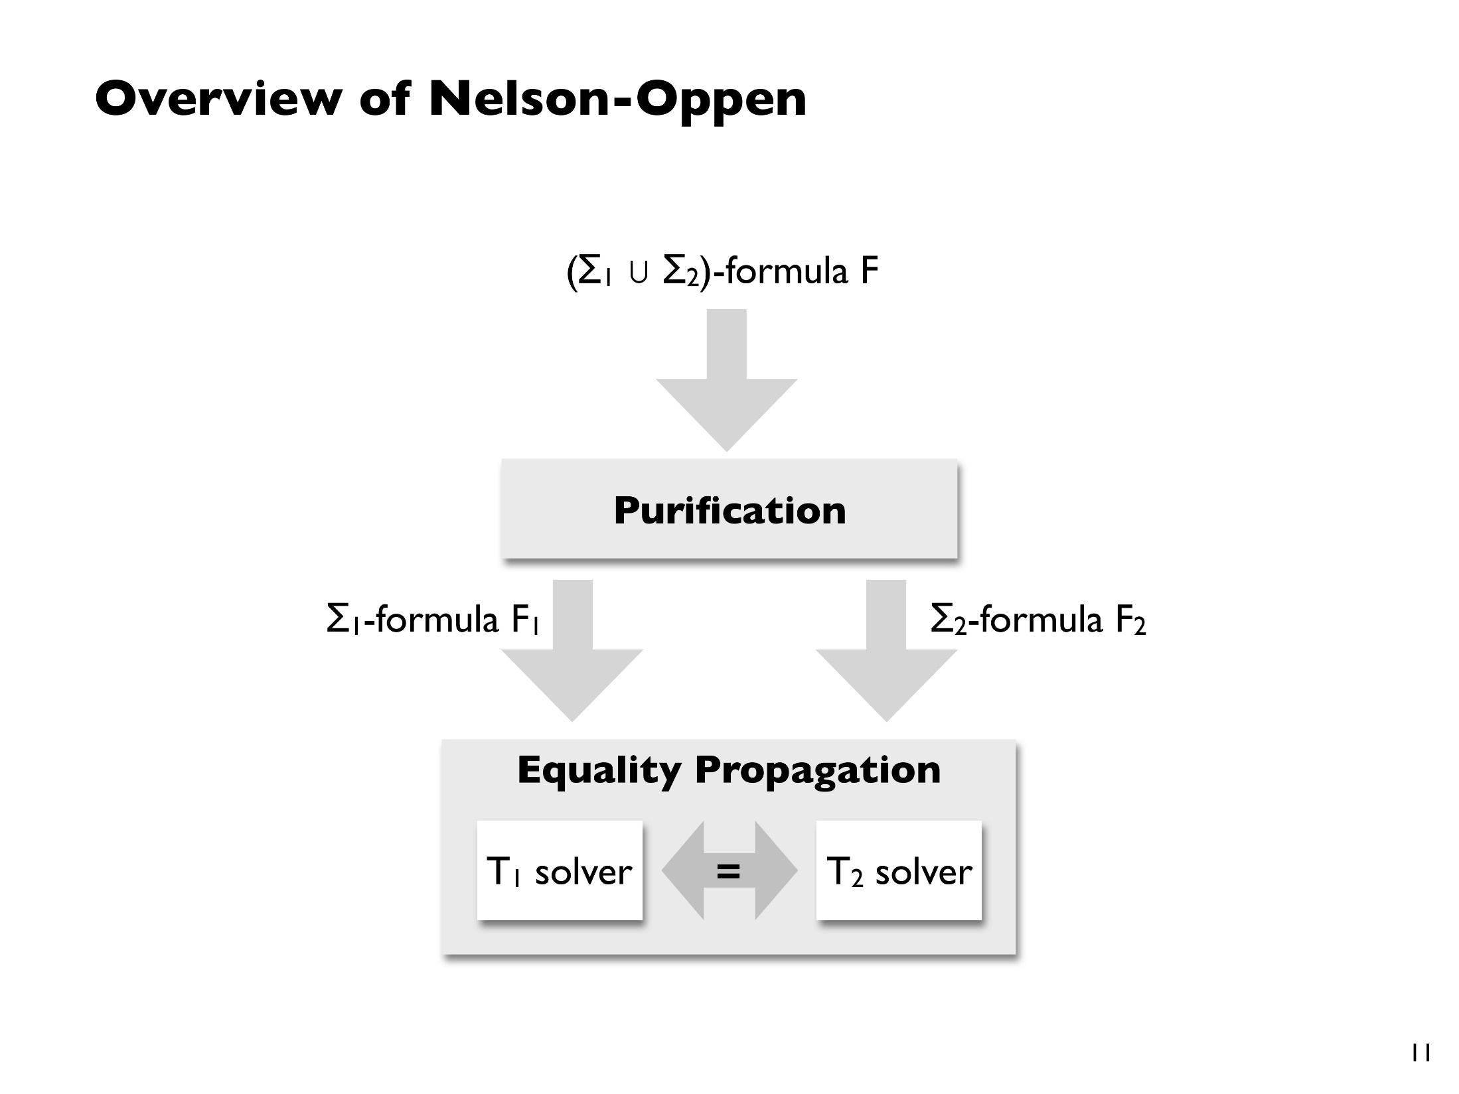
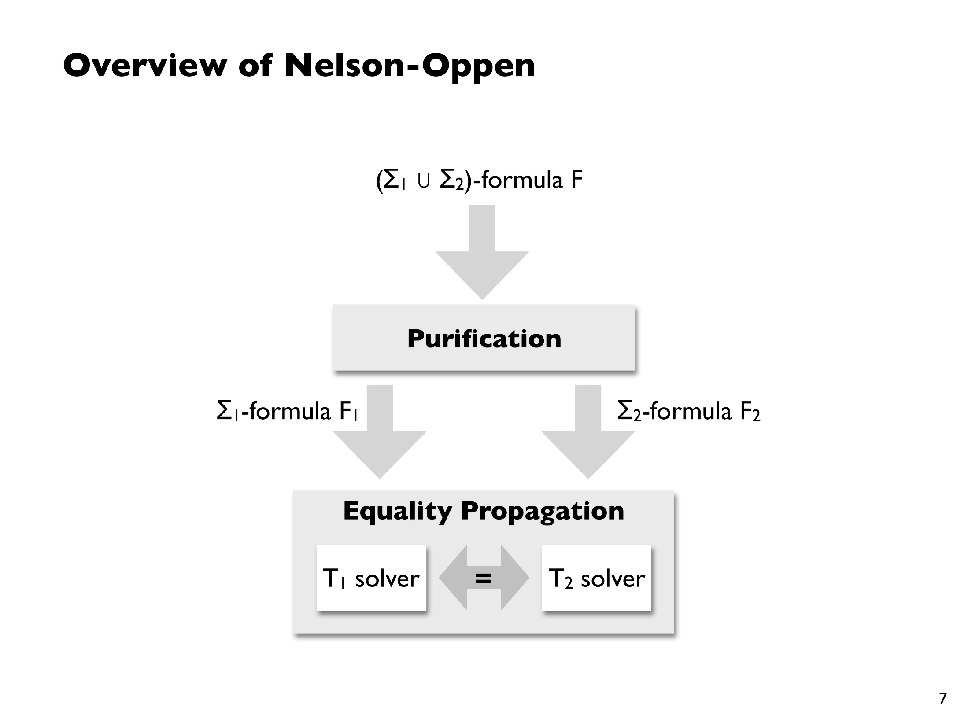
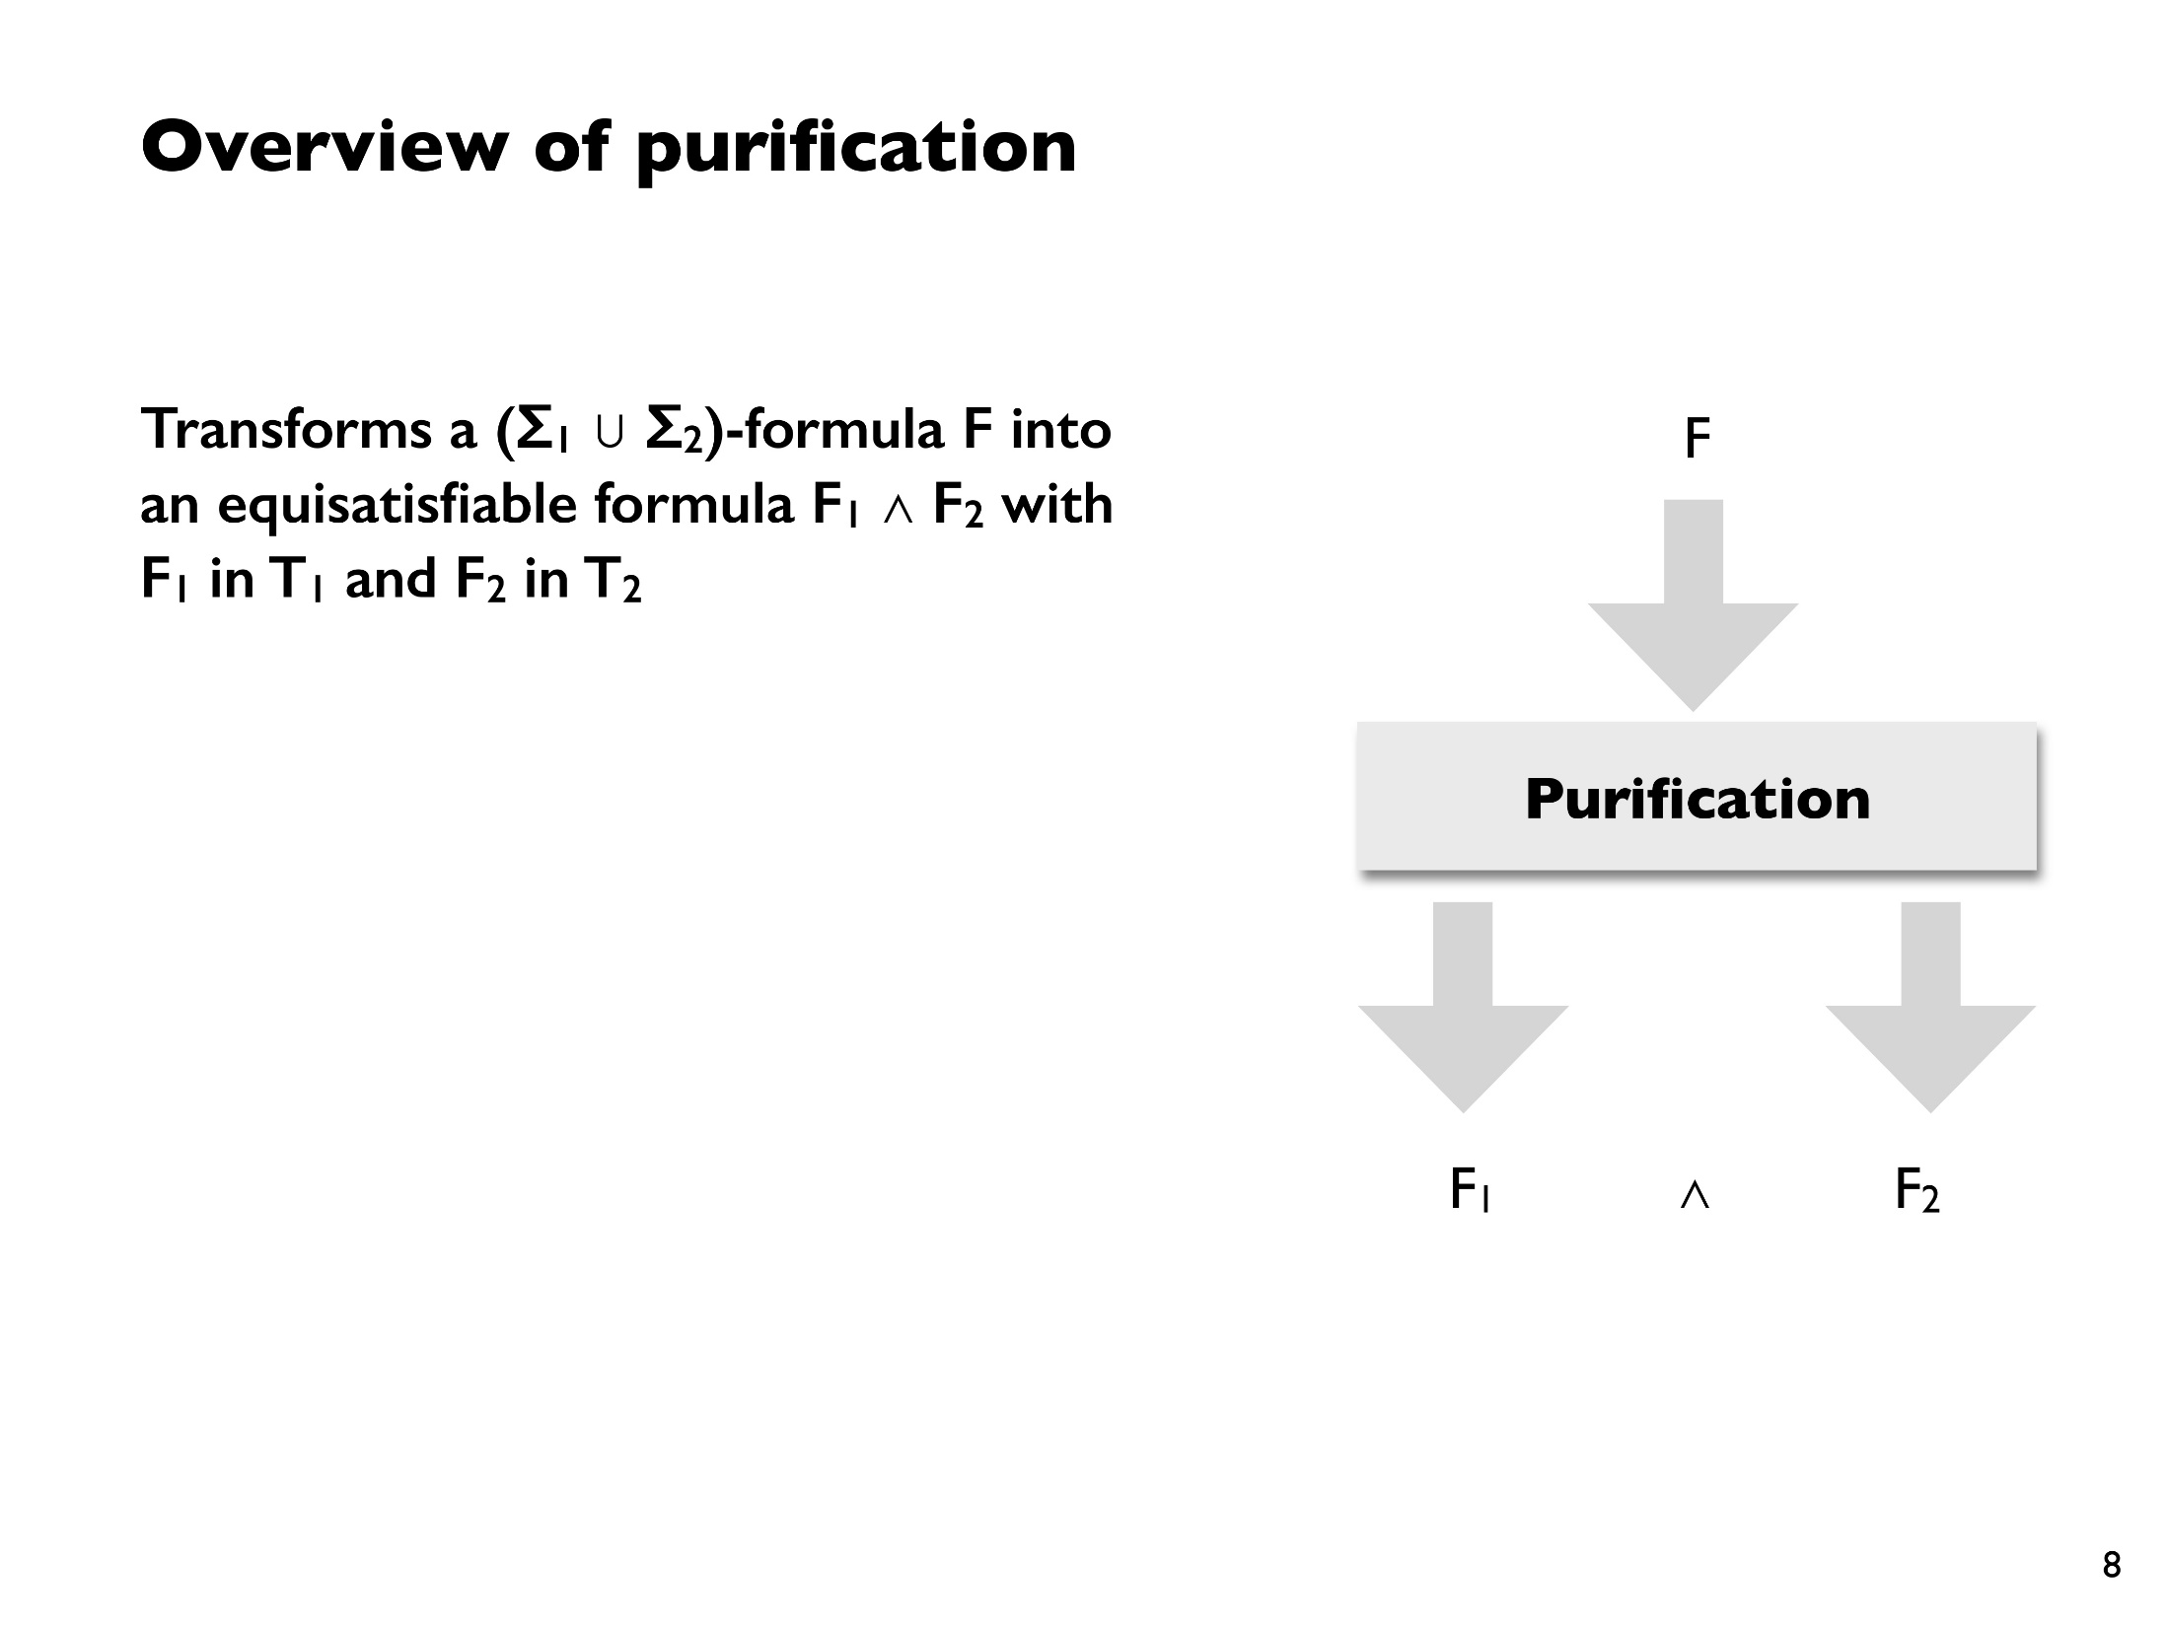
From CSE 507 by Emina Torlak

Slide 23
Z3 SMT prover
DECIDABLE THEORIES
boolean expressions e ::= true | false | !e | e && e | e ==> e | ...
linear integer arithmetic e ::= ... | -2 | -1 | 0 | 1 | 2 | e + e | e – e | e <= e | ...
bit vector arithmetic e ::= ... | e & e | e << e | ...
uninterpreted functions e ::= ... | f(e,…,e)
arrays e ::= ... | e[e] | e[e := e]
MAYBE
sequences e ::= ... | [e,…,e] | e + e | e[e..] | e[..e] | e.Length | …
sets e ::= … | {e,…,e} | e U e | {x | e} | e.Count | …
UNDECIDABLE
quantifiers e ::= ... | forall x :: e | exists x :: e
nonlinear arithmetic e ::= … | e * e | e / e | e % e
inductive definitions f(n) = … f(n – 1) …
Notes:
We use programmer-written quantifiers heavily,
and Dafny uses quantifiers to axiomatize arrays and datatypes.
For our purposes, for any new theory to be a useful addition to the SMT solver, it has to play well with quantifiers

Slide 24
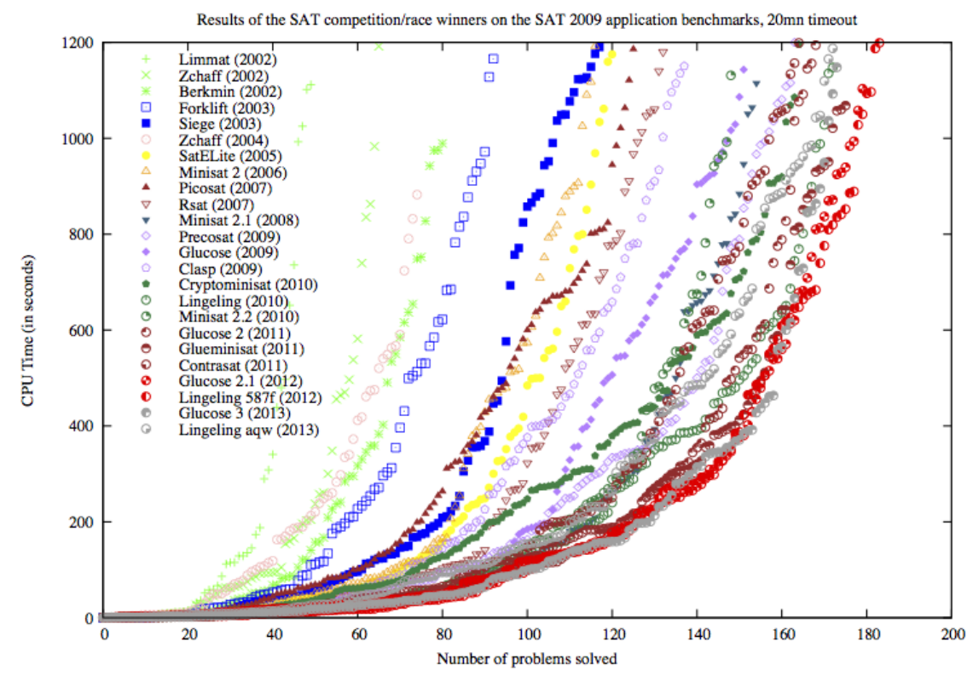
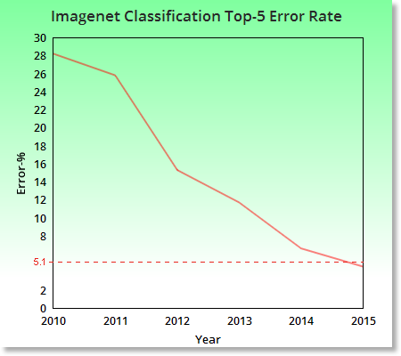
The power of benchmarks
The International SAT Solver Competitions, by Matti Järvisalo, Daniel Le Berre, Olivier Roussel, Laurent Simon

Slide 25
Plan
Overview
Z3: SAT/SMT
Boogie: Hoare logic
Dafny: Advanced tips and tricks

Slide 26
Boogie = Intermediate Language for Verification
GPU Verify
STORM (C)
Boogie x86
…
Corral
Poirot
Forró
QED
C B Analyze
Diego-matic
Spec#
VCC (C)
HAVOC (C)
Dafny
Chalice
Eiffel (EveProofs)
Java BML
Region Logic
Boogie
Boogie Verification Debugger
inference
SymDiff
SMT Lib
Z3
TPTP

Slide 27
Boogie Syntax
TYPES
primitive types t ::= bool | int | bv8 | bv16 | bv32 | …
array types | [t]t
EXPRESSIONS
variables e, P ::= x
boolean expressions | true | false | !e | e && e | e ==> e | ...
linear integer arithmetic | ... | -2 | -1 | 0 | 1 | 2 | … | e + e | e – e | e <= e | ...
bit vector arithmetic | e & e | e << e | ...
uninterpreted functions | f(e,…,e)
arrays | e[e] | e[e := e]
quantifiers | (forall x:t :: e) | (exists x:t :: e)
STATEMENTS
primitive statements s ::= x := e | assert e; | assume e; | …
compound statements | s1 s2 | if(e) {s1} else {s2} | while(e) invariant P; {s} | …

Slide 28
Hoare logic: Reasoning about imperative code
substitute x + 1 for x in x > 5:
x + 1 > 5
?
x := x + 1;
x > 5
initial assumption
x > 4
x := x + 1;
x > 5
imperative code
goal: prove x > 5
Why does x > 4 come from?
Why is it a sufficient assumption to guarantee x > 5 ?

Slide 29
Reasoning about assignment
substitute e for x in P
initial assumption
P{x := e}
x := e;
P
imperative code
goal: prove P
If we want to ensure that P holds after the assignment to x,
we must require that P{x := e} holds before the assignment.

Slide 30
What about more complicated programs?
initial assumption
y + 3 > 5
x := y;
x + 3 > 5
i := 3;
x + i > 5
while (i != 0)
invariant x + i > 5;
{
(x + 1) + (i - 1) > 5
i := i - 1;
(x + 1) + i > 5
x := x + 1;
x + i > 5
}
x > 5
substitute y for x
substitute 3 for i
“invariant” =
induction hypothesis:
what we expect to be
true at beginning of each
loop iteration
imperative code
substitute i - 1 for i
substitute x + 1 for x
goal: prove x > 5

Slide 31
What about more complicated programs?
y + 3 > 5
x := y;
x + 3 > 5
i := 3;
x + i > 5
while (i != 0)
invariant x + i > 5;
{
(x + 1) + (i - 1) > 5
i := i - 1;
(x + 1) + i > 5
x := x + 1;
x + i > 5
}
x > 5
proof obligation:
assuming i == 0,
assuming x + i > 5,
prove x > 5
proof obligation:
assuming i != 0,
assuming x + i > 5,
prove (x + 1) + (i - 1) > 5

Slide 32
Hoare logic rules: (P) s (Q)
(P) s (Q) describes “partial correctness”:
If P is true for the initial state, and s terminates,
then Q will be true for the final state.
(P{x := e}) x := e (P)
(P && e) assert e; (P)
(P) assume e; (P && e)
P ==> P'
(P‘) s (Q‘)
Q' ==> Q
-----------
(P) s (Q)
(P1) s1 (P2)
(P2) s2 (P3)
------------------------
(P1) s1 s2 (P3)
(P && e) s1 (Q)
(P && !e) s2 (Q)
---------------------------------
(P) if (e) {s1} else {s2} (Q)
(I && e) s (I)
---------------------------------------------
(I) while(e) invariant I; {s} (I && !e)

Slide 33
Weakest (liberal) precondition
If P = wlp(s, Q), then P is in some sense the “best” (weakest) P
such that (P) s (Q). Thus, wlp provides an algorithm for computing P.
wlp(x:=y;, x + 3 > 5)
= (x + 3 > 5){x := y}
= y + 3 > 5
y + 3 > 5
x:=y;
x + 3 > 5
i:=3;
x + i > 5
wlp(x:=y; i:=3;, x + i > 5)
= wlp(x:=y, wlp(i:=3, x + i > 5))
= wlp(x:=y, x + 3 > 5)
= y + 3 > 5
wlp(i:=3;, x + i > 5)
= (x + i > 5){i := 3}
= x + 3 > 5
wlp(x := e, P) = P{x := e}
wlp(assert e, P) = e && P
wlp(assume e, P) = e ==> P
wlp(s1 s2, P) = wlp(s1, wlp(s2, P))
wlp(if(e) {s1} else {s2}, P) = (e ==> wlp(s1, P)) && (!e ==> wlp(s2, P))
Notes:
Liberal in the sense that s may not terminate

Slide 34
Plan
Overview
Z3: SAT/SMT
Boogie: Hoare logic
Dafny: Advanced tips and tricks

Slide 35
Exercise: Max frequency
method find_max_frequency<T(==)>(elts:seq<T>)
returns (max_elt:T, count:int)
ensures count_occurrences(elts, max_elt) == count;
ensures forall elt ::
elt in elts ==> count_occurrences(elts, elt) <= count;

Slide 36
Dafny tips and caveats
Quantifiers and triggers
Debugging
Controlling function unrolling
Sequences
Non-linear arithmetic
Dynamic frames

Slide 37
UNDECIDABLE
quantifiers e ::= ... | forall x₁:t₁,…,x_{n}:t_{n} :: e | exists x₁:t₁,…,x_{n}:t_{n} :: e
Universal quantifiers are “easy” to prove:
assert forall x:int :: ValidID(x) ==> OkayToSend(x);
var x_new:int;
assume ValidID(x_new);
assert OkayToSend(x_new);
Existential quantifiers are easy to use:
assume exists x:int :: ValidID(x) ==> OkayToSend(x);
var x_new:int;
assume ValidID(x_new) ==> OkayToSend(x_new);
Note: Use Dafny’s let-such-that operator to grab x_new, i.e., the “witness”:
var my_x:int :| ValidID(my_x) ==> OkayToSend(my_x);

Slide 38
UNDECIDABLE
quantifiers e ::= ... | forall x₁:t₁,…,x_{n}:t_{n} :: e | exists x₁:t₁,…,x_{n}:t_{n} :: e
The converse cases are not so easy!
When should Z3 use this fact?
assume forall x:int :: ValidID(x) ==> OkayToSend(x);
What values should Z3 use to prove this?
assert exists x:int :: ValidID(x) ==> OkayToSend(x);

Slide 39
UNDECIDABLE
quantifiers e ::= ... | forall x₁:t₁,…,x_{n}:t_{n} :: e | exists x₁:t₁,…,x_{n}:t_{n} :: e
Z3 relies on triggers
pattern (“trigger”) to match
assume forall x:int {ValidID(x)}::
ValidID(x) ==> OkayToSend(x);
var z;
assert ValidID(z);
This causes Z3 to trigger the quantifier and hence learn:
OkayToSend(z);

Slide 40
UNDECIDABLE
quantifiers e ::= ... | forall x₁:t₁,…,x_{n}:t_{n} :: e | exists x₁:t₁,…,x_{n}:t_{n} :: e
Z3 relies on triggers
assume forall x:int {ValidID(x)}::
ValidID(x) ==> OkayToSend(x);
Subtleties
Trigger must include all quantified variables
Non-quantified terms checked for equality
Z3 must “think” about the triggering term
var z;
assert ValidID(z);
var z;
assume ValidID(z);
assert exists x:int {ValidID(x)}::
ValidID(x) ==> OkayToSend(x);
Triggers may be written by the user,
or chosen automatically by Dafny or Z3.
Usually a bad idea!
Why?

Slide 41
UNDECIDABLE
quantifiers e ::= ... | forall x₁:t₁,…,x_{n}:t_{n} :: e | exists x₁:t₁,…,x_{n}:t_{n} :: e
Concrete example:
What does Dafny know about sets?
Will this work?
assert |a * b| <= |a|;
What would work?

Slide 42
UNDECIDABLE
quantifiers e ::= ... | forall x₁:t₁,…,x_{n}:t_{n} :: e | exists x₁:t₁,…,x_{n}:t_{n} :: e
Concrete example:
What does Dafny know about sets?
Will this work?
assert |a * b| <= |a|;
What would work?
assert |a - b| == |a| - |a * b|;
assert |a * b| <= |a|;

Slide 43
UNDECIDABLE
quantifiers e ::= ... | forall x₁:t₁,…,x_{n}:t_{n} :: e | exists x₁:t₁,…,x_{n}:t_{n} :: e
Beware of infinite matching loops!
badly behaved trigger
Example:
forall x:int {f(x)} :: f(f(x)) > f(x-1);
assert f(3) <= f(f(2));
f(f(3)) > f(2)
&& f(f(f(3))) > f(f(3)-1)
&& f(f(f(f(3)))) > f(f(f(3)-1)-1)
…

Slide 44
UNDECIDABLE
quantifiers e ::= ... | forall x₁:t₁,…,x_{n}:t_{n} :: e | exists x₁:t₁,…,x_{n}:t_{n} :: e
Beware of infinite matching loops!
a better choice
Example:
forall x:int {f(f(x))} :: f(f(x)) > f(x-1);
assert f(3) <= f(f(2));
f(f(2)) > f(1)
Choose triggers carefully!

Slide 45
Dafny debugging
Whiteboard + (imaginary) friends
Assertions and assumes
Calc statement
Forall statement
:timeLimit/Multiplier
Beware! Fix timeouts before other errors
Boogie verification debugger
Z3 axiom profiler

Slide 46
Controlling function unrolling
Fuel
{:fuel} annotation
Computation
{:opaque} annotation
Example 1:
function pow2(n:nat):nat
{
if n == 0 then 1 else 2*pow2(n-1)
}
Example 2:
function Fib(n: nat): nat
{
if n < 2 then n else Fib(n-2) + Fib(n-1)
}
method ComputeFib(N: nat) returns (x: nat)
ensures x == Fib(N)

Slide 47
Sequences
Axiomatization
Beware extensionality!
predicate P(s:seq<int>)
method test()
{
var s := [1,2,3];
var s' := [1,2] + [3];
//assert s == s';
assert P(s) == P(s');
}

Slide 48
Non-linear arithmetic
var x := a + b;
assume x * (F(w) + (G(x, y) % z)) == P(b);
assert (a+b) * (F(w) + (G(x, y) % z)) == P(b);
Why would we write something like that!?
Manipulating arrays of bits, bytes, and words
BigInteger library

Slide 49
“Solution” 1:
var x := a + b;
assume x * (F(w) + (G(x, y) % z)) == P(b);
assert (a+b) * (F(w) + (G(x, y) % z)) == P(b);
MultiplyObvious(x, a+b, (F(w) + (G(x, y) % z)));
lemma MultiplyObvious(x:int, a_plus_b:int, z:int)
requires x == a_plus_b;
ensures x * z == a_plus_b * z;
{}

Slide 50
“Solution” 2: Abandon non-linear automation
lemma lemma_div_is_strictly_ordered(x:int, d:int)
requires 0 < x;
requires 1 < d;
ensures x/d < x;
{
lemma_fundamental_div_mod(x, d);
}
lemma lemma_fundamental_div_mod(x:int, d:int)
requires d != 0;
ensures x == d * (x/d) + (x%d);
{ }
lemma lemma_mod_of_zero_is_zero(m:int)
requires 0 < m;
ensures 0 % m == 0;
{ }
…
/noNLarith
…
Non-linear
lemmas
…
Non-linear
basics
Non-linear enabled

Slide 51
“Solution” 2: Abandon non-linear automation
var x := a * b;
assume x * (F(w) + (G(x, y) % z)) == P(b);
assert (a+b) * (F(w) + (G(x, y) % z)) == P(b);
✓
/noNLarith
assume F(x) == v * (y + z);
lemma_mul_is_distributive_add(v, y, z);
assert F(x) == (v * y) + (v * z);
Non-linear
lemmas
😐
Non-linear
basics
Non-linear enabled

Slide 52
A real example
calc {
1. (d2i(base,inseq) / power(base,i)) % base;
{ reveal_power(); }
2. (d2i(base,inseq) / (base*power(base,i-1))) % base;
{ lemma_div_denominator(d2i(base, inseq), base, power(base,i-1)); }
3. ((d2i(base, inseq)/base)/power(base,i-1)) % base;
4. (((d2i_private(base,inseq[0..|inseq|-1])*base +
inseq[|inseq|-1])/base)/power(base,i-1)) % base;
{ lemma_div_multiples_vanish_fancy(
d2i_private(base, inseq[0..|inseq|-1]),
inseq[|inseq|-1],
base);
lemma_mul_is_commutative_forall();
}
5. ((d2i_private(base, inseq[0..|inseq|-1]))/power(base,i-1)) % base;
{ assert inseq[0..|inseq|-1] == inseq[..|inseq|-1]; }
6. ((d2i_private(base, inseq[..|inseq|-1]))/power(base,i-1)) % base;
7. (d2i(base, (inseq[..|inseq|-1])) / power(base,(i-1))) % base;
{ lemma_DigitSeq_extract(base, inseq[..|inseq|-1], i-1); }
8. (inseq[..|inseq|-1])[|(inseq[..|inseq|-1])|-1-(i-1)];
9. inseq[|inseq|-1-i];
}

Slide 53
Dynamic frames
Reads and modifies clauses
Boogie translation
Using old()
Anecdotal advice
Comparison with implicit frames and separation logic

Slide 54
Example: Contracts
class Account {
function balance( ): Int
{ … }
method deposit(n: Int)
requires 0 < n
ensures balance( ) == old(balance( )) + n
{ … }
method withdraw(n: Int)
requires n <= balance( )
{ … }
}
method demo(a: Account)
requires 0 <= a.balance( )
{
a.deposit(200);
a.withdraw(100);
}
Courtesy of Peter Müller
Notes:
we omit non-nullness specs

Slide 55
Example: Side Effects
class Account {
function balance( ): Int
{ … }
method deposit(n: Int)
requires 0 < n
ensures balance( ) == old(balance( )) + n
{ … }
}
method demo(a: Account, l: List)
{
var tmp := l.length( );
a.deposit(200);
assert tmp == l.length( );
}
method demo(a: Account, l: List)
{
var tmp := l.length( );
a.deposit(200);
assert tmp == l.length( );
}
Courtesy of Peter Müller

Slide 56
Example: Side Effects
class Account {
transactions: List;
function balance( ): Int
{ … }
method deposit(n: Int)
requires 0 < n
ensures balance( ) == old(balance( )) + n
{ transactions.append(n); }
function getTransactions( ): List
{ transactions }
}
method demo(a: Account, l: List)
{
var tmp := l.length( );
a.deposit(200);
assert tmp == l.length( );
}
class Account {
transactions: List;
function balance( ): Int
{ … }
method deposit(n: Int)
requires 0 < n
ensures balance( ) == old(balance( )) + n
{ transactions.append(n); }
}
demo( a, a.getTransactions( ) );
Courtesy of Peter Müller

Slide 57
The Frame Problem
l
l
a
a
{ P } S { Q }
{ P ∧ R } S { Q ∧ R }
Courtesy of Peter Müller
Notes:
Rule is unsound even if R and C have no free variables in common (that is, if the heap is the only common variable)

Slide 58
Footprints
l
l
a
a
{ P } S { Q }
footprint( S ) ∩ footprint( R ) = ∅
{ P ∧ R } S { Q ∧ R }
Courtesy of Peter Müller
Notes:
Footprints need to be defined abstractly because we cannot enumerate all locations statically

Slide 59
Explicit Footprints
l
a
{ P } S { Q }
modifies( S ) ∩ reads( R ) = ∅
{ P ∧ R } S { Q ∧ R }
Courtesy of Peter Müller

Slide 60
Explicit Footprints: Effects
class Account {
balance: Int;
method deposit( n: Int )
requires 0 < n
modifies { this }
{ balance := balance + n; }
}
class List {
…
len: Int;
function length( ): Int
reads { this }
{ len }
}
method demo(a: Account, l: List)
{
var tmp := l.length( );
a.deposit(200);
assert tmp == l.length( );
}
Limitations?
Breaks information hiding
Can’t support statically unknown set of locations
Courtesy of Peter Müller
Notes:
information hiding
statically-unknown set of locations

Slide 61
Explicit Footprints: Dynamic Frames
class Account {
balance: Int;
footprint: Set;
function valid( ): Bool {
this ∈ footprint
}
method deposit(n: Int)
requires 0 < n ∧ valid( )
modifies footprint
{ balance := balance + n; }
}
class List {
…
footprint: Set;
function valid( ): Bool {
this ∈ footprint ∧ (next != null ==> next ∈ footprint ∧ next.footprint ⊆ footprint)
}
function length( ): Int
requires valid( )
reads footprint
{ … }
}
method demo(a: Account, l: List)
requires a.valid( ) ∧ l.valid( )
requires a.footprint ∩ l.footprint == ∅
{
var tmp := l.length( );
a.deposit(200);
assert tmp == l.length( );
}
Courtesy of Peter Müller
Notes:
information hiding
statically-unknown set of locations

Slide 62
Explicit Footprints: Dynamic Frames
class Account {
transactions: List;
footprint: Set;
function valid( ): Bool {
this ∈ footprint ∧ transactions ∈ footprint ∧
transactions.footprint ⊆ footprint ∧
transactions.valid( )
}
method deposit(n: Int)
requires 0 < n ∧ valid( )
modifies footprint
{ transactions.append( n ); }
}
method demo(a: Account, l: List)
requires a.valid( ) ∧ l.valid( )
requires a.footprint ∩ l.footprint == ∅
{
var tmp := l.length( );
a.deposit(200);
assert tmp == l.length( );
}
Notes:
information hiding
statically-unknown set of locations

Slide 63
Explicit Footprints: Dynamic Frames
class Account {
transactions: List;
footprint: Set;
function valid( ): Bool {
this ∈ footprint ∧ transactions ∈ footprint ∧
transactions.footprint ⊆ footprint ∧
transactions.valid( )
}
…
function getTransactions( ): List
{ transactions }
}
method demo(a: Account, l: List)
requires a.valid( ) ∧ l.valid( )
requires a.footprint ∩ l.footprint == ∅
{
var tmp := l.length( );
a.deposit(200);
assert tmp == l.length( );
}
demo( a, a.getTransactions( ) );
Courtesy of Peter Müller
Notes:
information hiding
statically-unknown set of locations

Slide 64
Explicit Footprints: Limitations
method demo(a: Account, l: List)
requires a.valid( ) ∧ l.valid( )
requires a.footprint ∩ l.footprint == ∅
{
var tmp := l.length( );
a.deposit(200);
assert tmp == l.length( );
}
Automatic reasoning about sets
Concurrency
Courtesy of Peter Müller
Notes:
list of lists is not as easy as appending to a list

Slide 65
Implicit Footprints
l
a
{ P } S { Q }
{ P ∧ R } S { Q ∧ R }
{ P  R } S { Q  R }
Courtesy of Peter Müller

Slide 66
Implicit Footprints: Permissions
class Account {
balance: Int;
function balance( ): Int
requires acc(balance)
{ balance }
method deposit(n: Int)
requires 0 < n ∧ acc(balance)
ensures acc(balance)
{
balance := balance + n;
}
}
class List {
…
len: Int;
function length( ): Int
requires acc(len)
{ len }
}
method demo(a: Account, l: List)
requires acc(a.balance) * acc(l.len)
{
var tmp := l.length( );
a.deposit(200);
assert tmp == l.length( );
}
a.balance
a.balance
l.len
?
B
L
Courtesy of Peter Müller
Notes:
information hiding
statically-unknown set of locations

Slide 67
Summary
Program verification is becoming more automatic
A well-designed language and verifier, plus a great SMT solver, go a long way
Questions:
parno@microsoft.com

