Slide 1
Bringing Clothing into Desired Configurations with Limited Perception
Joseph Xu

Slide 2
Introduction
Non-rigid objects possess inherently high-dimensional configuration spaces, and therefore pose a number of difficult challenges.
Laundry folding tasks are hard to be accomplished with general purpose manipulators.
Extensive work has been done on enabling specialized and general-purpose robots to manipulate laundry.

Slide 3
Related work
Uses the idea of iteratively grasping the lowest-hanging point
Compares the shape observed while pulling taut with pre-recorded template images.
None of this prior work demonstrates the ability to generalize to previously unseen articles of clothing.
Assume a known, spread-out, or partially spread out configuration.

Slide 4
What tasks can the robot do?
The robot is presented with an unknown article of clothing and wishes to identify it, works it into an identifiable configuration, and subsequently brings it into a desired configuration.

Slide 5
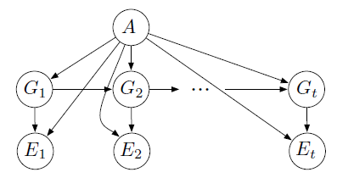
What’s the theory/algorithm behind it?
Hidden Markov model
loosely speaking, a process satisfies the Markov property if one can make predictions for the future of the process based solely on its present state just as well as one could knowing the process's full history.
1. Initial distribution:
2. Transition model:

Slide 6
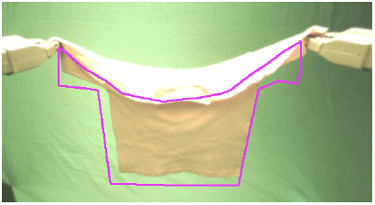
What’s the theory/algorithm behind it?
Hidden Markov model (continue)
During repetitive grasping, lowest hanging point is long a straight line from the holding point. The grasp state will converge to the region of the rims of the clothing article. compare to the whole mesh of the clothing article, this is a small number of regions.
3. Height observation.
4. Contour observation
With the help of cloth simulator, the dynamic time warping algorithm is used to find the best alignment of each predicted contour to the actual contour. The score associated with each alignment is then used to update the belief

Slide 7
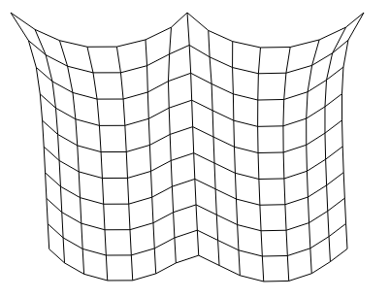
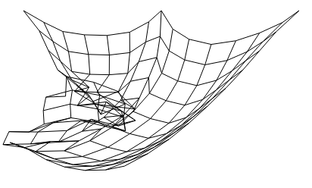
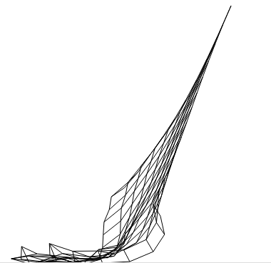
What’s the theory/algorithm behind it?
Cloth simulator
http://andrew-hoyer.com/andrewhoyer/experiments/cloth/
And also a video from Wang et al. 2010

Slide 8
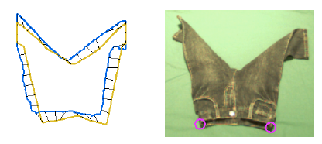
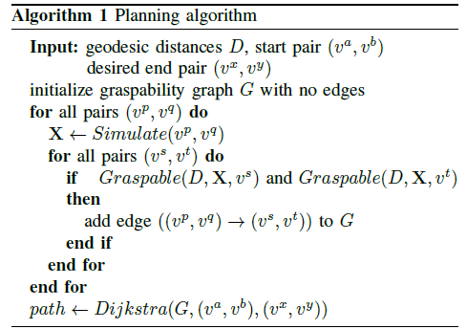
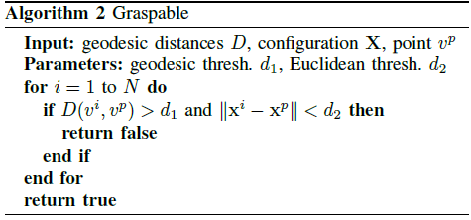
What’s the theory/algorithm behind it?
Planning algorithm
The authors assume that the disambiguation phase correctly identifies the article and grasp state of the cloth.
Graspability graph (simulated)

Slide 9
Experiments
The PR2 robot is entirely autonomous throughout the procedure.
A green-colored background was used to simplify the task of image segmentation.
The system requires mesh models of all clothing articles under consideration (nearly-autonomous process).
The final 3D mesh contains approximately 300 triangle elements per clothing article.
All experimental runs start with the clothing article in a random configuration on the table in front of the robot.

Slide 10
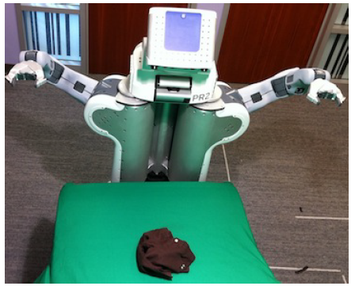
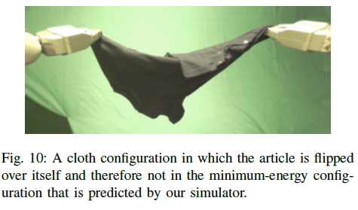
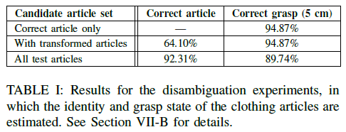
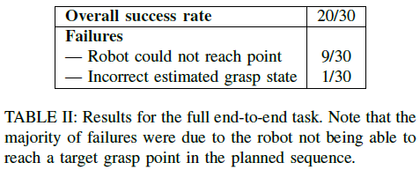
Results

Slide 11
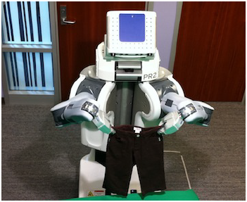
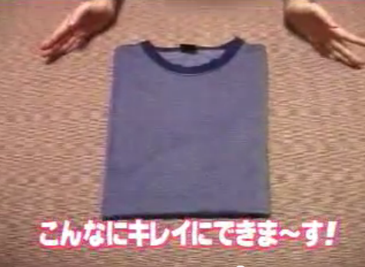
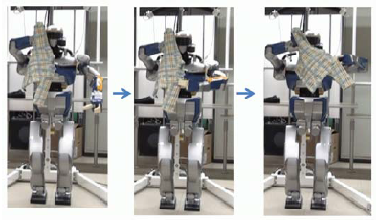
After-reading discussion
http://rll.berkeley.edu/ICRA_2011/
http://www.youtube.com/watch?v=GXKpIjIzfBY
http://www.youtube.com/watch?v=tnegMm7GiaM

