Slide 1
CSE 599 – Arm Planning
Joseph Xu

Slide 2
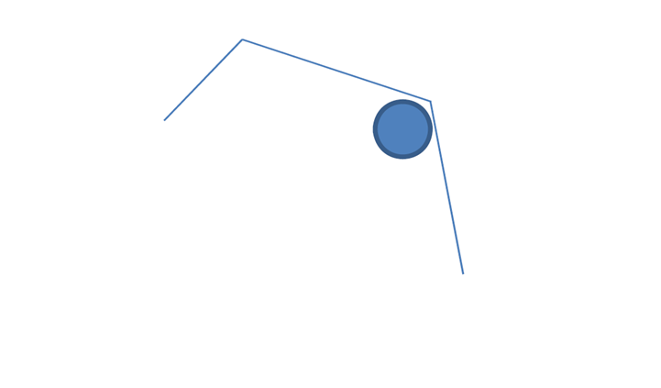
Denavit-Hartenberg (DH) notation
Joint 3
Y₂
Y₃
X₃
X₂
Joint 2
l₃
l₂
Y₂
(Y₀)
l₁
l₁ = 1.0
(X₀)
X₁
l₂ = 1.0
Joint 1
l₃ = 0.5

Slide 3
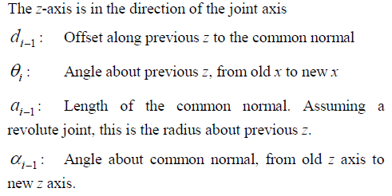
Denavit-Hartenberg (DH) notation
$i$ | $$α_{i−1}$$ | $$a_{i−1}$$ | $$d_{i}$$ | $$θ_{i}$$
Link 1 | 0 | 0 | 0 | $$θ_{1}$$
Link 2 | 0 | $$l_{1}$$ | 0 | $$θ_{2}$$
Link 3 | 0 | $$l_{2}$$ | 0 | $$θ_{3}$$

Slide 4
Denavit-Hartenberg (DH) notation
By following the general format of ${}_{i}^{i−1}T$, it stands for “transition from i frame to i-1 frame”
$${}_{3}^{0}{T= }{}_{1}^{0}{T∙{}_{2}^{1}{T∙{}_{3}^{2}{T }}}$$

Slide 5
The reason of using Jacobians
If we know the value of a function and its derivative at some ө, we can estimate what the value of the function is at other points near ө
The basic element of the Jacobians

Slide 6
Jacobians of the Arm

Slide 7
Compute the Jacobians
a’_{i}: unit length rotation axis in world space
r’_{i}: position of joint pivot in world space
e: end effector position in world space
•
•
graphics.ucsd.edu/courses/cse169_w05/CSE169_13.ppt

Slide 8
Algorithm of the Inverse Kinematics

Slide 9
Sovling f(ө) = goal
If we want the end effector to reach goal point, we can think of it as minimizing f(ө)-goal and just step towards goal with the incremental angle value:
parameter β to scale our step (0≤ β ≤1)

Slide 10
Simplification of the inverse Jacobians and choice of β
The inverse of Jacobians can be replaced by the transpose for our 3-linik simple system. Therefore, we have:
β is in a form of (β1, β2, β3). And each of its component can be individually adjusted based on how fast you want to control the specific joint angles.

Slide 11
Results

