Slide 1
CSE 599 - Walk through of the Dijkstra and A* algorithms in Python
Joseph Xu

Slide 2
Initialization part 1: Construct an empty list for all the nodes (self.visited) and prepare a sorted list for the next node (toVisit)
self.visited = [] # (cost_to_reach, parent_node_ID)
if self.graph != None: # check the status of the loaded map
for i in range(self.graph.getNodeCount()):
self.visited.append(None)
toVisit = PriorityQueue()
# (cost_to_reach, current_node_ID, parent_node_ID)

Slide 3
Initialization part 2:Prepare for the main loop by using the start point
# Start of the algorithm
self.visited[start] = (0, None)
toVisit.put((0, start, None))
# And prepare the drawing:
draw = deque([])

Slide 4
Main loop part 1: Use the closet node from toVisit for the next node
while not toVisit.empty(): # test condition
# temporary tuple for getting the next node
nextTuple = toVisit.get()
next = nextTuple[1] # Get the “current_node_ID”
nextDist = self.visited[next][0] # Get the “cost_to_reach”

Slide 5
Main loop part 2: Draw the progress only for the most recent 50 points.
if len(draw) >= 50:
draw.popleft() # Throw away the oldest node
draw.append(next) # Add ”next” to the right side of the deque
self.DrawList(draw, width=2, height=2) # change the size of the symbol

Slide 6
Main loop part 3: Check to see whether the algorithm reaches the goal node
if next == goal: #Success!
lastPathNode = goal # Construct the path list
self.pathCost = self.visited[goal][0] #it's the total cost of the whole path, the value will be used in the GUI
self.path = []
# the following loop is for constructing the shortest path to the goal node backward.
while self.visited[lastPathNode][1] != None: # Until it reaches the start
self.path.append(lastPathNode)
lastPathNode = self.visited[lastPathNode][1] # 1 denotes the node we just came from
self.path.append(start) # Add the start node to the right side of the path
self.path.reverse()
return

Slide 7
Main loop part 4: Look for the neighbor node of the “next” node, and based on its visit status, choose to either creat or update the node
for adjacency in self.graph.getAdjacencies(next): # For each neightbor, see if have a path to
nextNbr, cost = adjacency[0], adjacency[1] #the cost is the distannce from "next" to "nextNbr"
totalTravel = nextDist + cost
if self.visited[nextNbr] == None: # The neighbor is unvisited
self.visited[nextNbr] = ( totalTravel, next ) # Mark the node as visited
toVisit.put( (totalTravel, nextNbr, next) ) # Add node to priority queue
elif totalTravel < self.visited[nextNbr][0]: # The neighbor has been visited, but that is shorter
# if we've found a shorter route to nextNbr
self.visited[nextNbr] = (totalTravel, next) # then replace old route to nextNbr with new
toVisit.put( (totalTravel, nextNbr, next))
#else: Node has been visited, but current path is equal or longer

Slide 8
Main loop part 4 (A* case): Look for the neighbor node of the “next” node, and based on its visit status, choose to either creat or update the node
for adjacency in self.graph.getAdjacencies(next): # For each neightbor, see if have a path to
nextNbr, cost = adjacency[0], adjacency[1] #the cost is the distannce from "next" to "nextNbr"
totalTravel = nextDist + cost
if self.visited[nextNbr] == None: # The neighbor is unvisited
self.visited[nextNbr] = ( totalTravel, next ) # Mark the node as visited
goalDist = euclidDist(nextNbr, goal, self.graph)
toVisit.put( (totalTravel + goalDist, nextNbr, next) ) # Add node to priority queue
elif totalTravel < self.visited[nextNbr][0]: # The neighbor has been visited, but that is shorter
# if we've found a shorter route to nextNbr
self.visited[nextNbr] = (totalTravel, next) # then replace old route to nextNbr with new
goalDist = euclidDist(nextNbr, goal, self.graph)
toVisit.put( (totalTravel + goalDist, nextNbr, next))
#else: Node has been visited, but current path is equal or longer

Slide 9
Path finding using Laplace’s equations
Step 1. Define the V(start, goal)
Step 2. Assign values to the state of the node:
Start. state = +1, goal.state = -1
for all the nodes in graph G
if Num(node. adjacency) >= 8
node. state = + 0.2 ??? “10000”
else node.state = + 0.8
Step 3. Solve laplace’s equations using
while (error > threshold)
for all the nodes in graph G
v(i,j)=(v(i+1,j)+v(i-1,j)+v(i,j+1)+v(i,j-1))/4

Slide 10
Path finding using Laplace’s equations
Step 4. Finding the Gradients, and normalize the values in both x and y direction.
Step 5. Follow the streamlines of the gradient .
Try separate list for the node’s state.

Slide 11
CSE 599 – Arm Planning and Forward Kinematics
Joseph Xu

Slide 12
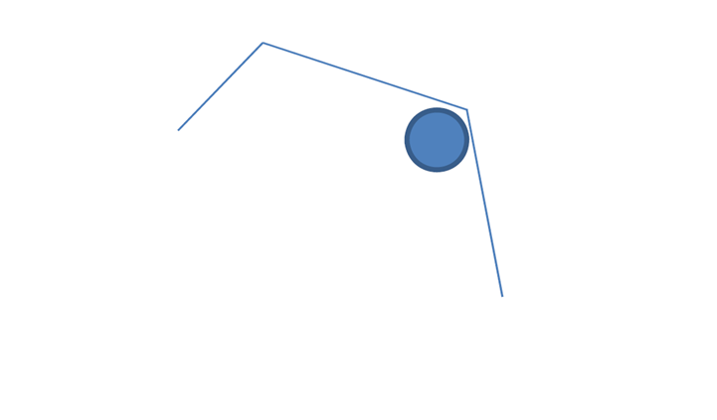
Denavit-Hartenberg (DH) notation
Y₃
Y₂
X₃
l₃
l₂
X₂
Y₂
(Y₀)
l₁
l₁ = 1.0
l₂ = 1.0
(X₀)
X₁
l₃ = 0.5

Slide 13
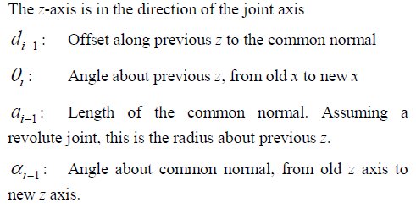
Denavit-Hartenberg (DH) notation
$i$ | $$α_{i−1}$$ | $$a_{i−1}$$ | $$d_{i}$$ | $$θ_{i}$$
Link 1 | 0 | 0 | 0 | $$θ_{1}$$
Link 2 | 0 | $$l_{1}$$ | 0 | $$θ_{2}$$
Link 3 | 0 | $$l_{2}$$ | 0 | $$θ_{3}$$

Slide 14
Denavit-Hartenberg (DH) notation
By following the general format of ${}_{i}^{i−1}T$, it stands for “transition from i frame to i-1 frame”
$${}_{3}^{0}{T= }{}_{1}^{0}{T∙{}_{2}^{1}{T∙{}_{3}^{2}{T }}}$$

