Slide 1
Path Planning Using Laplace’s Equation
C. I. Connolly J. B. Burns
R. Weiss

Slide 2
Abstract
Method for planning smooth paths
Uses Laplace equation to constrain set of potential functions over configuration space
Once function has been computed, paths can be found quickly [i.e. this is not single query path planning like RRT]
Solutions of Laplace eqn have no local mins!
Can be computed in massively parallel fashion

Slide 3
Intro
Potential functions for planning introduced by Khatib
Obstacles have “charges” which repel effector
Goal attracts effector
Fast and easy, but plagued by local minima
Kotitschek showed that “good” potential functions (without minima) exist that will guide a robot from almost any start to the goal
Solns of Laplace’s eqn are a (weak) form of Koditschek’s navigation function

Slide 4
Laplacian operator
Laplacian operator (“del squared”) is the divergence of the gradient
In Cartesian coordinates, sum of 2nd partial derivatives
“Flux density of the gradient flow” of a function
Physical examples
1: rate at which a chemical dissolved in a fluid moves toward (away from) a point is proportional to the Laplacian of the concentration at that point; equivalent to the diffusion equation
2: electrostatics, with conducting surfaces at fixed potentials (NOT with charges at fixed locations, which corresponds to the usual potential function)
3: gravitational fields in free space
Also used in computer vision for edge detection
There is also a Laplacian operator defined on graphs!

Slide 5
Harmonic functions
Solutions phi of Laplace equation are called harmonic functions
Harmonic functions have no local minima away from boundaries
Imagine a stretchy material stretched across a frame
There is no way to make it indent down without putting a weight in the middle
You need a charge to do that [when there are charges on the RHS, it’s called Poisson’s equation]

Slide 6
No local minima example
If phi is concave down along x (so 2nd partial is –ve), then phi must be concave up along y (to make 2nd partial positive, so that they sum to 0)
To create a local min, both 2nd partials would need to have the same sign

Slide 7
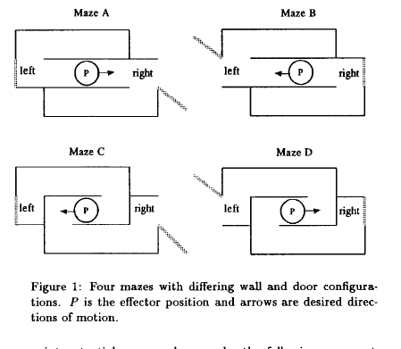
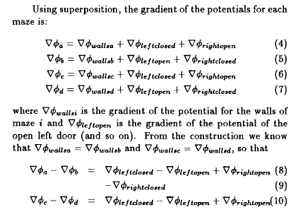
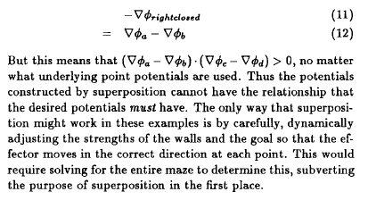
Superposition (i.e. potential fn method) is not usable

Slide 8
Numerical solns of Laplace eqn

Slide 9
Planning
Follow gradient from start to goal

Slide 10
Examples

Slide 12
Solving Laplace
% Todo: vectorize this
maxr=1;
errs=zeros(M,N);
iter=0;
while maxr>maxerr
for i=2:M-1
for j=2:N-1
if ~bc(i,j),
tmp=v(i,j);
v(i,j)=(v(i+1,j)+v(i-1,j)+v(i,j+1)+v(i,j-1))/4;
errs(i,j)=abs(v(i,j)-tmp);
end
end
end
maxr=max(max(errs));
iter=iter+1;
end

Slide 13
Finding Gradients
vx = ones(FOV,FOV);
vy = ones(FOV,FOV);
vx(2:FOV-1,:) = .5*(v(3:FOV,:)-v(2:FOV-1,:)) + .5*(v(2:FOV-1,:)-v(1:FOV-2,:));
vy(:,2:FOV-1,:) = .5*(v(:,3:FOV)-v(:,2:FOV-1)) + .5*(v(:,2:FOV-1)-v(:,1:FOV-2));
gradvmag = (vx.*vx + vy.*vy).^.5;
vxn = vx ./ gradvmag;
vyn = vy ./ gradvmag;

Slide 14
Follow streamlines
for i = 1:length(startx),
newx = startx(i);
newy = starty(i);
pathl(i) = 1;
trajx(i,pathl(i)) = startx(i);
trajy(i,pathl(i)) = starty(i);
% Follow streamline
v0 = v(newx,newy);
t = 1;
eps = .1;
while (v0 > -1+eps),
bestx = newx;
besty = newy;
v0n = v0;
newx = bestx-step*intrp(vxn,bestx,besty);
newy = besty-step*intrp(vyn,bestx,besty);
v0n = intrp(v,newx,newy);
t = t+1;
if t>MAXTRAJ,
input('This is taking a long time...')
end
v0 = v0n;
pathl(i) = pathl(i)+1;
trajx(i,pathl(i)) = newx;
trajy(i,pathl(i)) = newy;
end
end

