Slide 1
Dave Lattanzi’s RRT Algorithm

Slide 2
General Concept
Use dictionaries for trees
Create a randomized stack of nodes
Iterate through stack
“Extend” each tree towards last node
Check for intersections at each step

Slide 3
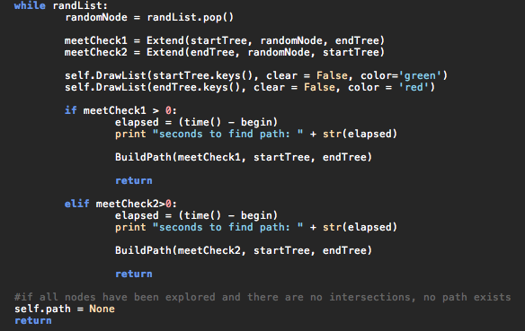
Main Function

Slide 4
“Extend” Function
Build a dictionary of nodes in tree and their distances to the random node
Search dictionary to get nearest node
Almost certainly not optimal
Call “step” until trapped, goal, or found path
Check for intersections after each step
Doesn’t return for intersection

Slide 5
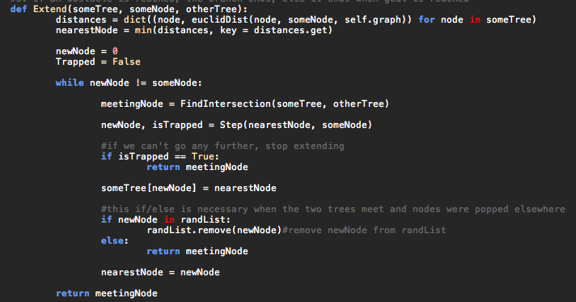
“Extend” Function

Slide 6
“Step” Function
Finds all neighbors of a node & their distances to random node
Finds the neighbor with the minimum distance, passes that to Extend as new node
If the specified node is the closer than all neighbors to the random node, the tree is declared “trapped”

Slide 7
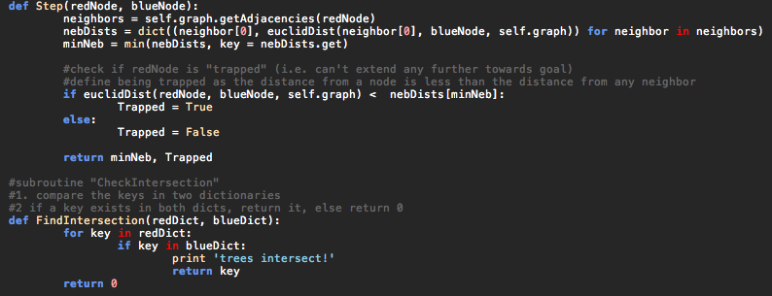
“Step” and “FindIntersection”

Slide 8
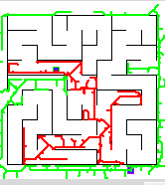
Conclusions:
Tight corners are an issue
Fast (usually)
Time is random
Could be optimized

