Slide 1
Robots in Human Environments
Basic Autonomous Capabilities
O. Khatib et al.
Presented by Andrew Lewis

Slide 2
Overview
Introduction
Integration of Mobility and Manipulation
Cooperative Manipulation
Collision avoidance
Conclusion

Slide 3
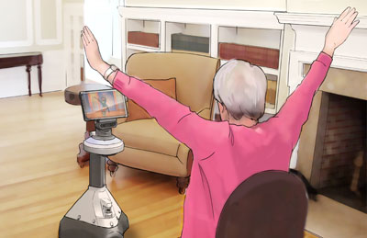
Introduction
Automated workers -> Automated helpers
“Synergy of the human/robot team…”
What is needed for this transition?

Slide 4
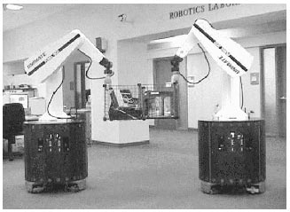
Integration of Mobility and Manipulation
Macro/mini structures
Minimize instantaneous kinetic energy

Slide 5
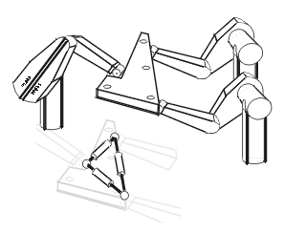
Cooperative Manipulation
Augmented object and virtual linkage model
Centralized -> Decentralized control structure

Slide 6
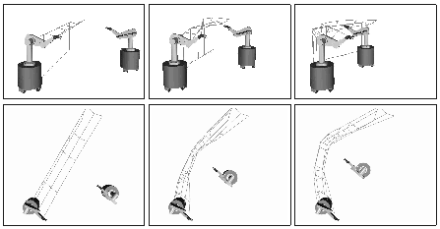
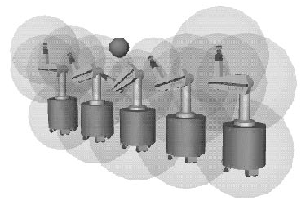
Collision-Free Path Modification Behaviors
Elastic bands and bubbles
Elastic Strip and protective hulls -> elastic tunnel
Dynamically modify motion in response to environment

Slide 7
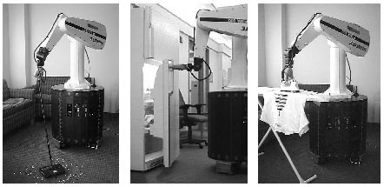
Conclusion
Stanford mobile platform
Basic necessary capabilities
Mobility/Manipulation
Cooperation
Collision avoidance

