Slide 1
Arm Planning
Andrew Lewis

Slide 2
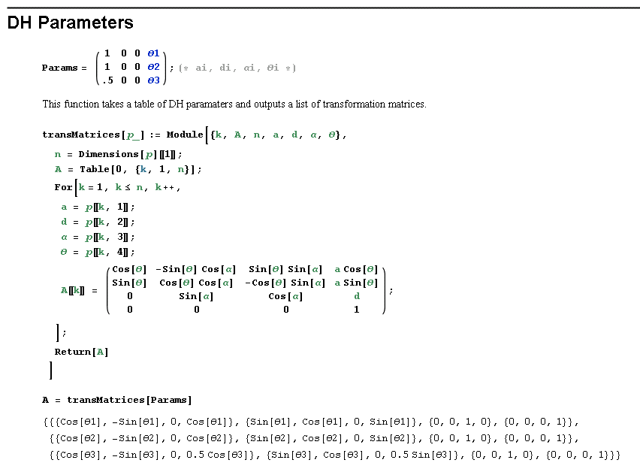
DH Parameters
Use a matrix of parameters to create A matrices
Abstract
Any number of params
3d

Slide 3
Forward Kinematics
Theta + d -> points
Abstract
Up to 8 theta or d (easily expanded)
3D

Slide 4
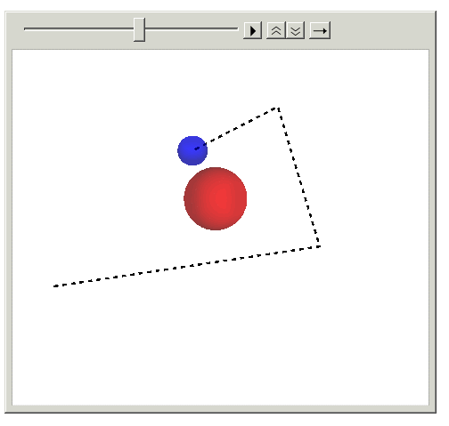
Visual Simulation

Slide 5
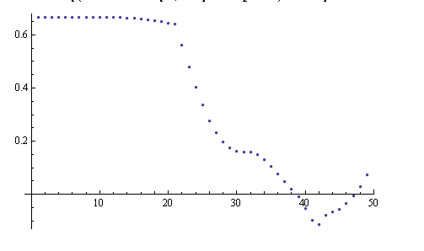
Collision Detection
For each segment
Dot product with obstacle
> 0 within segment
Pythagorean
< 0 outside segment
Distance to each point

Slide 6
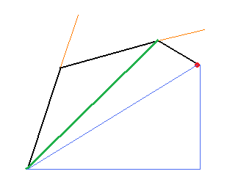
Inverse Kinematics
Overdefined system
Pick effective length of link1 and 2
OR
Pick orientation of final link

