Slide 1
Control of a humanoid robot using EEG

Slide 2
Problem
EEG is low bandwidth
Hard to exercise fine grained control

Slide 3
Solution
Use an autonomous robot
Provide various options for user to select from
Use P300 to detect which option is selected

Slide 4
User Study
4 training sessions to train classifier for grids: 2x2, 2x3, 3x2
.25sec flash alternating between options
One binary classifier for P300
Spatial projection algorithm
a multichannel time-series response to an event and projects all the channels to form a single time series that is maximally discriminative.

Slide 5
Brain-Robot Interface
Robot offers image choices to the user
A border flashes alternating on images
User selects an option using P300 response

Slide 6
Results
98.4% classification accuracy
97% accuracy without the spatial filter
Grid layout did not have a significant impact

Slide 7
P3 example

Slide 8
Number of Flashes
95% accuracy with 5 flashes
Using .25 sec flash, with 4 options, a command can be sent every 5 seconds

Slide 9
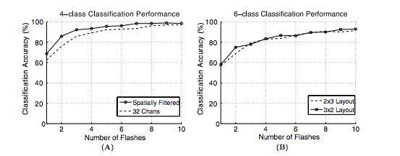
Number of Flashes

Slide 10
Generalizing Classification

Slide 11
Training Time

Slide 13
Discussion
New mode of interaction
Many potential uses

