Slide 1
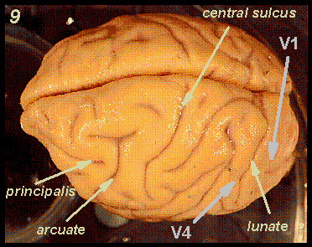
Operant Conditioning of Cortical Activity
E Fetz, 1969
http://web.mit.edu/bcs/schillerlab/research/A-Vision/A5-1.html

Slide 2
Background
Many foundations considered a given now
Muscle – motor unit correlation
Voluntary control of activity
Operant conditioning of firing
Notes:
Engage audience and ask what the confounding factors could be

Slide 3
Design
Goal: Determine modulator(s)
Experimental Paradigm
Controls (What could modulate firing rate?)
Stimuli
Reaching for pellet
Getting a pellet
Notes:
Engage audience and ask what the confounding factors could be

Slide 4
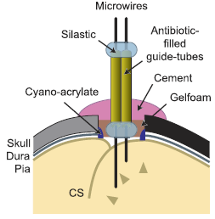
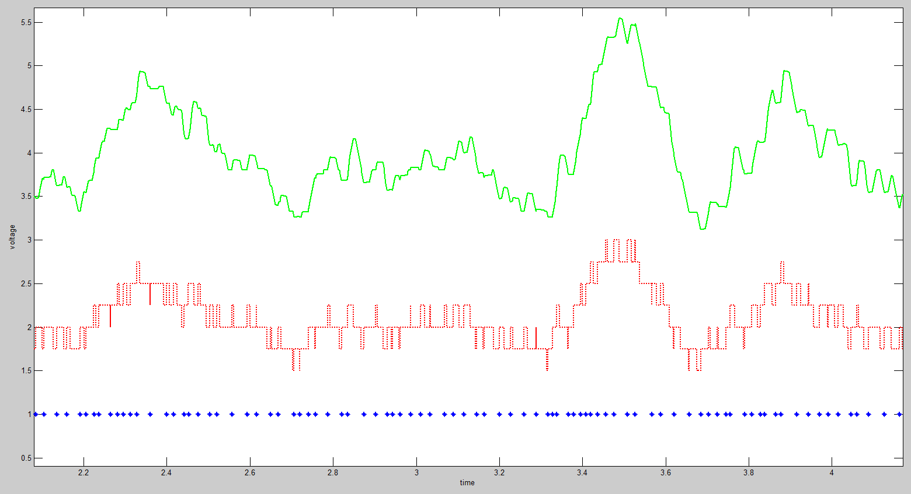
Methods
Jackson 2007

Slide 5
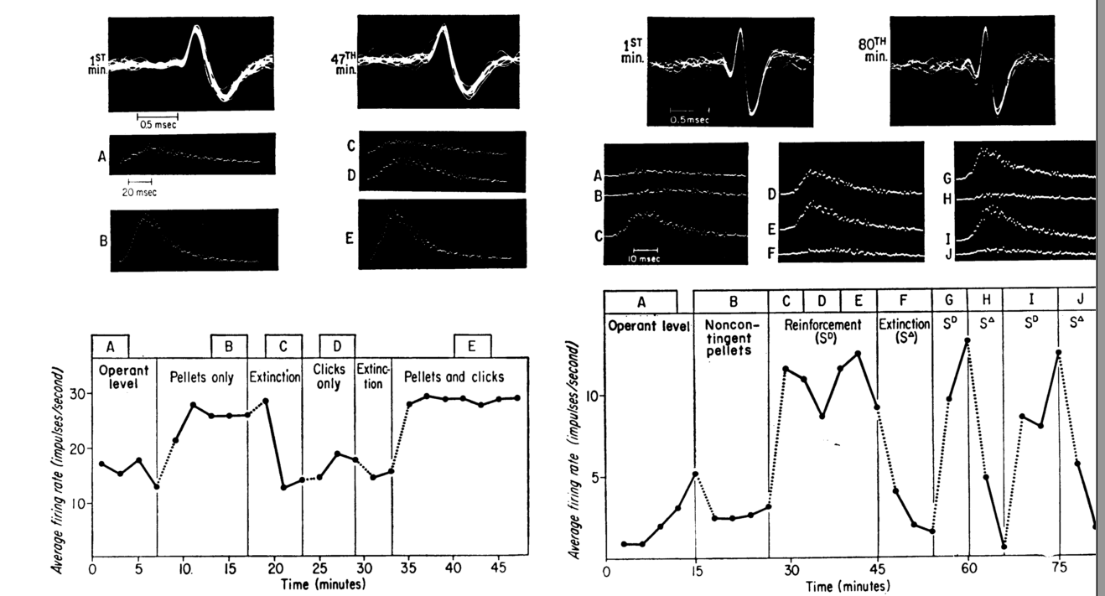
Results
Avg.
Wave
ISIs
Different feedback modalities / subjects

Slide 6
Summary / Criticisms
Modulation of firing rate is reward bound
Do documentation of movement, what is the monkey learning to do?
Notes:
TODO

Slide 7
Real-time control of a robot arm using simultaneously recorded neurons in the motor cortex.
Chapin et al. 1999

Slide 8
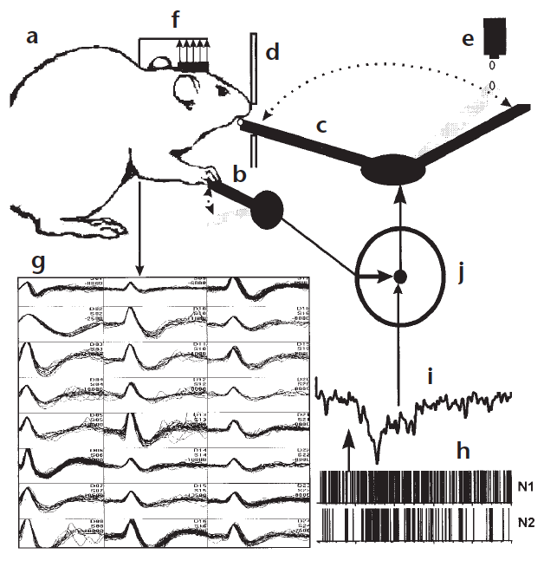
Lever-movement/robot-arm mode
Water Dispenser
Robot Arm
Lever

Slide 9
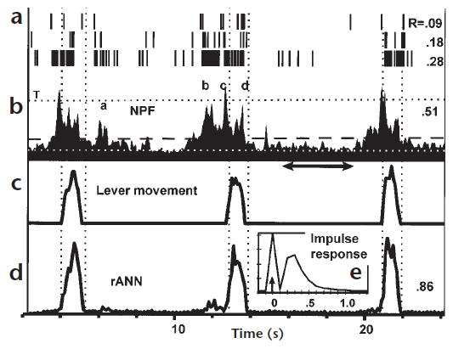

Slide 10
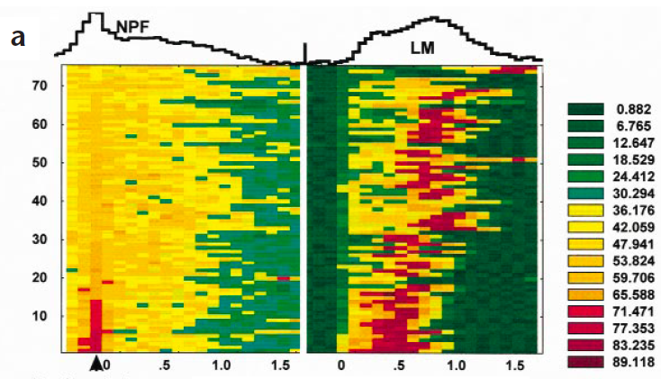
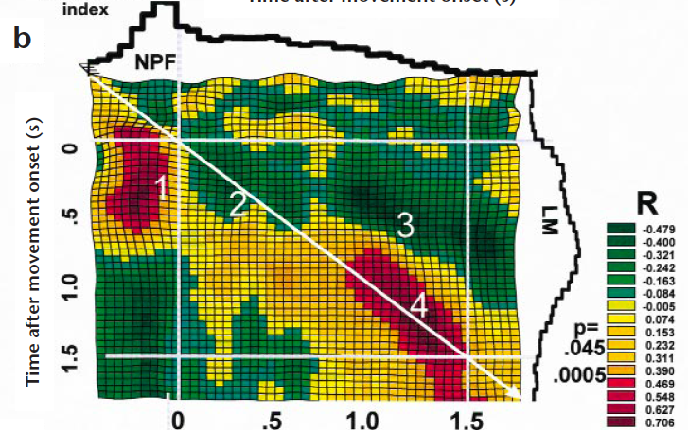
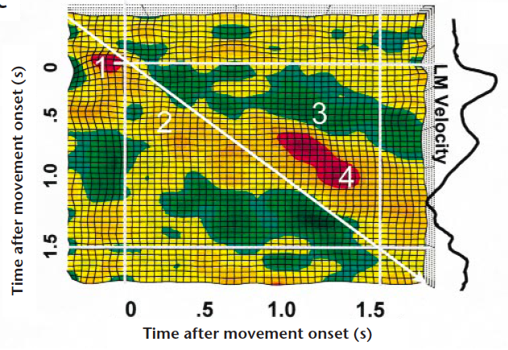
Trials #
What does spatio-temporal mean in this context?
Time from movement onset (s)

Slide 11
NP-function/robot-arm mode
Water Dispenser
Robot Arm
Lever

Slide 12
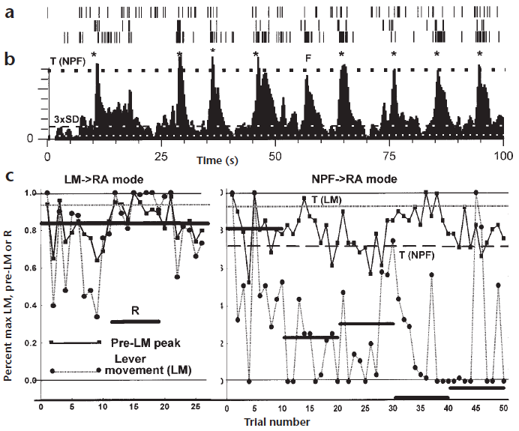
NP-function/robot-arm mode
Did not press the lever, but still continued to reach

Slide 13
Was it the rats’ “imaginary movement” that triggered the robot-arm movement?
The decoder did not discriminate physical movements and imaginary movements in neural signal. What kind of potential drawbacks could that make in real application?
What kind of additional signals could potentially help discriminate physical vs imaginary movements?

Slide 14
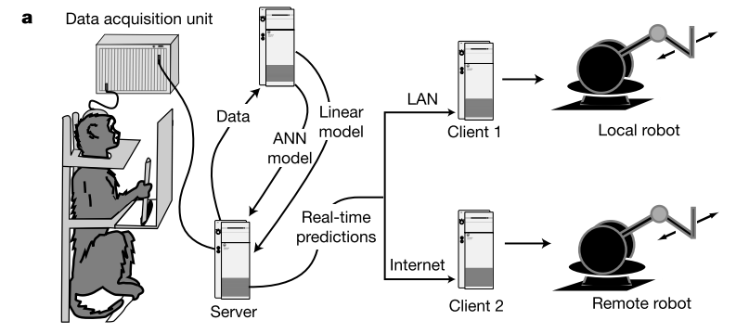
Real-Time prediction of hand trajectory by ensembles of cortical neurons in primates
Wessberg et al. 2000

Slide 15
Background
Builds on previous paper, can “binary” decision be expanded to an analog signal?
Primary and secondary motor cortices involved in reaching tasks (M1, PMd, PP)
Notes:
Extension rat paper in to a prediction model – TODO
Operant conditioning of firing rates, there’s hand movement

Slide 16
Experiment
Hypotheses
1-D and 3-D prediction
Task dependent activation
Linear vs. Non-linear Models
Control External Device
Experimental Overview

Slide 17
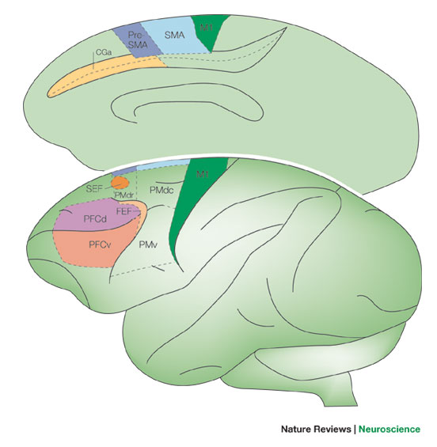
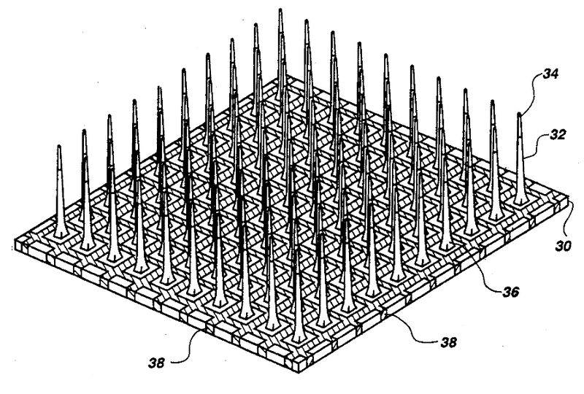
Methods - Recording
Nieder 2005
Notes:
Don’t forget ipsilateral M1

Slide 18
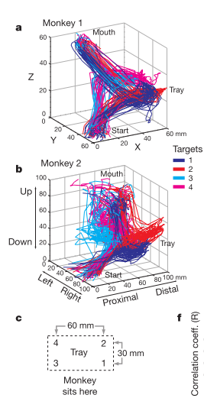
Methods - Tasks

Slide 19
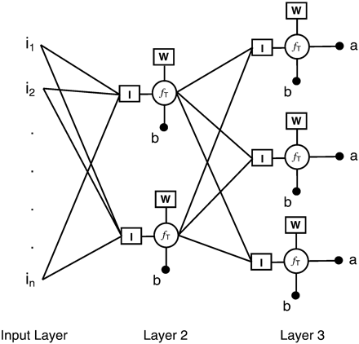
Methods - Models
Regression (linear)
Weights
Firing rates
Artificial Neural Network (non-linear)
Position
Regression intercepts
Error
Notes:
Learning vector quantization (LVQ) ANN
Winner take all or nearest neighbor
Looking for spatiotemporal patterns corresponding to hand positions

Slide 20
Results - Data

Slide 21
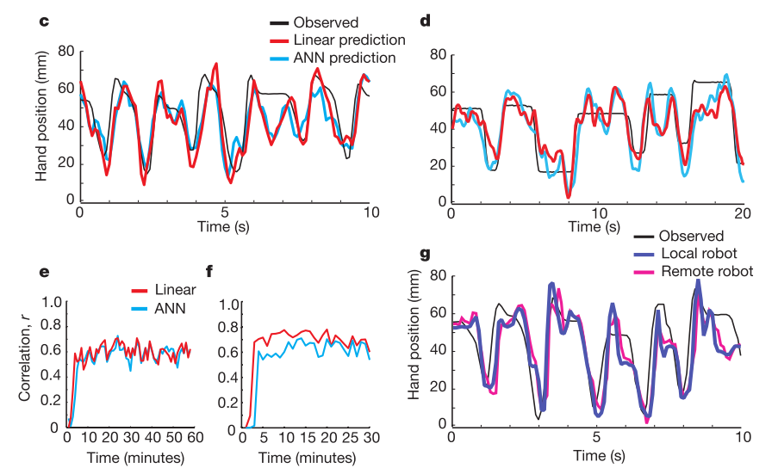
Results – Prediction, 1-D
Notes:
Online control vs Offline control

Slide 22
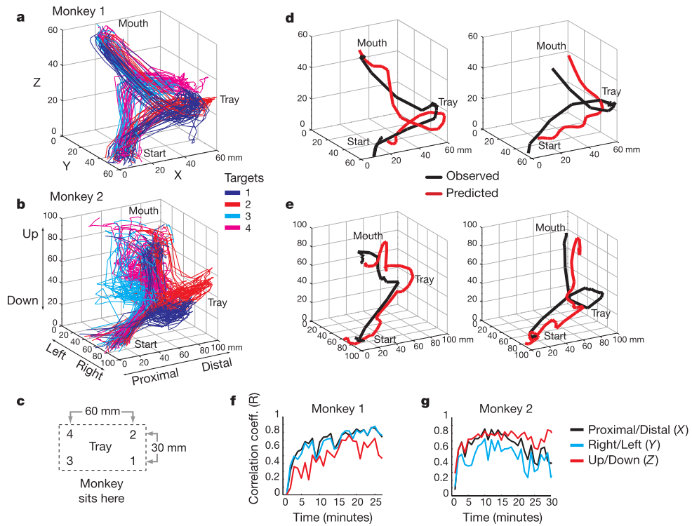
Results – Prediction, 3-D

Slide 23
Results – Neuron Dropping

Slide 24
Discussion / Criticisms
Max accuracy with short training times (10 minutes)
Generalizability of classifier
Relative contributions of motor areas
More neurons != more accuracy. Why?
Why does PMd contribute to better decoding w/ fewer neurons?
Real time decoding different from offline decoding (ANNs better in offline, just more computationally expensive)
Assumption of hyperbolic relationship, limited in extrapolation
Engineering application is showy, but open loop.
Notes:
Correlation of activity, hurts assumption of hyperbolic relationship
Different areas, PMd, why better decoding? More information? Less correlation between individual firing rates?

