Slide 1
Decoupling the Cortical Power Spectrum
Real-Time Representation of Finger Movements

Slide 2
Overview
Introduction
Materials and Methods
Results
Discussion/Summary

Slide 3
Introduction
During active movement the electric potentials reveal two processes in power spectrum
Low frequencies < 40Hz
High frequencies > 75Hz
Synchronous rhythms
Analogous to lower-frequency phenomena

Slide 4
Problem/Solution
Problem:
High frequency reflect a broad-band spectral change across the entire spectrum
synchronous rhythms at low frequencies
Solution:
Demonstrate that decomposition can separate low-frequency narrow-band rhythms from broad-spectral at all frequencies (5 – 200Hz)

Slide 5
New Method
General studies:
Specific frequency ranges of the power spectral density (PSD) were selected for analysis
Interpretation – tied to frequency-specific processes
New method:
Extract and remove the low-frequency α and β rhythms to reveal behaviorally modulated broadband changes in the ECoG signal, across all the frequencies
-- improved spatial resolution of local cortical populations
-- real-time signals correlated with individual finger movements

Slide 6
Materials and Methods

Slide 7
Subjects & Recordings
Subjects:
10 epileptic patients (at Harborview Hospital in Seattle)
-- 18- to 45-year-old, 6 female
Each had sub-dural electrocorticographic (ECoG) grids placed for exteded clinical monitoring
Recordings:
Performed at patients’ bedside
Signal was amplified in parallel with clinical recording.

Slide 8
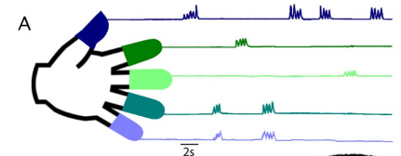
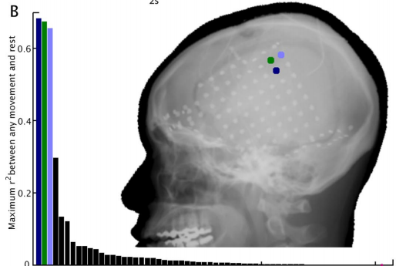
Movement Task
Method:
Word displayed on a monitor to move fingers during 2 s
-- 3-5 times move in each trial
2 s rest trial followed each movement trial
30 movement cues for each finger – random interleaved trial types
100-150 total movements per finger

Slide 9
Spectral Analysis & Decompositions
Discrete spectral analysis and decomposition:
Scalp-referenced ECoG potentials were re-referenced with respect to common average reference
Each electrode –
Samples of PSD

Slide 10
Spectral Analysis & Decompositions
Continuous spectral analysis and decomposition:
Wavelet approach
Each channel –
Calculate time-varying continuous Fourier components with fixed uncertainty
Use same procedure as discrete case to examine and decompose movement-onset averaged PSD change.

Slide 11
Results

Slide 12
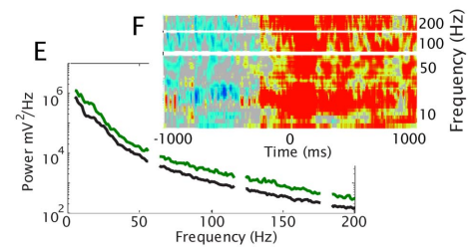
Movement-related Spectral Changes
The characteristic decrease in power of lower frequencies, and a spectrally broad increase in power at higher frequencies of the ECoG
(Mean of reconstructed PSD samples from same electrode)

Slide 13
Movement-related Spectral Changes
First PSC –
Consistently showed the frequency element magnitudes that were non-zero
Each element was closer to the average across all elements than it was to zero
High γ changes may be a reflection of this broad spectral phenomenon

Slide 14
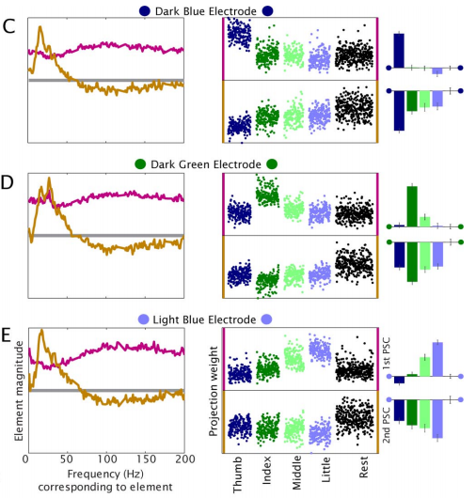

Slide 15
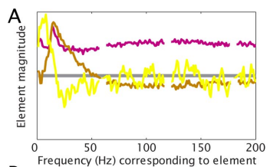
Movement-related Spectral Changes
Second PSC:
Peaked in the α/β range, reflecting a process in a narrow range of frequencies
Beginning near zero and peaking at a low frequency
Consistent with “event-related de-synchronization”
Reflects resting rhythms that decrease when the cortical areas are activated

Slide 16
Spatial Distribution of the Principal Spectral Components
The motor somatotopy identified by the first PSC consistently agreed with the sites that produced finger motor movement when stimulated with electrical current
Second PSC, all finger movement types were different from rest at each of the three sites, and corre-sponded to decreases in power in the α/β range

Slide 17
Constraints
Decoupling was less robust in the case where behavioral variance was not robust
-- fingers were not moved independently
Partially shared variance between the broad spectral phenomenon
ERD resulted in the presence of residual amounts of each both of the first two PSCs

Slide 18
Conclusion
At the single neuron level can, at a coarser spatial scale, be resolved by an aggregate signal generated by the local neuronal population at large
High frequencies in the unit recordings are dominated by individual unit activity from nearby neurons.
The cortical surface electrodes pick up and “average” aggregate activity from large neuronal populations.

Slide 19
Conclusion
Spatial distribution of this synchronous process does not exhibit strong specificity for individual finger movements
The broad-band signal is specific for movement of individual fingers.

Slide 20
Discuss
Although these neuronal populations are partially synchronized to a low-frequency, β oscillation, the aggregate broad-band, asynchronous, activity independently maintains specificity for different classes of finger movement

Slide 21
Future Work
Separable, continuous, measure for different finger movements
Further use of digit-based paradigms
Human motor cortex
Applications (clinical mapping, brain-machine interfaces)
Isolation of broad-band phenomenon
Accessing the activity of local cortical populations
Notes:
This finding of separable, continuous, measure for different finger movements in adjacent cortical areas supports further use of digit-based paradigms to study human motor cortex, and for use in applications such as clinical mapping and brain-machine interfaces.

