Slide 2
Direct Neural Sensory Feedback and Control of a Prosthetic Arm

Slide 3
Introduction
Modern artificial limbs by amputees may be enhanced with appropriate, graded, distally referred sensations
Touch
Joint movement

Slide 4
Problem
Different sensory feedback systems tried do no provide discrete and natural sensations.
➔ Users have to translated unrelated motion into intended one.

Slide 5
Possible Solutions to Explore
Provide direct neural interface with nerve fibers
In peripheral nerve stumps
Allows feedback provided through sensory pathways associated with missing parts of arm
Allows control signals derived from neural activity generated by amputee

Slide 6
Study Purposes
Demonstrate sensory feedback about
Joint position
Grip force
From artificial arm
Through stimulation of peripheral nerves

Slide 7
Methods
Sensory input
Motor output

Slide 8
Methods
Electrodes
LIFEs
Another to saddle connector, adhered to skin surrounding percutaneous electrodes exited arm
Connector used to interface outside circuitry:
Recording hardware
Stimulation hardware

Slide 9
Methods
Subject training
With
One or more electrodes providing sensory input
Output from motor control channels fed to loudspeaker
Instructed to attempt a missing limb movement while listening to nerve activity over loudspeaker
Ex. finger flexion
Recorded signals fed to DAC to computer to quantify neural activity associated with movement

Slide 10
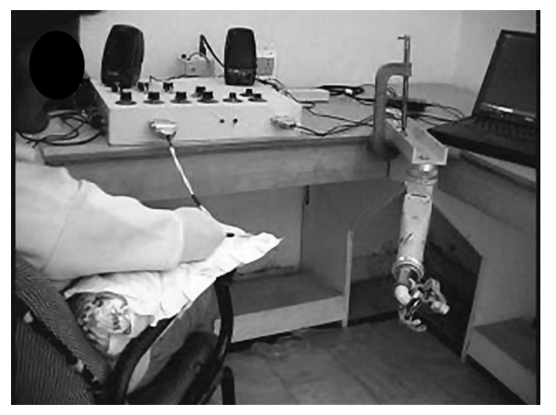
Methods

Slide 11
Methods
Subject training (cont.)
Subject asked to control cursor position on computer screen by modulating motor activity
Cursor position linearly related to level of motor activity
Minimal output: left end of screen
Maximal output: right end of screen
Goal: place cursor and make it stay within random stationary target for specified period of time
Subject scored on percentage of time of success in a block of trials
Task difficulty increased with improved performance
Target size change
Time constraint change

Slide 12
Methods
Nerve-arm interface
Force sensor in thumb of hand
Position sensor in elbow of prosthesis
Both to provide sensory feedback
Input mapped logarithmically to stimulus frequency to selected stimulating electrode
Tactile sensation for force
Proprioception for position
Actuators in elbow & hand controlled by nueronal firing rate recorded from motor control electrode

Slide 13
Methods
Sensory Input
3 subjects
For each, one tactile & proprioceptive electrode selected for testing
Prior to testing
3 & then 5 different force/position matches with visual feedback
Testings:

Slide 14
Methods
Sensory input (cont.)
Force applied to sensor on thumb
Subject asked to rate force using open numerical scale without visual feedback
Elbow of artificial arm moved to different positions
Subject asked to match perceived angle of elbow flexion/extension without visual feedback

Slide 15
Methods
Motor output
3 subjects
Eah with one of vailable motor channel electrodes
2 for grip force
1 for elbow control
Prior to testing
Subject given time to train for given movement
Testings:

Slide 16
Methods
Grip force control:
Subject asked to match 3 levels of force (typically 22, 44, & 67 N) and,
Within 5 s for each target value
After succeeding more than 70 % of target values, 5 levels (ranging from 13 to 67 N)
Within 5 s for each target value
Match random target value (ranging from 22 to 67 N)
Elbow position control:
Similar with grip force control training paradigm

Slide 17
Results
Sensory input
All 3 subjects could judge changes in indentation or force applied to thumb sensor
Slops of linear regression lines significantly different from 0 (at the end of testing)
Regression slope of only 1 subject significantly increased
Significant decrease in variance of residuals around regression lines in 2 subjects

Slide 18
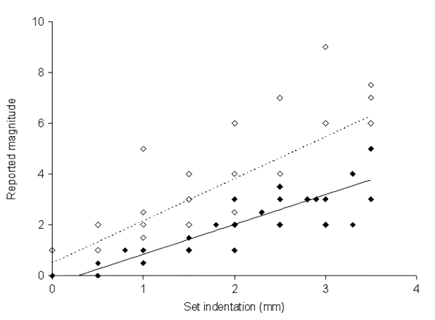
Results

Slide 19
Results
Subjects could judge static position of elbow join in artificial arm
Linear regression P-value < 0.001 at the end of testing
General increase in slops of regression lines with time statistically significant in 2 subjects
Statistically significant decline in variance around regression line in only 1 subject

Slide 20
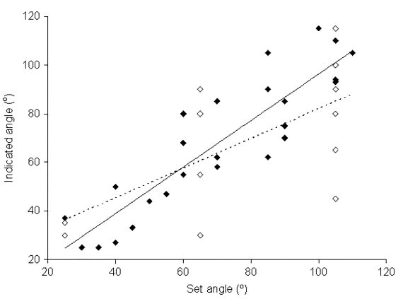
Results

Slide 21
Results
Motor output
Grip force control
Linear regression P-value >> 0.05
Significant nonzero slope
Significant decline in variance around regression in time in both subjects
No significant change in slopes of regression lines

Slide 22
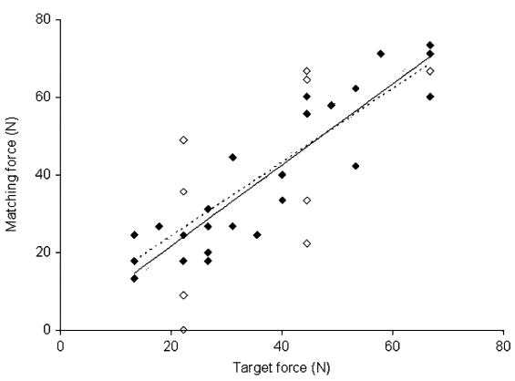
Results

Slide 23
Results
Elbow control
Linear regression P-value >> 0.5
significant nonzero slope
Significant increase in slopes of regression line
Significant decline in variance of residuals around regression line in time

Slide 24
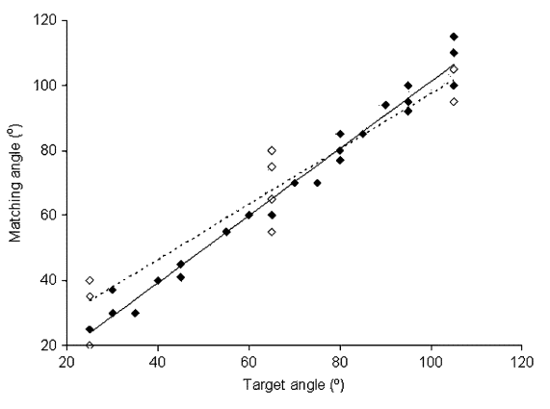
Results

Slide 25
Conclusions
Appropriate, graded, distally referred sensations can be used to provide feedback information about grip force & limb position
Control of trip force & limb position can be affected by motor activity from peripheral nerve stumps with electrodes

Slide 26
Conclusions
Improved performance in some subjects over short period may suggest further training may provide better feedback & control
May provide pain-free integration of artificial arm into amputee’s body in future

Slide 27
Further Studies
Optimization of sensory stimulation paradigms
Optimal processing of motor control signals
Different training regimes
Improving operational characteristics of artificial arm
Nonvisual control of artificial arm

Slide 28
Further Studies
Implementation of implanted bidirectional telemetry system
Implementation of viable permanent percutaneous connector system
Design constraints
Weight
Power supply

