Slide 1
A High-Performance Brain-Computer Interface
4.19.2012

Slide 2
Introduction
Problem:
The speed and accuracy with which keys can be selected using BCI’s is far lower than for systems relying on eye movement
Competition with communication prostheses relying on saccades or speech
At the time, current information transfer rates were around 1 bit/sec (human) and 1.6 bit/sec (monkey)

Slide 3
Background
Most BCI’s are used to guide continuous motion, such as a cursor.
If this motion results in a discrete choice, why not train on the discrete choice specifically, “direct end-point control”
Focus on premotor cortex (PMd). Neural activity contains the end-point information of an upcoming reach.
Good signal for horizontal/vertical directionality of upcoming reach
Potentially occurs through rehearsal of movement
Notes:
Training on the intended target benefits from not having to estimate continuous trajectory

Slide 4
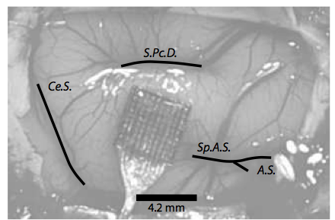
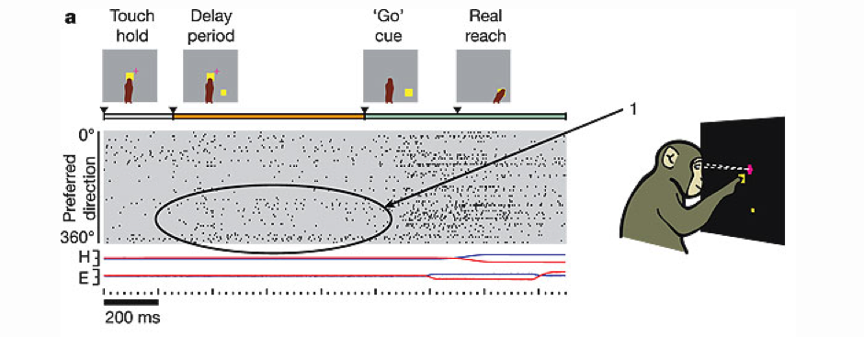
Instructed Delay Reach Trial
a, Standard instructed-delay reach trial. Data from selected neural units are shown (grey shaded region); each row corresponds to one unit and black tick marks indicate spike times. Units are ordered by angular tuning direction (preferred direction) during the delay period. For hand (H) and eye (E) traces, blue and red lines show the horizontal and vertical coordinates, respectively. The full range of scale for these data is ^15 cm from the center touch cue.
Notes:
In contrast, we report here that neurons in the dorsal premotor cortex (PMd) of monkeys might contribute to mental rehearsal of processes that normally occur before the onset of movement. Unlike mirror neurons, their activities predict the directionality of impending events before the onset of movement, they respond to abstract visual cues that have become associated with action only through training, and they do not require the actor to be in view. These PMd neurons emit very similar responses when the monkeys actively perform the motor task, indicating that passive observation of the artificial stimulus events might evoke a covert rehearsal
Spikes were sorted and then modeled as a Poisson or multivariate Gaussian
Neural data from 96 electrode array collected and the mean waveform was used for spike sorting . This data was then clustered in a modified Principle Component Space.

Slide 6
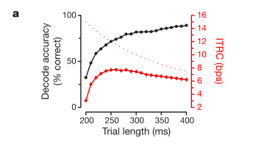
Optimization of T_{int} is based on two metrics
Single-trial accuracy
Percentage of targets correctly predicted plateaus around 85-90% at 200-250 ms
Information Transfer Rate Capacity (bps)
Measures the rate at which information is conveyed from the subject, through the BCI, to the environment. Closely related to the single trial accuracy divided by the trial length length.
Notes:
the optimal ITRC occurs at short trial lengths, despite relatively low single-trial accuracy at these trial lengths. The highest ITRC is 7.7bps at a total trial time of 260ms, which corresponds to a Tint of 70 ms (Tskip 1⁄4 150 ms, Tdecþrend 1⁄4 40 ms)
Longer T_{int} will average away more noise and result in more accurate predictions of reach end-point. However, a longer T_{int} will also reduce the total number of cursor positionings that can be made per second. Speed-Accuracy tradeoff

Slide 7
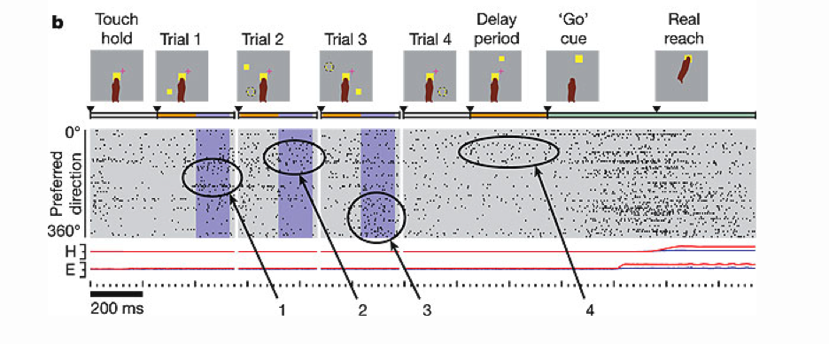
Prosthetic Cursor Trials
b, Chain of three prosthetic cursor trials followed by a standard instructed-delay reach trial. Tskip is denoted by the orange parts of the time line. Neural activity was integrated (Tint) during the purple shaded interval and used to predict the reach target location. After a short processing time (Tdec+rend approximately 40 ms), a prosthetic cursor was briefly rendered and a new target was displayed. The dotted circles represent the reach target and prosthetic cursor from the previous trial, both of which were rapidly extinguished before the start of the trial indicated. Trials shown here are from experiment H20041106.1 with monkey H.
Notes:
Included a reach action in order to make the experiment as similar as possible to the control experiement

Slide 9
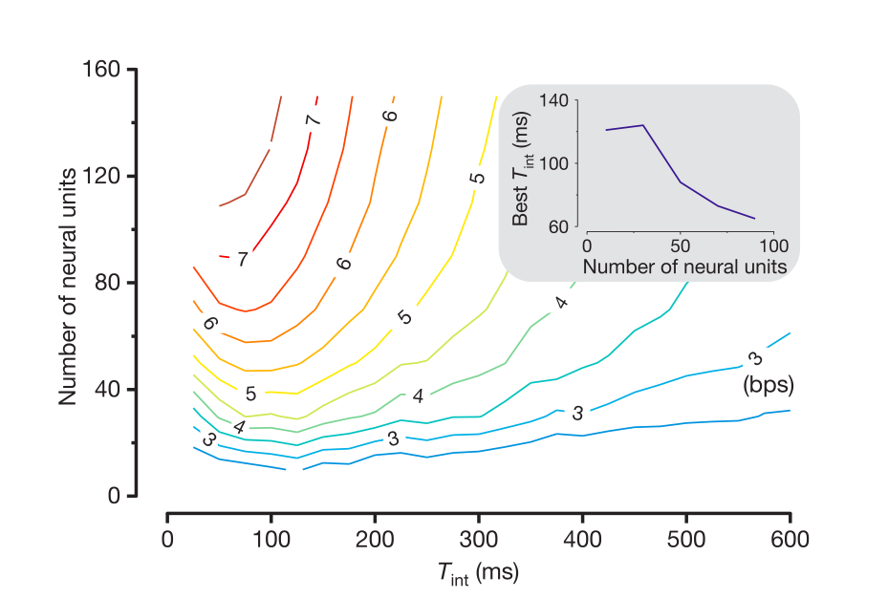
Controls
Neural Activity
Presence of neural activity in PMd after brief display of visual target, confirms that sustained neural activity is motor-related rather than purely sensory
Neural Loss
Single-trial accuracy falls as neuron ensemble size decreases. However, it is possible to compensate partially for this performance loss by increasing Tint

Slide 10
Results and Discussion
At its fastest, this direct end-point control BCI demonstrates selection speeds (3.5 trials per second) on par with saccadic eye movements
Information transfer rate of up to 6.5 bits/sec, ~15 words/min
The ITRC for saccades is much higher due to their exceptional precision and accuracy, but an advantage of BCI’s is they don’t rely on repurposing natural processes for a new use.
While real patients may have to choose from several objects in their workspace, these objects will not ordinarily be presented immediately prior to a decision to execute a prosthetic reach. Furthermore, BCIs will typically rely on internally-generated target plans as opposed to externally presented stimuli

Slide 11
Fast Trial Video

Slide 12
ITRC

