Slide 2
Motivation
Increase bandwidth of BCI.
Reduce training time
Use non invasive technique

Slide 3
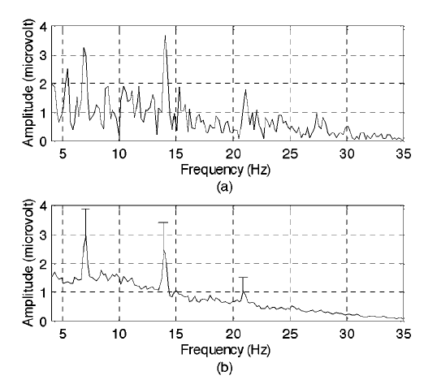
Methods: underlying phenomenon
Steady State visually evoked potential (SSVEP)
Exact multiples of stimulus frequency in EEG data
Instantaneous FFT
7 Hz flicker
Average FFT
Are harmonics due to physiology or signal processing?

Slide 4
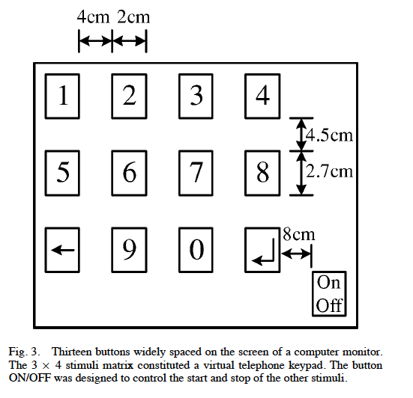
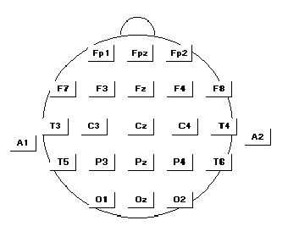
Methods: experiment setup
Each bottom flicker at different frequency (6 to 14 Hz)
User gazes at one bottom to select it.
Signals at 01 and 02 electrodes, ear lobes reference and ground. 10-20 system

Slide 5
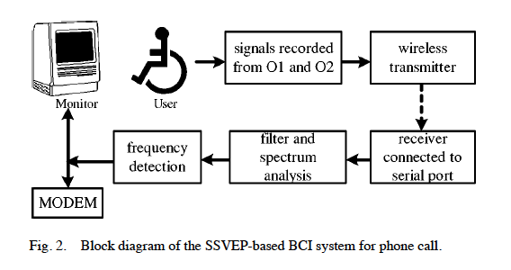
Methods: signal processing
Bandpass filter 4 to 35 Hz
Calculate FFT every 0.3 sec
1024 point FFT on 512 points of data, rest are zeros
Determine the sum of fundamental frequency and second harmonic
Threshold is twice the mean of the spectrum
Same fundamental has to be detected in 4 consecutive FFTs

Slide 6
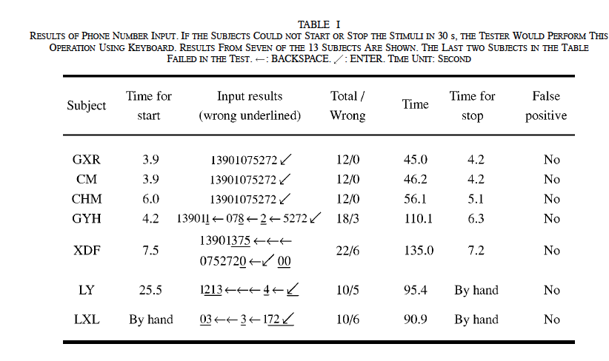
Results Task 1: inputting a phone number
6 subjects no errors
2 subjects some errors
5 subjects couldn’t input number

Slide 7
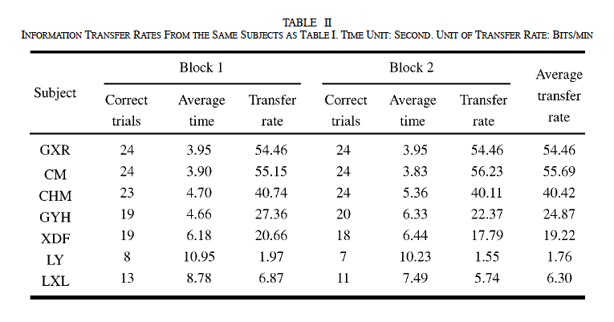
Results Task 2: transfer speed

Slide 8
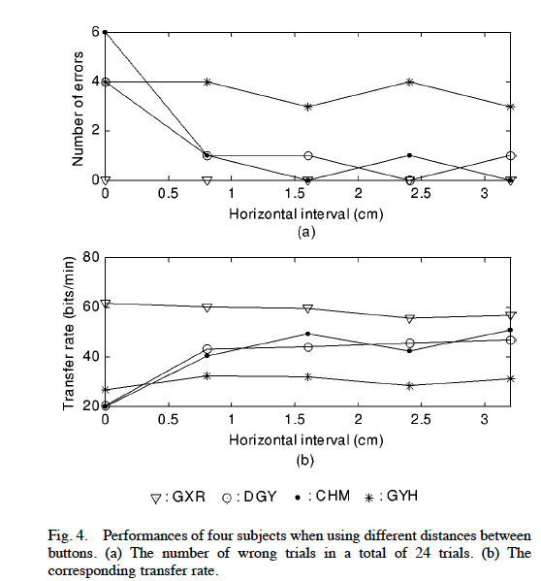
Results Task 3: buttons spacing

Slide 9
Conclusion
Subjects respond differently, no statistically significant results obtained.
Up to 55 bits /min transfer rate
Requires no training
Input accuracy decreases when subject is listening to conversations
Advanced signal processing to remove brain background activity can be used in a future.

Slide 10
Discussion
Strengths
Simple and straightforward experimental approach.
Presents convincing evidence for effectiveness of SSVEP BCI.
Weaknesses
SSVEP based BCI doesn’t work for everyone.
Inconsistent result (ex. bandwidth from 1 bit/sec to 55 bit/sec)
Crude signal processing.
No control of eye and face movements

Slide 11
Questions
What are some practical application of this system beyond paralyzed patients?
How does the performance (bandwidth, accuracy, training) of this BCI system compare to invasive methods?

