Slide 1
BCIs using EEG for multidimensional control!
Compared to invasive BCIs
Pros/cons
Real-world clinical application
Performance optimization

Slide 2
Control of a two-dimensional movement signal by a noninvasive brain-computer interface
Jonathan R. Wolpaw and Dennis J. McFarland
2004

Slide 3
Control of a two-dimensional movement signal by EEG
Invasive BCIs
Technically difficult, clinically risky
Thought to be best for controlling prosthetics
Noninvasive BCIs
Easier, safer
Can provide multidimensional control within range reported for invasive BCIs

Slide 4
Subjects
Subject | A | B | C | D
Age | 41 | 27 | 31 | 23
Sex | Male | Female | Male | Male
Injury | Complete midthoracic (T7) | None | None | Incomplete midcervical (C6)
Years since injury | 26 | -- | -- | 7
Prior experience with BCIs | 91 hours | 11 hours | None | 19 hours

Slide 5
Study protocol
Notes:
8 possible target locations (block-randomized, so each target ocurred once in every 8 trials)
First, target appears
1 s later, cursor appears in the middle of the screen
Cursor’s movement is controlled by user’s EEG
If the cursor reached the target within 10 s, the target flashed a reward
If not, the cursor and target disappeared
In either case, the screen went blank for 1 s, and then the next trial began
A daily session consisted of 8 3-min runs separated by 1-min breaks, 2-4 session per week (ABCD: 68, 22, 40, 25 sessions)

Slide 6
Control of cursor movement
Vertical and horizontal dimensions
Linear equation
Independent variable: Weighted combination of the amplitudes of mu (8-12Hz) or beta (18-26Hz) frequency bands over left and right sensorimotor cortices
Updated by adaptive algorithm after each trial

Slide 7
Control of cursor movement
Cursor moved every 50 ms
Last 400 ms filtered
Laplacian filter from L and R sensorimotor cortex
And analyzed
Autoregressive frequency analysis
To determine amplitudes in mu- and beta- rhythm frequency bands
Notes:
Selection of mu and/or beta based on the characteristics of each user’s previously developed one-dimensional control
Form of combination based on initial studies of two-dimensional control

Slide 8
Control of cursor movement
Full topographical and spectral analyses showed that cursor control was due to user’s sensorimotor rhythm control, not non-EEG artifacts
Notes:
(B) Topographical and spectral properties of user A's EEG control. In
this user, vertical movement was controlled by a 24-Hz beta rhythm and
horizontal movement by a 12-Hz mu rhythm. (Top) Scalp topographies (nose
at top) of the correlations of the 24-Hz and 12-Hz rhythms with vertical and
horizontal target levels, respectively. The sites of the left- and right-side scalp
electrodes [locations C3 and C4 over sensorimotor cortex (21)] that controlled
the cursor are marked. Vertical correlation is greater on the left side, whereas
horizontal correlation is greater on the right side. The topographies are for R
rather than R2 to show the opposite (i.e., positive and negative, respectively)
correlations of right and left sides with horizontal target level.

Slide 9
Results
Notes:
Topographical and spectral properties of user A’s control
Vertical movement controlled by 24-Hz beta activity, horizontal by 12-Hz mu activity
At the top are the scalp topographies (nose at top) of the correlations of the 24-Hz and 12-Hz rhythms with vertical and horizontal target levels, respectively. The xs mark the sites of the left and right scalp electrodes that controlled the cursor.
The middle figures each have 4 traces corresponding to the four vertical and four horizontal target levels, showing the voltage spectra from which the vertical and horizontal variables were derived, along with their corresponding r-squared spectra. The arrows point to the frequency bands used in these variables, and the weights in the variables show that vertical movement was determined more by 24-Hz amplitude on the left, and horizontal movement by 12-Hz amplitude on the right.
The bottom traces are samples of EEG activity from electrodes that contributed to the vertical and horizontal variables for trials in which the target was at the top/bottom (1/6) or right or left (3 or 8) of the screen edge. Both mu and beta rhythms changed for each control dimension, but the algorithm’s focus on beta for vertical and mu for horizontal gave independent vertical and horizontal variables.

Slide 10
Control of cursor movement
M= vertical (v) or horizontal (h) movement
a= gain
R= right-side amplitude (h or v)
L= left-side amplitude (h or v)
w= weight
b= mean voltage for the user’s previous performance

Slide 11
Adaptive algorithm
Initial V weights= +1.0, H weights= +1.0 & -1.0
V movement initially controlled by sum of R and L vertical amplitudes
H movements initially controlled by difference of R and L horizontal amplitudes
Weights adapted after each trial
Least-mean-square algorithm determines weights that minimize the difference between actual and predicted target location
Notes:
Weird method b/c did it in another paper, plus creates bigger difference between V and H…?
LMS algorithm determined the weights for the linear functions that would have given the best results had they actually been used for past trials.

Slide 12
Calculated variables correlated with appropriate dimensions
Notes:
Shows that each user developed two independent control signals: one for vertical and one for horizontal movement of the cursor
Also showed that the vertical and horizontal control signals did not interfere with each other

Slide 13
Results
Subject | A | B | C | D
Age | 41 | 27 | 31 | 23
Sex | Male | Female | Male | Male
Injury | Complete midthoracic (T7) | None | None | Incomplete midcervical (C6)
Years since injury | 26 | -- | -- | 7
Prior experience with BCIs | 91 hours | 11 hours | None | 19 hours
Completed trials | 742 | 521 | 528 | 717

Slide 14
Typical trial
http://www.pnas.org/content/suppl/2004/12/07/0403504101.DC1/03504Movie1.mov

Slide 15
Results
Subject | A | B | C | D
Age | 41 | 27 | 31 | 23
Sex | Male | Female | Male | Male
Injury | Complete midthoracic (T7) | None | None | Incomplete midcervical (C6)
Years since injury | 26 | -- | -- | 7
Prior experience with BCIs | 91 hours | 11 hours | None | 19 hours
Completed trials | 742 | 521 | 528 | 717
How often reached the target within 10 s | 89% | 70% | 78% | 92%
Avg. movement times | 1.9 s | 3.9 s | 3.3 s | 1.9 s

Slide 16
Cursor trajectories
Notes:
Each user’s average cursor path to each target for the fastest 53-75% of the user’s target hits, and average time is shown at the targets. Crossed lines correspond to tenths of the time taken to reach the target. Circled numbers are the target locations.

Slide 17
Additional questions
Can users move the cursor to targets at novel locations?
Present 8 new targets mixed in with original 8 targets
Movement time is 10% more during first novel session, 5% more in next 7 sessions (no significant differences)
Do they use covert muscle contractions to control sensorimotor rhythms?
Record EMG from forearm flexors and extensors
Notes:
Choose flexors and extensors because they are strongly represented in the area of sensorimotor cortex where EEG control was focused

Slide 18
Notes:
EMG activity during cursor control.
A= EMG amplitudes as % of maximum voluntary contraction during cursor movement for each direction (open bars=top or left, hatched bars=bottom or right, for vertical and horizontal cursor movements). Dots are r-squared values, indicating no correlation of EMG with target direction.
B= Samples of right forearm extensor EMG activity from user D. The top trace shows maximum voluntary contraction, the other traces are from trials in which the target was at the top, bottom, right, or left edges of the screen. EMG activity during these trials was very low.

Slide 19
Invasive vs. Noninvasive
Notes:
Compared the best users (monkey or human) from three other studies to the best user from this study. Values are calculated from the dimensions of the targets, the cursors, and the workspaces in each study, or drawn from the text of those papers.
The values for Serruya etal. (6) (except for hit rate, which is not stated in the paper) are taken from that paper's text and its figure 1, a and d.
The values for Taylor etal. (7) are derived from that paper's text and its table 2 (Monkey M, 2.0-cm targets).
For Carmena etal. (9), movementtime and hit rate are derived from sessions 19-21 of Monkey 2 as displayed in that study's figure 1 C and the target, cursor, and workspace dimensions needed to calculate movement precision, which are not stated in the paper, are derived from its figure 1 B (Task 1). The resulting value for target size was confirmed by the magnitude of movement evident in individual trials in the paper's figure 6G during the g phase (in which the cursor must remain in the target).

Slide 20
Conclusions
Noninvasive BCIs can provide multidimensional control comparable to invasive BCIs
Users can move the targets to novel locations
Users do not use covert muscle contractions to control sensorimotor rhythms

Slide 21
Possible improvements
Could improve speed and accuracy (and extend to three dimensions) by:
Expanding the adaptive algorithm to include more EEG locations, frequency bands, and/or features
Refining the user training protocol
Improving the translation of EEG features into cursor movements
Using these EEG methods in ECoG
Better spatial resolution and frequency range

Slide 22
A brain-actuated wheelchair: Asynchronous and non-invasive Brain–computer interfaces for continuous control of robots
F. Galan, M. Nuttin, E. Lew, P.W. Ferrez, G. Vanacker, J. Philips, J. del R. Millan
2008

Slide 23
Intro
Study the possibility to interact on the environment without using the human nervous system through non-invasive BCI (EEG)
Using a simulated wheelchair
Test different control signals
Create a system to compensate for differences between calibration and online samples
Is it possible to find (rather) stable subject-specific EEG features to reduce the differences between samples extracted from calibration and online operation sessions?
How shared control techniques can minimize the impact of changes in the user’s EEG signals during the online operation?
Notes:
Adaptive algorithms have two main limitations
they are based on supervised approaches requiring the correct output for every sample, and so the user cannot operate the BCI autonomously.
2) Adaptation in the wrong moment (e.g., when the user is not properly executing the mental tasks because of fatigue, distraction, etc) will incorrectly change the feedback
(the device’s behavior) and will disrupt user’s learning process.
Points this paper will address:
1) the selection of stable user-specific EEG features that maximize the separability between the different mental tasks,
2) the implementation of a shared control system (Philips et al., 2007; Vanacker et al., 2007) between the BCI and the intelligent simulated wheelchair.

Slide 24
Methods
EEG data acquisition and preprocessing
Spatially filtered with a common average reference
Power spectral density calculated over last 1s every 62.5ms
8-48Hz
Equaled 1344-dimensional vector
64 channels x 21 frequency components
Obviously, not all these 1344 features are used as control signals.
Notes:
Welch method? Hanning windows?

Slide 25
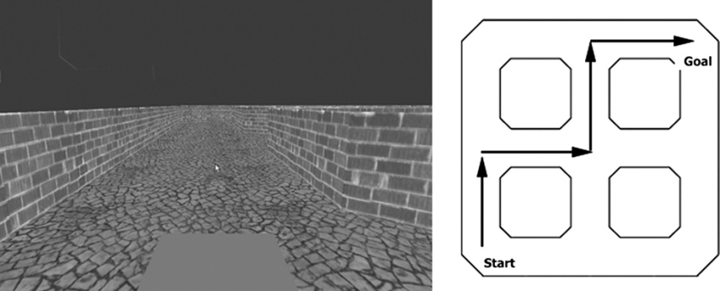
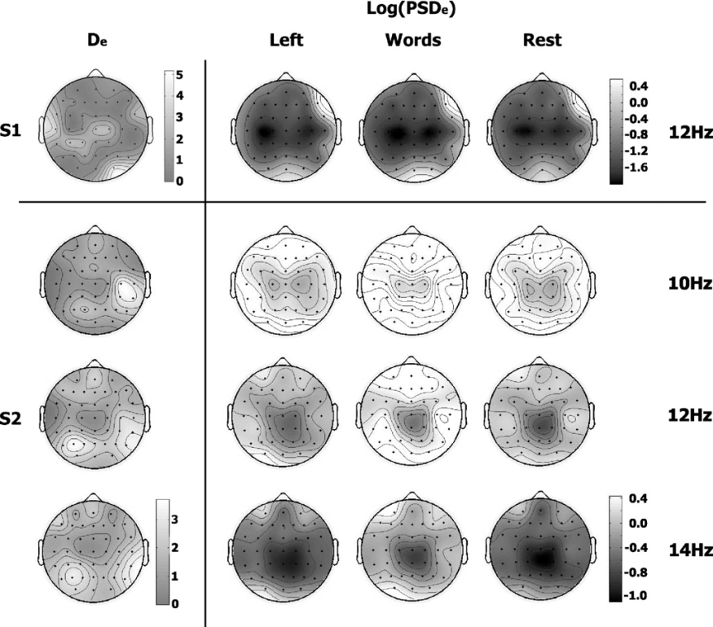
Methods cont.
Calibration Sessions and Feature Extraction
Calibration sessions recorded during the first morning and afternoon driving sessions
Execute three mental tasks
Imagined left hand movement
Rest
Word association
Electrode contribution with scalp layout and (Log(PSDe))
Fig. 1.
Notes:
(Log(PSDe)) is the averages logarithmic transform of the PSD
The mental task to be executed was selected by the operator in order to counterbalance the order, while the subjects decided when they started to execute the mental task.

Slide 26
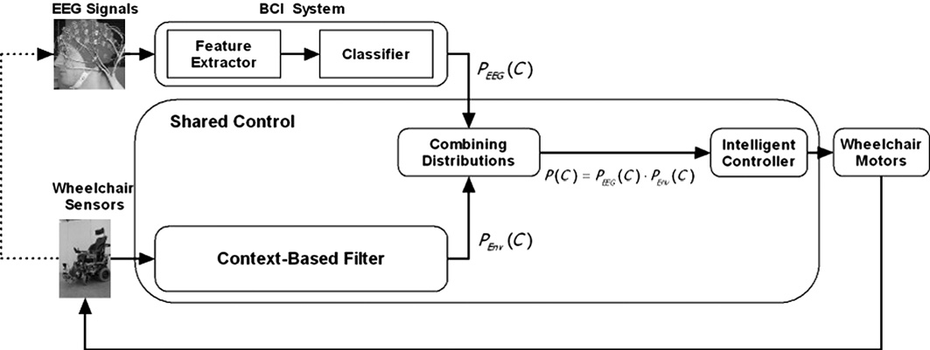
Methods cont.
System description
The intelligent wheelchair
Feeds contextual filter to build probability distribution PEnv(C) over the possible mental steering commands C = {Left, Right, Forward}
The BCI system
Estimates the probabilities PEEG(C)of the different mental commands from the EEG signals
Fig.3
Both streams of information are combined
to produce a filtered estimate of the user’s intent
P(C) = PEEG(C) x PEnv(C).
Notes:
The system is integrated by two entities
Calculates the probability that you want to go in a direction and can go in that direction

Slide 27
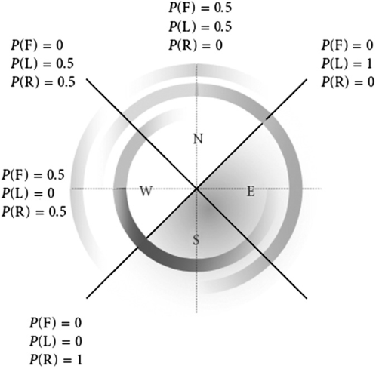
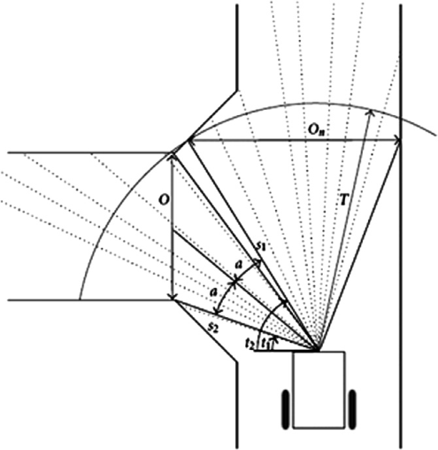
Methods cont.
System description cont. - Context-based filter
Wheelchair senses opening over certain threshold
Then the width is calculated
Fig. 4
Fig. 5
Shows how the regions West and North are deemed probable navigation directions, as extracted from the environment
Notes:
Fig. 5. Environmental belief over the four quadrants in function of the wheelchair orientation in Fig. 4. The inner circle shows the probability of a
Right command P(R), the middle circle shows the probability of a Left command P(L), and the outer circle the probability of a Forward
command P(F). The figure also shows the resulting probabilities of the three steering command along each direction.

Slide 28
Methods cont.
System description cont. - Feature extractor
Canonical Variates Analysis (CVA) also known as Multiple Discriminant Analysis
Extracts Canonical Discriminant Spatial Patterns (CDSPs)
S_{k} =(s_{k1}, . . . , s_{knk} )’
n_{k} X c matrix with the estimated spectral power of a frequency band for class k = 1,. . ., l
k= classes or mental state ( imagined left hand movement, rest and word association)
n_{k} =number of samples
c = number of channels
S=(S’₁,..... S’_{l} ) l -1 CDSPs of S are the eigenvectors A of W-¹B whose eigenvalues are larger than 0
A maximizes the quotient B between the between-classes dispersion matrix B and the pooled within-classes dispersion matrix W.
CDSPs are obtained by projecting X = SA
To measure CDSPs they computed a discrimination index for each channel from the structure matrix
the pooled correlation matrix between the original channels in S and the CDSP X
Given the c x (l 1) structure matrix T, where
e = 1, . . ., c,
normalized eigenvalues
the proposed discrimination index is computed as
See Galan et al. (2007) for more details.
Notes:
CVA maximize the differences in mean spectral power between a given number of classes.
Note that the direction of the eigenvectors A maximizes the quotient between the between-classes dispersion matrix B and the pooled within-classes dispersion matrix W. Thus, the CDSPs are obtained by projecting X = SA.

Slide 29
Methods cont.
System description cont. - Classifier
The classifier utilized is a statistical Gaussian classifier
The output of this statistical classifier is an estimation of the posterior class probability distribution for a sample; i.e., the probability that a given single trial belongs to each mental task (or class).
Notes:
(see Milla´n et al., 2004 for more details).

Slide 30
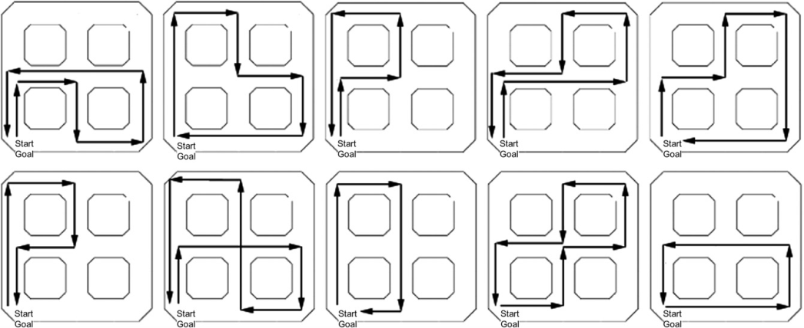
Methods cont.
Experimental tasks
Task 1
Subjects sat facing a monitor with a fixation point in the center with a simulated first person wheelchair
Driving was coordinated by the three mental states
left hand imagination movement to turn Left
rest to go Forward
words association to turn Right
The monitor display and the pre-specified path
Task 2
Subject 1 participated in a second experiment four months later
10 trials in the same simulated environment where he was asked to drive the simulated wheelchair following 10 different complex and random paths never tried before
Notes:
Task 1.
Every subject participated in five experimental sessions, each consisting of 10 trials. The time elapsed between
two consecutive experimental sessions was variable to assess the system robustness over time: 1 day between sessions
1 and 2, 2 months between sessions 2 and 3, 1 h between sessions 3 and 4, and finally 1 day between sessions 4 and 5.
Task 2.
To further assess the performance of the brain-actuated wheelchair Subject 2 did not participate in this task because she was not available.

Slide 31
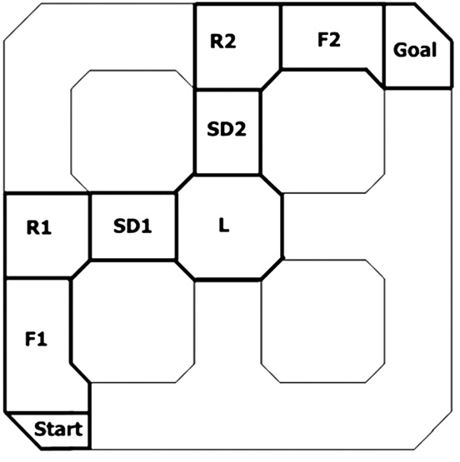
Methods cont.
Analysis
Robustness was assessed in task 1 on three criteria
the percentage of goals reached
the BCI classifier accuracy
the shared control accuracy (the actual mental commands sent to the wheelchair after combining the probability distributions from the BCI and contextual filter)
Limitation: Need to know the subjects intent
subjects had to verbally inform the operator whenever they switched mental task
interferes with the driving task operating properly
Improper movements made it difficult to asses the accuracy of the BCI
Fig. 7
Notes:
The three criteria were analyzed over time (5 sessions) and context
For the contextual analysis, the path was split into seven stretches
Compared the performance of the two subjects to that of a random BCI to further assess their level of mental control
Top view of the world and the path stretches. Stretches F1 and F2 were labeled as Forward, R1 and R2 labeled as Right, L labeled as Left, and SD1 and SD2 labeled as strategy dependent. The subjects can go through SD1 by means of two strategies, either executing Forward or executing Right followed by Left. Through SD2, subjects can execute
either Forward or Left followed by Right.

Slide 32
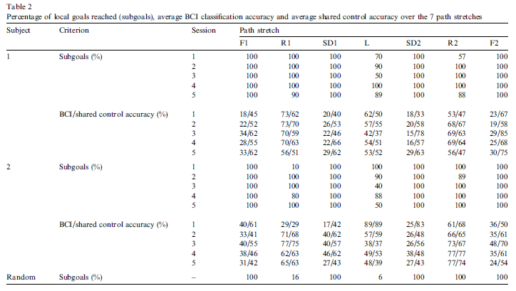
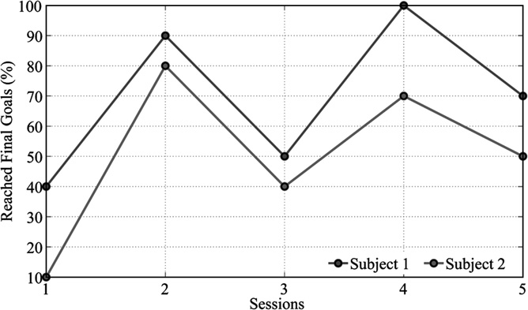
Results
Task 1
Global performance
Shared control boosted
effectiveness for straight
paths
Shared control
helped to generate
smooth trajectories
?>
Fig. 8
Depicts the percentage of final goals reached over the five sessions for the two experimental subjects
Notes:
For both subjects, sessions 1 and 3 are the sessions with less reached final goals (40% and 10% in session 1, 50% and 40% in session 3). Note that between session 2 and session 3 passed 2 months, so sessions 1 and 3 can be considered as sessions where the subjects learn (session 1) and re-learn (session 3) how to interact with the system and its dynamics.
Veering

Slide 33
Table 3. Inter-trial differences in performance: subject 1, session 4
Trial | Stretch | BCI Acc. | Shared control Acc. | Wheelchair behavior
2 | R1 | 92% | 67% | Right
 | R2 | 48% | 68% | Right
8 | R1 | 65% | 76% | Right
 | R2 | 74% | 53% | Right

Slide 34
Results Cont.
Task 2
Performed better without having to tell intended movement
Subject 1 reached the final goal in 80% of the trials. He failed in the last 2 trials, where he was not able to turn
right at the starting point.
Notes:
Making this first Right turn
requires a very high BCI performance because the subject
has to rotate the wheelchair by 90 being almost in the
same place (i.e., without entering the corridor it is facing).

Slide 35
Conclusions
Asynchronous and non-invasive EEG-based BCI prototype for brain-actuated wheelchair driving
No need for adaptive algorithm or external tuning by human operator
Two key components
Stable user-specific EEG features that maximize the separability between the patterns generated by executing different mental tasks.
Shared control system between the BCI system and the intelligent simulated wheelchair
When BCI accuracy is low the shared controller boosts effectiveness but when BCI accuracy is high the shared control degrades accuracy
Worked well when the user did not have to verbalize their intent

Slide 36
Conclusions cont.
Does not require training, rather use mutual learning of the BCI and shared controller
Only tested on healthy individuals
They think it will work on disabled people because it has user specific calibration
Does not use a fixed set of mental tasks

Slide 37
Discussion points
EEG signal less specific than single unit?
Problems using rest state as a control signal
Invasive BCIs potentially able to operate in background, EEG requires more focus
Talking disrupted accuracy

Slide 38
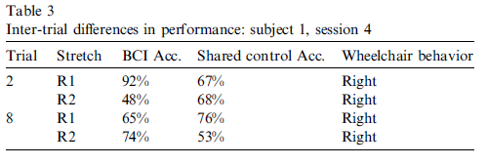
Tables

