Slide 1
Electrocorticography-Based Brain Computer Interface – The Seattle Experience

Slide 2
Rough Comparison
 | EEG | ECoG | Implanted Arrays
Invasiveness | Low | Medium | High
EMG Noise | High | Medium | Low
Risk | Low | Medium | High
Stability | High | Medium | Low
Spatial Resolution | 1 cm | 0.01 cm | 0.001 cm
Price | $100s | gazillion? | buzillion?

Slide 3
Task
Control vertical position of cursor to hit the target
Horizontal
Speed
= 1 screen width
/ 5.5 seconds

Slide 4
Task Interface
Decoder
Input (1,000 Hz):
- 64 ECoG electrodes
Output (25 Hz):
“up” or “down”
magnitude
Visual feedback
Human User

Slide 5
System Overview
ECoG electrode placement
Decoding
Learning (Model)
Experiment

Slide 6
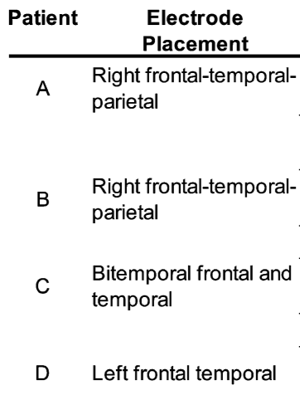
ECoG Placement

Slide 7
Decoding
For each user U and user action A
Feature functions f(x)
Feature weights w
Output is linear combination of feature functions
How to choose features?
How to weight features?

Slide 8
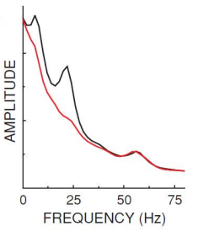
Feature Selection
Rest state
Action state

Slide 9
Feature Selection + Learning
Training data = <signal, action state> pairs
Signal = input from electrodes
Action state = “performing action” or “not”
Possible features = amplitude of
{electrode1, electrode2, …} x {freq1, freq2, …}
Rank features using autoregressive model
Choose top K
Weights from autoregressive model (?)

Slide 10
Experiment
Offline training to learn features, weights
Online development testing
Online feature, weight adjustment
Final round of testing

Slide 11
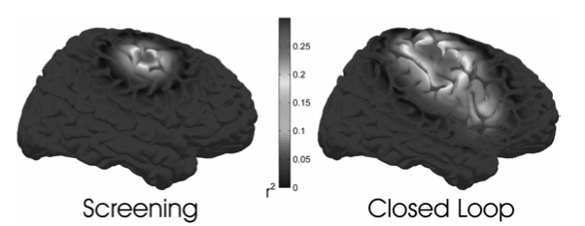
Interesting Observation
Offline (no feedback) looks different than online (with feedback)

Slide 12
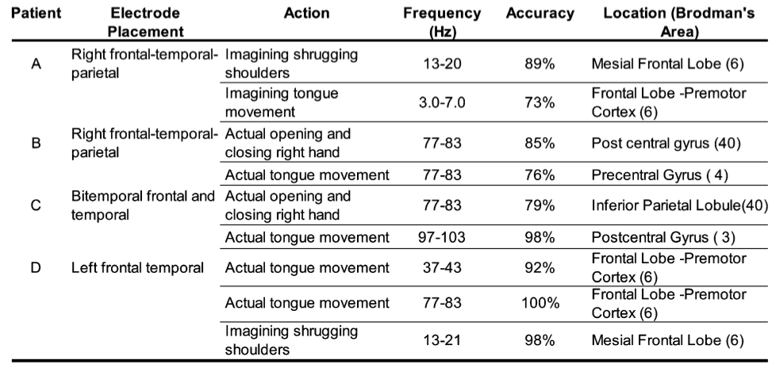
Results

Slide 13
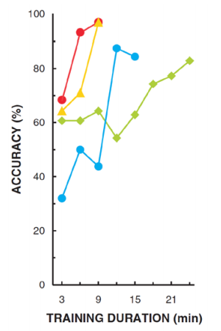
Results (from related paper)

Slide 14
Conclusions
Users can control a 1d cursor with ECoG
Closed loop looks different than “open loop”
Experimenting with epilepsy patients is hard

