Slide 1
Mimicking the Human ear
Philipos Loizou (author)
Oliver Johnson (me)

Slide 2
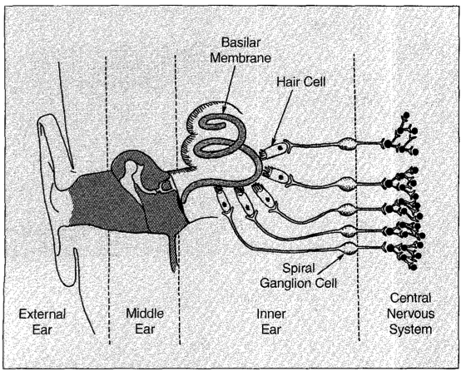
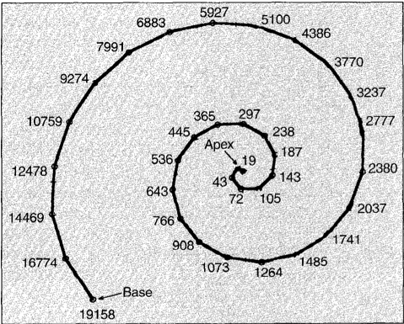
Anatomy and signal processing of the Ear
Von Bekesy, max freq. response by location in Basilar membrane
Implants are for people with hair cell loss causing profound deafness (90dB or more) and functioning cochlear nerve.
Notes:
http://www.gcaudio.com/resources/howtos/loudness.html
45-130k

Slide 3
Auditory Encoding theories
Place Theory
Neural amplitude of firing differs by location for different frequencies. Brain decodes combination of amplitudes’ location of firing.
Motivates multichannel implants.
Volley Theory, frequency determined by neuron firing rate.
Nerve fibers fire at rates proportional to period of input signal, up to 5kHz.
Low frequencies nerve fibers fire at each cycle, high frequency is encoded by combinations of groups.
Is this not spatially dependent?
Notes:
There are two major encoding schemes that drive cochlear implants

Slide 4
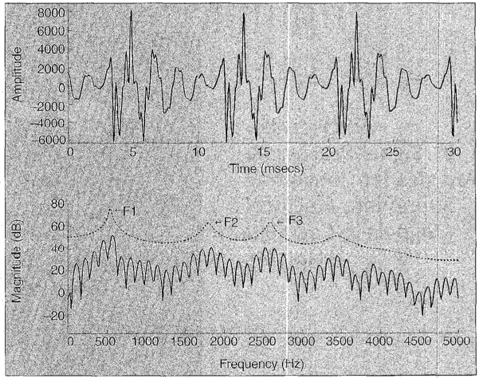
Speech Encoding
Source-filter model of speech production
Linear system of F0, F1, F2, F3

Slide 5
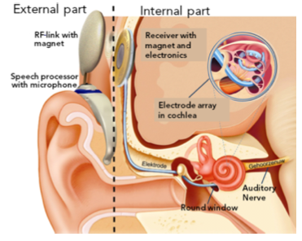
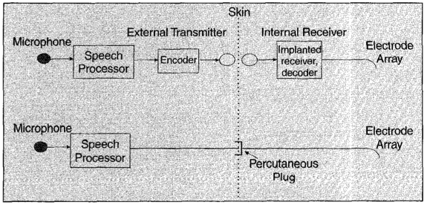
Cochlear Implant Design
Transmission Link
Electrode Design
Stimulation Type
Signal Processing

Slide 6
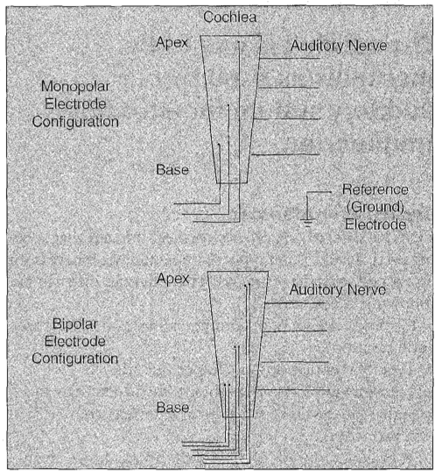
Electrode Design
Typically implanted near the scala tympani to be near the auditory neurons that lie along the length of the cochlea (preserves ‘place’ mechanism
Bipolar vs. Monopole
Insertion depth
Up-shifting in frequency when F0 is represented at 22mm depth

Slide 7
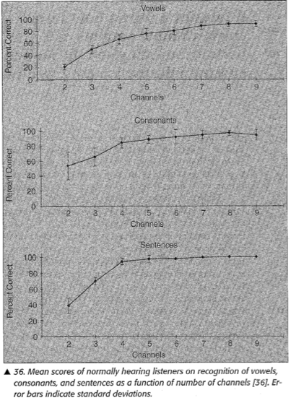
Single Channel vs Multi-Channel
Author surprised at success rate for single channel implants.
Single Channel
Limited spectral information
Signal contains information on F0 and F1, some patients could discriminate F2
Used temporal encoding only up to 1kHz (neural refractory)
Can extract freq information from periodicity of input stimulus up to 300-500Hz
Multi
How many electrodes to use
What information should be transmitted, what does the ear encode
Notes:
http://www.utdallas.edu/~loizou/cimplants/cdemos.htm#nchan
http://www.healthaffairs.uci.edu/hesp/simulations/simulationsmain.htm

Slide 8
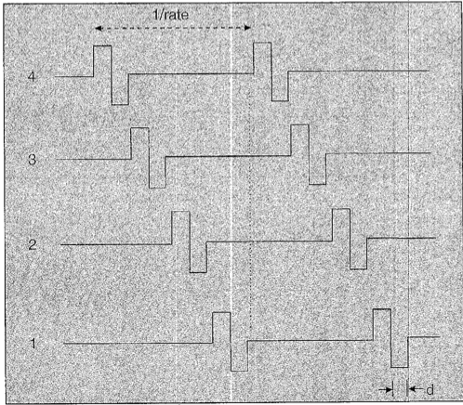
Stimulation Types – Waveform Strategies
Compressed Analog and Continuous Interleaved Sampling Approaches
Analog
Advantages: Contiguous frequency bands, simpler electronics
Disadvantages: Cross channel interference
Pulsatile
Advantages: Increase pulse rates, more control over stimulation ordering, can envelope signal to person’s dyn. range.
Implant listeners range as low as ~5dB
Disadvantages: Required digital impl.

Slide 9
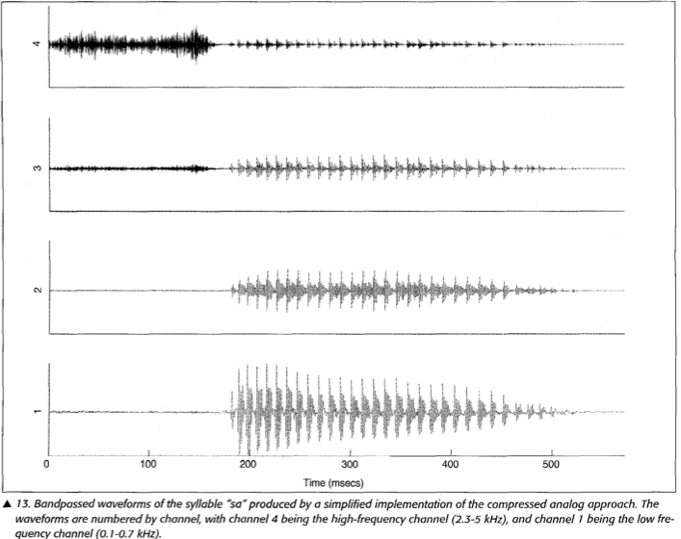
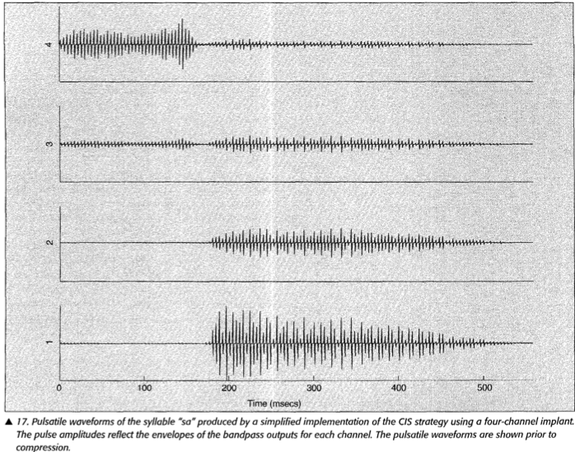
CA and pulsatile comparison

Slide 10
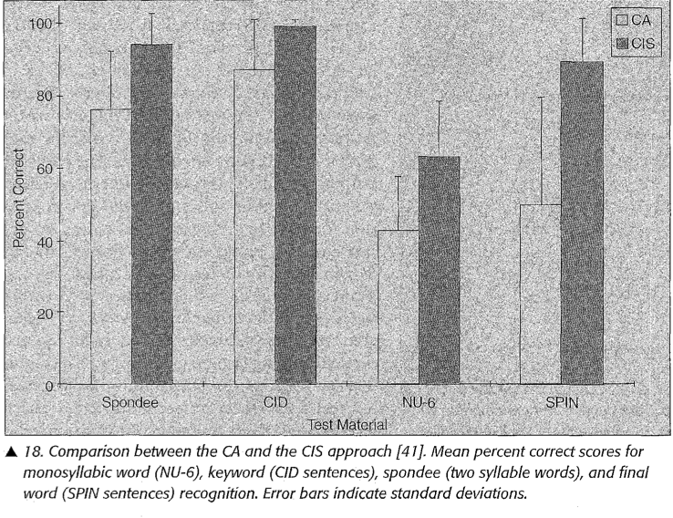
CA vs CIS
Notes:
In Clarion S-Series 50% of users preferred the CA strategy over the CIS strategy in the enhavnce bipolar mode
Paired pulsatile sampler, simulataneous on two channel

Slide 11
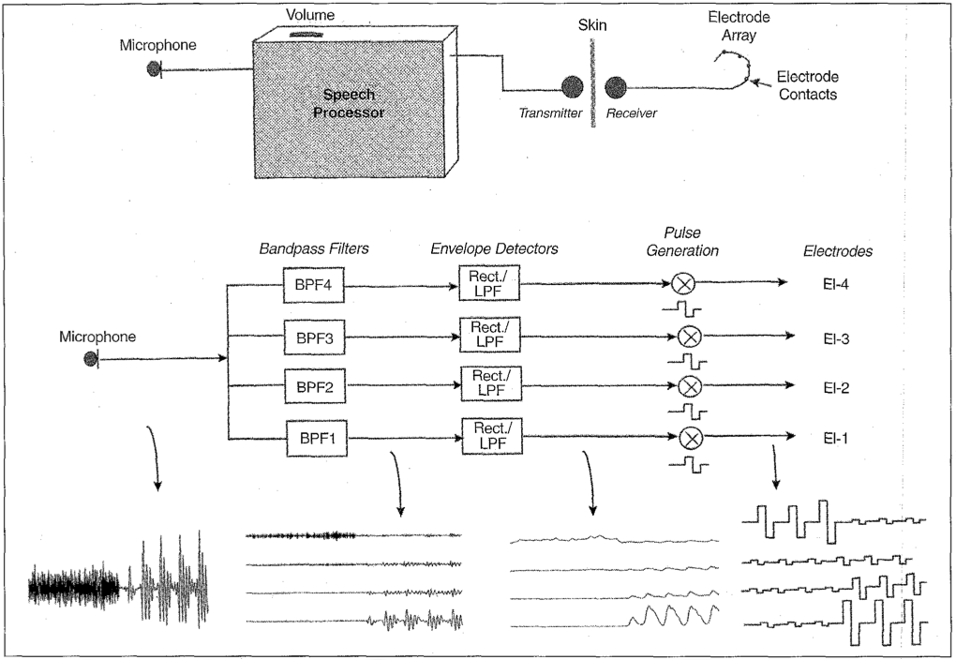

Slide 12
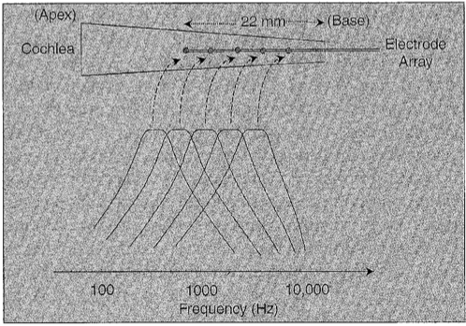
Electrode placement and mapping
Notes:
p.126 talk about the electrode placement as well as electrode depth into cochlea

Slide 13
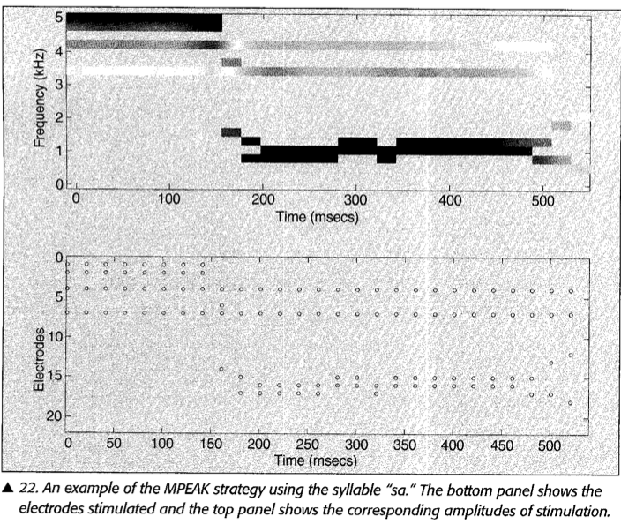
Speech Decoding – Feature Extraction
MPEAK saying “sa”
Notes:
Spatial Encoding

Slide 14
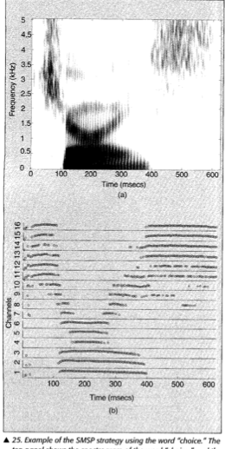
Speech Decoding
SMSP displaying pronunciation of the word “choice”

Slide 15
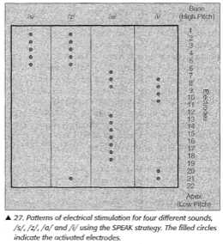
Speech Decoding
SPEAK
Pronunciation of several phonemes.

Slide 16
Hybrid Systems
Spectral Maxima Sound Processor (SMSP)
Combines CIS components with more electrodes doing feature extraction for spatial mapping
Electro-Acoustic Systems
Low freq hearing aid amp. Cochlear implant for high frequencies
Notes:
Poor noise tolerance in feature extraction systems

Slide 17
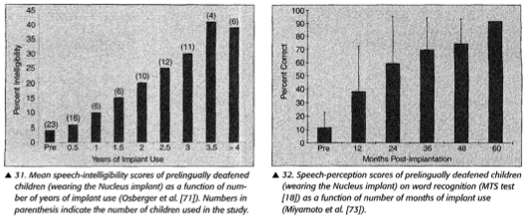
Improvement in speech and hearing

Slide 18
Factors Affecting performance
Duration of Deafness
Age of onset
People with post-lingual deafness perform better than those with pre-lingual deafness
Age at implantation
Possibly minimum age of 2, better young than older.
Duration of implant use
Individual Factors
Number of surviving spiral ganglion cells
Electrode placement and electrode depth
Electrical dynamic range
Signal processing strategy

Slide 19
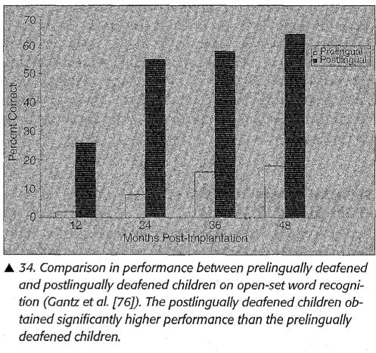
Pre- vs. Post-lingually deafened performance comparison

Slide 20
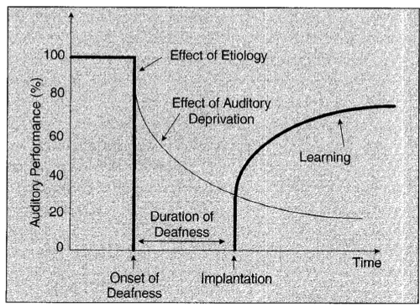
Implantation timeline
Notes:
Blamey’s three stage model for auditory performance in postlingually deaf adults

Slide 21
Conclusions (look at more recent papers)
Proven that profoundly deaf people can hear and speak with the implant. Longitudinal studies have shown this to be true for a majority of pre-lingually deaf as well
Auditory performance is most positively affected by two factors
Acquiring speech and language before hearing loss
Shorter duration of deafness
Signal processing advances in both speed of processing and speech decoding

Slide 22
Future work
Continued comparison of feature extraction vs. CIS methods.
Discover more Inter-patient performance variability factors
Develop tests to predict a person’s performance pre-surgically, such as the P100 look at visual cortical re-mapping.
Electrode array design for high degree of specificity to allow finer channel selectivity

Slide 23
Questions raised…
Comparison of what processing strategies work better for pre- vs. post-lingual deafness onset
Longitudinal studies for implantation success (one study with 30 people only had 9 electrode replacements in 8 people) over a 10 year study
A lot of manual refinement by audiologists, did not see much in terms of optimizing algorithms/adaptive learning
As a model for other BMIs for how long it takes a person to truly integrate with a machine interface
Initiate Real discussions on ‘elective’ BMI procedures, gives us a roadmap for future applications.
Spoken language differences

