Slide 1
Methods in Leading Face Verification Algorithms
Alon Milchgrub

Slide 2
Overview
Problem Statement
Joint Bayesian
Transfer Learning
DeepID
DeepFace

Slide 3
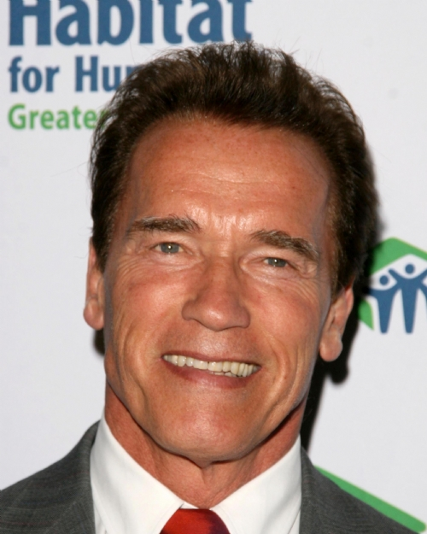
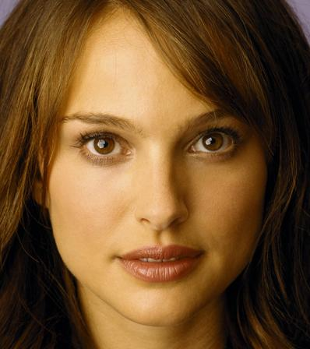
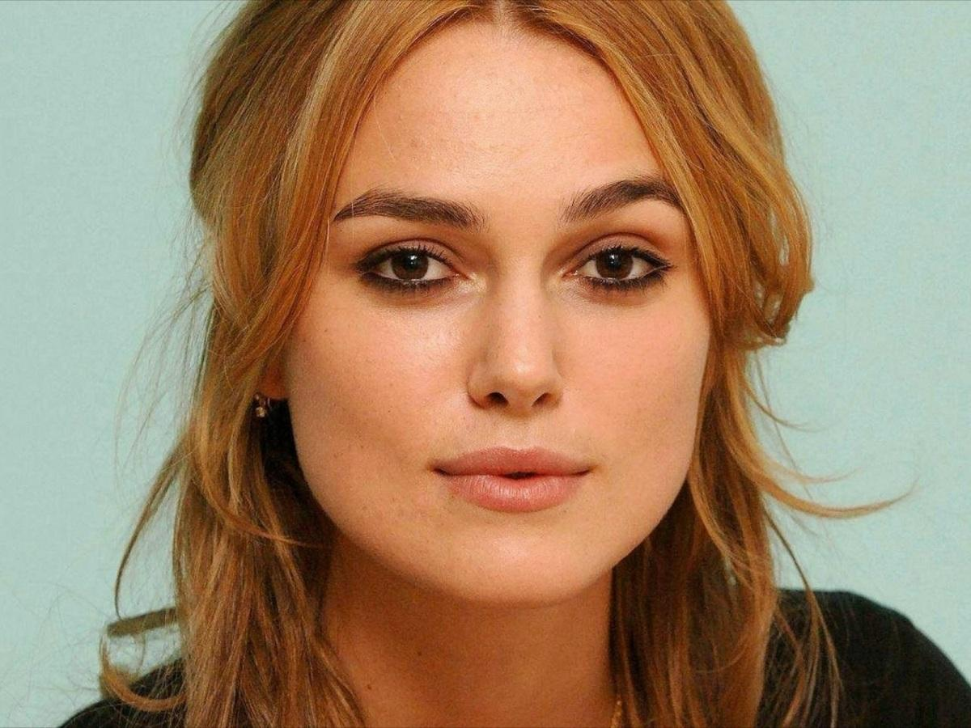
Problem Statement
Given a pair of face images – do they belong to the same subject?
Facially base identification.
Automatic tagging of images (facebook…).
$$≠$$
$$=$$
$$≠$$

Slide 4
Joint Beysian
Bayesian Face Revisited: A Joint Formulation, Chen, Cao, Wang, Wen and Sun, ECCV’12

Slide 5
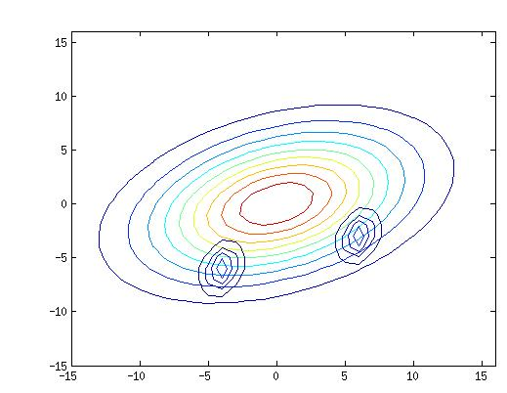
Joint Bayesian Bayesian Face Revisited: A Joint Formulation, Chen, Cao, Wang, Wen and Sun, ECCV’12
Models the relation the joint probability of two faces belong to the same person.
A facial feature $x$ is modeled as the sum of two independent Gaussian variables.
$$x=μ+ε$$
$μ∼N\left(0, S_{μ}\right)$ represents face identity.
$ε∼N\left(0, S_{ε}\right)$ represents intra-personal variations.

Slide 6
Joint Bayesian Bayesian Face Revisited: A Joint Formulation, Chen, Cao, Wang, Wen and Sun, ECCV’12
Given two feature vectors $x_{1}$ and $x_{2}$.
$H_{I}$ – the intra-personal (same) hypothesis.
The identities are the same, the intra-personal variations independent.
$H_{E}$ –the extra-personal (different) hypothesis.
Both the identities and the intra-personal variations independent.
$P\left(x_{1},x_{2}|H_{I}\right)$ and $P\left(x_{1},x_{2}|H_{E}\right)$ are also a Gaussians with zero mean.

Slide 7
Joint Bayesian Bayesian Face Revisited: A Joint Formulation, Chen, Cao, Wang, Wen and Sun, ECCV’12
Similarity measure - likelihood ratio:
$$r\left(x_{1},x_{2}\right)=log\frac{P\left(x_{1},x_{2}|H_{I}\right)}{P\left(x_{1},x_{2}|H_{E}\right)}$$
Has a closed-form solution.
$S_{μ}$ and $S_{ε}$ can be learned using and EM algorithm.
Can be thought of as a form of probabilistic reference-based method.
Using low level features (LBP, LE) achieved accuracy of 92.4% in LFW.

Slide 8
Transfer Learning Algorithm
A Practical Transfer Learning Algorithm for Face Verification, Cao, Wipf, Wen, and Duan, ICCV’13

Slide 9
Transfer Learning Algorithm A Practical Transfer Learning Algorithm for Face Verification, Cao, Wipf, Wen, and Duan, ICCV’13
Motivation:
Hard to train Joint Bayesian classifier if labeled data is scarce (over-fitting).
e.g. family photo album.
Idea:
Train on the parameters $Θ_{s}=\left\{S_{μ},S_{ε}\right\}$ on a big source-domain.
Use the results to learn the parameters $Θ_{t}=\left\{T_{μ},T_{ε}\right\}$ reflecting both the source-domain and the (scarce) target-domain.

Slide 10
Transfer Learning Algorithm A Practical Transfer Learning Algorithm for Face Verification, Cao, Wipf, Wen, and Duan, ICCV’13
Example:
LFW (Labeled Faces in the Wild) contains ~6000 subjects.
~4000 subject have only one image.
Only 85 have more than 15 images.
WDRef (Wide and Deep Reference dataset) contains ~100,000 of ~3000 subjects.

Slide 11
Transfer Learning Algorithm A Practical Transfer Learning Algorithm for Face Verification, Cao, Wipf, Wen, and Duan, ICCV’13
Model:
$$\min_{Θ_{t}}{−log p\left(χ\right)+λ KL\left(P\left(χ|Θ_{t}\right)∥P\left(χ|Θ_{s}\right)\right)}$$
KL, Kullback-Leibler divergence, quantifies the information in the approximation.
Solved using the same EM algorithm as Joint Bayesian (with modifications).

Slide 12
Transfer Learning Algorithm A Practical Transfer Learning Algorithm for Face Verification, Cao, Wipf, Wen, and Duan, ICCV’13
Using high-dimensional (~100,000) LBP reduced to 2000 via PCA.
Trained on WDRef and tested on LFW.
Achieved accuracy of 96.33%.
95.17% to the same setting without transfer learning.
92.4% without the high-dimensional features too.

Slide 13
DeepID
Deep Learning Face Representation from Predicting 10,000 Classes, Sun, Wang and Tang, CVPR’14

Slide 14
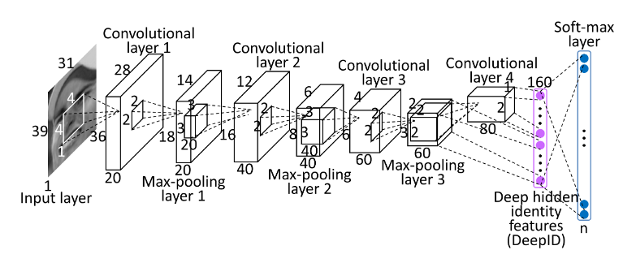
DeepID Deep Learning Face Representation from Predicting 10,000 Classes, Sun, Wang and Tang, CVPR’14
Learning the features using Convolutional Neural Networks (DNN).

Slide 15
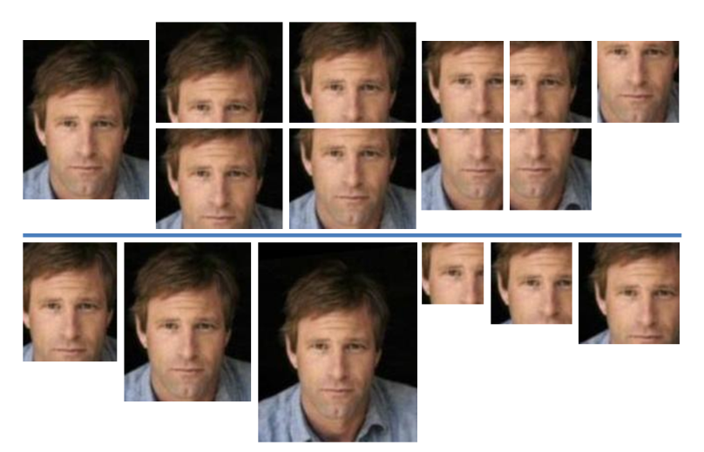
DeepID Deep Learning Face Representation from Predicting 10,000 Classes, Sun, Wang and Tang, CVPR’14
Each of 60 networks is trained on one of 60 patches (and their horizontally flipped counterpart).
10 Regions, 3 Scales, RGB or gray channels.

Slide 16
DeepID Deep Learning Face Representation from Predicting 10,000 Classes, Sun, Wang and Tang, CVPR’14
Each of 60 networks is trained on one of 60 patches (and their horizontally flipped counterpart).
10 Regions, 3 Scales, RGB or gray channels.
Each network outputs 2 160-dimsional DeepID.
The total length of DeepID is 19,200 ($60×2×160$)
Feature dimension reduced to 150 using PCA.
Joint Bayesian used for face verification.

Slide 17
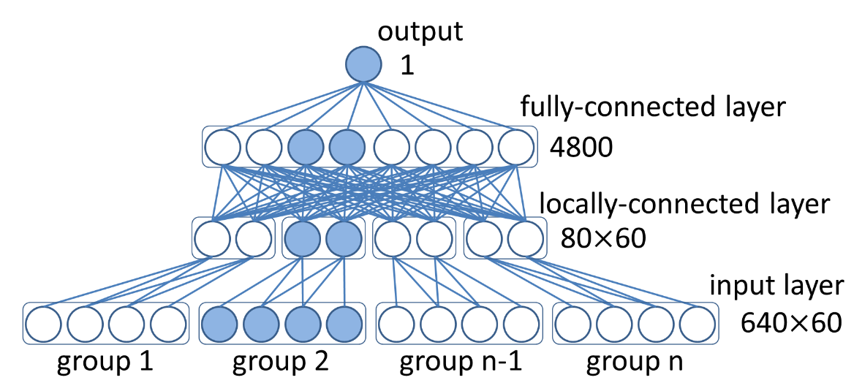
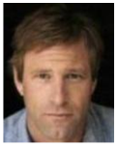
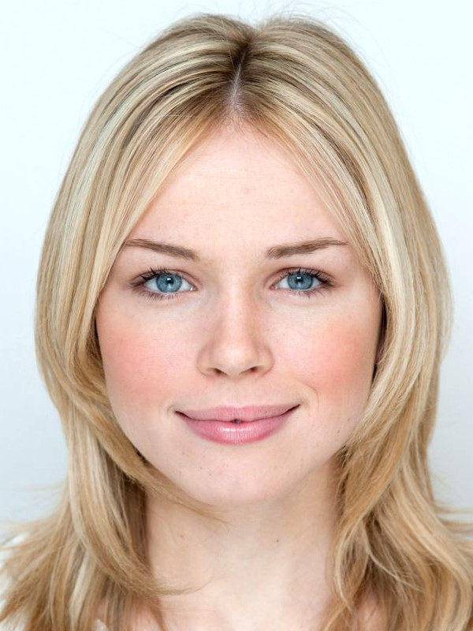
DeepID Deep Learning Face Representation from Predicting 10,000 Classes, Sun, Wang and Tang, CVPR’14
Additionally, another NN was trained for comparison of verification.
Same?
Different??

Slide 18
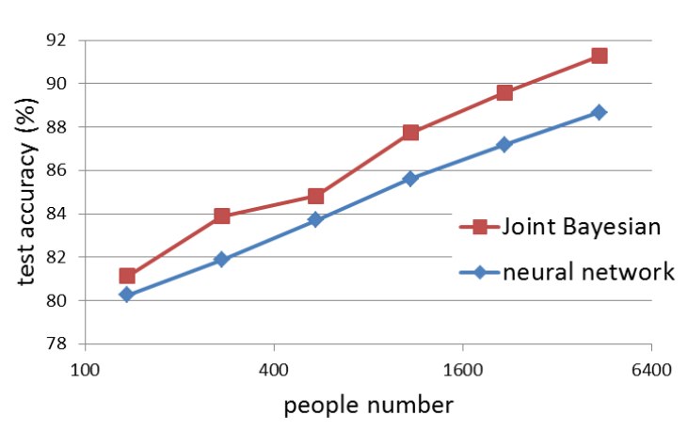
DeepID Deep Learning Face Representation from Predicting 10,000 Classes, Sun, Wang and Tang, CVPR’14
Learning effective features
Input is a single patch covering the whole face.

Slide 19
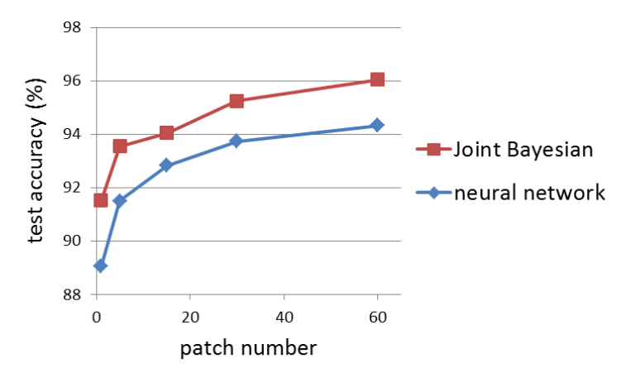
DeepID Deep Learning Face Representation from Predicting 10,000 Classes, Sun, Wang and Tang, CVPR’14
Over-complete representation
Notable combination of features are presented.

Slide 20
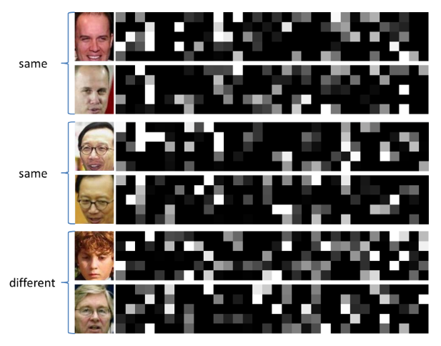
DeepID Deep Learning Face Representation from Predicting 10,000 Classes, Sun, Wang and Tang, CVPR’14
Resulting DeepID’s

Slide 21
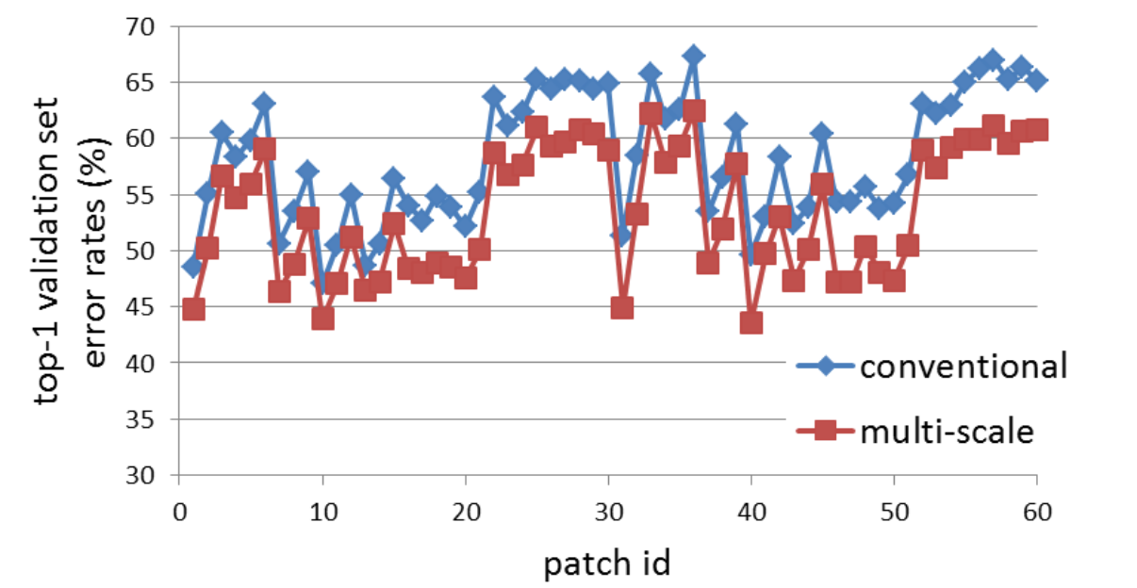
DeepID Deep Learning Face Representation from Predicting 10,000 Classes, Sun, Wang and Tang, CVPR’14
Multi-scale ConvNets
Connecting both 3rd and 4th layers to the DeepID layer.
Improves accuracy from 95.35% to 96.05%

Slide 22
DeepID Deep Learning Face Representation from Predicting 10,000 Classes, Sun, Wang and Tang, CVPR’14
Applying transfer learning:
Source domain - CelebFaces+, containing the ~200k images of ~10k celebrities.
Target domain – 9 out of 10 from LFW.
(Using 32k-dimensional DeepID features).
Achieves accuracy of 97.45% (versus human-level performance 97.53%).

Slide 23
DeepFace
DeepFace: Closing the Gap to Human-Level Performance in Face Verification, Taigman, Yang, Ranzato and Wolf, CVPR’14

Slide 24
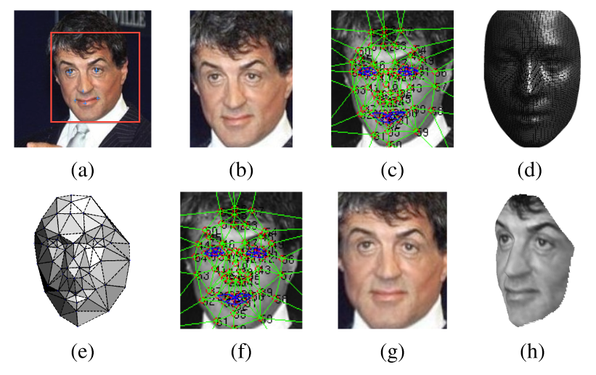
DeepFace DeepFace: Closing the Gap to Human-Level Performance in Face Verification, Taigman, Yang, Ranzato and Wolf, CVPR’14
Applying a sophisticated face alignment method:

Slide 25
DeepFace DeepFace: Closing the Gap to Human-Level Performance in Face Verification, Taigman, Yang, Ranzato and Wolf, CVPR’14
Use a Deep Neural Network for learning the features:
Features dimensionality: 4096
Using inner-product as metric.
Also experimented with $χ^{2}$ and Siamese network.

Slide 26
DeepFace DeepFace: Closing the Gap to Human-Level Performance in Face Verification, Taigman, Yang, Ranzato and Wolf, CVPR’14
Data Set:
Training – Social Face Classification (SFC) – 4.4M images of ~4K people.
Testing - LFW
Accuracy:
Without the alignment: 87.9%
Without frontalization: 94.3%
With Frontalization, LBP/SVM: 91.4%
Single DNN: 97%
DNN ensamble (Single, Gradient, align2d, Siamese): 97.35%

Slide 27
Questions?

