Slide 1
On the Object Proposal
Presented by Yao Lu
10-03-2014

Slide 2
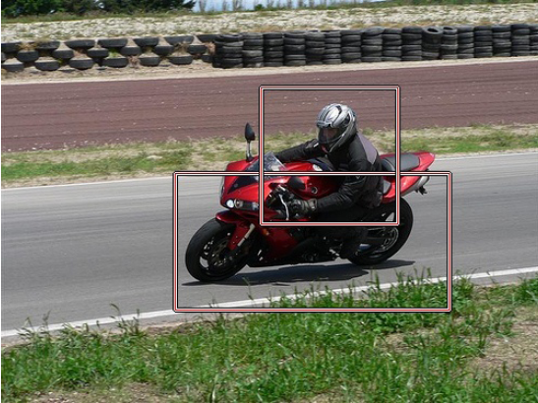
Intro to Object Proposal
Motivation
Sliding window based object detection
Iterate over window size, aspect ratio, and location

Slide 3
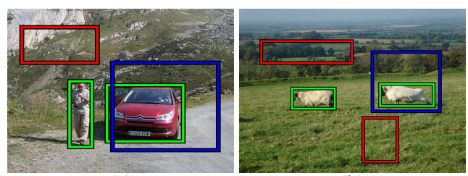
Intro to Object Proposal
Goal
  Fast execution
  High recall with low # of candidate boxes
  Unsupervised/weakly supervised
Difference with image saliency

Slide 4
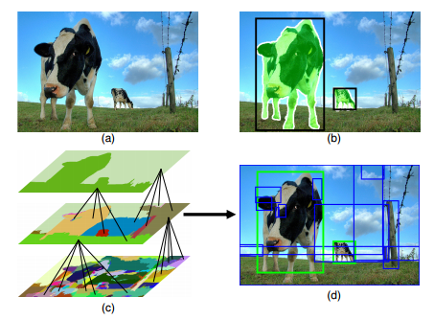
Selective Search
Selective search
K. Van de Sande et al. Segmentation as selective search for object recognition. ICCV 2011.
Merge of multiple segmentation to propose candidate box
1536 boxes = 96.7 recall

Slide 5
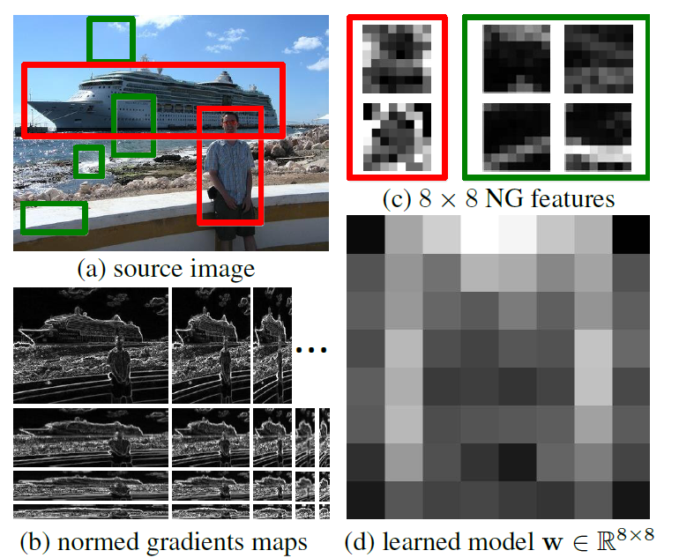
BING
M. Cheng et al. “BING: Binarized normed gradients for objectnetss estimation at 300fps”, CVPR 2014.
  Resize images to different size & aspect ratio
  Train an 8x8 template using a linear SVM
  Use linear combination to integrate predictions.
  Binarize the template to speed-up

Slide 6
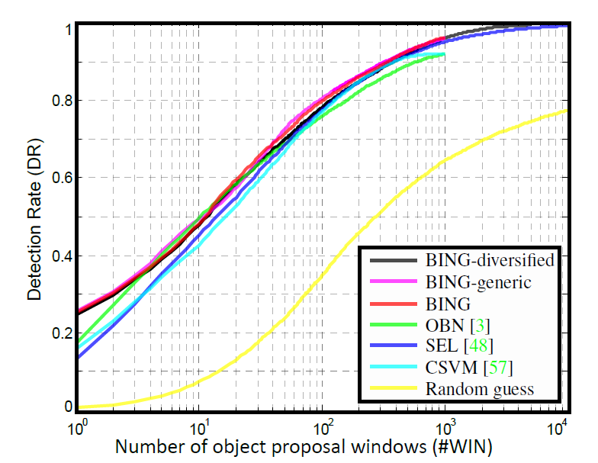
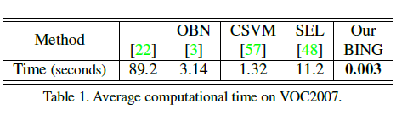
BING
Pascal VOC 07
1000 => 0.95 recall
Speed

Slide 7
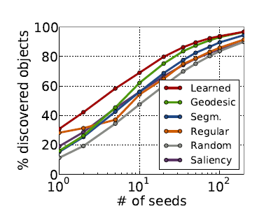
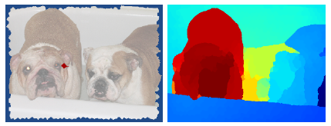
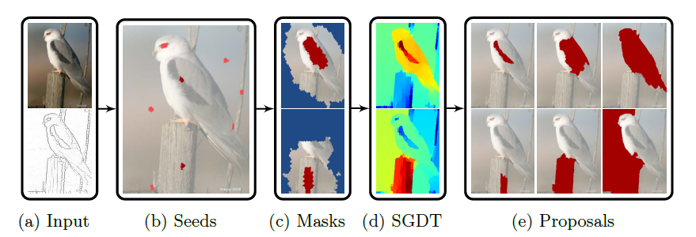
Geodesic Object Proposal
P. Krahenbuhl and V. Koltun. Geodesic Object Proposals. ECCV 2014.

Slide 8
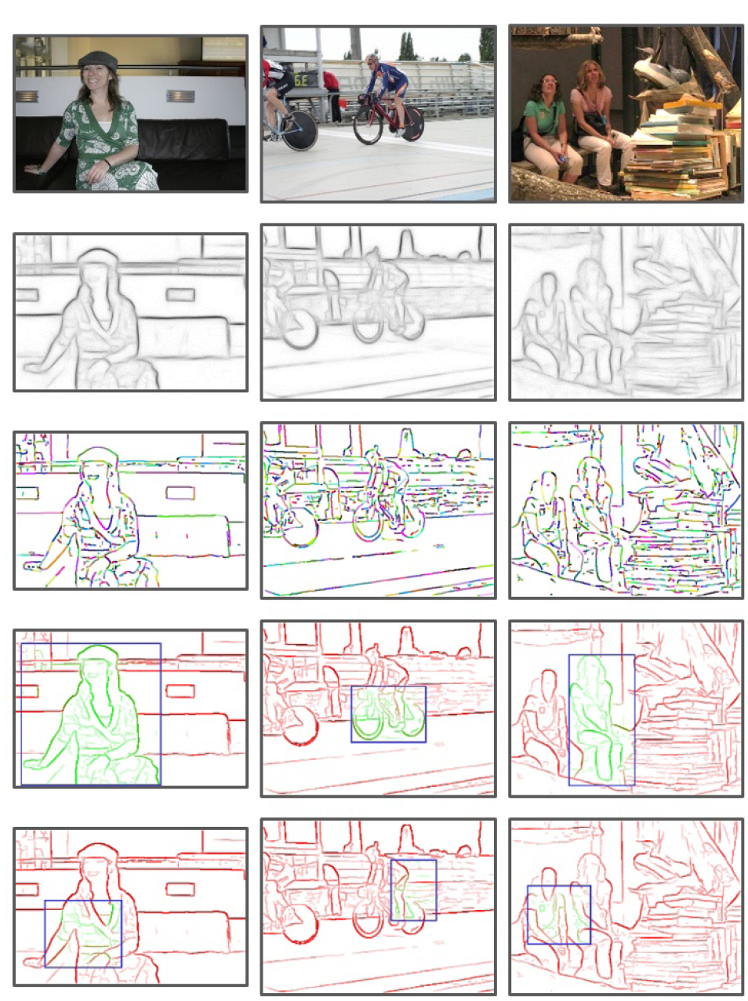




Edge Boxes
C. Lawrence Zitnick and P. Dollar, “Edge Boxes: Locating Object Proposals from Edges”, ECCV 2014.
# of contours wholly within in a box
indicates the objectness
Method
  Edge detection. (m, $θ$)
  Group edges using connectivity and
  orientation. Affinity between edge groups:
  Rank wb on sliding window

Slide 9
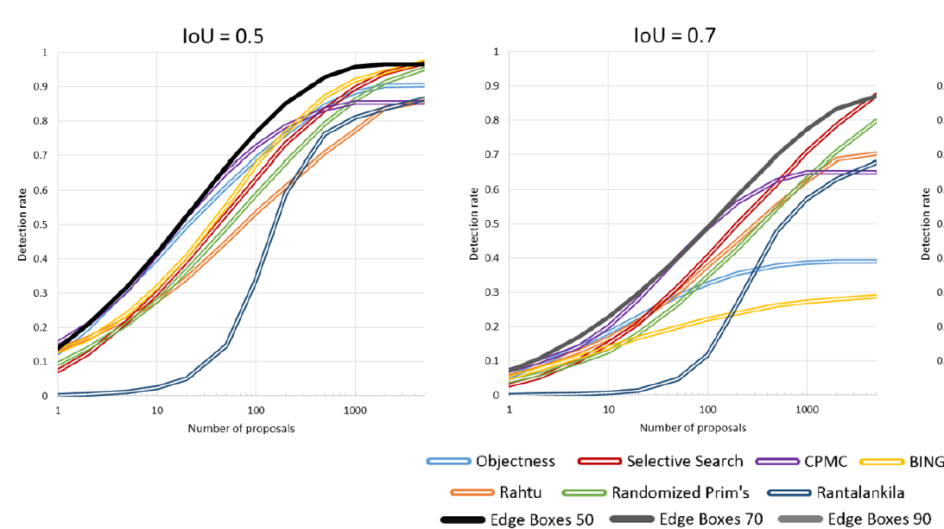
Edge Boxes

Slide 10
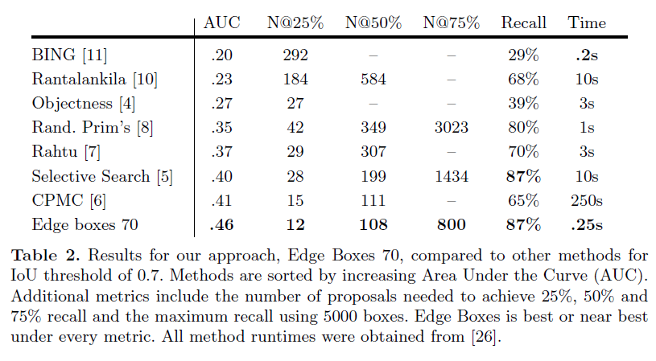
Edge Boxes

Slide 11
Conclusion
Object proposal greatly enhances object detection efficiency.
Current methods have very simple intuitions
  Selective search
  BING
  Geodesic object proposal
  Edge boxes
Future goal of object proposal:
  Less # of boxes
  Higher recall
  Faster speed

