Slide 1
(Self-) Localization
faster
aerial images + GIS
road maps

Slide 2
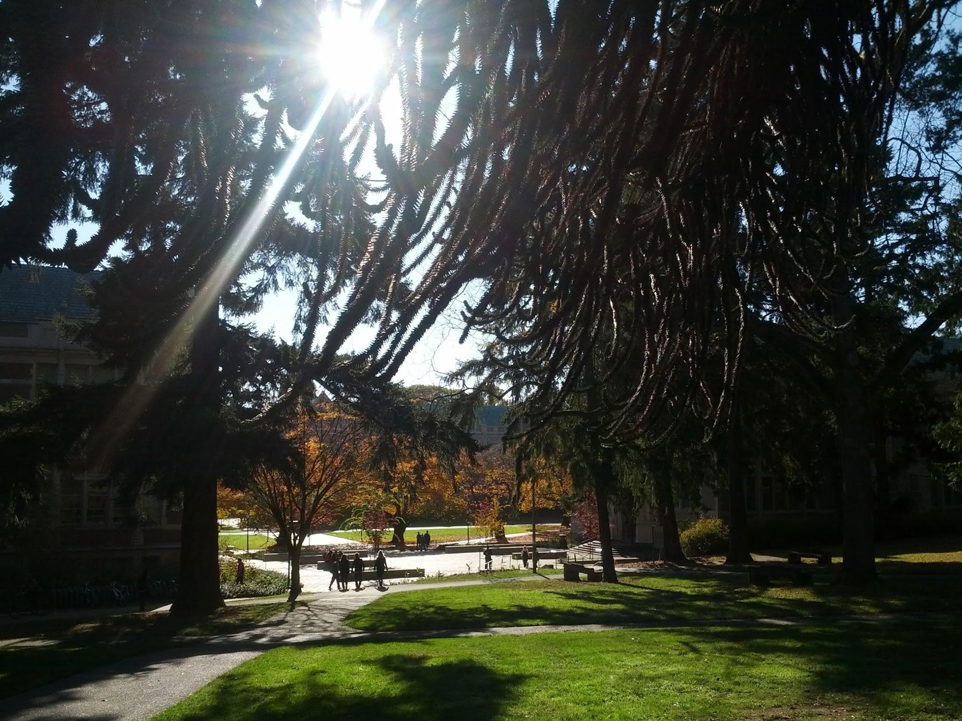
Where am I?
Quad
Denny Hall

Slide 3
What data can I collect?
Image(s)
  main focus of these papers
Sensor data
  GPS (aren’t you done yet?)
  Inertial, temperature, pressure, etc.

Slide 4
External Data
User Imagery:
  Flickr, Panoramio,.
  Sparse, but detailed
Collected Imagery:
  Satellite, Aerial, Street View, etc.
  Good coverage
GIS Data:
  Road map
  Terrain classification, Elevation, etc.
Other:
  Sun position tables, Stars, etc

Slide 5
(Self-) Localization
faster
aerial images + GIS
road maps
Graph-Based Discriminative Learning for Location Recognition
Song Cao, Noah Snavely
CVPR 2013

Slide 6
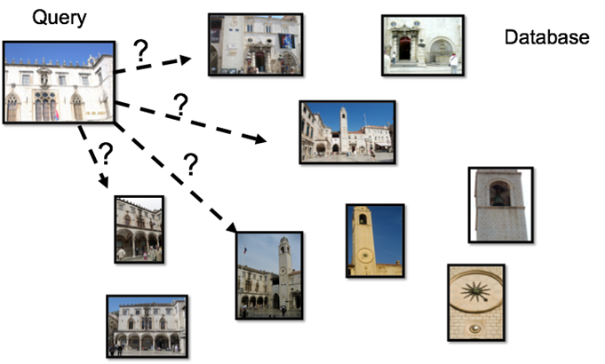
Setup
Retrieval from large database of user photos
Problem to solve: accuracy and speed at scale

Slide 7
Image Retrieval 101
Visual Words paradigm
Vocabulary of visual words
  Discretize SIFT features in image DB into a set of visual words
Compute a histogram of visual words for each image.
Compare images using their histograms and retrieve closest images.
Post process:
  Do geometric verification with all SIFT features and RANSAC.
Video Google: A text retrieval approach to object matching in videos, Sivic, Zisserman, CVPR’03

Slide 8


Image Retrieval 201
How to compare histograms?
Compare their tf-idf tables
  term frequency - inverse document frequency
tf-idf
  term is a visual word, document is an image
  term frequency: how many times did this visual word appear in the image?
  inverse document frequency: is this visual word common in the whole database?
low idf - 0.1
high idf - 14
“the”
“snowboard”

Slide 9
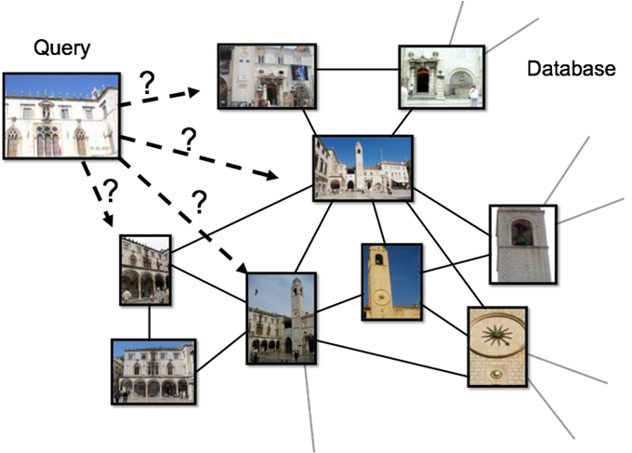
Image Graph 101

Slide 10
Idea
Learn distance metric from data
  Distance says if two images (BoW histograms) look alike
  Learn at:
    Global level: one distance for whole database
    Instance Level: Exemplar SVM
    In between: this paper

Slide 11
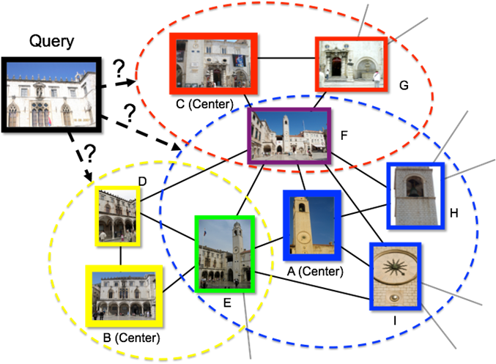
In between?
Divide graph in overlapping subgraphs
One distance function per subgraph
Distance function: is the image inside or outside the subgraph?

Slide 12
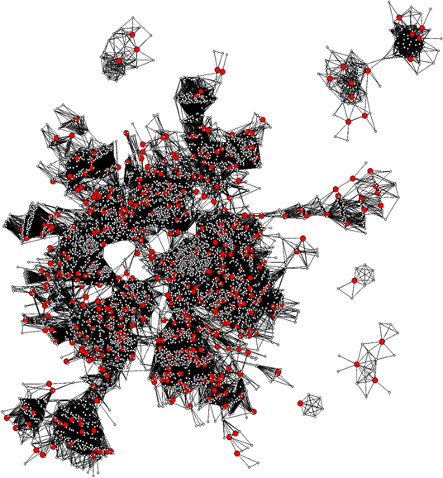
Graph Subdivision
Minimum dominating set
  Minimum set of vertices whose neighborhoods cover the whole graph
  NP-hard, use greedy algorithm
  Same as in Skeletal Sets for SfM
Example Dubrovnik:
  # images: 6044, # centers: 188
Skeletal graphs for efficient structure from motion Snavely, Seitz, Szeliski, CVPR’08

Slide 13
Learn distance functions
SVM distance function
  q image features
  Image is in subgraph if wq + b > 0
Positive examples:
  images in same subgraph
Negatives:
  images not in subgraph
  hard ones: images neighbouring the subgraph
Calibrate all distance functions
  convert to probabilities using Platt’s method
  fits sigmoids to P(y|x=1) and P(y|x=-1)
Probabilities for SV Machines, Platt, 1999

Slide 14
Retrieval
Extract visual words from image
Compute distance to each subgraph with their own distance functions
For closest subgraphs:
  use distance function to chose the closest images in the subgraph
Return the best images

Slide 15
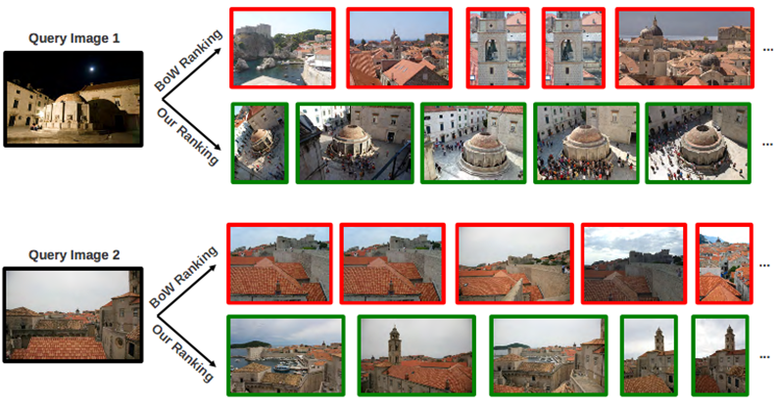
Retrieval

Slide 16
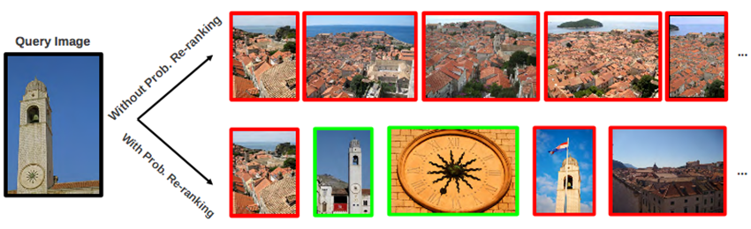
Re-ranking
Problem: sometimes it fails very badly
  Top images are really similar
  Images from top subgraphs are prefered, increasing the issue
Idea: increase diversity
  Given the first image is wrong, what’s the most likely image to be right?

Slide 17
Bag-of-Words Regularization
If all subgraphs’ probabilities are low (<0.1), revert to BoW model.
Weighted average between Graph based probabilities and BoW probabilities, fitted using logistic regression.
Interleave results between models.
Applied to all
Applied to +BoW

Slide 18
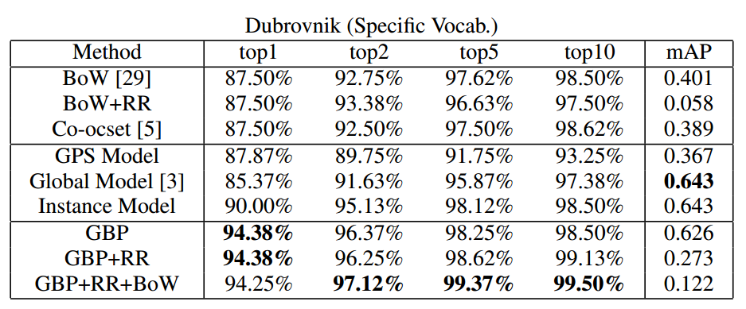
Experiments
Metric: Is there an image in the top-k that can pass geometric verification with the query?

Slide 19
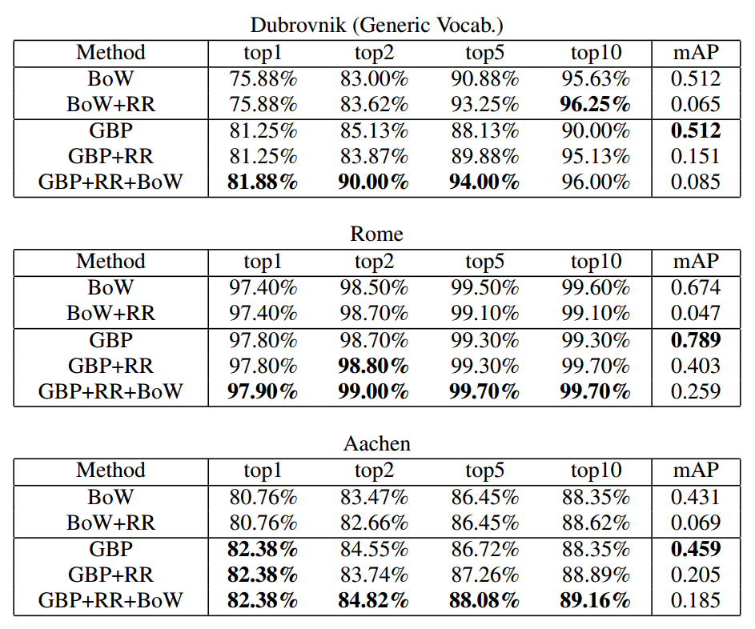
Experiments

Slide 20
(Self-) Localization
faster
aerial images + GIS
road maps
Cross-View Image Geolocation.
Tsung-Yi Lin, Serge Belongie, and James Hays
CVPR 2013

Slide 21

Where am I now?
Larch
Mountains
Snow
Excuse my hair...

Slide 22
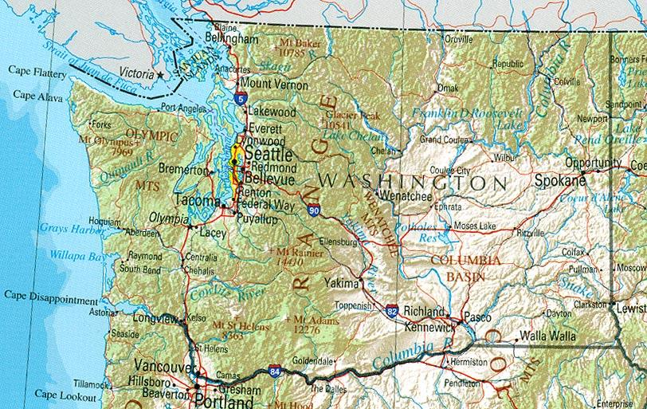
Where am I?
Larches

Slide 23
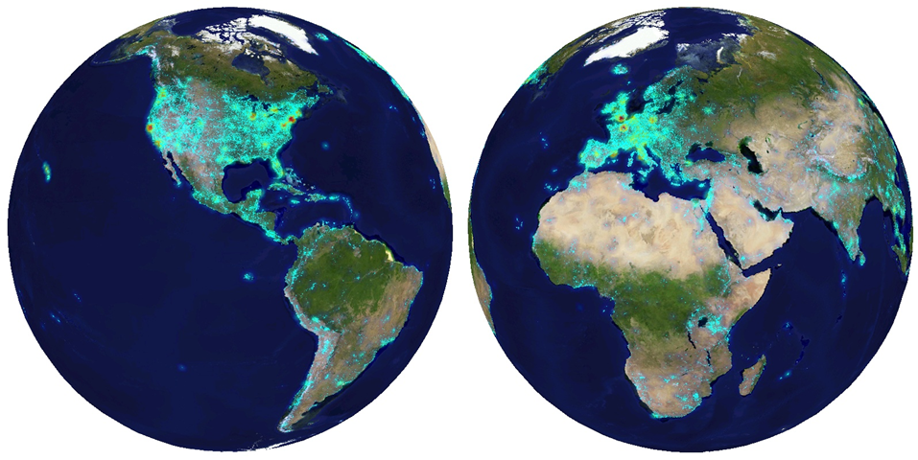
Motivation
User photos are really sparse
Who cares about me?

Slide 24
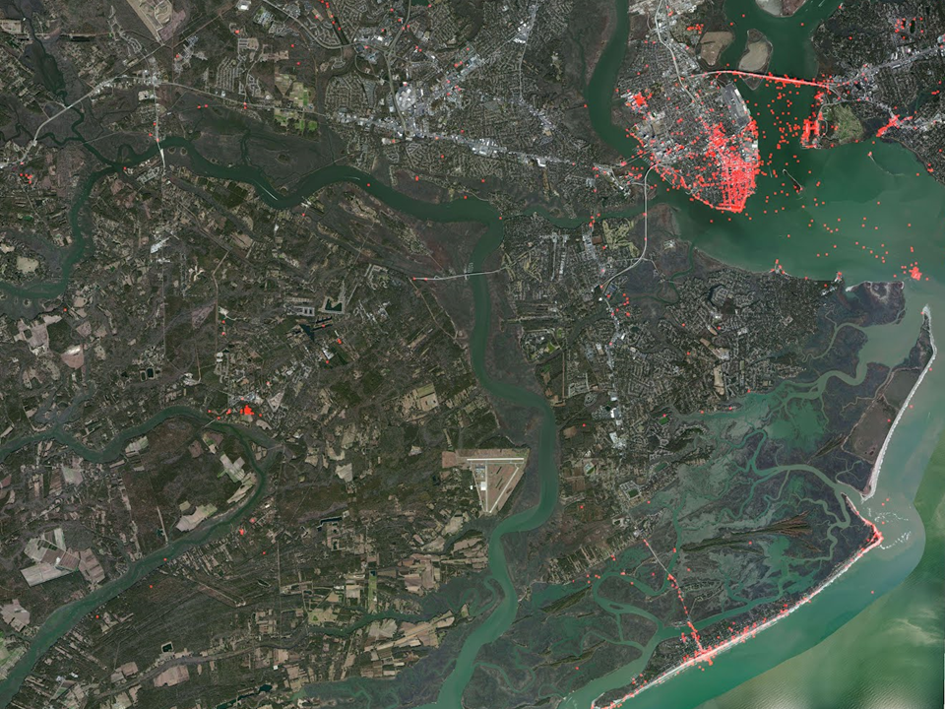
Satellite
Aerial
Street View

Slide 25
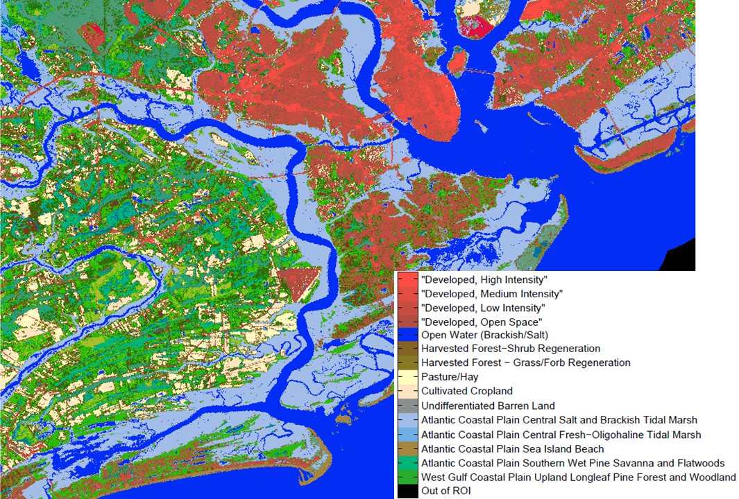
Non image data
GIS Land attributes
Elevation Maps
others

Slide 26
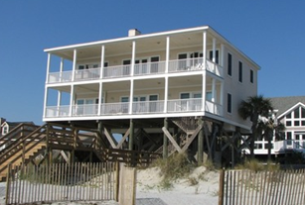
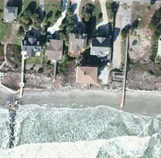

Geo-tagged
ground level image
Aerial image
Land Cover
Attributes

Slide 27
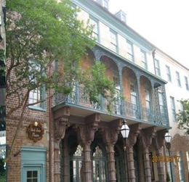
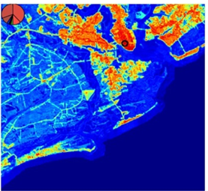
Algorithm
Input
Heatmap

Slide 28
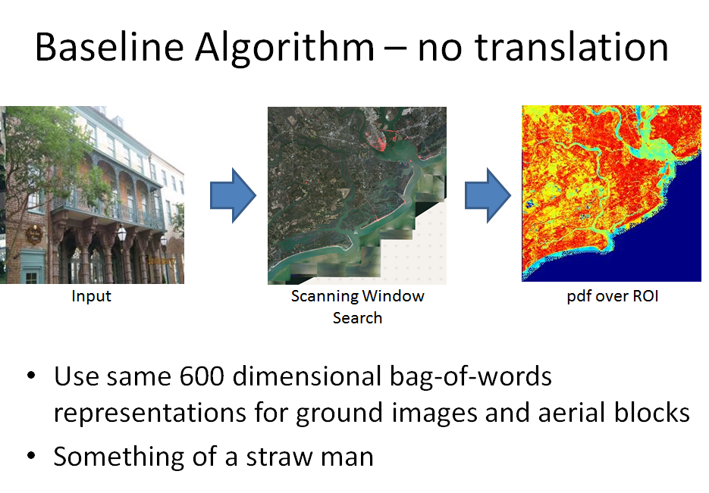

Slide 29
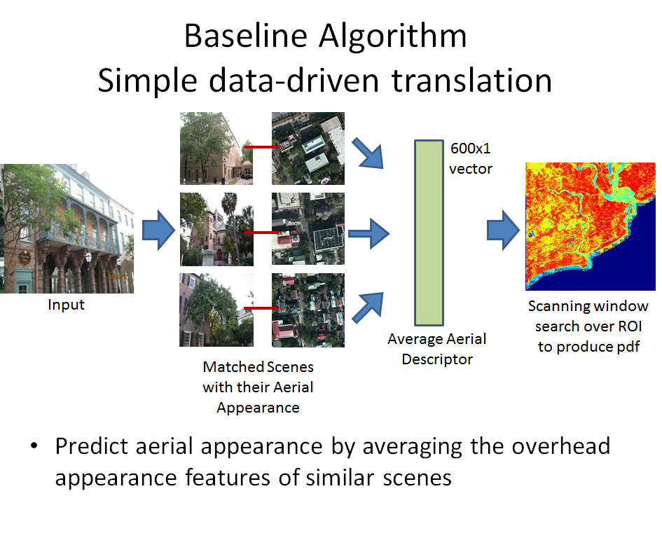

Slide 30
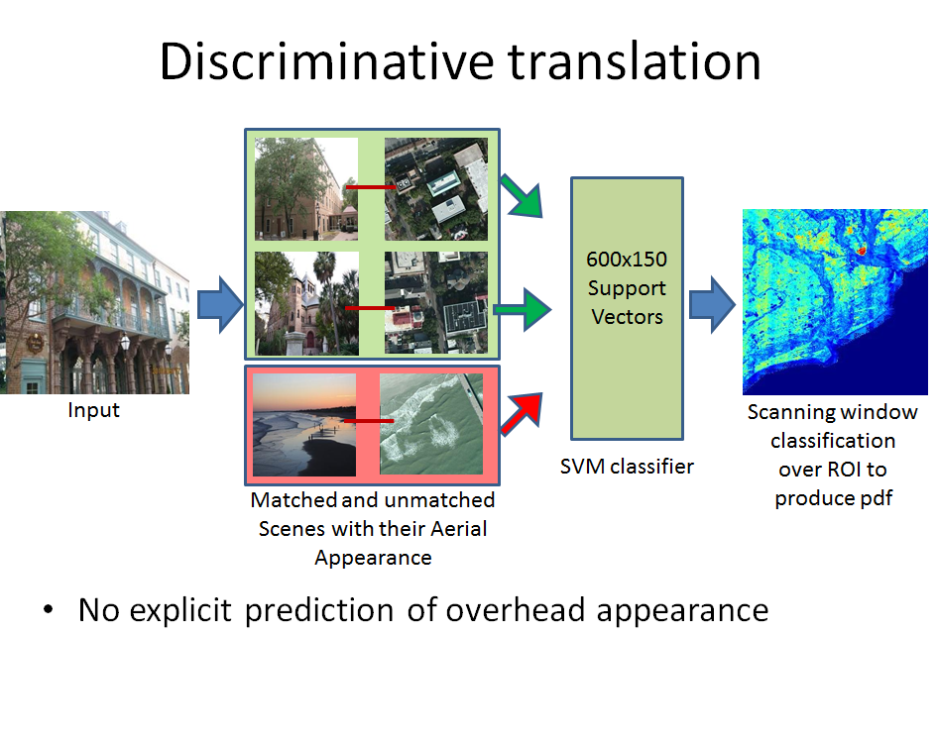

Slide 31
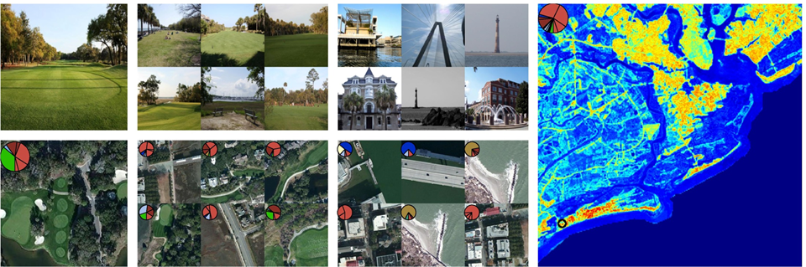
Results
Query
Positive Examples
Negative Examples
Heatmap
Aerial Image (not provided!)

Slide 32
Quantitative Performance
Percentage of test cases where ground truth location is in top 1% of predicted locations
Direct ground match (im2gps): 0%
Chance: 1%
Direct match (no translation): 2%
Land Cover Oracle (cheating): 4%
Data-driven translation: 8%
Our method: 17%

Slide 33
(Self-) Localization
faster
aerial images + GIS
road maps
Lost! Leveraging the Crowd for Probabilistic Visual Self-Localization
Marcus A. Brubaker, Andreas Geiger and Raquel Urtasun
CVPR 2013
Runner-up for best paper award!

Slide 34
And what about now? Where am I?
I’m somewhere in North Seattle…
And this is the path I’ve driven in the past few seconds

Slide 35
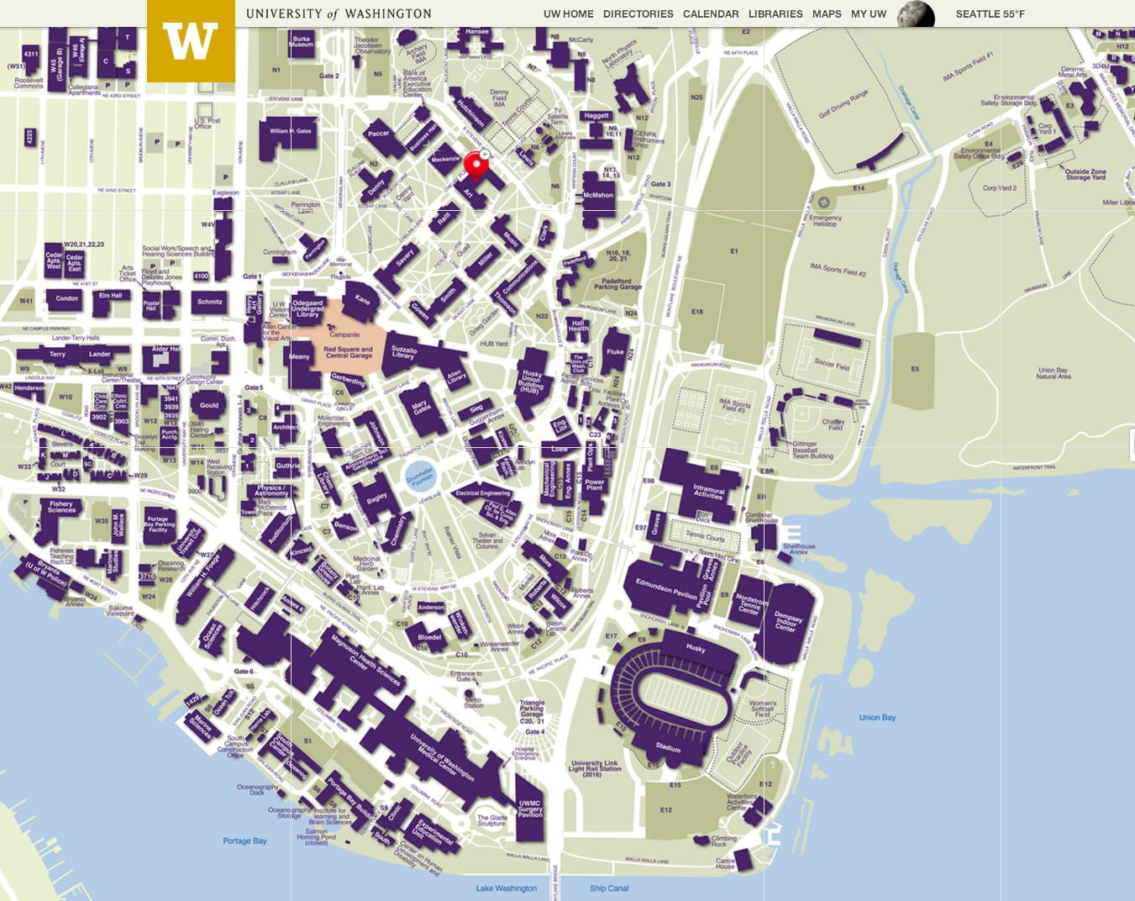
And what about now? Where am I?

Slide 36
Idea
Use visual odometry for estimating motion
Probabilistic model of all possible locations and transitions between them.
Key observations:
convert road map to directed graph
update probabilistic state of car given odometry
use Mixture of Gaussians for positions within one segment
prune low probability modes

Slide 37
Quantitative Results
Map size 2km² and 47km of roads
Same approach works equally well for maps with 2150km of roads
Runs real-time!
Better than GPS!
Average | Stereo Odometry | Monocular Odometry
Position Error | 3.1m | 18.4m
Heading Error | 1.3° | 3.6°
Localization Time | 36s | 62s

Slide 38
Discussion
Why is localization still interesting? In which setting?
1st paper: Is the setup for localization correct? Main objective vs partial objective?
2nd paper: Where is it going? Harvesting imagery with drones?
3rd paper: Localization indoors: can we localize ourselves with Glass?

