Slide 1
Depth Extraction from Video Using Non-parametric Sampling
Kevin Karsch
University of Illinois
Ce Liu
Microsoft Research
New England
Sing Bing Kang
Microsoft Research

Slide 2
Problem Statement
Given an image/video, estimate distance from the camera
No parallax necessary Camera motion OK Scene motion OK

Slide 3
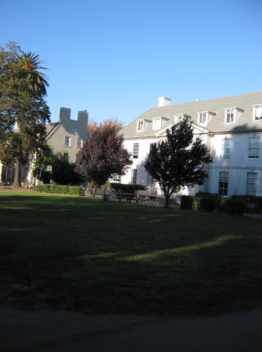
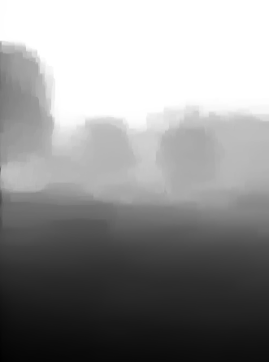
Problem Statement
Given an image/video, estimate distance from the camera
No parallax necessary Camera motion OK Scene motion OK
Input
Our estimated depth

Slide 4
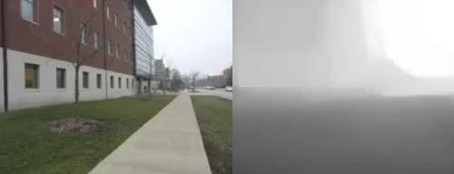
Problem Statement
Given an image/video, estimate distance from the camera
No parallax necessary Camera motion OK Scene motion OK
Input
Estimated depth

Slide 5
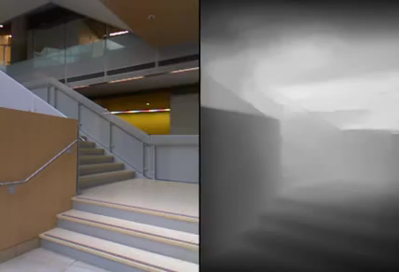
Problem Statement
Given an image/video, estimate distance from the camera
No parallax necessary Camera motion OK Scene motion OK
Input
Estimated depth
Notes:
and can handle dynamic scenes, or in fact any combination static/dynamic scene/camera.

Slide 6
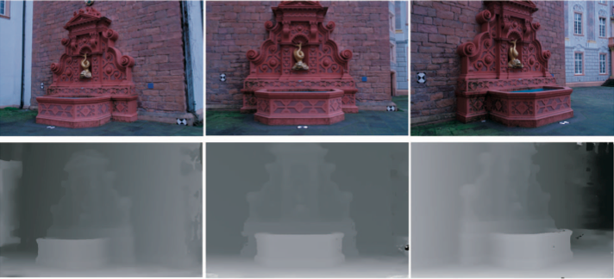
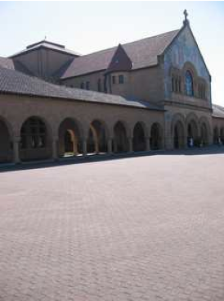
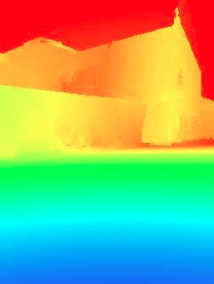
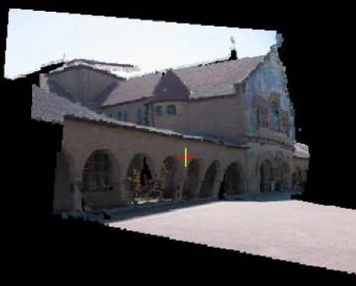
Related Work
  [Zhang et al. ’09]
  [Liu et al. ’10]
Multiview reconstruction
Very accurate for videos with moving camera
May fail for dynamic scenes
  [Newcombe and Davidson ’10]
  [Furukawa and Ponce ’09]
  [Zhang et al. ‘09]
  …
Parametric learning
Works well for single images
No literature on extending to video
  [Liu et al. ’10]
  [Saxena et al. ‘09]
  [Hoiem et al. ’05]
  …

Slide 7
Related Work
  [Zhang et al. ’09]
  [Liu et al. ’10]
Multiview reconstruction
Very accurate for videos with moving camera
May fail for dynamic scenes
  [Newcombe and Davidson ’10]
  [Furukawa and Ponce ’09]
  [Zhang et al. ‘09]
  …
Parametric learning
Works well for single images
No literature on extending to video
  [Liu et al. ’10]
  [Saxena et al. ‘09]
  [Hoiem et al. ’05]
  …

Slide 8
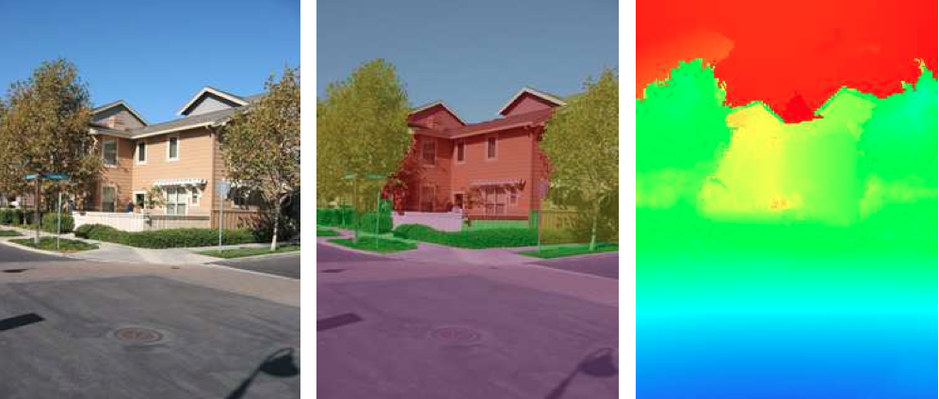
Training set
Pixel level [Saxena et al. ‘05]
All data
Object level [Lui et al. ‘10]
Tree
Sky
…
Ground
Scene level (ours)
Forest
Office
Street-level
…

Slide 9
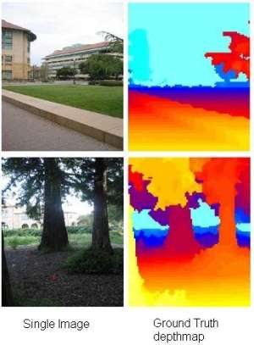
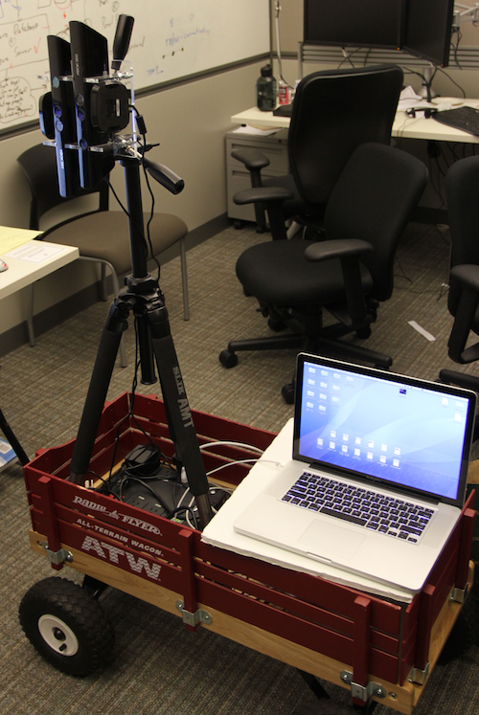
RGBD Datasets
Laser rangefinder
Outdoor scenes
[Saxena et al.]
MSR-V3D
Indoor scenes
(Ours)

Slide 10
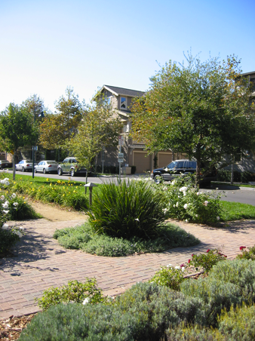
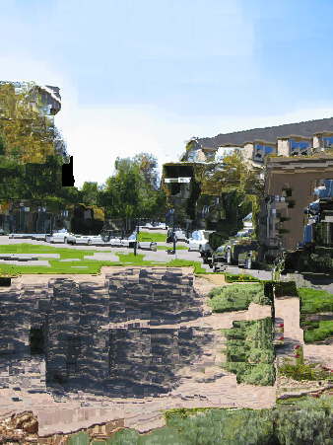
SIFT Flow Refresher
Optical flow using dense SIFT features
  Larger search window
  Modified smoothness constraints
Scenes rearranged so semantics are matched
ψ
Warping
operator
A
B
[Liu et al. ‘08, ‘09]

Slide 11
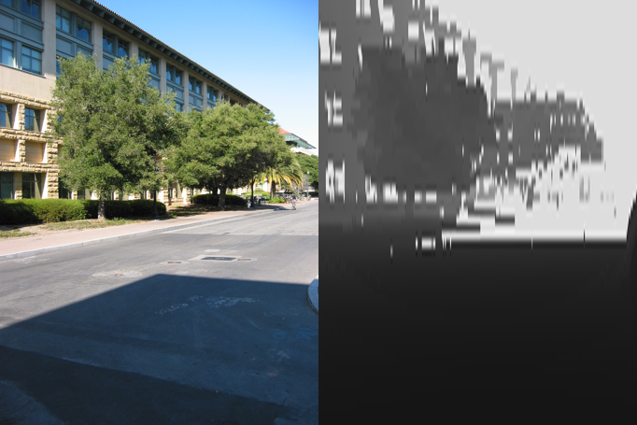
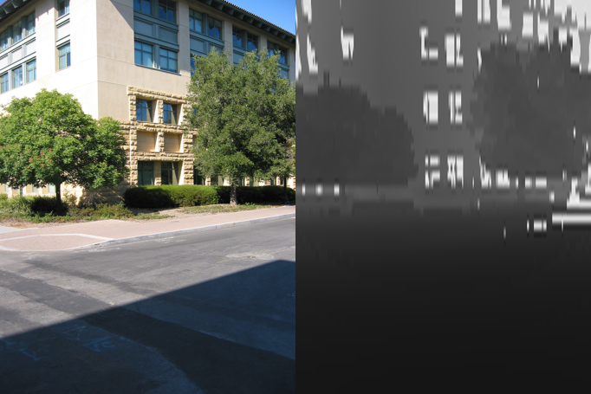
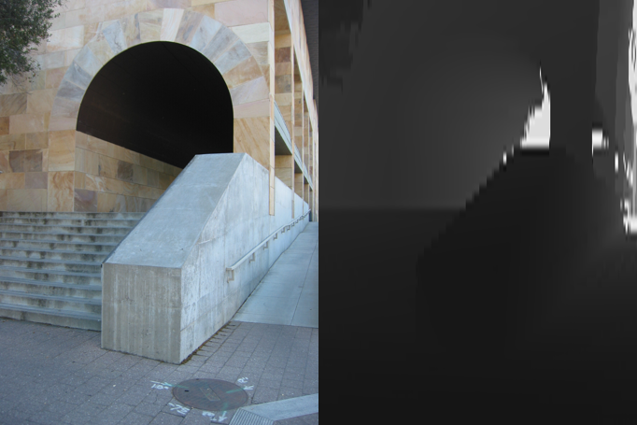
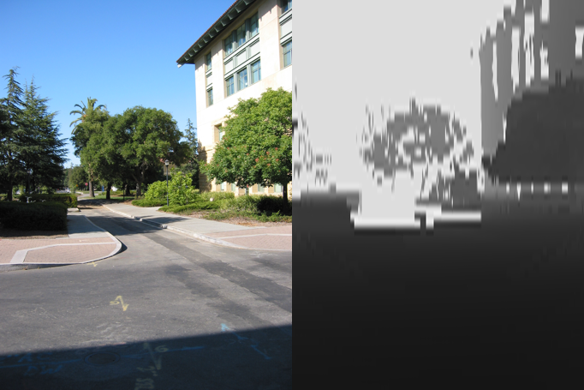
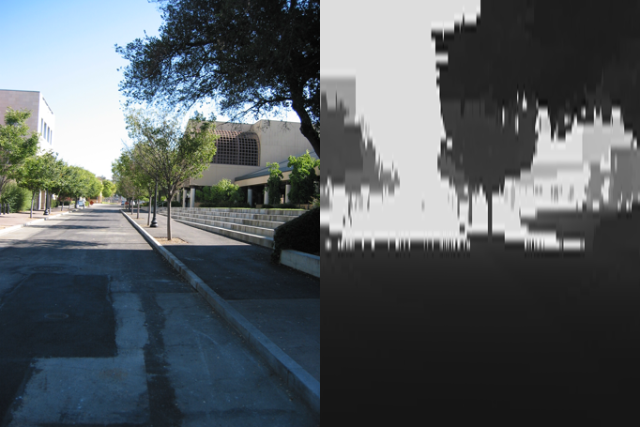
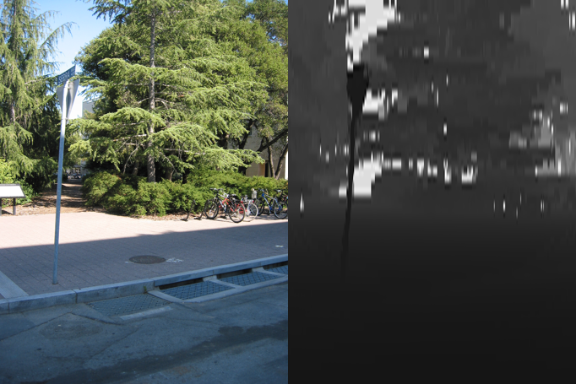
Algorithm
Input image
RGBD Database
kNN query

Slide 12
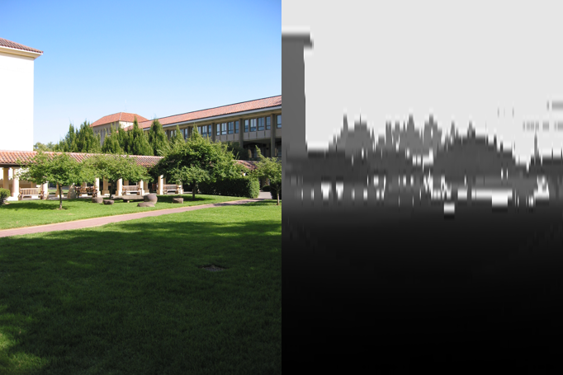
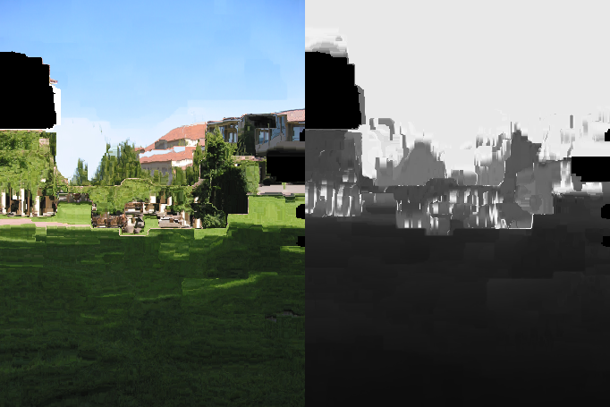
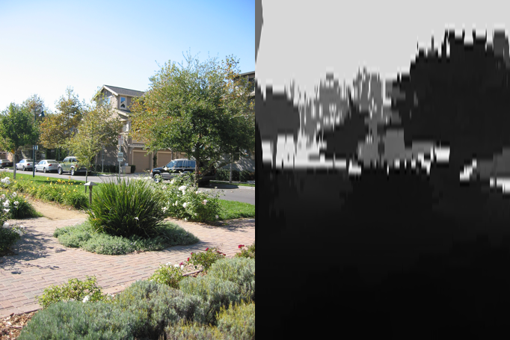
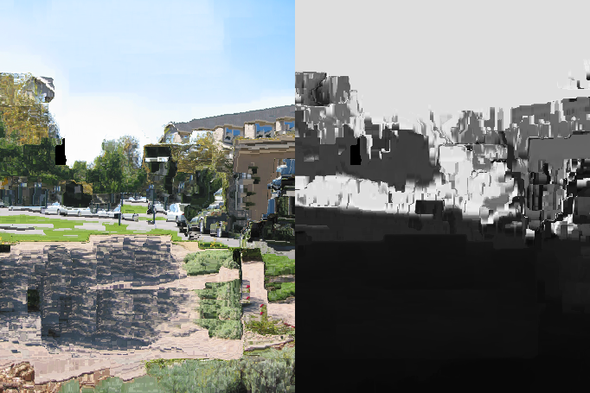
Algorithm
Candidates
Warped candidates
Input
SIFT
flow

Slide 13
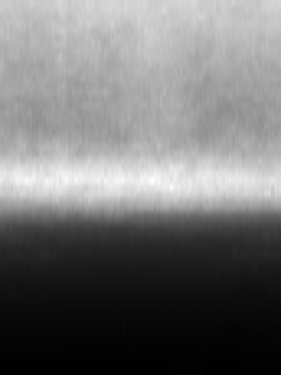
Algorithm
Input
Prior
Inferred depth
Depth
inference
Warped candidates

Slide 14
Inference
Enforce depth to match candidates
: inferred depth
: warped
candidate depth
: depth confidence
: image-based
weights
: constant
weights
Spatial
smoothness
Match to database mean
Both absolute and relative depth are transferred
Regularize with smoothness and prior

Slide 15
Inference
Enforce depth to match candidates
Not a discrete MRF!
: inferred depth
: warped
candidate depth
: depth confidence
: image-based
weights
: constant
weights
Spatial
smoothness
Match to database mean
Both absolute and relative depth are transferred
Regularize with smoothness and prior

Slide 16
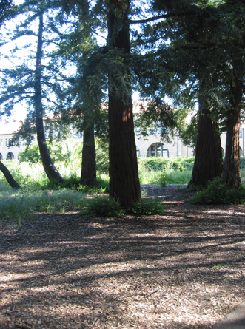
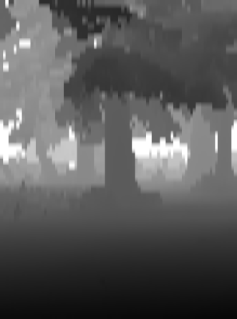
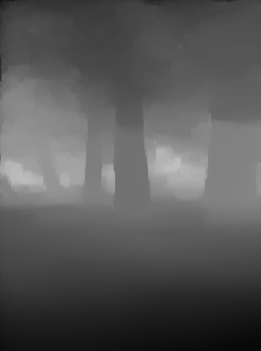
Input
True depth
Inferred depth

Slide 17
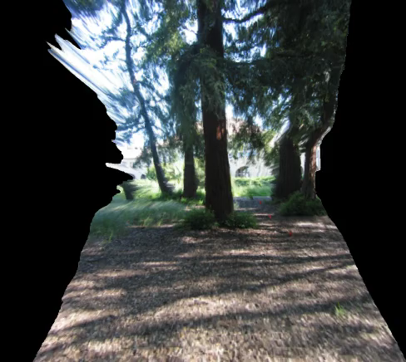
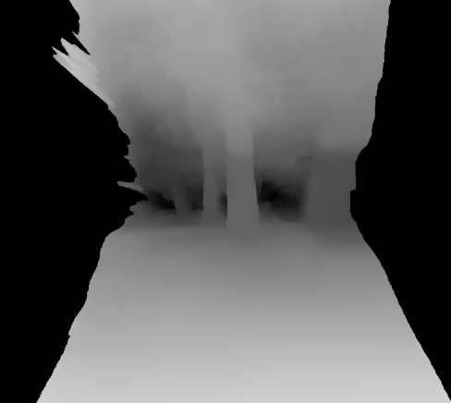

Slide 18
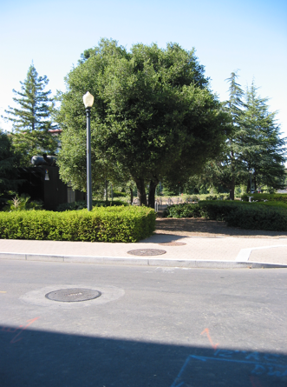
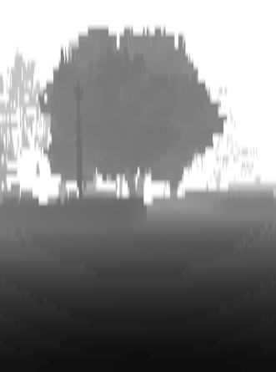
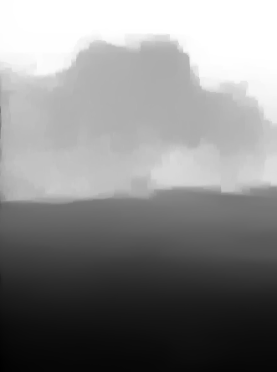
Input
True depth
Inferred depth

Slide 19
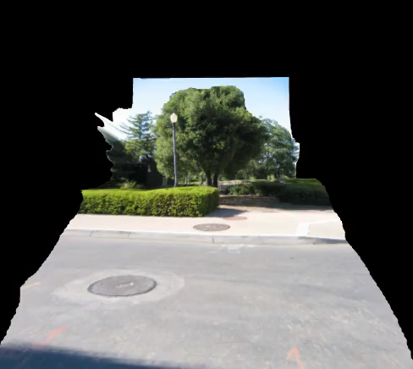
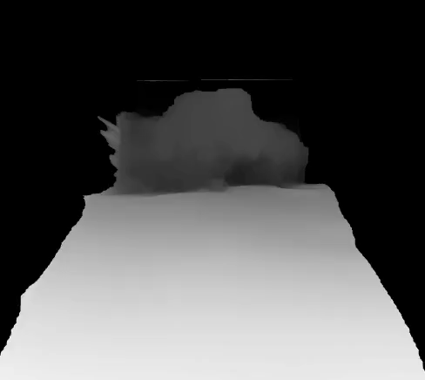

Slide 20
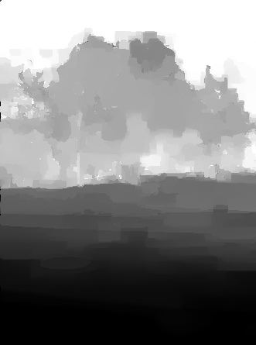
Result without relative depth term (γ = 0)
Result with relative
depth term (γ > 0)

Slide 21
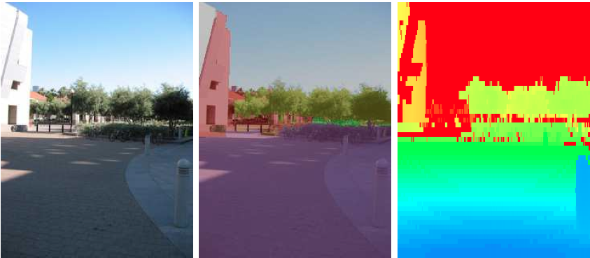
Evaluation: Make3D Dataset
RGBD+labeled data
RGB Labels Depth

Slide 22
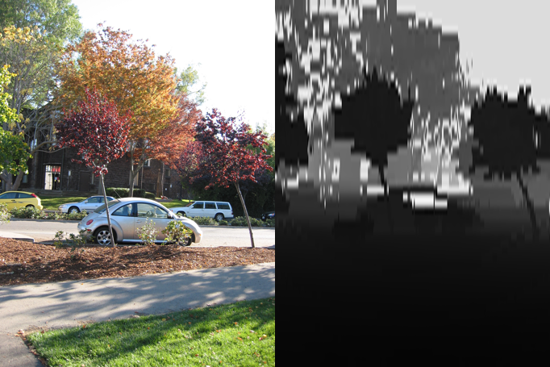
Video Extension
Input
Prior
Inferred depth
Depth
inference
Warped
candidates
Temporal information
Optical
flow
Motion
segmentation

Slide 23
Video Inference
: binary motion mask
: hypothesized depth
of motion mask
: constant weights
Single image objective
Depth changes are gradual frame-to-frame
Moving objects are usually on the ground

Slide 24
Video Inference
: binary motion mask
: hypothesized depth
of motion mask
: constant weights
Single image objective
Smooth along direction of optical flow
Depth changes are gradual frame-to-frame
Moving objects are usually on the ground

Slide 25
Video Inference
: binary motion mask
: hypothesized depth
of motion mask
: constant weights
Single image objective
Smooth along direction of optical flow
Coerce moving objects to be “grounded”
Depth changes are gradual frame-to-frame
Moving objects are usually on the ground
  Motion mask = threshold flow-weighted, relative pixel differences
  Ce Liu’s optical flow http://people.csail.mit.edu/celiu/OpticalFlow

Slide 26
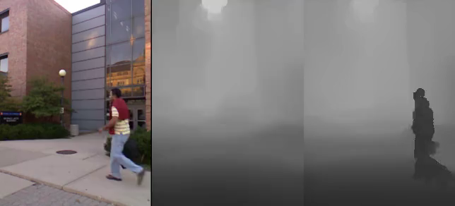
Input
Inferred depth
without temporal info
with
temporal info

Slide 27
Results

Slide 28
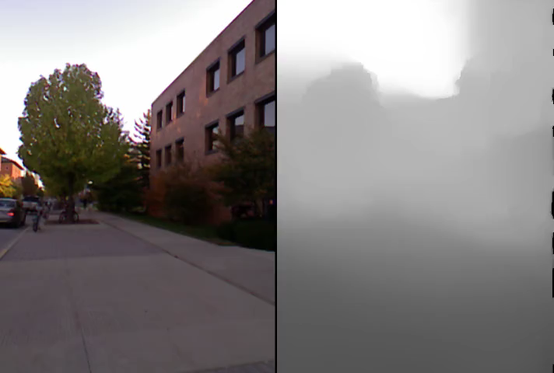

Slide 29
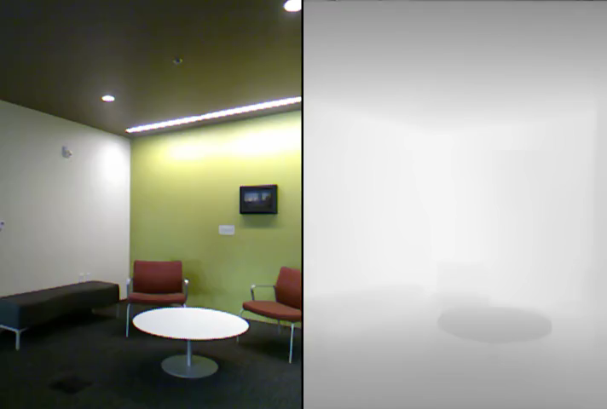

Slide 30
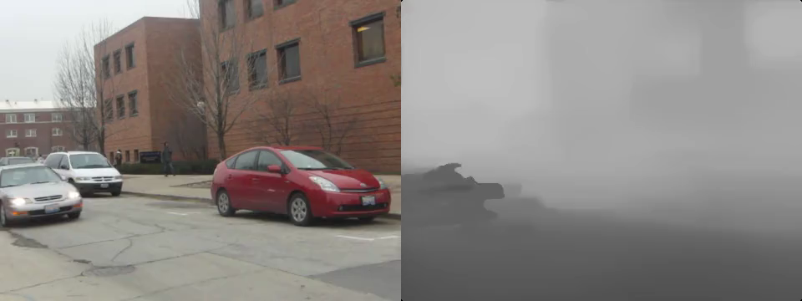

Slide 31
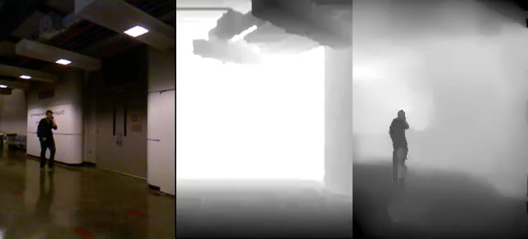
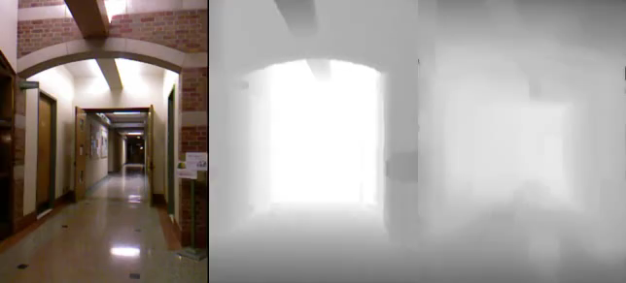
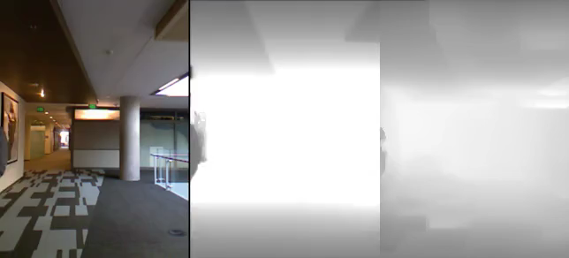
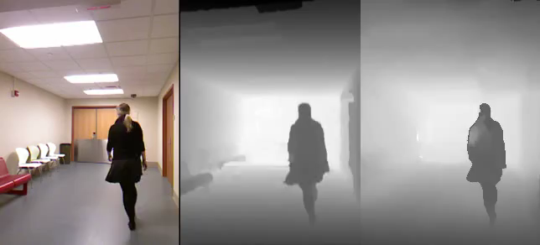
MSR-V3D evaluation
Input
Kinect*
Ours
Input
Kinect*
Ours
*Naïve hole filling applied to Kinect data (for visualization only)

Slide 32
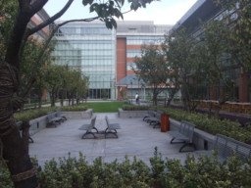
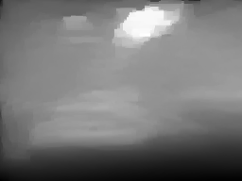
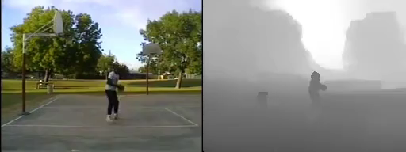
Limitations
No similar training images
Inaccurate motion estimation
Floating objects

Slide 33
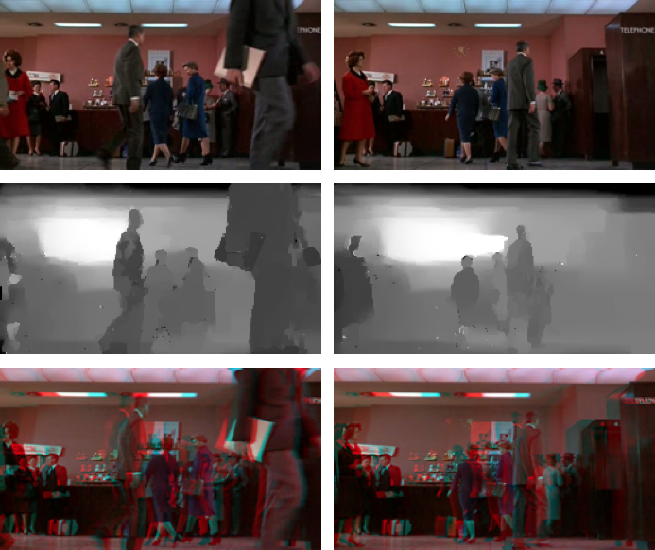
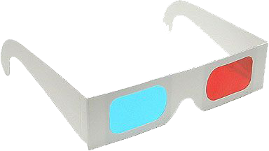
Application: 2D-to-3D
Input
Depth
Anaglyph “3D”

Slide 34


Thanks!
More results, code and dataset available at: http://kevinkarsch.com/depthtransfer
Our 2D-to-3D
Youtube 2D-to-3D

