Slide 1
Presentation of “Shape Estimation in Natural Illumination,” by Johnson and Adelson
Daniel J Butler
University of Washington
11/29/2011

Slide 2
Question:
Notes:
I’ve only seen the statue in pictures.

Slide 3
Question:
Does Michaelangelo’s David have a six-pack?
Notes:
I’ve only seen the statue in pictures.

Slide 4
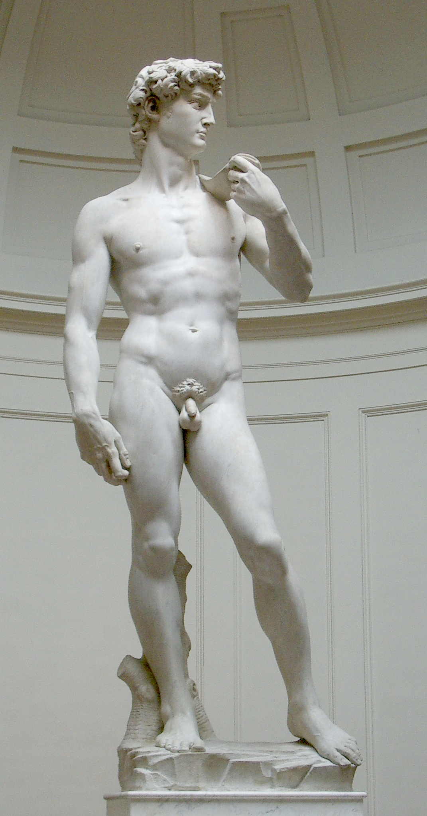

Slide 5
How do you know?

Slide 6
How do you know?
Shape from shading.

Slide 7
You can even do unfamiliar objects!
entoforms, by macuono
Notes:
An algorithmic sculpture
, very complex, but still easy to see its shape

Slide 8
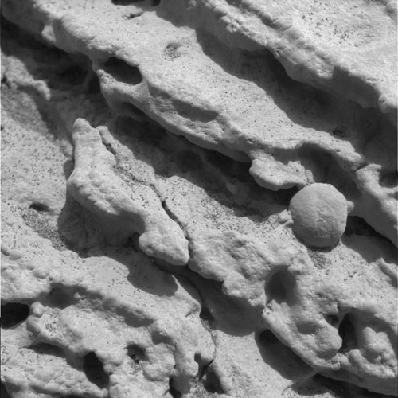
… on other planets!
Martian geology
Notes:
Rock formations on Mars

Slide 9
Each pixel value
contains information about
the surface normal at that point.

Slide 10
Each pixel value
contains information about
the surface normal at that point.
(Assume lighting direction is known.)

Slide 11
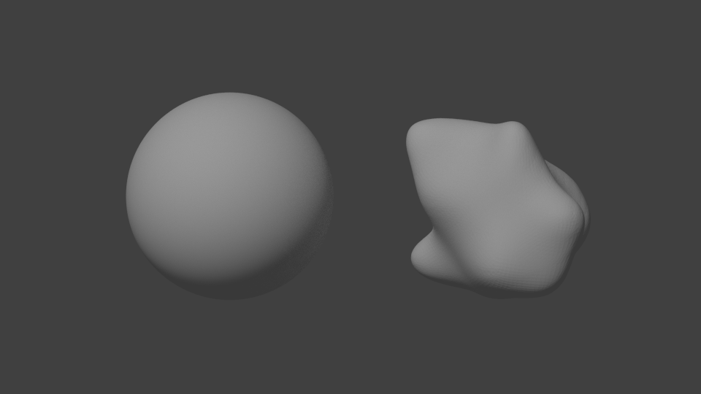
Ideally, every point could be mapped to one on the sphere

Slide 12
Ideally, every point could be mapped to one on the sphere
Same intensity

Slide 13
Ideally, every point could be mapped to one on the sphere

Slide 14
Ideally, every point could be mapped to one on the sphere
Inferred normal

Slide 15
Unfortunately, there is ambiguity.

Slide 16
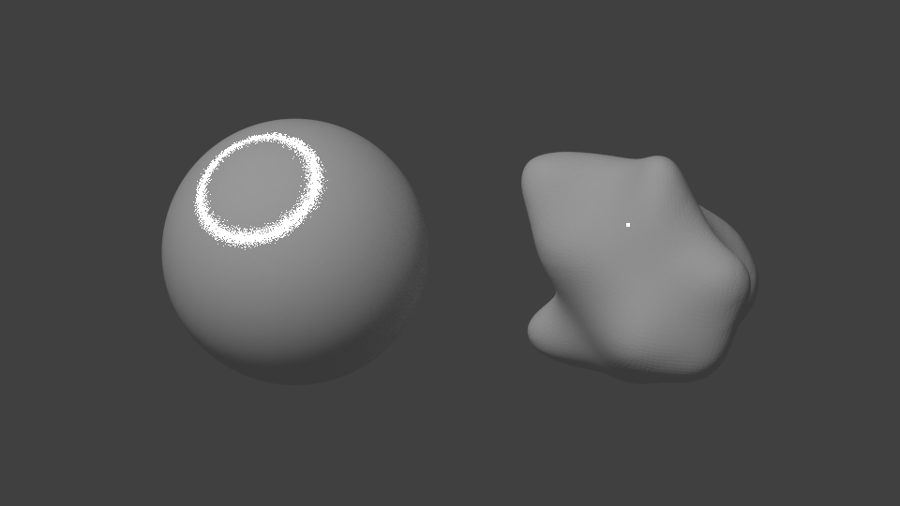
Unfortunately, there is ambiguity.
Same intensity

Slide 17
Unfortunately, there is ambiguity.
Same intensity
?

Slide 18
Horn showed:
Despite local ambiguity, if you know some normals,
you can infer the whole normal map by integrating across space
Notes:
Horn’s 1970 PhD thesis

Slide 19
Results of classical shape-from-shading
J.-D. Durou, M. Falcone, and M. Sagona.
Numerical methods for shape-from-shading: A new survey with benchmarks.
Computer Vision and Image Understanding, 109(1), 2008.

Slide 20
Shape Estimation in Natural Illumination
Micah K. Johnson and Edward H. Adelson
Massachusetts Institute of Technology

Slide 21
Idea:
Natural scenes have complex lighting,
which makes shape-from-shading easier
Statistics of Real-World Illumination
Dror, Leung, Adelson, and Willsky, CVPR ’01

Slide 22
Photometric Stereo

Slide 23
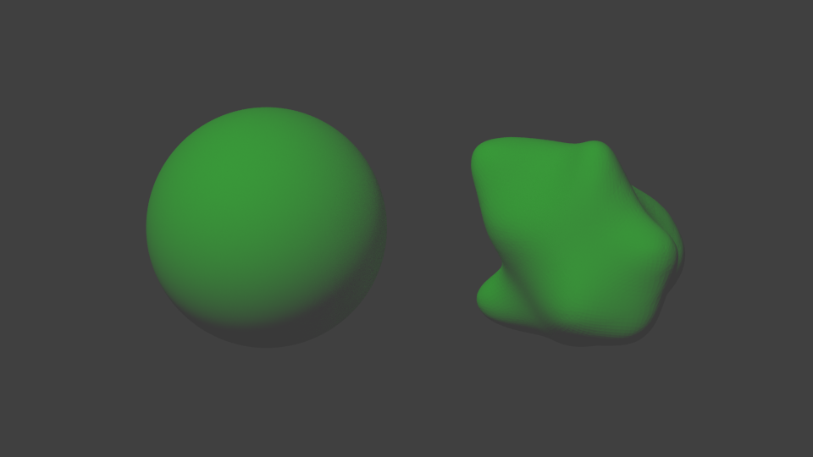
Photometric Stereo

Slide 24
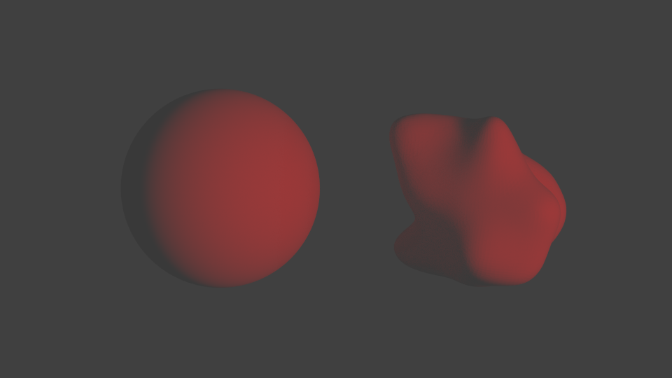
Photometric Stereo

Slide 25
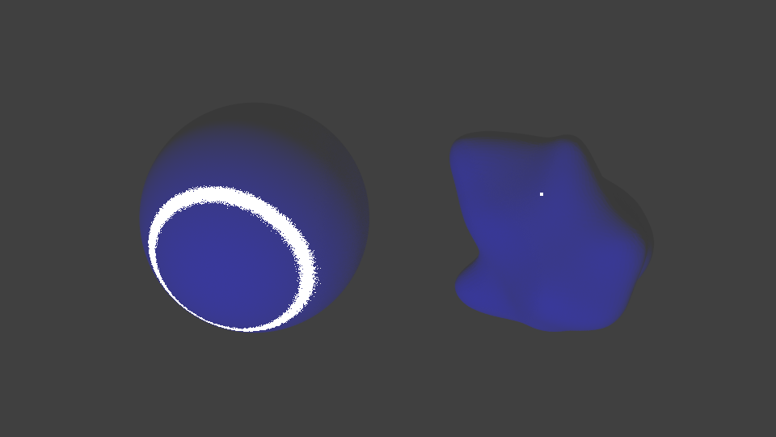
Photometric Stereo

Slide 26
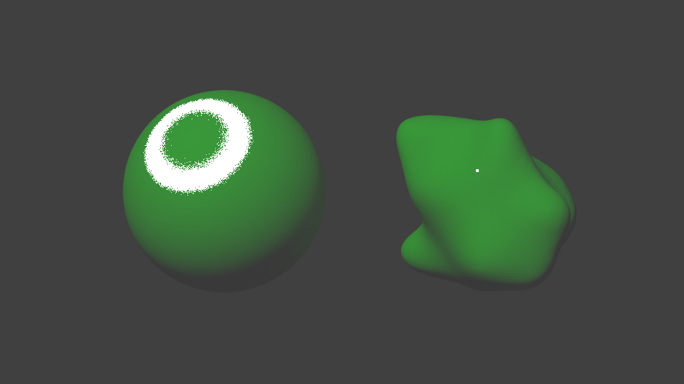
Photometric Stereo

Slide 27
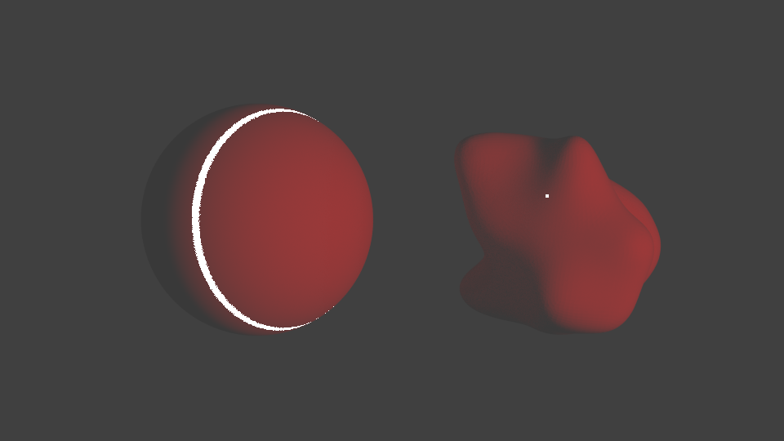
Photometric Stereo

Slide 28
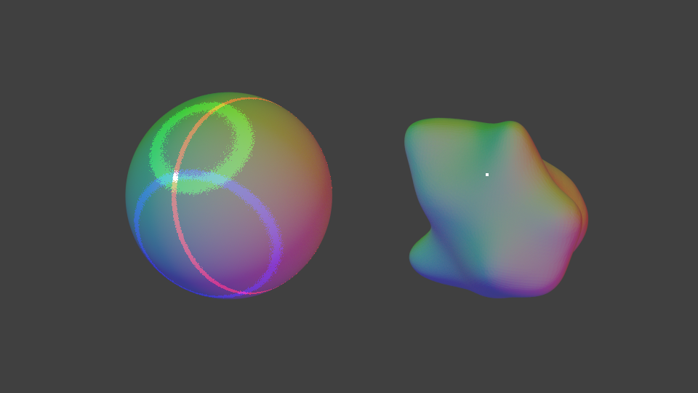
Photometric Stereo

Slide 29
Photometric Stereo
No local ambiguity → no complicated global algorithm!

Slide 30
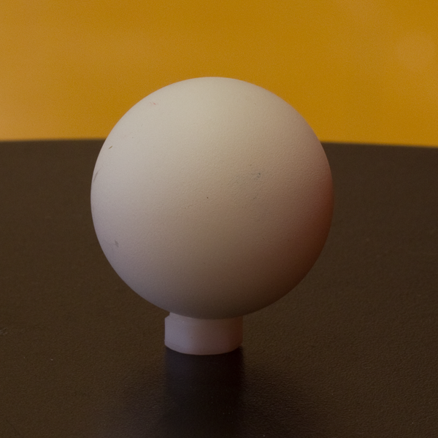
Notes:
If lighting were uniform, the ambiguous regions would be ring-shaped

Slide 31
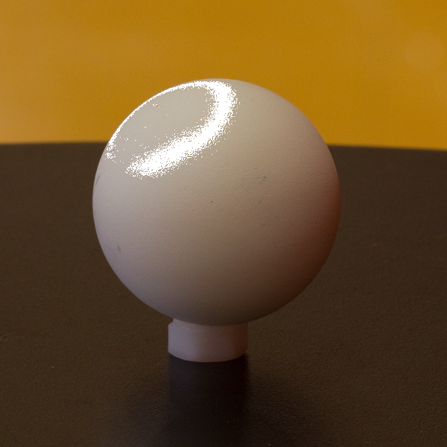
Not quite, photometric stereo, but not quite single-channel:

Slide 32
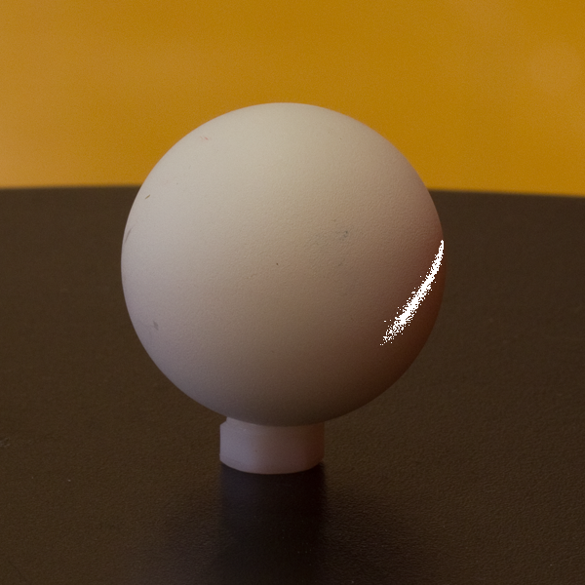
Not quite, photometric stereo, but not quite single-channel:

Slide 33
Not quite, photometric stereo, but not quite single-channel:
Still ambiguous, but global optimization should be easier

Slide 34
The Objective Function
Three terms:
Pixel intensities implied by normals should match the observations
Curl of the normal map should be close to 0 (normal map is the gradient of z(x,y))
Along directions where the image does not change, neither should the normals (lighting and gradients are not coincidentally aligned)

Slide 35
The Optimization Procedure
At each pixel, in raster scan order:
Try optimizing 3x3 patch with three different initializations (patch, patch left, patch above)
Pick the “best” outcome and keep it
Do this at coarse scales first, then upsample to initialize finer scales

Slide 36
Some results:

Slide 37
More results:

Slide 38
Across all surface normals from all 100 images,
90% have an angular error lower than 10 degrees

Slide 39
My thoughts:
Basic insight is very cool
Important step along the way to robust shape-from-shading
Constant albedo assumption must eventually be addressed
Cast shadows and occlusion must eventually be addressed

Slide 40
My questions:
How good is their algorithm under uniform lighting?
Where do the environment maps come from? Natural?
There are self-occlusions in the blobs data set … how badly does the algorithm fail on them?

Slide 42
Barron and Malik, CVPR ‘11

Slide 43
Sources
Flickr users Shawn Clover, Justin Frisch
http://www.flickr.com/photos/shawnclover/5382492085/
http://www.flickr.com/photos/shawnclover/5386000348
http://www.flickr.com/photos/purplegecko/2158408860/
NASA/JPL care of Wikipedia
http://en.wikipedia.org/wiki/File:Opportunity_photo_of_Mars_outcrop_rock.jpg

Slide 44
Thank you

Slide 47
Micah Kimo Johnson
Computer Science and Artificial Intelligence Laboratory
Massachusetts Institute of Technology
MIT 2008–2010
Postdoc, Brain & Cognitive Sciences
Advisor: Edward H. Adelson
Dartmouth 2002–2007
Ph.D. Computer Science
Lighting and Optical Tools for Image Forensics
Advisor: Hany Farid

Slide 48
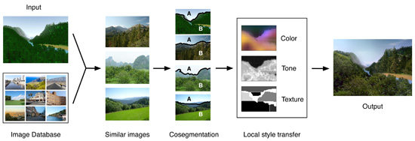
GelSight
CG2Real

Slide 49
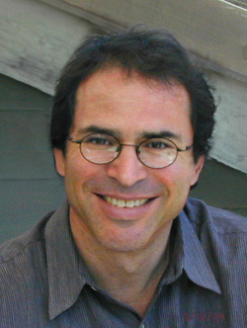
Edward “Ted” Adelson
John and Dorothy Wilson Professor of Vision Science
Dept. of Brain and Cognitive Sciences
Massachusetts Institute of Technology
Education
1974-1979. Ph. D. in Experimental Psychology, University of Michigan Dissertation: The response of the rod system to bright flashes of light

Slide 50
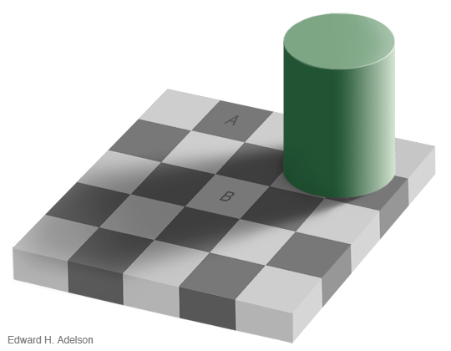

Slide 51
“Layered Representation for Motion Analysis”
Wang and Adelson, CVPR ‘93

Slide 52
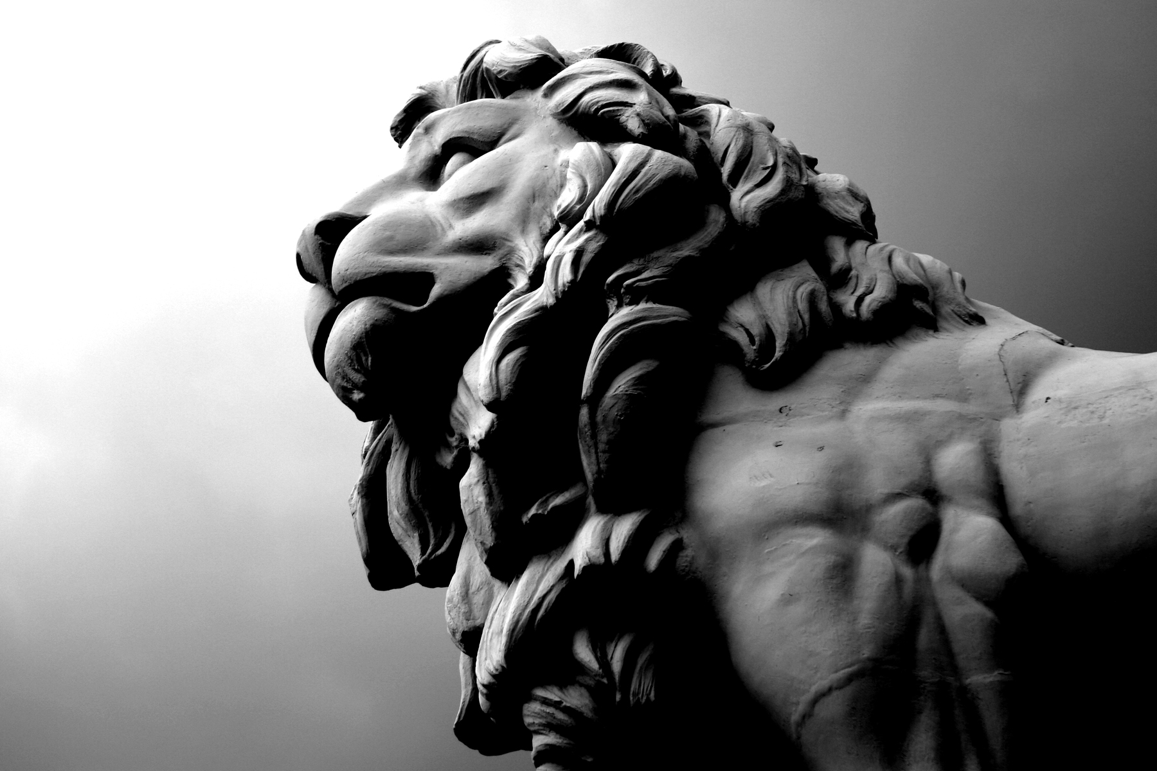

Slide 53
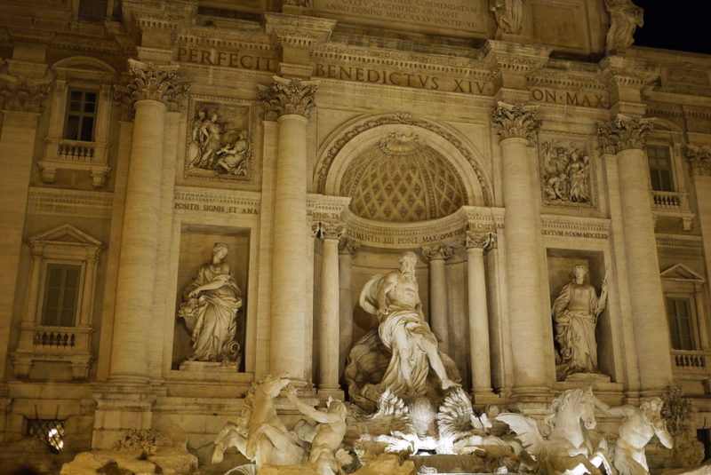

Slide 54
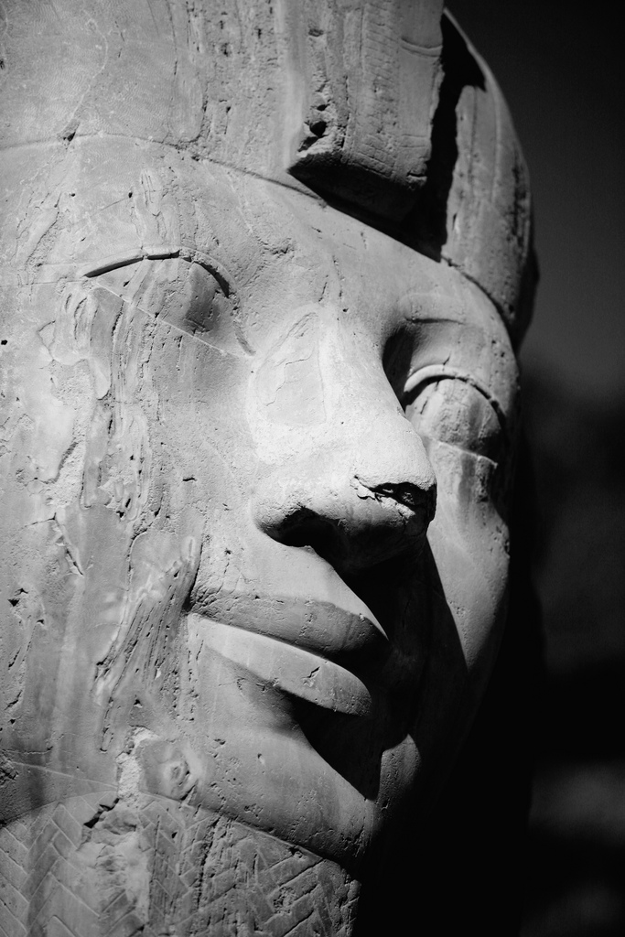

Slide 58
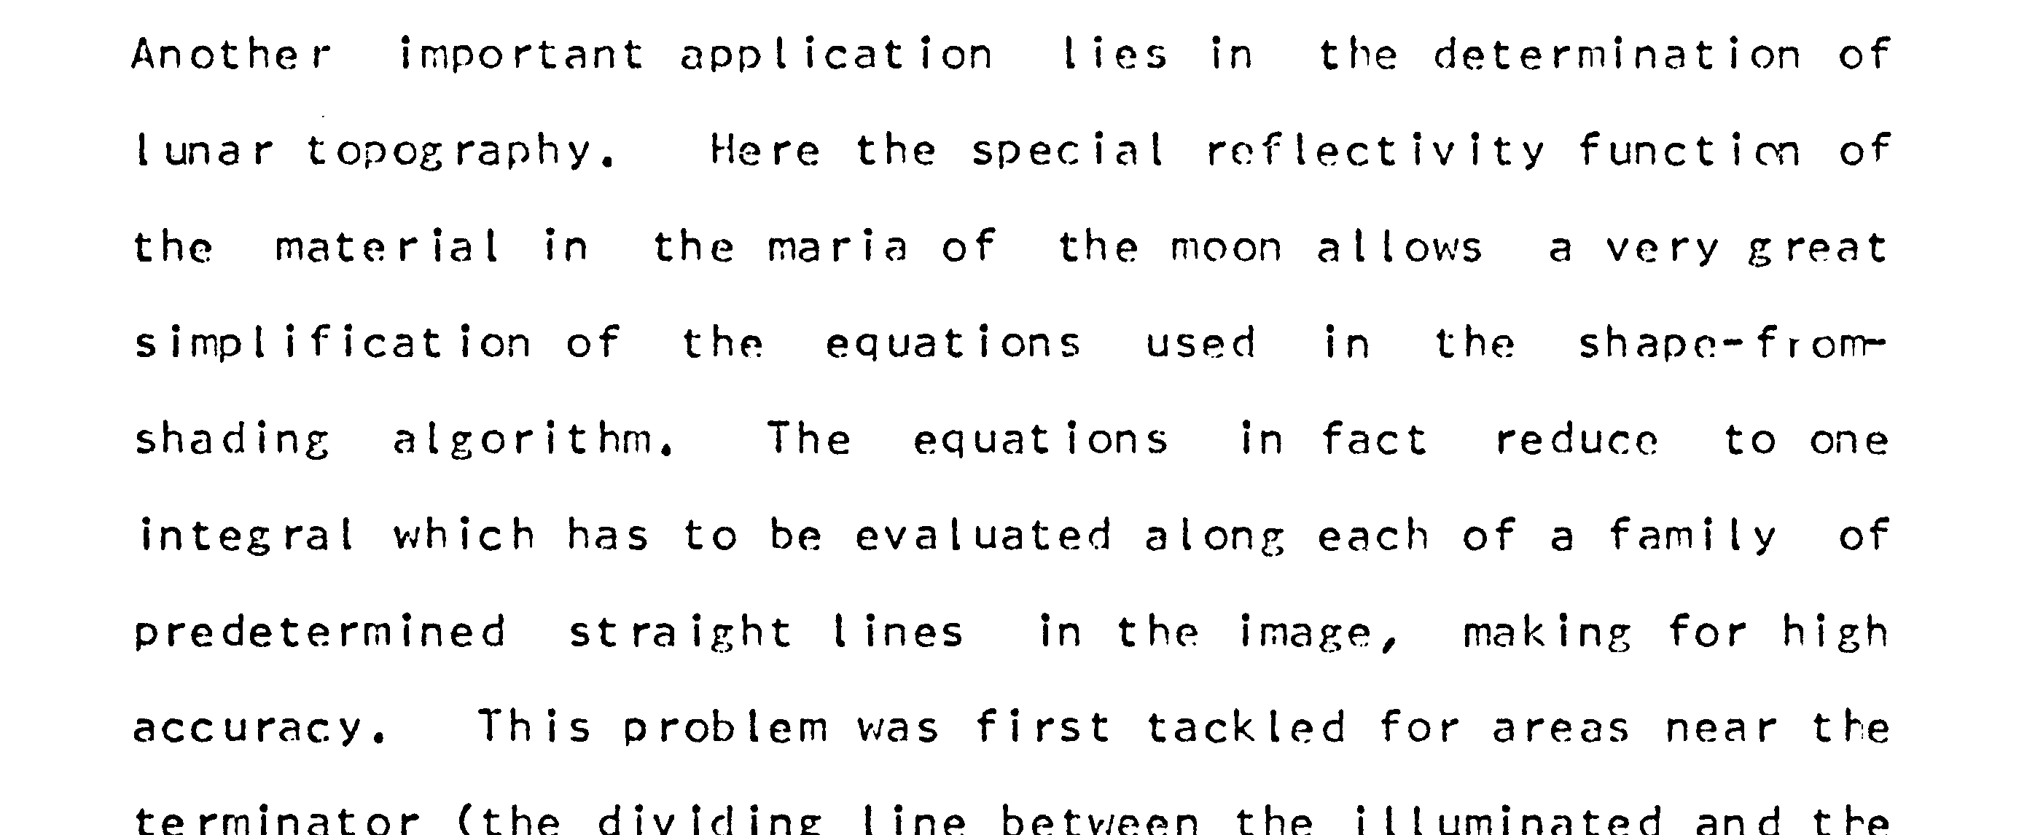

Slide 59
Zhang, Tsai, Cryer, and Shah, PAMI ‘99

Slide 60
Classical Shape-from-Shading
Horn’s assumptions:
light source is far away
reflectance and albedo are constant at all points on the surface
no shadows or interreflections

Slide 61
Classical Shape-from-Shading
Under these assumptions, there is a simple model of image intensity:
$$I\left(x\right)=b∙n\left(x\right)$$
$b$ : lighting direction
$n\left(x\right)$ : surface normal at position $x$

Slide 62
Shading function modeled as quadratic:
$$s\left(n\right)=n∙An+b∙n+c$$

