Slide 1
Fault Tolerant, Efficient, and Secure Runtimes
Ben Zorn
Research in Software Engineering (RiSE) Microsoft Research In collaboration with:
Emery Berger and Gene Novark, UMass - Amherst
Ted Hart and Karthik Pattabiraman, Microsoft Research

Slide 2
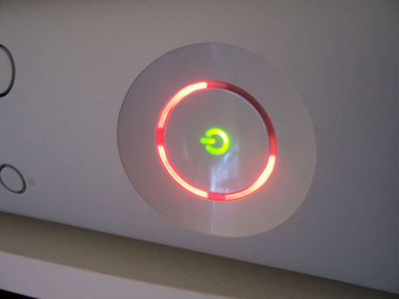
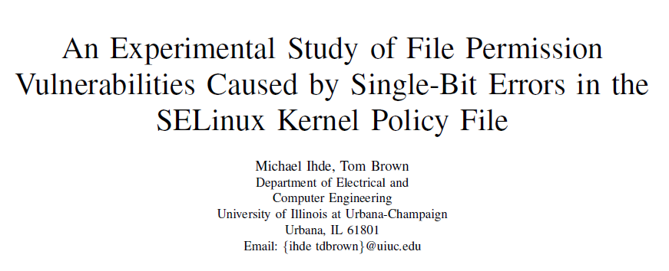
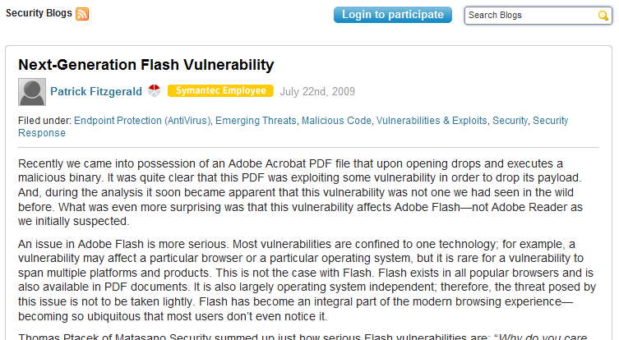
Software and Hardware Bugs are Expensive
Xbox 360 Red Ring of Death

Slide 3
The “Good Enough” Revolution
Source: WIRED Magazine (Sep 2009) – Robert Kapps
http://www.wired.com/gadgets/miscellaneous/magazine/17-09/ff_goodenough
People prefer “cheap and good-enough” over “costly and near-perfect”
Flakey systems are inevitable, so…

Slide 4
Memory Corruption
Buffer overflow char *c = malloc(100); c[100] = ‘a’;
Premature call to free char *p1 = malloc(100); char *p2 = p1; free(p1); p2[0] = ‘x’;
Random bit flip
c
a
0
99
p1
p2
x
0
99
0
1

Slide 5
Goal: Tolerate Memory Errors
Ideally:
Software continues in presence of errors (Failure Oblivious Computing, Martin Rinard)
Degradation in performance and/or quality acceptable outcome
Software detects when errors occur and fixes them
Avoid stopping if error is detected (fail fast)
Controversial position, especially for security issues
No changes to existing software
My related projects:
DieHard, Exterminator, Samurai, Flicker, Nozzle

Slide 6
Platforms: What does 90% Safe Mean?
Platforms necessary in computing ecosystem
Extensible frameworks provide lattice for 3rd parties
Tremendously successful business model
Examples: Windows, iPod/iPhone, browsers, etc.
Platform power derives from extensibility
Tension between isolation for fault tolerance, integration for functionality
Platform only as reliable as weakest plug-in
Tolerating bad plug-ins necessary by design

Slide 7
Outline
Motivation
Exterminator
Heap that automatically fixes software errors
Builds on DieHard allocator (PLDI’06, Berger & Zorn)
Samurai
What if all memory is not equal? Critical Memory
Eurosys 2008 (Pattabiraman, Grover, and Zorn)
Recent projects
Flicker – Can intentionally introducing corruption be valuable?
Nozzle – How safe is your type safe heap?

Slide 8
DieHard Allocator in a Nutshell
Existing heaps are packed tightly to minimize space
Tight packing increases likelihood of corruption
Predictable layout is easier for attacker to exploit
Randomize and overprovision the heap
Expansion factor determines how much empty space
Does not change semantics
Replication increases benefits
Enables analytic reasoning
Normal Heap
DieHard Heap
Notes:
Empty space can be filled with canaries, allows detection of corruption in non-objects
We define “infinite heap semantics”
Programs execute as if each object allocated with unbounded memory
All frees ignored

Slide 9
Randomized Heaps in Practice
DieHard (now DHard – don’t ask)
Windows, Linux version implemented by Emery Berger
Try it right now! (http://prisms.cs.umass.edu/emery/index.php?page=diehard )
Mechanism automatically redirects malloc calls to DieHard DLL
DieHard applications: Firefox & Mozilla
Tolerates known software errors in browsers
RobustHeap
Windows prototype implemented by Ted Hart to understand applicability to Microsoft applications
Mechanisms in common with both DieHard and Exterminator

Slide 10
Exterminator Motivation
DieHard limitations
Tolerates errors probabilistically, doesn’t fix them
Memory and CPU overhead
Provides no information about source of errors
“Ideal” solution addresses the limitations
Program automatically detects and fixes memory errors
Corrected program has no memory, CPU overhead
Sources of errors are pinpointed, easier for human to fix
Exterminator = correcting allocator
Joint work with Emery Berger, Gene Novark
Plan: isolate / patch bugs with no human intervention while tolerating them

Slide 11
Exterminator Components
Focus on specific issues:
How to detect heap corruptions effectively?
DieFast allocator
How to isolate the cause of a heap corruption precisely?
Heap differencing algorithms
How to automatically fix buggy C code without breaking it?
Correcting allocator + hot allocator patches

Slide 12
Detect: DieFast Allocator
Randomized, over-provisioned heap
Canary = random bit pattern fixed at startup
Leverage extra free space by inserting canaries
Inserting canaries
Initialization – all cells have canaries
On allocation – no new canaries
On free – put canary in the freed object with prob. P
Checking canaries
On allocation – check cell returned
On free – check adjacent cells
100101011110

Slide 13
Installing and Checking Canaries
Initially, heap full of canaries
Free
Allocate
Allocate
1
1
2
Install canaries
with probability P
Check canary
Check canary

Slide 14
Isolate: Heap Differencing
Strategy
Run program multiple times with different randomized heaps
If detect canary corruption, dump contents of heap
Identify objects across runs using allocation order
Insight: Relation between corruption and object causing corruption is invariant across heaps
Detect invariant across random heaps
More heaps => higher confidence of invariant

Slide 15
Attributing Buffer Overflows
corrupted
canary
delta is constant but unknown
?
Run 1
1
2
4
X
3
Run 2
Which object caused?
2
2
4
4
X
3
1
Now only 2 candidates
Run 3
1
2
3
4
4
4
X
One candidate!
Precision increases exponentially with number of runs

Slide 16
Fix: Correcting Allocator
Group objects by allocation site
Patch object groups at allocate/free time
Associate patches with group
Buffer overrun => add padding to size request
malloc(32) becomes malloc(32 + delta)
Dangling pointer => defer free
free(p) becomes defer_free(p, delta_allocations)
Changes preserve semantics, no new bugs created
Correcting allocation may != detecting allocator
Correction allocator can be space, CPU efficient
“Patches” created separately, installed on-the-fly

Slide 17
Exterminator Overhead

Slide 18
Exterminator Effectiveness
Squid web cache buffer overflow
Crashes glibc 2.8.0 malloc
3 runs sufficient to isolate 6-byte overflow
Mozilla 1.7.3 buffer overflow (recall demo)
Testing scenario - repeated load of buggy page
23 runs to isolate overflow
Deployed scenario – bug happens in middle of different browsing sessions
34 runs to isolate overflow

Slide 19
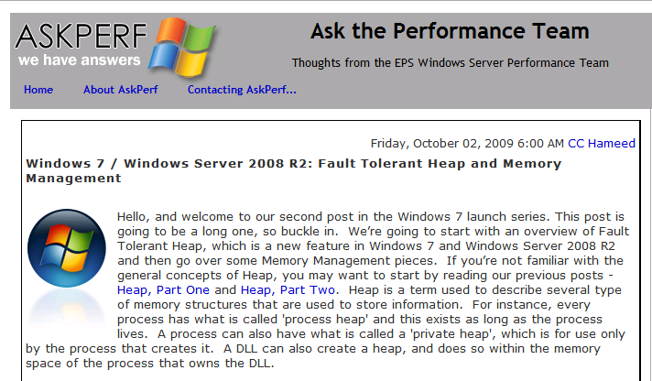
A Commercial Fault Tolerant Heap
Windows 7 shipped with Fault Tolerant Heap (FTH)
Developed by Solom Heddaya, Silviu Calinoiu, Windows Reliability
Windows heap improves the reliability of entire ecosystem (e.g., any 3rd party apps that use it)
Detects when applications crash unexpected
Enables additional mechanisms to reduce likelihood of further crashes
Identifies causes of crashes and reports through Online Crash Analysis (OCA) reporting
More information
http://msdn.microsoft.com/en-us/library/dd744764(VS.85).aspx
http://channel9.msdn.com/shows/Going+Deep/Silviu-Calinoiu-Inside-Windows-7-Fault-Tolerant-Heap/ (in-depth video discussion by Silviu)

Slide 20
Outline
Motivation
Exterminator
Heap that automatically fixes software errors
Builds on DieHard allocator (PLDI’06, Berger & Zorn)
Samurai
What if all memory is not equal? Critical Memory
Eurosys 2008 (Pattabiraman, Grover, and Zorn)
Recent projects
Nozzle – How safe is your type safe heap?
Flicker – Can intentionally introducing corruption be valuable?

Slide 21
The Problem: A Dangerous Mix
Danger 1:
Flat, uniform
address space
0xFE00
555
0x8000
888
Danger 2:
Unsafe
programming
languages
My Code
int *p = 0xFE00;
*p = 555;
int A[1]; // at 0xADE0
A[1] = 777; // off by 1
Library Code
int *p = 0x8000;
*p = 888;
// forge pointer
// to my data
int *q = 0xADE0;
*q= 999;
Danger 3:
Unrestricted
3rd party code
Result: corrupt data, crashes
security risks
0xADE0
999
777

Slide 22
Critical Memory
Insight
Some data is more important: critical data
Protect it with isolation & replication
Goals:
Harden programs from both SW and HW errors
Unify existing ad hoc solutions
Enable local reasoning about memory state
Leverage powerful static analysis tools
Allow selective, incremental hardening of apps
Provide compatibility with existing libraries, apps

Slide 23
Motivation for Critical Memory
Code
critical int balance; balance += 100;
lib_function (x, y); if (balance < 0) { chargeCredit(); } else { // use x, y, etc. }
Some data really is more important (e.g., balance)
3rd party code (lib_function) can trash important data
Many programs already protect “critical data”
Save documents to disk
Protect data structure metadata
Store some data in a DB
Data
x, y, etc
non-critical
data
balance
critical
data

Slide 24
How Critical Memory Works
int buffer[10];
critical int balance ;
map_critical(&balance);
temp1 = 100;
cstore(&balance, temp1);
temp = load ( (buffer+40));
store( (buffer+40), temp+200);
temp2 = cload(&balance);
if (temp2 > 0) { … }
buffer overflow
into
balance
balance = 100;
buffer[10] += 200; …..
if (balance < 0) { …
NormalMem
0
100
100
300
100
Critical
Mem
0
100
100
100
100
balance

Slide 25
Samurai Implementation
Two replicas
Shadow pointers in metadata
Randomized to reduce correlated errors
base
Replica 1
Critical load checks 2 copies,
detects/repairs on mismatch
Metadata
shadow pointer 1
shadow pointer 2
Update
Base
Object
Vote
Critical store writes to all copies
Replica 2
Metadata protected with checksums/backup
Protection is only probabilistic
regular store causes
memory error !
Heap

Slide 26
Samurai Performance Overheads

Slide 27
Samurai: Protecting Allocator Metadata
Average = 10%

Slide 28
Teasers for Other Projects
Flicker (2009 - Liu, Pattabiraman, Moscibroda, & Zorn)
Question: Would there be a reason to artificially introduce memory errors?
Answer: Yes, to save power!
Nozzle (2009 –Ratanaworabhan, Livshits, Zorn)
Question: Is it okay to let a malicious attacker allocate any objects they want in my C#/Java/JavaScript heap?
Answer: No! They may initiate a heap-spraying attack against you.

Slide 29
Conclusion
Software and hardware will have errors
We need to build systems that tolerate errors
Compatible with existing software
Low enough overhead to apply widely
My research agenda explores ways to do this
DieHard / Exterminator / RobustHeap: automatically detect and correct memory errors (with high probability)
Samurai / Flicker: enable local reasoning, allow selective hardening, compatibility
Open problems
Reason formally about partially correct systems
Explore what the programming model looks like

Slide 30
Additional Information
Web sites:
RobustHeap, Samurai, Flicker are on my home page: http://research.microsoft.com/~zorn
DieHard: http://prisms.cs.umass.edu/emery/index.php?page=diehard
Publications
Emery D. Berger and Benjamin G. Zorn, "DieHard: Probabilistic Memory Safety for Unsafe Languages", PLDI’06.
Karthik Pattabiraman, Vinod Grover, and Benjamin G. Zorn, "Samurai: Protecting Critical Data in Unsafe Languages", Eurosys 2008.
Gene Novark, Emery D. Berger and Benjamin G. Zorn, “Exterminator: Correcting Memory Errors with High Probability", PLDI’07.
Paruj Ratanaworabhan, Benjamin Livshits, and Benjamin G. Zorn, “Nozzle: A Defense Against Heap-spraying Code Injection Attacks”, USENIX Security Symposium, 2009.
Song Liu, Karthik Pattabiraman, Thomas Moscibroda, and Benjamin G. Zorn, “Flicker: Saving Refresh-Power in Mobile Devices through Critical Data Partitioning”, Microsoft Research Technical Report, MSR-TR-2009-138, 2009.

Slide 31
Backup Slides

Slide 32
Flicker Motivation: DRAM Refresh
Error rate
Power
The
opportunity
The cost
Refresh cycle time
64 msec
1 sec
Current refresh rate
A better rate?
If we are prepared to tolerate errors, we can lower refresh rates pretty drastically to save power (upto 30% overall memory power)

Slide 33
Flicker Solution: Critical Partitioning
Partition application data, refresh at different rates:
crit
non-crit
Application Data
crit
non-crit
Minimal H/W changes: Variation of PASR DRAM
High refresh
No errors
Low refresh
Some errors
Flicker DRAM
Notes:
So we have Flicker, which protects critical data. The key idea of Flicker is to partition application data into critical part and non-critical part. Different data are placed in different part of the DRAM and refreshed at different rate. Critical data is placed in high refresh part, which has no error. And non-critical data is placed in low refresh part which consumes less power. With this partitioning, DRAM errors are exposed to the application and handled with software techniques.

Slide 34
Flicker Contributions
Innovation
First software technique to intentionally lower hardware reliability for energy savings
Applicability
Minimal changes to hardware – based on PASR mode in existing DRAMs
No modifications required for legacy applications – incremental deployment
Effectiveness
Reduced overall DRAM power by 20-25%
Negligible loss of performance ( < 1 %) and reliability across wide range of apps
Notes:
The contribution of flicker is as follows.

Slide 35
Heap-spraying Attacks
What?
New method to enable malicious exploit
Targeted at browsers, document viewers, etc. - Current attacks include IE, Adobe Reader, and Flash
Effective in any application the allows JavaScript
shellcode = malicious code sled = code that when executed will eventually reach sled
Heapp
sled
sled
sled
sled
sled
fcn pointer
shellcode
shellcode
shellcode
shellcode
shellcode
sled
sled
1
exploit
3
jump
sled
shellcode
shellcode
sled
sled
sled
2
spray
shellcode
shellcode
shellcode
shellcode
How?
1. Attacker must have existing vulnerability (i.e., overwrite a function pointer) 2. Attacker allocates many copies of malicious code as JavaScript strings
3. When attacker subverts control flow, jump is likely to land in malicious code0

Slide 36
Nozzle: Effective Heap Spray Prevention
Approach: runtime monitoring of object content
Invoked with memory allocator
Scans objects for “suspicious” nature
Raises alert on detection
What’s suspicious?
User data that looks like code
Semantic properties of code are a signature
Accumulates information across all objects in heap
Effectiveness
Detects real attacks on IE, FireFox, Adobe Reader
Very low false positive rate on real content (web, documents)
Low overhead (<10% with 10% sampling rate)
More information:
See “Nozzle: A Defense Against Heap-spraying Code Injection Attacks”, Ratanaworabhan, Livshits, and Zorn, USENIX Security Symposium, August 2009
Nozzle web site: http://research.microsoft.com/en-us/projects/nozzle/

Slide 37
Hardware Trends (1) Reliability
Hardware transient faults are increasing
Even type-safe programs can be subverted in presence of HW errors
Academic demonstrations in Java, OCaml
Soft error workshop (SELSE) conclusions
Intel, AMD now more carefully measuring
“Not practical to protect everything”
Faults need to be handled at all levels from HW up the software stack
Measurement is difficult
How to determine soft HW error vs. software error?
Early measurement papers appearing

Slide 38
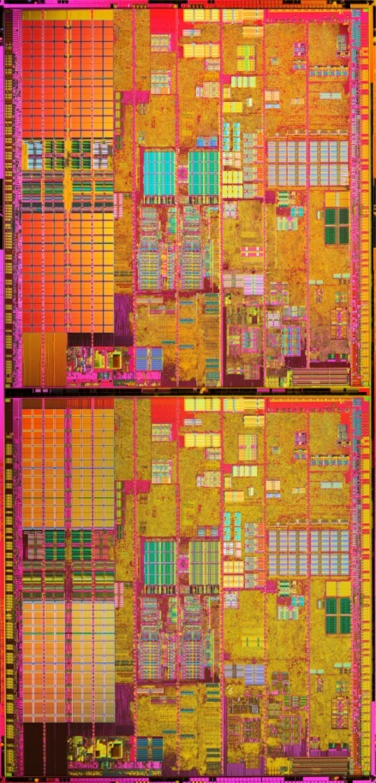
Hardware Trends (2) Multicore
DRAM prices dropping
2Gb, Dual Channel PC 6400 DDR2 800 MHz $85
Multicore CPUs
Quad-core Intel Core 2 Quad, AMD Quad-core Opteron
Eight core Intel by 2008?
Challenge: How should we use all this hardware?

Slide 39
DieHard: Probabilistic Memory Safety
Collaboration with Emery Berger
Plug-compatible replacement for malloc/free in C lib
We define “infinite heap semantics”
Programs execute as if each object allocated with unbounded memory
All frees ignored
Approximating infinite heaps – 3 key ideas
Overprovisioning
Randomization
Replication
Allows analytic reasoning about safety

Slide 40
Overprovisioning, Randomization
Expand size requests by a factor of M (e.g., M=2)
1
2
3
4
5
Pr(write corrupts) = ½ ?
1
2
3
4
5
Randomize object placement
4
2
3
1
5
Pr(write corrupts) = ½ !

Slide 41
Replication (optional)
Replicate process with different randomization seeds
P1
1
3
2
5
4
P2
input
4
3
1
5
2
P3
5
2
1
4
3
Broadcast input to all replicas
Voter
Compare outputs of replicas, kill when replica disagrees

Slide 42
DieHard Implementation Details
Multiply allocated memory by factor of M
Allocation
Segregate objects by size (log2), bitmap allocator
Within size class, place objects randomly in address space
Randomly re-probe if conflicts (expansion limits probing)
Separate metadata from user data
Fill objects with random values – for detecting uninit reads
Deallocation
Expansion factor => frees deferred
Extra checks for illegal free

Slide 43
DieHard Caveats
Primary focus is on protecting heap
Techniques applicable to stack data, but requires recompilation and format changes
Trades space, processors for memory safety
Not applicable to applications with large footprint
Applicability to server apps likely to increase
In replicated mode, DieHard requires determinism
Replicas see same input, shared state, etc.
DieHard is a brute force approach
Improvements possible (efficiency, safety, coverage, etc.)

Slide 44
Over-provisioned, Randomized Heap
Segregated size classes
- Static strategy pre-allocates size classes - Adaptive strategy grows each size class incrementally
L = max live size ≤ H/2
F = free = H-L
2
4
5
3
1
6
…
object size = 8
object size = 16
H = max heap size, class i

Slide 45
Randomness enables Analytic Reasoning Example: Buffer Overflows
k = # of replicas, Obj = size of overflow
With no replication, Obj = 1, heap no more than 1/8 full: Pr(Mask buffer overflow), = 87.5%
3 replicas: Pr(ibid) = 99.8%

Slide 46
DieHard CPU Performance (no replication)

Slide 47
DieHard CPU Performance (Linux)

Slide 48
Correctness Results
Tolerates high rate of synthetically injected errors in SPEC programs
Detected two previously unreported benign bugs (197.parser and espresso)
Successfully hides buffer overflow error in Squid web cache server (v 2.3s5)
But don’t take my word for it…

Slide 49
Deploying Exterminator
Exterminator can be deployed in different modes
Iterative – suitable for test environment
Different random heaps, identical inputs
Complements automatic methods that cause crashes
Replicated mode
Suitable in a multi/many core environment
Like DieHard replication, except auto-corrects, hot patches
Cumulative mode – partial or complete deployment
Aggregates results across different inputs
Enables automatic root cause analysis from Watson dumps
Suitable for wide deployment, perfect for beta release
Likely to catch many bugs not seen in testing lab

Slide 50
Experiments / Benchmarks
vpr: Does place and route on FPGAs from netlist
Made routing-resource graph critical
crafty: Plays a game of chess with the user
Made cache of previously-seen board positions critical
gzip: Compress/Decompresses a file
Made Huffman decoding table critical
parser: Checks syntactic correctness of English sentences based on a dictionary
Made the dictionary data structures critical
rayshade: Renders a scene file
Made the list of objects to be rendered critical

Slide 51
Detecting Dangling Pointers (2 cases)
Dangling pointer read/written (easy)
Invariant = canary in freed object X has same corruption in all runs
Dangling pointer only read (harder)
Sketch of approach (paper explains details)
Only fill freed object X with canary with probability P
Requires multiple trials: ≈ log₂(number of callsites)
Look for correlations, i.e., X filled with canary => crash
Establish conditional probabilities
Have: P(callsite X filled with canary | program crashes)
Need: P(crash | filled with canary), guess “prior” to compute

Slide 52
Third-party Libraries/Untrusted Code
Library code does not need to be critical memory aware
If library does not update critical data, no changes required
If library needs to modify critical data
Allow normal stores to critical memory in library
Explicitly “promote” on return
Copy-in, copy-out semantics
critical int balance = 100; … library_foo(&balance);
promote balance;
… __________________
// arg is not critical int *
void library_foo(int *arg)
{ *arg = 10000; return; }

Slide 53
Related Work
Conservative GC (Boehm / Demers / Weiser)
Time-space tradeoff (typically >3X)
Provably avoids certain errors
Safe-C compilers
Jones & Kelley, Necula, Lam, Rinard, Adve, …
Often built on BDW GC
Up to 10X performance hit
N-version programming
Replicas truly statistically independent
Address space randomization (as in Vista)
Failure-oblivious computing [Rinard]
Hope that program will continue after memory error with no untoward effects

Slide 54
Samurai Experimental Results
Implementation
Automated Phoenix pass to instrument loads and stores
Runtime library for critical data allocation/de-allocation (C++)
Protected critical data in 5 applications (mostly SPEC)
Chose data that is crucial for end-to-end correctness of program
Evaluation of performance overhead by instrumentation
Fault-injections into critical and non-critical data (for propagation)
Protected critical data in libraries
STL List Class: Backbone of list structure (link pointers)
Memory allocator: Heap meta-data (object size + free list)

Slide 55
Samurai: Heap-based Critical Memory
Software critical memory for heap objects
Critical objects allocated with crit_malloc, crit_free
Approach
Replication – base copy + 2 shadow copies
Redundant metadata
Stored with base copy, copy in hash table
Checksum, size data for overflow detection
Robust allocator as foundation
DieHard, unreplicated
Randomizes locations of shadow copies

Slide 56
Samurai: STL Class + WebServer
STL List Class
Modified memory allocator for class
Modified member functions insert, erase
Modified custom iterators for list objects
Added a new call-back function for direct modifications to list data
Webserver
Used STL list class for maintaining client connection information
Made list critical – one thread/connection
Evaluated across multiple threads and connections
Max performance overhead = 9%

