Slide 1
Language Agnostic Specification and Verification for .NET
Manuel Fähndrich
UW RiSE Seminar
10/27/2009

Slide 2
Quick Group Overview
MSR -> RiSE -> Programming Languages and Analysis
Controlling Side-Effects (Daan Leijen)
Abstract Interpretation (Francesco Logozzo)
Typed Assembly Language (Juan Chen)
Trace Compilation and Jscript (Herman Venter)
Data Parallel Optimizations (Songtao Xia)

Slide 3
A very brief history of CodeContracts
Formal Verification
Extended Static Checking
ESC/M3
ESC/Java
Spec#
Boogie
JML
CodeContracts

Slide 4
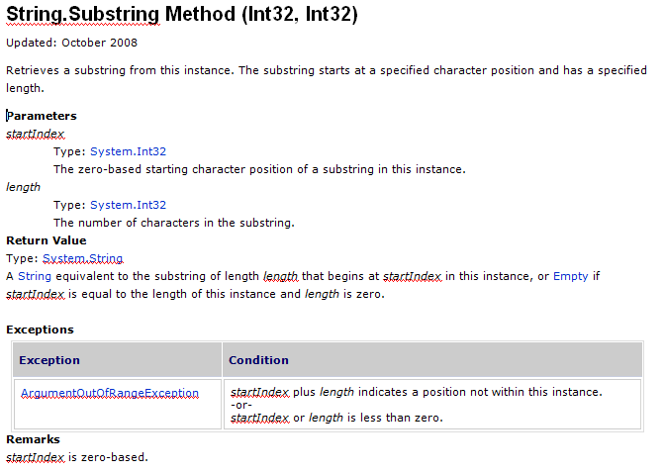
What are Contracts ?
Notes:
Most of you have probably used MSDN documentation about APIs you are programming against. Some of you may have implemented these APIs. When I go to MSDN, I’m usually looking for documentation on how to use a method. In other words, I’m looking for the contract of the method. The contract should tell me the requirements on my part, the caller, about what values to pass or not to pass. Similarly, the contract should tell me what the method guarantees to me the caller. E.g., returning non-null, etc. Let’s look at an example.

Slide 5
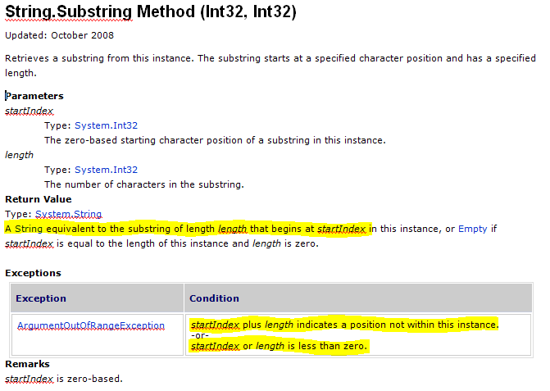
Where are the Contracts ?

Slide 6
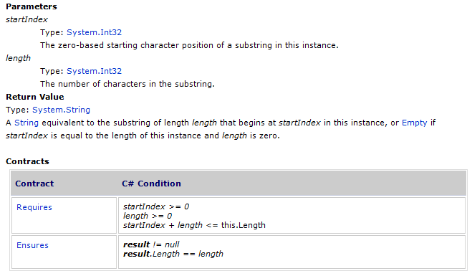
API Documentation with Contracts

Slide 7
Why Write Specifications ?
Contracts document design decisions
Preconditions, postconditions, and object invariants
Facilitate code reuse and evolution
Contracts are executable
Checked documentation
Amplify testing through oracles, including test exploration (Pex)
Contracts help static verification
Early error detection
Clarify responsibility at interfaces
Assertions help, but
Not seen as a contract between 2 parties
Every team has their own
Difficult to tool against
Notes:
Important API and internal code properties are not documented or checked, making coding difficult and maintenance worse.
Same contract thus serves as documentation, acts as runtime checking, and as specification for static checking.

Slide 8
The CodeContracts Project
Language-Agnostic Contracts for .NET
Specifying Contracts in Code
preconditions, postconditions, object invariants
Runtime Checking
Static Checking
API Doc
Generation

Slide 9
Embedded Contract Language Idea
Specification approaches
Eiffel, Spec#: non-mainstream languages
JML: specifications in comments
Many research languages or extensions with
Specifications or type systems
Alternative
Embedding in an existing language CodeContracts

Slide 10
Specifying Contracts (C#)
public virtual int Add(object value) { Contract.Requires( value != null ); Contract.Ensures( Count == Contract.OldValue(Count) + 1 ); Contract.Ensures( Contract.Result<int>() == Contract.OldValue(Count) ); if (count == items.Length) EnsureCapacity(count + 1); items[count] = value; return count++; }
Features
Language expression syntax
Type checking / IDE
Declarative
Special Encodings
Result and Old
[ContractInvariantMethod] void ObjectInvariant() { Contract.Invariant( items != null ); }
Notes:
Make a simpler example (too many contracts, explain old better)
Talk about static methods!!!
Questions: what happens at runtime, how can I choose what’s in my build, what’s the methodology (can I rely on the checks?)
Quantifiers?

Slide 11
Specifying Contracts (in VisualBasic)
Function Add( ByVal value As Object ) As Integer
Contract.Requires(value IsNot Nothing)
Contract.Ensures(Count = Contract.OldValue(Count) + 1)
Contract.Ensures(Contract.Result(Of Integer)() = Contract.OldValue(Count))
If _items.Length = _count Then
EnsureCapacity(_count + 1)
End If
_items(_count) = value
Dim oldCount = _count
_count = _count + 1
Return oldCount
End Function

Slide 12
Static Methods as Contract Markers
namespace System.Diagnostics.Contracts {
public static class Contract {
public static void Requires(bool condition) { … }
public static void Ensures(bool condition) { … }
public static void Invariant(bool condition) { … }
public static T Result<T>() { … }
public static T OldValue<T>(T value) { … }
...
} }
Library reusable from C#, VisualBasic, F#, …

Slide 13
Contracts == Metadata + IL
Contracts are written in development language
Standard IDE
Standard compilers translate contracts to IL
csc, vbc, …
Downstream tools extract contracts from IL
ccrewrite
ccrefgen
cccheck
ccdocgen

Slide 14
Demo

Slide 15
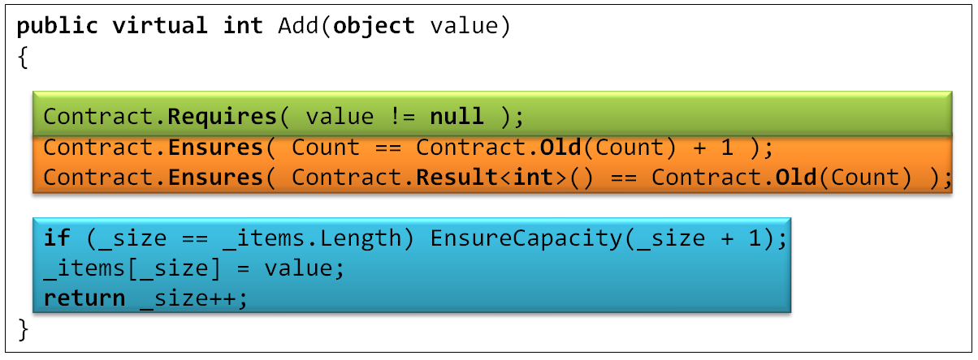
Compilation and Runtime Checking
Executable runtime
Contract checking
Compile
/d:CONTRACTS_FULL
.method public hidebysig newslot virtual instance int32 Add(object 'value') cil managed
{
.locals init (int32 'Contract.Old(Count)',
int32 'Contract.Result<int>()')
ldarg.1
ldnull
ceq
ldc.i4.0
ceq
ldstr "value != null"
call void __RewriterMethods::RewriterRequires$PST06000009(bool, string)ldarg.0
ldarg.0
call instance int32 TabDemo.BaseList::get_Count()
stloc.3
ldarg.0
ldfld int32 TabDemo.BaseList::count
ldarg.0
ldfld object[] TabDemo.BaseList::items
ldlen
conv.i4
ceq
ldc.i4.0
ceq
stloc.1
ldloc.1
brtrue IL_004d
nop
ldarg.0
ldarg.0
ldfld int32 TabDemo.BaseList::count
ldc.i4.1
add
call instance void TabDemo.BaseList::EnsureCapacity(int32)
nop
nop
ldarg.0
ldfld object[] TabDemo.BaseList::items
ldarg.0
ldfld int32 TabDemo.BaseList::count
ldarg.1
stelem.ref
ldarg.0
dup
ldfld int32 TabDemo.BaseList::count
dup
stloc.2
ldc.i4.1
add
stfld int32 TabDemo.BaseList::count
ldloc.2
stloc.0
br IL_0072
ldloc.0
stloc.s 'Contract.Result<int>()'
br IL_007a
ldarg.0
call instance int32 TabDemo.BaseList::get_Count()
ldloc.3
ldc.i4.1
add
ceq
ldstr "Count == Contract.Old(Count) + 1"
call void __RewriterMethods::RewriterEnsures$PST0600000B(bool, string)
ldloc.s 'Contract.Result<int>()'
ldloc.s V_4
ceq
ldstr "Contract.Result<int>() == Contract.Old(Count)"
call void __RewriterMethods::RewriterEnsures$PST0600000B(bool, string)
ldloc.s 'Contract.Result<int>()'
ret
}
Release Compile
.method public hidebysig newslot virtual instance int32 Add(object 'value') cil managed
{
ldarg.1
ldnull
ceq
ldc.i4.0
ceq
call void [Microsoft.Contracts]Microsoft.Contracts.Contract::Requires(bool)
ldarg.0
call instance int32 TabDemo.BaseList::get_Count()
ldarg.0
call instance int32 TabDemo.BaseList::get_Count()
call !!0 [Microsoft.Contracts]Microsoft.Contracts.Contract::Old<int32>(!!0)
ldc.i4.1
add
ceq
call void [Microsoft.Contracts]Microsoft.Contracts.Contract::Ensures(bool)
call !!0 [Microsoft.Contracts]Microsoft.Contracts.Contract::Result<int32>()
ldarg.0
call instance int32 TabDemo.BaseList::get_Count()
call !!0 [Microsoft.Contracts]Microsoft.Contracts.Contract::Old<int32>(!!0)
ceq
call void [Microsoft.Contracts]Microsoft.Contracts.Contract::Ensures(bool)
ldarg.0
ldfld int32 TabDemo.BaseList::count
ldarg.0
ldfld object[] TabDemo.BaseList::items
ldlen
conv.i4
ceq
ldc.i4.0
ceq
stloc.1
ldloc.1
brtrue.s IL_0069
ldarg.0
ldarg.0
ldfld int32 TabDemo.BaseList::count
ldc.i4.1
add
call instance void TabDemo.BaseList::EnsureCapacity(int32)
ldarg.0
ldfld object[] TabDemo.BaseList::items
ldarg.0
ldfld int32 TabDemo.BaseList::count
ldarg.1
stelem.ref
ldarg.0
dup
ldfld int32 TabDemo.BaseList::count
dup
stloc.2
ldc.i4.1
add
stfld int32 TabDemo.BaseList::count
ldloc.2
stloc.0
br.s IL_008b
ldloc.0
ret
} // end of method BaseList::Add
Rewrite IL
.method public hidebysig newslot virtual instance int32 Add(object 'value') cil managed
{
ldarg.0
ldfld int32 TabDemo.BaseList::count
ldarg.0
ldfld object[] TabDemo.BaseList::items
ldlen
conv.i4
ceq
ldc.i4.0
ceq
stloc.1
ldloc.1
brtrue.s IL_0029
ldarg.0
ldarg.0
ldfld int32 TabDemo.BaseList::count
ldc.i4.1
add
call instance void TabDemo.BaseList::EnsureCapacity(int32)
ldarg.0
ldfld object[] TabDemo.BaseList::items
ldarg.0
ldfld int32 TabDemo.BaseList::count
ldarg.1
stelem.ref
ldarg.0
dup
ldfld int32 TabDemo.BaseList::count
dup
stloc.2
ldc.i4.1
add
stfld int32 TabDemo.BaseList::count
ldloc.2
stloc.0
br.s IL_004b
ldloc.0
ret
}
Inheritance
WF checks
Invariants
Source strings

Slide 16
Contract Reference Assemblies
Language-agnostic, persisted contract format
Free produced by all compilers
MSIL encodes conditions
Fixed interpretation
Uniform format to down-stream tools
Library for extracting contracts from MSIL
Compile
/d:CONTRACTS_FULL
Contract Reference Assembly
.method public hidebysig newslot virtual instance int32 Add(object 'value') cil managed
{
ldarg.1
ldnull
ceq
ldc.i4.0
ceq
call void [Microsoft.Contracts]Microsoft.Contracts.Contract::Requires(bool)
ldarg.0
call instance int32 TabDemo.BaseList::get_Count()
ldarg.0
call instance int32 TabDemo.BaseList::get_Count()
call !!0 [Microsoft.Contracts]Microsoft.Contracts.Contract::Old<int32>(!!0)
ldc.i4.1
add
ceq
call void [Microsoft.Contracts]Microsoft.Contracts.Contract::Ensures(bool)
call !!0 [Microsoft.Contracts]Microsoft.Contracts.Contract::Result<int32>()
ldarg.0
call instance int32 TabDemo.BaseList::get_Count()
call !!0 [Microsoft.Contracts]Microsoft.Contracts.Contract::Old<int32>(!!0)
ceq
call void [Microsoft.Contracts]Microsoft.Contracts.Contract::Ensures(bool)
ldarg.0
ldfld int32 TabDemo.BaseList::count
ldarg.0
ldfld object[] TabDemo.BaseList::items
ldlen
conv.i4
ceq
ldc.i4.0
ceq
stloc.1
ldloc.1
brtrue.s IL_0069
ldarg.0
ldarg.0
ldfld int32 TabDemo.BaseList::count
ldc.i4.1
add
call instance void TabDemo.BaseList::EnsureCapacity(int32)
ldarg.0
ldfld object[] TabDemo.BaseList::items
ldarg.0
ldfld int32 TabDemo.BaseList::count
ldarg.1
stelem.ref
ldarg.0
dup
ldfld int32 TabDemo.BaseList::count
dup
stloc.2
ldc.i4.1
add
stfld int32 TabDemo.BaseList::count
ldloc.2
stloc.0
br.s IL_008b
ldloc.0
ret
} // end of method BaseList::Add
.method public hidebysig newslot virtual instance int32 Add(object 'value') cil managed
{
ldarg.1
ldnull
ceq
ldc.i4.0
ceq
call void [Microsoft.Contracts]Microsoft.Contracts.Contract::Requires(bool)
ldarg.0
call instance int32 TabDemo.BaseList::get_Count()
ldarg.0
call instance int32 TabDemo.BaseList::get_Count()
call !!0 [Microsoft.Contracts]Microsoft.Contracts.Contract::Old<int32>(!!0)
ldc.i4.1
add
ceq
call void [Microsoft.Contracts]Microsoft.Contracts.Contract::Ensures(bool)
call !!0 [Microsoft.Contracts]Microsoft.Contracts.Contract::Result<int32>()
ldarg.0
call instance int32 TabDemo.BaseList::get_Count()
call !!0 [Microsoft.Contracts]Microsoft.Contracts.Contract::Old<int32>(!!0)
ceq
call void [Microsoft.Contracts]Microsoft.Contracts.Contract::Ensures(bool)
} // end of method BaseList::Add
ccrefgen

Slide 17
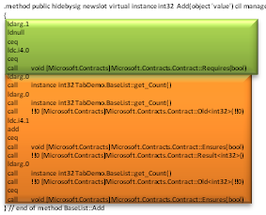
Modularity
Contract Reference Assemblies
csc
.method public hidebysig newslot virtual instance int32 Add(object 'value') cil managed
{
ldarg.1
ldnull
ceq
ldc.i4.0
ceq
call void [Microsoft.Contracts]Microsoft.Contracts.Contract::Requires(bool)
ldarg.0
call instance int32 TabDemo.BaseList::get_Count()
ldarg.0
call instance int32 TabDemo.BaseList::get_Count()
call !!0 [Microsoft.Contracts]Microsoft.Contracts.Contract::Old<int32>(!!0)
ldc.i4.1
add
ceq
call void [Microsoft.Contracts]Microsoft.Contracts.Contract::Ensures(bool)
call !!0 [Microsoft.Contracts]Microsoft.Contracts.Contract::Result<int32>()
ldarg.0
call instance int32 TabDemo.BaseList::get_Count()
call !!0 [Microsoft.Contracts]Microsoft.Contracts.Contract::Old<int32>(!!0)
ceq
call void [Microsoft.Contracts]Microsoft.Contracts.Contract::Ensures(bool)
ldarg.0
ldfld int32 TabDemo.BaseList::count
ldarg.0
ldfld object[] TabDemo.BaseList::items
ldlen
conv.i4
ceq
ldc.i4.0
ceq
stloc.1
ldloc.1
brtrue.s IL_0069
ldarg.0
ldarg.0
ldfld int32 TabDemo.BaseList::count
ldc.i4.1
add
call instance void TabDemo.BaseList::EnsureCapacity(int32)
ldarg.0
ldfld object[] TabDemo.BaseList::items
ldarg.0
ldfld int32 TabDemo.BaseList::count
ldarg.1
stelem.ref
ldarg.0
dup
ldfld int32 TabDemo.BaseList::count
dup
stloc.2
ldc.i4.1
add
stfld int32 TabDemo.BaseList::count
ldloc.2
stloc.0
br.s IL_008b
ldloc.0
ret
} // end of method BaseList::Add
ccrewrite
Runtime checks
cccheck
Compile-time warnings

Slide 18
Research Challenges
Decompilation + Instrumentation
Closures
Iterators
Presence of generics
Analysis of a full OO imperative-language
At MSIL level
Performance

Slide 19
Static Checker Design Decisions
Abstract interpretation (rather than WP theorem proving)
More automation (loop invariants, post-conditions)
More control over precision/speed tradeoff
Research in Abstract Domains
Sub-polyhedra
Array partitions (with P. Cousot)

Slide 20
CCCheck Architecture
Requires and Ensures Inference
Abstract Interpreters
Backward
analysis
Proof-obligations
Non-null
Contracts
Non-null
Arrays
Pointers
Arrays
Pointers
Abstract Domains
Strings
Numerical
Symbolic
Fix-point Engine
String
Expression refinement
Used in conditionals and some transfer functions
Expression IL (expression recovery)
Similar to SSA form
Suitable for Abstract Interpretation
Old eliminated
Scalar program (heap eliminated)
Temp IL (stack eliminated)
requires/ensures/invariant are subroutines
spliced in where needed
Subroutines (method, finally, contracts)
MSIL+ (assert, assume, old, ldstack, …)
Turns calls into primitives
Contract Extractor + CFG Builder
.NET Assembly Reader

Slide 21
Pros and Cons of IL Verification
Pros
Relatively small language of instructions
Well-specified semantics
Type/name/overloading resolution done by compiler
Targeted by multiple languages (C#,VB,F#,…)
Cons
Some expression recovery needed
or abstract domains get too complicated (CC’08)
Source context not precise enough (from pdb’s)
Abstractions are lost / some need to be recovered
Closures, Iterators, etc…

Slide 22
Abstract Interpretation (on 1 slide)
Abstract states
Abstract step
x++
x < y
x <= y
Abstraction
Concretization
Soundness
Concrete states
x = 1
y = 10
Concrete step
x = 2
y = 10
x = 0
y = 1
x = 1
y = 1
x++
x = 100
y = 200
x = 101
y = 200
…
…

Slide 23
Scalar Programs
Control-flow graphs
Composed of tree fragments
Passive form (SSA) assumptions
sv2 == sv0 + sv1
Assignments at tree boundaries (renaming)
Suitable for
Abstract Interpretation
Weakest Preconditions

Slide 24
MSIL+
Analyzed code is MSIL+
Stack machine
All requires/ensures/invariant calls turn into
assume
assert
Extra synthetic instructions
begin_old
end_old
ldstack.i
ldresult
scall subroutine

Slide 25
Contract subroutines
int Increment(int i) {
Contract.Requires(i > 0);
Contract.Ensures(Contract.Result<int>() == i+1);
return i+1;
}
Subroutine : Increment.requires
ldarg.1 // i
ldc 0
cgt
assume
Subroutine : Increment.ensures
ldresult
begin_old
ldarg.1 // i
end_old
ldc 1
add
ceq
assert

Slide 26
Subroutines and Inheritance
B.Inc.Req
B.Inv
B.Inc
B.Inc.Ens
D.Inv
D.Inc
D.Inc.Ens

Slide 27
Contract Subroutines at Call Sites
B.Inc.Req
B.Inv
B.Inc.Ens
call D.Inc
D.Inv
D.Inc.Ens

Slide 28
Dealing with Disjunctions
M(int y) {
Contract.Ensures( y < 0 && result <= 0 ||
y >= 0 && result >= 0);
int x = 0;
int oldy = y;
while (y != 0) {
Contract.Assert( oldy < 0 && x <= 0 ||
oldy > 0 && x >= 0 );
if (y < 0) { if (*) x--; y++; }
else { if (*) x++; y--; }
}
return x;
}

Slide 29
Dealing with Disjunctions (2)
No disjunctions in abstract invariants
Prove assertions via (weakest) precondition backward path
assert y0 < 0 ⇒ x0 <= 0 √
assert y0 < 0 ⇒ x4 <= 0
assert x4 <= 0
assert b0

Slide 30
Dealing with Disjunctions (2)
No disjunctions in abstract invariants
Prove assertions via weakest precondition backward path
assert y0 < 0 /\ x4 <= 0 ⇒ x4 - 1 <= 0 √
assert y0 < 0 ⇒ x5 - 1 <= 0
assert y0 < 0 ⇒ x3 <= 0
assert y0 < 0 ⇒ x4 <= 0
assert x4 <= 0
assert b0

Slide 31
Contract Format: Future Proof
Contracts as MSIL
Provides extension point
bool ProtectedBy<T>(ref T data, object lock);
No lock-in to particular tools
Language integration
C#, VB may provide syntax in the future, emit same format
CCrewrite
FxCop
CCCheck
Boogie
Coq, Isabelle
Prove Correct
Find Bugs

Slide 32
Ongoing and Future Work
Static checking
Iterators
Quantifiers
Z3 integration
Cross-assembly contract inference
Runtime checking
Robustness
Concurrency

Slide 33
Summary and Conclusions
Embedded Contract Languages are great
No a-priori restrictions what can be expressed
Compiled contract format is Metadata + MSIL
Uniform format for tools
Same contracts used for
Runtime checking
Static checking
Documentation generation
IL Analysis pros outweight the cons

Slide 34
Questions ?
More information
http://research.microsoft.com/contracts
http://msdn.microsoft.com/devlabs/dd491992.aspx
Email
mailto:maf@microsoft.com
mailto:mbarnett@microsoft.com
mailto:logozzo@microsoft.com

Slide 35
Backups

Slide 36
Specifications where no Code allowed
[ ContractClass( typeof( CloneableContract )) ]
public interface ICloneable { object Clone(); }
public class CloneableContract : ICloneable { object ICloneable.Clone() { Contract.Ensures(Contract.Result<object>() != null); Contract.Ensures(Contract.Result<object>().GetType() == this.GetType()); return default(object); } }

