Slide 1
The Social Programmer
Robert DeLine
Microsoft Research
University of Washington, 6 Oct 2009

Slide 2
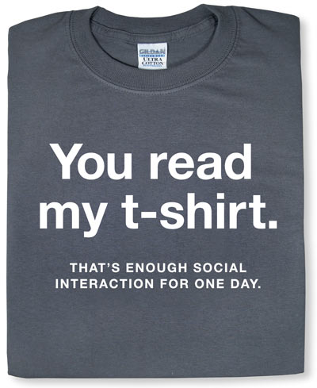
thinkgeek.com

Slide 3
People and their Roles
test
spec
pm
customers
dev

Slide 4
People and their Roles
test
spec
pm
customers
dev

Slide 5
People and their Roles
test
spec
pm
dev

Slide 6
People and their Roles
test
spec
pm
dev

Slide 7
People and their Roles

Slide 8
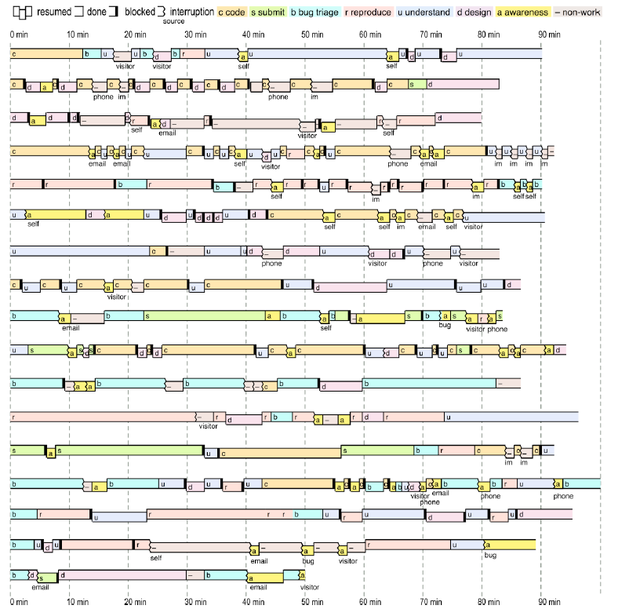
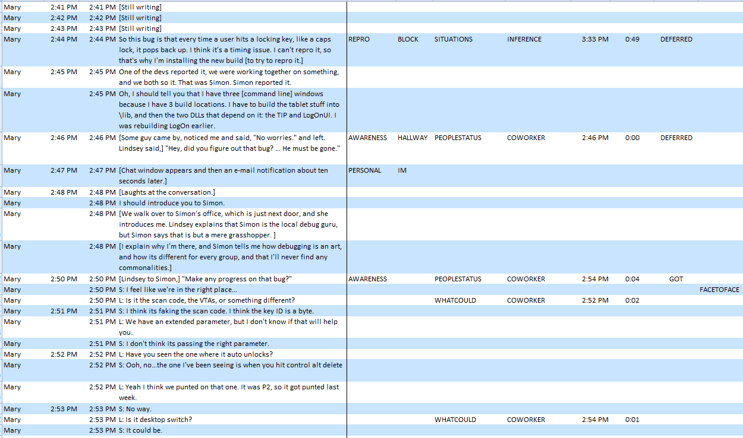
code
submit
bug triage
bug repro
understanding
design
awareness
non-work (—)
Ko, DeLine, and Venolia, ICSE 2007

Slide 9
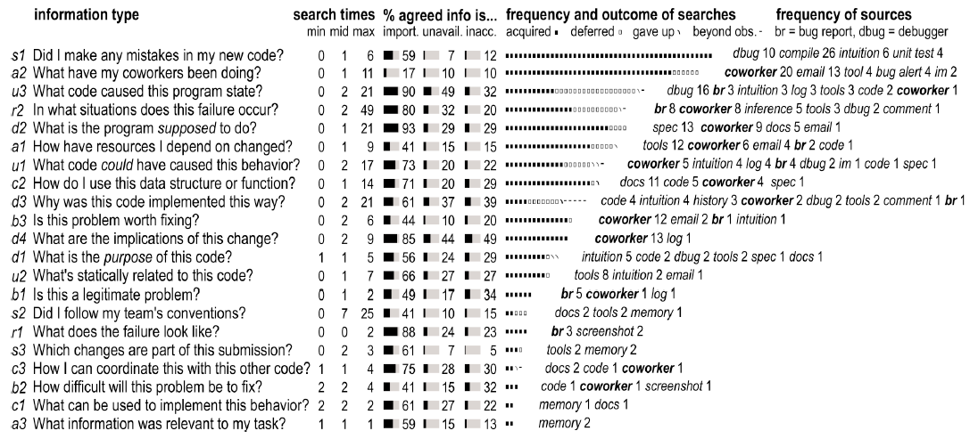
Developer Information Needs

Slide 10
Developers are thread schedulers!
void BeDeveloper()
{
while ( ! quittingTime) {
try {
var task = readyTasks.PickOne();
while ( ! (task.IsDone || task.IsBlocked)) { task.MakeProgress(); }
if (task.IsBlocked) {
readyTasks.Remove(task);
blockedTasks.Add(task);
}
}
catch (Interruption interruption) {
var info = interruption.FreshInformation;
if (info != null) {
foreach (var task in blockedTasks) {
if (task.BlockedOnInformationNeed(info)) {
blockedTasks.Remove(task);
readyTasks.Add(task);
}
}
}
}
}
}

Slide 11
Making the most of existing data
Share Point
Product Studio
Source Depot
Email
etc.
Links from
Source schema
Structured documents
Plain-text allusions
Computed relationships
Logging user behavior
etc.
Graph gives basis for
Link-analysis scoring
Diary of an artifact
Recommendations
etc.
From: Joe Coder
To: Project XYZ Dev Team
Subject: Re: account bug
I managed to repro bug #3242 on my machine last night. I think it might have to do with the Account.Add method that got changed in the last push. I’ll take a look.
The Bridge
Venolia, MSR 06

Slide 12
Social networking for development teams
Facebook
Codebook
Begel and DeLine, MSR 06

Slide 13
Engineers need help finding people
Survey to rate difficulty of coordination tasks
110 respondents out of 1000 engineers (PMs, SDEs, SDETs)
31 tasks in 8 categories, from prior interviews
In our survey to Microsoft engineers:
83% want a better tool to find engineers responsible for a feature.
67% want a better tool to find knowledgeable experts about features.
64% want a better tool to find relevant code, specs, bugs, etc., belonging to another team.
(Begel, Phang, and Zimmerman, in submission to ICSE 10)
Notes:
Interacting with people are very important aspects of software enginnering that is currently not well supported by tools.

Slide 14
Scenario: Bug in an external library
Xin found a bug in his code, probably caused by an external library that was just updated.
He looked on Bing but didn’t find anything.
Of course not, it’s not released yet!
Is he using this library correctly?
Can he find someone to look at his code and tell him what’s wrong?
Has someone already filed a bug against this?
He thinks this a bug in their design, who owns the specs?

Slide 15
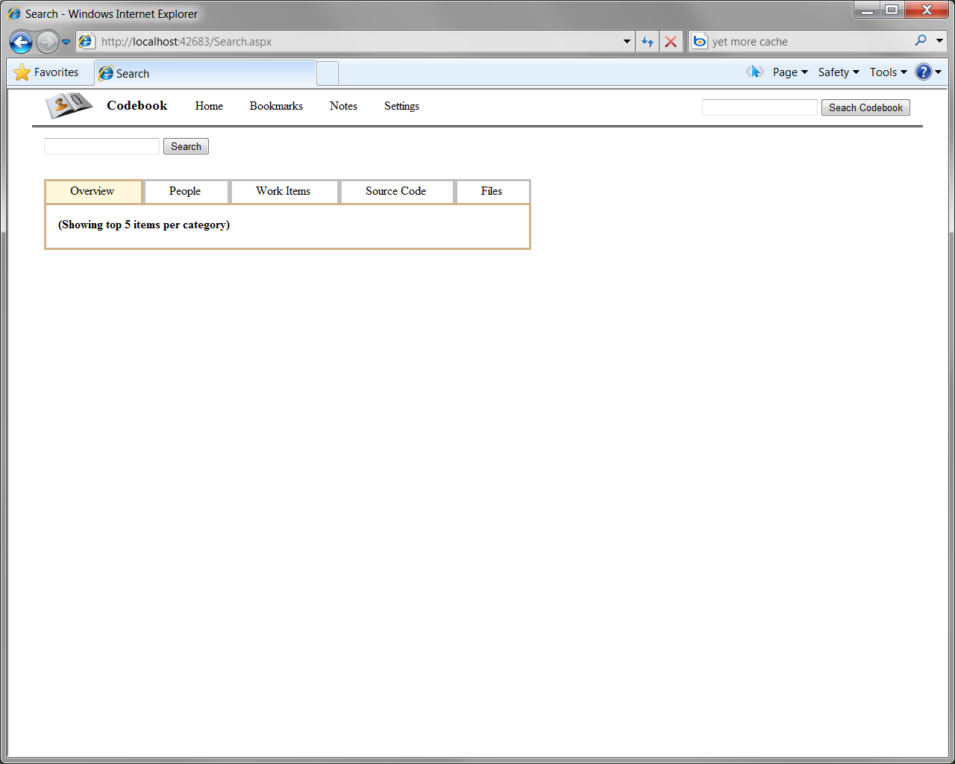
With Codebook
Go to Codebook Portal …

Slide 16
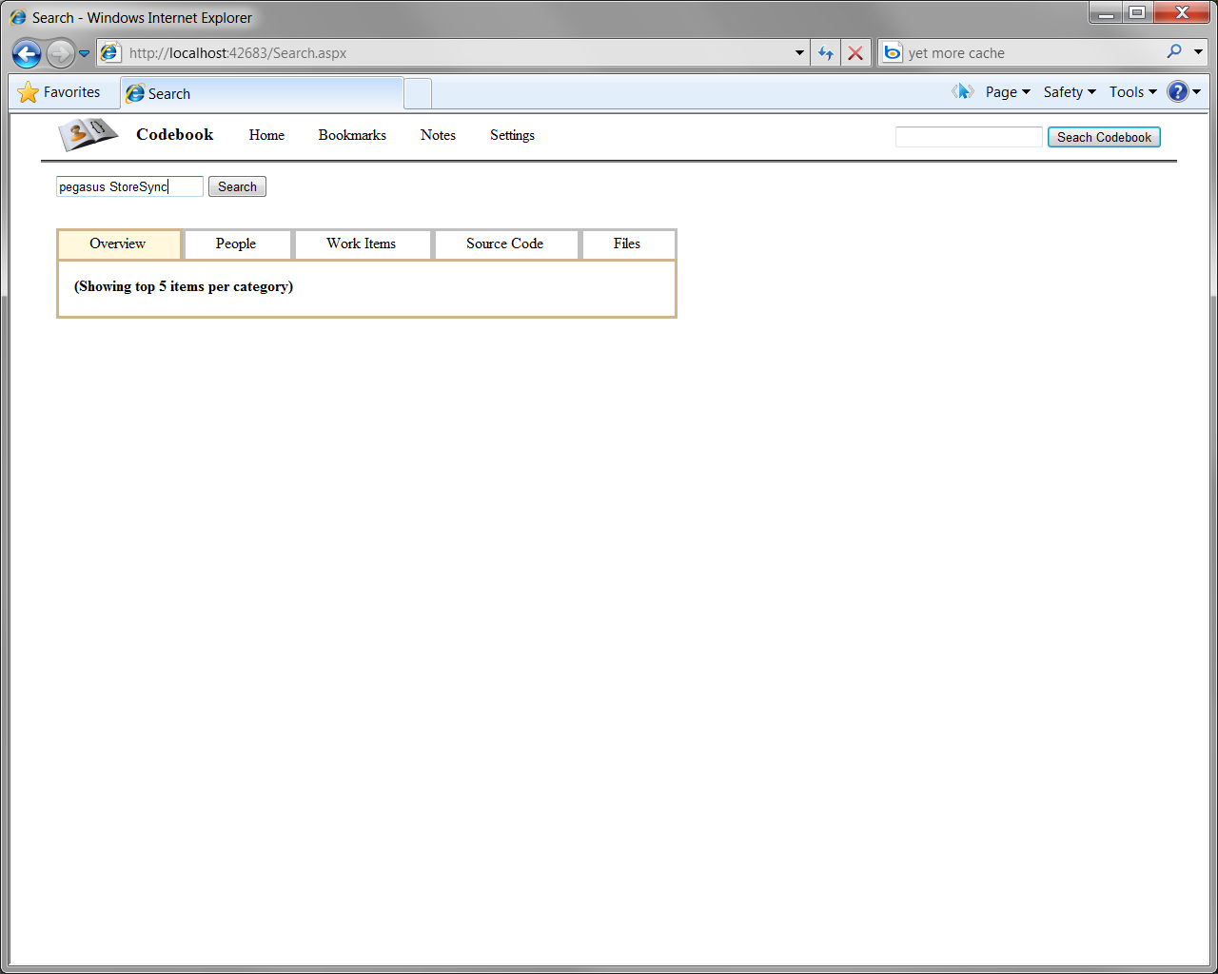
The problem is in the StoreSync() method in the Pegasus project, so Xin enters “pegasus StoreSync”

Slide 17
Xin gets all people, work items, code, and files which are related to “pegasus StoreSync”.
(Names and photos have been anonymized)

Slide 18
Aha! This is the method, and that’s the SDE who wrote it.

Slide 19
Perhaps this SDE can look at his code.

Slide 20
Savant is the SDE, and his contact info is listed.

Slide 21
Savant is also highlighted in other results

Slide 22
There doesn’t seem to be specs or bugs, but Savant works with this crew.

Slide 23
Xin can contact the PM to get the spec or file a bug

Slide 24
Now that he has found the SDE and the PM, he can fix his code!

Slide 25
Challenge: Most frustrating needs
What code caused this program state? 61% unsatisfied, max 21 min
Why was the code implemented this way? 44%, 21 min
In what situations does this failure occur? 41%, 49 min
What code could have caused this behavior? 36%, 17 min
How have the resources I depend on changed? 24%, 9 min
What is the program supposed to do? 15%, 21 min
What have my coworkers been doing? 14%, 11 min

Slide 26
Potential future tools
What code caused this program state? 61% unsatisfied, max 21 min
Why was the code implemented this way? 44%, 21 min
In what situations does this failure occur? 41%, 49 min
What code could have caused this behavior? 36%, 17 min
How have the resources I depend on changed? 24%, 9 min
What is the program supposed to do? 15%, 21 min
What have my coworkers been doing? 14%, 11 min
program analysis
awareness tools
model-base eng.
research.microsoft.com/hip

