Slide 1
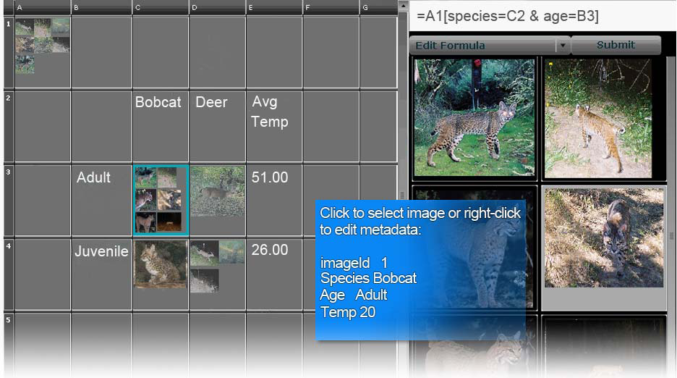
PhotoSpread: A Spreadsheet for Managing Photos
Sean Kandel, Eric Abelson, Hector Garcia-Molina, Andreas Paepcke, Martin Theobald
Stanford University
CSE 590H - January 22, 2008
Presented by Scott Saponas & Yaw Anokwa

Slide 2
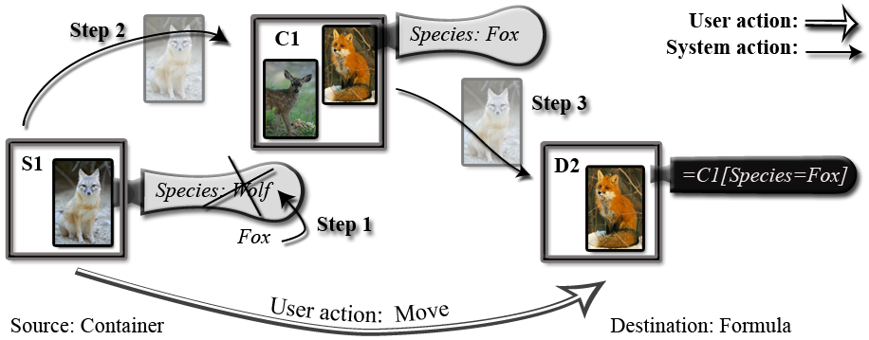
Spreadsheet to Organize & Analyze
Drag & drop photos for grouping
Tag photos with metadata
Create formulas based on metadata and groups

Slide 3
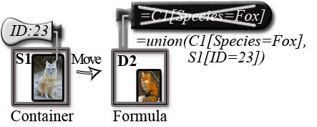
Spreadsheet to Organize & Analyze
Modify/add metadata by dragging photos into groups
or
Modify formula by dragging photos into groups

Slide 4
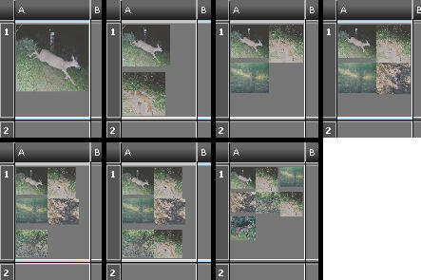
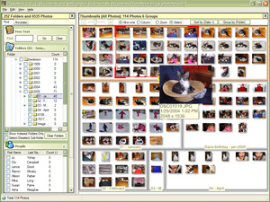
Compared System with Other Apps
No other single system fulfilled the needs of their field biologists
Combines power of spreadsheets with photo tagging systems
Could picasa & google spreadsheets be combined to create online collaborative system?
How could PhotoSpread be integrated with EyePatch?

Slide 5
Advocate
Photo-analytics tool for biologists
Leverages spreadsheet skills
Faster than previous solution
May change the exploration possible with field photos

Slide 6
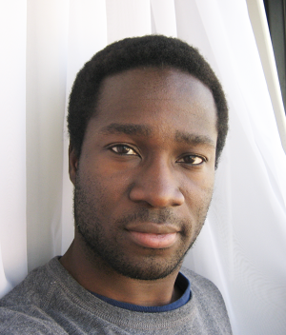
Critic
UI could be simpler but more powerful
For filtering, use “smart playlists” like iTunes
Is there easier way to tag? Maybe tabletop GUI?
Are parts of this application faster/slower than existing practice?
Does doing a comparative study actually matter?
If no, what more evaluation would you like to see?

Slide 7
Small Groups

