Slide 1
Morphometric Analysis of Biomedical Images
Sara Rolfe
10/9/17

Slide 2
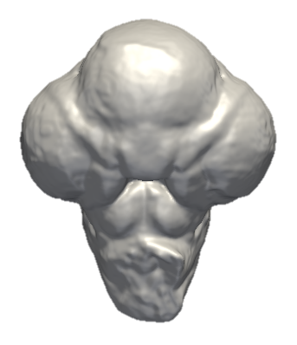
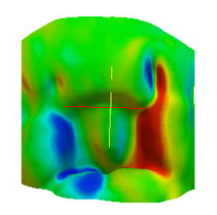
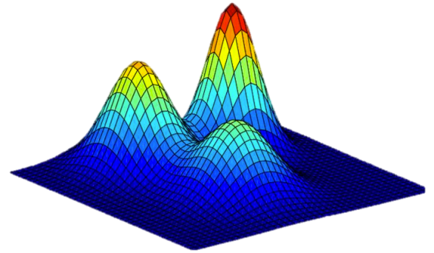
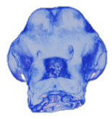
Morphometric Analysis of Biomedical Images
Object surface contours
Framework to quantify, compare, and visualize image differences
Validation
on multiple datasets
Compact representation
of feature differences
Image difference features
Framework for Morphometric Shape Analysis

Slide 3
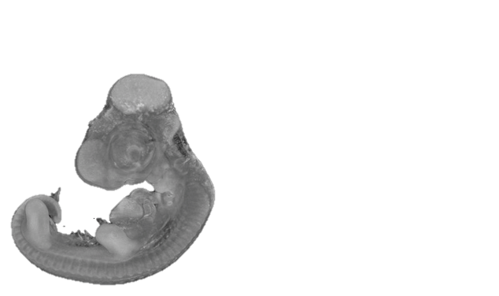
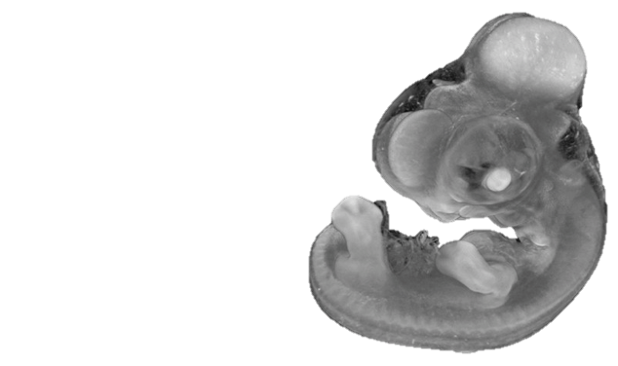
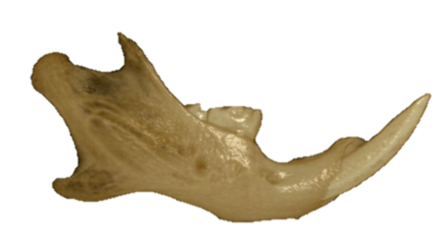
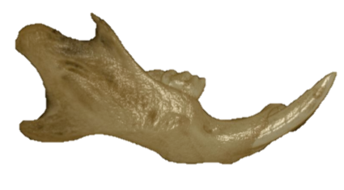
Quantification and Description of Morphological Differences
Trend towards increased use of biomedical imaging in craniofacial medicine
Increased need for tools enabling assessment of biomedical images.
Identify optimal treatment strategies
Quantify genetic and epigenetic impact on phenotypes.
Two developmental stages of a chick embryo
Left and right mouse hemi-mandibles
Notes:
craniofacial developmental abnormalities to understand gene-environment interactions that contribute to disease susceptibility and severity.
I developed new computational tools for biomedical image analysis to assist in identifying these causative factors.

Slide 4
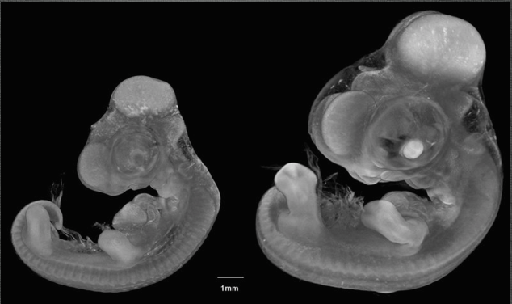
Challenges in Quantifying 3D Shape Change
Traditional methods rely on landmark points
Tedious and subject to variability
Require locations where landmarks can be reliably placed
Spatially sparse
Embryonic growth
Alternative analysis technique is needed
Notes:
To correlate growth abnormalities observed back to genetic and environmental factors, it is crucial to have detailed information about the shape changes, both normal and abnormal, during development.
Typical morphometric analysis relies on the precise identification of landmarks on images of the specimens which are easily repeatable. Landmarks typically placed at the junctures between identifiable structures. The embryos have few of these landmarks.
Due to these constraints and the progress that is being made in the quality and availability of high resolution 3D scan data, alternative techniques are needed that are capable of more descriptive analysis of shape change.

Slide 5
High Resolution 3D Scan Data
Chick embryo
2D image slices

Slide 6
Problematic Scan Data
High quality image
Low quality image
Notes:
These images show one axial slice from two different scans, one high and one low quality. Your eye can probably follow a smooth contour around the edge of the chick embryo, distinguishing background from the foreground. However, this is not a simple task to automate.

Slide 7
Problematic Scan Data
High quality image
Low quality image
Notes:
These images show one axial slice from two different scans, one high and one low quality. Your eye can probably follow a smooth contour around the edge of the chick embryo, distinguishing background from the foreground. However, this is not a simple task to automate.

Slide 8
Problematic Scan Data
High quality image
Low quality image
Notes:
These images show one axial slice from two different CT scans, one high and one low quality. Your eye can probably follow a smooth contour around the edge of the chick embryo, distinguishing background from the foreground. However, this is not a simple task to automate.

Slide 9
Problematic Scan Data
High quality image
Low quality image
Notes:
These images show one axial slice from two different CT scans, one high and one low quality. Your eye can probably follow a smooth contour around the edge of the chick embryo, distinguishing background from the foreground. However, this is not a simple task to automate.

Slide 10
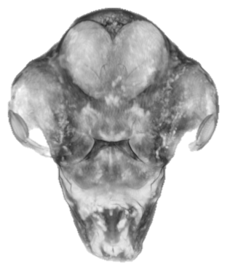
Preprocessing: 3D Surface Generation
Surface Extraction
3D scan of embryo head
Surface contour of embryo head
Notes:
Here you can see the three dimensional surface that is generated from the contours. In the following slides, the chick embryo images will be shown as 3D contours, such as the image on the right
Point out anatomical structure

Slide 11
Geodesic Active Contours
Method for detecting image boundaries
Start with contour approximating image boundary
Initial contour evolved over time according to “forces” calculated from image
Snakes: Active contour models, Kass, M. and Witkin, A. and Terzopoulos, D.

Slide 12
Steps for Geodesic Active Contour Algorithm
Model the shape with an estimated surface
Define energy function for surface as:
E = Internal energy (curvature) + external energy (image edges)
Derive curve to minimize energy
Propagate curve using level set to attain minimum energy

Slide 13
Geodesic Active Contour Implementation
Image Level Set
Input Image
Image Surface Estimate
Output Surface
Active Contour Filter

Slide 14
Geodesic Active Contour Implementation
Input Image
Otsu Threshold Noise Filter
Confidence Connected Filter
Fast Marching Filter
Image Level Set
Smoothing Filter
Gradient Magnitude Filter
Sigmoid Filter
Edge Image
Output Surface
Active Contour Filter
Notes:
Otsu threshold noise filter classifies foreground and background in the image and sets background to predefined level to reduce low level noise.
Confidence connected image filter then segments image into foreground and background using the mean and st dev
Fast marching filter creates a level set based on distance from the edges in the segmented image
Sigmoid filter remaps the values from the gradient magnitude filter to intensify differences between high and low gradient values.

Slide 15
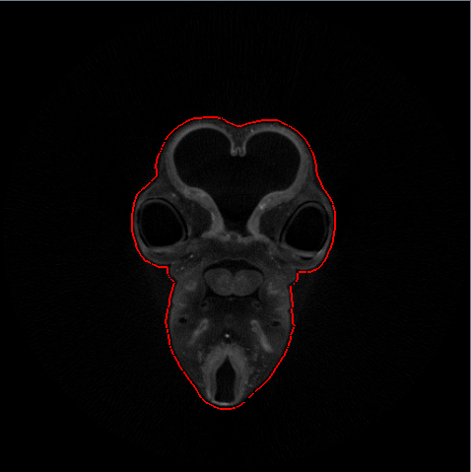
2D Example

Slide 16
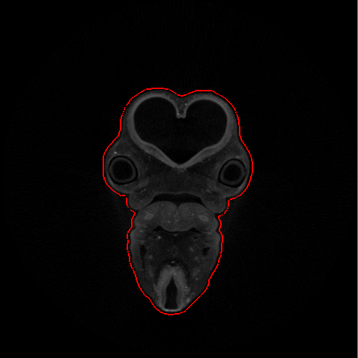
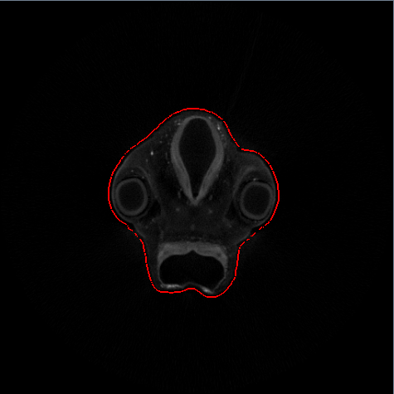
3D Surface Generation
Notes:
Here you can see the three dimensional surface that is generated from the contours. In the following slides, the chick embryo images will be shown as 3D contours, such as the image on the right
Point out anatomical structure

Slide 17
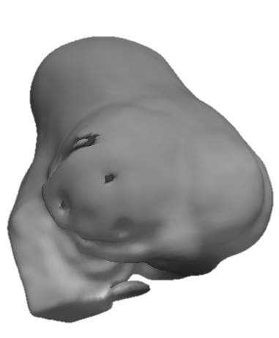
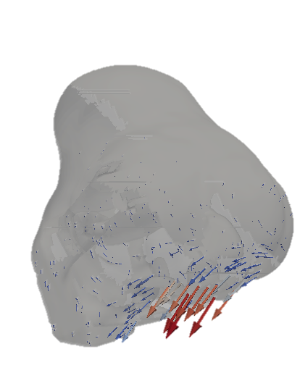
Deformable Registration
Dense field of vectors describes transformation at each point
Essentially provides continuous landmark data
Overlay of two objects
Deformation Vectors
Notes:
Difference between two images can be expressed as a vector field transforming one image to the other

Slide 18
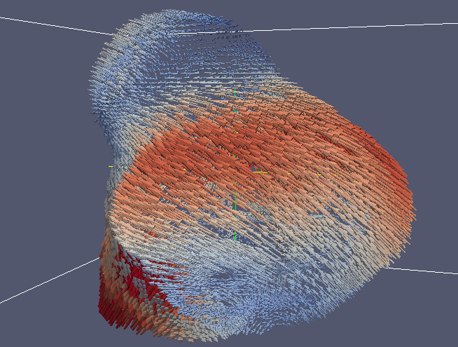
Reducing Data Dimensionality
High resolution images can have over a million surface points
Need to reduce this number to track meaningful differences
Displaying 500,000 vectors

Slide 19
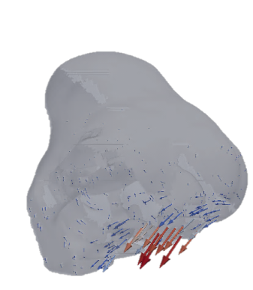
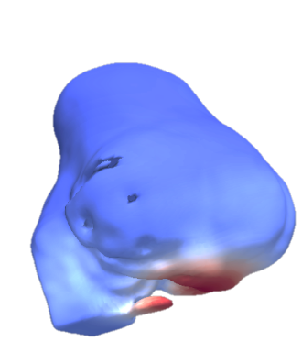
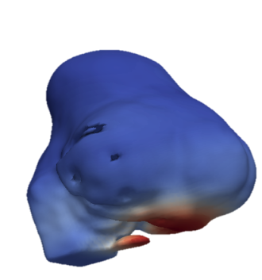
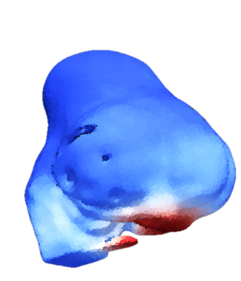
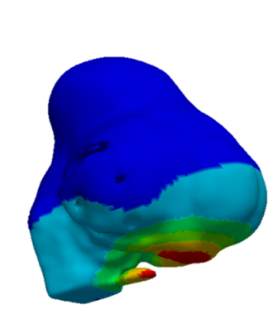
Overview of Base Methodology
Deformable Registration
Low-level feature extraction
Mid-level feature extraction
Image 1
Image 2
Group similar features
Compact
Feature Description
Notes:
Overview of the pipeline we have developed, will walk briefly through each step.

Slide 20
Overview of Base Methodology
Image 1
Deformable Registration
Low-level feature extraction
Mid-level feature extraction
Image 2
Group similar features
ROIs
Surface normal angle
Low-Level Features
Magnitude: Vector length
Normal angle: Cosine distance from normal angle
Reference vector angle: Cosine distance from reference vector
Reference vector angle
Notes:
In this slide I’ve zoomed in on the low-level feature extraction.

Slide 21
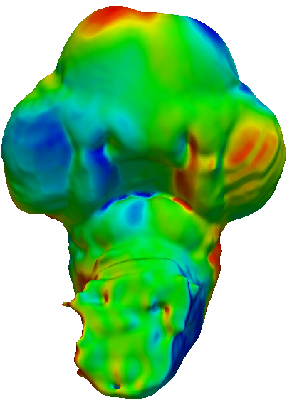
Spatiograms for Identifying Regions
Heat Map of Feature Values
Bin spatial distributions
…
Bins contain Gaussian distributions describing spatial position of values
Notes:
To generate a spatiogram from a feature difference image like the one seen here, the values are first partitioned into histogram bins, as is typically done in a histogram.
However, the spatial position of the points in each bin is recorded.
The spatial distribution of the points in each bin is later modeled using a mixture of Gaussian distributions.
Each bin is then characterized by the number of values in the bin, a number of Gaussian distributions, and the mean and variance of each Gaussian in the bin.

Slide 22
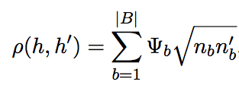
Calculating the Spatiogram Distance Metric
Based on the Bhattacharya coefficient: measures overlap between statistical samples
Spatiograms represented as histograms with an added dimension
B = number of bins,
= value of bin b
= spatial weighting term expressing similarity of distributions
Notes:
The Bhattacharya coefficient is modified to include a spatial weighting term to address the similarity of the Gaussian distributions in corresponding bins.

Slide 23
Chick Embryo Developmental Sequence
HH 19.5
HH 24
HH 24.5
HH 25
HH 26
Developmental Growth Sequence
16 specimens
5 developmental stages
Notes:
The first data set we used to validate our methods is a set of 16 normal chick embryos from 5 developmental stage groups.
This slide shows an example from each age group.
Some changes are obvious, others are subtle.
There is also variation within groups that complicates the dataset.

Slide 24
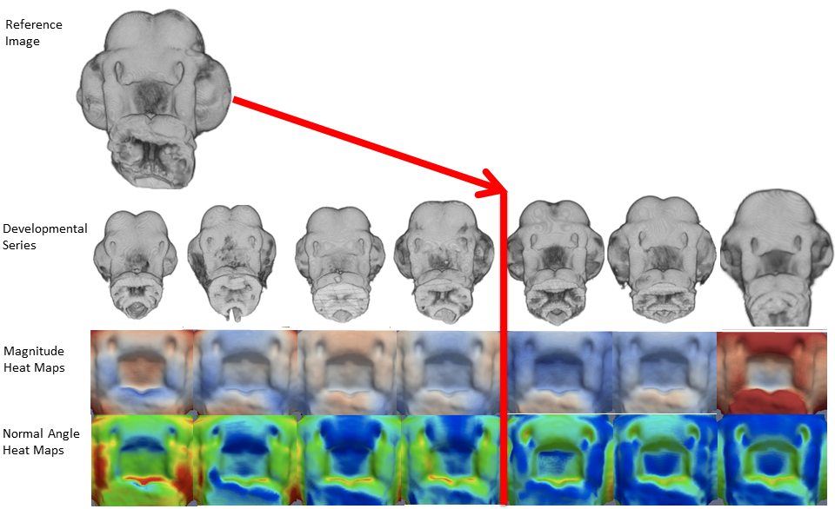
Application to Developmental Sequence
Notes:
These retrieval experiments help validate the methods that we’re using
They could be used to help determine the developmental stage group of an individual specimen.
But the goal is to use them to examine differences that are not previously known, such as differences due to genetic manipulation or variance within groups.
This slide shows the feature heat maps from a template image that is warped to a developmental sequence of images.
Progressive changes can be seen in the sequence, indicating that this can be used to explore variation both within and across developmental stage groups.

Slide 25
Retrieval of Similar Growth Trajectories
Normal Angle
Magnitude
Query feature heat maps
Heat maps of top 3 ranked results
Notes:
To verify our methods, we used the fact that the comparison between two given stages should be most similar to other comparison between those same two stages.
We did similarity retrieval by using the features from one image comparison as a query, and ranking the similarity of other image comparisons in the database
Most similar image comparisons should be returned.
In the example in this slide, the three image comparisons returned are visually similar to the query, and do each represent comparisons between the same two stages as the query.

Slide 26
Similarity Scores: Growth Trajectory
Average Score: 0.049
Close to the ideal score of 0
Developmental Stage
 | HH 24 | HH 24.5 | HH 25 | HH 26
HH 19.5 | 0.087 | 0.018 | 0.156 | 0.020
HH 24 | X | 0.017 | 0.021 | 0.045
HH 24.5 | 0.044 | X | 0.008 | 0.069
HH 25 | 0.007 | 0.100 | X | 0.072
HH 26 | 0.030 | 0.067 | 0.045 | X
Template
Notes:
The average retrieval scores for the transitions between each developmental stage group were very low, indicating successful retrievals
As a rule of thumb scores of 0.1 and under are considered very good.

Slide 27
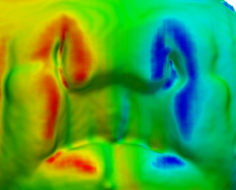
Morphological Shape Change: Characterizing Asymmetry
Zoom of Facial Region
Angle Heat Map
Normal Reference Image
Normal Image
(ii) (iv)
Cleft Image
(i)
(iii) (v)

Slide 28
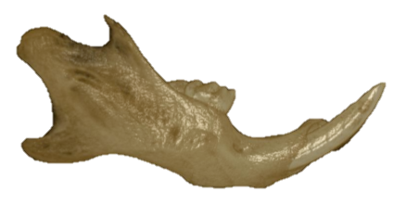
Assessing Mouse Mandible Symmetry
Deformable Registration
Low-level feature extraction
Mid-level feature extraction
Image 1
Image 2
Group similar features
Asymmetry Score
ROIs
Notes:
Overview of the pipeline we have developed, will walk briefly through each step.

Slide 29
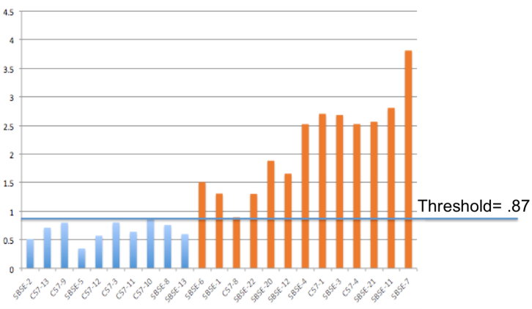
Assessing Mouse Mandible Symmetry
Tool for characterizing and quantifying the asymmetry in bilaterally paired structures.
Applied it to the two sides of the mandible of the mouse.
Asymmetry scores compared to human expert
our
score = height
blue = normal
orange = abnormal
Correlation Coefficient = .92
Rolfe, S. M., Camci, E. D., Mercan, E., Shapiro, L. G., & Cox, T. C. "A New Tool for Quantifying and Characterizing Asymmetry in Bilaterally Paired Structures.“ IEEE EMBS ‘13 Jul 2013.

Slide 30
Retrieval of Specimen with Similar Morphological Shape Differences
Magnitude Sample Query
Magnitude Heat Map
Left/Right Overlay
(i) Query Image (ii) First Result (iii) Second Result
Correlation between distance from most asymmetric and expert asymmetry ranking = 0.91
Rolfe, S. M., Camci, E. D., Mercan, E., Shapiro, L. G., & Cox, T. C. "A New Tool for Quantifying and Characterizing Asymmetry in Bilaterally Paired Structures.“ IEEE EMBS ‘13 Jul 2013.
Zoom of Facial Region
Angle Heat Map
Normal Reference Image
Normal Image
(ii) (iv)
Cleft Image
(i)
(iii) (v)

Slide 31
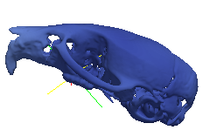
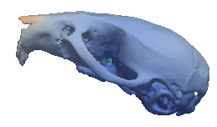
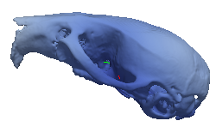
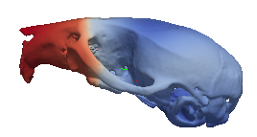
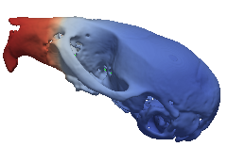
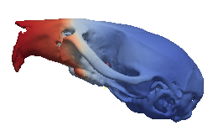
Morphological Shape Change: Additional Applications
Magnitude Heat Maps – Mouse Skull
Wild Type to Wild Type
Wild Type to Mutant
Notes:
In the examples that we ran here we were able to differentiate between comparisons of two wild types and mutants to wild types.
Indicating that this framework could provide shape information for these applications.

Slide 32
Questions?
Object surface contours
Framework to quantify, compare, and visualize image differences
Validation
on multiple datasets
Compact representation
of feature differences
Image difference features
Framework for Morphometric Shape Analysis

