Slide 1
Imaging Brain Structure and Function
Thomas J. Grabowski, Jr., MD
Professor, Radiology and Neurology (joint)
Director, UW Integrated Brain Imaging Center
Director, UW Alzheimer’s Disease Research Center
CSE/EE 577
October 18, 2017

Slide 2
Why image the brain?
What’s wrong? (Medical diagnosis)
How does it work? (Neuroscience)
To aid intervention (Medical treatment,
Engineering)

Slide 3
Why is the brain hard to image?
Different soft tissues (gray, white) give low contrast to xrays
Cerebral anatomy is 3D complex and variable
Neurophysiological processes must be imaged indirectly through their coupled vascular and metabolic effects
Much of the organization of the brain is still poorly understood.
Cerebral functional zones are defined by microscopic features that can’t be imaged directly

Slide 4
Digital image paradigm
Images are matrices of values of a physical or physiological parameter, extended over an anatomic space.
The parameter is not derived “directly” from hardware sensors, but by post-acquisition computation.
Images may be inputs to further workflow.
Paradoxically, imaging is an abstract concept

Slide 5
Outline
The brain
Brain imaging modalities
Standard anatomical space
Image processing

Slide 6
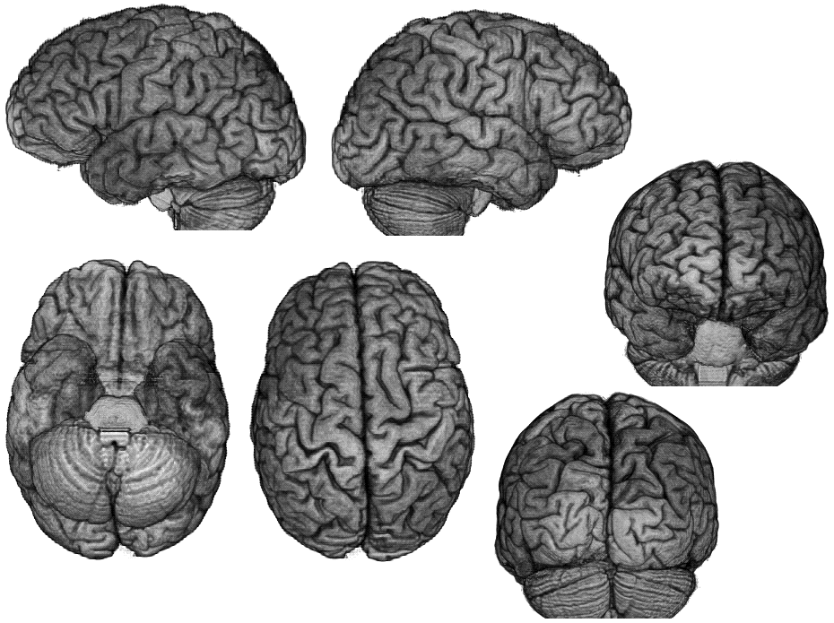

Slide 7
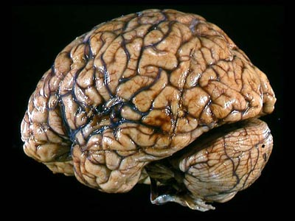
The brain is an organ

Slide 8
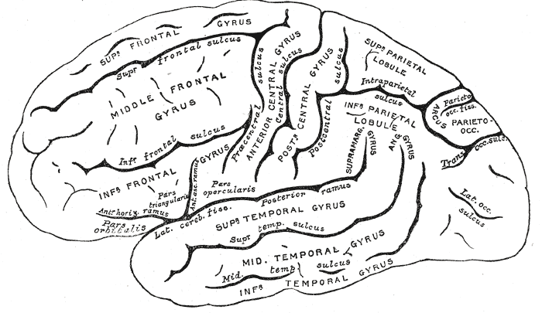
Sulci and Gyri of the Cerebral Cortex

Slide 9
Cortical thickness
FreeSurfer, CARET

Slide 10
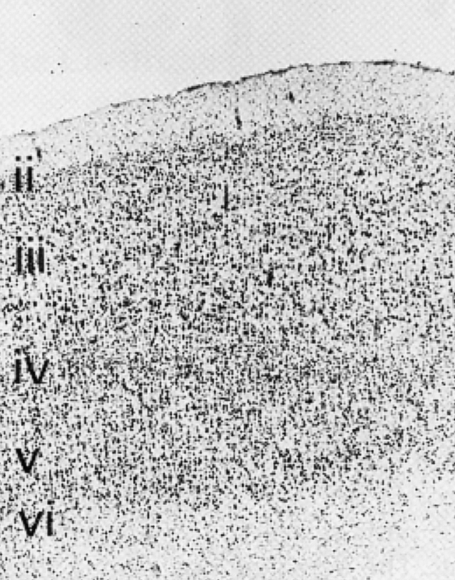
I Molecular layer
II External granular layer
III External pyramidal layer
IV Internal granular
V Internal pyramidal
VI Multiform layer

Slide 11
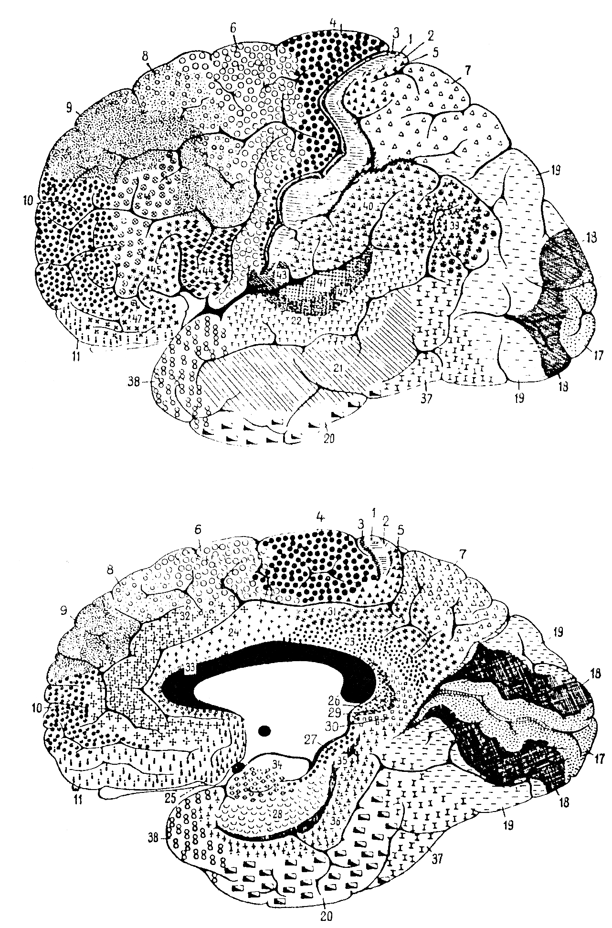
Brodmann’s cytoarchitectonic map
(1909)

Slide 12
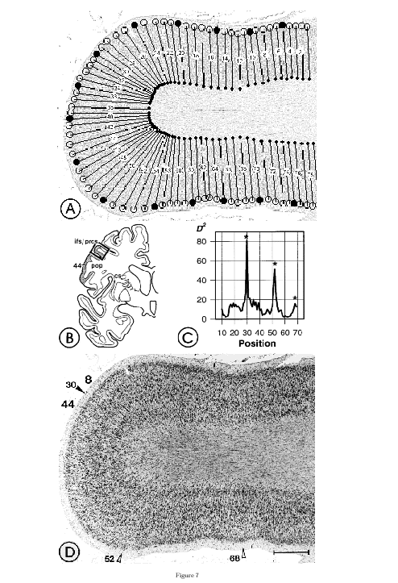
From Amunts et al

Slide 13
Julich cytoarchitectonic map
(2009)

Slide 15
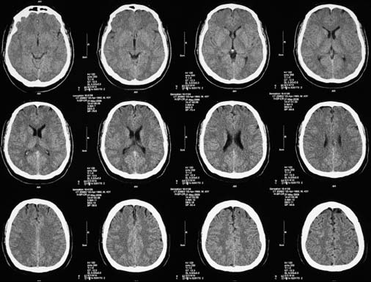
Xray Computed Tomography

Slide 16
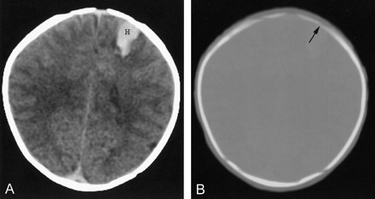
Tissue vs. Bone Windows
+30
+70
+1000
Hounsfield Number – radiodensity

Slide 17
Computed tomography
First tomographic anatomic imaging technique
Modest soft tissue contrast
Contrast agent (iodinated) already existed
Good sensitivity to pathology, esp. blood
Good resolution of bony structures
Rapid (good throughput, low sensitivity to motion)
Finds uses as a first-line emergency technique
Integrated with PET for attentuation correction and anatomic image fusion
Used very extensively in body imaging

Slide 18
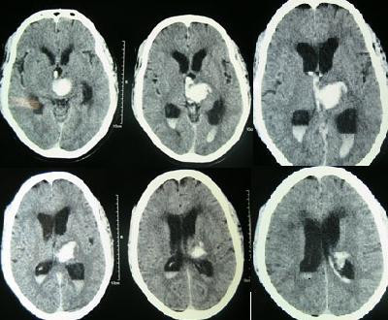
Intracerebral hypertensive hemorrhage

Slide 19
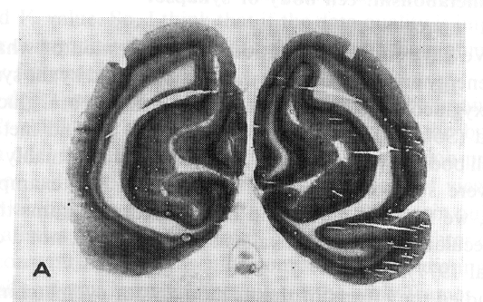
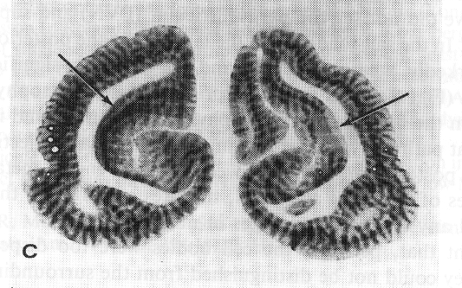
In theory, metabolic mapping techniques
can resolve cortical processes at the level
of cortical columns.
2-deoxyglucose: visual stim in cats
Eyes open
Eyes closed
One open, one closed

Slide 21
Positron Emission Tomography
(PET)
Images of physiological parameters are inferred from the distribution of positron-emitting radiopharmaceuticals

Slide 22
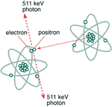
Positron emission

Slide 23
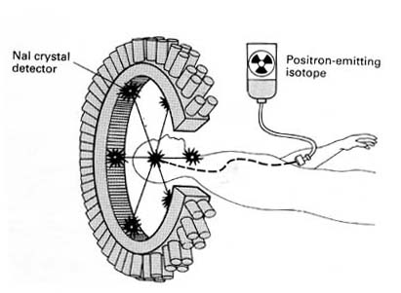
PET detectors

Slide 24
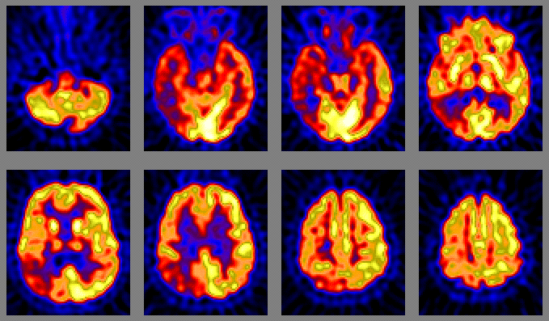
[¹⁸F]Fluorodeoxyglucose PET

Slide 25
PET
Physiologically distributed signal
Unrivaled sensitivity
A medical procedure with ionizing radiation
Requires radionuclide source (cyclotron) and radiochemistry facilities
Tracers exist for tissue metabolism (18F-FDG), blood flow (15O-water), DNA synthesis (18F-FLT), Alzheimer disease proteins, and more.

Slide 26
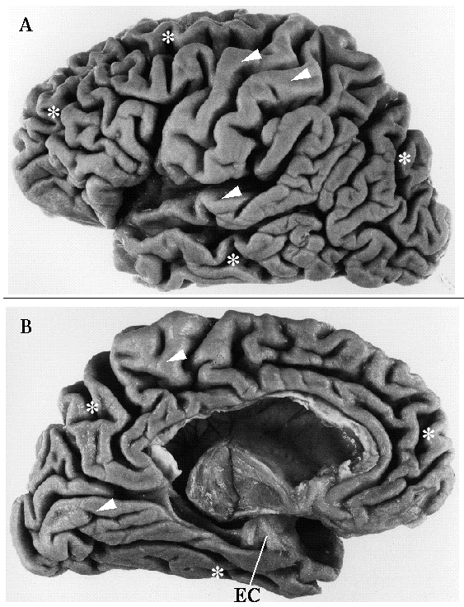
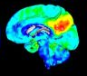
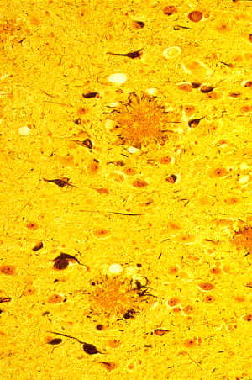
BRAIN IMAGING OF Alzheimer’s disease
Amyloid
Plaques
AMYLOID PET SCAN
Detects amyloid plaques
Stereotypical distribution
Leads symptoms by 15 years
Doesn’t change over time
Use: to certify diagnosis
Spinal fluid is an alternative.
TAU PET SCAN
Detects tau tangles
Variable distribution
Correlates well with symptoms
Tracks advance of disease
Use: to delineate disease impact
To track treatment
Neurofibrillary
Tangles

Slide 28
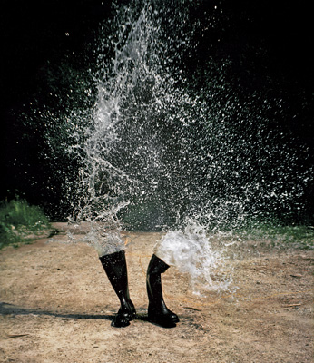
Magnetic Resonance Imaging
(MRI)
Wassersteifel
Roman Signer
1986

Slide 29

MRI
Water molecules have a natural frequency at which they can accept and radiate energy
More precisely, the hydrogen nuclei have a quantum mechanical property called spin angular momentum
The spin states of hydrogen nuclei diverge in energy level in the presence of a magnetic field
Water protons absorb or give off energy to move between these energy levels, at the natural frequency, the Larmor frequency, which is a function of the magnetic field strength.

Slide 30
In a magnetic field, protons precess at a natural frequency.
Energy can go in or out of this system only at this frequency.

Slide 31
Excitation
Radiofrequency energy at the Larmor frequency transfers to the water protons of the system.
This does two things:
  Introduces a transverse component to the magnetization
  Synchronizes the precession of the protons
When the pulse of RF input stops, the system (water in the magnet) will radiate radiofrequency energy for a little while

Slide 32
Relaxation: T1, T2, T2*
With time (described by T1) the excited dipoles will relax back into alignment with the field.
Before that happens, their precession will get out of phase (described by T2) and no more signal will be available.
But even before that, local imperfections in the field will probably cause even faster dephasing (described by T2*).

Slide 33
T1 relaxation occurs at different rates in different tissues
T1 relaxation is slowest in a homogeneous sample of water (e.g. in CSF)
T1 relaxation is faster in lipid-rich white matter than in gray matter
Differential relaxation is the key to tissue contrast in MRI

Slide 34

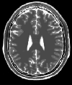

Together, the values of TR and TE emphasize different tissue parameters.
T1
T2
PD
TR = 300 msec
TE = 20 msec
TR = 3000 msec
TE = 120 msec
TR = 3000 msec
TE = 20 msec
A short TR and short TE emphasizes T1 contrast.
A long TR and long TE emphasizes T2 contrast.
A long TR and short TE emphasizes proton density contrast.

Slide 35
FLAIR : FLuid-Attenuated Inversion Recovery
  T2 weighting with black spinal fluid

Slide 36
The MRI signal is rich
Proton density
Relaxation times (T1, T2)
Magnetic field distortion (T2*)
Flow
Diffusion
Chemical shift
Magnetization transfer
……

Slide 37
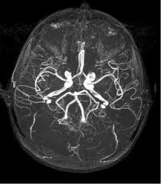
Magnetic resonance angiography
“MRA”

Slide 38
The “economy” of MRI
In MRI signal is the sum of the longitudinal magnetization of the protons in the field of view
This is a like fixed budget, that can be used more or less efficiently, and can be spent to obtain some combination of:
  Better spatial resolution
  Better signal to noise ratio (SNR)
  Reduced imaging time
There are always trade-offs!
Advances in MRI are often in the form of a smarter pulse sequence.

Slide 39
Efficient pulse sequences
Maximize the amount of time spent listening for the signal
Maximize the number of protons in the sample that are being put to work at any one time
Optimize the relationship between TR and TE to maximize signal
We use two efficient sequences extensively: MP-RAGE and EPI GRE fMRI

Slide 40
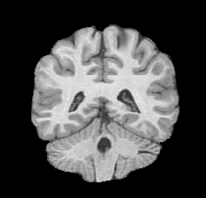

Slide 41


Slide 43
Diffusion Tensor Imaging

Slide 44

Diffusion
Ellipsoid = Probability of Diffusion Distribution
Random “walk” of the water molecular also known as “Brownian motion ”
Isotropic Diffusion
Anisotropic Diffusion

Slide 45
Diffusion eigenvectors
Diagonalization of this tensor provides three eigenvectors (ev₁, ev₂ and ev₃) with three corresponding eigenvalues (λ₁, λ₂ and λ₃)
ev₁λ₁
ev₃λ₃
ev₂λ₂

Slide 46
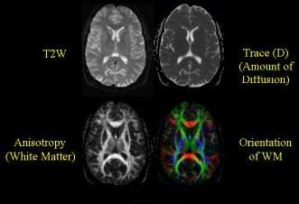
Diffusion Tensor Images

Slide 47
Diffusion imaging
Parameters neurologists are used to seeing
  Diffusion-weighted image
  Apparent diffusion coefficient - ADC
Parameters neuroscientists are used to seeing
  Diffusion fractional anisotropy – FA
    A measure of how constrained water is to diffuse in only certain directions
  Diffusion principal eigenvector
    The axis along which water diffuses most freely

Slide 49
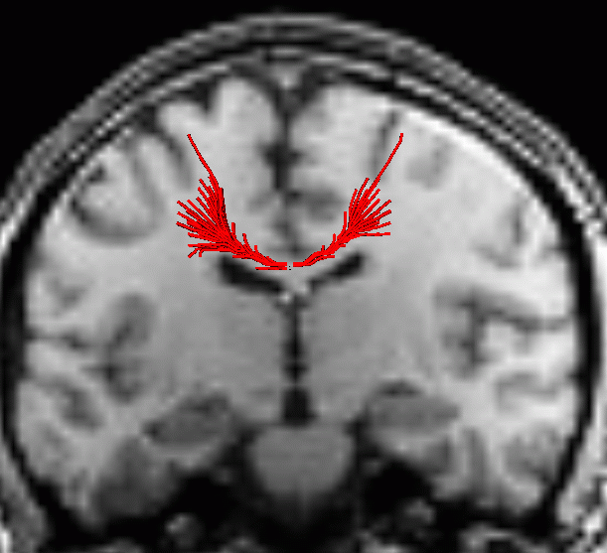
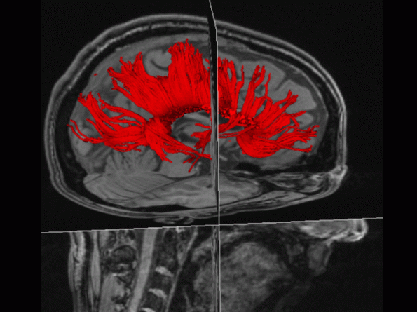
DTI Tract Tracing

Slide 50
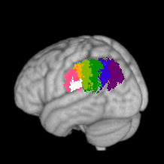
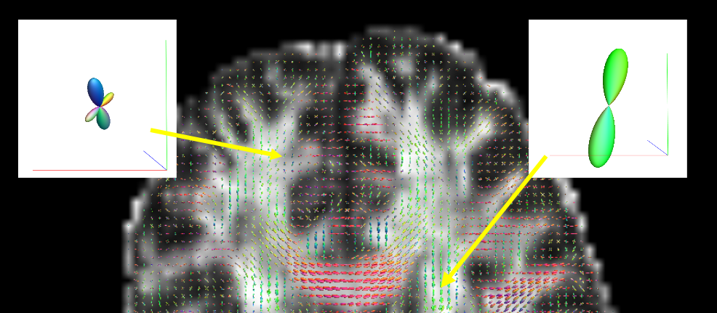
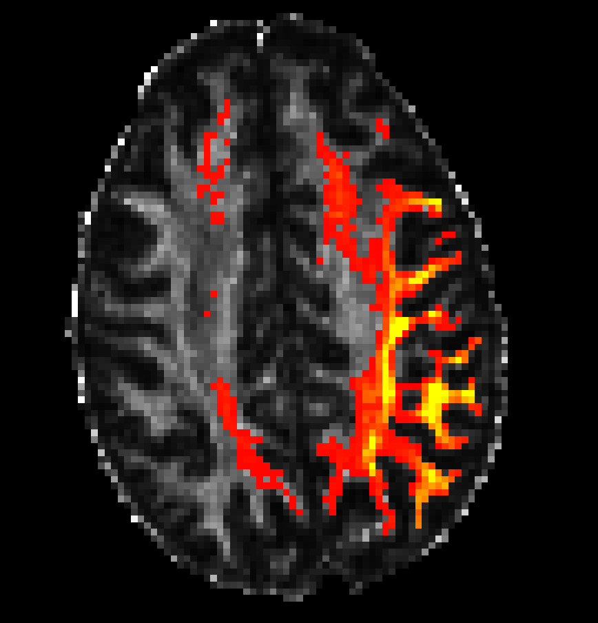
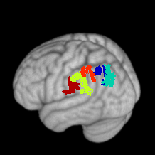
In vivo Connectivity-based Cortex Parcellation
Preprocess DWI
Model Diffusivity
Compute and cluster tractograms

Slide 52
Functional Magnetic Resonance Imaging (fMRI)

Slide 53
Physiological basis of fMRI
Brain activity is imaged indirectly, through parameters related to metabolic substrate delivery.

Slide 54
Neurovascular coupling
Synaptic electrochemical activity
  DEPENDS ON
Maintenance of membrane potentials
  WHICH DEPENDS ON
Metabolism of glucose
  WHICH DEPENDS ON
Substrate delivery via blood flow

Slide 55
Basis of fMRI signal
Metabolism
Neural
Activity
dHb
T₂*
MR Signal
Blood
Flow
Hemodynamic
Response
Function (HRF)
Blood
Oxygenation
Dependent
Signal
“BOLD”

Slide 56
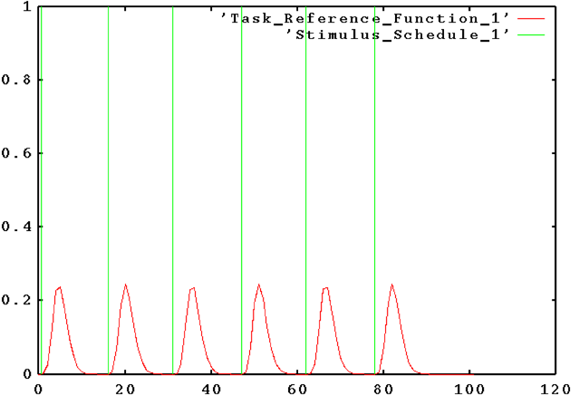
MRI signal
Time, seconds

Slide 57
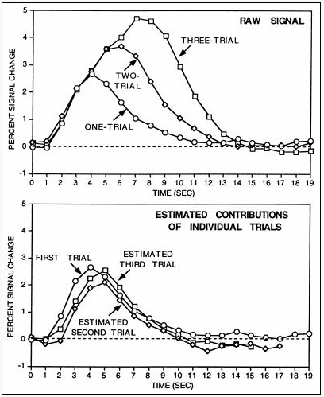
HRF sums linearly over trials
A. Dale and R. Buckner
Hum Brain Mapp 5:329
1997

Slide 58
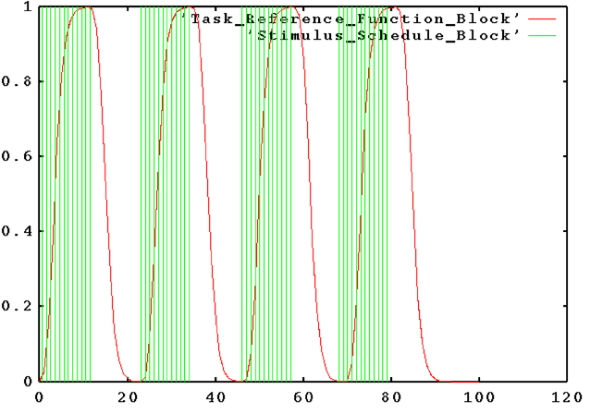
Block Design
MRI signal
Time, seconds

Slide 59
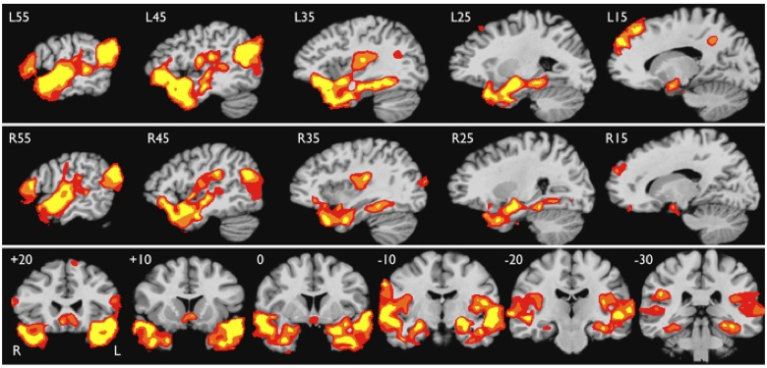
Activation of the anterior temporal lobes during listening to discourse.

Slide 60
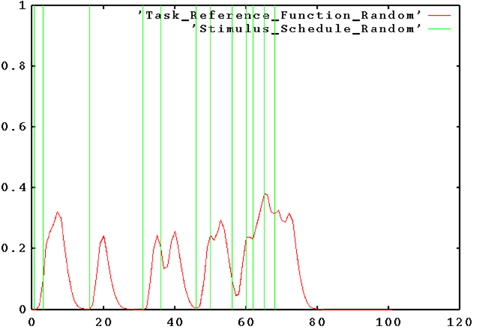
Event-Related Design
MRI signal
Time, seconds

Slide 61
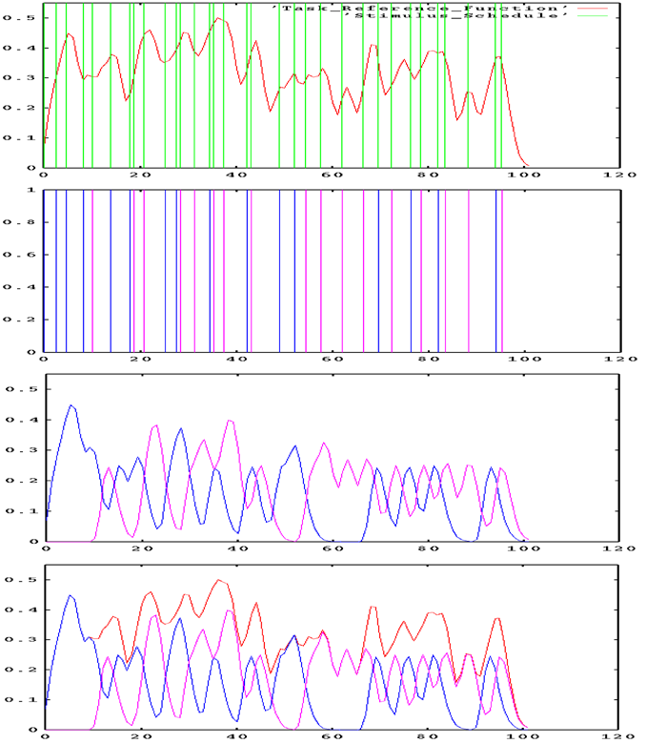

Slide 62
Activation of hippocampus during successful memory encoding and retrieval

Slide 63
Two fMRI paradigms
Activation paradigm
  Signal model: predicted BOLD timecourse
Functional connectivity paradigm
  Signal model: correlated signal timecourses

Slide 64
Resting State Paradigm
Finger tapping
Box car GLM
Resting
Fourier transform
ICA
Biswal et al., 1997

Slide 65
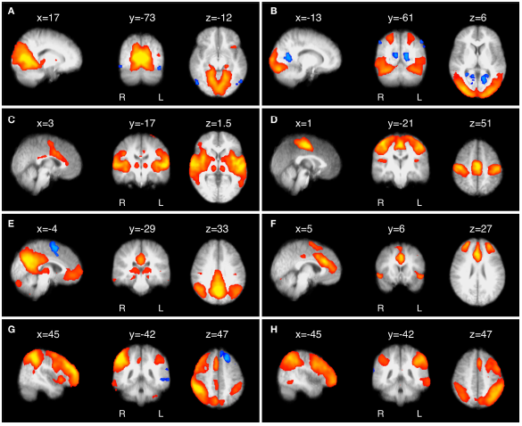
Early visual network
Ventral visual network
Auditory network
Motor network
Default mode network
Salience network
R dorsal attention network
L dorsal attention network
Damoiseaux et al 2006

Slide 66
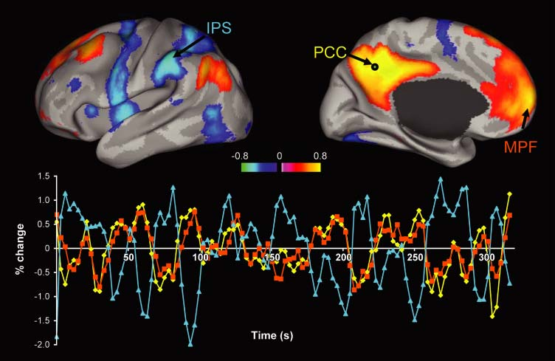
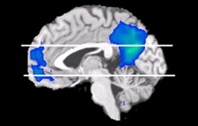

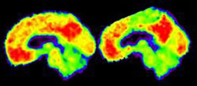
“Default” Mode Network
Relevance to adaptive behavior
Deactivation DMN
Activation DAN
Raichle & Mintun, 2007
Relevance to disease
Grecius & Dougherty, 2007
Notes:
Opportunity emerges in the demonstration of the system level of involvement in both health and disease

Slide 67
Summary: functional connectivity paradigm
BOLD fluctuations formerly thought to be “noise” are correlated across distant sites.
Analysis of functional connectivity “at rest” identifies consistent “intrinsic networks”
Functional connectivity is grounded in anatomic connectivity
Intrinsic networks may reflect a fundamental level of large-scale physiologic organization

Slide 69
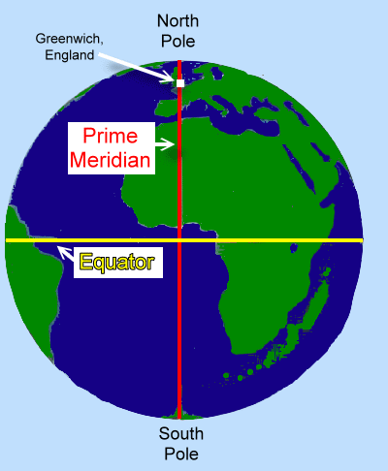
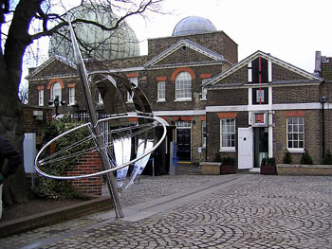
Anchoring standard space

Slide 70
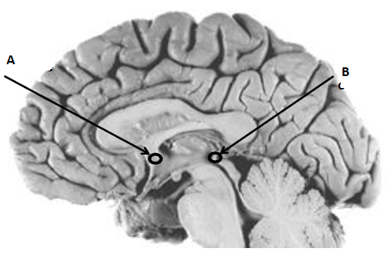
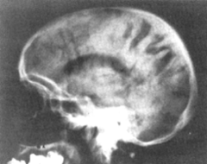

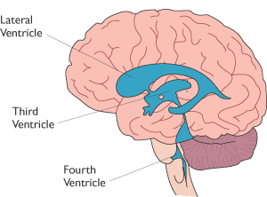
Anchoring standard space
The brain “equator” is the intercommisural line

Slide 71
Talairach Space

Slide 72
Talairach Space
Montreal Neurological Institute (MNI) space

Slide 73
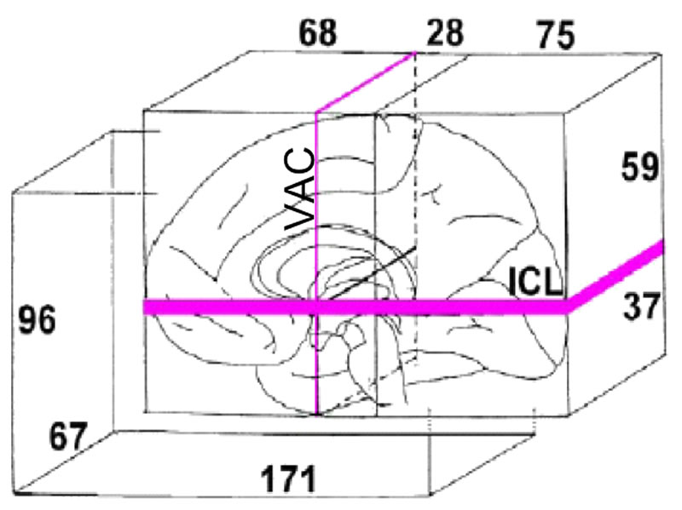

Slide 74
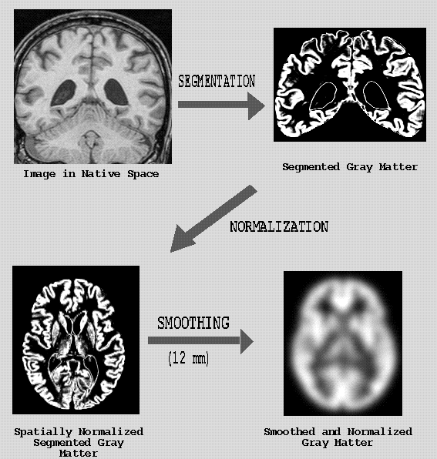
Voxel-based morphometry

Slide 75
Limits on interpretation of spatial normalization
Anatomic variability in Talairach space
  1.5 cm
Irreducible cortical variability
  This variability is itself variable
  Cytoarchitecture adds another layer of variability
Not always easy to assign results to one location
  Local maximum of statistic field, vs center of mass
  Extent-based statistics vs Magnitude-based statistics
fMRI data are typically smoothed for SNR reasons

Slide 77
fMRI Data Post-Processing
Image Acquisition
Physiologic data
acquisition
Motion correction
Stimulus recording
Anatomic alignment
Convolution w/ HRF (EV)
Intensity normalization
General linear model
Multiple linear regression
Test statistics
Thresholding/inference
Interpretation

Slide 78
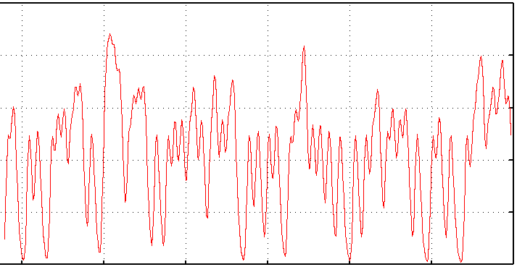
fMRI time series
MR
signal
time

Slide 79
fMRI signal reflects multiple simultaneous effects
Task
Physiologic fluctuations
  Cardiac pulsatility
  Respiratory effects
  CSF flow/pulsation
Head motion/spin history
Slow drifts
Thermal noise

Slide 80
Statistical analysis
Problem: at each voxel, estimate the task effect in the presence of other effects
Technique: multiple linear regression
supported by the general linear model:
Y = β₁X₁ + β₂X₂ + … + ε
  The task effect is estimated by regression coefficient (β) and tested with a t statistic

Slide 81
Activation of the anterior temporal lobes during listening to discourse.

Slide 82
Summing Up
MRI approaches to brain structure and function continue to diversify and become more powerful, driven mostly by conceptual and software innovation.
Multispectral/multimodal approaches are now common, clinically and in research.
Imaging approaches are beginning to analyze brain activity in terms of natural systems structure (columns, fields, large scale systems)
Most of the techniques have not (YET) found their way into clinical application

Slide 83

Questions?

