Slide 1

Digital Pathology:
Diagnostic Errors, Viewing Behavior and Image Characteristics
Ezgi Mercan

Slide 2
Our Aim
We propose novel image features and viewing behavior analysis methods
to investigate the causes of diagnostic errors and
to discover accurate and efficient interpretation strategies for pathologists.

Slide 3
Outline
Introduction
ROI Localization in WSIs
Tissue Label Segmentation
Automated Diagnosis of ROIs
Viewing Behavior Analysis
Conclusions

Slide 4
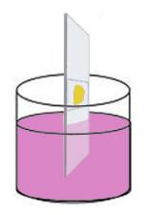

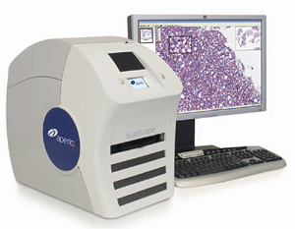
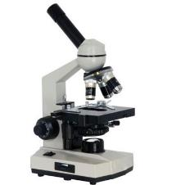
Medical Diagnosis of Cancer
1. Introduction 2. ROI Localization 3. Tissue Segmentation 4. Automated Diagnosis 5.Viewing Behavior Analysis 6. Conclusions
tissue specimen
H&E staining
glass slide
light microscope
whole slide imaging

Slide 5
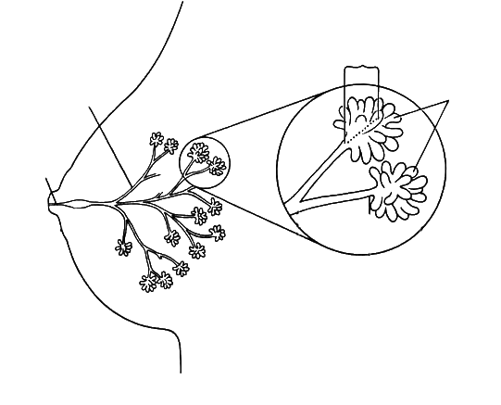
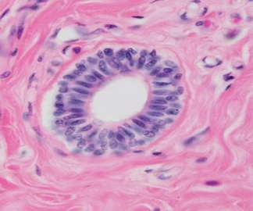
Breast Histopathology
1. Introduction 2. ROI Localization 3. Tissue Segmentation 4. Automated Diagnosis 5.Viewing Behavior Analysis 6. Conclusions
terminal ducts
segmental ducts
ductules
duct
(epithelium)
stroma
(connective tissue)
female breast
a duct
lumen

Slide 6
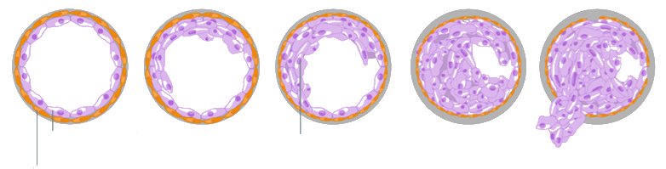
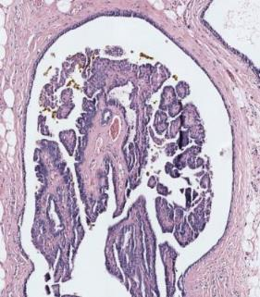
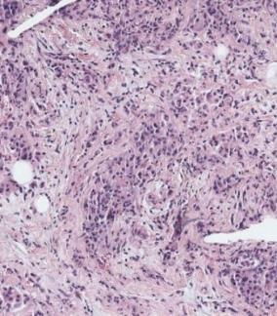
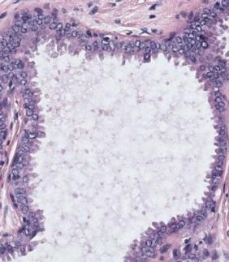
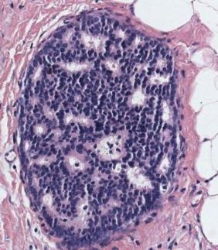
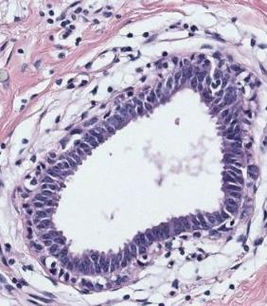
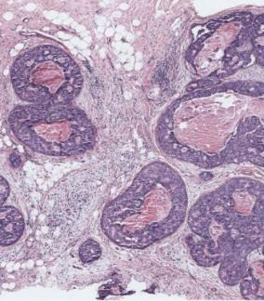
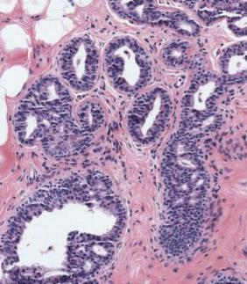
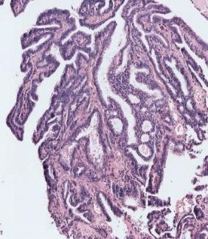
Diagnostic Categories
1. Introduction 2. ROI Localization 3. Tissue Segmentation 4. Automated Diagnosis 5.Viewing Behavior Analysis 6. Conclusions
normal duct
benign
atypia
ductal carcinoma in situ (DCIS)
invasive
normal epithelial cells
cancer cells
atypical ductal hyperplasia
flat epithelial atypia
papilloma w/atypia
invasive carcinoma
columnar cell change
usual ductal hyperplasia
intraductal papilloma
ductal carcinoma in situ (DCIS)

Slide 7


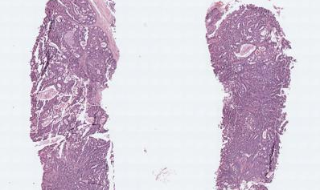
digiPATH Dataset
1. Introduction 2. ROI Localization 3. Tissue Segmentation 4. Automated Diagnosis 5.Viewing Behavior Analysis 6. Conclusions
pathologist
(n=87)
assessment
(n=5,220)
case
(n=240)
age
years in practice
# cases per week
affiliation
lab size
education
pathology perception
participant ROI*
participant diagnosis
viewport log
digital WSI
consensus ROI
consensus diagnosis
confidence score
difficulty score
borderline diagnoses
biopsy type
breast density
patient age
diagnostic outcome
ROI identification*
diagnostic agreement
efficiency

Slide 8
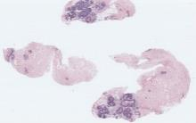
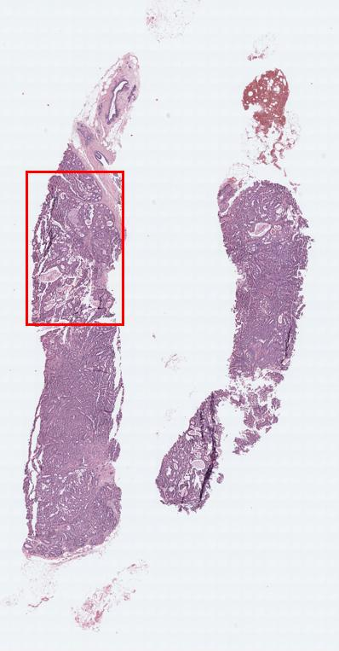
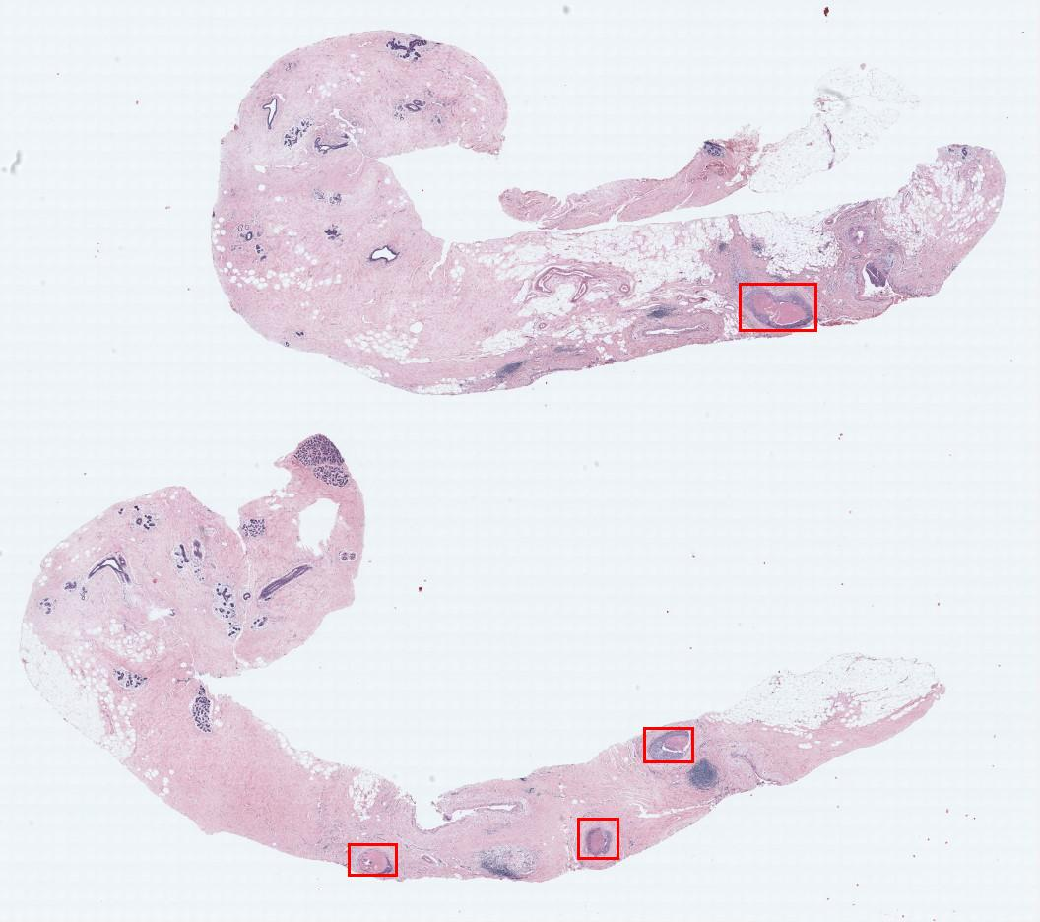
1. Introduction 2. ROI Localization 3. Tissue Segmentation 4. Automated Diagnosis 5.Viewing Behavior Analysis 6. Conclusions
Expert Consensus Data Collection
digital
WSI
Consensus
Diagnosis
benign
atypia
(DCIS)
invasive
# Cases
60
80
78
22
Consensus
ROIs
102
128
162
36
3 world experts

Slide 9
digiPATH Dataset
1. Introduction 2. ROI Localization 3. Tissue Segmentation 4. Automated Diagnosis 5.Viewing Behavior Analysis 6. Conclusions
pathologist
(n=87)
assessment
(n=5,220)
case
(n=240)
age
years in practice
# cases per week
affiliation
lab size
education
pathology perception
participant ROI*
participant diagnosis
viewport log
digital WSI
consensus ROI
consensus diagnosis
confidence score
difficulty score
borderline diagnoses
biopsy type
breast density
patient age
diagnostic outcome
ROI identification*
diagnostic agreement
efficiency

Slide 10

1. Introduction 2. ROI Localization 3. Tissue Segmentation 4. Automated Diagnosis 5.Viewing Behavior Analysis 6. Conclusions
Participant Data Collection
N=87
Baseline Survey
Pathologist Characteristics
Breast Histopathology Perceptions
Assessment
$$×60$$
Interpretation
using
Digital Slide Viewer
Viewport Tracking Logs
ROI selection
Region of Interest (ROI)
Histology Form
Diagnosis
Case Difficulty
Confidence in Assessment

Slide 11
Outline
Introduction
ROI Localization in WSIs
Tissue Label Segmentation
Automated Diagnosis of ROIs
Viewing Behavior Analysis
Conclusions

Slide 12
digiPATH Dataset
1. Introduction 2. ROI Localization 3. Tissue Segmentation 4. Automated Diagnosis 5.Viewing Behavior Analysis 6. Conclusions
pathologist
(n=87)
assessment
(n=5,220)
case
(n=240)
age
years in practice
# cases per week
affiliation
lab size
education
pathology perception
participant ROI*
participant diagnosis
viewport log
digital WSI
consensus ROI
consensus diagnosis
confidence score
difficulty score
borderline diagnoses
biopsy type
breast density
patient age
Diagnostic Outcome
Accuracy & Efficiency

Slide 13
Localization of Diagnostically Relevant Regions of Interest in Whole Slide Images
1. Introduction 2. ROI Localization 3. Tissue Segmentation 4. Automated Diagnosis 5.Viewing Behavior Analysis 6. Conclusions
Whole slide images are big (50,000 x 20,000 pixels).
The diagnostic decision making is a complex cognitive process that includes visual search and interpretation tasks.
Region of Interest (ROI): Parts of the whole slide to which the pathologists paid attention.
Our aims are:
  To understand what attracts’ pathologists attention, and
  To model diagnostically relevant regions computationally using image features.
E. Mercan, et al., International Conference on Pattern Recognition, 2014.
E. Mercan, et al., Journal of Digital Imaging, 2016.

Slide 14
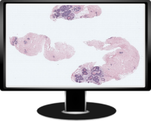
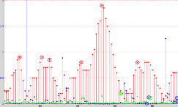
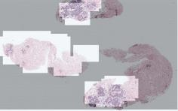


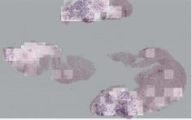




  ROI Localization in WSIs
1. Introduction 2. ROI Localization 3. Tissue Segmentation 4. Automated Diagnosis 5.Viewing Behavior Analysis 6. Conclusions
Tracking Data Analysis to Discover ROIs
A Model based on Color and Texture to Predict ROIs
our viewport analysis
ROIs to which pathologist
actually paid attention
tracking data
an unseen WSI
our computational model based on color and texture
our predicted ROIs

Slide 15
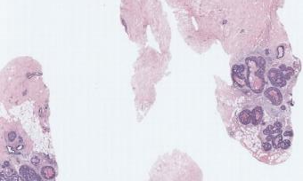
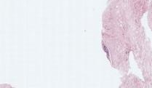
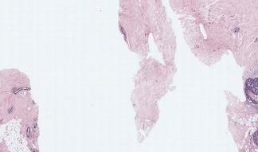
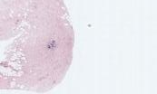
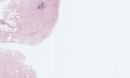
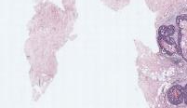

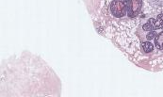
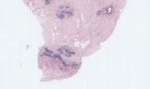
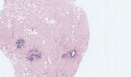
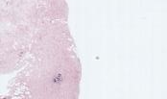
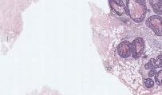




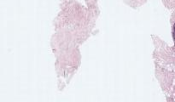
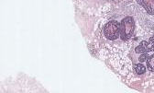
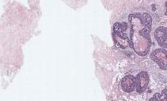
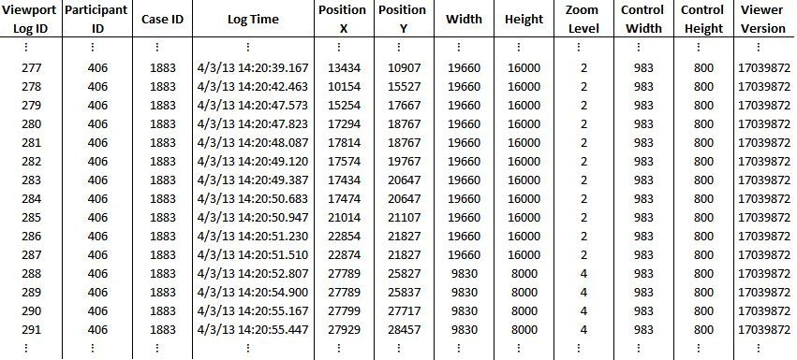
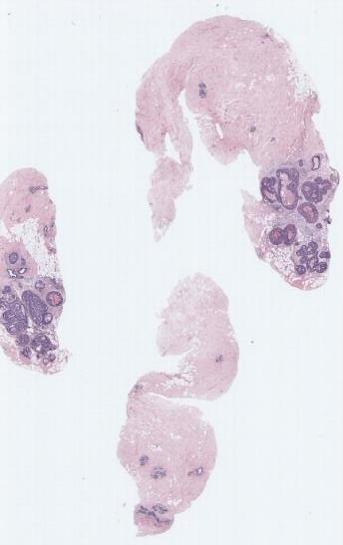
Viewport Log Analysis
1. Introduction 2. ROI Localization 3. Tissue Segmentation 4. Automated Diagnosis 5.Viewing Behavior Analysis 6. Conclusions
Where did pathologists really look?
viewport: a rectangular part of the image pathologist sees on the screen
viewport logs: records all viewports
  panning: changes the location of viewport
  zooming in/out: changes the size of viewport

Slide 16
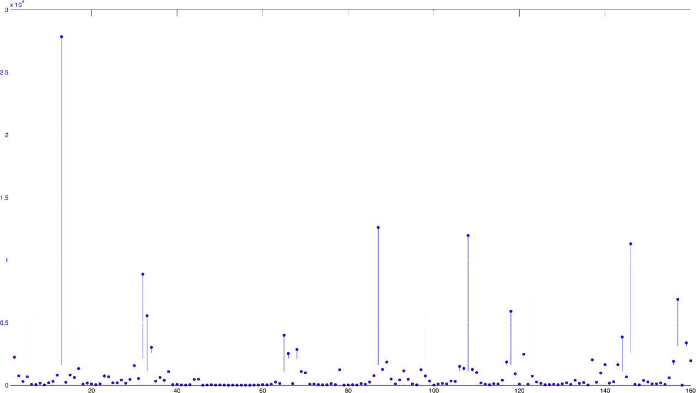
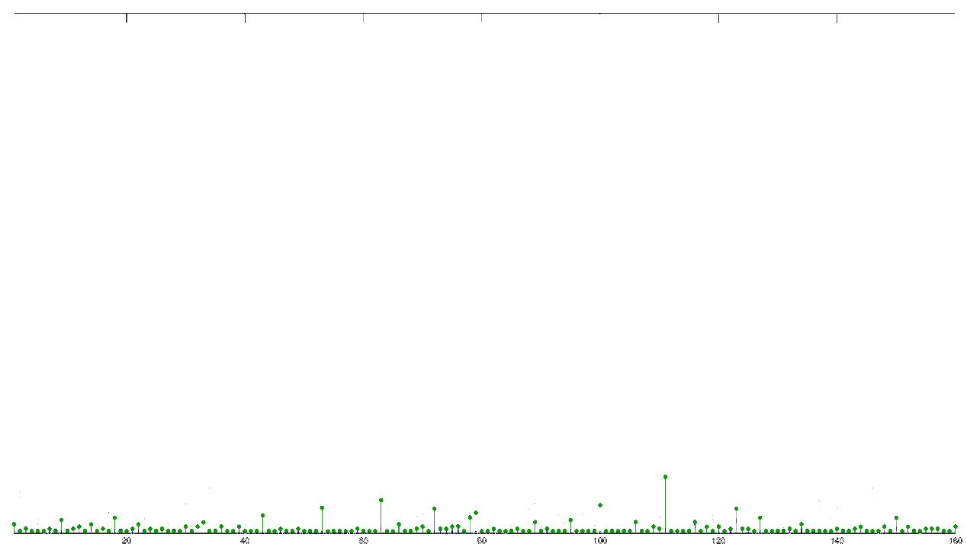
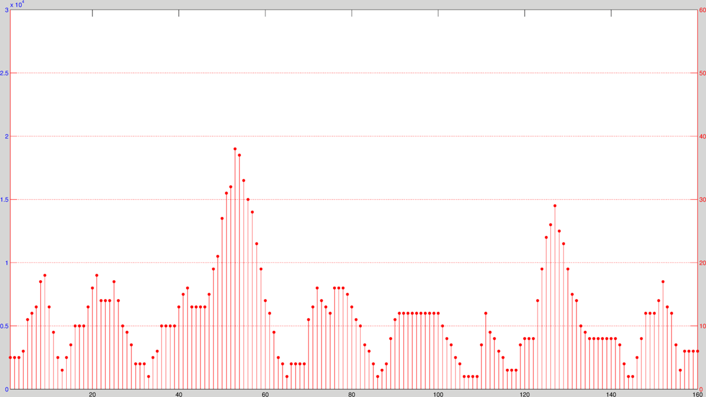
Zoom Level - The value of the magnification per each log entry. Higher the zoom, the smaller the rectangle.
1. Introduction 2. ROI Localization 3. Tissue Segmentation 4. Automated Diagnosis 5.Viewing Behavior Analysis 6. Conclusions
Displacement - The distance between the two consecutive viewport rectangles in pixels.
Duration - The amount of time a pathologist spent at each viewport rectangle.

Slide 17
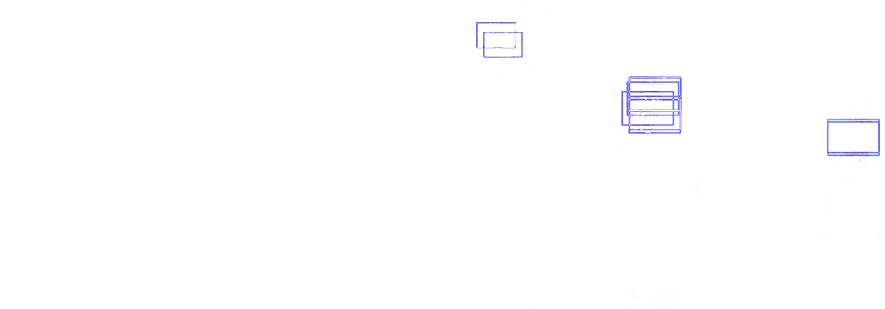

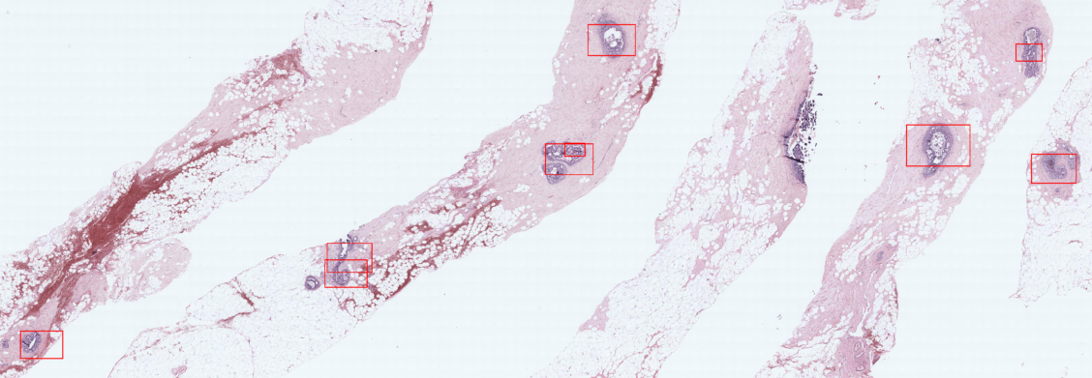
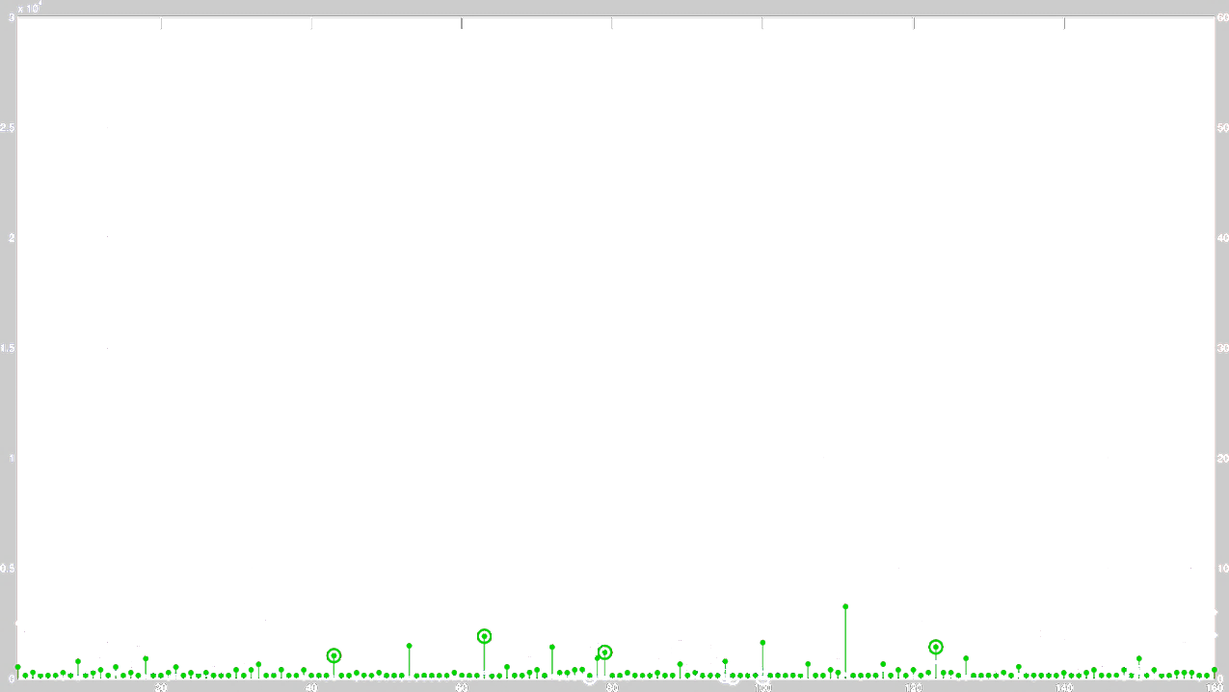
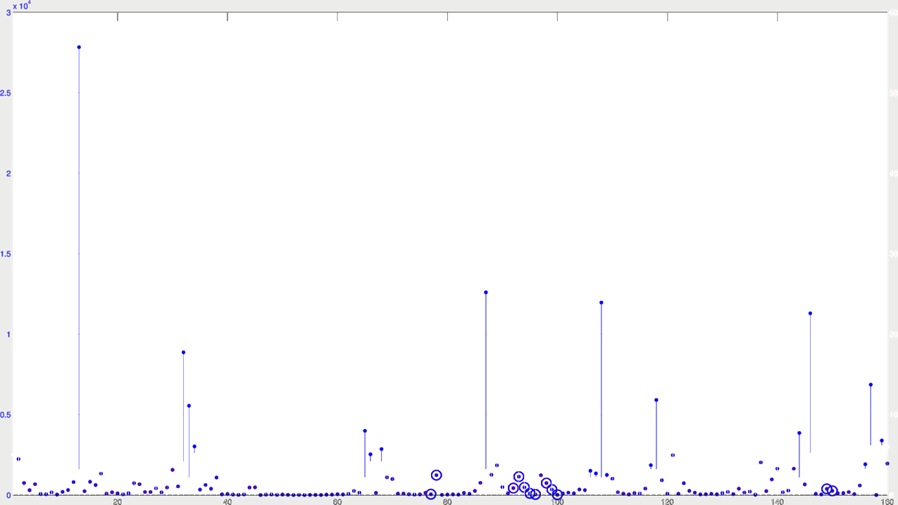
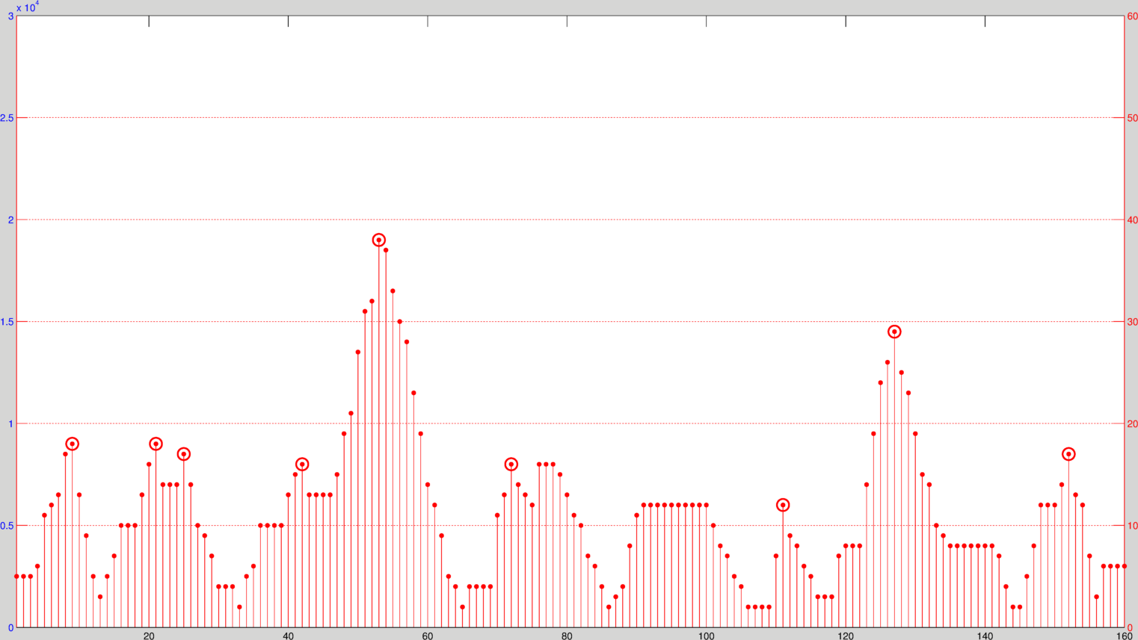


1. Introduction 2. ROI Localization 3. Tissue Segmentation 4. Automated Diagnosis 5.Viewing Behavior Analysis 6. Conclusions
Zoom Peaks:
$$zoom\left(i\right)>zoom\left(i+1\right) \\ zoom\left(i\right)>zoom(i−1)$$
Slow Pannings:
$$zoom\left(i\right)=zoom\left(i−1\right) \\ displacement\left(i\right)<100 px$$
Fixations:
$$duration\left(i\right)>2 sec$$
displacement (pixels)
zoom level / duration (seconds)
viewports / log entries

Slide 18
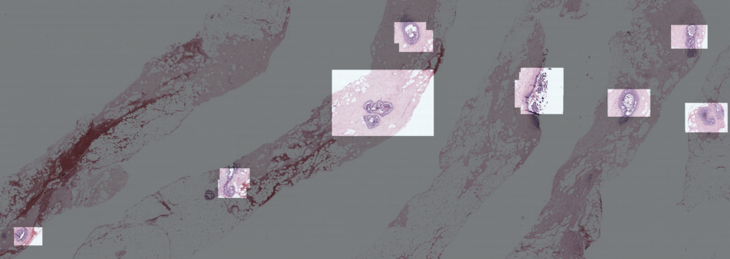
1. Introduction 2. ROI Localization 3. Tissue Segmentation 4. Automated Diagnosis 5.Viewing Behavior Analysis 6. Conclusions
Union of three defines diagnostically
important ROIs
Can we model these ROIs using image features?

Slide 19
  ROI Localization in WSIs
1. Introduction 2. ROI Localization 3. Tissue Segmentation 4. Automated Diagnosis 5.Viewing Behavior Analysis 6. Conclusions
Tracking Data Analysis to Discover ROIs
A Model based on Color and Texture to Predict ROIs
our viewport analysis
ROIs to which pathologist
actually paid attention
tracking data
an unseen WSI
our computational model based on color and texture
our predicted ROIs

Slide 20
Visual Bag-of-Words Model
1. Introduction 2. ROI Localization 3. Tissue Segmentation 4. Automated Diagnosis 5.Viewing Behavior Analysis 6. Conclusions

Slide 21























































Learning Visual Dictionary
1. Introduction 2. ROI Localization 3. Tissue Segmentation 4. Automated Diagnosis 5.Viewing Behavior Analysis 6. Conclusions
K-means
clustering
ROIs
color (L*a*b) and
texture (LBP)
histograms
Visual Dictionary
120x120 pixel patches
Words are obtained from ROIs.
Each pixel patch is a visual word.
We calculated color and texture histograms from each visual word.
Using k-means clustering we obtained a visual dictionary.

Slide 22
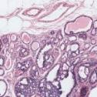
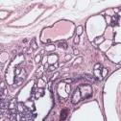
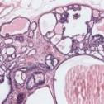









1. Introduction 2. ROI Localization 3. Tissue Segmentation 4. Automated Diagnosis 5.Viewing Behavior Analysis 6. Conclusions
Training: Sliding Window
Visual bag : overlapping sliding windows
Each visual bag has 900 visual words.
Bag-of-words: a histogram of K visual words from the visual dictionary
Bags inside the ROIs are positive samples.
Bags outside the ROIs are negative samples.
+++---
3600x3600 pixel
overlapping sliding windows
whole slide images
a histogram (bag of words)
for each sliding window

Slide 23



Evaluation
1. Introduction 2. ROI Localization 3. Tissue Segmentation 4. Automated Diagnosis 5.Viewing Behavior Analysis 6. Conclusions
Each sliding window is a sample.
Evaluation metric: Accuracy
$$accuracy=\frac{\# correctly classified sliding windows}{total \# sliding windows}$$
Ground Truth
(from viewport analysis)
Prediction
(from visual bag-of-words model)

Slide 24




































1. Introduction 2. ROI Localization 3. Tissue Segmentation 4. Automated Diagnosis 5.Viewing Behavior Analysis 6. Conclusions
  Experiments
K = # words
Dictionary size:
  K = 200 ⟶ 5
patch clusters
Visual words:
  patches
  superpixels
superpixel clusters
We ran 10-fold cross-validation experiments using Logistic Regression.
Dataset:
  N=240 whole slide images
  Expert viewport logs.

Slide 25
Prediction Results
1. Introduction 2. ROI Localization 3. Tissue Segmentation 4. Automated Diagnosis 5.Viewing Behavior Analysis 6. Conclusions
Superpixels are slightly better visual words than patches but the difference is not statistically significant.

Slide 26

Dictionary Size
1. Introduction 2. ROI Localization 3. Tissue Segmentation 4. Automated Diagnosis 5.Viewing Behavior Analysis 6. Conclusions
K = 40
Removing the visual words that describe the epithelium reduces the accuracy significantly.
K = 30

Slide 27



Results
1. Introduction 2. ROI Localization 3. Tissue Segmentation 4. Automated Diagnosis 5.Viewing Behavior Analysis 6. Conclusions
Ground Truth
(from viewport analysis)
Prediction

Slide 28
Summary
1. Introduction 2. ROI Localization 3. Tissue Segmentation 4. Automated Diagnosis 5.Viewing Behavior Analysis 6. Conclusions
We presented
  a novel viewport log analysis to detect diagnostically relevant ROIs from pathologists’ actions, and
  a visual bag-of-words model based on color and texture features to predict ROIs in unseen WSIs.
74% prediction accuracy in 240 WSIs.

Slide 29
Outline
Introduction
ROI Localization in WSIs
Tissue Label Segmentation
Automated Diagnosis of ROIs
Viewing Behavior Analysis
Conclusions

Slide 30
digiPATH Dataset
1. Introduction 2. ROI Localization 3. Tissue Segmentation 4. Automated Diagnosis 5.Viewing Behavior Analysis 6. Conclusions
pathologist
(n=87)
assessment
(n=5,220)
case
(n=240)
age
years in practice
# cases per week
affiliation
lab size
education
pathology perception
participant ROI*
participant diagnosis
viewport log
digital WSI
consensus ROI
consensus diagnosis
confidence score
difficulty score
borderline diagnoses
biopsy type
breast density
patient age
Diagnostic Outcome
Accuracy & Efficiency

Slide 31
Tissue Label Segmentation
1. Introduction 2. ROI Localization 3. Tissue Segmentation 4. Automated Diagnosis 5.Viewing Behavior Analysis 6. Conclusions
For an automated diagnosis system, we need to describe the structural changes that lead to cancer.
Segmentation is a powerful that provides information about the distribution and arrangement of different tissue types.
S. Mehta, E. Mercan, et al., British Machine Vision Conference, 2017 (submitted).

Slide 32






































1. Introduction 2. ROI Localization 3. Tissue Segmentation 4. Automated Diagnosis 5.Viewing Behavior Analysis 6. Conclusions
Superpixel Clustering
empty space
k-means
clustering
blood cells
color (L*a*b) and
texture (LBP)
histograms
loose stroma
dense stroma
superpixel segmentation of an ROI
normal nuclei
Each superpixel cluster can be identified as a biologically meaningful building block of the tissue.
abnormal nuclei
superpixel clusters

Slide 33
Superpixel Clustering
1. Introduction 2. ROI Localization 3. Tissue Segmentation 4. Automated Diagnosis 5.Viewing Behavior Analysis 6. Conclusions
benign
atypia
DCIS
Patterns emerge when we label the superpixels in an unsupervised manner.

Slide 34



Supervised Tissue Label Segmentation
1. Introduction 2. ROI Localization 3. Tissue Segmentation 4. Automated Diagnosis 5.Viewing Behavior Analysis 6. Conclusions
ground truth
label image
classifier
original image
We tested two models using a subset of ROIs (N=58):
Support Vector Machines (SVM)
Convolutional Neural Nets (CNN)

Slide 35








Training Labels
1. Introduction 2. ROI Localization 3. Tissue Segmentation 4. Automated Diagnosis 5.Viewing Behavior Analysis 6. Conclusions
background
benign epithelium
normal stroma
secretion
necrosis
malignant epithelium
desmoplastic stroma
blood

Slide 36














Superpixel + SVM-based Segmentation
1. Introduction 2. ROI Localization 3. Tissue Segmentation 4. Automated Diagnosis 5.Viewing Behavior Analysis 6. Conclusions
Ground Truth
no neighborhood
1 neighborhood
2 neighborhoods
color and texture
histograms
background
benign epithelium
normal stroma
secretion
necrosis
malignant epithelium
desmoplastic stroma
blood

Slide 37
















1. Introduction 2. ROI Localization 3. Tissue Segmentation 4. Automated Diagnosis 5.Viewing Behavior Analysis 6. Conclusions
CNN-based Segmentation
Input Image
$$384×384$$
Ground Truth
Plain
Multi-Resolution
$$256×256$$
Encoder-Decoder
Encoder-Decoder
background
benign epithelium
normal stroma
secretion
necrosis
malignant epithelium
desmoplastic stroma
blood
Segmentation
$256×$256
Segmentation
joint work with Sachin Mehta
$256×$256

Slide 38










































1. Introduction 2. ROI Localization 3. Tissue Segmentation 4. Automated Diagnosis 5.Viewing Behavior Analysis 6. Conclusions
CNN-based Segmentation
Training set: 38 ROIs
Test set: 20 ROIs
ROI
Segmented ROI
CNN
Overlapping Patches
256x256 pixel
Segmented Patches

Slide 39



Supervised Tissue Label Segmentation
1. Introduction 2. ROI Localization 3. Tissue Segmentation 4. Automated Diagnosis 5.Viewing Behavior Analysis 6. Conclusions
Superpixel + SVM
CNN
Each superpixel is assigned a class label.
Context: Two circular neighborhoods
Relatively simple model
Faster to train (~3 hours)
Each pixel is assigned a class label.
Context: 256x256 and 384x384 pixel patches
More complex model
~1 week to train on special hardware

Slide 40




Evaluation
1. Introduction 2. ROI Localization 3. Tissue Segmentation 4. Automated Diagnosis 5.Viewing Behavior Analysis 6. Conclusions
Each pixel is a sample.
false
negatives
+
-
true
negatives
precision
recall
+
-
+
+
-
true
positives
-
-
false
positives
+
-
-
+
+
-
+
+
-
-
$$\frac{\# tp}{\# tp+\# fp}$$
$$\frac{\# tp}{\# tp+\# fn}$$
$$\# tp=true positive$$
$$\# tn=true negative$$
$$\# fp=false positive$$
$$\# fn=false negative$$
$$F_{1} score=2×\frac{precision×recall}{precision+recall}$$
predictions

Slide 41
Results
1. Introduction 2. ROI Localization 3. Tissue Segmentation 4. Automated Diagnosis 5.Viewing Behavior Analysis 6. Conclusions
Mean F₁-score
SP+SVM | 0.40
CNN | 0.50

Slide 42



Confusion Matrices
1. Introduction 2. ROI Localization 3. Tissue Segmentation 4. Automated Diagnosis 5.Viewing Behavior Analysis 6. Conclusions
Superpixels + SVM
CNN

Slide 43






Segmentation Results
1. Introduction 2. ROI Localization 3. Tissue Segmentation 4. Automated Diagnosis 5.Viewing Behavior Analysis 6. Conclusions
RGB
Ground Truth Labels
SVM Predictions
CNN Predictions
background
benign epi
normal stroma
secretion
necrosis
malignant epi
desmoplastic stroma
blood

Slide 44
Summary
1. Introduction 2. ROI Localization 3. Tissue Segmentation 4. Automated Diagnosis 5.Viewing Behavior Analysis 6. Conclusions
Tissue-label segmentation is a useful abstraction.
We developed a set of 8 tissue labels and collected pixel-label data from a pathologist on 58 ROIs.
We trained two models: SVM and CNN
CNNs performed significantly better than SVMs both quantitatively and qualitatively.

Slide 45
Outline
Introduction
ROI Localization in WSIs
Tissue Label Segmentation
Automated Diagnosis of ROIs
Viewing Behavior Analysis
Conclusions

Slide 46
digiPATH Dataset
1. Introduction 2. ROI Localization 3. Tissue Segmentation 4. Automated Diagnosis 5.Viewing Behavior Analysis 6. Conclusions
pathologist
(n=87)
assessment
(n=5,220)
case
(n=240)
age
years in practice
# cases per week
affiliation
lab size
education
pathology perception
participant ROI*
participant diagnosis
viewport log
digital WSI
consensus ROI
consensus diagnosis
confidence score
difficulty score
borderline diagnoses
biopsy type
breast density
patient age
Diagnostic Outcome
Accuracy & Efficiency

Slide 47
Automated Diagnosis of ROIs
1. Introduction 2. ROI Localization 3. Tissue Segmentation 4. Automated Diagnosis 5.Viewing Behavior Analysis 6. Conclusions
Diagnostic errors are alarmingly high for pre-invasive lesions of the breast.
In the digiPATH study, the agreement between pathologists and experts for the atypia cases is only 48%.
Novel image features for diagnosis can help
  develop computer aided diagnosis systems, and
  study the reasons for diagnostic errors.

Slide 48

Superpixel Label
Frequency and Co-occurrence Histograms
1. Introduction 2. ROI Localization 3. Tissue Segmentation 4. Automated Diagnosis 5.Viewing Behavior Analysis 6. Conclusions
Frequency Histogram
Co-occurrence Histogram
stroma
necrosis
bg-bg
epi-bg
nec-bg
nec-str
secretion
epi-epi
secr-bg
secr-epi
secr-str
nec-epi
nec-nec
epithelium
secr-secr
nec-secr
background
stroma-bg
stroma-epi
stroma-stroma

Slide 49



Structure Feature
1. Introduction 2. ROI Localization 3. Tissue Segmentation 4. Automated Diagnosis 5.Viewing Behavior Analysis 6. Conclusions
benign
atypia
(DCIS)
invasive
background
benign epi
duct layer
malignant epi
normal stroma
desmoplastic str
secretion
blood
necrosis

Slide 50






1. Introduction 2. ROI Localization 3. Tissue Segmentation 4. Automated Diagnosis 5.Viewing Behavior Analysis 6. Conclusions
Inner Layers
Outer Layers
background
malignant epithelium
desmoplastic stroma
blood
benign epithelium
normal stroma
secretion
necrosis

Slide 51




Structure Feature
1. Introduction 2. ROI Localization 3. Tissue Segmentation 4. Automated Diagnosis 5.Viewing Behavior Analysis 6. Conclusions
duct layer
inner layer 1
inner layer 2
inner layer 3
inner layer 4
inner layer 5
outer layer 1
outer layer 2
outer layer 3
outer layer 4
outer layer 5
duct layer
inner layer 1
inner layer 2
inner layer 3
inner layer 4
inner layer 5
outer layer 1
outer layer 2
outer layer 3
outer layer 4
outer layer 5
background | benign epi | malign. epi | normal str | desmo. str | secretion | blood | necrosis
background | benign epi | malign. epi | normal str | desmo. str | secretion | blood | necrosis

Slide 52



1. Introduction 2. ROI Localization 3. Tissue Segmentation 4. Automated Diagnosis 5.Viewing Behavior Analysis 6. Conclusions
RGB image of an ROI
unsupervised
supervised
k-means clustering
SVM / CNN
Low-Level
Color & Texture
Features
Superpixel
Label
Freq. & Cooc. Histograms
Superpixel
Label
Freq. & Cooc. Histograms
Structure
Feature

Slide 53




Diagnostic Classification
1. Introduction 2. ROI Localization 3. Tissue Segmentation 4. Automated Diagnosis 5.Viewing Behavior Analysis 6. Conclusions
Benign
Atypia
DCIS
Invasive
N=428
Invasive
DCIS
Atypia
Benign
N=36
N=162
N=128
N=102
4-class classification

Slide 54
1. Introduction 2. ROI Localization 3. Tissue Segmentation 4. Automated Diagnosis 5.Viewing Behavior Analysis 6. Conclusions
Diagnostic Classification
Benign
Atypia
DCIS
Invasive
N=428
Invasive
Benign
Atypia
DCIS
N=392
N=36
Atypia
DCIS
Benign
N=290
N=102
1-diagnosis-at-a-time
mimicking pathologists
DCIS
Atypia
N=162
N=128

Slide 55


Evaluation
1. Introduction 2. ROI Localization 3. Tissue Segmentation 4. Automated Diagnosis 5.Viewing Behavior Analysis 6. Conclusions
Each ROI is a sample.
false
negatives
+
-
true
negatives
accuracy
sensitivity
specificity
+
-
+
+
-
true
positives
-
-
false
positives
+
-
-
+
+
-
+
+
-
-
$$\frac{\# tp+\# tn}{ all}$$
$$\frac{\# tp}{\# tp+\# fn}$$
$$\frac{\# tn}{\# tn+\# fp}$$
$$\# tp=true positive$$
$$\# tn=true negative$$
$$\# fp=false positive$$
$$\# fn=false negative$$

Slide 56
Experiments
1. Introduction 2. ROI Localization 3. Tissue Segmentation 4. Automated Diagnosis 5.Viewing Behavior Analysis 6. Conclusions
We subsampled the training data for a uniform distribution of all classes.
We trained SVMs with different features
We ran 10-fold cross-validation experiments for the 4 classification tasks:
All
All
All
All
Benign
Invasive
Invasive
Non-invasive
Invasive
Non-invasive
Invasive
Non-invasive
Atypia
DCIS
Atypia or DCIS
Benign
Atypia or DCIS
Benign
Atypia or DCIS
Benign
DCIS
Atypia
DCIS
Atypia
DCIS
Atypia

Slide 57
1. Introduction 2. ROI Localization 3. Tissue Segmentation 4. Automated Diagnosis 5.Viewing Behavior Analysis 6. Conclusions
Accuracy for
4-class classification
All
Benign
Invasive
Atypia
DCIS
.56
No background
No background and stroma

Slide 58
1. Introduction 2. ROI Localization 3. Tissue Segmentation 4. Automated Diagnosis 5.Viewing Behavior Analysis 6. Conclusions
Accuracy for
invasive vs. benign & atypia & DCIS
All
Invasive
Non-invasive
Atypia or DCIS
Benign
DCIS
Atypia
No background
.94
No background and stroma

Slide 59
1. Introduction 2. ROI Localization 3. Tissue Segmentation 4. Automated Diagnosis 5.Viewing Behavior Analysis 6. Conclusions
Accuracy for
atypia & DCIS vs. benign
All
Invasive
Non-invasive
Atypia or DCIS
Benign
DCIS
Atypia
No background
.70
.70
No background and stroma

Slide 60
1. Introduction 2. ROI Localization 3. Tissue Segmentation 4. Automated Diagnosis 5.Viewing Behavior Analysis 6. Conclusions
Accuracy for
DCIS & atypia
All
Invasive
Non-invasive
Atypia or DCIS
Benign
DCIS
Atypia
No background
.85
No background and stroma

Slide 61
Results – Accuracies
1. Introduction 2. ROI Localization 3. Tissue Segmentation 4. Automated Diagnosis 5.Viewing Behavior Analysis 6. Conclusions
 | Average Accuracy
 | Invasive vs. Non-invasive | Atypia & DCIS vs. Benign | DCIS vs. Atypia | 4-class
Participant Pathologists | .98 | .81 | .80 | .70
Freq. and Cooc. Hist. | .94 | .70 | .83 | .46
Structure Feature | .91 | .70 | .85 | .56
sensitivity
specificity
.84
.99
.72
.62
.70
.82
sensitivity
specificity
.70
.95
.83
.42
sensitivity
specificity
.85
.45
.89
.80

Slide 62

Structure Feature
1. Introduction 2. ROI Localization 3. Tissue Segmentation 4. Automated Diagnosis 5.Viewing Behavior Analysis 6. Conclusions
benign epithelium
malignant epithelium
necrosis
atypia
ROIs
DCIS
duct
inner 1
inner 2
inner 3
inner 4
inner 5
outer 1
outer 2
outer 3
outer 4
outer 5
secretion
benign epi
necrosis
blood
malignant epi

Slide 63
Summary
1. Introduction 2. ROI Localization 3. Tissue Segmentation 4. Automated Diagnosis 5.Viewing Behavior Analysis 6. Conclusions
Image features to describe the diagnostically important visual characteristics:
  superpixel label frequency and co-occurrence histograms
  structure feature
Different features are informative for different diagnoses:
  Superpixel label frequency and co-occurrence histograms for invasive cancer (0.94 accuracy).
  Structure features for benign, atypia and DCIS (0.70 and 0.85 accuracies).

Slide 64
Outline
Introduction
ROI Localization in WSIs
Tissue Label Segmentation
Automated Diagnosis of ROIs
Viewing Behavior Analysis
Conclusions

Slide 65
digiPATH Dataset
1. Introduction 2. ROI Localization 3. Tissue Segmentation 4. Automated Diagnosis 5.Viewing Behavior Analysis 6. Conclusions
pathologist
(n=87)
assessment
(n=5,220)
case
(n=240)
age
years in practice
# cases per week
affiliation
lab size
education
pathology perception
participant ROI*
participant diagnosis
viewport log
digital WSI
consensus ROI
consensus diagnosis
confidence score
difficulty score
borderline diagnoses
biopsy type
breast density
patient age
Diagnostic Outcome
Accuracy & Efficiency

Slide 66
Diagnostic Search Patterns:
Scanners and Drillers
1. Introduction 2. ROI Localization 3. Tissue Segmentation 4. Automated Diagnosis 5.Viewing Behavior Analysis 6. Conclusions
Histopathological diagnosis is a visual search.
Prior work in radiology showed that physicians tend to adopt different search strategies.
Our aim is:
  To find efficient and accurate visual search strategies for diagnosis.
  To understand the factors affecting visual search patterns.
E. Mercan, et al., Journal of Digital Imaging, 2017 (accepted).

Slide 67


Scanners and Drillers
1. Introduction 2. ROI Localization 3. Tissue Segmentation 4. Automated Diagnosis 5.Viewing Behavior Analysis 6. Conclusions
Scanner
Viewport Graph
Viewport
Pathologist’s Screen

Slide 68

Scanners and Drillers
1. Introduction 2. ROI Localization 3. Tissue Segmentation 4. Automated Diagnosis 5.Viewing Behavior Analysis 6. Conclusions
Scanner
Viewport Graph
Viewport
Pathologist’s Screen
Driller
Viewport Graph
Viewport
Pathologist’s Screen

Slide 69







Scanning Percentage
1. Introduction 2. ROI Localization 3. Tissue Segmentation 4. Automated Diagnosis 5.Viewing Behavior Analysis 6. Conclusions
$$\frac{scanning}{total}= 94\%$$
drill
drill
drill
zoom level
scan
scan
scan
scan
$$\frac{scanning}{total}=47\%$$
zoom level

Slide 70
Zoom Level Statistics
1. Introduction 2. ROI Localization 3. Tissue Segmentation 4. Automated Diagnosis 5.Viewing Behavior Analysis 6. Conclusions
Average Zoom Level
Maximum Zoom Level
Zoom Level Variance
zoom level
zoom level

Slide 71

Statistical Analysis
1. Introduction 2. ROI Localization 3. Tissue Segmentation 4. Automated Diagnosis 5.Viewing Behavior Analysis 6. Conclusions
What factors affect interpretative strategy?
Pathologists
(n=87)
Assessments
(n=5,220)
Generalized Estimating Equations
(GEE) Model
Pathologist Characteristics
Breast Histopathology Perceptions
Scanning Percentage
joint work with Prof. Tad Brunye

Slide 72



Pathologist Demographics
1. Introduction 2. ROI Localization 3. Tissue Segmentation 4. Automated Diagnosis 5.Viewing Behavior Analysis 6. Conclusions
Age
Gender
Facility Size
N=10
N=30
N=25
N=32
N=36
N=57
N=16
N=55

Slide 73


Pathologist Demographics
1. Introduction 2. ROI Localization 3. Tissue Segmentation 4. Automated Diagnosis 5.Viewing Behavior Analysis 6. Conclusions
Experience (years)
Baseline Confidence
N=2
Scanning Percentage
N=8
N=21
N=65
N=22
N=43
N=13

Slide 74
Interpretation Order
1. Introduction 2. ROI Localization 3. Tissue Segmentation 4. Automated Diagnosis 5.Viewing Behavior Analysis 6. Conclusions
Participants learn to drill
even in the course of 60 cases.

Slide 75
Statistical Analysis
1. Introduction 2. ROI Localization 3. Tissue Segmentation 4. Automated Diagnosis 5.Viewing Behavior Analysis 6. Conclusions
How does interpretative strategy influence diagnostic outcome?
Assessments
(n=5,220)
ANOVA
Diagnostic
Accuracy & Efficiency
Under-interpretation
Over-interpretation
Interpretation Time
Average Zoom Level
Maximum Zoom Level
Zoom Level Variance
Scanning Percentage

Slide 76
Diagnostic Accuracy and Efficiency
1. Introduction 2. ROI Localization 3. Tissue Segmentation 4. Automated Diagnosis 5.Viewing Behavior Analysis 6. Conclusions
Scanning does not affect diagnostic accuracy
but it costs time.

Slide 77
1. Introduction 2. ROI Localization 3. Tissue Segmentation 4. Automated Diagnosis 5.Viewing Behavior Analysis 6. Conclusions
Diagnostic Concordance
Average Zoom Level
*
*
*
*
* p<0.02 (ANOVA)

Slide 78
Diagnostic Concordance
1. Introduction 2. ROI Localization 3. Tissue Segmentation 4. Automated Diagnosis 5.Viewing Behavior Analysis 6. Conclusions
*
*
*
*
*
*
*
*
*
*
*
*
* p<0.02 (ANOVA)

Slide 79
Summary
1. Introduction 2. ROI Localization 3. Tissue Segmentation 4. Automated Diagnosis 5.Viewing Behavior Analysis 6. Conclusions
Pathologists exhibit two viewing patterns:
  scanning and drilling
We developed four objective measures to quantify the viewing behavior:
  maximum zoom level
  average zoom level
  zoom level variance
  scanning percentage

Slide 80
Summary
1. Introduction 2. ROI Localization 3. Tissue Segmentation 4. Automated Diagnosis 5.Viewing Behavior Analysis 6. Conclusions
Scanning is correlated with
  sex (females > males), age (+) , facility size (-), experience (-) and confidence (-).
Pathologists learn to drill in the course of 60 cases.
Scanning is not predictive of diagnostic accuracy but it is inefficient in terms of time.
Increasing average and maximum zoom levels, and variance correlates with over-interpretation.

Slide 81
Outline
Introduction
ROI Localization in WSIs
Tissue Label Segmentation
Automated Diagnosis of ROIs
Viewing Behavior Analysis
Conclusions

Slide 82
Our Aim
1. Introduction 2. ROI Localization 3. Tissue Segmentation 4. Automated Diagnosis 5.Viewing Behavior Analysis 6. Conclusions
We propose novel image features and viewing behavior analysis methods
to investigate the causes of diagnostic errors and
to discover accurate and efficient interpretation strategies for pathologists.

Slide 83
Contributions
1. Introduction 2. ROI Localization 3. Tissue Segmentation 4. Automated Diagnosis 5.Viewing Behavior Analysis 6. Conclusions
Novel analysis methods for the viewing behavior:
  Analysis methods for the tracking logs to detect diagnostically relevant regions
  Objective measures to quantify the interpretation patterns
Novel image features for the pre-invasive and invasive lesions of the breast:
  An 8-label supervised segmentation
  Structure feature to describe the changes associated with pre-invasive lesions

Slide 84
digiPATH
1. Introduction 2. ROI Localization 3. Tissue Segmentation 4. Automated Diagnosis 5.Viewing Behavior Analysis 6. Conclusions
pathologist
(n=87)
assessment
(n=5,220)
case
(n=240)
Viewing Pattern Characterization
✓
Image Characteristics and Viewing Patterns

Viewport Analysis
✓
Image Analysis
✓

Slide 85









Acknowledgments
Linda Shapiro
Su-In Lee
Joann Elmore
Don Weaver
Tad Brunye
Selim Aksoy
Bilge Soran
Sara Rolfe
Shu Liang
Deepali Aneja
Yao Lu
Yuguang Lee
Sachin Mehta
Shima Nofallah
Sean Yang
Bindita Chaudhuri
Nathan Sjoquist
Shenqi Tang
Irma Lam
Mabel Raza
Nicola Dell
Raven Travillian
Jia Wu
Shulin Yang
Alfred Gui
Safiye Celik
Scott Lundberg
Nao Hiranuma
Javad Hosseini
Gabriel Schubiner
Hugh Chen
Mara Rendi
Jamen Bartlett
Dilip Nagarkar
Tom Morgan
Paul Frederick
Andrea Radick
Ross Lambert
Natalia Oster
Hannah Shucard
Parmita Mehta
Mike Chung
Robert Gens
Kivanc Muslu
Paul Pham
Jinna Lei
R01 CA172343, R01 CA140560, and KO5 CA104699

Slide 86
1. Introduction 2. ROI Localization 3. Tissue Segmentation 4. Automated Diagnosis 5.Viewing Behavior Analysis 6. Conclusions
F₁ score for
invasive vs. benign & atypia & DCIS
All
Invasive
Non-invasive
Atypia or DCIS
Benign
DCIS
Atypia
No background
No background and stroma

Slide 87
1. Introduction 2. ROI Localization 3. Tissue Segmentation 4. Automated Diagnosis 5.Viewing Behavior Analysis 6. Conclusions
F₁ score for
atypia & DCIS vs. benign
All
Invasive
Non-invasive
Atypia or DCIS
Benign
DCIS
Atypia
No background
No background and stroma

Slide 88
1. Introduction 2. ROI Localization 3. Tissue Segmentation 4. Automated Diagnosis 5.Viewing Behavior Analysis 6. Conclusions
F₁ score for
DCIS & atypia
All
Invasive
Non-invasive
Atypia or DCIS
Benign
DCIS
Atypia
No background
No background and stroma

