Slide 1

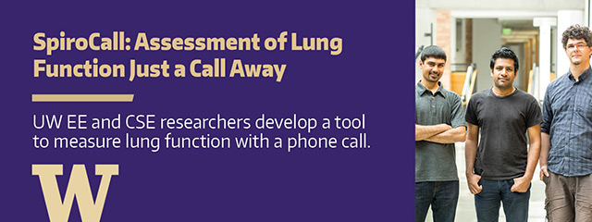

Fast Mitosis Detection in Histopathological Images using Deep Learning Neural Networks
Yuguang Li
Advisor: Linda Shapiro

Slide 2
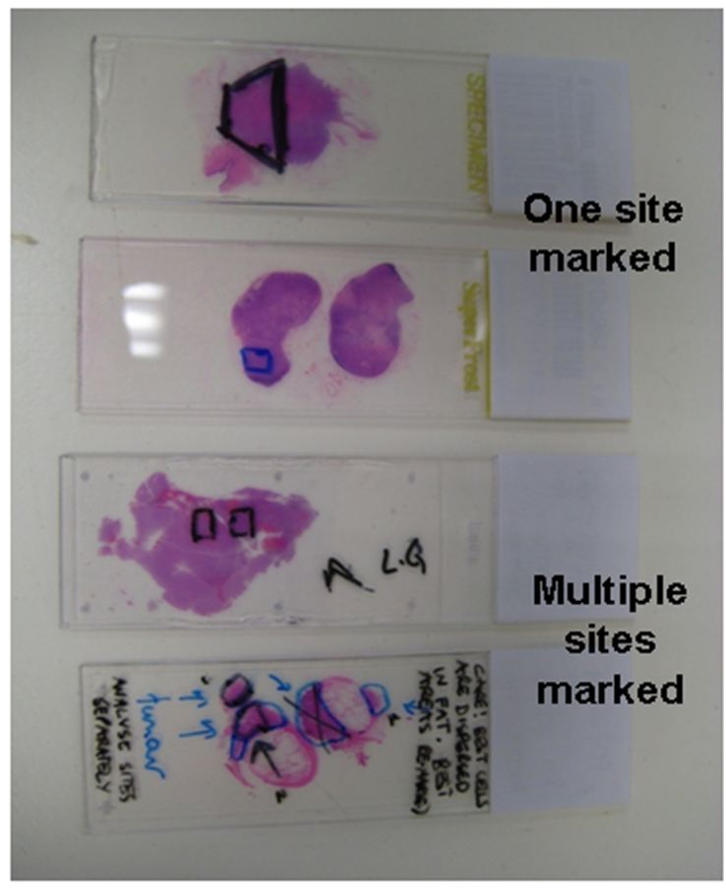
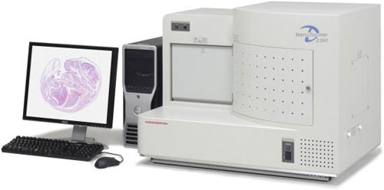
Histopathological Image Analysis – Breast Cancer Diagnosis
Terminology:
Histopathological Images
Tissue Staining
Whole Image Slides
Tissue Slide Staining
Image Scanning
Histopathological Image Analysis

Slide 3
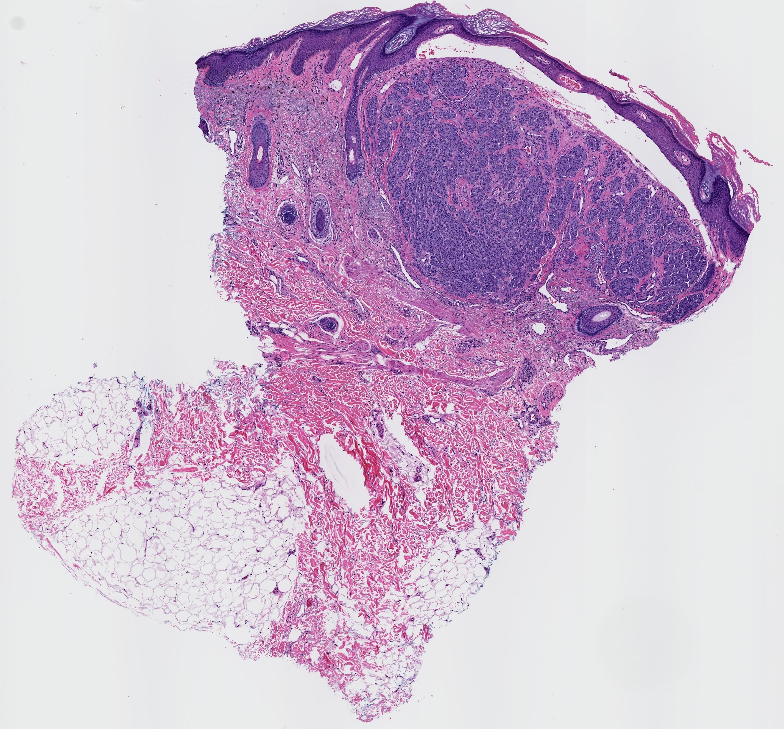
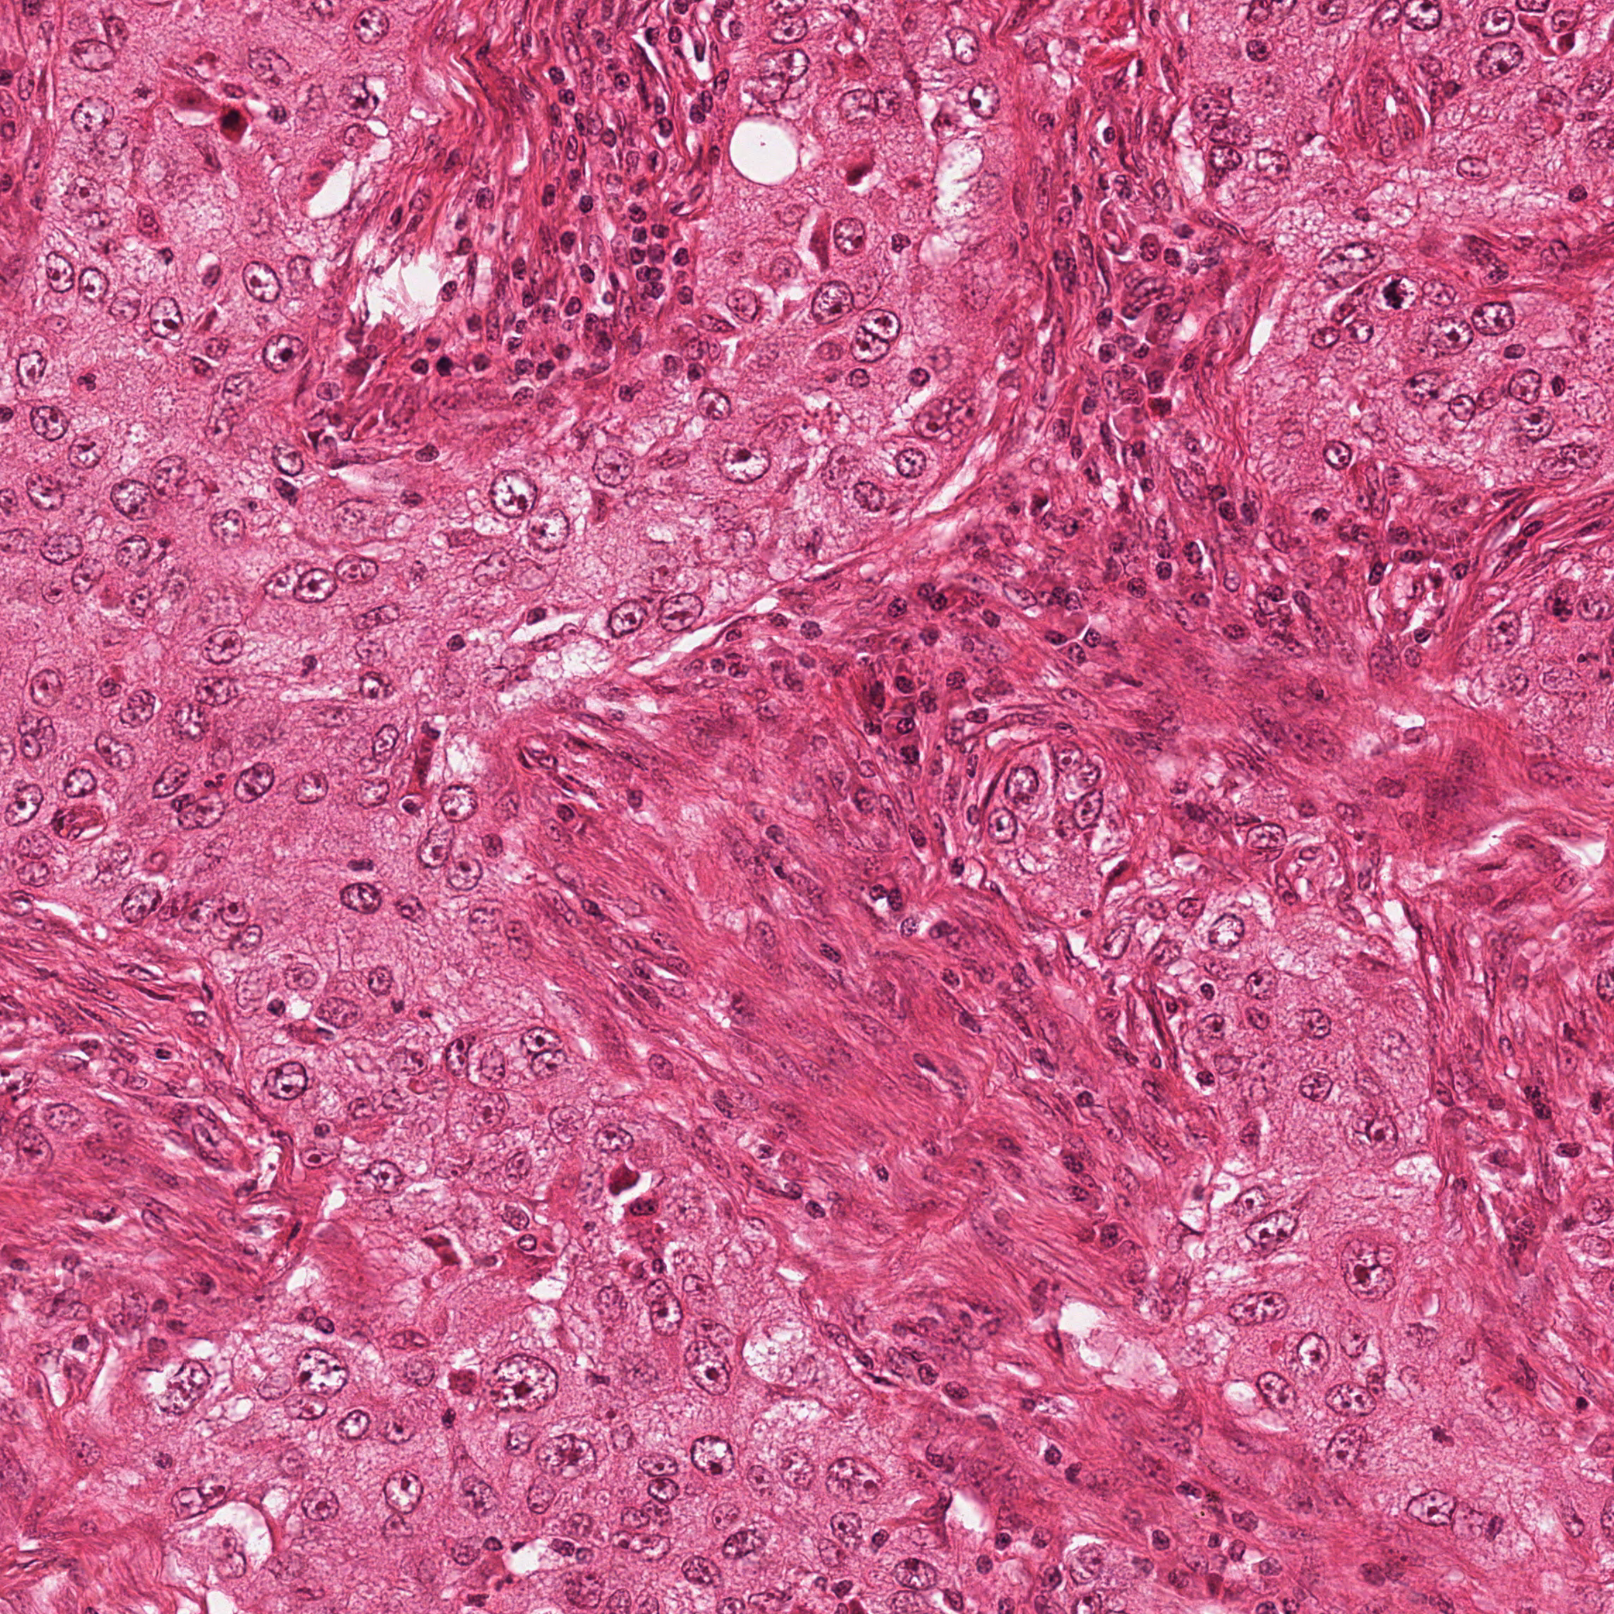
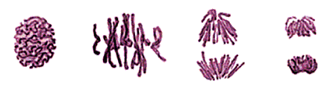
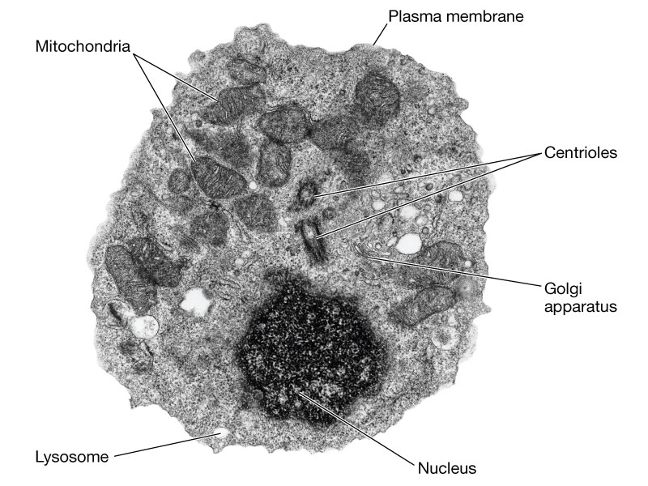
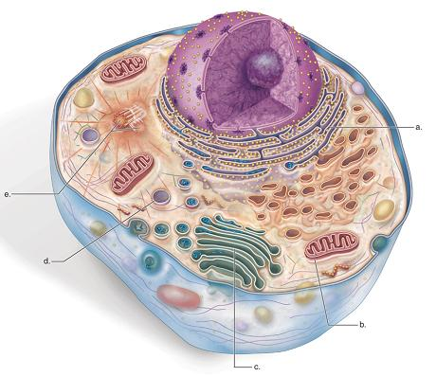
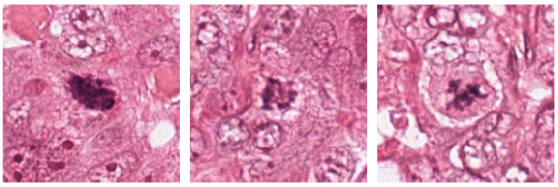
Histopathological Image Analysis
Terminology:
Histopathological Images
Whole Slide
Tissue Staining
Scale x10
Whole Image Slides
Scale x40
Region of Tumor
Region of Interest
Cell
Mitosis
Yuguang Li Quals– 2016 Spring

Slide 4
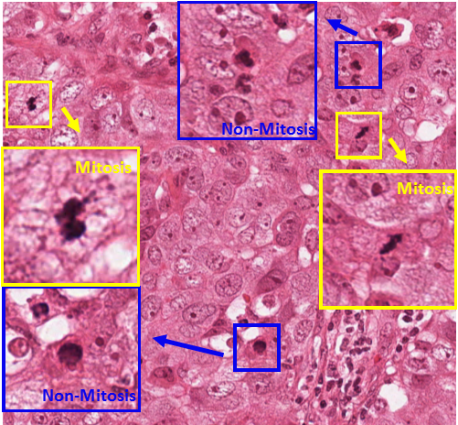
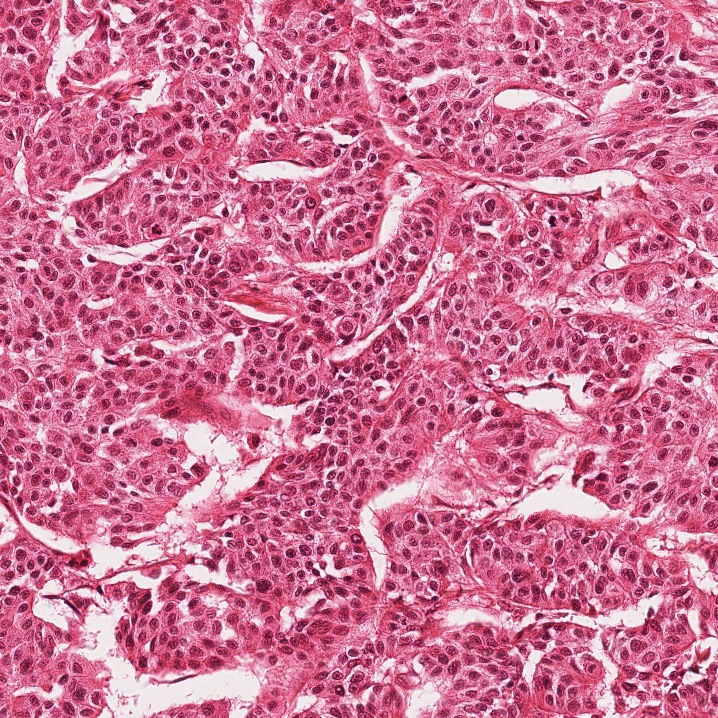
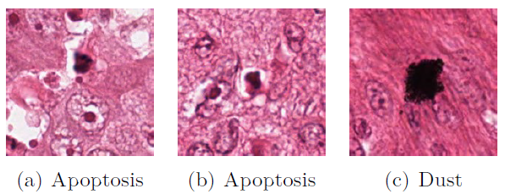
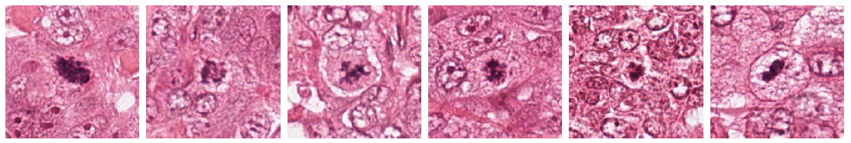
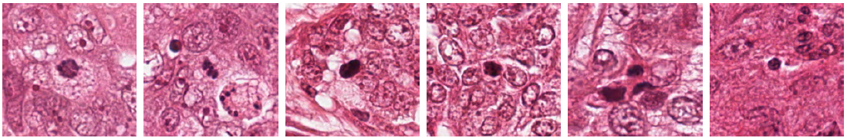
Objectives: Counting Mitosis
Challenges in Mitosis Detection:
Small objects with a large variety of shape configurations & texture variation
Low frequency of appearance.
Similarity with other types of nuclei
Mitosis
Non-Mitosis
Objective

Slide 5
MITOS dataset – ICPR 2012 Mitosis Detection Challenge
General Information
50 high-power fields (x40 magnitude) images in 5 different biopsy slides stained with Hematosin.
Each field has 2048*2048 pixels representing a 512×512μm2 area.
Expert pathologists manually annotated 300 mitoses. Average Mitosis size 30*30 pixels. Every pixel of each mitosis is labeled.
The annotated mitoses are what two pathologists agreed on. So there are mitosis-like regions unannotated in these images.
Training Set
Testing Set
35 images (7 images from each biopsy slides)
200 mitoses annotated
15 images (3 images from each biopsy slides)
100 mitoses annotated
Research Dataset

Slide 6
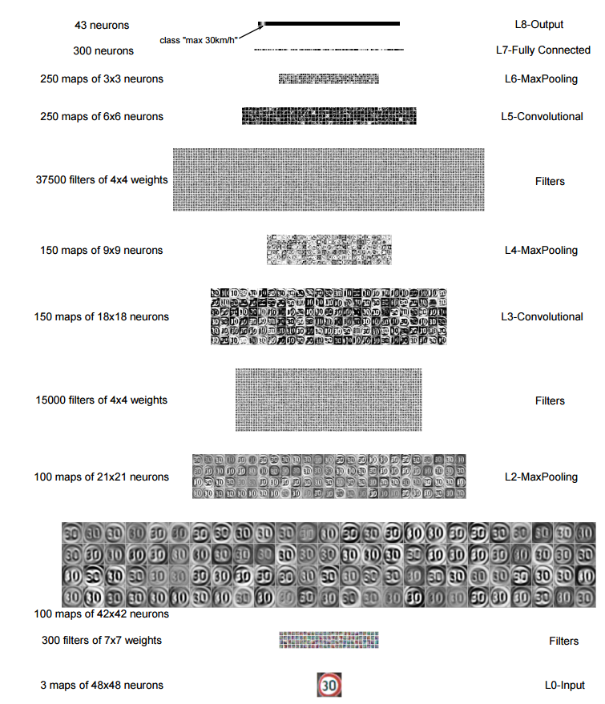

Convolutional Neural Network
Structure Figure
Convolutional Neural Network
Image Collection with different class labels
Mention that the CNN features could be classified with different classifiers. They represent different image features from different regions and cases

Slide 7
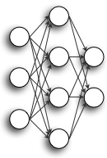

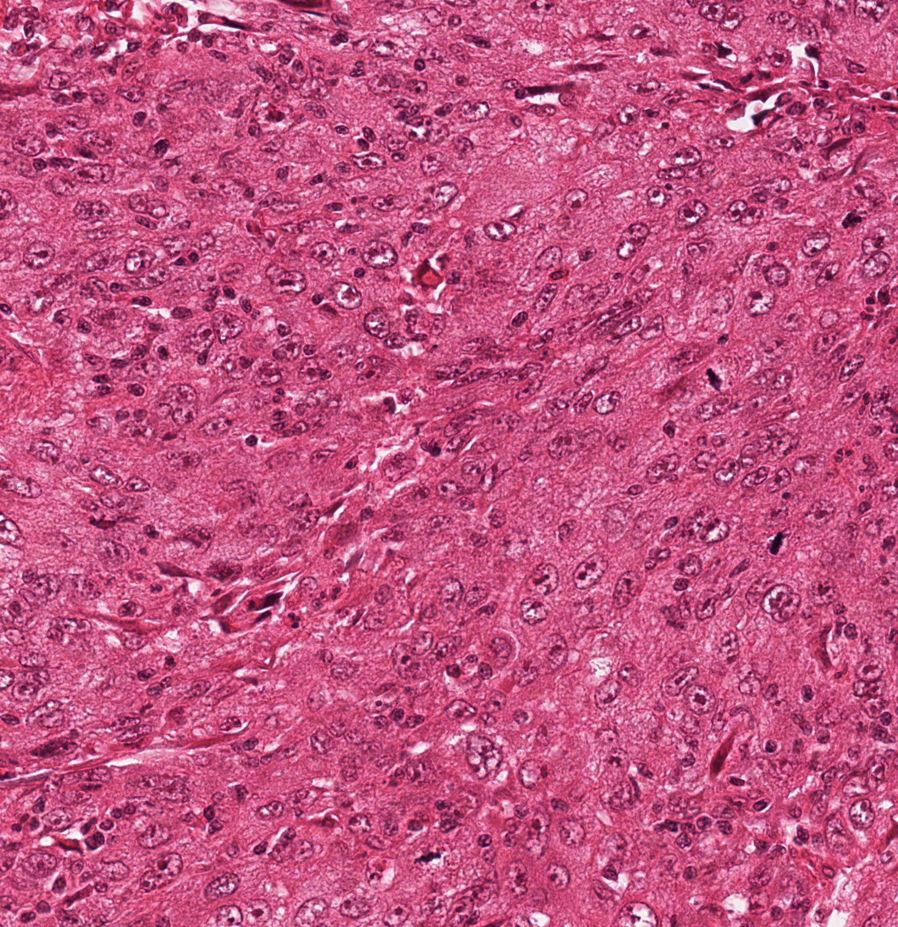
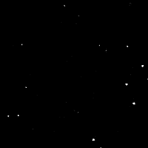
Structure of Convolutional Neural Network
12-layer CNN Model
Layer | Type | Neurons | Filter Size
0 | Input | 3M x 101 x 101 | --
1 | Conv | 16M x 100 x 100 | 2 x 2
2 | MaxPool | 16M x 50 x 50 | 2 x 2
3 | Conv | 16M x 48 x 48 | 3 x 3
4 | MaxPool | 16M x 24 x 24 | 2 x 2
5 | Conv | 16M x 22 x 22 | 3 x 3
6 | MaxPool | 16M x 11 x 11 | 2 x 2
7 | Conv | 16M x 10 x 10 | 2 x 2
8 | MaxPool | 16M x 5 x 5 | 2 x 2
9 | Conv | 16M x 4 x 4 | 2 x 2
10 | MaxPool | 16M x 2 x 2 | 2 x 2
11 | FullyConn | 100 | 1 x 1
12 | FullyConn | 2 | 1 x 1
RGB Patch Input
CNN Classifier
Probability
Testing method: Sliding Window
Original Image
Probability Map
Convolutional Neural Network

Slide 8
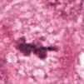
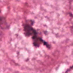
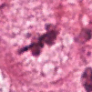
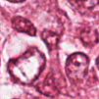
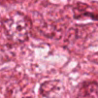
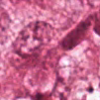
Training of Convolutional Neural Network
Objective:
Create an image patch classifier react positively when mitosis is found in the center of a patch.
Augmented Training Samples:
Challenges:
training
Very few positive samples exist in the images. Only 200 Mitosis in training set. All the rest of the areas are non-mitosis
Trained classifier needs to be rotational and shift invariant.
Solutions:
testing
We used random rotation, shift and mirroring to augmented the positive training samples.
In the first stage, we are using 66000 mitosis and 66000 non-mitosis patches in training samples.
Non-mitosis samples are randomly selected from the non-mitosis areas.
Convolutional Neural Network

Slide 9
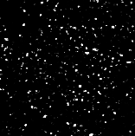
Training technique: Semi-supervised Learning
66000 Mitosis
66000 Non-mitosis
Step 1: Initial training set
Apply rotations and shifts on 200 mitosis.
Positive Samples ----
Negative Samples ----
Randomly sampled from the non-mitosis pixels.
Sampling Probability Map
Have the classifier learn difficult samples.
66000 Mitosis
1million Non-mitosis
Step 2: Augmented training set
Positive Samples ----
Same samples as above
Negative Samples ----
Use the probability of false positive samples from last step as sampling probabilities to create a lot more difficult samples.
Convolutional Neural Network

Slide 10
Testing Process
Original Input Image
Accuracy from CNN Model with/ without 8 direction Average
 | Precision | Recall | F-Score
Single Direction | 0.78 | 0.74 | 0.758
8-direction Average | 0.78 | 0.79 | 0.784
Original Paper | 0.88 | 0.70 | 0.782
Rotate 90° with/ without mirroring (8 images)
8 CNN predictions
Accuracy from CNN Model with different thresholds
Threshold Values | Precision | Recall | F-Score
0.5 | 0.6905 | 0.8614 | 0.7665
0.6 | 0.7339 | 0.8345 | 0.7723
0.7 | 0.7767 | 0.7921 | 0.7843
0.8 | 0.8409 | 0.7327 | 0.7831
0.9 | 0.8659 | 0.7030 | 0.7760
Average Probability
Final Label from thresholding
Convolutional Neural Network

Slide 11
CNN extracted feature Classification
-------Merging Different CNN models
Layer | Type | Neurons | Filter Size
0 | I | 3M x 101 x 101 | --
1 | C | 16M x 98 x 98 | 4 x 4
2 | MP | 16M x 49 x 49 | 2 x 2
3 | C | 16M x 46 x 46 | 4 x 4
4 | MP | 16M x 23 x 23 | 2 x 2
5 | C | 16M x 20 x 20 | 4 x 4
6 | MP | 16M x 10 x 10 | 2 x 2
7 | C | 16M x 8 x 8 | 3 x 3
8 | MP | 16M x 4 x 4 | 2 x 2
9 | FC | 100 | 1 x 1
10 | FC | 2 | 1 x 1
Random Forest Classifier
High Dimensional Input Data
Random Subsets
Random Subsets
Random Subsets
tree
tree
tree
… ...
Convolutional Neural Network

Slide 12
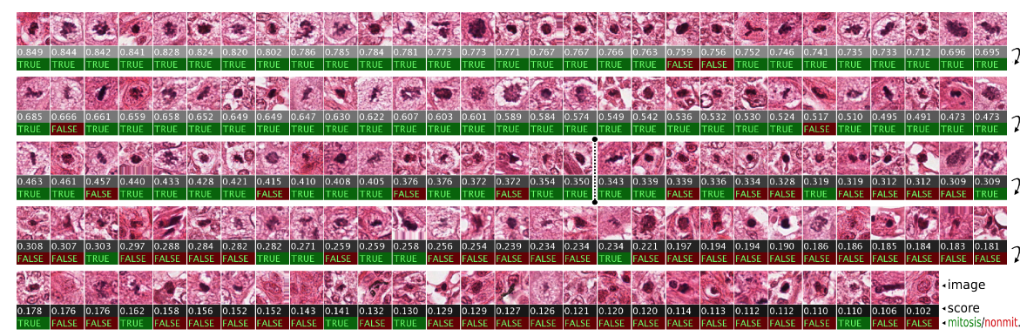
 | 10-layer DNN |  |  |  | 12-layer DNN
 | Prec | Recall |  | F-meas | Prec |  | Recall | F-meas
Original Paper | 0.78 | 0.72 |  | 0.751 | 0.88 |  | 0.70 | 0.782
Scanning window + Initial Samples | 0.74 | 0.13 |  | 0.221 | 0.93 |  | 0.04 | 0.084
Scanning window + Augmented Samples | 0.80 | 0.74 |  | 0.769 | 0.78 |  | 0.79 | 0.784
Extracted DNN feat. + RF classifier | 0.79 | 0.76 |  | 0.775 | 0.84 |  | 0.73 | 0.781
Merged block-wise DNN feat. + RF classifier | Precision: |  | 0.82 | Recall: | 0.76 | F-meas: |  | 0.789
CNN Classifier Accuracy
Convolutional Neural Network

Slide 13
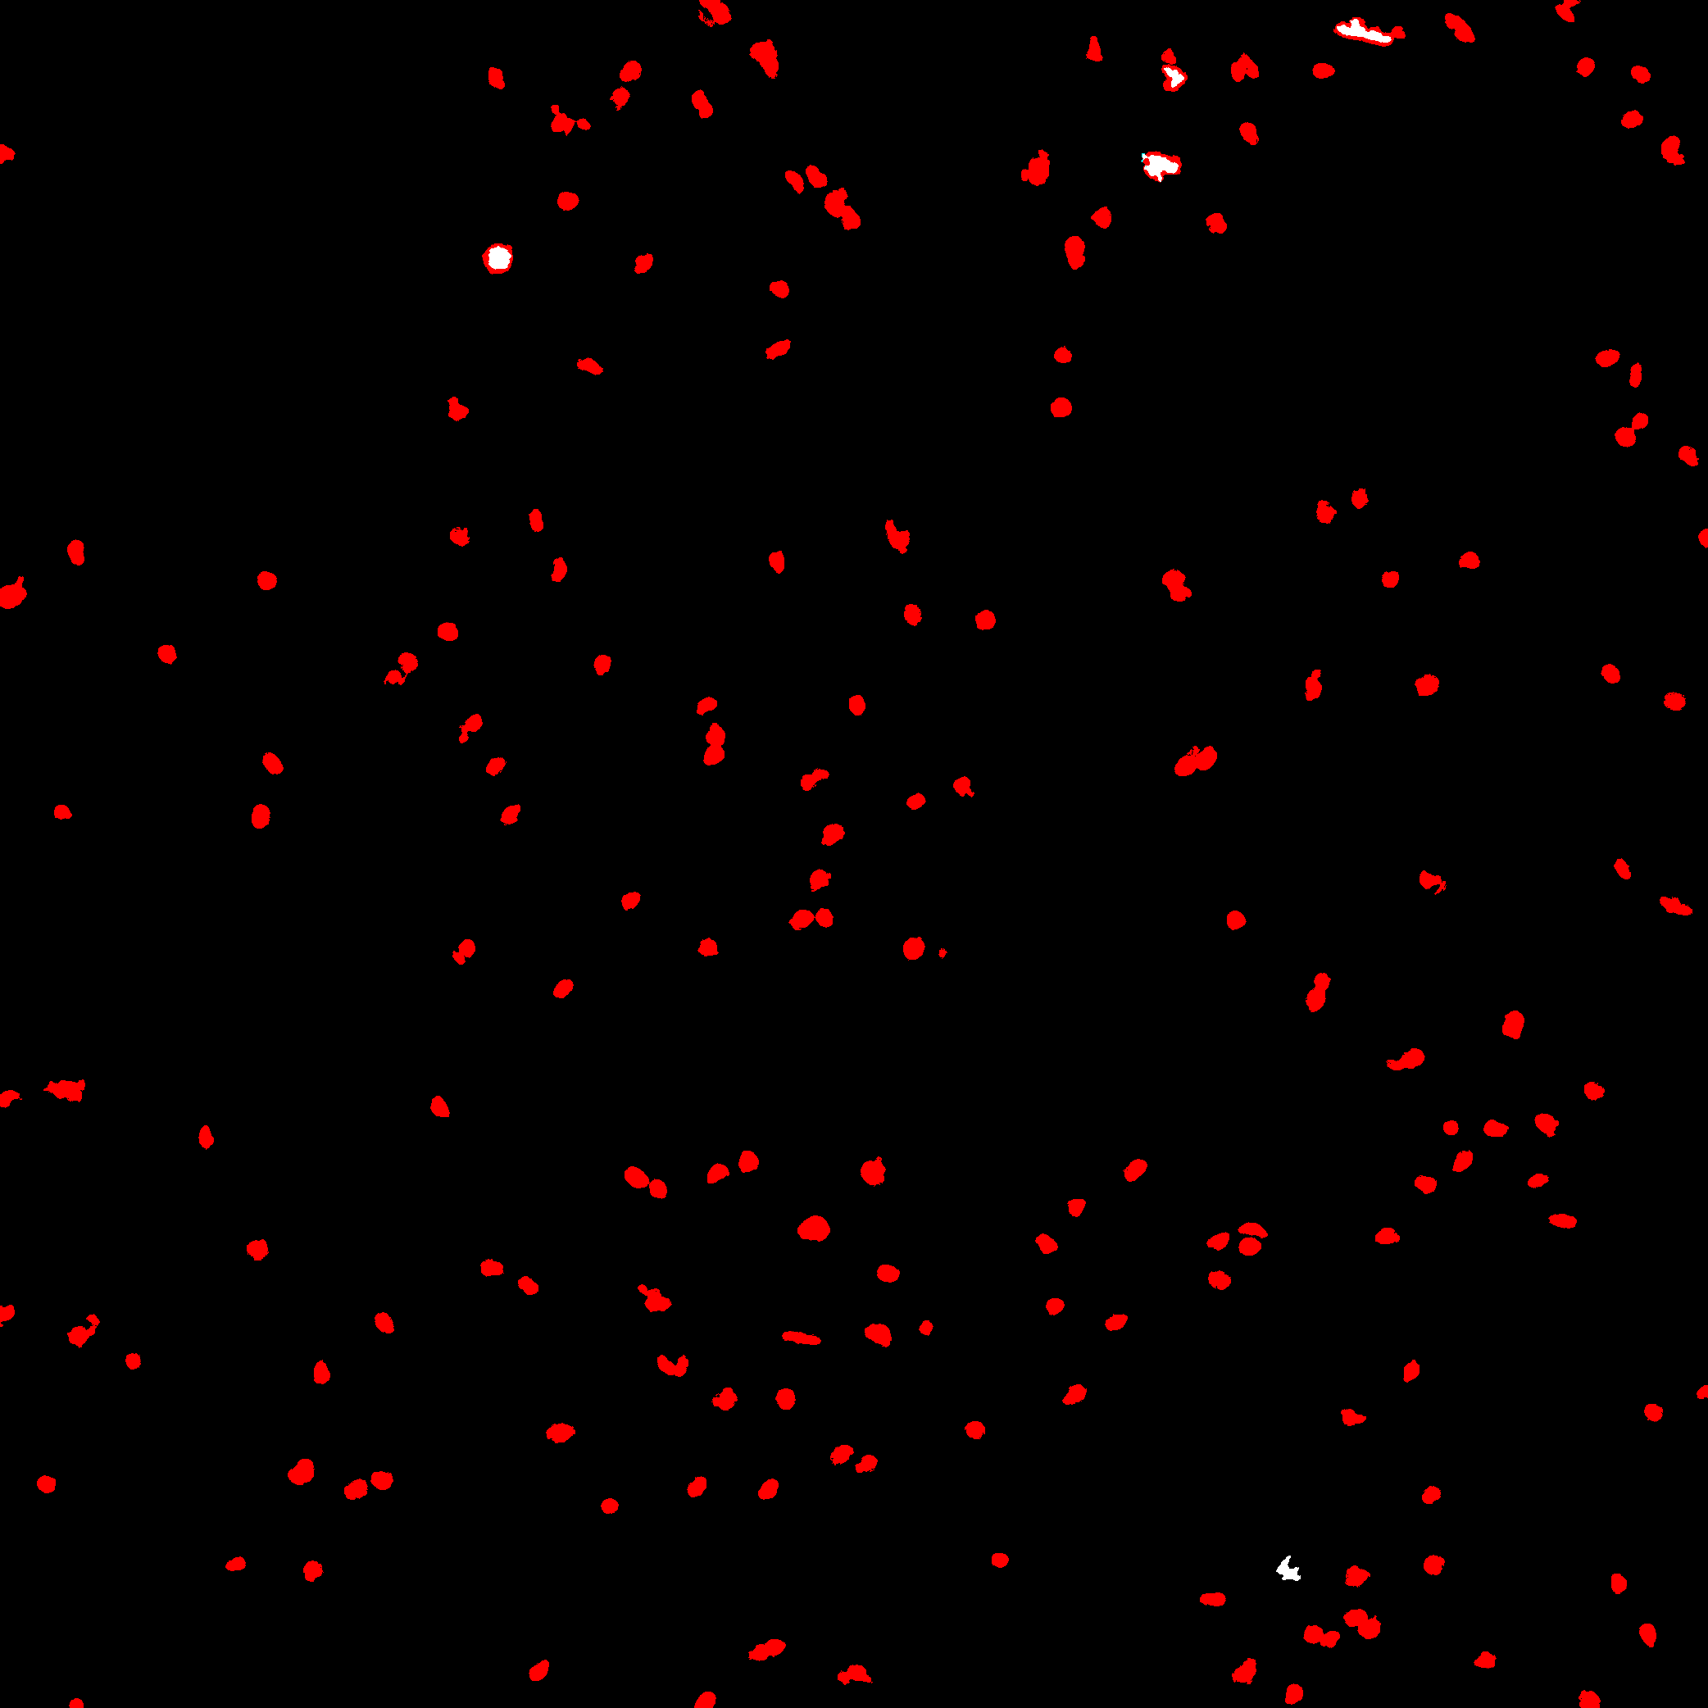
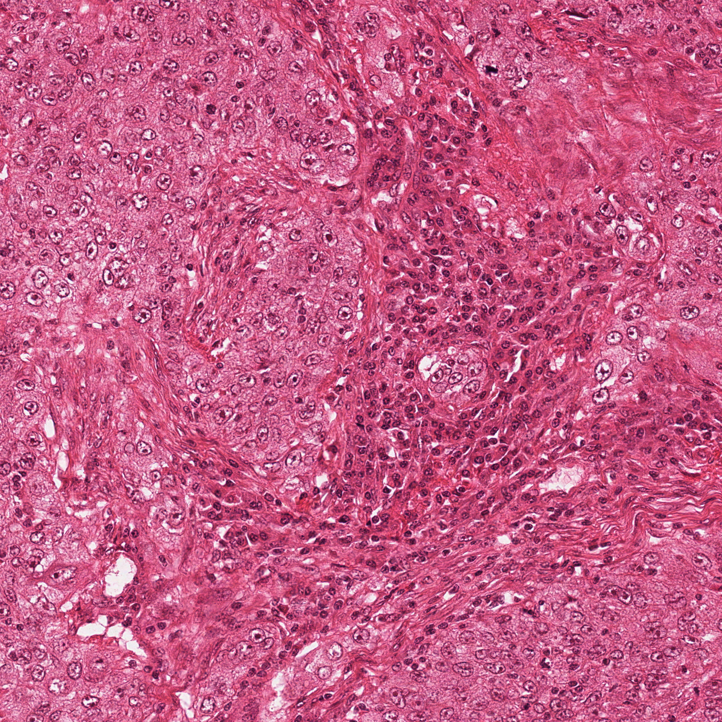
Training Efficiency
Testing Efficiency
Convolutional Neural Network (Caffe library)
Convolutional Neural Network (5-pixel scanning interval)
 | ICPR Initial Set | ICPR Augmented Set
 | NVIDIA K40 | NVIDIA K40 | CPU
10-layer CNN | 40 min. | 8 hrs. | 20hrs
12-layer CNN | 2 hrs. | 12 hrs. | 45hrs
Image tested with 8 rotations: 24min per image with CPU
Lots of unnecessary scans!!!
CNN-feature-based Method
Random forest classifier is trained in less than 1 minute with extracted features on a CPU machine.
Yuguang Li Quals– 2016 Spring
Accuracy & Efficiency

Slide 14
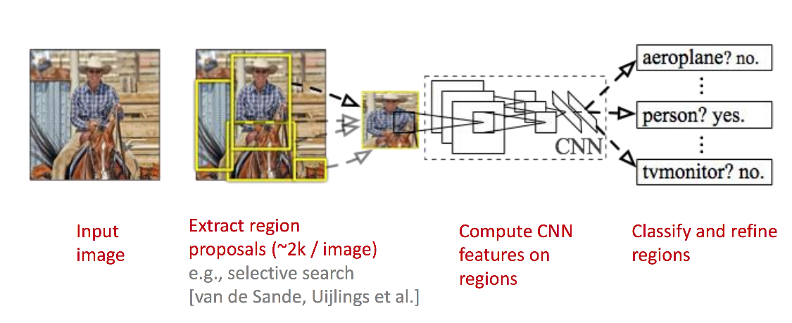
Region-based Convolutional Neural Network
Region-based convolutional network

Slide 15
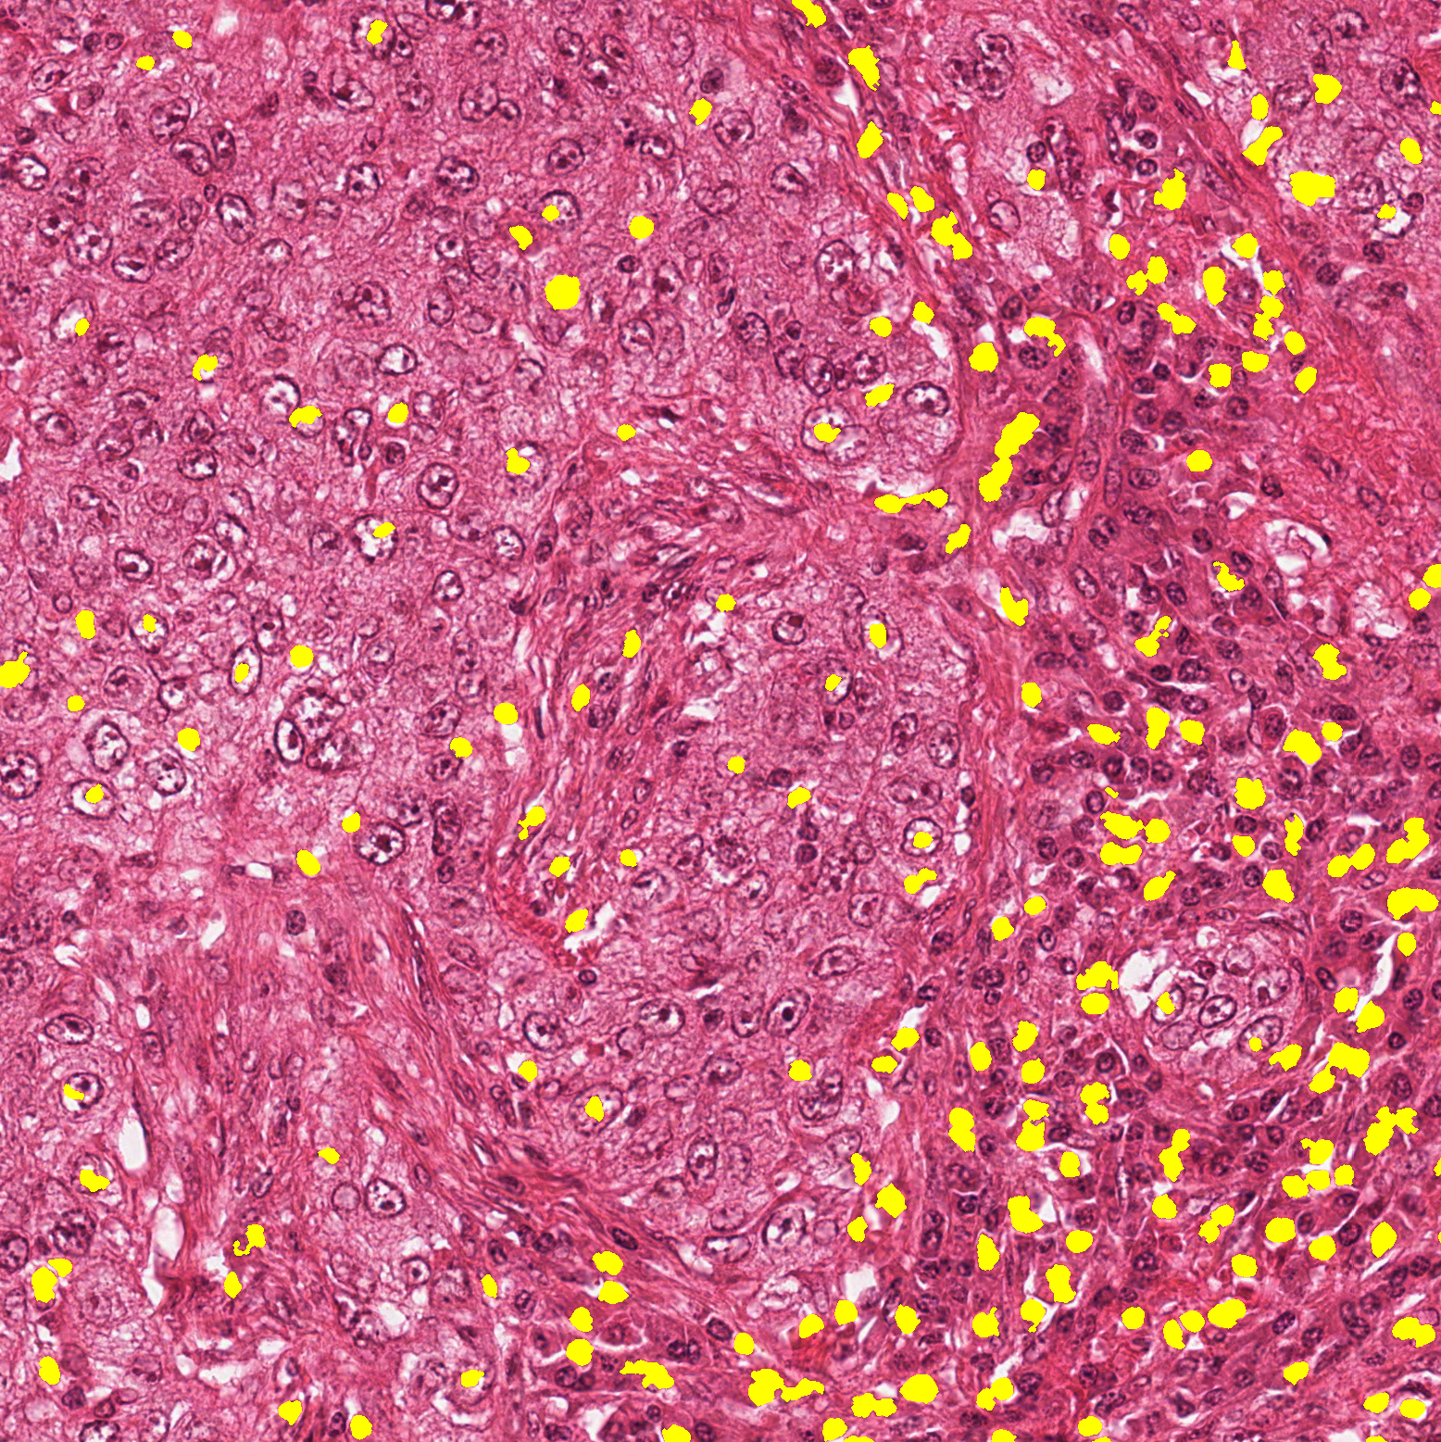
Initial Mitotic Region Proposal Generation
List of features (10 dimensions)
Multiscale Gaussian Smoothing
Multiscale Laplacian of Gaussian
Difference of Gaussians
Structure Tensor Eigenvalues
Hessian of Gaussian Eigenvalues
Idea: Only Scan in proposed regions
Speed (2000 * 2000 pixel RGB image):
Proposal Generation – 10sec/per image
CNN classification in 8 directions – 20sec/per image with cpu.
Calls CNN function 3200 times /per image instead of 320,000 times / per image
Mitosis Candidates
Yuguang Li Quals– 2016 Spring
Region-based convolutional network

Slide 16
Final RCNN-Based Mitosis Detection Pipeline
Stage 1: The CCE extracts
pixelwise features at
different scales and
classifies each pixel as
possibly mitosis or not
Stage 3: The FMP uses
the same CNN to check
multiple pixels and also
multiple rotations.
Stage 2: The FCE uses a
CNN to check a fixed size
region centered at each
positive pixel to decide if
it is a possible mitosos.

Slide 17
Coarse Candidate Extractor
37 multi-scale features
  Color (pixel values in Gaussian-smoothed color images)
  Edge (Gaussian Gradient Magnitude, Gaussian Gradient Magnitude, Laplacian of Gaussian and Difference of Gaussian)
  Texture (Structure Tensor Eigenvalues and Hessian of Gaussian Eigenvalues)
Feature selection to reduce 37 to 10.
Random forest classifier with six trees uses the 10 features to label pixels as mitotic candidate or not.

Slide 18
Fine Candidate Extractor
Uses a CNN model trained using the ground truth training data provided by the organizers of the ICPR12 and ICPR 14 contests.
We color normalized it according to a color transfer method described in Reinhard et al. 2001.
Each pixel of each training image is labeled a mitosis if it is a pixel of a mitotic region and within 8 µm of the centroid.
For ICPR14 data, which is probabilistic, only mitotic regions with probability > 0.6 were used.
The two stage sampling techniques from Ciresan et al 2013 were used to build the final training image sample set.

Slide 19
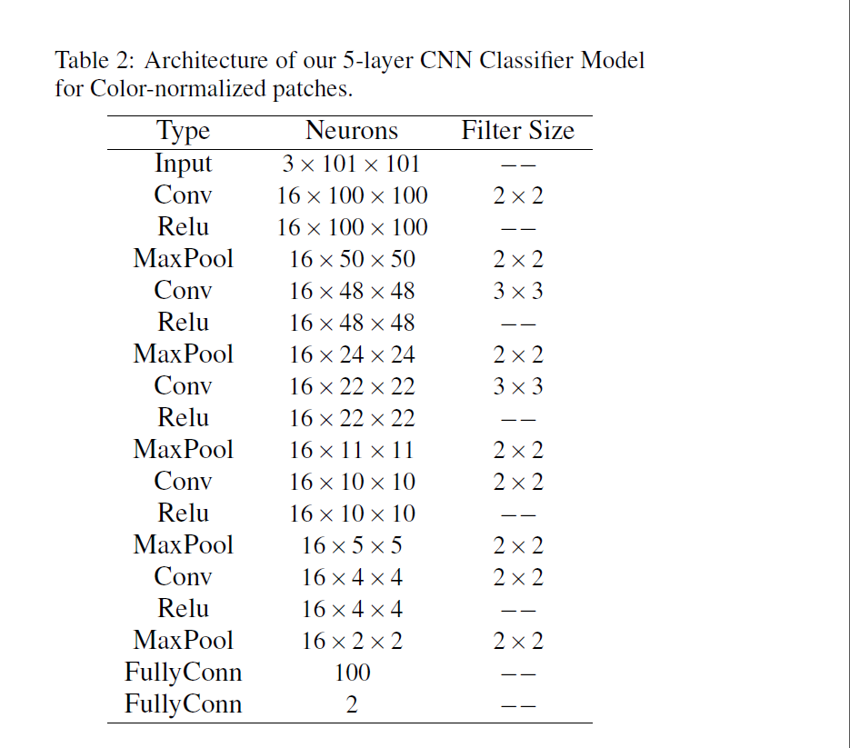

Slide 20
Final Mitosis Predictor
Inputs the binary image produced by the FCE and uses the same trained CNN, but in a sequence of scans of multiple different pixels of the input image.
Each pixel that passes Stage 2 leads to a detailed search of a region around it for evidence of a mitotic figure.
A spiral scan path carries out this detailed search.
Pixels that pass Stage 2 become the centers for the first scan in Stage 3 at an intermediate threshold.
If a pixel in the first scan passes, the system goes into a finer scanning mode at a final threshold.

Slide 21
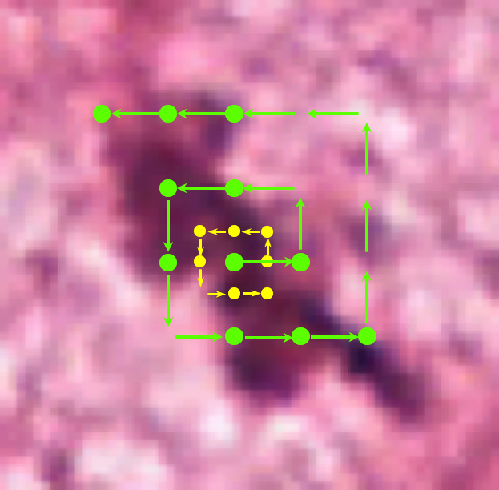
Scan path of final mitosis classifier

Slide 22
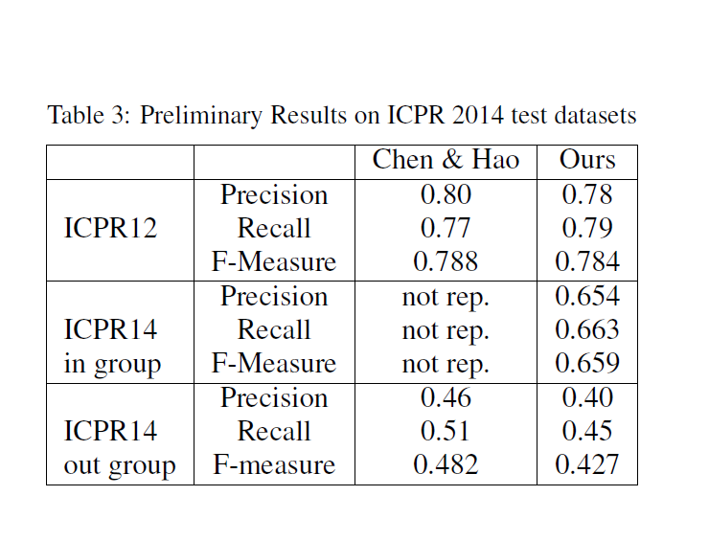
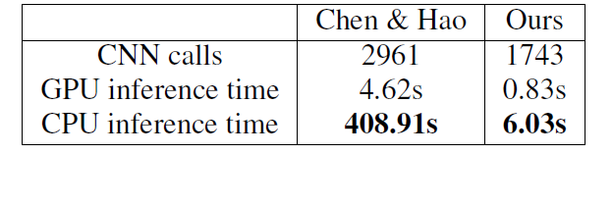
Results on ICPR 2012 and 2014 Datasets

