Slide 1
Automated Analysis and Classification of Melanocytic Tumor on SkinWhole Slide Images
Hongming Xua, Cheng Lub, Richard Berendtc, Naresh Jhac, Mrinal Mandala
University of Alberta

Slide 2
Highlights
A framework for whole slide skin image analysis
A multiresolution framework to generate skin epidermis and dermis image tiles
Both skin epidermis and dermis analyses are integrated for skin melanoma diagnosis
Both cytological and textural features are used for skin image classification
More than 95% classification accuracy is achieved

Slide 3
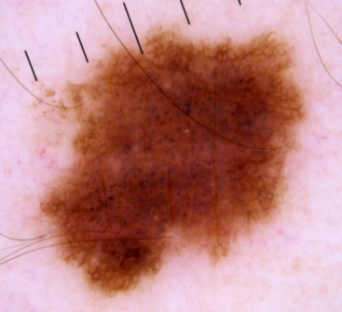
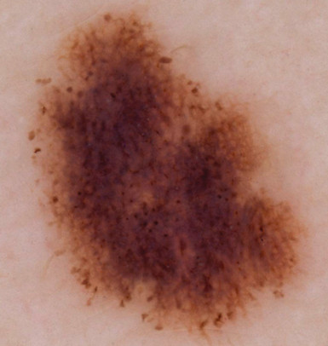
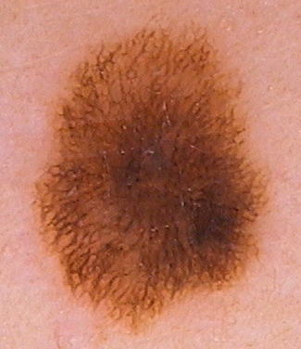
Skin Cancer & Melanoma
Skin cancer: most common of all cancers
Melanoma: most aggressive type of skin cancer
Early detection: significantly reduce mortality
Difficult diagnosis: similar to nevus
Compound Nevus
Dysplastic Nevus
Malignant Melanoma
(https://challenge.kitware.com/#challenge/n/ISIC_2017%3A_Skin_Lesion_Analysis_Towards_Melanoma_Detection)
Notes:
Compound nevus (most common type): nevus cells within both epidermis and dermis layers.
Dysplastic (atypical) nevus: it already has mild cytological atypia.

Slide 4
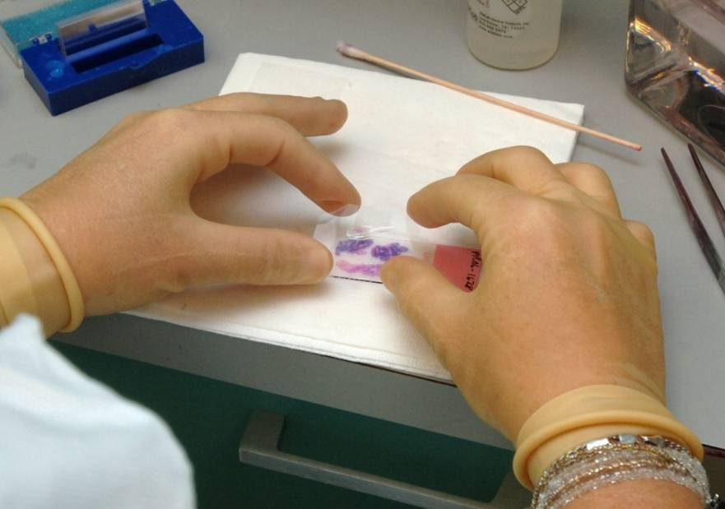
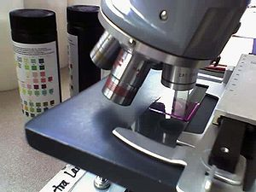
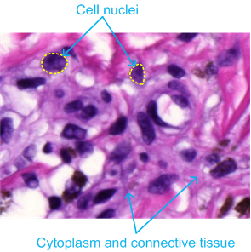
Histological Examination
Histological slides (H&E stained) provide a cellular level view of the cell and tissue.
(https://en.wikipedia.org/wiki/Histology)

Slide 5
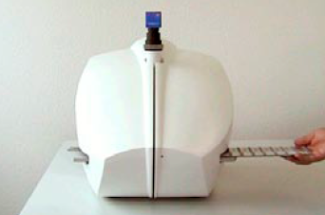
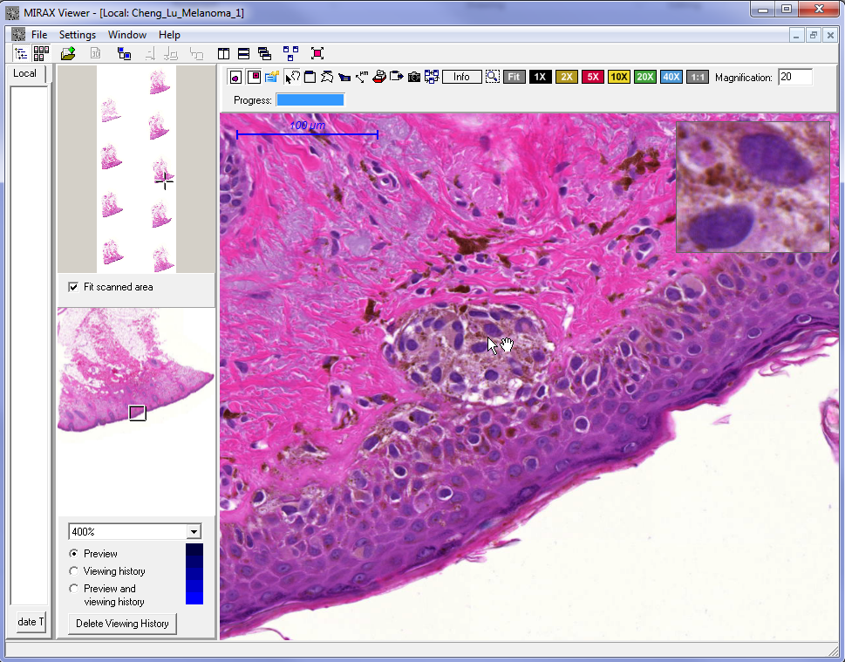
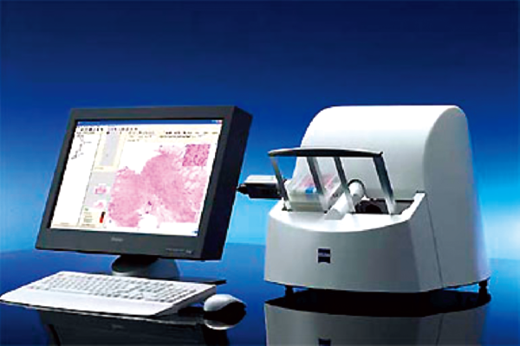
Digitized Biopsy Analysis
Digitized scanning: generate high resolution images
Visual examination: observe digital biopsy images
Digital Scanning
Exam on Monitor
MIRAX Viewer Software

Slide 6
Histological Grading of Melanoma
Breslow Thickness
  distance from skin granular layer to the deepest tumor cell
  the deeper the Breslow depth, the worse is the prognosis
L1: Cornified
L2: Granular
L3: Squamous & Basal
MART-1 stained image:
Melanoma (brown color)
Other nuclei (blue color)

Slide 7
Motivation & Objective Statement
Motivations
  Manual analysis: labor-intensive, inter- and intra- observer variations
  Computerized algorithms: objective, reliable, efficient
  Existing works: Little works done on analyzing skin biopsy images
  Objectives:
  Automated algorithms for skin biopsy image analysis
  Automated melanoma diagnosis system
  Automated measurement of melanoma invasion depth
Assist pathologists in melanoma diagnosis

Slide 8
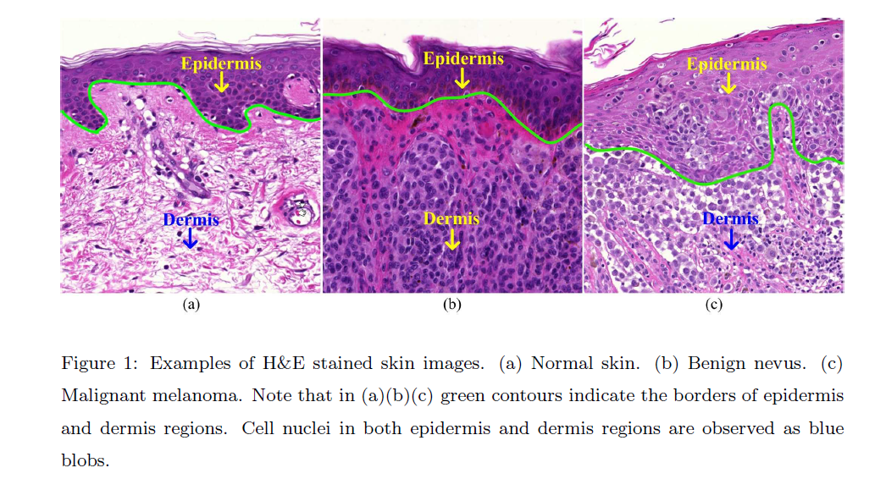
Normal Benign nevus Malignant melanoma

Slide 9
Proposed Framework

Slide 10
Epidermis Segmentation:
Coarse to Fine
This method first performs a coarse segmentation using global thresholding and shape analysis on the red channel of the image.
A second-pass of fine segmentation using k-means algorithm is then applied to enhance the poor quality segmentation identified based on epidermis thickness measurement.

Slide 11
My Interpretation (from thesis)
This method first performs a coarse segmentation based on thresholding the red channel of the H&E stained image followed by a connected components and a rule-based analysis related to area and shape.
It then uses line segments perpendicular to the axis of the candidate region to measure its depth.
If it judged too big, a fine segmentation is performed using RGB color channels to break this region into two classes, the top being epidermis.

Slide 12
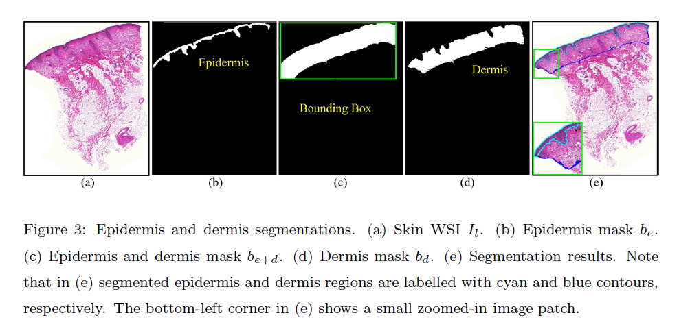

Slide 13
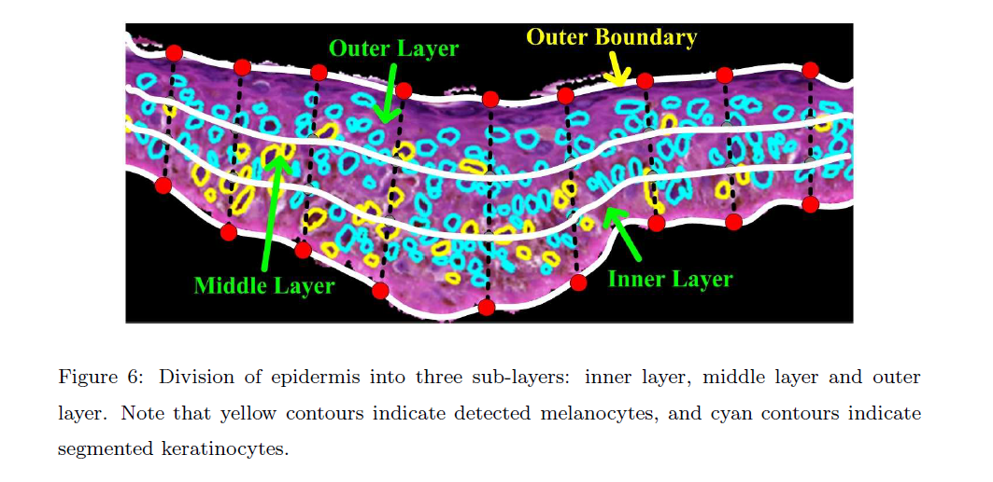
Epidermis
Next, the epidermis is divided into three layers.

Slide 14
Nuclei
All the nuclei in the epidermis are segmented, including keratinocytes and melanocytes.
Morphological (shape) features of the nuclei are computed and the average and SD computed
Ratio of total number of melanocytes to total number of nuclei is computed.

Slide 15
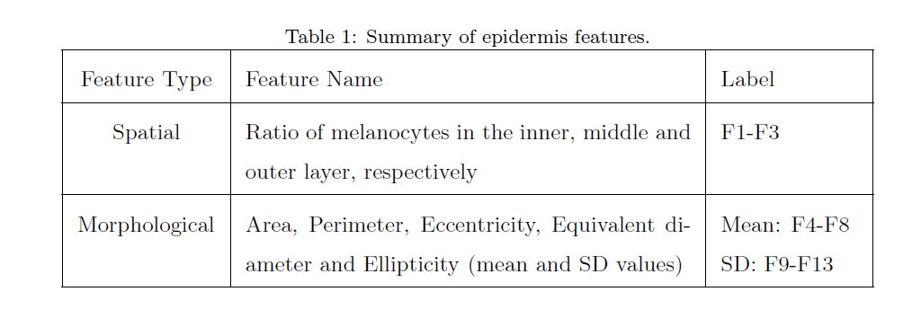
Epidermis Features

Slide 16
Dermis Analysis
Color Normalization
Nuclei Segmentation (much fancier)
Dermis Feature Computation

Slide 17
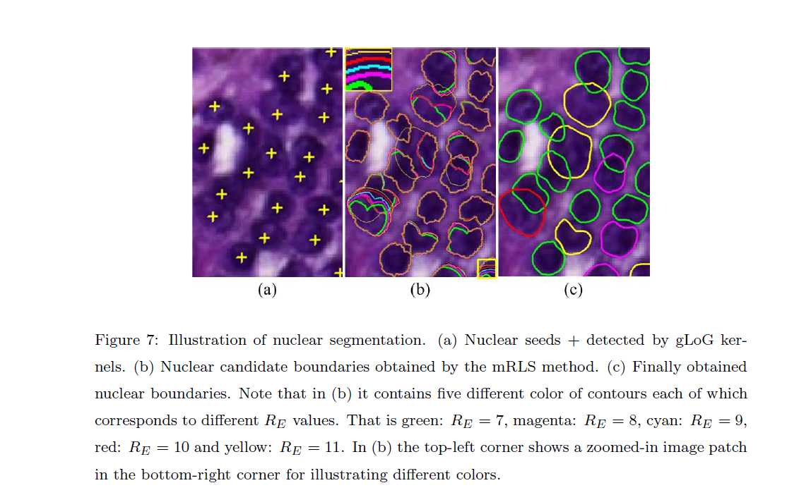
Nuclei Segmentation:
They want the exact boundaries

Slide 18
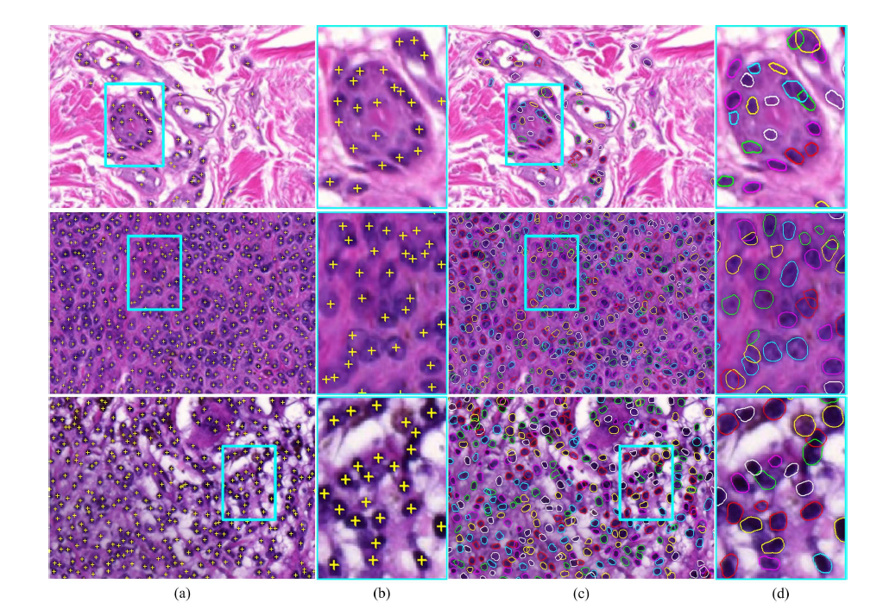
Normal
Skin Nevus
Melanoma

Slide 19
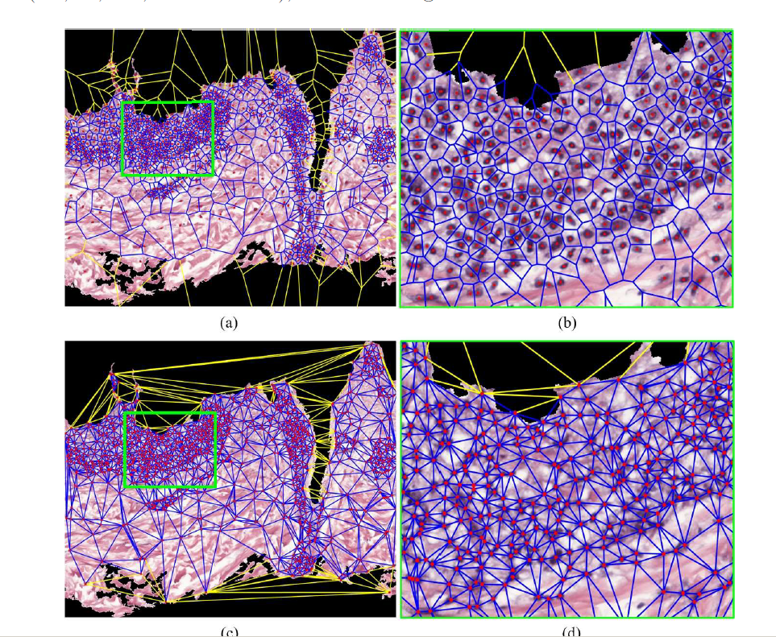
Voronoi
Diagram
Delaunay
Triangles

Slide 20
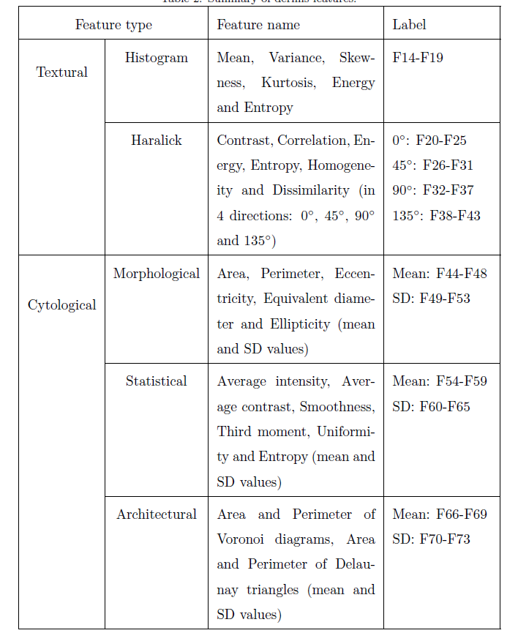
Texture features
Shape features
Color features
Architectural features

Slide 21
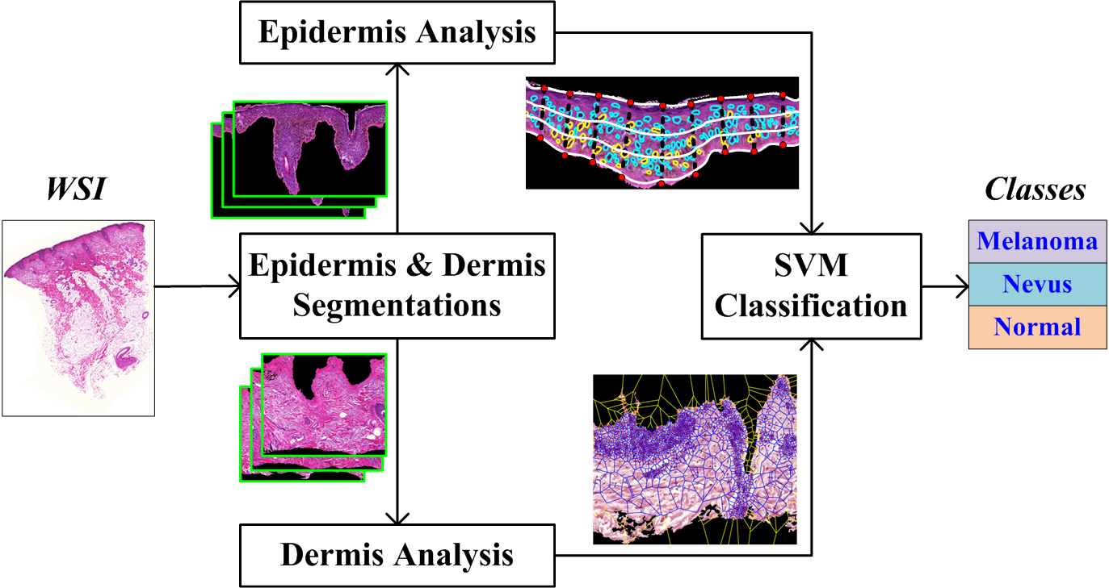
Skin WSI Analysis and Classification
Epidermis Analysis: 13 features (3 spatial distribution features & 10 nuclear morphological features)
Dermis Analysis: 60 features (30 textural features & 30 cytological features)

Slide 22
Experiments on Classification
Test strategies
  I: melanoma VS non-melanoma
  II: normal VS nevus VS melanoma
  III: lentiginous VS superficial spreading
  VS nodular
  IV: normal VS nevus VS lentiginous
  VS superficial spreading VS nodular
  Ten-fold cross evaluation
Tissue Classes |  | NO.
Normal |  | 17
Nevus (compound) |  | 17
Melanoma | lentiginous | 9
 | superficial spreading | 18
 | nodular | 5
Total |  | 66
Techniques | Average classification accuracies (%)
 | I | II | III | IV
LM technique [2015] | 88.86 | 89.07 | 90.17 | 90.24
Proposed with all features | 97.90 | 95.78 | 91.32 | 91.98
Proposed with feature selection | 97.80 | 98.08 | 95.81 | 95.73
Feature selection: Sequential Feature Selection method

Slide 23
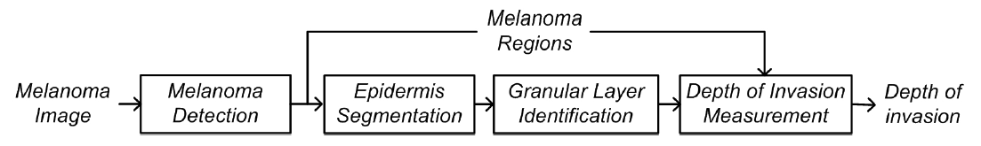
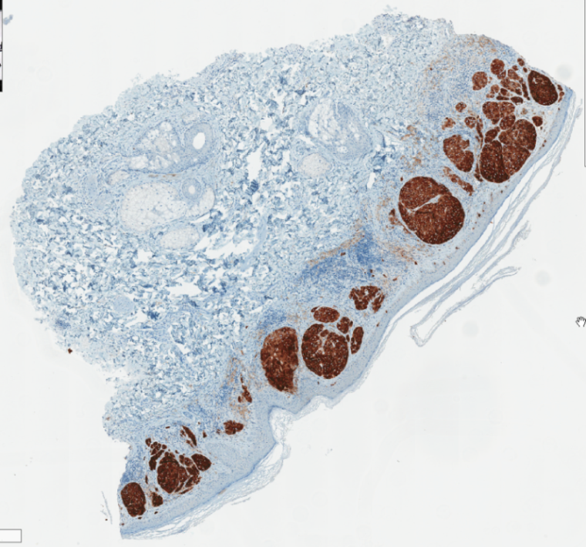
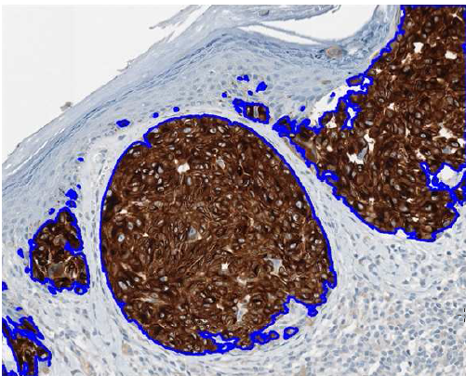
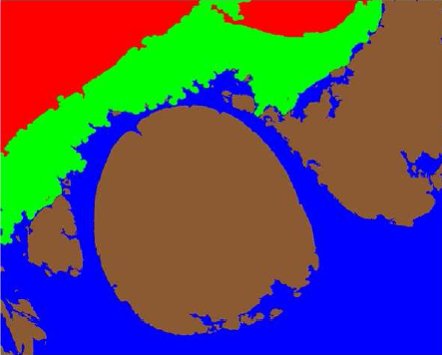
Melanoma Invasion Measurement
Using MART-1 stained skin biopsy images
RGB color features are used
Multi-thresholding is used
B
E
M
D
Brown regions Melanoma
Melanoma segmentation
Image segmentation
MART-1 stained skin biopsy

Slide 24
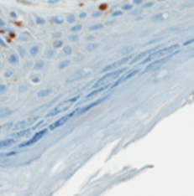
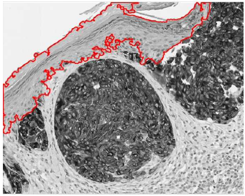
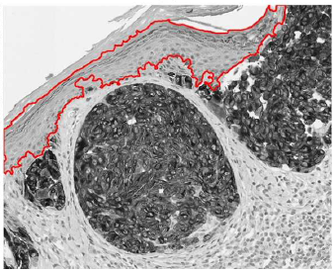
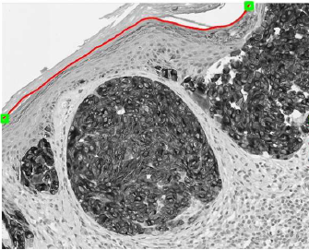
Granular Layer Identification
Granular layer-middle layer within epidermis
Cornified layer-lighter intensities than other layers
A Bayesian classification-to remove cornified layer pixels
Granular layer
Malpighian layer
Cornified layer
Cornified layer
Granular layer
Epidermis including cornified layer pixels
Epidermis excluding cornified layer pixels
Identified granular layer

Slide 25

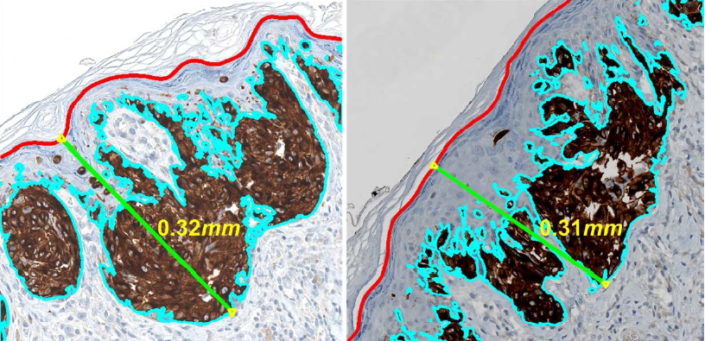
Invasion Depth Measurement
Invasion measurement – using multi-resolution Hausdorff distance measure

Slide 26
Evaluations & Comparisons
AE: average error; SD: standard deviation; APE: average percentage of error
Techniques | AE (microns) | SD (microns) | APE (%)
Mokhtari et al. [2014] | 28.03 | 29.70 | 10.66
Noroozi et al. [2015] | 20.54 | 17.21 | 6.81
Proposed | 10.95 | 17.49 | 3.53
Normalized errors with respect to Ground Truth

Slide 27
Conclusion
Several automated techniques for ROIs detection & segmentation in biopsy images
Automated skin whole slide biopsy image analysis
  Automated melanoma invasion depth measurement
Pros | Cons
Automatic & Efficient & Robust Second-opinion for pathologist in cancer diagnosis Outperform existing techniques. | Some of techniques need off-line training; Some of techniques need appropriate parameter settings

Slide 28
Publications
Refereed Journals:
Hongming Xu, Richard Berendt, Naresh Jha and Mrinal Mandal, “Automatic measurement of melanoma depth of invasion in skin histopathological images”, Micron, vol.97, pp.56-67, 2017.
Hongming Xu, Cheng Lu, Richard Berendt, Naresh Jha and Mrinal Mandal, “Automatic nuclear segmentation using multi-scale radial line scanning with dynamic programming”, accepted by IEEE Transactions on Biomedical Engineering (TBME), January, 2017.
Cheng Lu, Hongming Xu, Jun Xu, Hannah Gilmore, Mrinal Mandal and Anant Madabhushi, “Multiple-pass voting technique for nuclei detection in histopathological Images”, accepted by Scientific Report, August, 2016.
Hongming Xu, Cheng Lu, Richard Berendt, Naresh Jha and Mrinal Mandal, “Automatic nuclei detection based on generalized Laplacian of Gaussian filters”, IEEE Journal of Biomedical and Health Informatics (JBHI), vol.21, no.3, pp.826-837, 2017.
Hongming Xu and Mrinal Mandal, “Epidermis segmentation in skin histopathological images based on thickness measurement and k-means algorithm”, EURASIP Journal on Image and Video Processing, vol.2015, no.1, pp.1-14, 2015.
Hongming Xu, Cheng Lu, and Mrinal Mandal, “An efficient technique for nuclei segmentation based on ellipse descriptor analysis and improved seed detection algorithm,” IEEE Journal of Biomedical and Health Informatics (JBHI), vol.18, no.5, pp.1729-1741, 2014.

