Slide 1
Generative Adversarial Networks
(GANs)
Bindita Chaudhuri

Slide 2
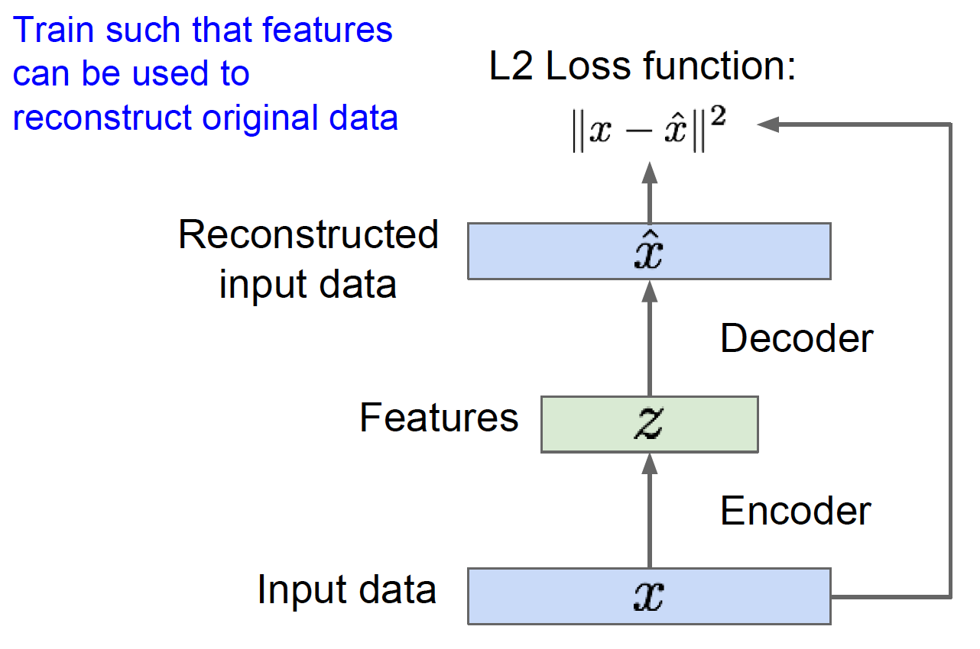

Unsupervised Learning: Autoencoders

Slide 3
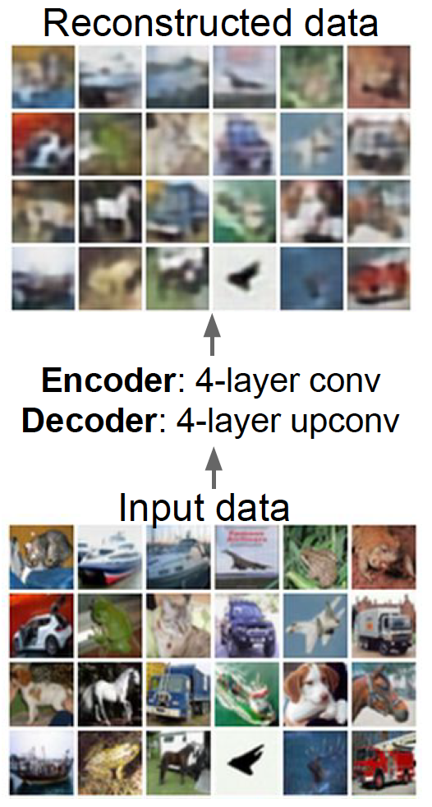
Unsupervised Learning: Autoencoders

Slide 4
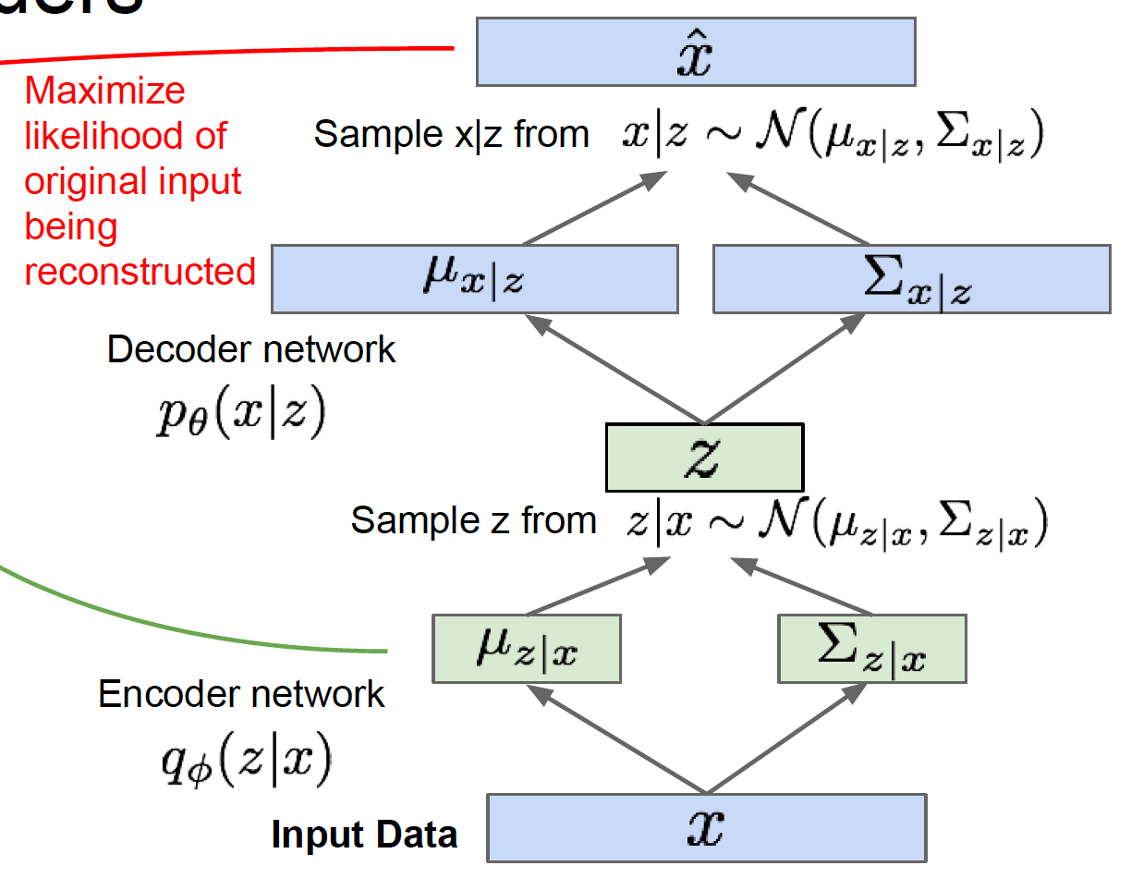
Unsupervised Learning: Variational Autoencoders

Slide 5
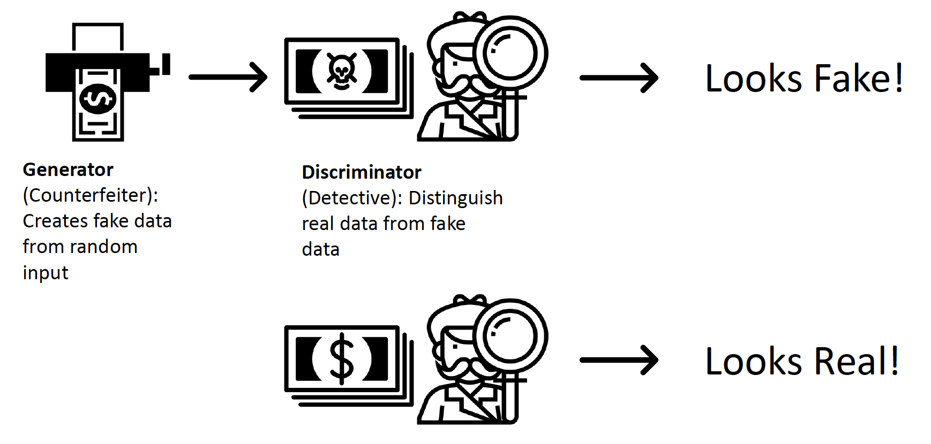
Generative Adversarial Networks: Idea

Slide 6
Generative Adversarial Networks: Idea

Slide 7
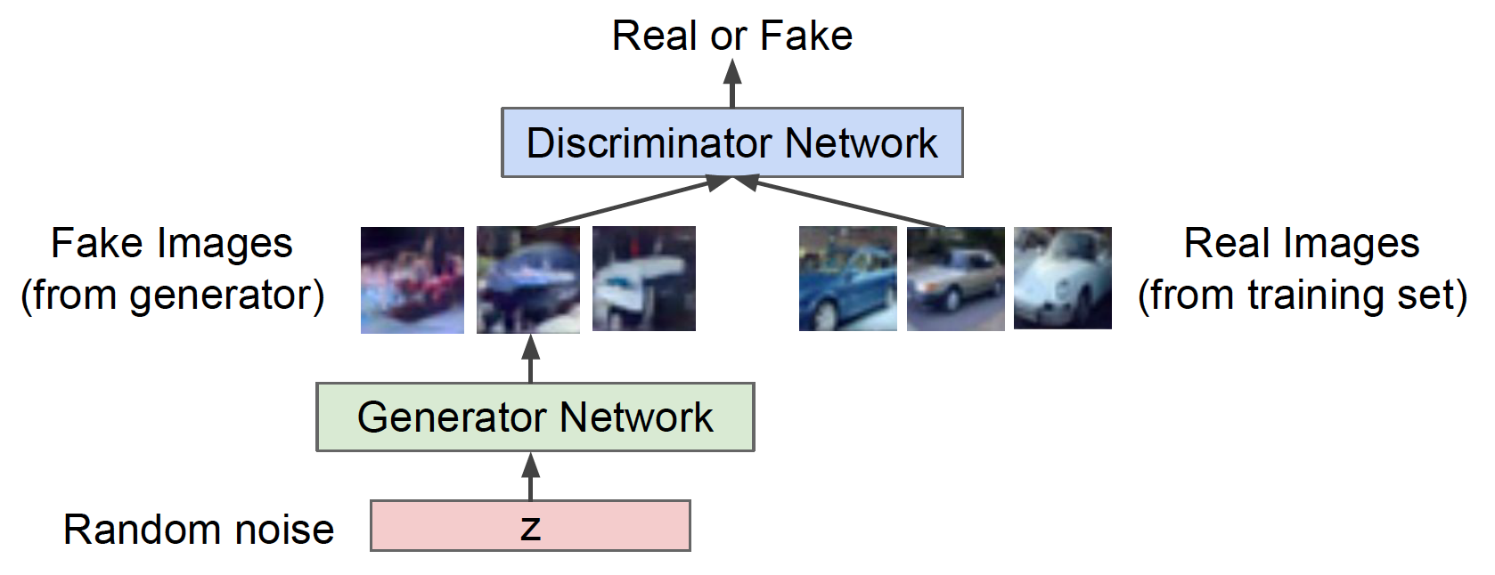
Generative Adversarial Networks

Slide 8
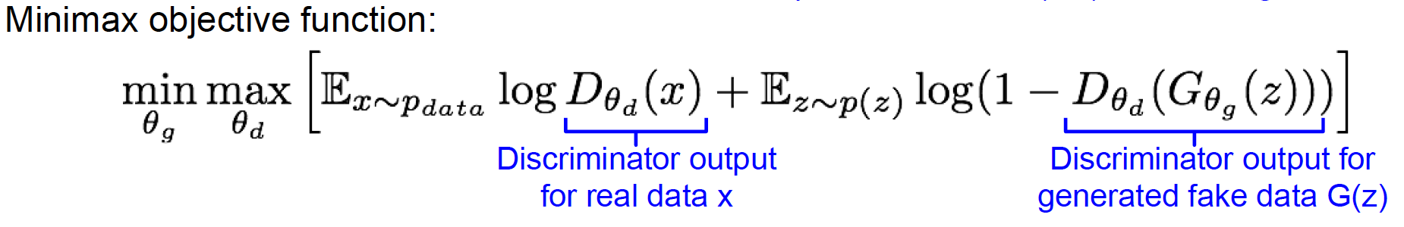
Generative Adversarial Networks

Slide 9
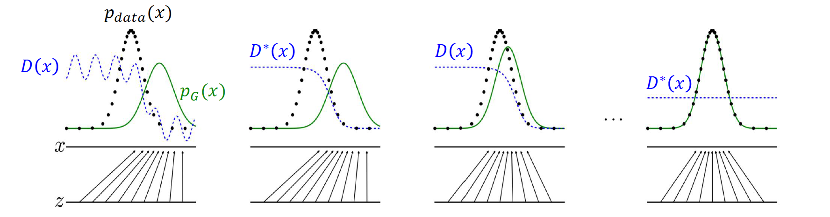
Distributions during training

Slide 10
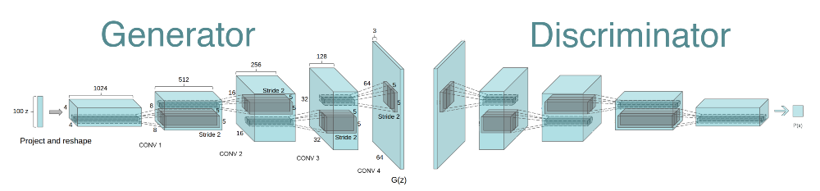
GAN: Sample Architecture (DC-GAN)

Slide 11
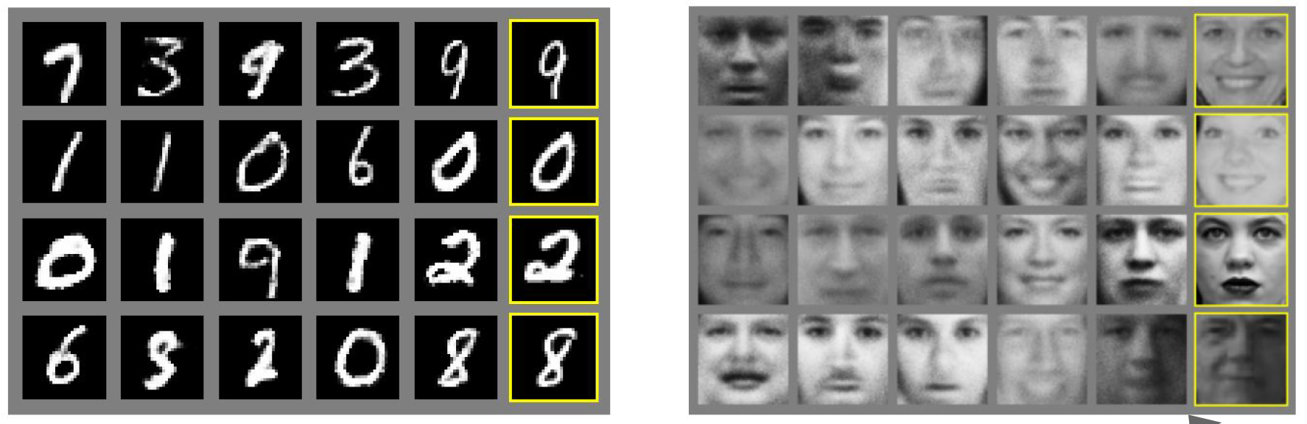
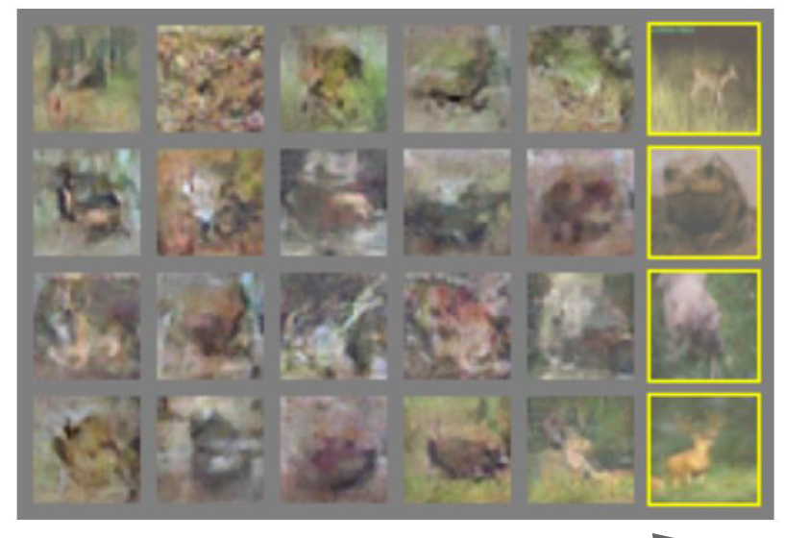
Generated Samples
MNIST
Faces
CIFAR 10

Slide 12
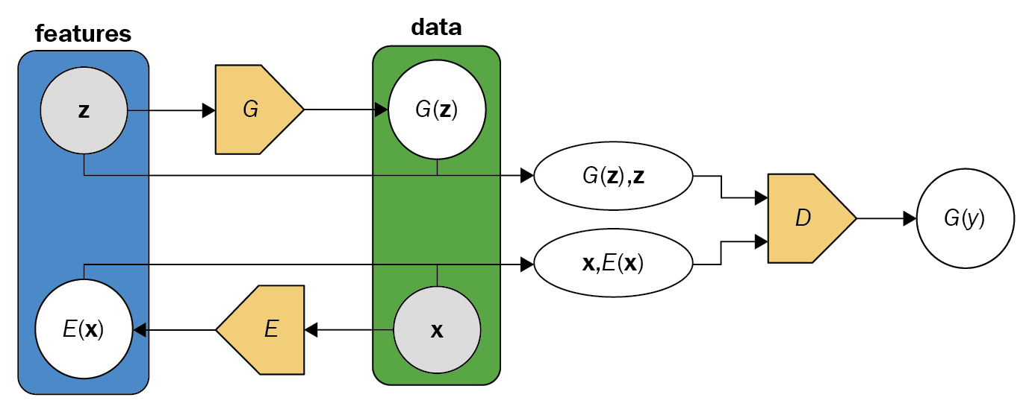
Bidirectional GAN (BiGAN)

Slide 13
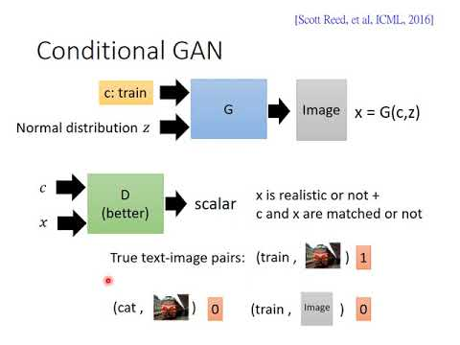
Conditional GAN (cGAN)
Generator
Discriminator

Slide 14
Conditional GAN (cGAN)
Generator
Discriminator

Slide 15
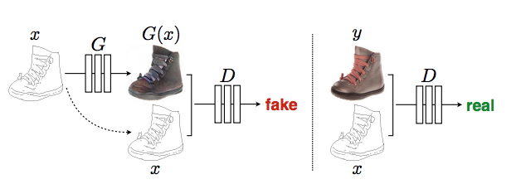
Pix2Pix: Type of cGAN
L1 loss

Slide 16
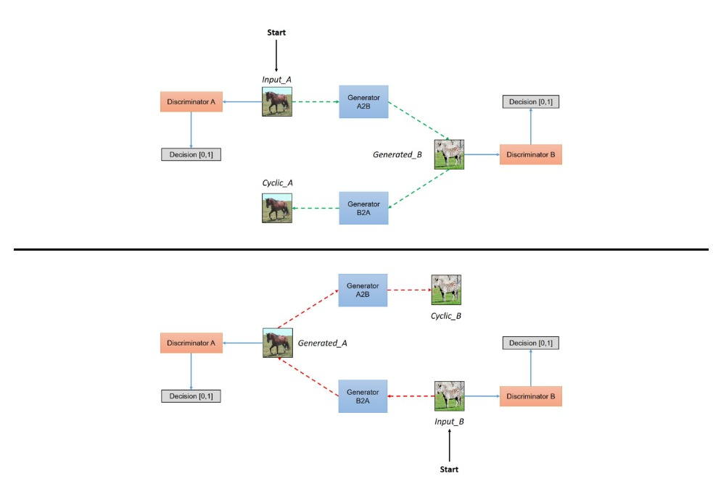
CycleGAN: Unsupervised Pix2Pix

Slide 17
CycleGAN: Unsupervised Pix2Pix

Slide 18
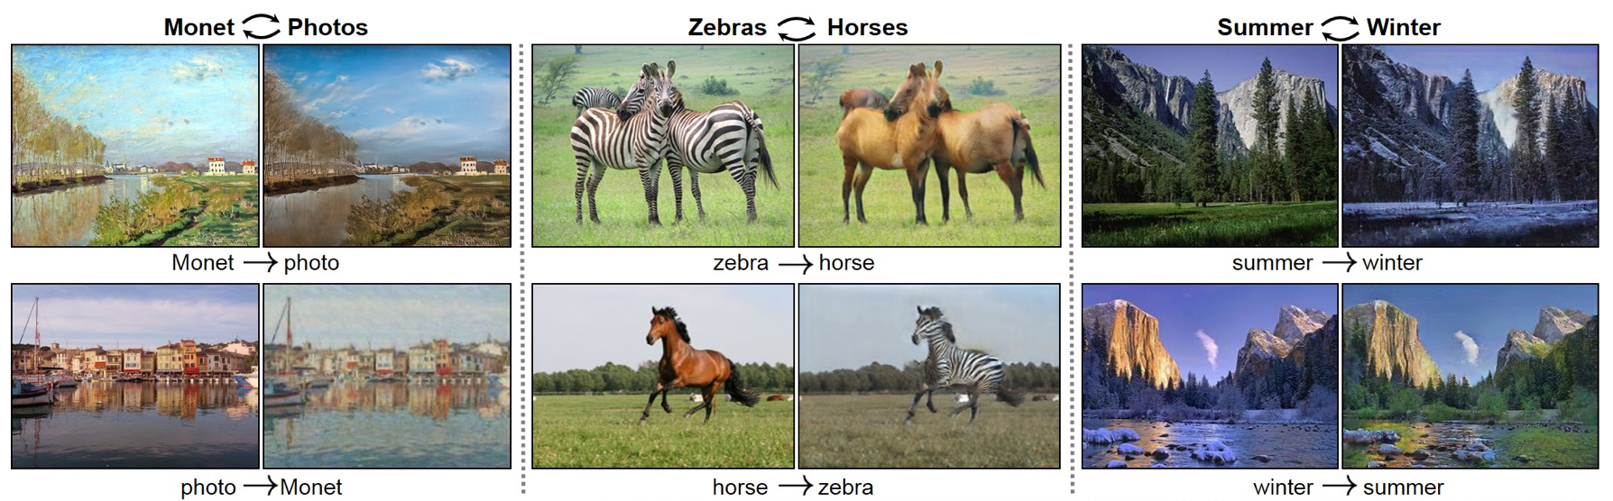
CycleGAN Results

Slide 19
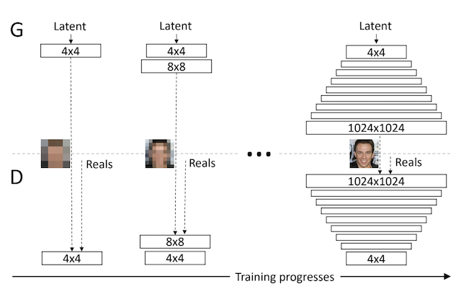
Progressive Growing of GANs

Slide 20
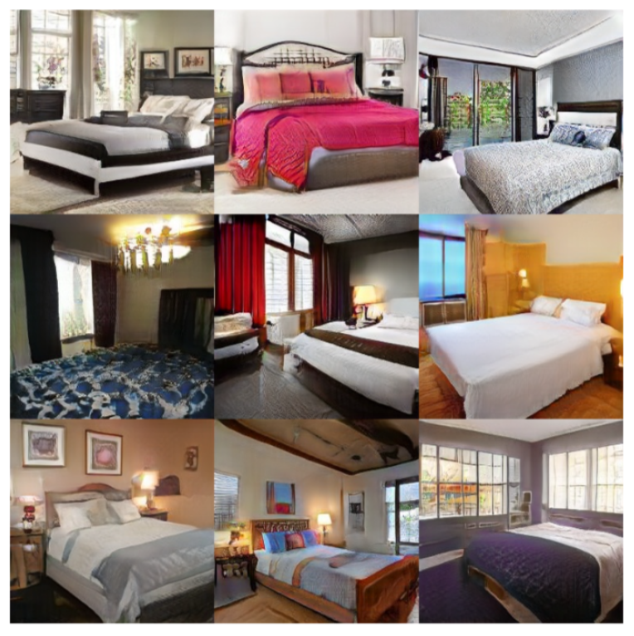
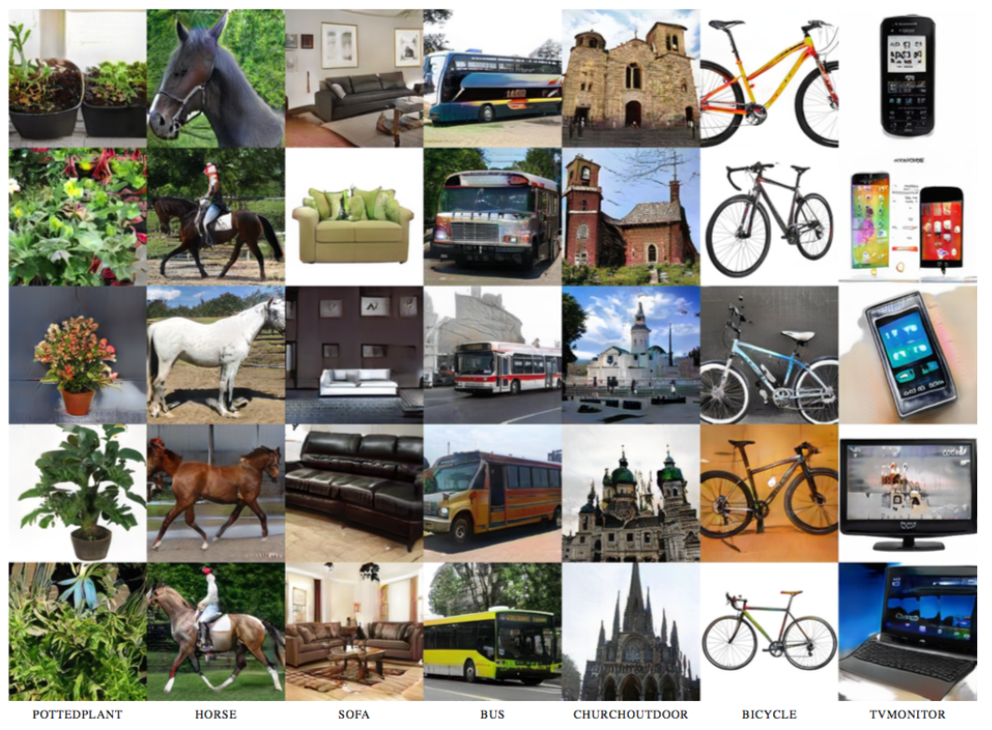
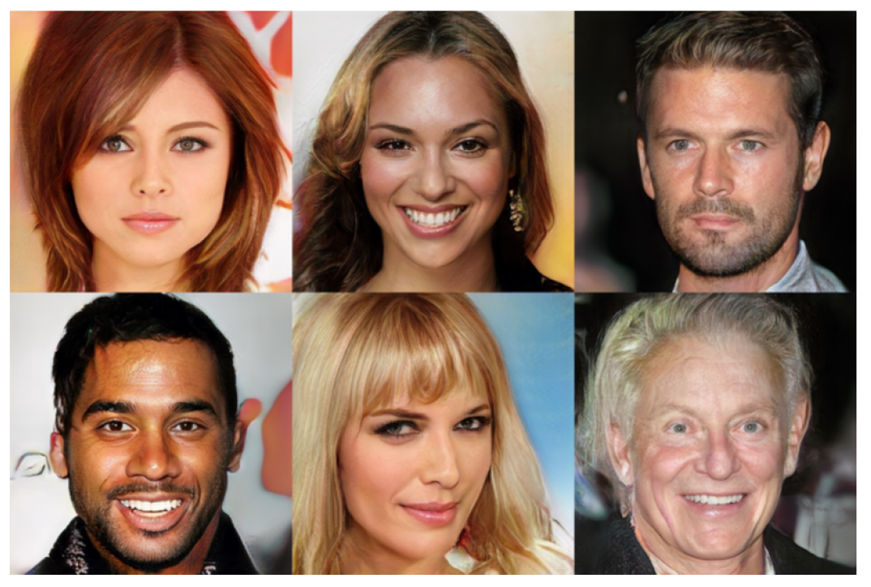
Progressive GAN Results
Celebrities
Bedrooms
Objects

Slide 21
Application: Neural Style transfer

Slide 22
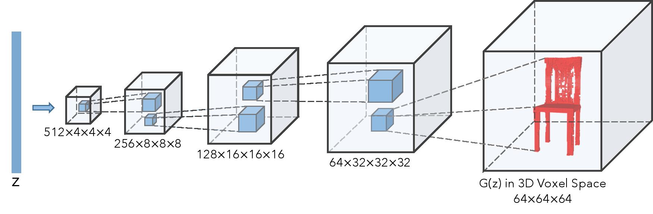
Application: 3D GAN

