Slide 1
Computer Vision CSE/EE 576 Edges and Lines Linda Shapiro Professor of Computer Science & Engineering Professor of Electrical & Computer Engineering

Slide 2
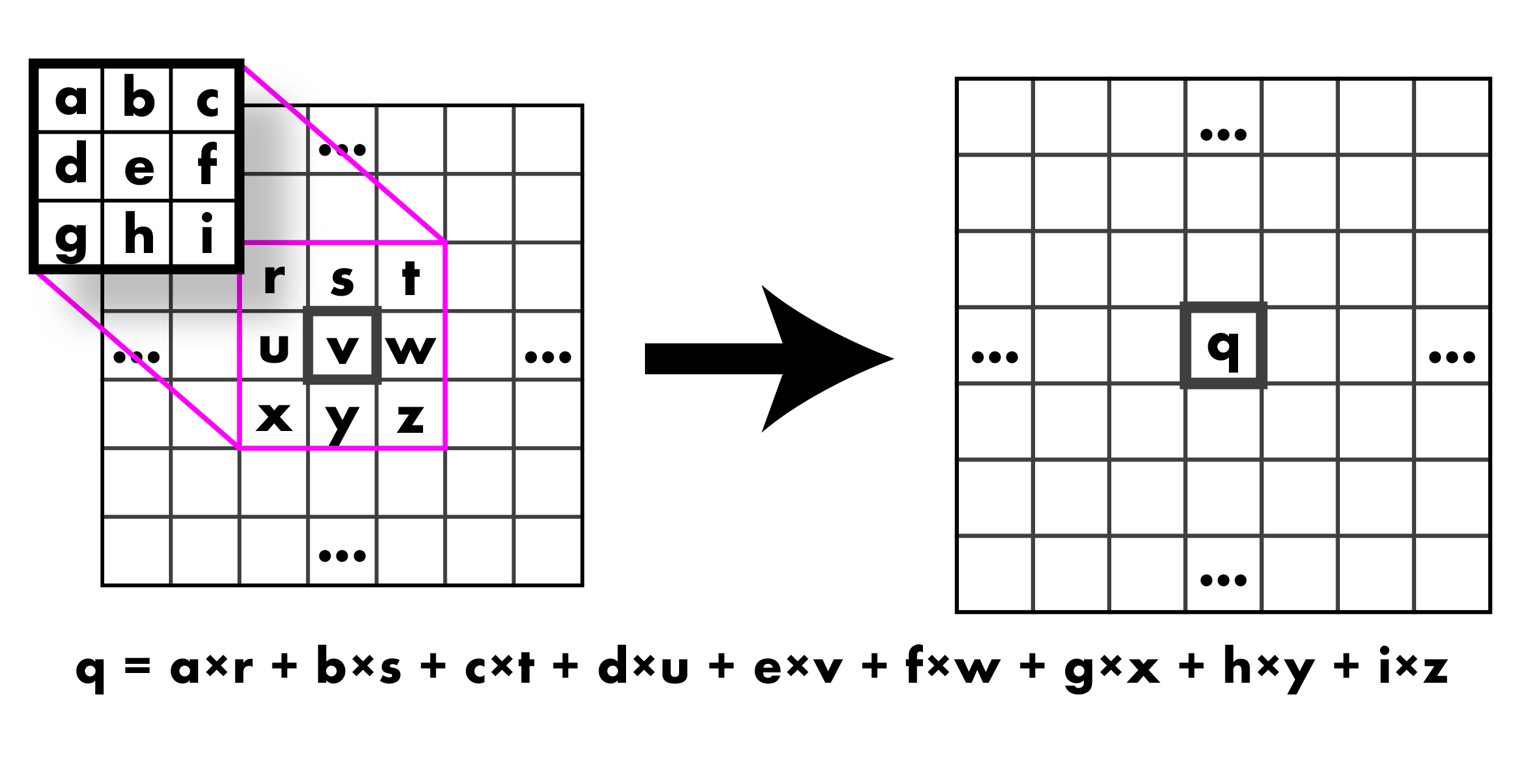
Convolution: Weighted sum over pixels

Slide 3
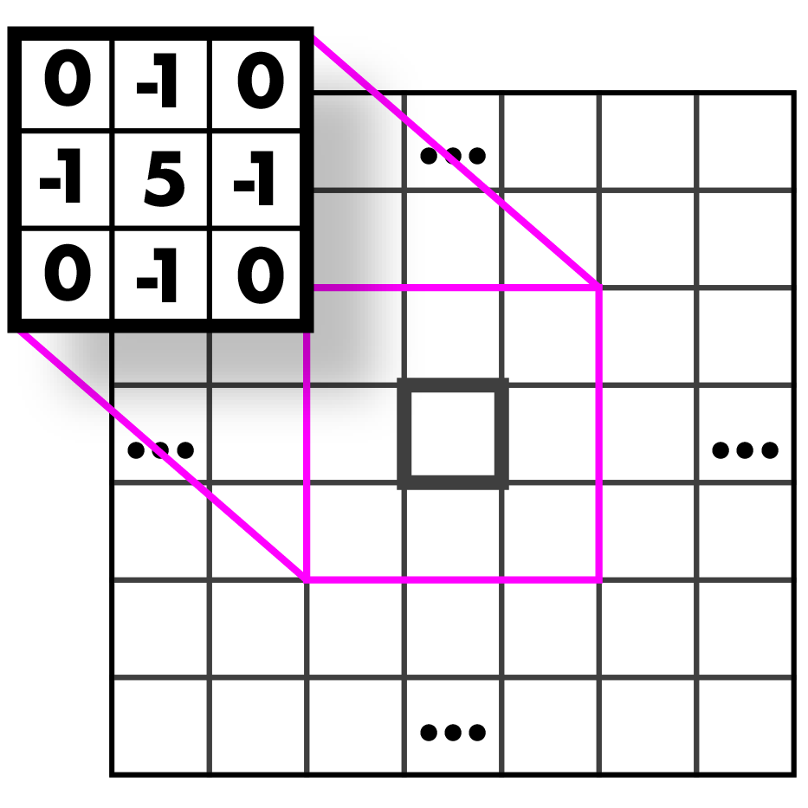
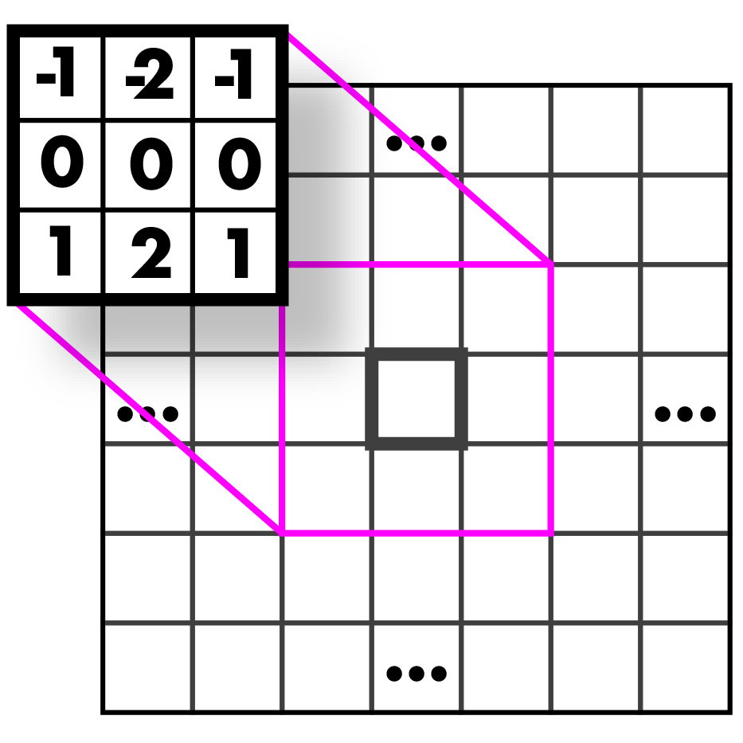
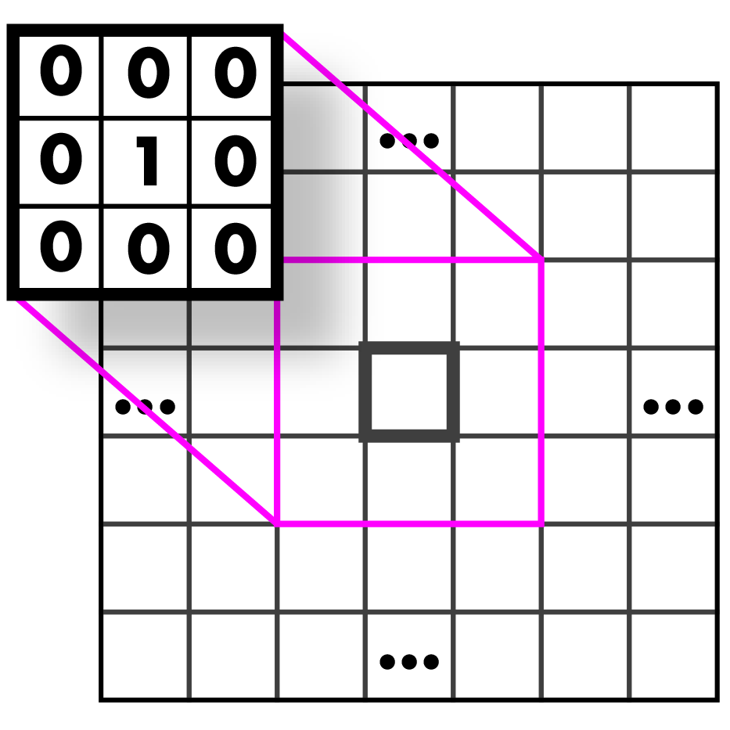
Filters

Slide 4
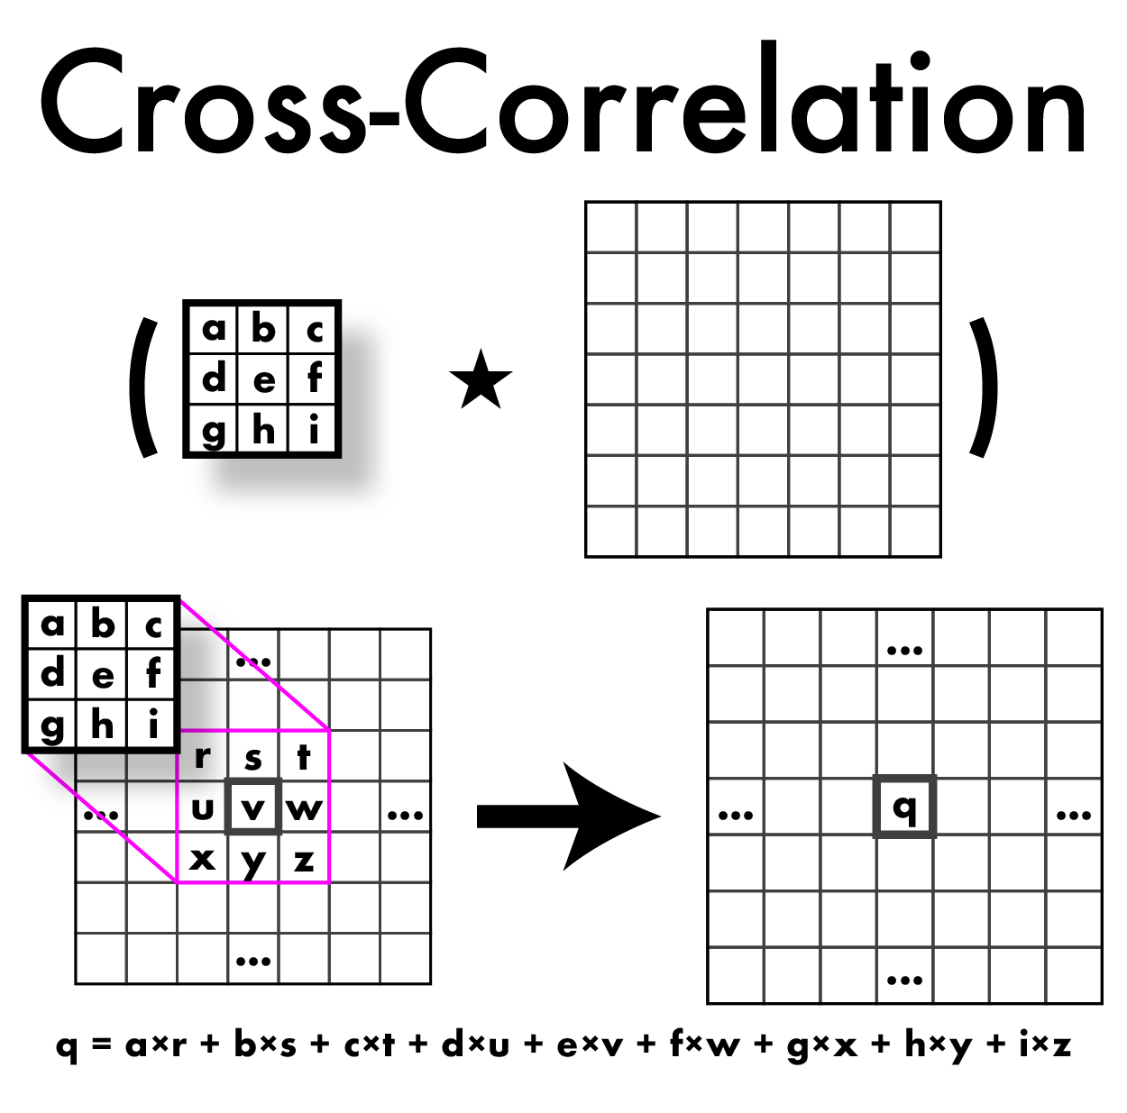
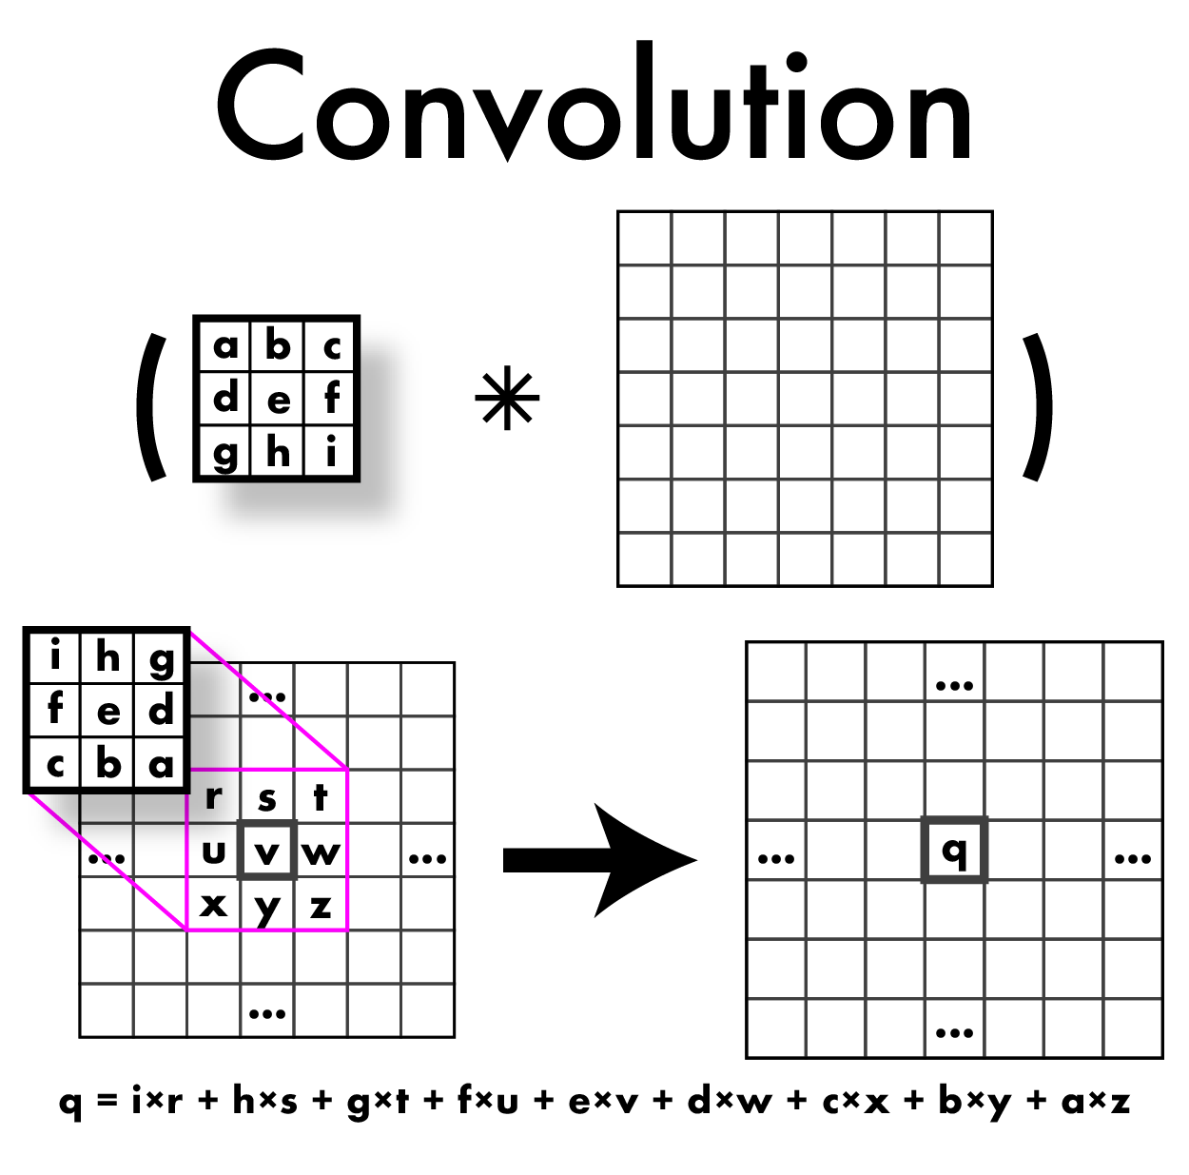
Cross-Correlation vs Convolution

Slide 5
Cross-Correlation vs Convolution
Do this in HW!

Slide 6
Cross-Correlation vs Convolution
These come from signal processing and have nice mathematical properties.

Slide 7
So what can we do with these convolutions anyway?
Mathematically: all the nice things
Commutative
A*B = B*A
Associative
A*(B*C) = (A*B)*C
Distributes over addition
A*(B+C) = A*B + A*C
Plays well with scalars
x(A*B) = (xA)*B = A*(xB)
BUT WE TEND TO USE CORRELATION BECAUSE OUR FILTERS ARE SYMMETRIC, AND THEN WE JUST CALL IT CONVOLUTION!

Slide 8
So what can we do with these convolutions anyway?
This means some convolutions decompose:
2D Gaussian is just composition of 1D Gaussians
Faster to run 2 1D convolutions
= +

Slide 9
So what can we do with these convolutions anyway?
Blurring
Sharpening
Edges
Features
Derivatives
Super-resolution
Classification
Detection
Image captioning
...

Slide 10
So what can we do with these convolutions anyway?
Blurring
Sharpening
Edges
Features
Derivatives
Super-resolution
Classification
Detection
Image captioning
...
Much of low-level computer vision
is convolutions
(basically)

Slide 11
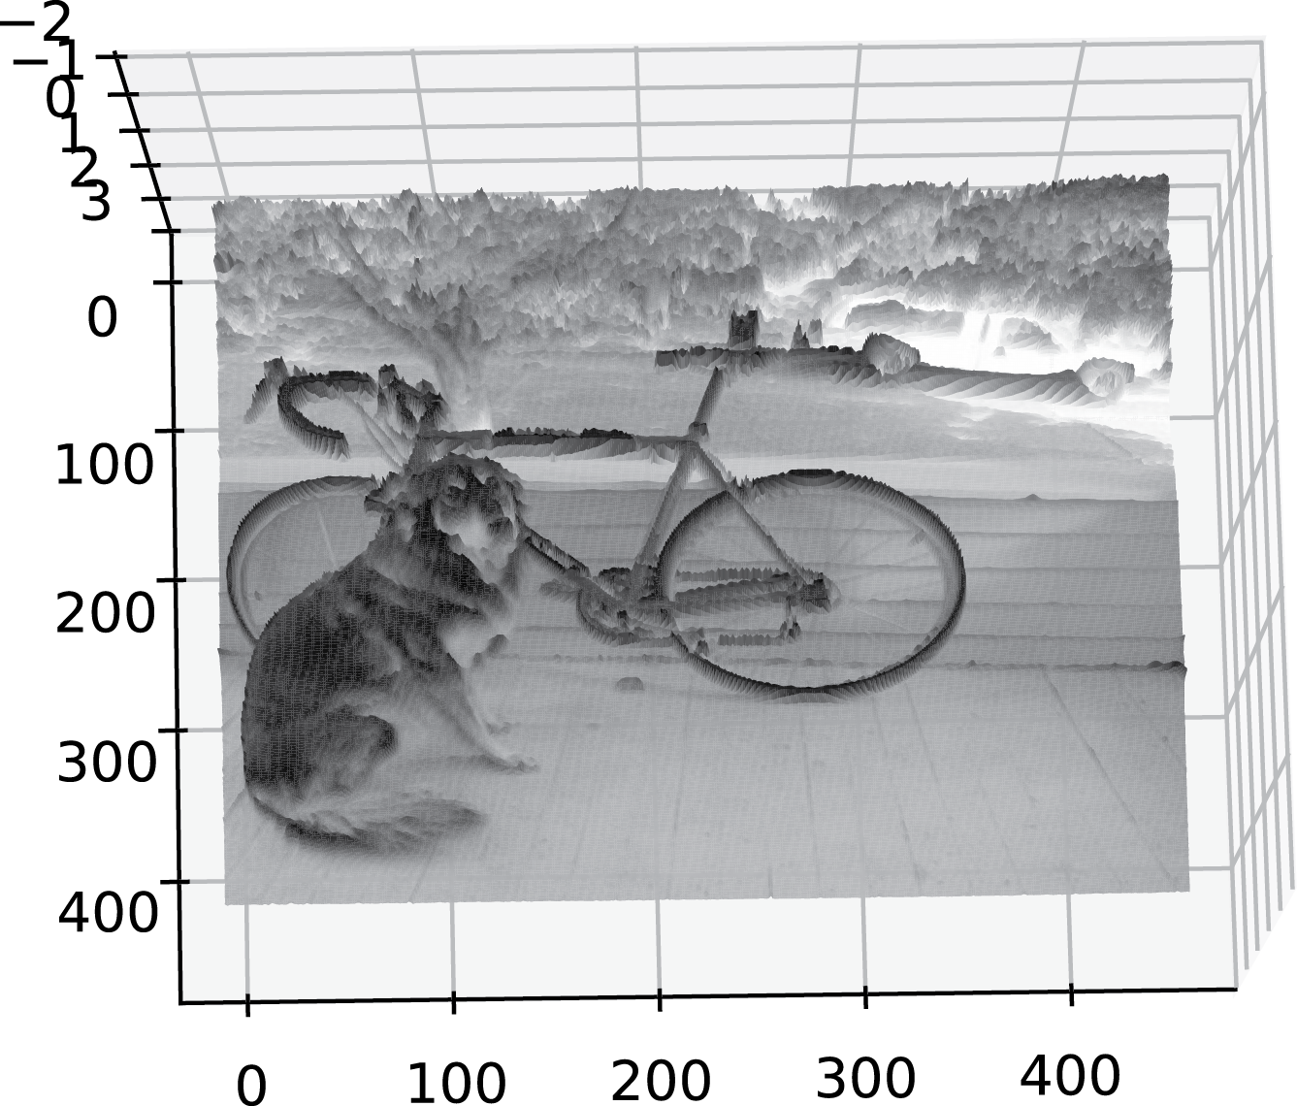
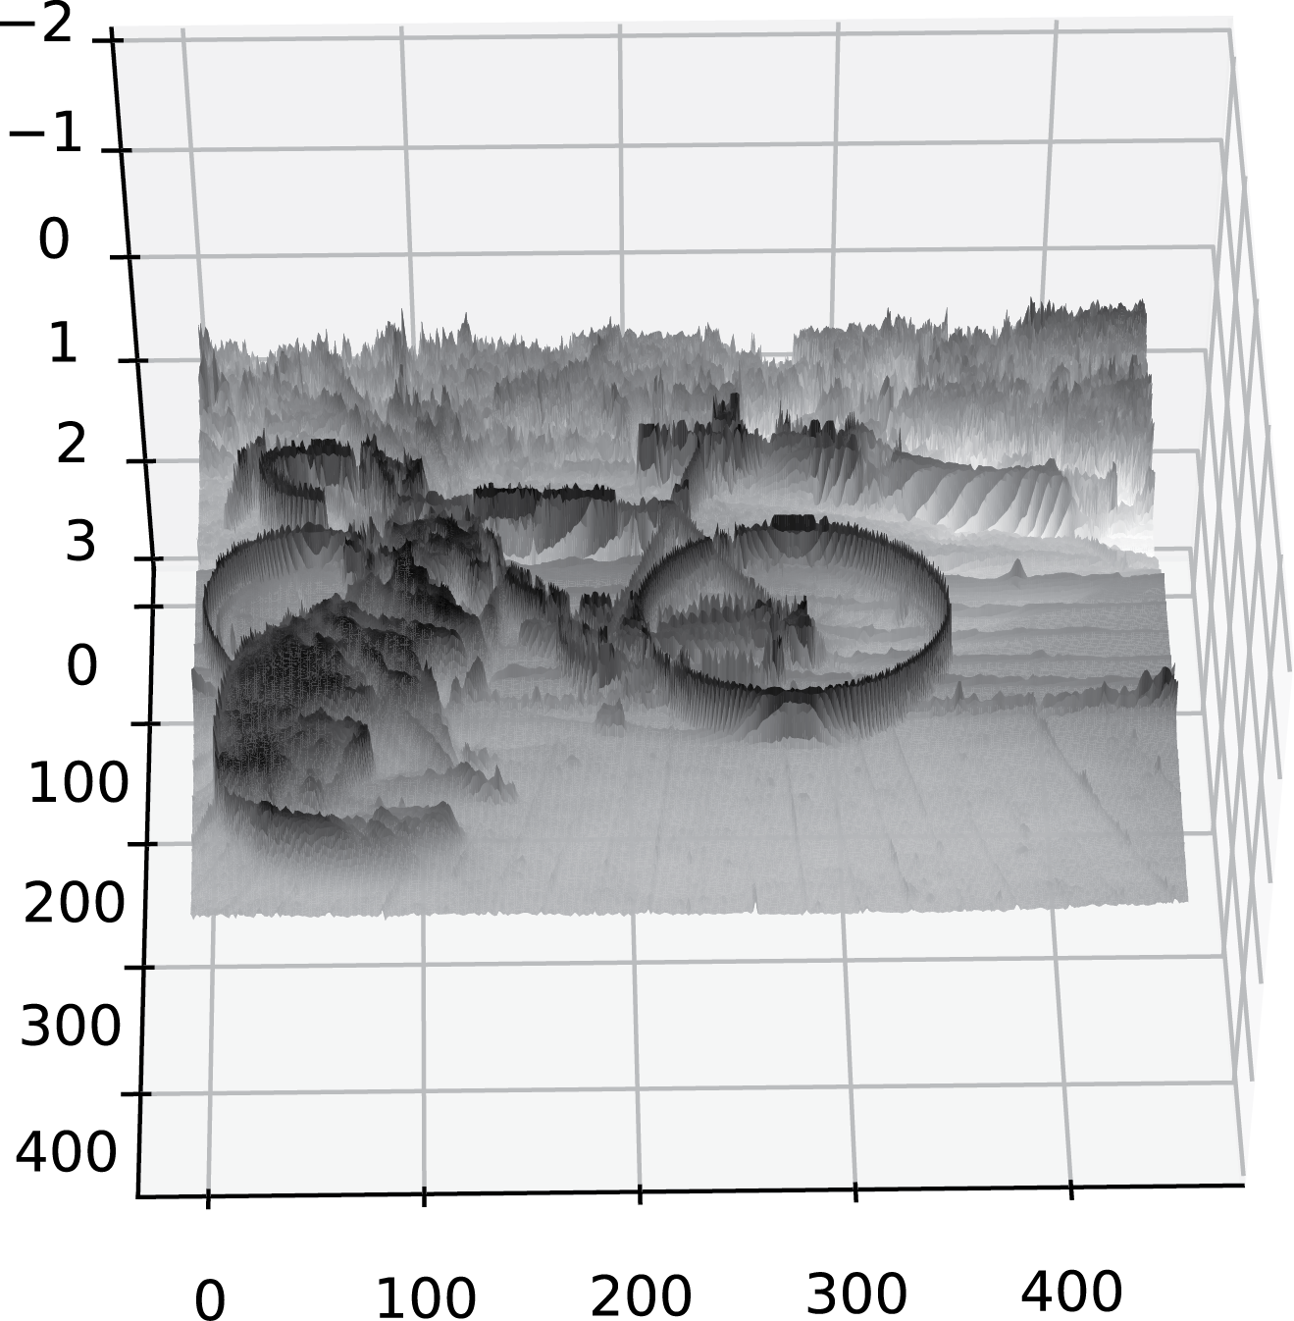
What’s an edge?
Image is a function.
Think of the gray tones as HEIGHTS.
Edges are rapid changes in this function

Slide 12
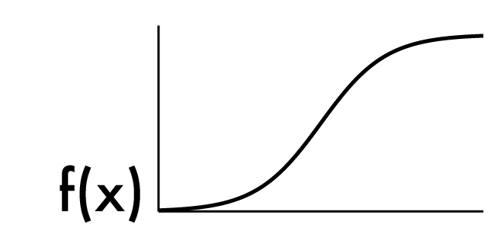
What’s an edge?
Image is a function
Edges are rapid changes in this function

Slide 13
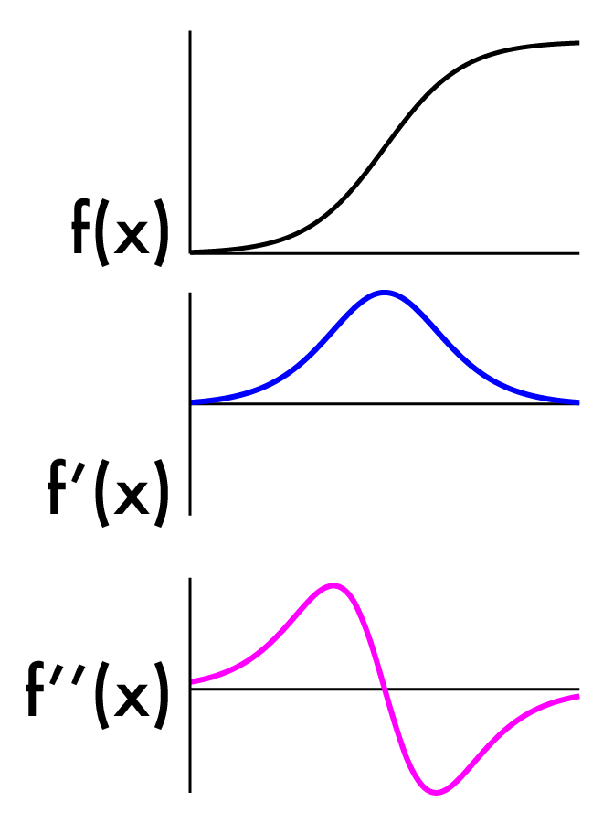
Finding edges
Could take derivative
Edges = high response

Slide 14
Image derivatives
Recall:
We don’t have an “actual” function, must estimate
Possibility: set h = 1
What will that look like?

Slide 15
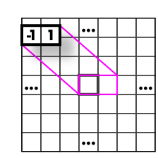
Image derivatives
Recall:
We don’t have an “actual” Function, must estimate
Possibility: set h = 1
What will that look like?

Slide 16
Image derivatives
Recall:
We don’t have an “actual” function, must estimate
Possibility: set h = 2
What will that look like?

Slide 17
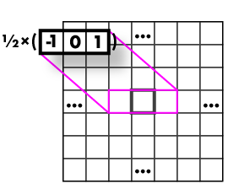
Image derivatives
Recall:
We don’t have an “actual” Function, must estimate
Possibility: set h = 2
What will that look like?

Slide 18
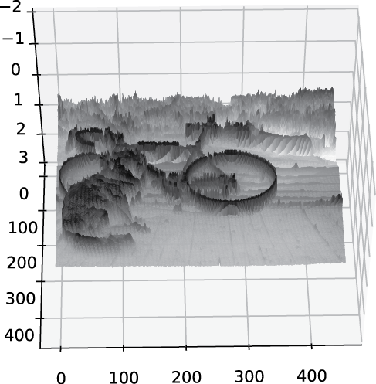
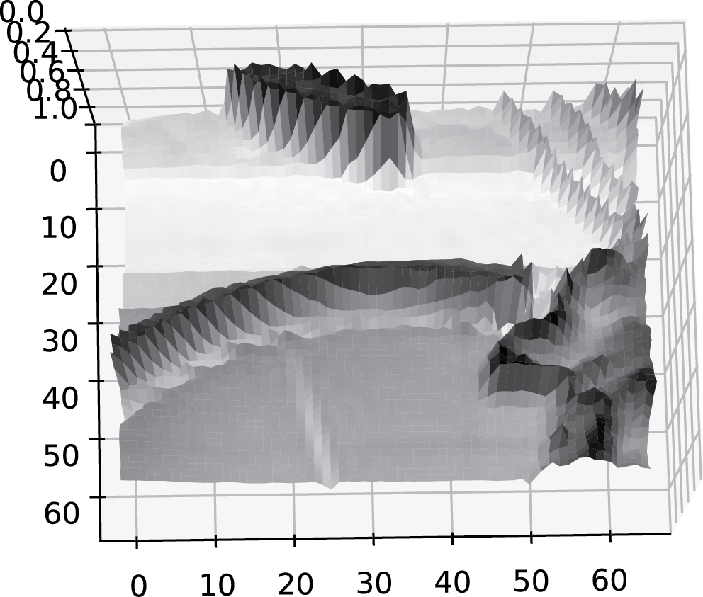
Images are noisy!

Slide 19
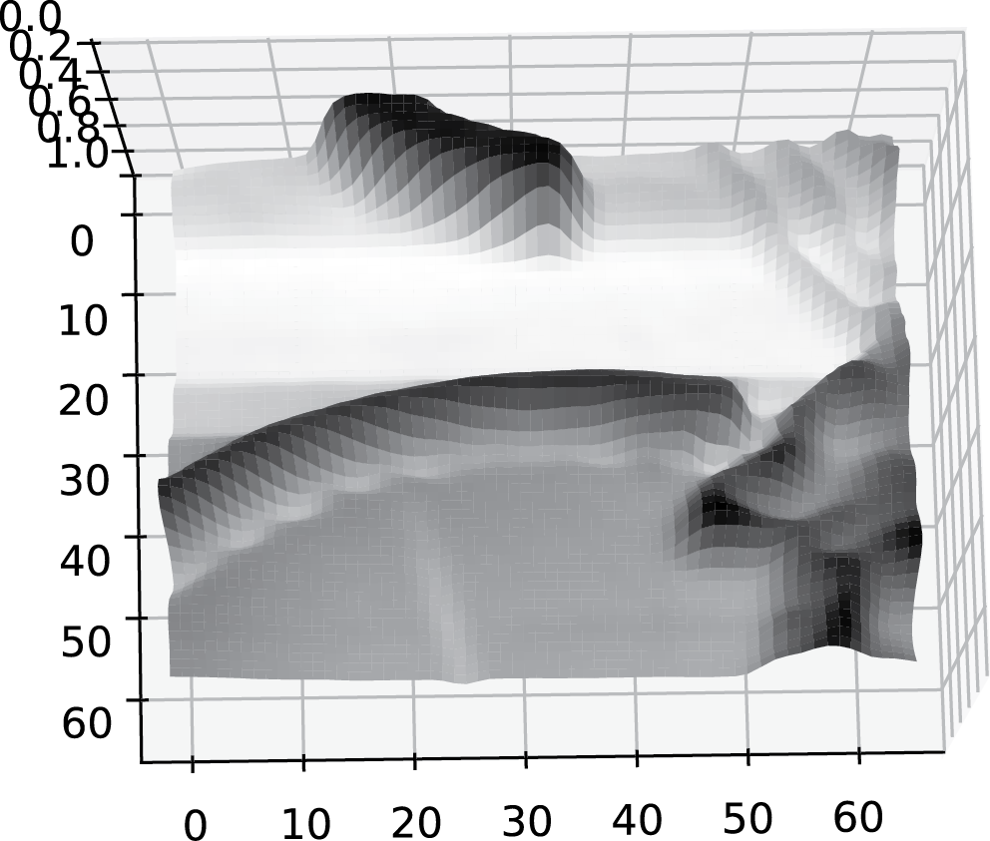
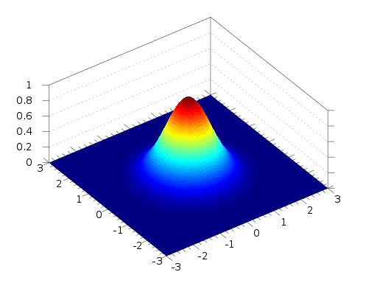
But we already know how to smooth
* =

Slide 20
But we already know how to smooth
* =

Slide 21
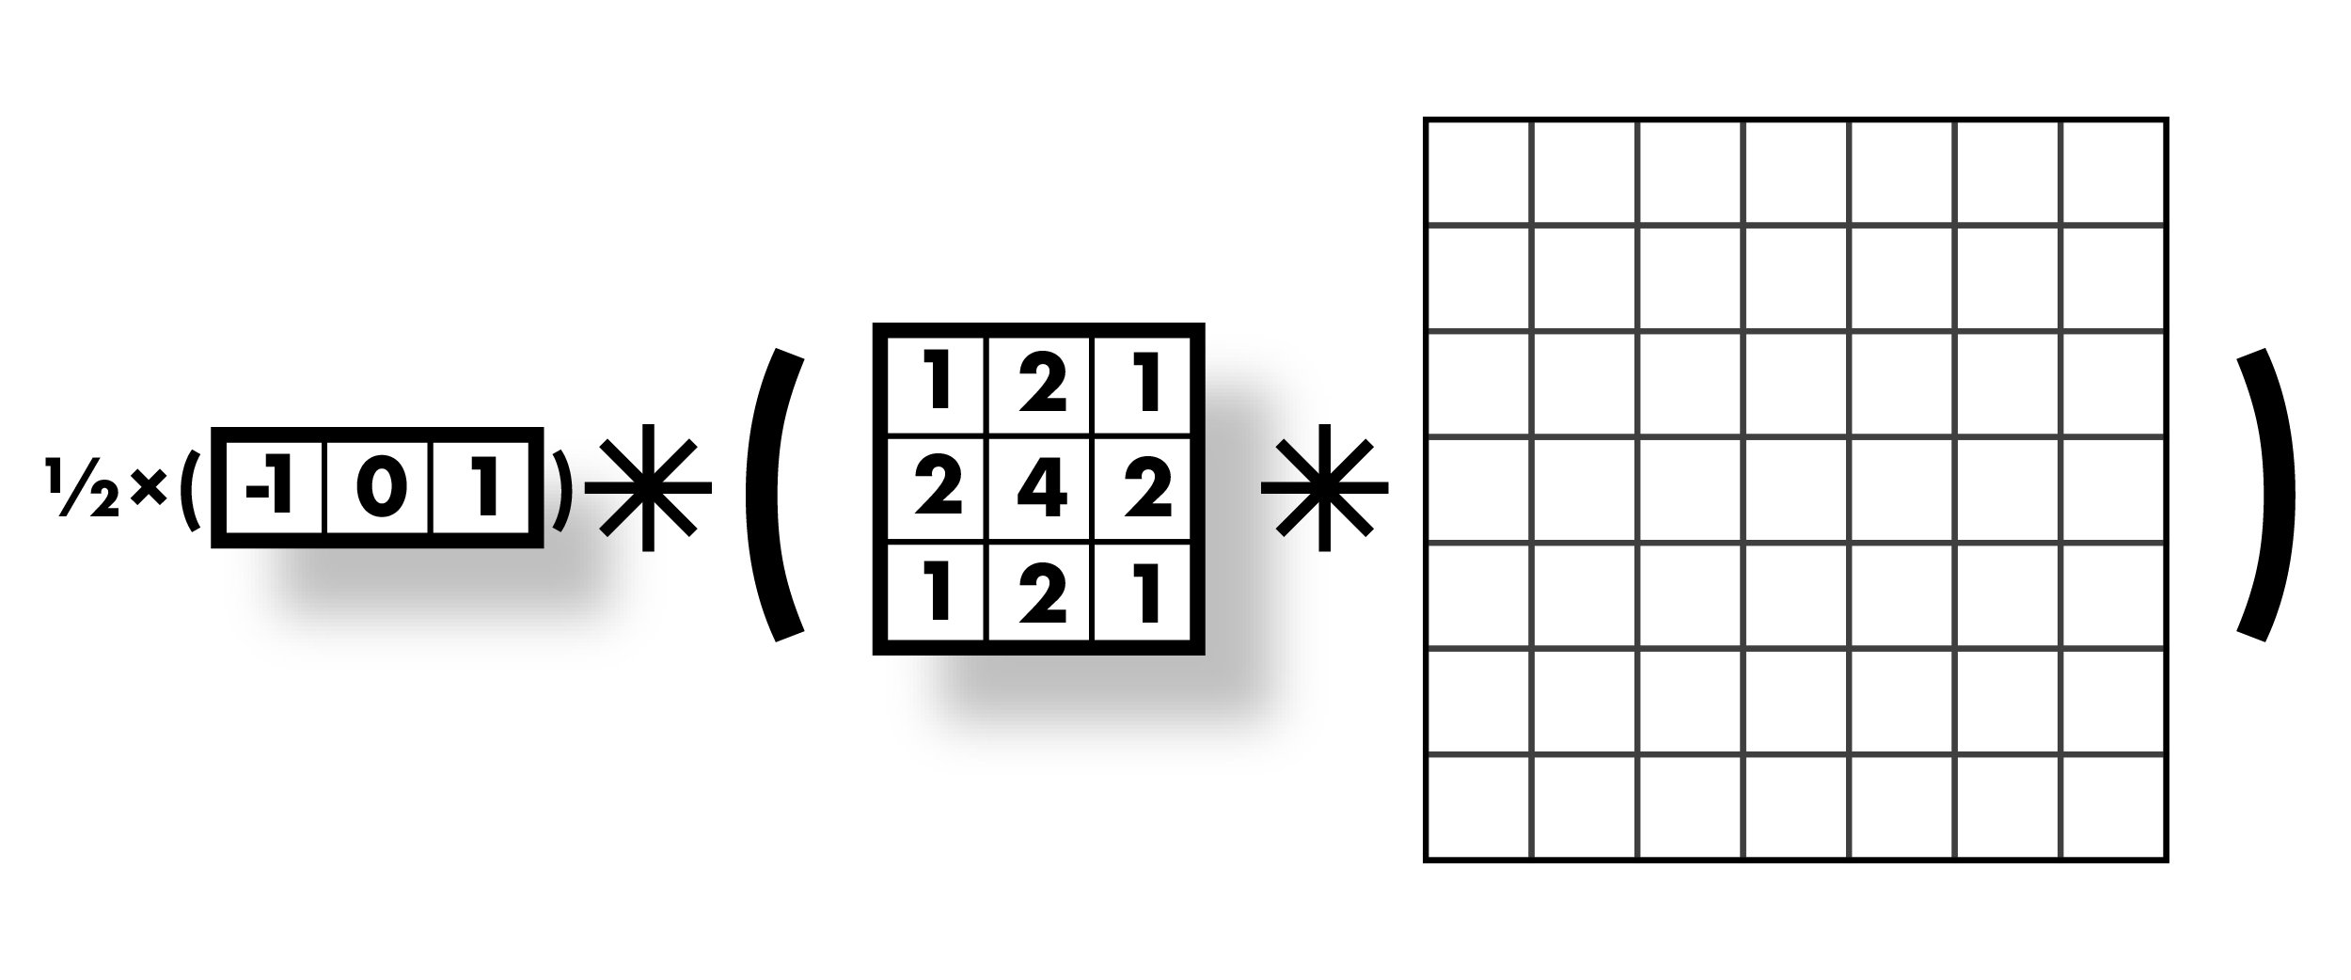
Smooth first, then derivative

Slide 22
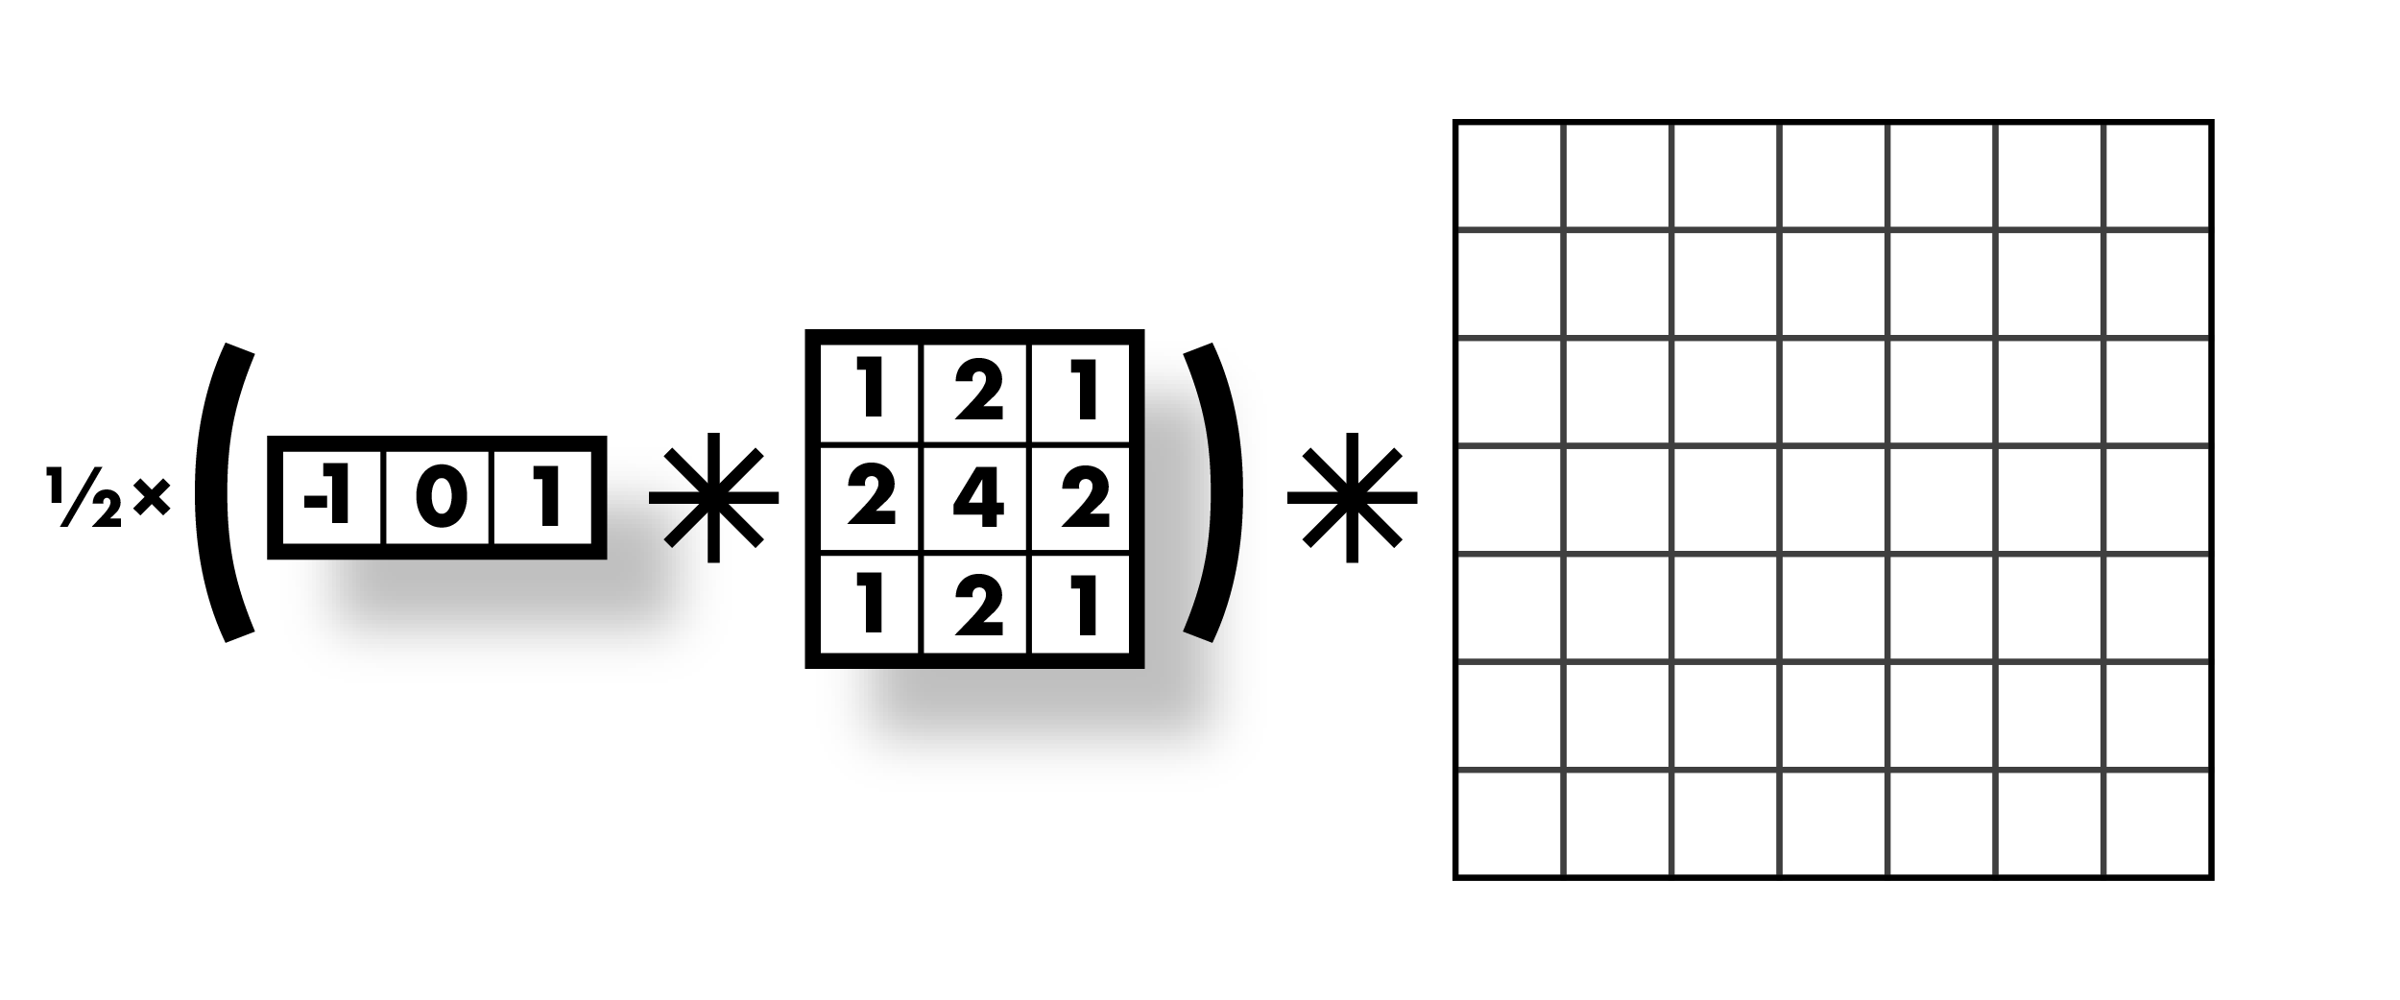
Smooth first, then derivative

Slide 23
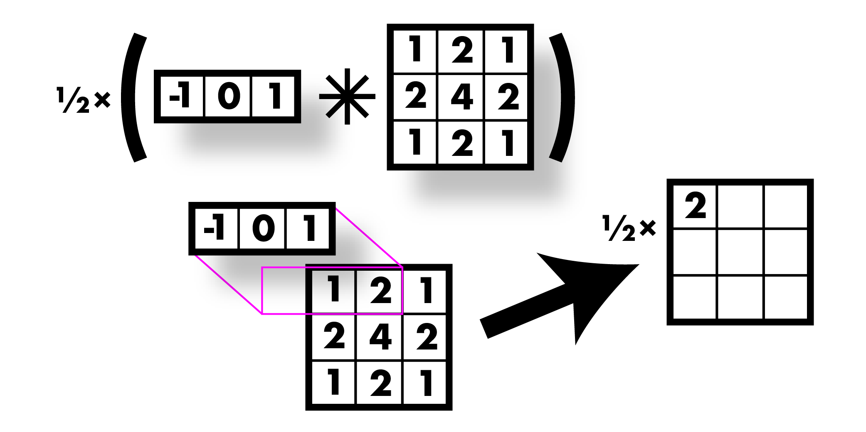
Smooth first, then derivative

Slide 24
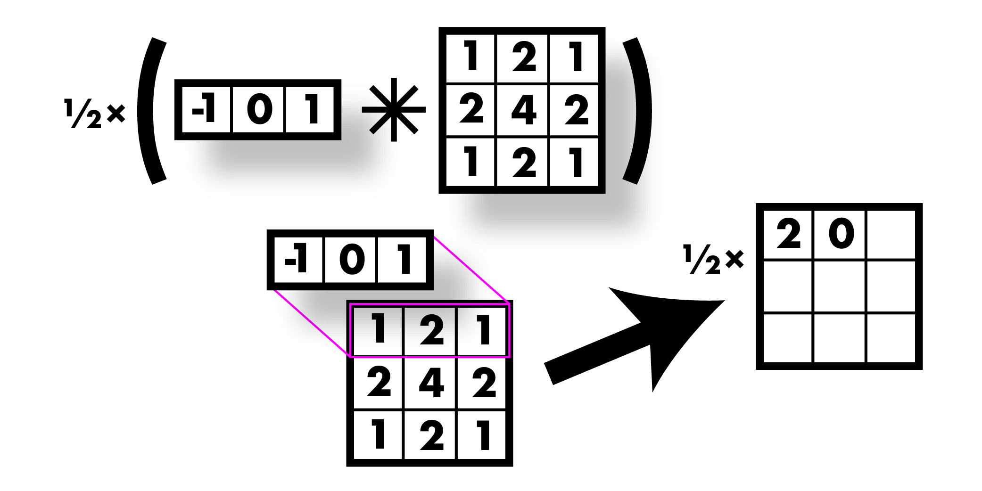
Smooth first, then derivative

Slide 25
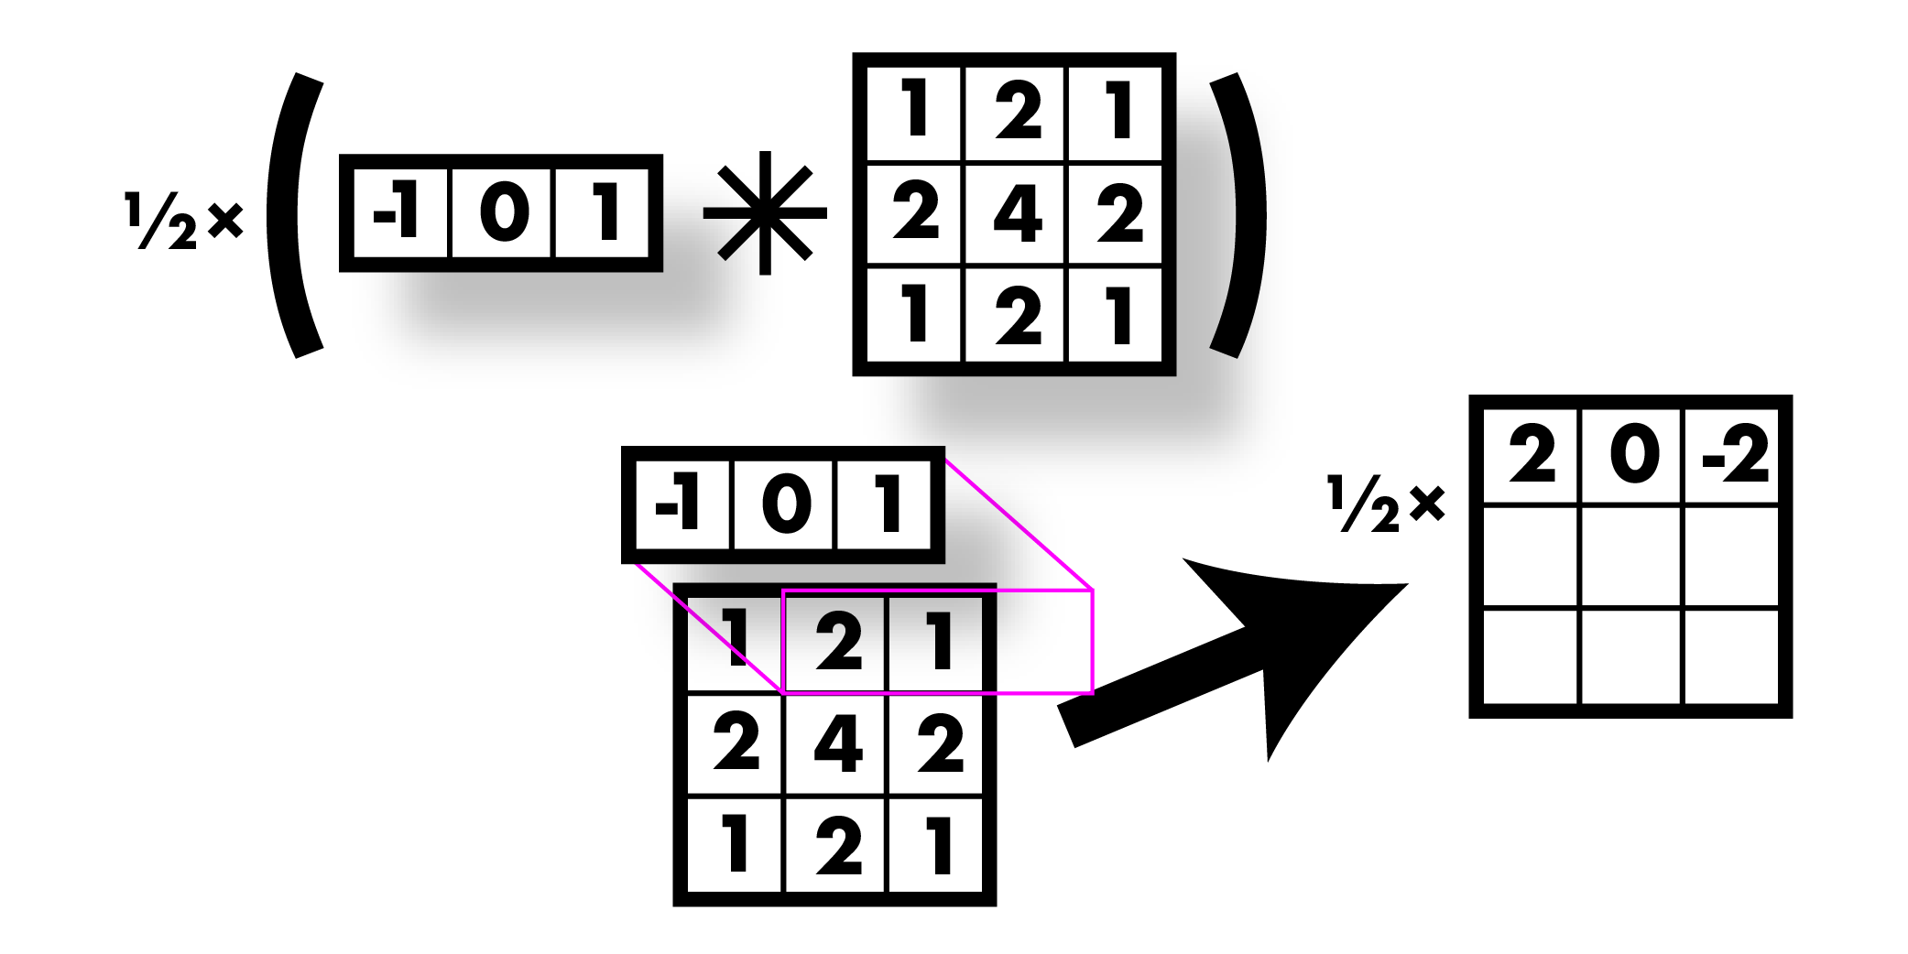
Smooth first, then derivative

Slide 26
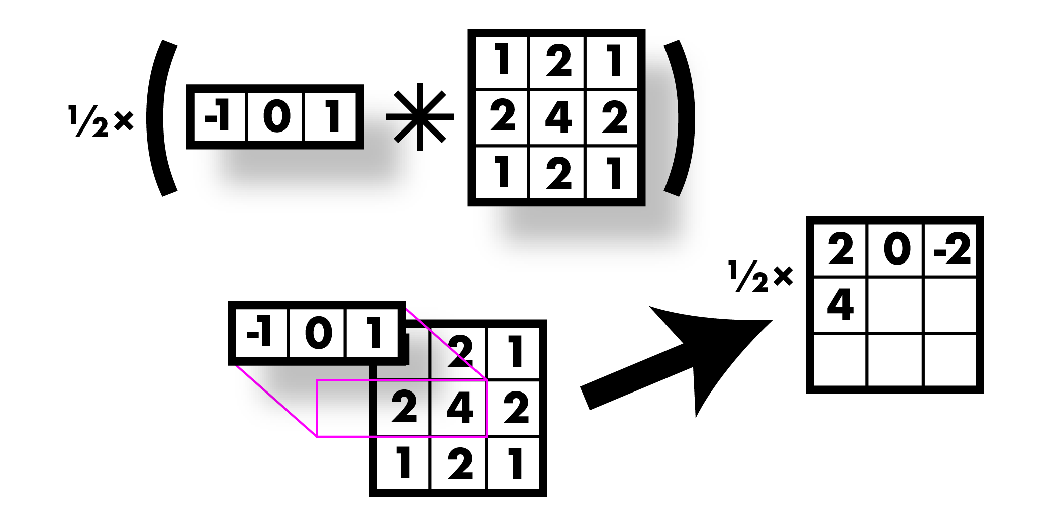
Smooth first, then derivative

Slide 27
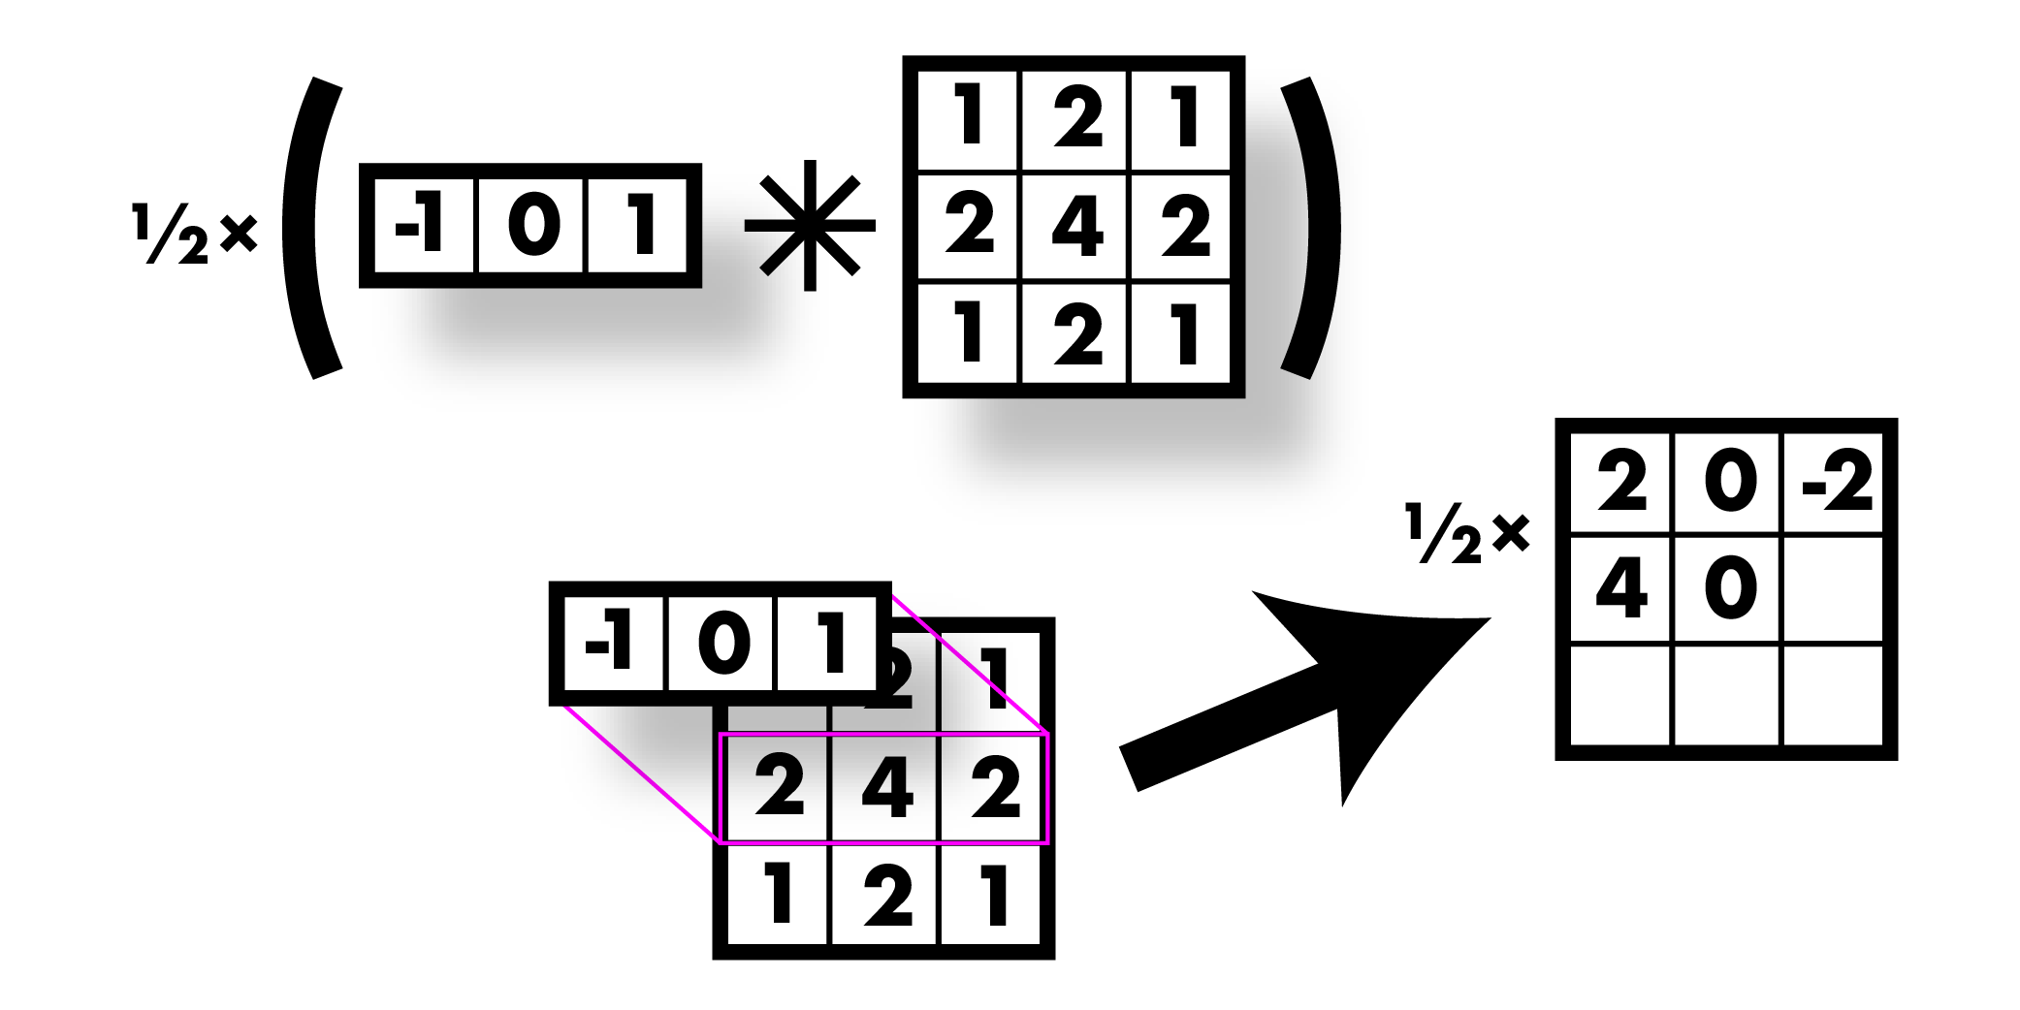
Smooth first, then derivative

Slide 28
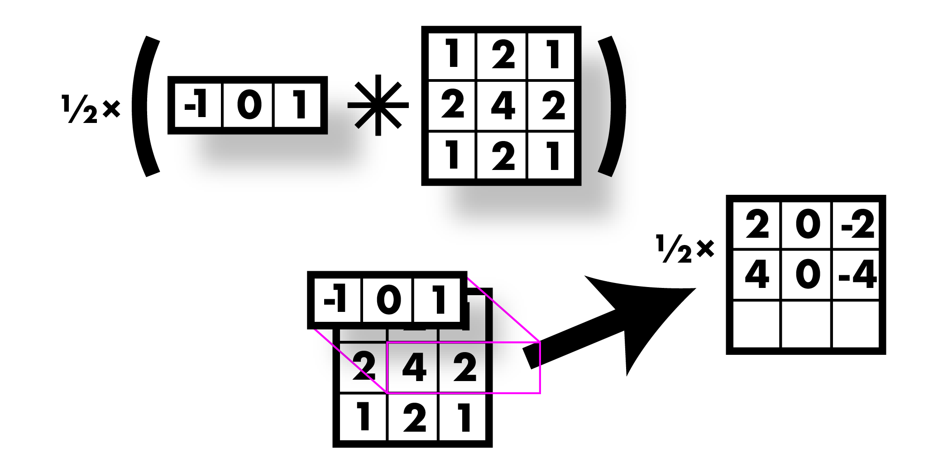
Smooth first, then derivative

Slide 29
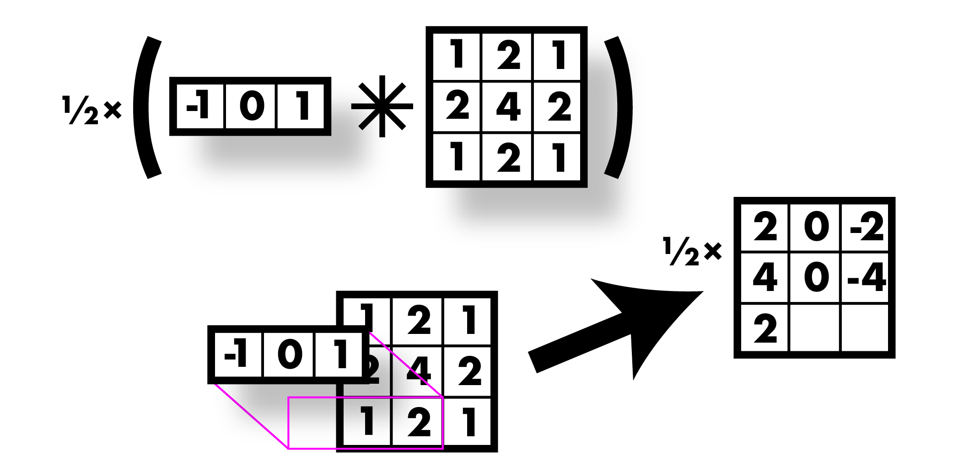
Smooth first, then derivative

Slide 30
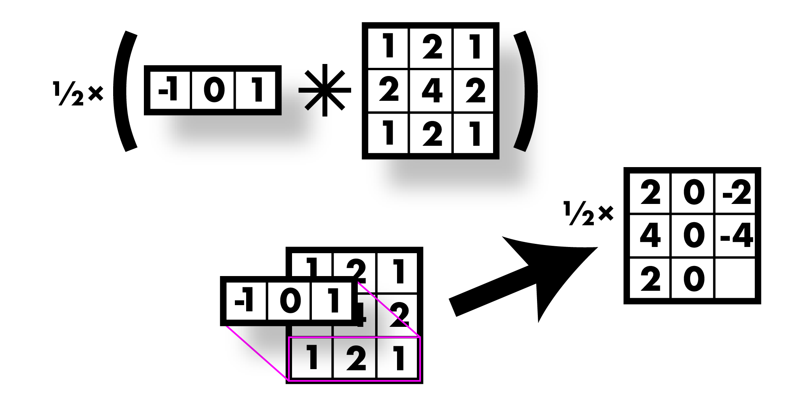
Smooth first, then derivative

Slide 31
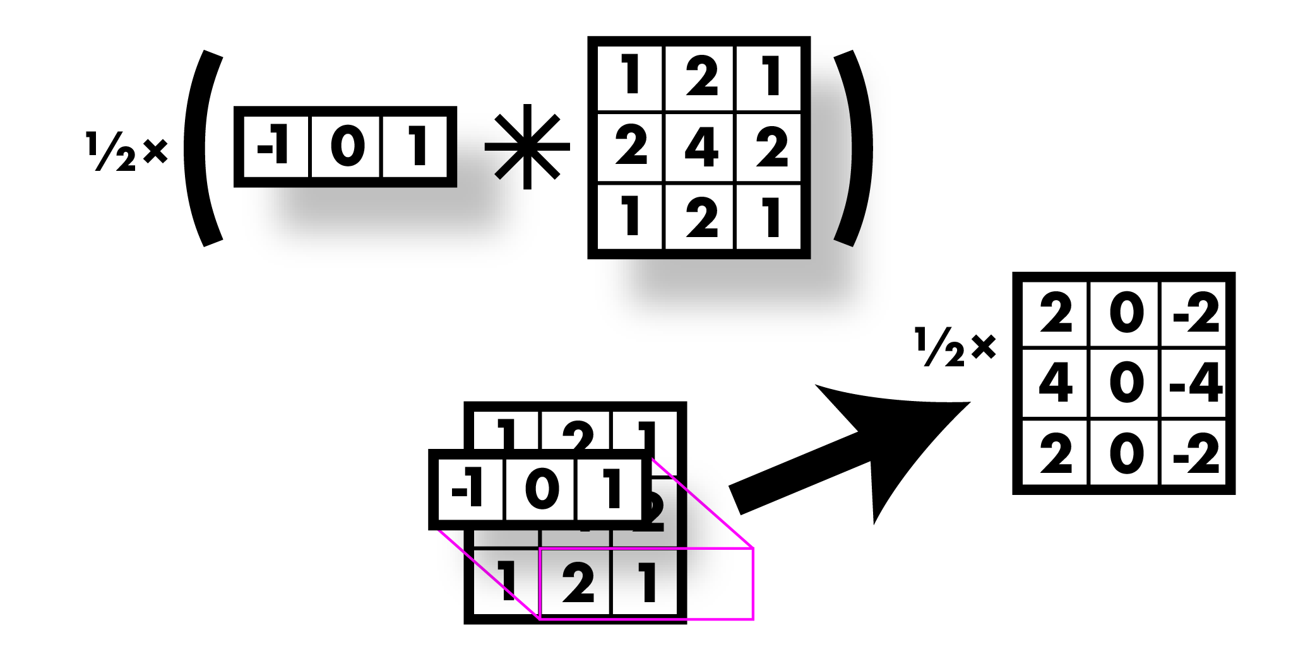
Smooth first, then derivative

Slide 32
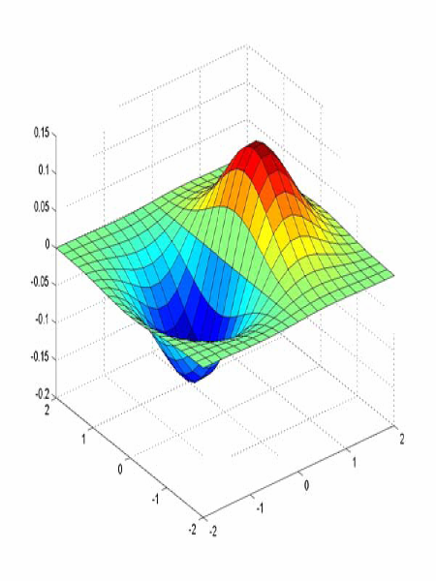
Sobel filter! Smooth & derivative

Slide 33
Image derivatives
Recall:
Want smoothing too!

Slide 34
Finding edges
Could take derivative
Find high responses
Sobel filters!
But let’s stop a moment get
some basics

Slide 35
Simplest image gradient
How would you implement this as a filter?
0 -1 1
The gradient direction is give
How does this relate to the direction of the edge?
perpendicular
The edge strength is given by the gradient magnitude

Slide 36
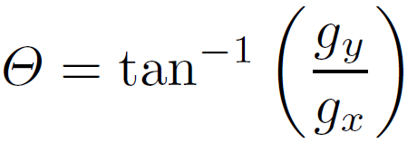
Sobel operator
Who was Sobel?
Irwin Sobel (born 1940)
Consultant (HP Labs Retired –
8Mar13) · Computer Vision & Graphics
In practice, it is common to use:
-1 | 0 | 1
-2 | 0 | 2
-1 | 0 | 1
-1 | -2 | -1
0 | 0 | 0
1 | 2 | 1
Magnitude:
Orientation:
What’s the C/C++ function?
Use atan2

Slide 37
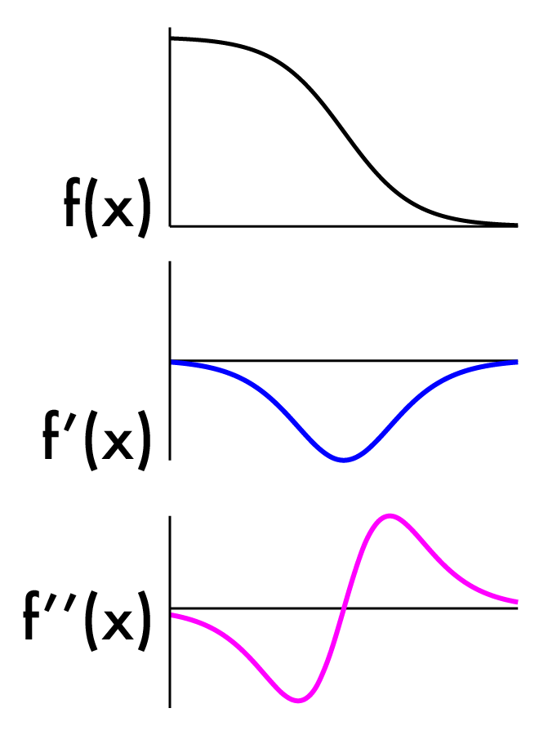
Finding edges
Could take derivative
Find high responses
Sobel filters!
But…
Edges go both ways
Want to find extrema

Slide 38
2nd derivative!
Crosses zero at extrema

Slide 39
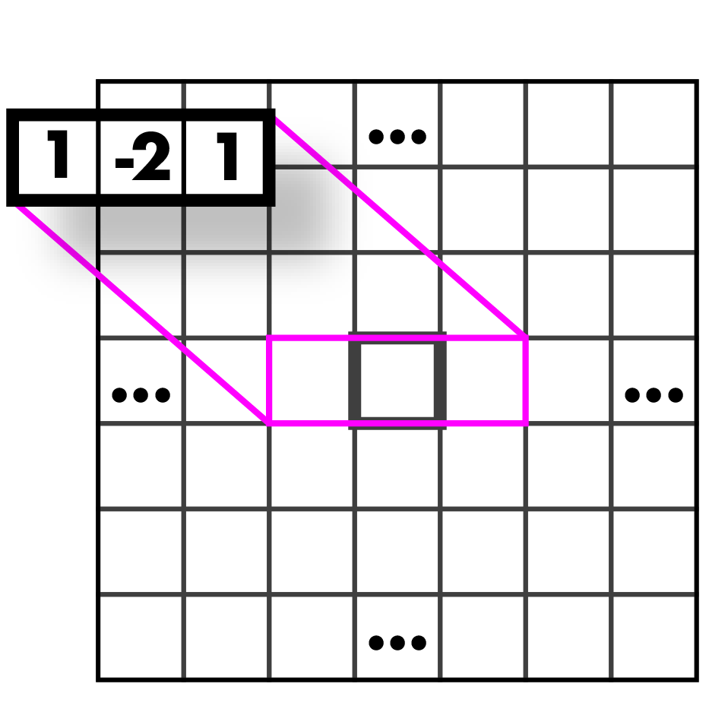
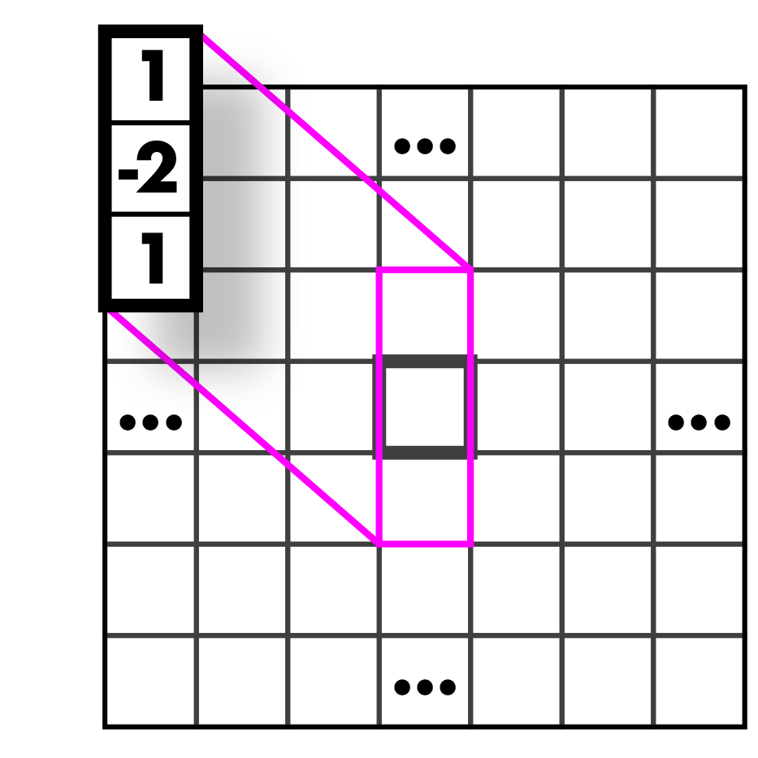
Laplacian (2nd derivative)!
Crosses zero at extrema
Recall:
Laplacian:
Again, have to estimate f’’(x):

Slide 40
Laplacians
Laplacian:

Slide 41
Laplacians
Laplacian:
Measures the divergence of the gradient
Flux of gradient vector field through small area

Slide 45
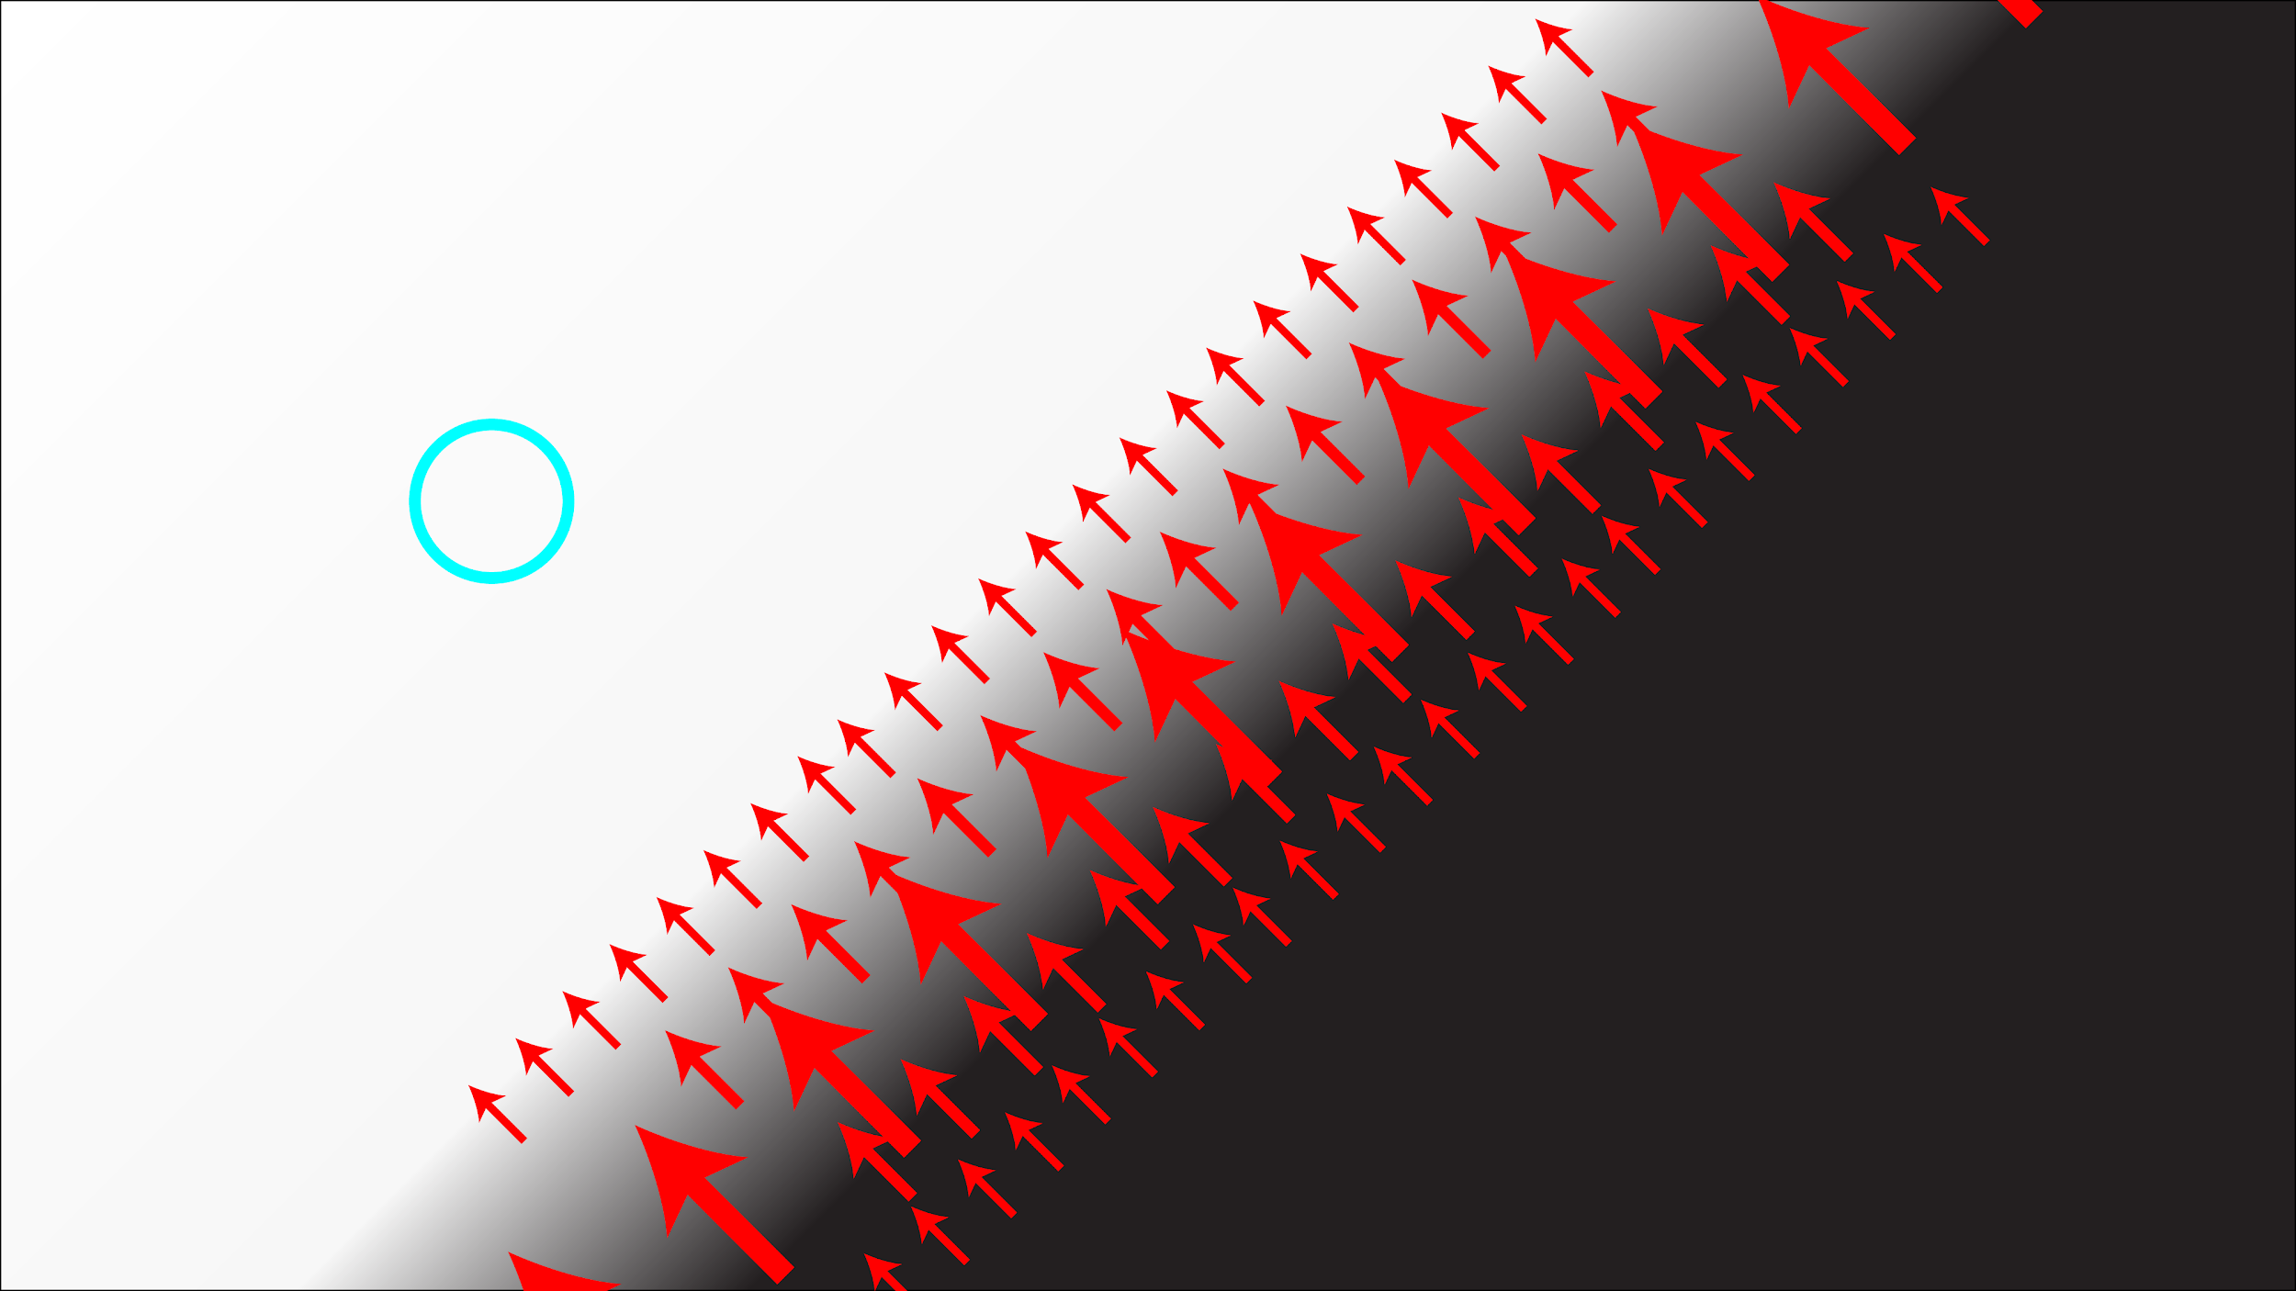

Slide 46
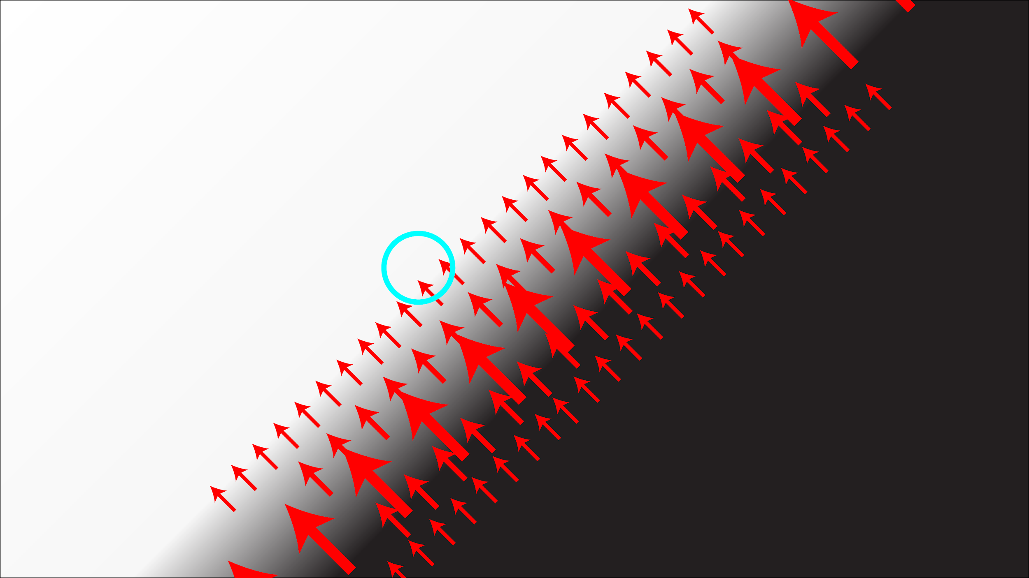

Slide 47
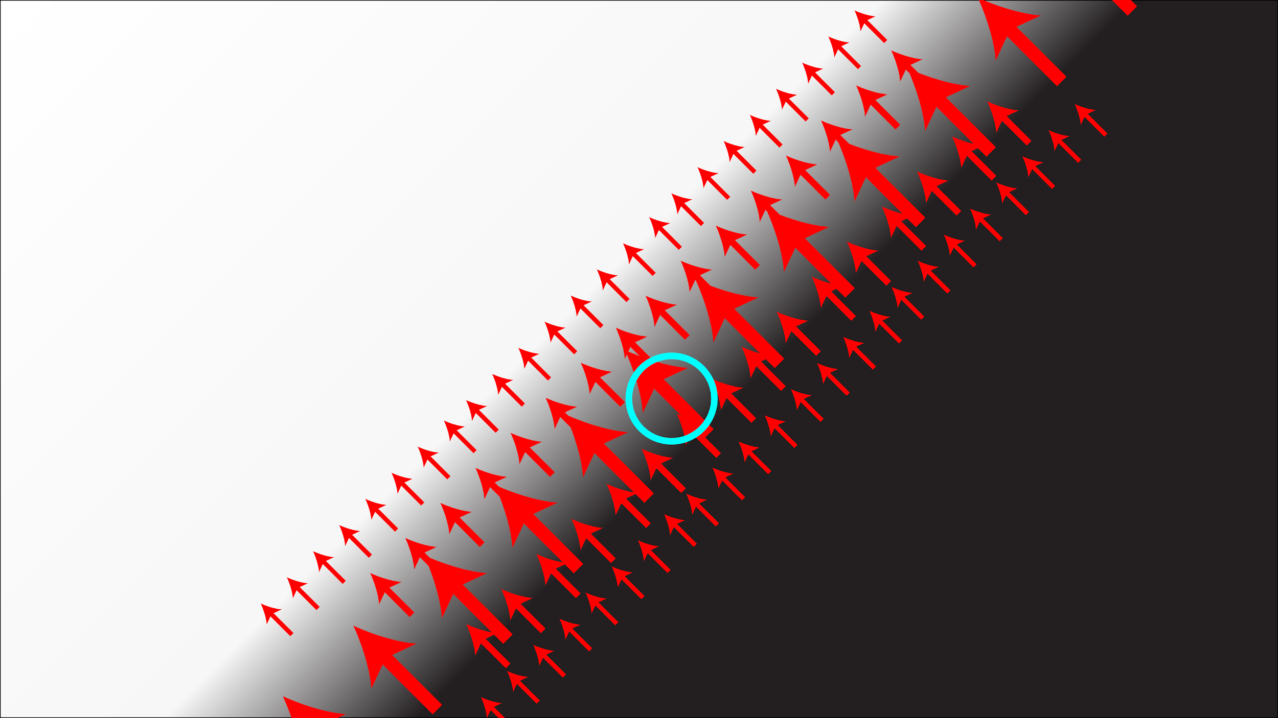

Slide 48
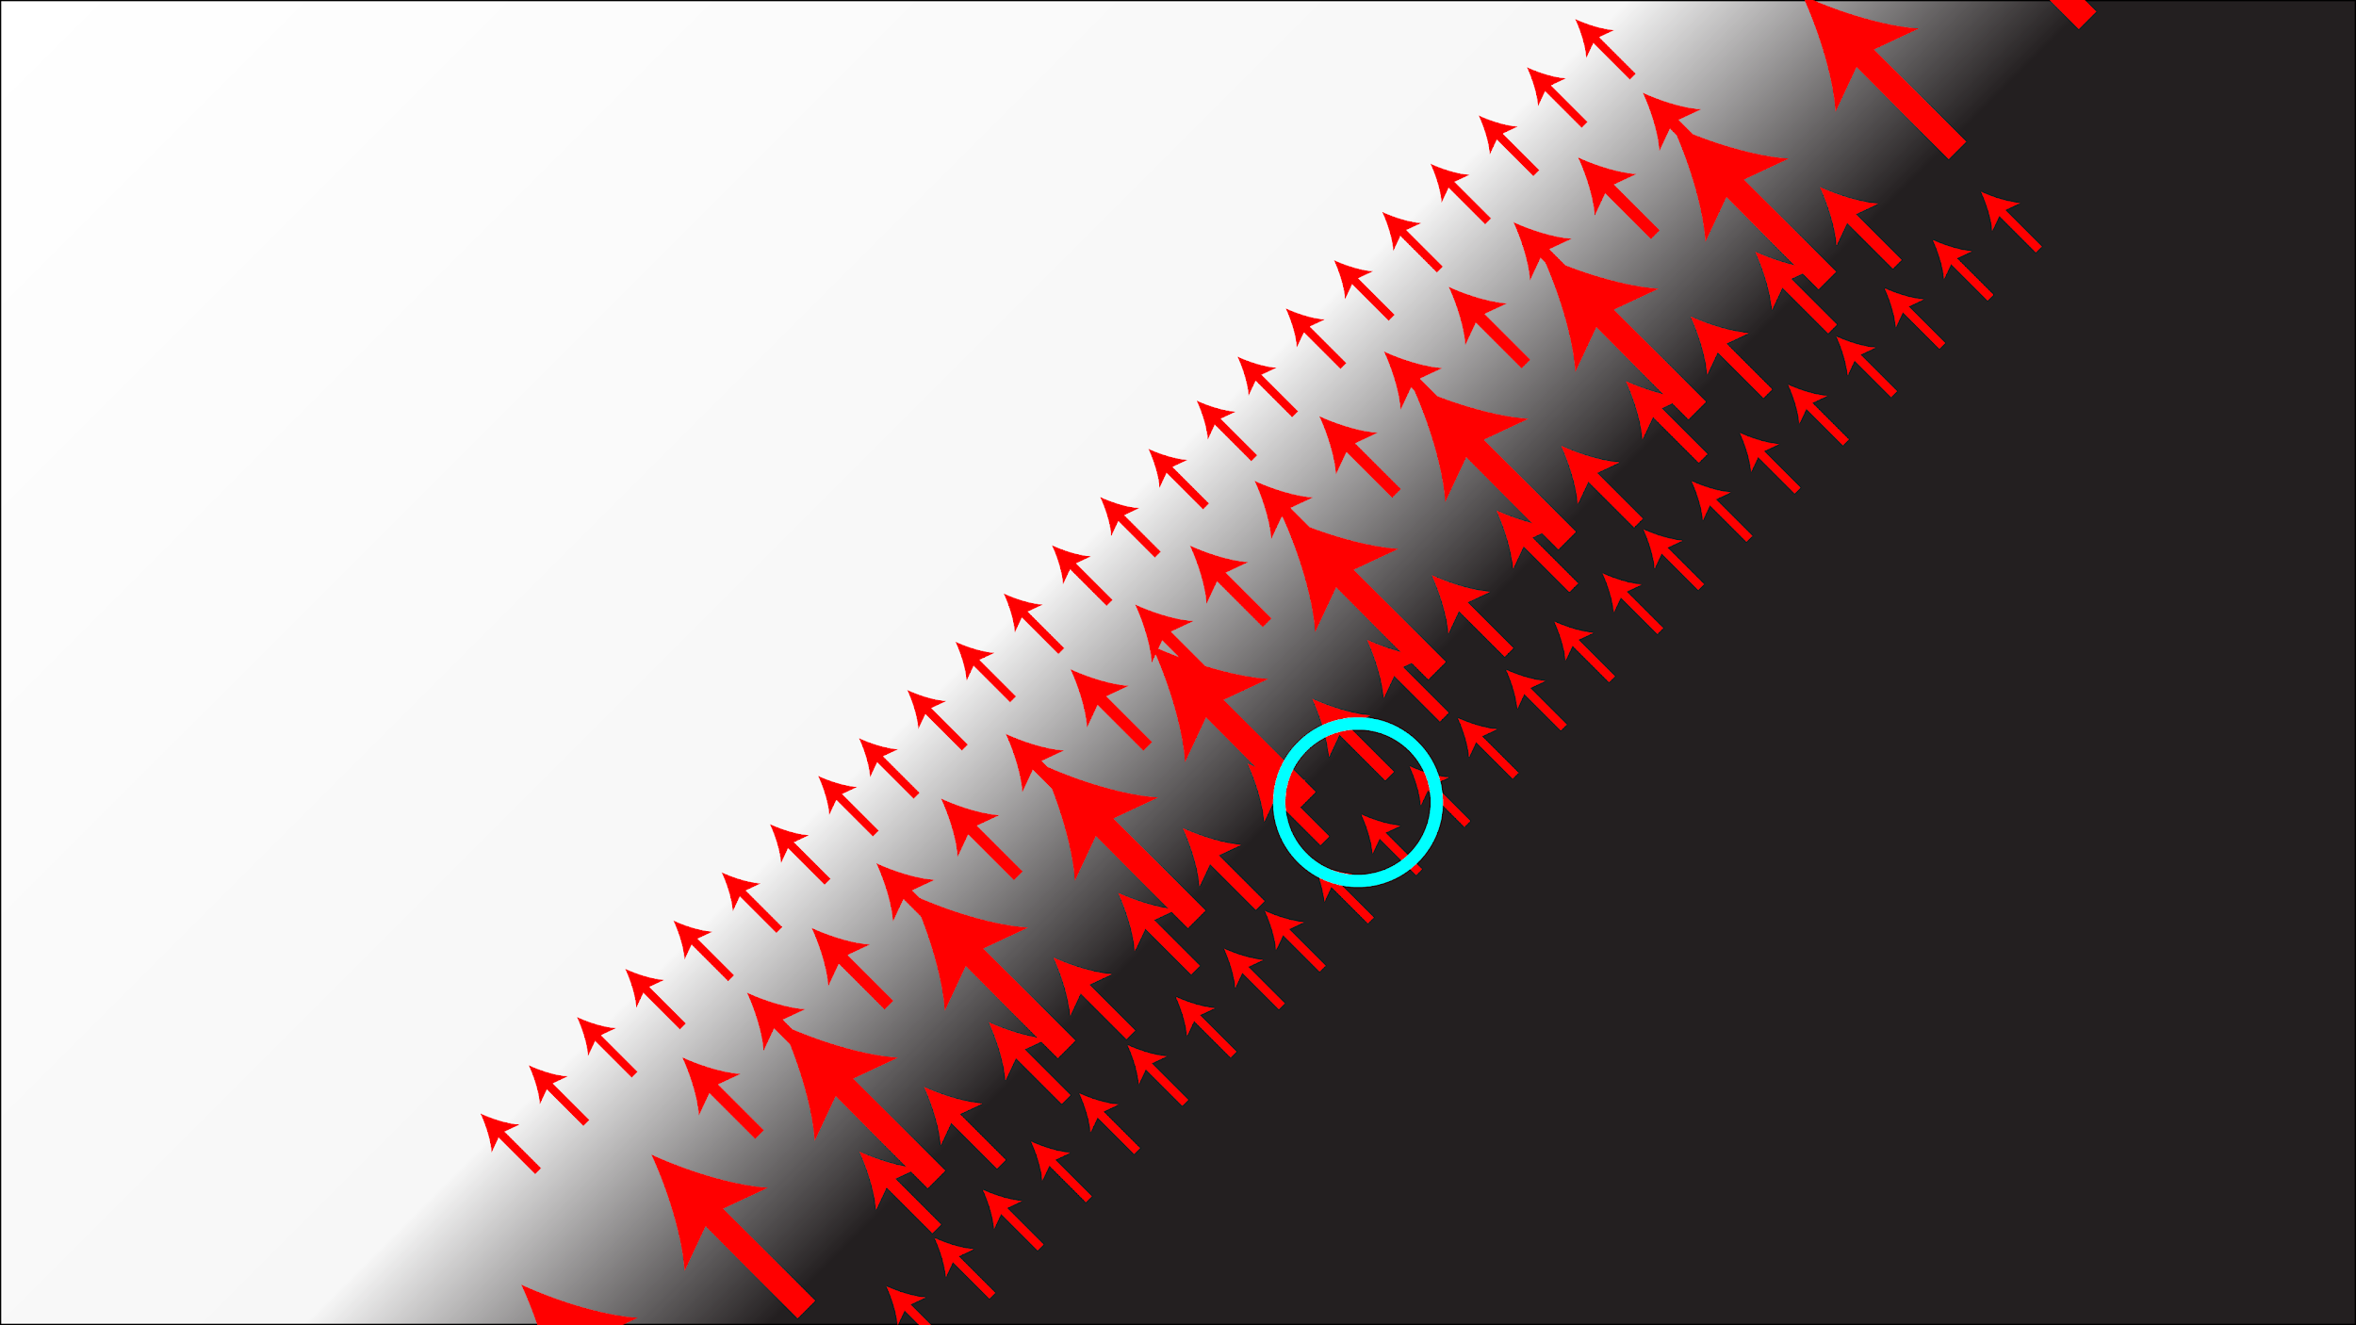

Slide 49
Laplacians
Laplacian:

Slide 50
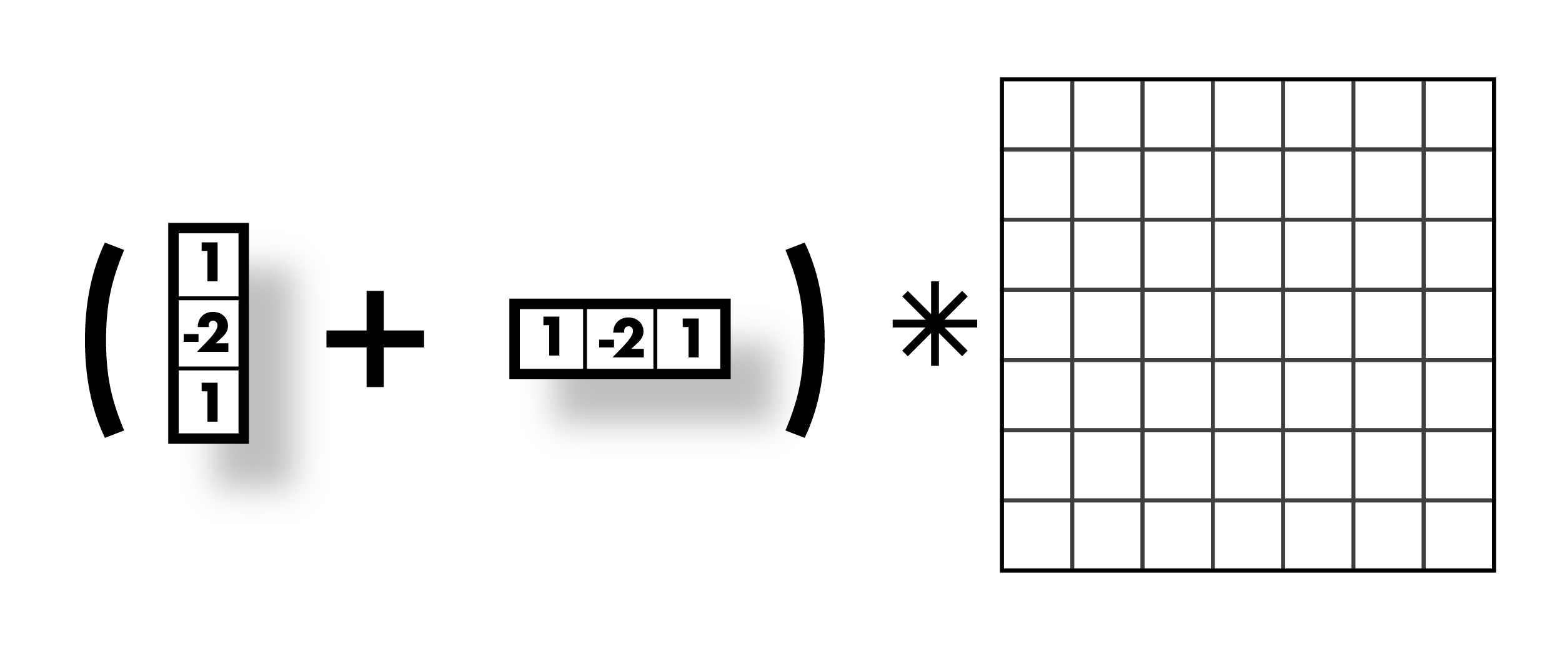
Laplacians
Laplacian:

Slide 51
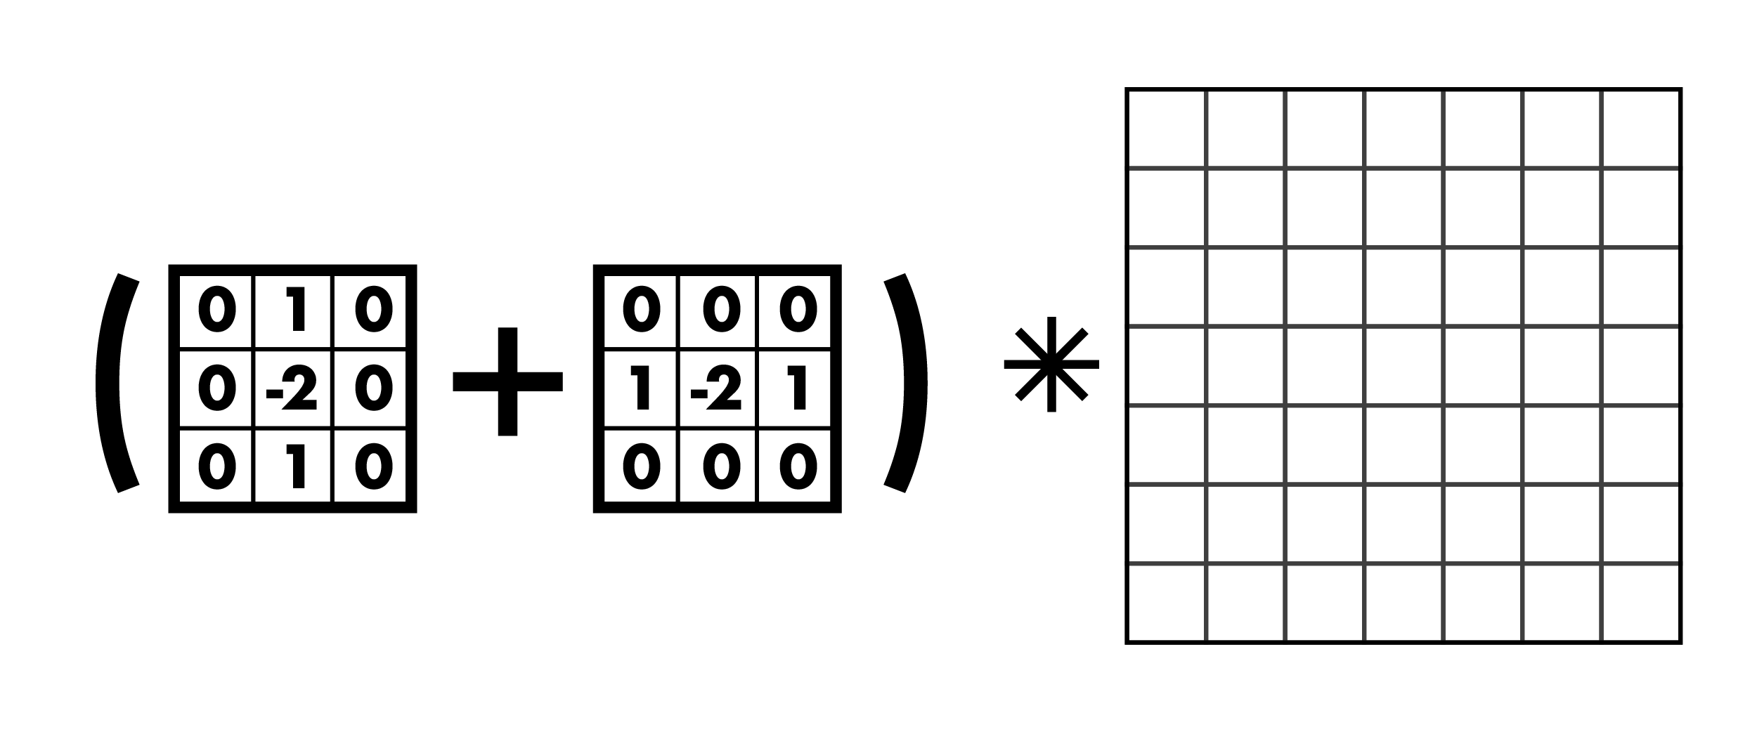
Laplacians
Laplacian:

Slide 52
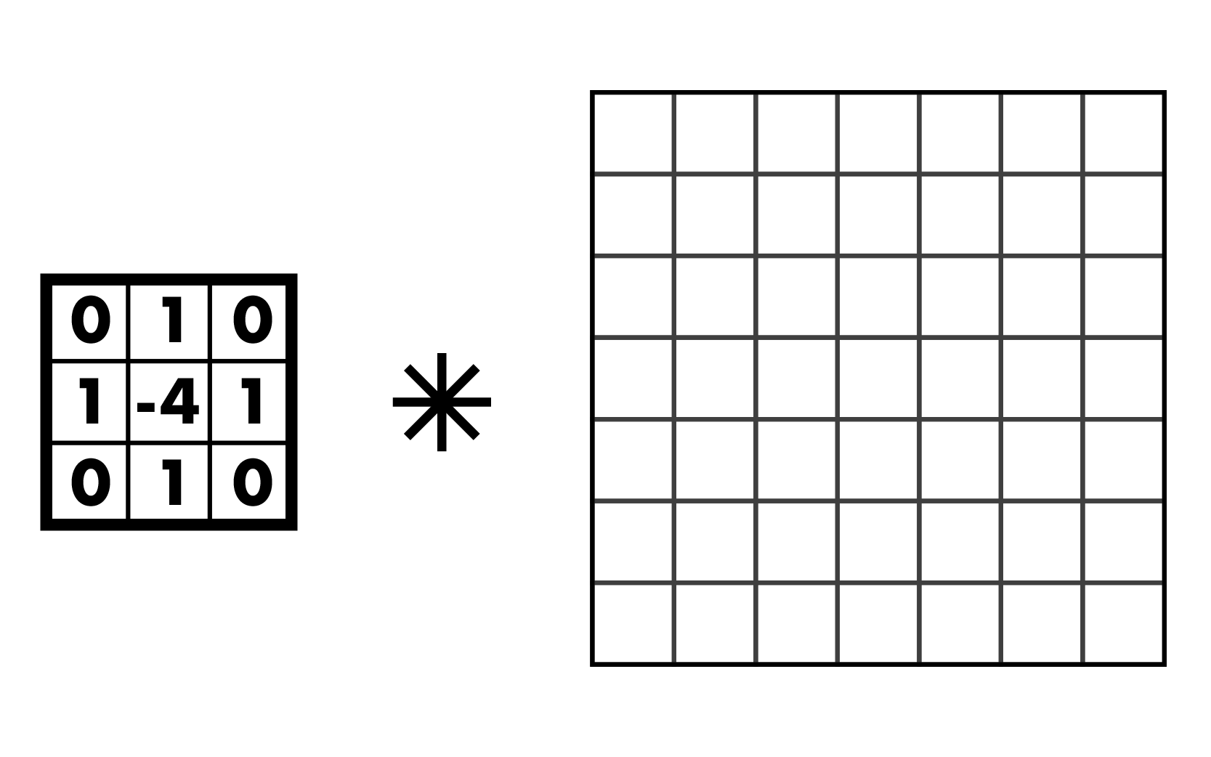
Laplacians
Laplacian:

Slide 53
Laplacians
Laplacian:
Negative Laplacian, -4 in middle
Positive Laplacian --->

Slide 54
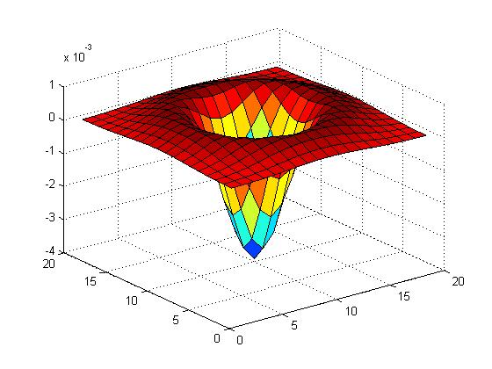
Laplacians also sensitive to noise
Again, use gaussian smoothing
Can just use one kernel since convs commute
Laplacian of Gaussian, LoG
Can get good approx. with 5x5 - 9x9 kernels

Slide 55
Another edge detector:
Image is a function:
Has high frequency and low frequency components
Think in terms of fourier transform
Edges are high frequency changes
Maybe we want to find edges of a specific size (i.e. specific frequency)

Slide 56
Difference of Gaussian (DoG)
Gaussian is a low pass filter
Strongly reduce components with frequency f < σ
(g*I) low frequency components
I - (g*I) high frequency components
g(σ1)*I - g(σ2)*I
Components in between these frequencies
g(σ1)*I - g(σ2)*I = [g(σ1) - g(σ2)]*I

Slide 57
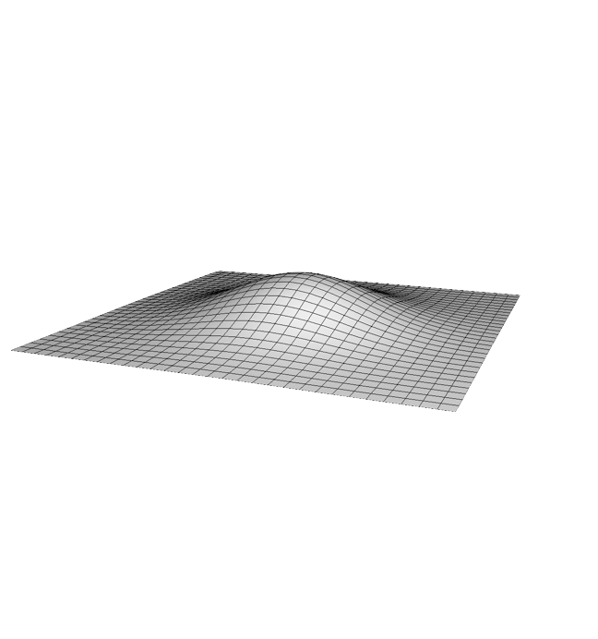
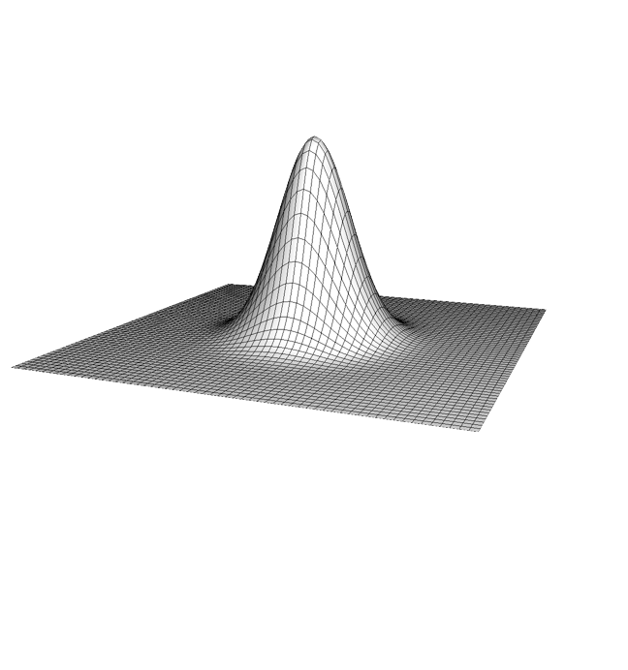
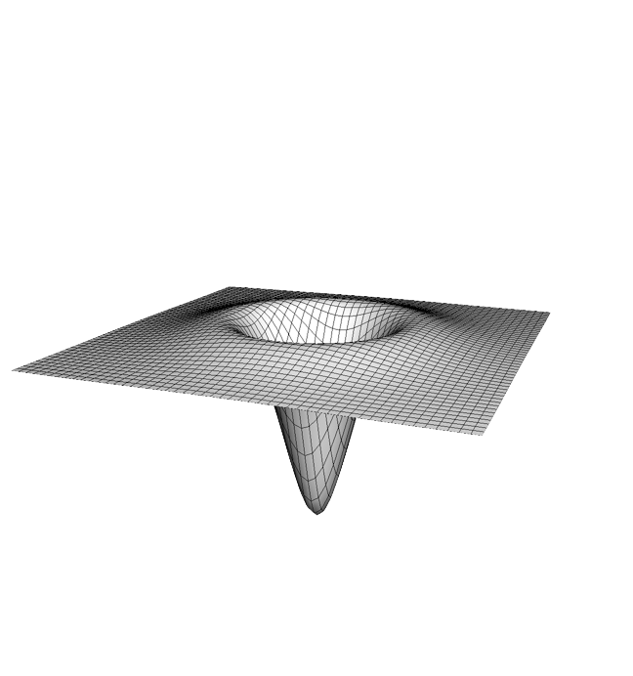
Difference of Gaussian (DoG)
g(σ1)*I - g(σ2)*I = [g(σ1) - g(σ2)]*I
σ = 2
σ = 1
=

Slide 58
Difference of Gaussian (DoG)
g(σ1)*I - g(σ2)*I = [g(σ1) - g(σ2)]*I
This looks a lot like our LoG!
(not actually the same but similar)

Slide 59
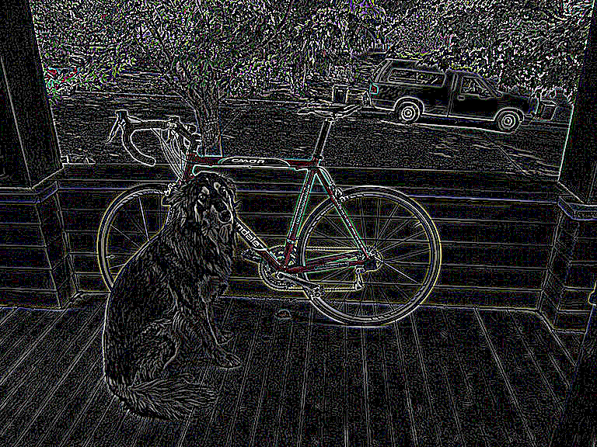
DoG (1 - 0)

Slide 60
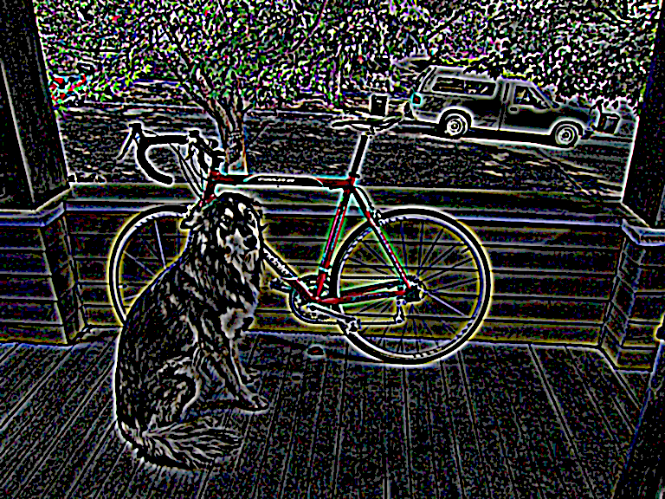
DoG (2 - 1)

Slide 61
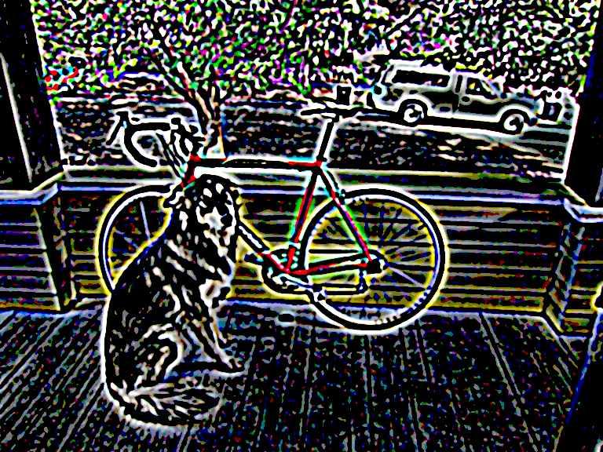
DoG (3 - 2)

Slide 62
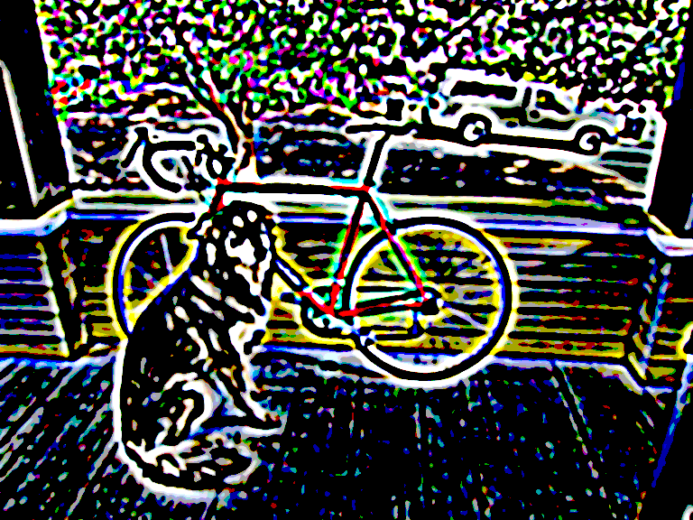
DoG (4 - 3)

Slide 63
Another approach: gradient magnitude
Don’t need 2nd derivatives
Just use magnitude of gradient

Slide 64
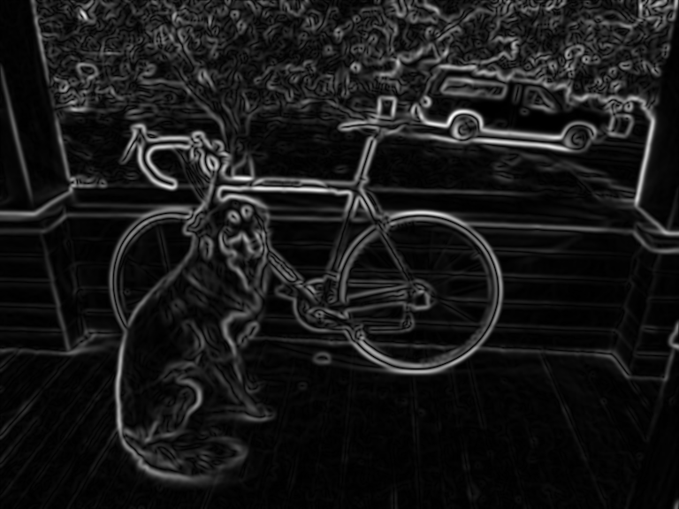
Another approach: gradient magnitude
Don’t need 2nd derivatives
Just use magnitude of gradient
Are we done? No!

Slide 65
Another approach: gradient magnitude
Don’t need 2nd derivatives
Just use magnitude of gradient
Are we done? No!

Slide 66
What we really want: line drawing

Slide 67
Canny Edge Detection
http://bigwww.epfl.ch/demo/ip/demos/edgeDetector/
Your first image processing pipeline!
Old-school CV is all about pipelines
Algorithm:
1. Smooth image (only want “real” edges, not noise)
2. Calculate gradient direction and magnitude
3. Non-maximum suppression perpendicular to edge
4. Threshold into strong, weak, no edge
5. Connect together components

Slide 68
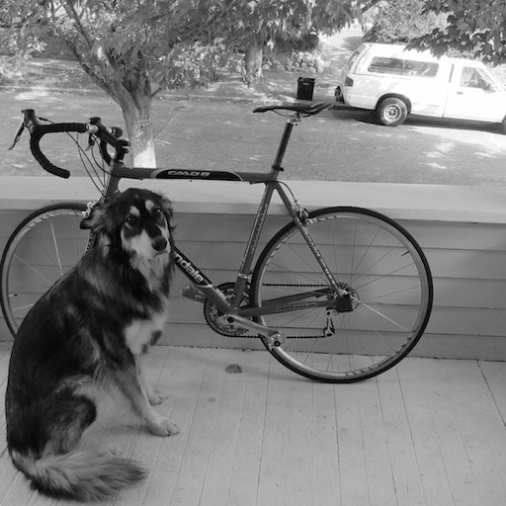
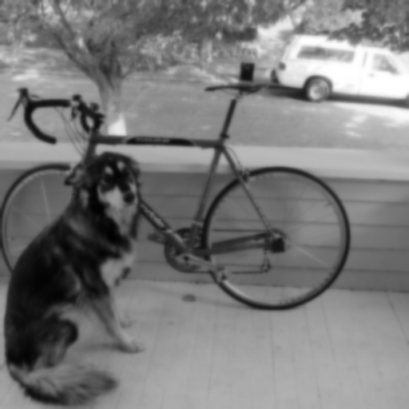
Smooth image
http://bigwww.epfl.ch/demo/ip/demos/edgeDetector/
You know how to do this, gaussians!

Slide 69
Gradient magnitude and direction
http://bigwww.epfl.ch/demo/ip/demos/edgeDetector/
Sobel filter

Slide 70
Non-maximum suppression
http://bigwww.epfl.ch/demo/ip/demos/edgeDetector/
Want single pixel edges, not thick blurry lines
Need to check nearby pixels
See if response is highest

Slide 71
Non-maximum suppression

Slide 72
Non-maximum suppression

Slide 73
Non-maximum suppression

Slide 74
Non-maximum suppression

Slide 75
Non-maximum suppression

Slide 76
Non-maximum suppression

Slide 77
Non-maximum suppression

Slide 78
Non-maximum suppression
http://bigwww.epfl.ch/demo/ip/demos/edgeDetector/

Slide 79
Threshold edges
http://bigwww.epfl.ch/demo/ip/demos/edgeDetector/
Still some noise
Only want strong edges
2 thresholds T and t, 3 cases
R > T: strong edge
R < T but R > t: weak edge
R < t: no edge
Why two thresholds?

Slide 80
Connect ‘em up!
http://bigwww.epfl.ch/demo/ip/demos/edgeDetector/
Strong edges are edges!
Weak edges are edges iff they connect to strong
Look in some neighborhood (usually 8 closest)

Slide 81
Canny Edge Detection
http://bigwww.epfl.ch/demo/ip/demos/edgeDetector/
Your first image processing pipeline!
Old-school CV is all about pipelines
Algorithm:
Smooth image (only want “real” edges, not noise)
Calculate gradient direction and magnitude
Non-maximum suppression perpendicular to edge
Threshold into strong, weak, no edge
Connect together components
Tunable: Sigma, thresholds

Slide 82
Canny Edge Detection
http://bigwww.epfl.ch/demo/ip/demos/edgeDetector/

Slide 83
Canny on Kidney

Slide 84
Canny Characteristics
The Canny operator gives single-pixel-wide images with good continuation between adjacent pixels
It is the most widely used edge operator today; no one has done better since it came out in the late 80s. Many implementations are available.
It is very sensitive to its parameters, which need to be adjusted for different application domains.

Slide 85
An edge is not a line...
How can we detect lines ?

Slide 86
Finding lines in an image
Option 1:
Search for the line at every possible position/orientation
What is the cost of this operation?
Option 2:
Use a voting scheme: Hough transform

Slide 87
Finding lines in an image
y
b
b₀
x
m₀
m
image space
Hough space
Connection between image (x,y) and Hough (m,b) spaces
A line in the image corresponds to a point in Hough space
To go from image space to Hough space:
given a set of points (x,y), find all (m,b) such that y = mx + b

Slide 88
Hough transform algorithm
Typically use a different parameterization
d is the perpendicular distance from the line to the origin
θ is the angle of this perpendicular with the horizontal.

Slide 89
Hough transform algorithm
Array H
Basic Hough transform algorithm
Initialize H[d, θ]=0
for each edge point I[x,y] in the image
compute gradient magnitude m and angle θ
H[d, θ] += 1
Find the value(s) of (d, θ) where H[d, θ] is maximum
The detected line in the image is given by
Complexity?
d
θ

Slide 90
How do you extract the line segments from the accumulators?
pick the bin of H with highest value V
while V > value_threshold {
order the corresponding pointlist from PTLIST
merge in high gradient neighbors within 10 degrees
create line segment from final point list
zero out that bin of H
pick the bin of H with highest value V }

Slide 91
Example
gray-tone image
DQ
THETAQ
0 0 0 100 100
0 0 0 100 100
0 0 0 100 100
100 100 100 100 100
100 100 100 100 100
- - 3 3 -
- - 3 3 -
3 3 3 3 -
3 3 3 3 -
- - - - -
- - 0 0 -
- - 0 0 -
90 90 40 20 -
90 90 90 40 -
- - - - -
Accumulator H
PTLIST
360
.
6
3
0
- - - - - - -
- - - - - - -
- - - - - - -
4 - 1 - 2 - 5
- - - - - - -
360
.
6
3
0
- - - - - - -
- - - - - - -
- - - - - - -
* - * - * - *
- - - - - - -
(3,1)
(3,2)
(4,1)
(4,2)
(4,3)
distance
angle
0 10 20 30 40 …90
(1,3)(1,4)(2,3)(2,4)

Slide 92
Line segments from Hough Transform

Slide 93
Extensions
Extension 1: Use the image gradient (we just did that)
Extension 2
give more votes for stronger edges
Extension 3
change the sampling of (d, θ) to give more/less resolution
Extension 4
The same procedure can be used with circles, squares, or any other shape, How?
Extension 5; the Burns procedure. Uses only angle, two different quantifications, and connected components with votes for larger one.
Notes:
Ask: what are the axes for a circle Hough space? What does a point in the image map to in the Hough space?

Slide 94
Chalmers University
of Technology

Slide 95
Chalmers University
of Technology

Slide 96
Hough Transform for Finding Circles
r = r0 + d sin θ
c = c0 - d cos θ
r, c, d are parameters
Equations:
Main idea: The gradient vector at an edge pixel points
to the center of the circle.
d
*(r,c)

Slide 97
Why it works
Filled Circle:
Outer points of circle have gradient
direction pointing to center.
Circular Ring:
Outer points gradient towards center.
Inner points gradient away from center.
The points in the away direction don’t
accumulate in one bin!

Slide 99
Finding lung nodules (Kimme & Ballard)

Slide 100
Finale
Edge operators are based on estimating derivatives.
While first derivatives show approximately where the edges are, zero crossings of second derivatives were shown to be better.
Ignoring that entirely, Canny developed his own edge detector that everyone uses now.
After finding good edges, we have to group them into lines, circles, curves, etc. to use further.
The Hough transform for circles works well, but for lines the performance can be poor. The Burns operator or some tracking operators (old ORT pkg) work better.

