Slide 1
Start Recording

Slide 2
Recap: Long Range Image Matching and Its Applications
May 14th , 2020

Slide 3
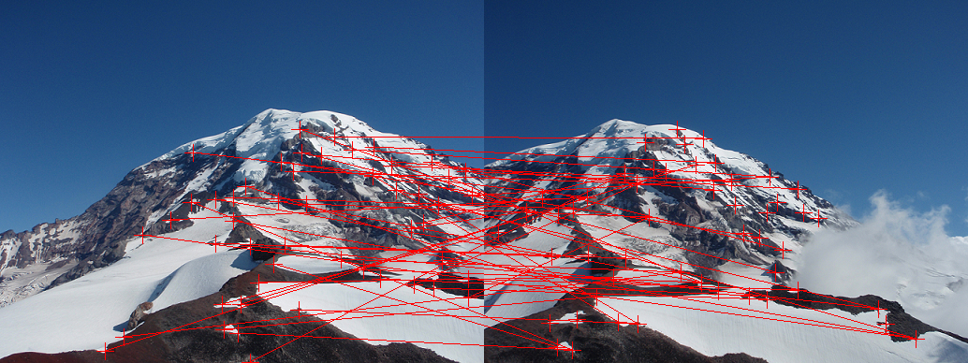

Matching patches: Corners + Descriptors!
via JoeRedmon
Harris Corners + Patch Colors / Intensities as Descriptors
Homography and Other Trasnformations for aligning with RANSAC
Choosing a Projection Surface such as Cylinders
Creating Panoramas
$$P^{′},P,P^{′′}$$
COP

Slide 4
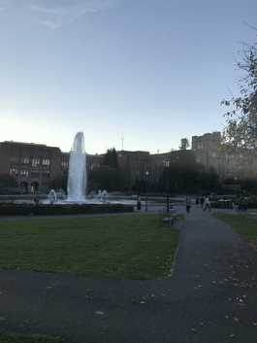
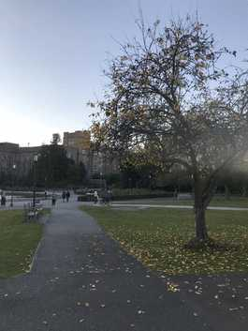
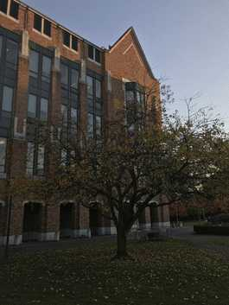
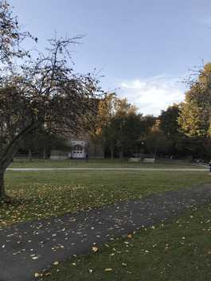
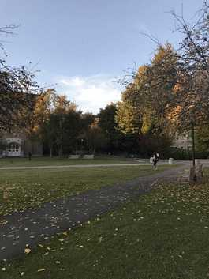
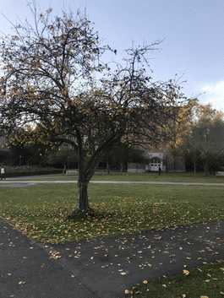
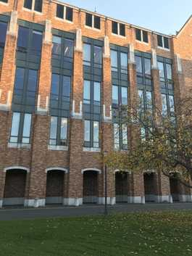
Wide Baseline Matching

Slide 5
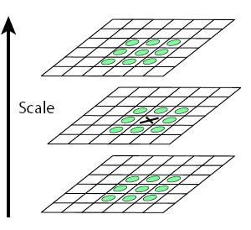
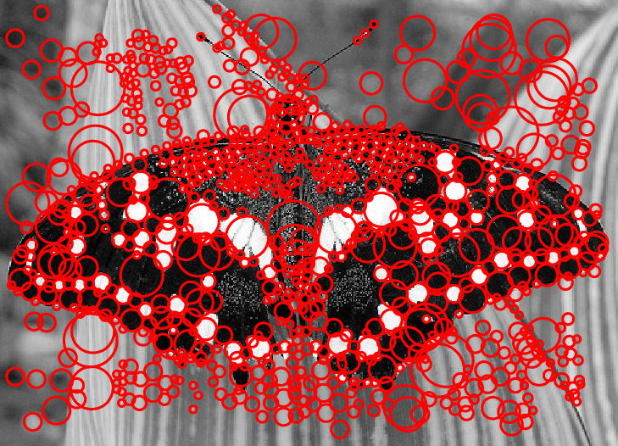
Scale-space blob detector
via Svetlana
Convolve image with scale-normalized Laplacian at several scales
Find maxima of squared Laplacian response in scale-space

Slide 6
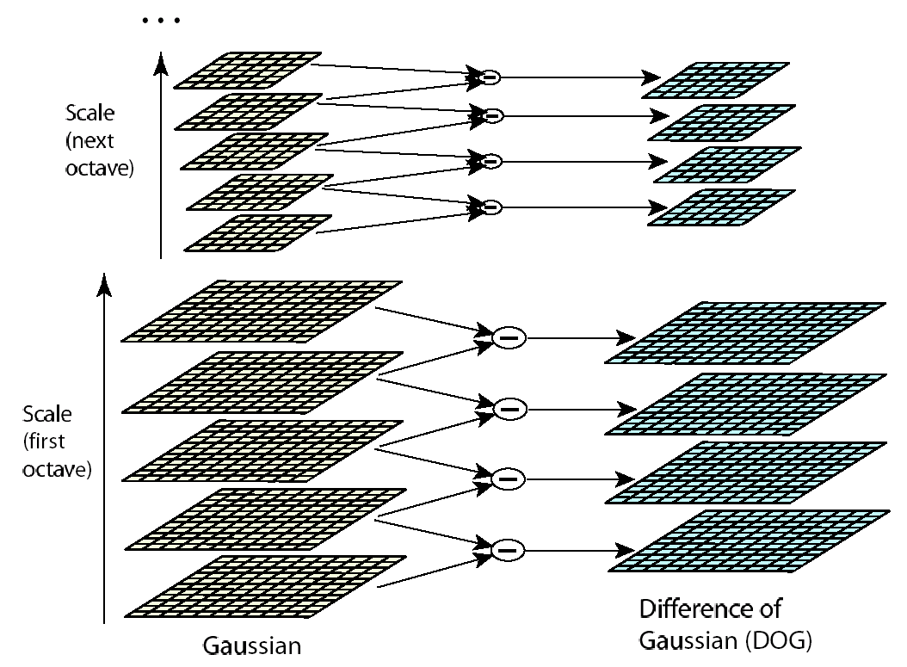
Efficient implementation
via Svetlana
David G. Lowe. "Distinctive image features from scale-invariant keypoints.” IJCV 60 (2), pp. 91-110, 2004.

Slide 7
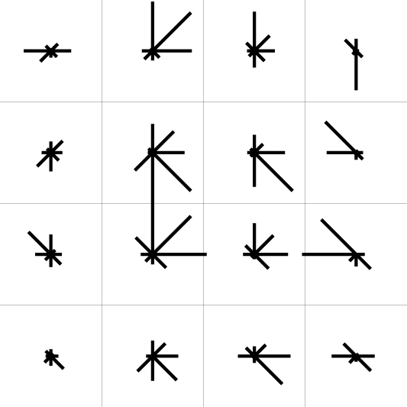
Feature descriptors: SIFT
via Svetlana
Descriptor computation:
  Divide patch into 4x4 sub-patches
  Compute histogram of gradient orientations (8 reference angles) inside each sub-patch
  Resulting descriptor: 4x4x8 = 128 dimensions
David G. Lowe. "Distinctive image features from scale-invariant keypoints.” IJCV 60 (2), pp. 91-110, 2004.

Slide 8

Rotational Normalization of SIFT Feature
via Svetlana
To assign a unique orientation to circular image windows:
  Create histogram of local gradient directions in the patch
  Assign canonical orientation at peak of smoothed histogram
0
2
π

Slide 9

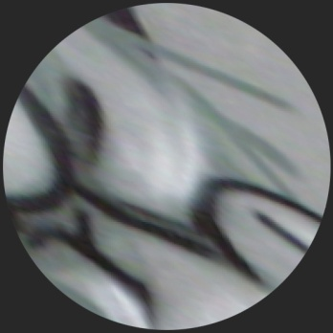
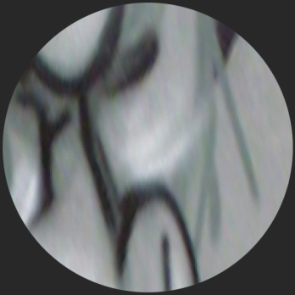

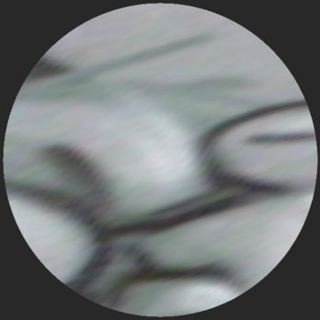
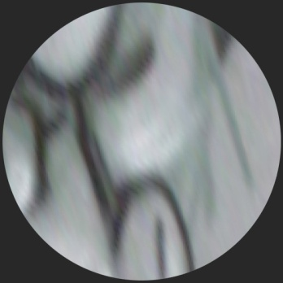
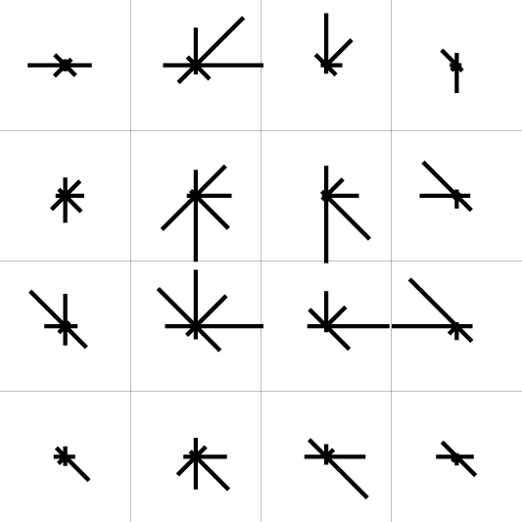
Normalization: From covariant regions to invariant features
via Svetlana
Eliminate rotational
ambiguity
Compute appearance
descriptors
Extract affine regions
Normalize regions
SIFT (Lowe ’04)

Slide 10

Invariance vs. covariance
via Svetlana
Invariance:
  features(transform(image)) = features(image)
Covariance:
  features(transform(image)) = transform(features(image))
Covariant detection => invariant description

Slide 11
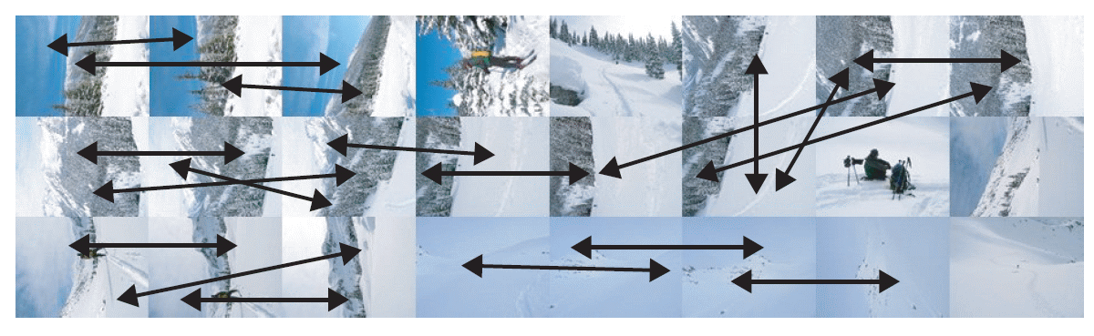
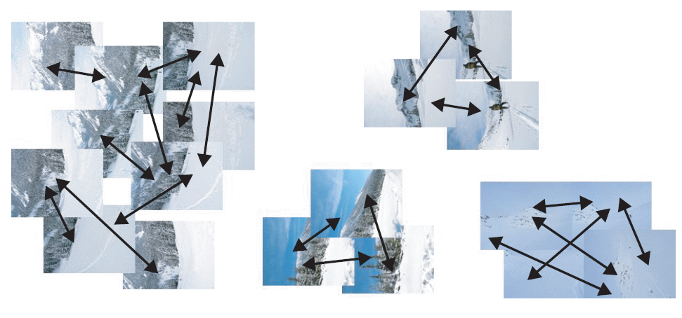
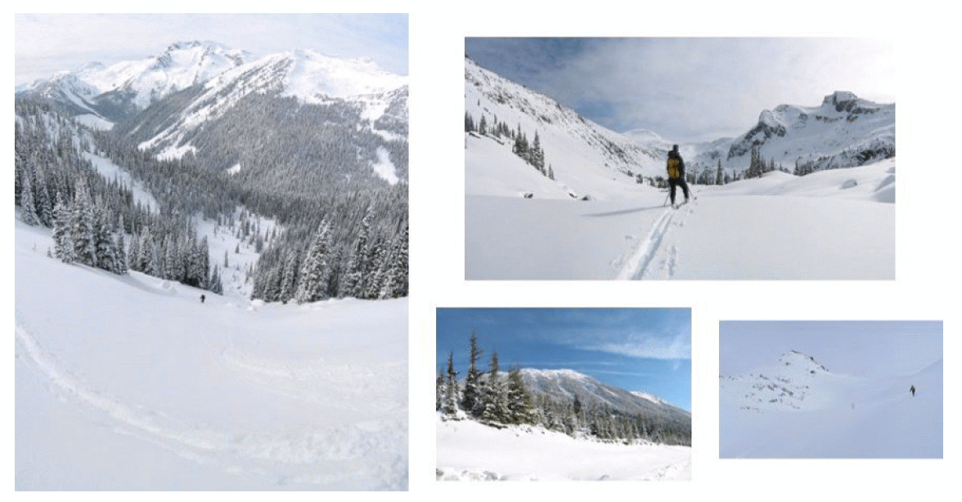
Application: Panoramas from a Jumble of Pictures
Extract SIFT features from all images
Find Pairwise Homographies
Find Connected Components over the pair connections
Bundle adjust the connected component to find image to panorama transformation
Render panorama with blending

Slide 12
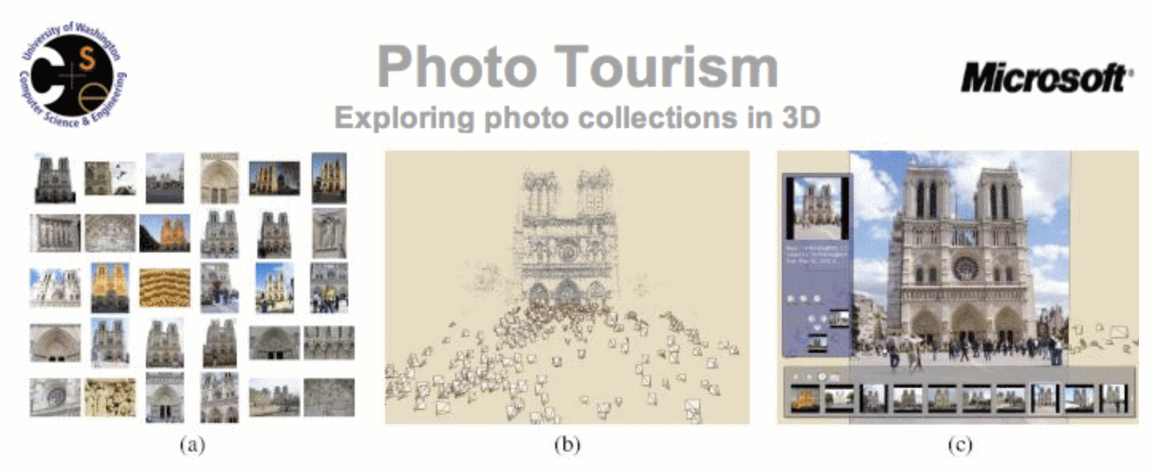
Photo Tourism / Photosynth
Automatically computes each photo's viewpoint, and
A sparse 3D model of the scene
Explorer interface enables interactively moving in 3D space by seamlessly transitioning between photographs

Slide 13
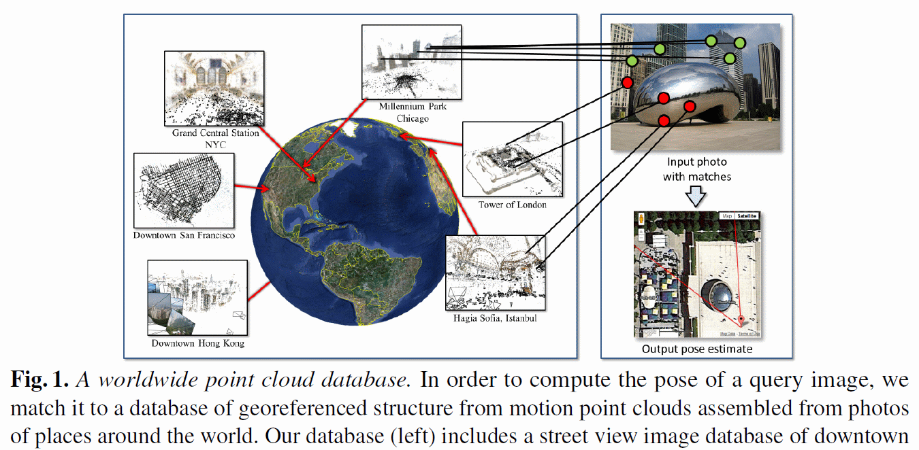
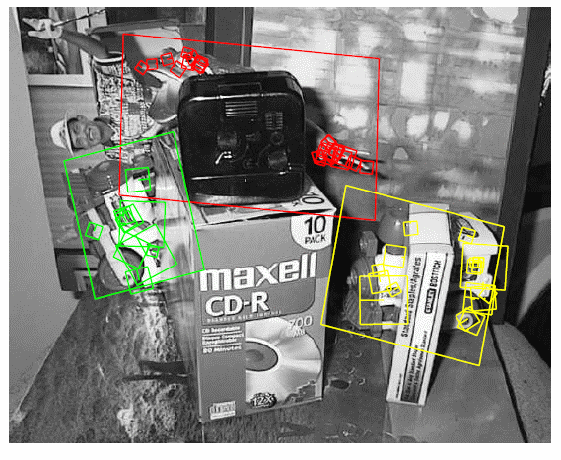
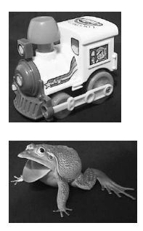
Application: Scalable Images based Search
David G. Lowe. "Distinctive image features from scale-invariant keypoints.” IJCV 60 (2), pp. 91-110, 2004.
Worldwide Pose Estimation
Yunpeng Li, Noah Snavely, Dan Huttenlocher, Pascal Fua
ECCV 2012
Find location of a Query image by matching against a large database of images indexed with their respective locations
Find instances of objects / images in a database of images

Slide 14
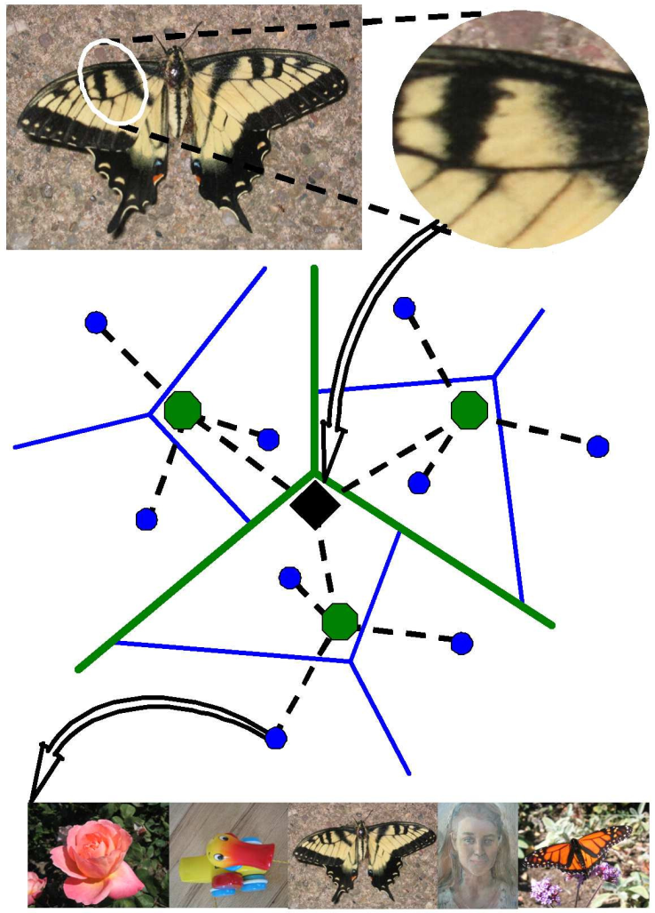
Efficient indexing technique: Vocabulary trees
Test image
Vocabulary tree with inverted index
Database
D. Nistér and H. Stewénius, Scalable Recognition with a Vocabulary Tree, CVPR 2006

Slide 15
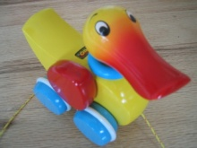

Populating the vocabulary tree/inverted index
Model images
Slide credit: D. Nister

Slide 16
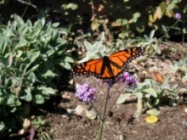

Model images
Populating the vocabulary tree/inverted index
Slide credit: D. Nister

Slide 17


Model images
Populating the vocabulary tree/inverted index
Slide credit: D. Nister

Slide 18
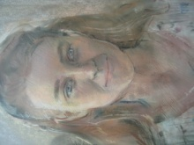

Model images
Populating the vocabulary tree/inverted index
Slide credit: D. Nister

Slide 19
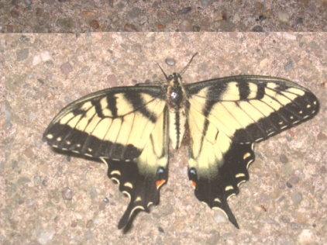
Model images
Test image
Looking up a test image
Slide credit: D. Nister
Notes:
When we then wish to query on an input image, we quantize the descriptor vectors of the input image in a similar way, and accumulate scores for the images in the database with so called term frequency inverse document frequency (tf-idf). This is effectively an entropy weighting of the information. The winner is the image in the database with the most common information with the input image.

Slide 20
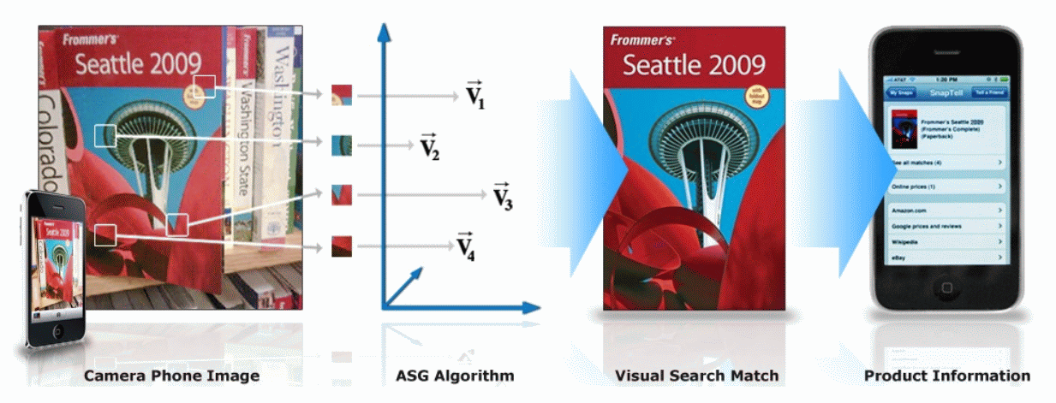
SnapTell : Visual Product Search (Acquired by A9 / Amazon)
ASG algorithm (Accumulated Signed Gradient) is a SIFT like feature
https://computervisionblog.wordpress.com/tag/image-recognition/
Many Others too…

Slide 21
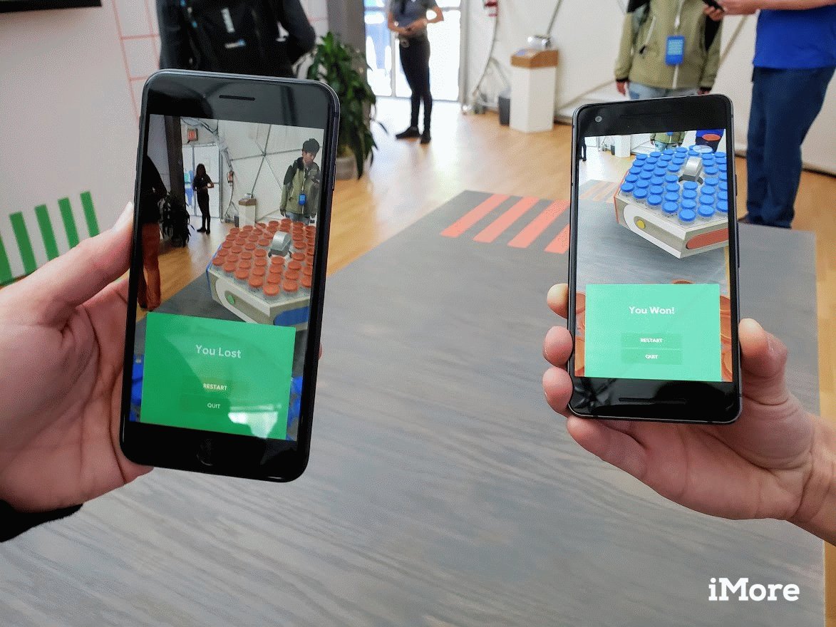
Google Cloud Anchors
Google ‘Cloud Anchors’ will help synchronize group AR experiences across iOS and Android devices
Employ Wide Baseline Matching
https://mediafocus.biz/google-cloud-anchors-will-help-synchronize-group-ar-experiences-across-ios-and-android-devices/

Slide 22


Minecraft Earth via Azure Spatial Anchors
https://www.theverge.com/2019/11/12/20961639/minecraft-earth-now-available-early-access-us-ios-android
https://youtu.be/AQEizp-VrVU
Spatial Anchors are built and quried with Wide Baseline Matching and SfM / SLAM

Slide 23
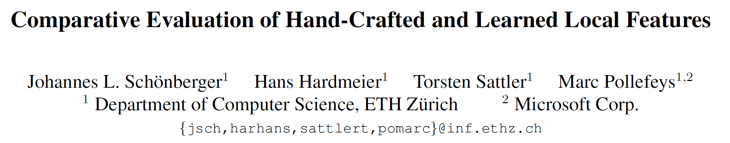
How do Hand-Crafted Features Compare with Learned Features?
CVPR 2017
“Hand-crafted features still perform on par or better than recent learned features for image-based reconstruction.
The current generation of learned descriptors shows a high variance across different datasets and applications.
The next generation of learned descriptors needs more training data.”

Slide 24
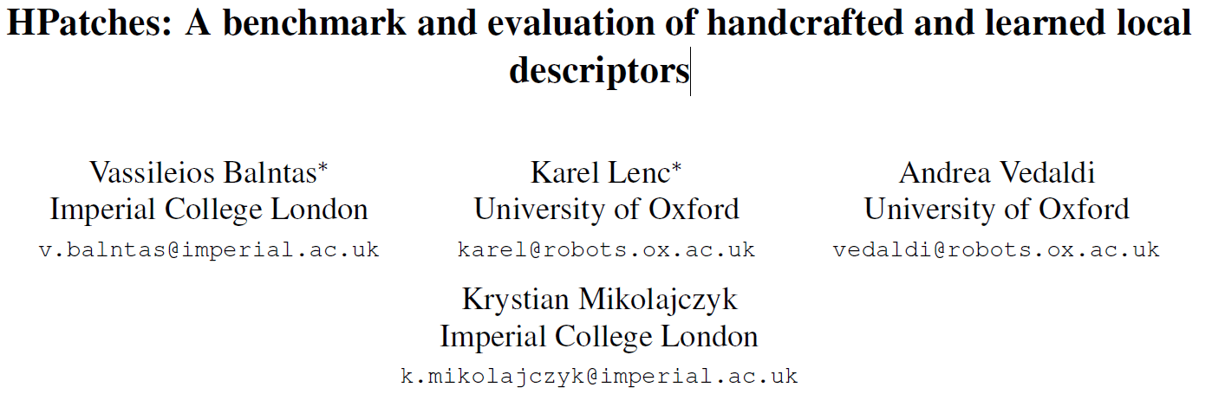
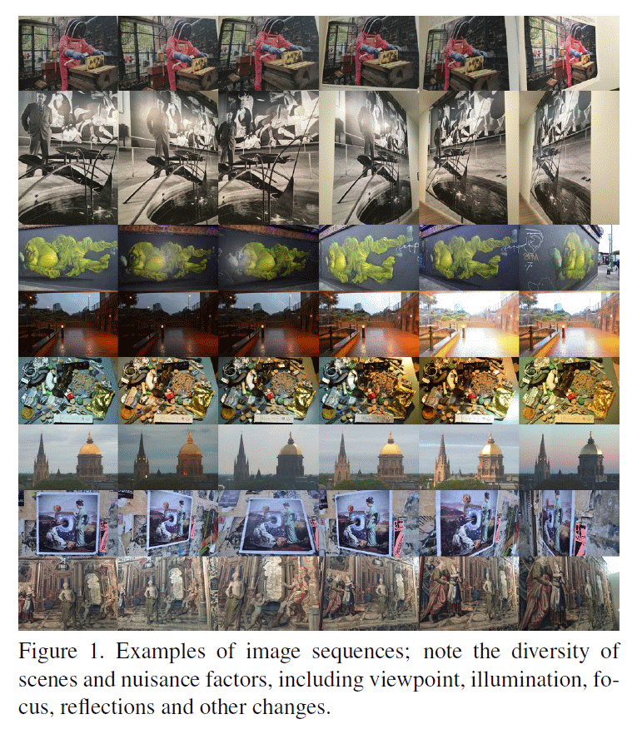
Viewpoint and Illumination Variations Dataset
https://github.com/hpatches/hpatches-dataset
Reproducible, patch-based: Descriptor evaluation should be done on patches to eliminate the detector related factors.
Diverse: Representative of many different scenes and image capturing conditions.
Real: Real data more challenging than a synthesized one due to nuisance factors that cannot be modelled in image transformations.
Large: For accurate and stable evaluation; to provide substantial training sets for learning based descriptors.
Multitask: Use cases, from matching image pairs to image retrieval.

Slide 25
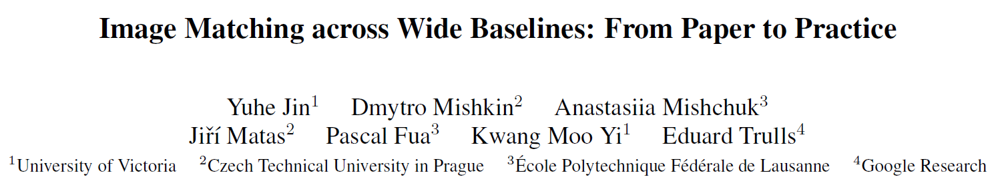
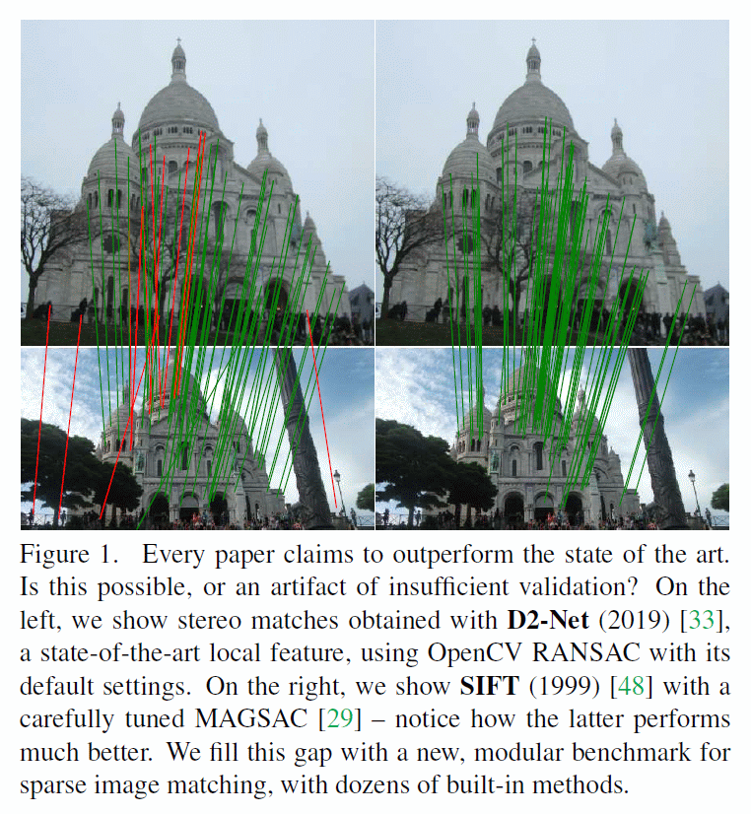
How do Hand-Crafted Features Compare with Learned Features?
Contributions
Dataset with 30k images with depth maps and ground truth poses
A modular pipeline incorporating dozens of methods for feature extraction and matching, and pose estimation
Two downstream tasks – stereo and multi-view reconstruction – evaluated with downstream and intermediate metrics
A thorough study of dozens of methods and techniques, hand-crafted and learned, and their combination, along with a procedure for hyper-parameter selection

Slide 26
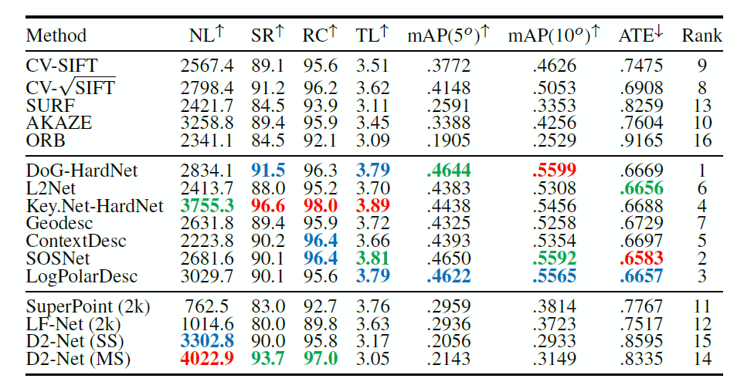
Multiview Results
(NL) Number of 3D Landmarks
(SR) Success Rate (%) in the 3D reconstruction across ‘bags’
(RC) Ratio of Cameras (%) registered in a ‘bag’
(TL) Track Length or number of observations per landmark;
mAP at 5-10degs
(ATE) Absolute Trajectory Error.

Slide 27
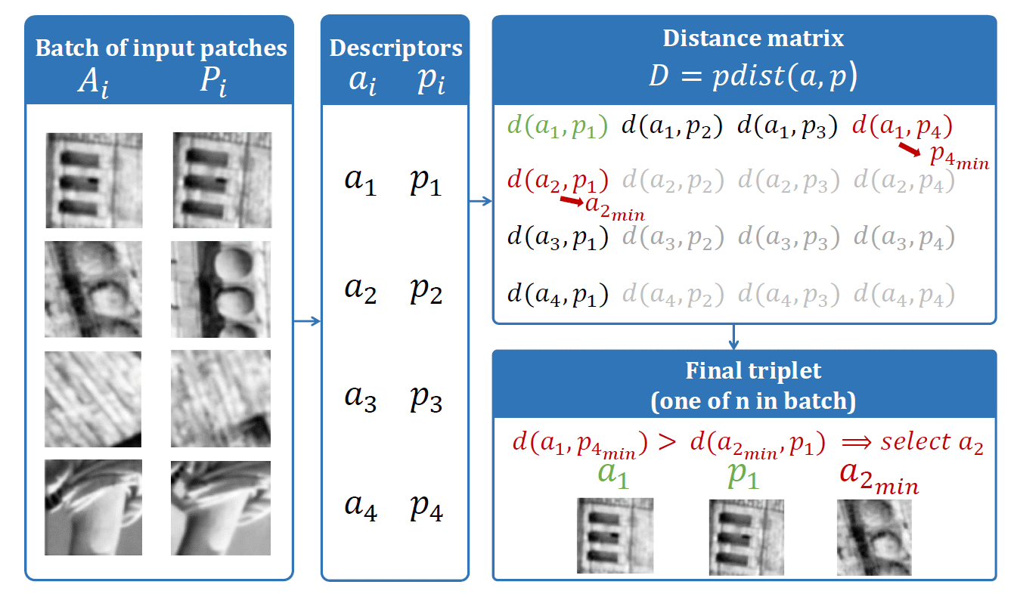
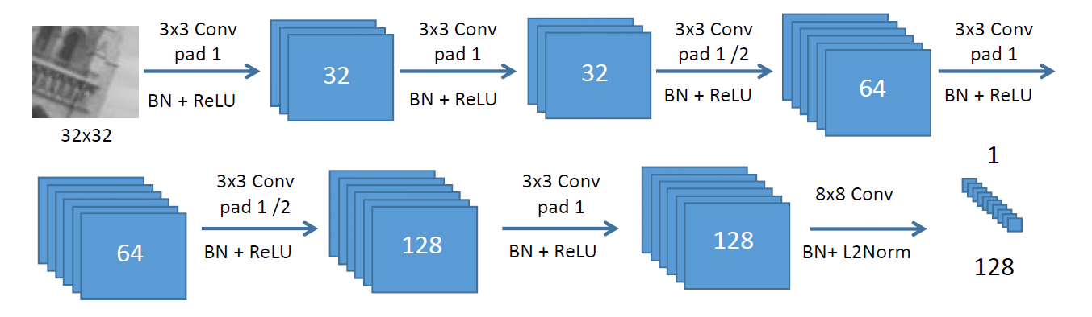
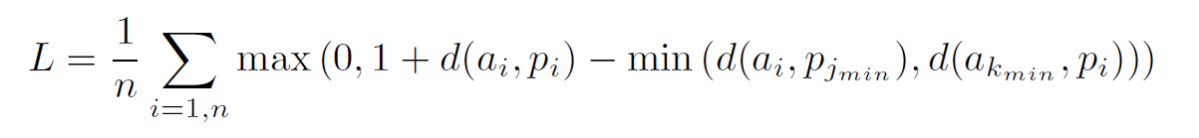
HardNet: Uses SIFT like Best-to-Next Distance for Training Descriptors
Choose the hardest negative, i.e. minimum distance to a negative.
Make gap between the matching and hard non-matching to be a maximum

Slide 28
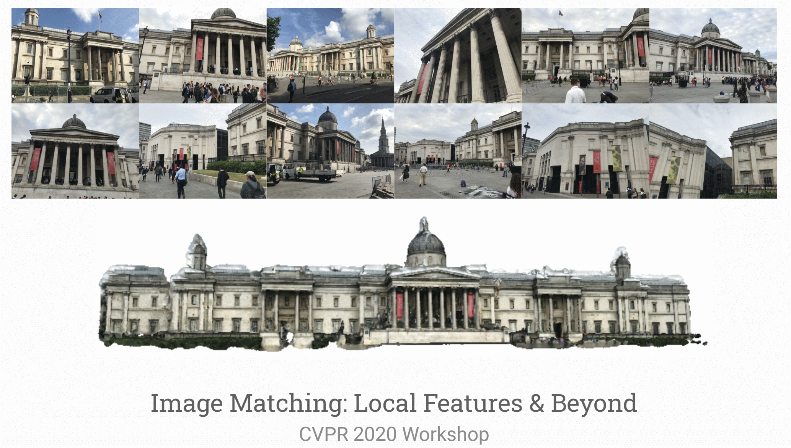
“Hot Topic”

Slide 29
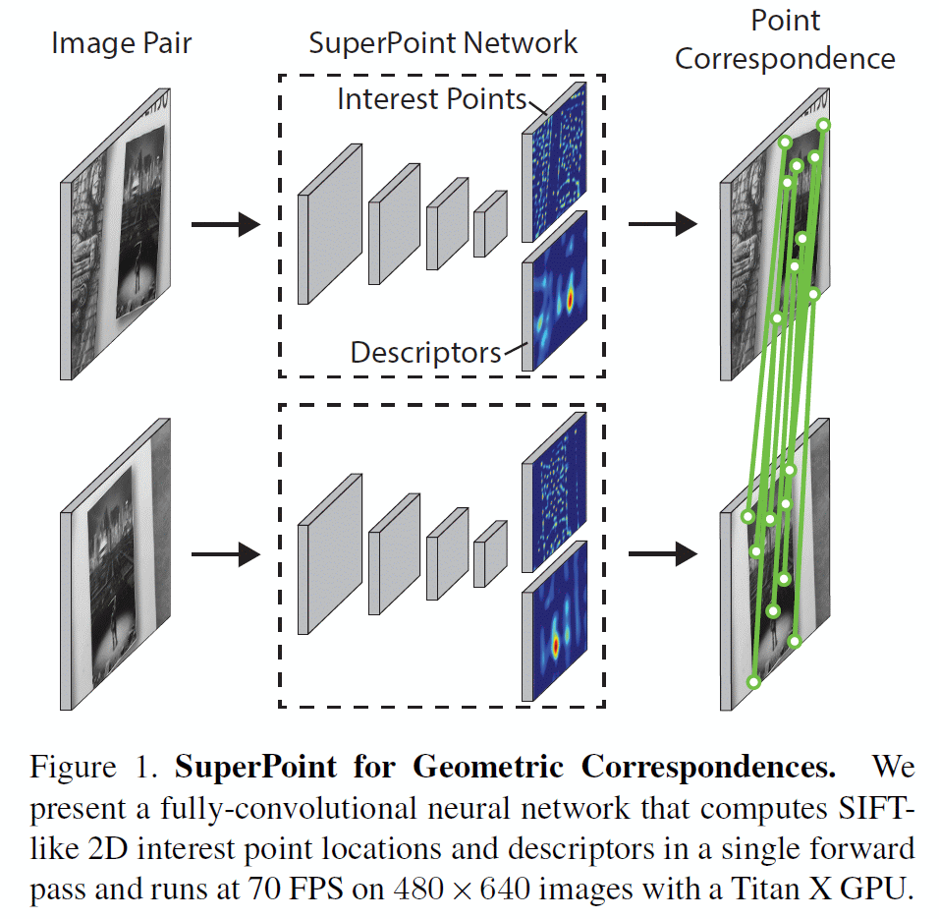
A Contemporary Example of Learned Features
SuperPoint: Self-Supervised Interest Point Detection and Description
CVPR 2018
Self-supervised framework for training interest point detectors and descriptors
Fully-convolutional model operates on full-sized images and jointly computes pixel-level interest point locations and associated descriptors in one forward pass.

Slide 30
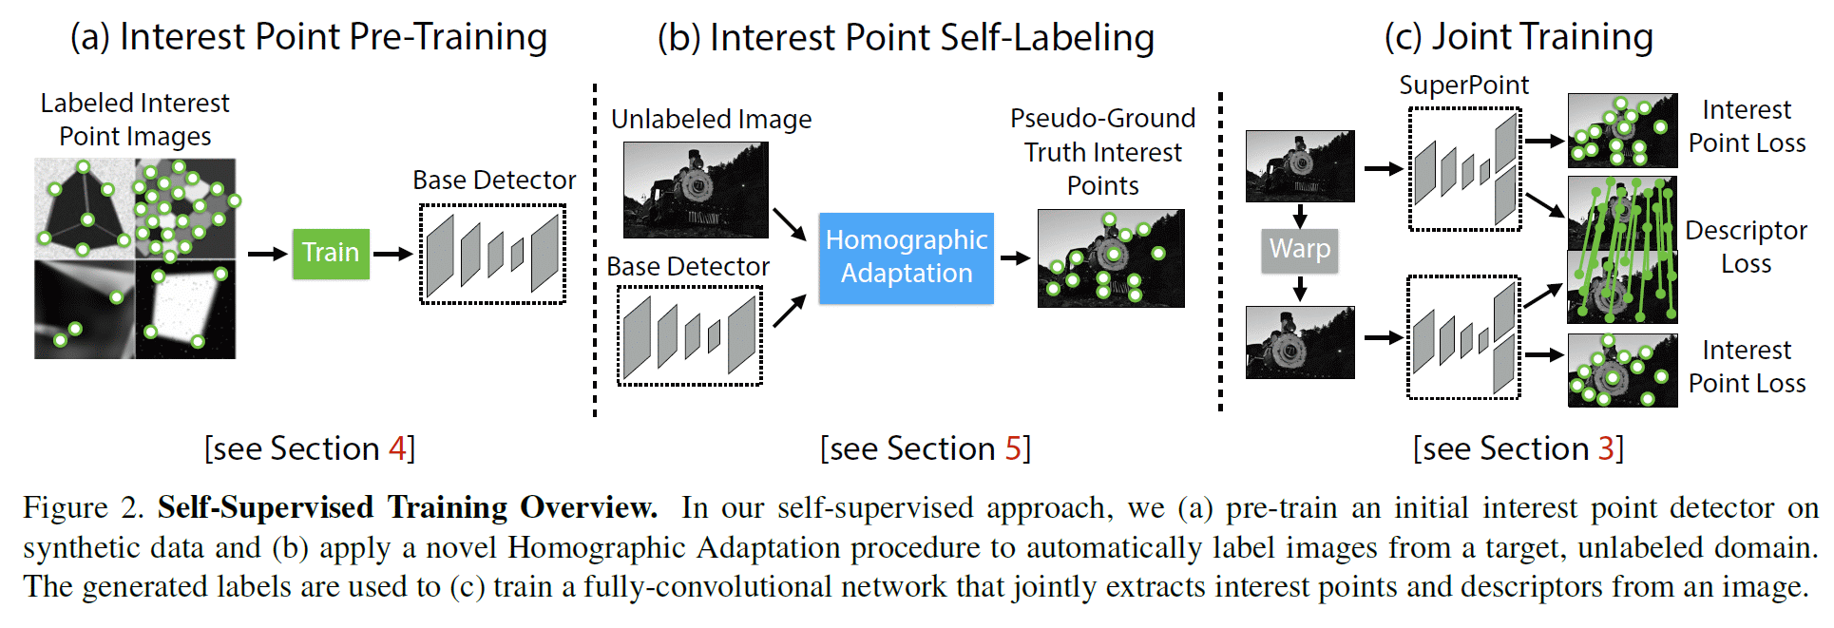
Self-Supervised Training

Slide 31
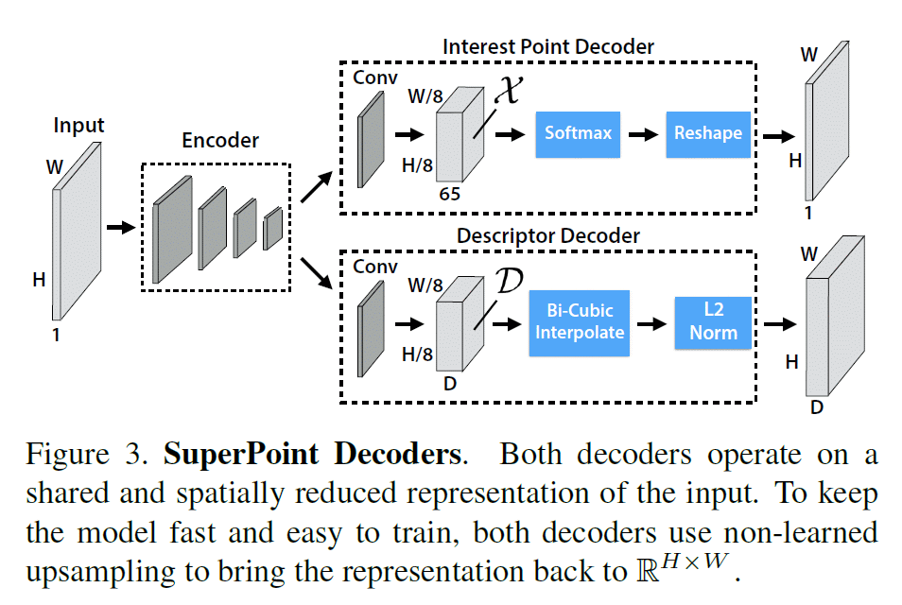
Superpoint Architecture
The interest point detector head computes Hc x Wc x 65 and outputs a tensor sized H x W.
The 65 channels correspond to local, non-overlapping 8 x8 grid regions of pixels plus an extra “no interest point” dustbin.
After a channel-wise softmax, the dustbin dimension is removed and Hc x Wc x 64 ➔ H x W reshape is performed.
The descriptor head computes Hc x Wc x D and outputs a tensor sized H x W x D.
To output a dense map of L2-normalized fixed length descriptors, first output a semi-dense grid of descriptors (e.g., one every 8 pixels).
The decoder then performs bicubic interpolation of the descriptor and then L2-normalizes to unit length.

Slide 32
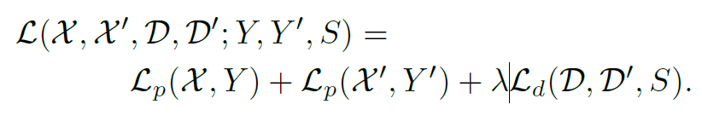
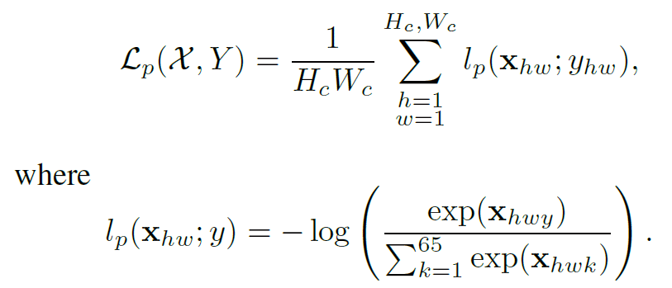
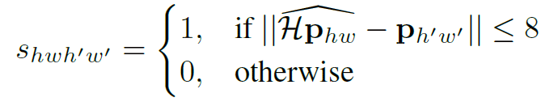
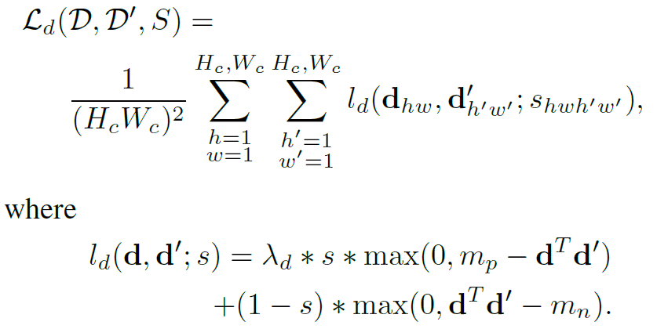
Joint Geometric and Classification Loss
The interest point detector loss function Lp is a fully convolutional cross-entropy
The descriptor loss is applied to all pairs of descriptor cells, (h, w) and (h’, w’)
The homography-induced correspondence between the (h, w) cell and the (h’, w’) cell can be written as:
The descriptor loss is given by:

Slide 33
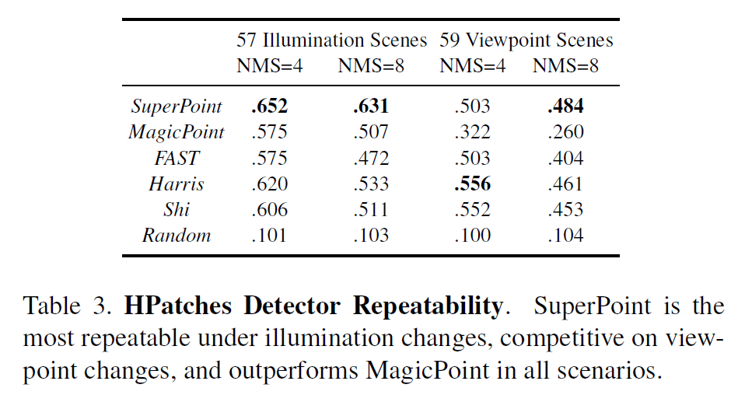
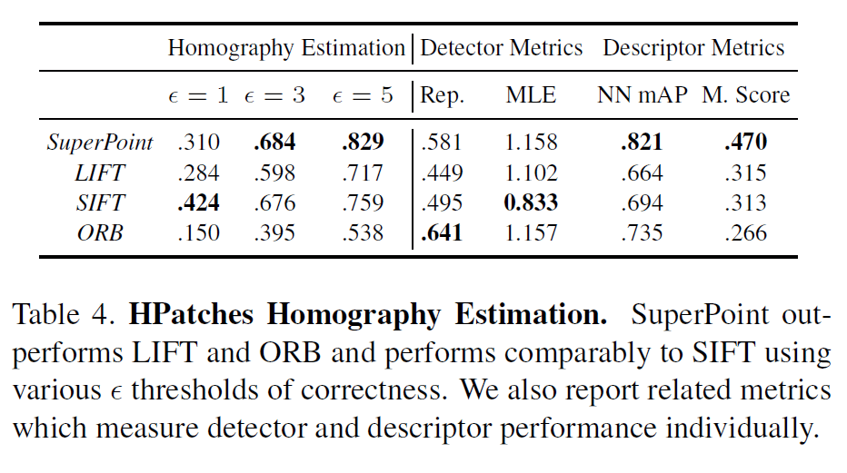
Comparative Results
SIFT performs well for sub-pixel precision homographies and has the lowest mean localization error (MLE).
SuperPoint scores strongly in descriptor-focused metrics such as nearest neighbor mAP and matching score (M. Score)

