Slide 1
Long Range Image Matching and Its Applications
Harpreet S Sawhney
Microsoft / Vision & Mixed Reality
May 12th , 2020

Slide 2
(Dynamic) Images Afford Two Types of Inferences
Inferences on scene content without object identity
  Frame-to-frame motions
  Foreground/background and independent object motions
  3D structure / 2-2.5D layers
  …
Inferences on scene content involving object identity
  Model-based object/event recognition
  Object/scene classification
  Object/scene fingerprinting
  Extended space-time tracking
  …

Slide 3
A Bit of Historical Perspective : My Work
Dynamic Images Afford Two Types of Inferences
Analysis / Manipulation of scene content without object / scene identity
  Pixels In ➔ Pixels Out
  1995 - 2003
  Stabilization, Mosaicking, 3D Structure,…
Inferences on scene content involving scene /object / event identity
  Pixels In ➔ Decisions / Labels Out
  2003 -
  Model-based object/event recognition
  Object/scene classification
  Object/scene fingerprinting
  Extended space-time tracking
  Multi-modal Video Analysis

Slide 4





(Dynamic) Images Afford Two Types of Inferences
Inferences on scene content without object identity
  Frame-to-frame motions
  Foreground/background and independent object motions
  3D structure / 2-2.5D layers
  …
Inferences on scene content involving object identity
  Model-based object/event recognition
  Object/scene classification
  Object/scene fingerprinting
  Extended space-time tracking
  …

Slide 5
Plan of Two Lectures : May 7th and 12th
Why and How of Edges in Images
  Computing Edges
Why Image / Video Alignment and Matching
A Swift Primer on Sum of Squares Optimization and Fitting
Short Range Matching with Patches
Image Transformations and Robust Fitting with RANSAC
Long Range Matching
  Quasi-Invariant Feature Detectors and Descriptors: SIFT, HOG
Location and Image based Object Instance Retrieval
Learned Features through Metric Learning with CNNs
Long Range Matching and Localization : Contrast between Hand-crafted and Learned Features
Take Home Lessons

Slide 6
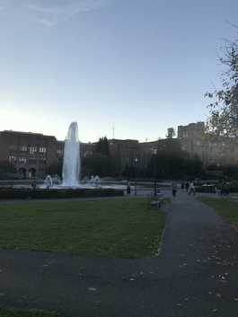
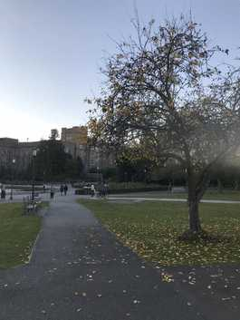
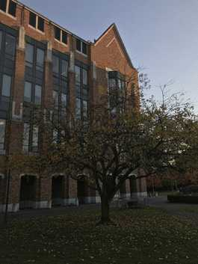
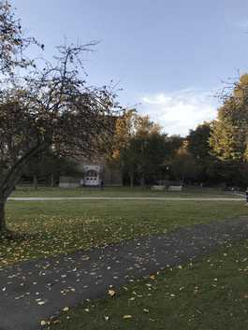
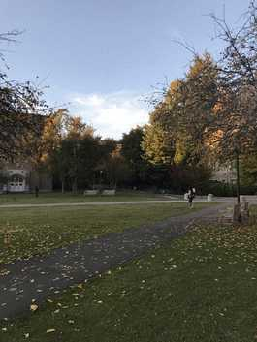
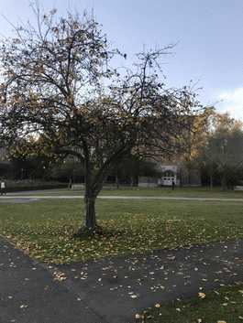
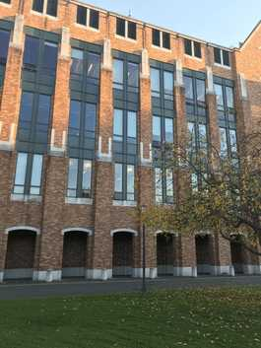
Jumble of Disparate Photos

Slide 7
How do you align and build a panorama?
Humans are not generally good at alignment!
This is a task where machines are superior : Fast, Accurate, Precise
Ingredients for a solution?

Slide 8
How do you align and build a panorama?
Humans are not generally good at alignment!
This is a task where machines are superior : Fast, Accurate, Precise
Ingredients for a solution?
Features that are invariant or quasi-invariant to larger changes in viewpoint and illumination.
  Patches used in the last lecture will be hopelessly inadequate. Why?
Aligning with limited overlap
  Local Alignment
Aligning and constraining the placement of multiple pictures simultaneously
  Global Alignment
Bundle Adjustment

Slide 9
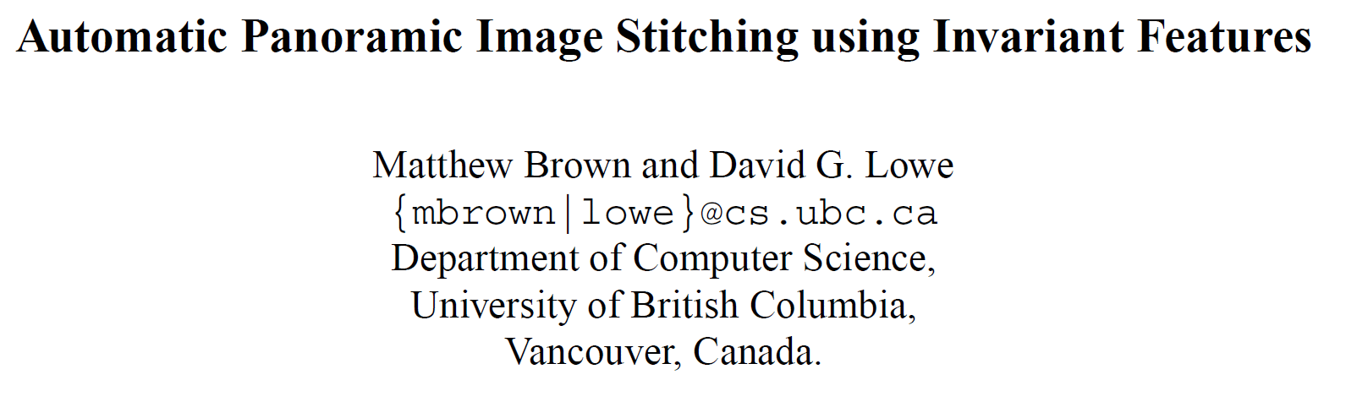
International Journal of Computer Vision. 74(1), pages 59-73, 2007
http://matthewalunbrown.com/papers/ijcv2007.pdf
http://matthewalunbrown.com/autostitch/autostitch.html#publications

Slide 10
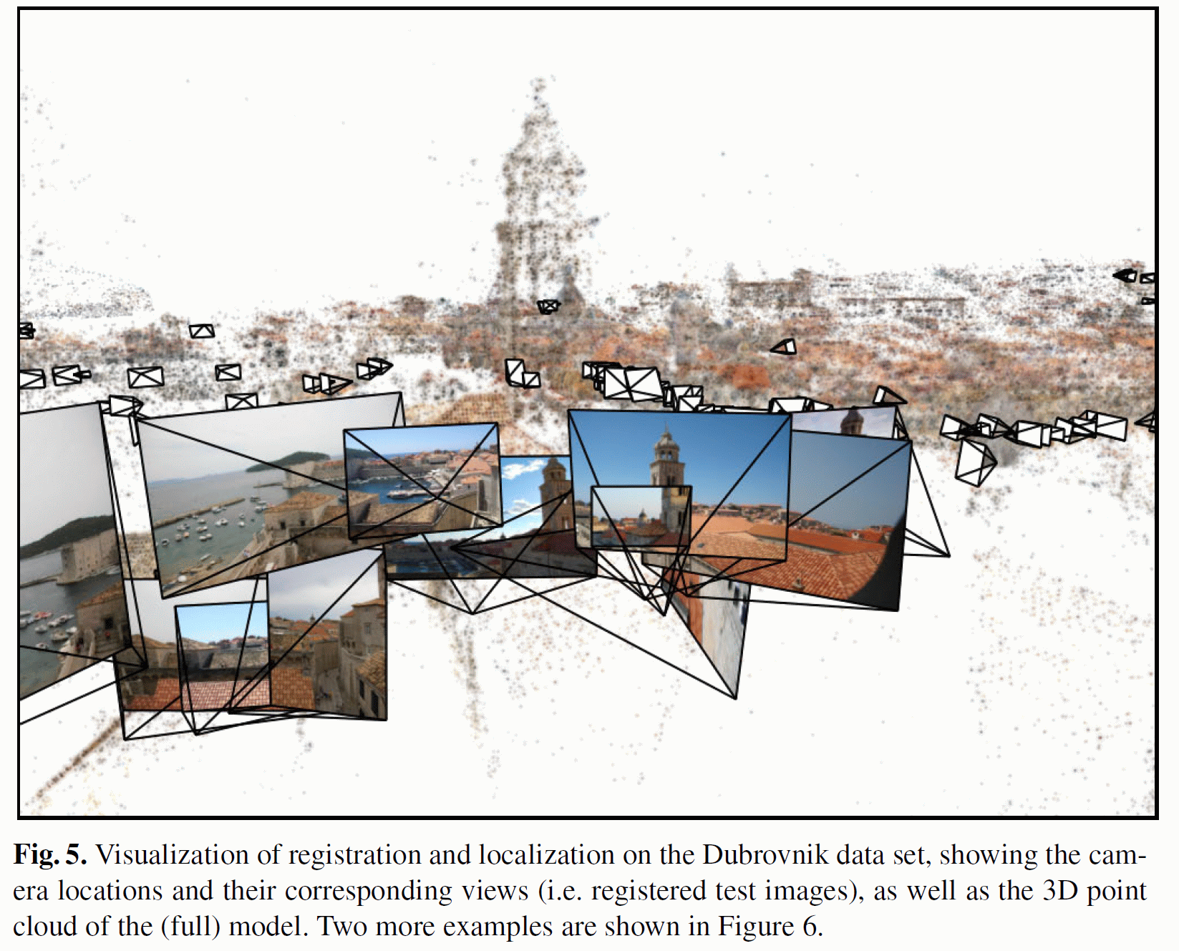
Location Recognition with Pre-built Image and SfM Database
Location Recognition using Prioritized Feature Matching
Yunpeng Li | Noah Snavely | Dan Huttenlocher
https://research.cs.cornell.edu/p2f/
ECCV 2010
Again need is for Long-range feature Matching under large time gaps between
database images and query images.

Slide 11
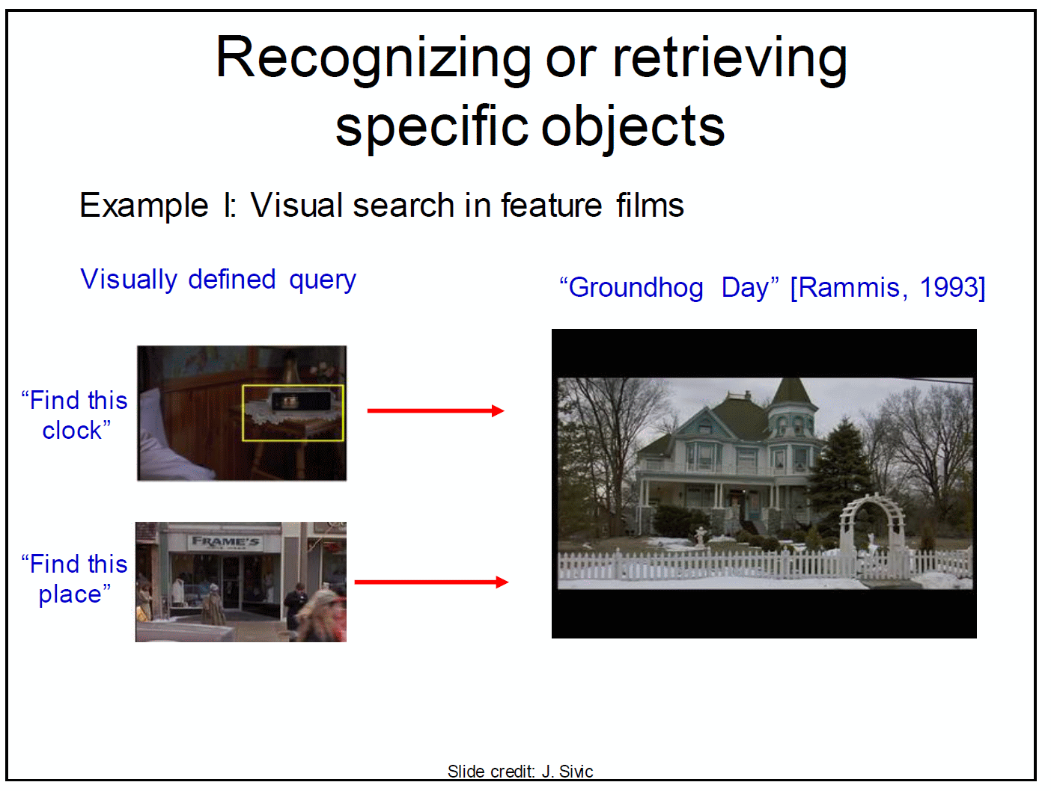
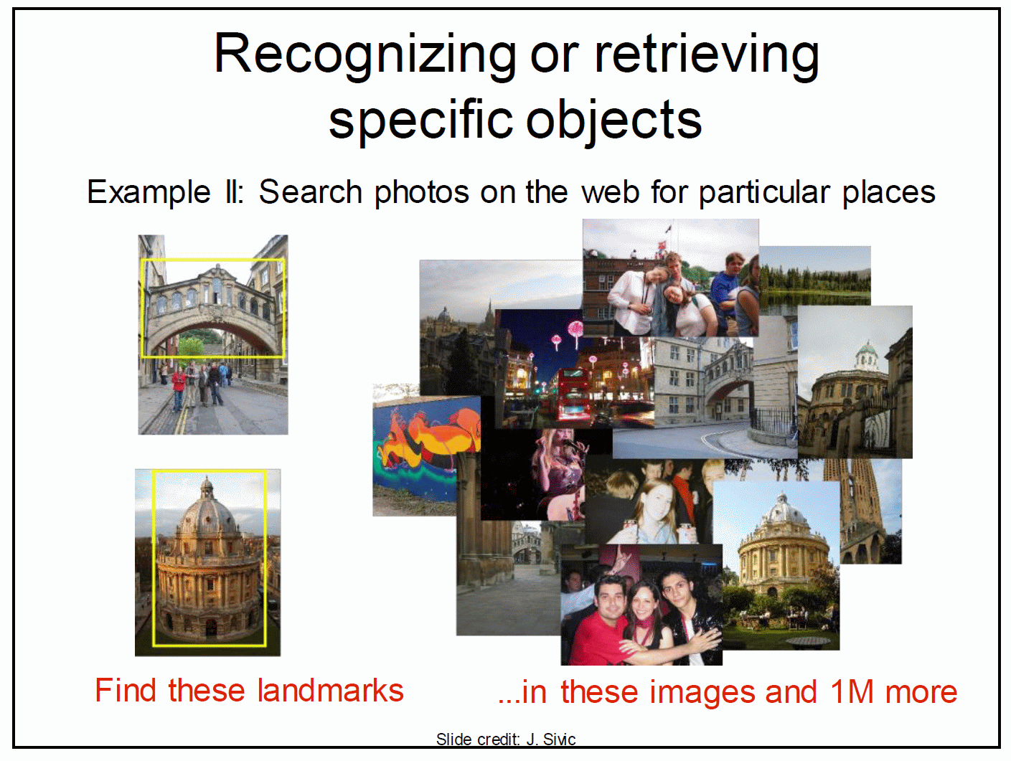
Instance Recognition & Retrieval: Specific Entity in a Large Database
Again long range feature matching against a large database of objects

Slide 12

Intuition behind Scale / Rotation / Affine Invariant Feature
How can we detect all the flowers?
A Blob detector computed over scale-space is a stable localizer of a feature’s position
And if we can make its descriptor invariant to Rotations and/or Affine transformations we can match it under large scale transformations

Slide 13
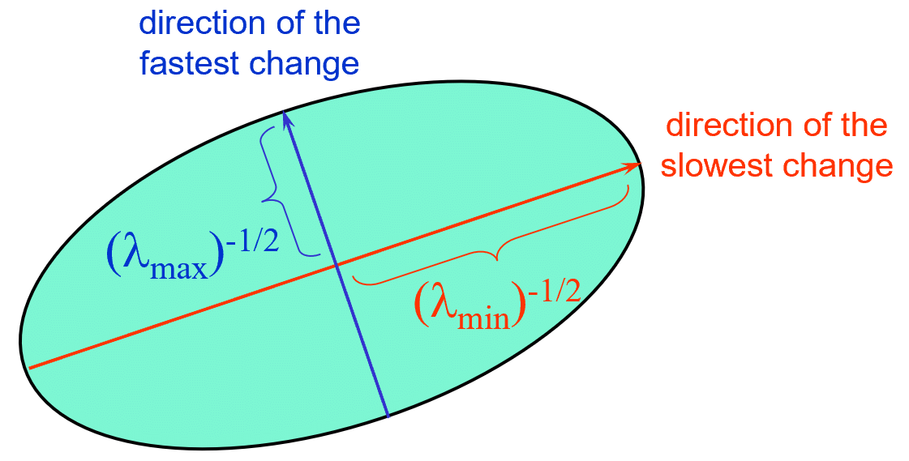

Are Harris corners good features for Long Range Matching?
via Svetlana
Recall the Second Moment Matrix and its use in Corner Detection:
$$M= R^{T}\left[\begin{matrix}λ_{max} & 0 \\ 0 & λ_{min}\end{matrix}\right] R$$
Geometrically this is an ellipse with orientation R and axes determined by the eigenvalues.
Cornerness determined by both eigenvalues non-zero and almost equal.

Slide 14
Cornerness : Variations with Affine intensity change
via Svetlana
I → a I + b
Only derivatives are used, so invariant to intensity shift I → I + b
Intensity scaling: I → a I
R
R
threshold
x (image coordinate)
x (image coordinate)
Partially invariant to affine intensity change

Slide 15
Image translation
via Svetlana
Derivatives and window function are shift-invariant
Corner location is covariant w.r.t. translation

Slide 16
Image rotation
via Svetlana
Second moment ellipse rotates but its shape (i.e. eigenvalues) remains the same
Corner location is covariant w.r.t. rotation

Slide 17
Scaling
via Svetlana
Corner
All points will be classified as edges
Corner location is not covariant w.r.t. scaling!

Slide 18
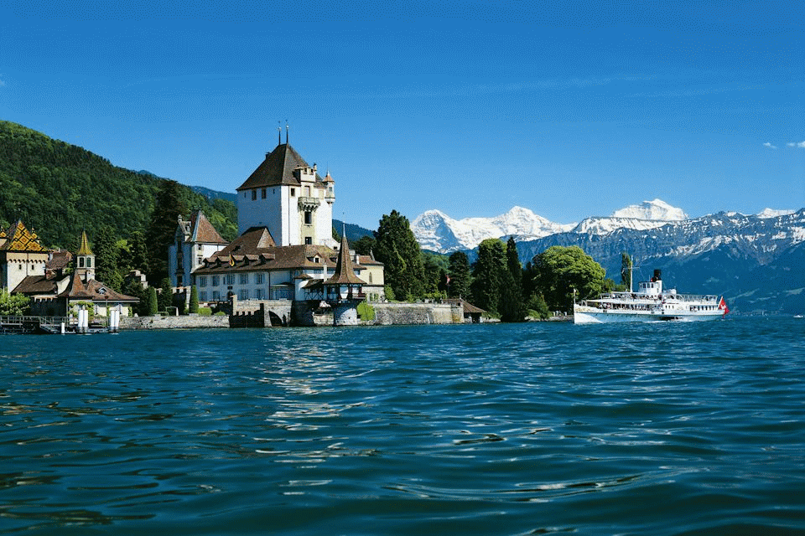
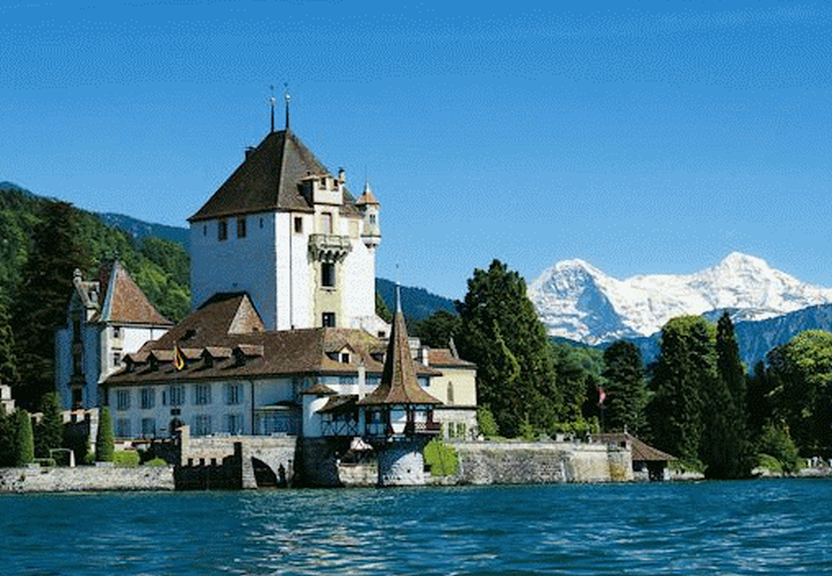
Scale & Rotation Covariance are Required for Long Range Matching
Independently detect corresponding locations in scaled, rotated versions of an imaged scene
Need scale covariant detector and rotation and scale normalization

Slide 19


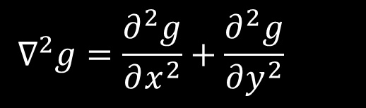
Blob detection in 2D
via Svetlana
Laplacian of Gaussian: Circularly symmetric operator for blob detection in 2D
$$∇^{2}g=\frac{∂^{2}g}{∂x^{2}}+\frac{∂^{2}g}{∂y^{2}}$$

Slide 20


Scale selection
via Svetlana
At what scale does the Laplacian achieve a maximum response to a blob of radius r?
The Laplacian is given by (up to scale):
Therefore, the maximum response occurs at
$$(x^{2}+y^{2}−2σ^{2})e^{−(x^{2}+y^{2})/2σ^{2}}$$
$$σ=r/\sqrt{2}.$$
r
0
circle
image
Laplacian

Slide 21
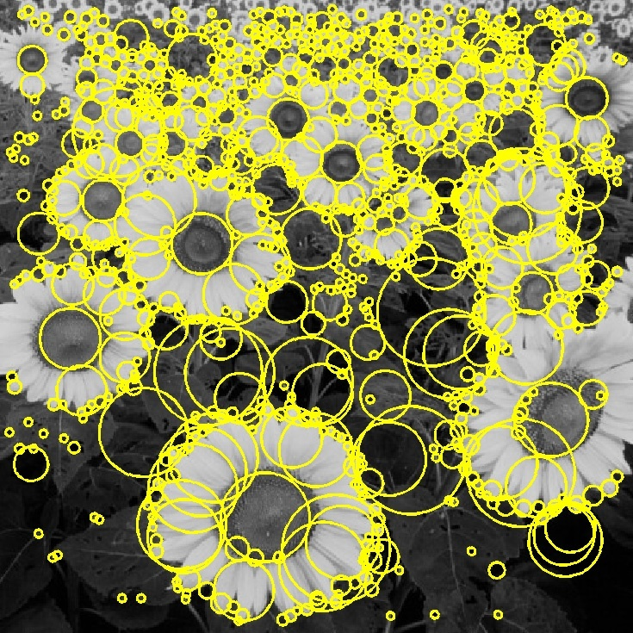
Basic idea
via Svetlana
Convolve the image with a “blob filter” at multiple scales
and
Compute extrema of filter response in the resulting scale space
T. Lindeberg, Feature detection with automatic scale selection, IJCV 30(2), pp 77-116, 1998

Slide 22
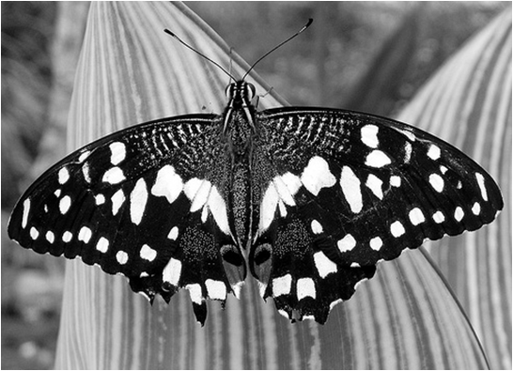
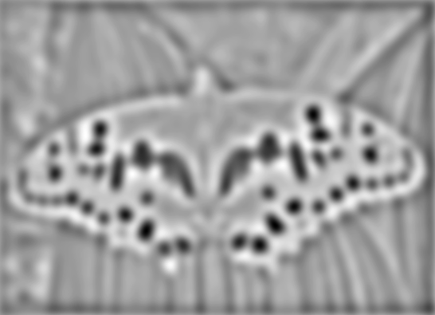

Blob detection
via Svetlana
minima
*
=
maxima
Find maxima and minima of blob filter response in space and scale
Source: N. Snavely

Slide 23
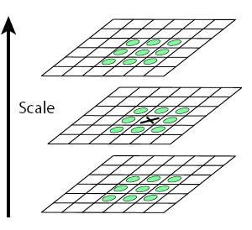
Scale-space blob detector
via Svetlana
Convolve image with scale-normalized Laplacian at several scales
Find maxima of squared Laplacian response in scale-space

Slide 24
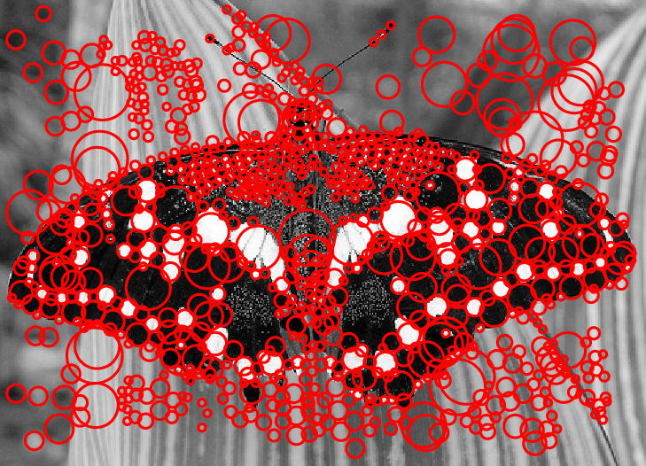
Scale-space blob detector: Example
via Svetlana

Slide 25
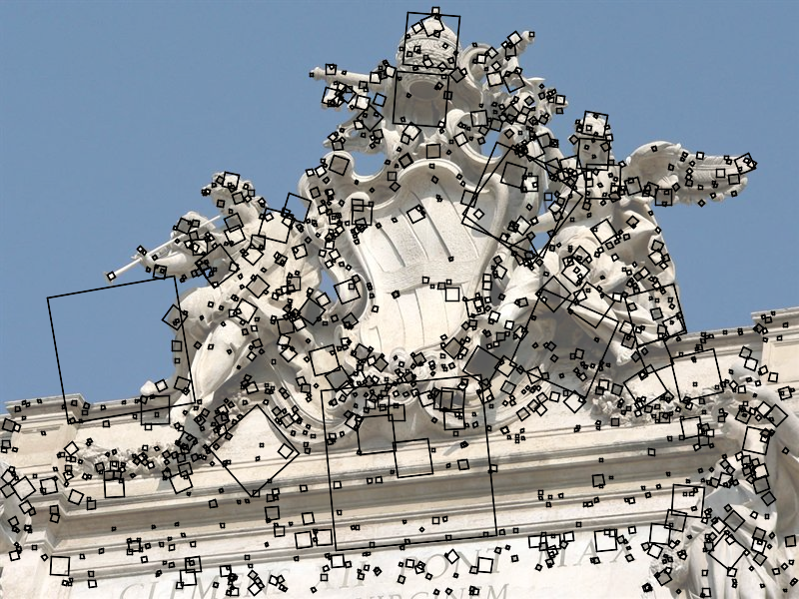
Basis for SIFT Keypoint Detection
via Svetlana
D. Lowe, Distinctive image features from scale-invariant keypoints,
IJCV 60 (2), pp. 91-110, 2004
Notes:
One of the most influential works in CV that has stood the test of time. Early patent expired on March 6th.

Slide 26
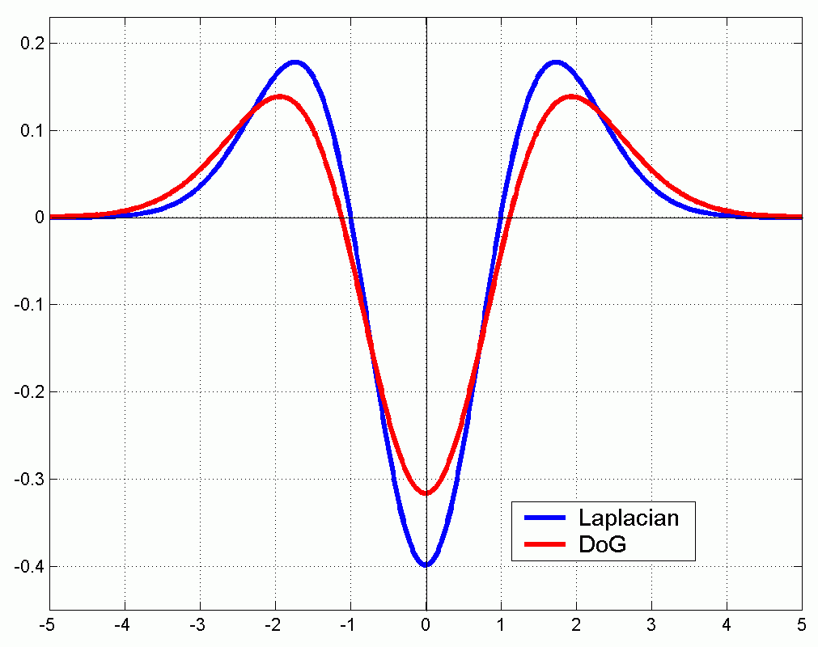
Efficient implementation
via Svetlana
Approximating the Laplacian with a difference of Gaussians:
(Laplacian)
(Difference of Gaussians)

Slide 27
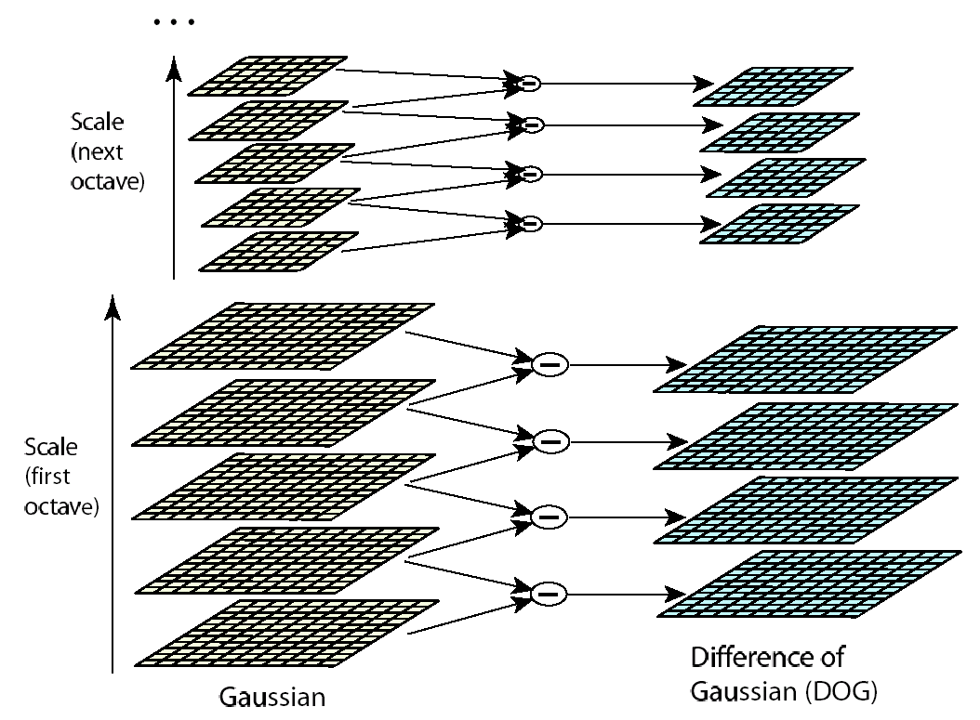
Efficient implementation
via Svetlana
David G. Lowe. "Distinctive image features from scale-invariant keypoints.” IJCV 60 (2), pp. 91-110, 2004.

Slide 28
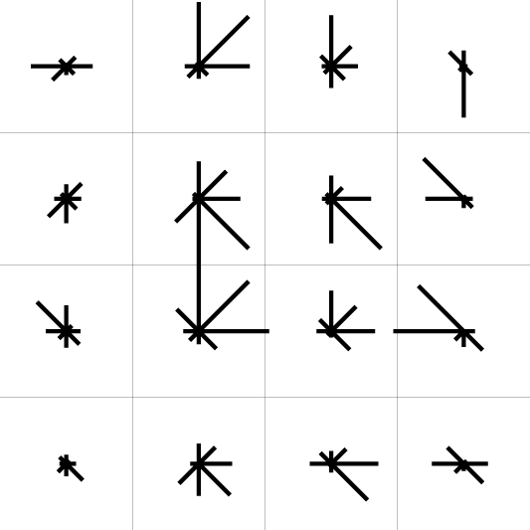
Feature descriptors: SIFT
via Svetlana
Descriptor computation:
  Divide patch into 4x4 sub-patches
  Compute histogram of gradient orientations (8 reference angles) inside each sub-patch
  Resulting descriptor: 4x4x8 = 128 dimensions
David G. Lowe. "Distinctive image features from scale-invariant keypoints.” IJCV 60 (2), pp. 91-110, 2004.

Slide 29
Feature descriptors: SIFT
via Svetlana
Descriptor computation:
  Divide patch into 4x4 sub-patches
  Compute histogram of gradient orientations (8 reference angles) inside each sub-patch
  Resulting descriptor: 4x4x8 = 128 dimensions
Advantage over raw vectors of pixel values
  Gradients less sensitive to illumination change
  Pooling of gradients over the sub-patches achieves robustness to small shifts, but still preserves some spatial information
David G. Lowe. "Distinctive image features from scale-invariant keypoints.” IJCV 60 (2), pp. 91-110, 2004.

Slide 30

Rotational Normalization of SIFT Feature
via Svetlana
To assign a unique orientation to circular image windows:
  Create histogram of local gradient directions in the patch
  Assign canonical orientation at peak of smoothed histogram
0
2
π

Slide 31

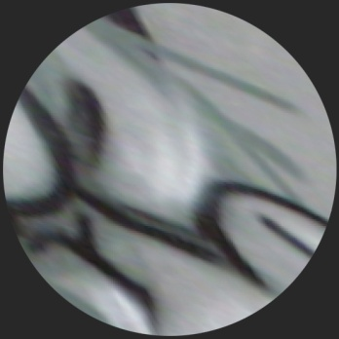
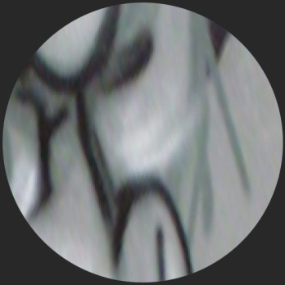

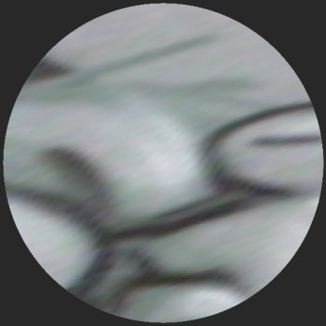
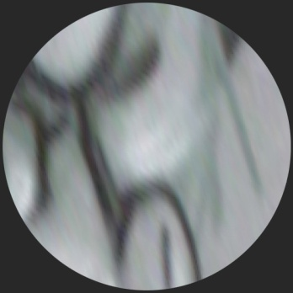
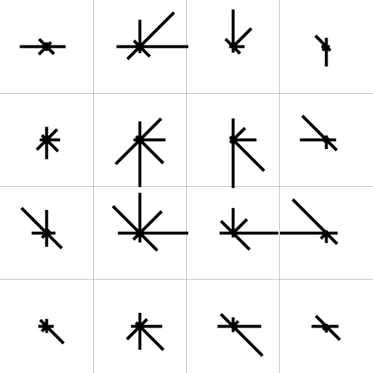
Normalization: From covariant regions to invariant features
via Svetlana
Eliminate rotational
ambiguity
Compute appearance
descriptors
Extract affine regions
Normalize regions
SIFT (Lowe ’04)

Slide 32

Invariance vs. covariance
via Svetlana
Invariance:
  features(transform(image)) = features(image)
Covariance:
  features(transform(image)) = transform(features(image))
Covariant detection => invariant description

Slide 33
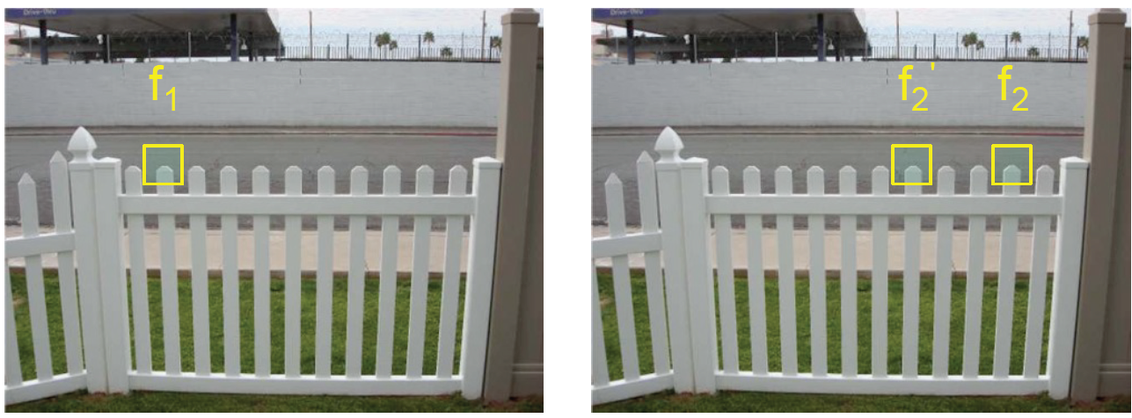
Problem: Ambiguous putative matches
Source: Y. Furukawa

Slide 34
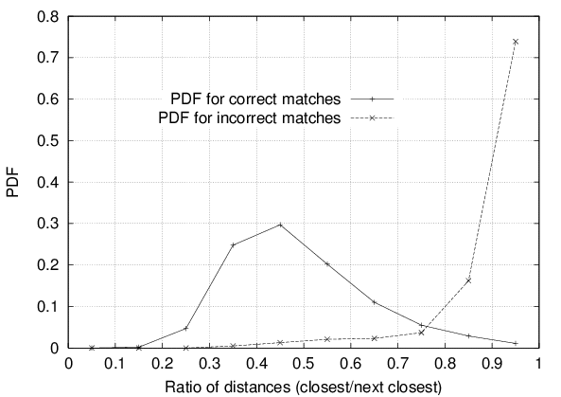
Rejection of unreliable matches
How can we tell which putative matches are more reliable?
Heuristic: compare distance of nearest neighbor to that of second nearest neighbor
  Ratio of closest distance to second-closest distance will be high for features that are not distinctive
  Threshold of 0.8 provides good separation
David G. Lowe. "Distinctive image features from scale-invariant keypoints.” IJCV 60 (2), pp. 91-110, 2004.

Slide 35
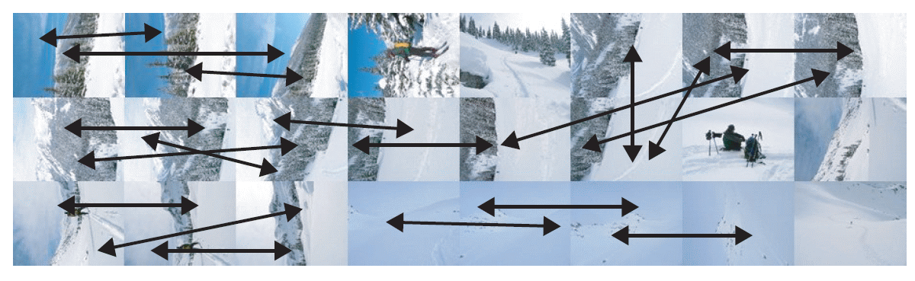
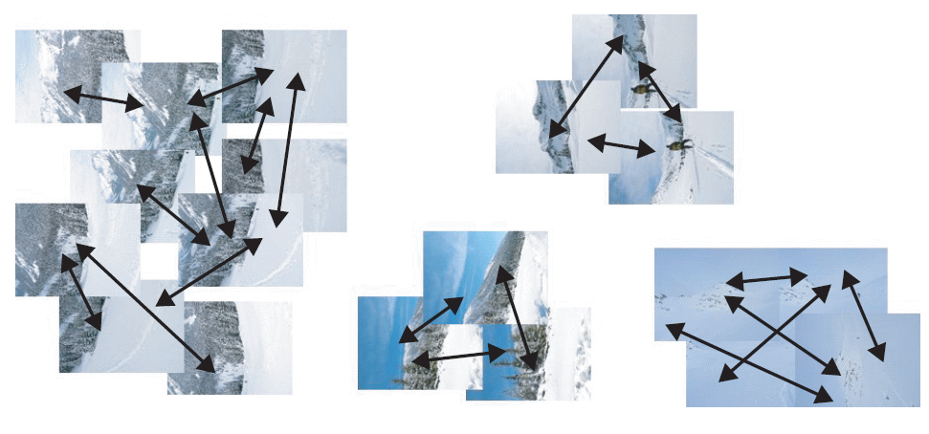
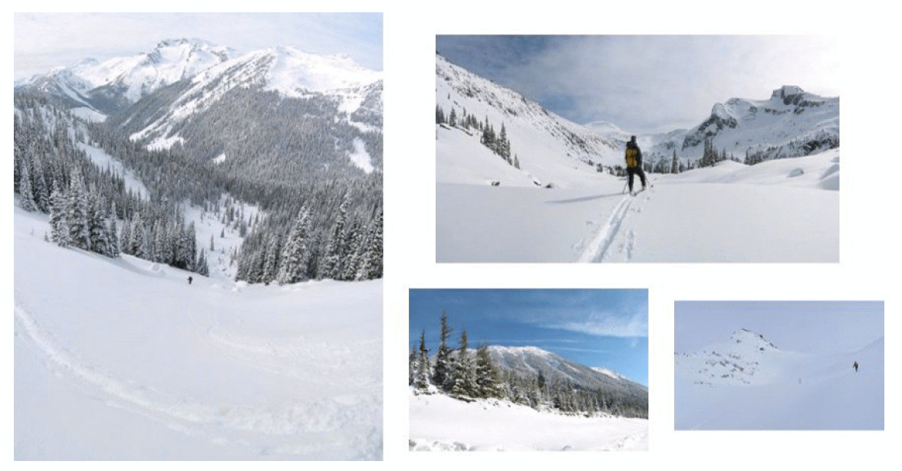
Application: Panoramas from a Jumble of Pictures
Extract SIFT features from all images
Find Pairwise Homographies
Find Connected Components over the pair connections
Bundle adjust the connected component to find image to panorama transformation
Render panorama with blending

Slide 36
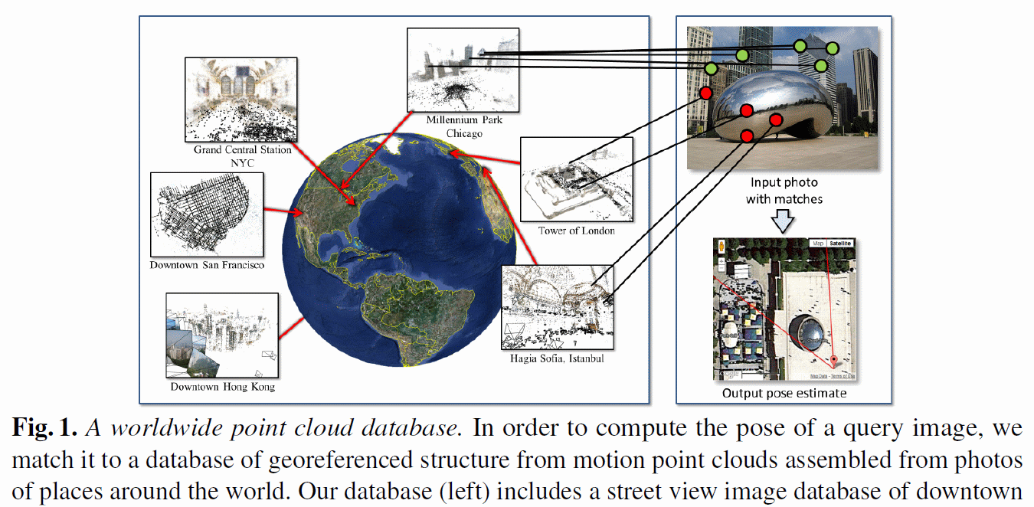
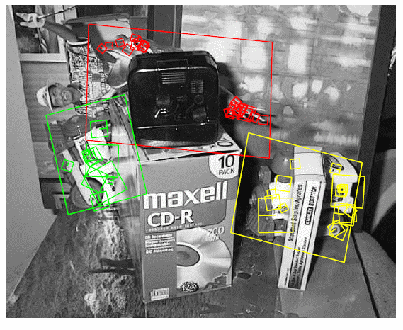
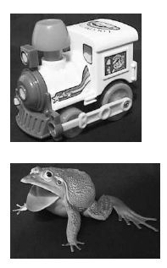
Application: Scalable Images based Search
David G. Lowe. "Distinctive image features from scale-invariant keypoints.” IJCV 60 (2), pp. 91-110, 2004.
Worldwide Pose Estimation
Yunpeng Li, Noah Snavely, Dan Huttenlocher, Pascal Fua
ECCV 2012
Find location of a Query image by matching against a large database of images indexed with their respective locations
Find instances of objects / images in a database of images

Slide 37
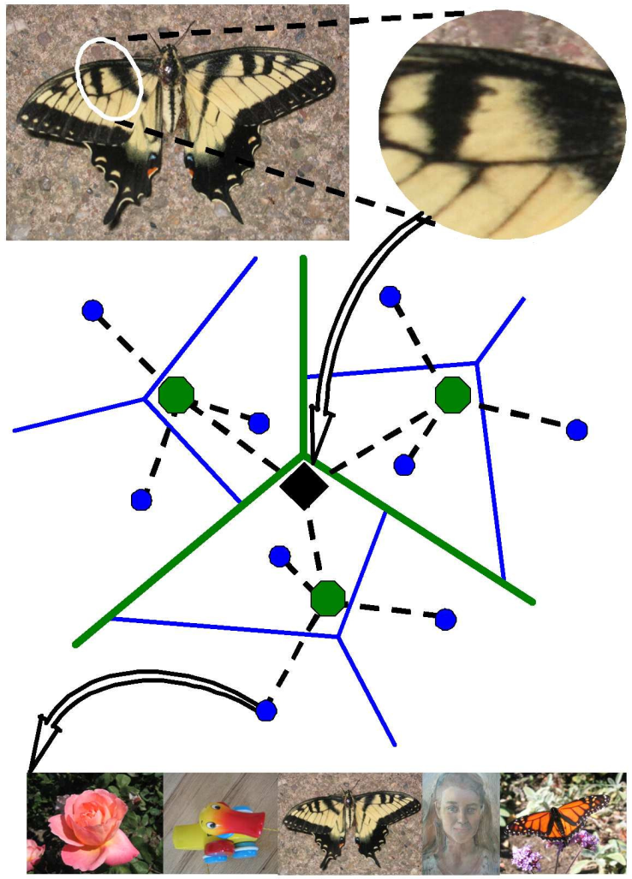
Efficient indexing technique: Vocabulary trees
Test image
Vocabulary tree with inverted index
Database
D. Nistér and H. Stewénius, Scalable Recognition with a Vocabulary Tree, CVPR 2006

Slide 38
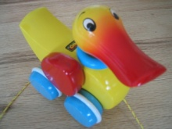

Populating the vocabulary tree/inverted index
Model images
Slide credit: D. Nister

Slide 39
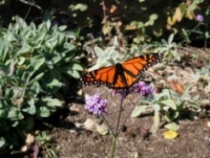

Model images
Populating the vocabulary tree/inverted index
Slide credit: D. Nister

Slide 40


Model images
Populating the vocabulary tree/inverted index
Slide credit: D. Nister

Slide 41
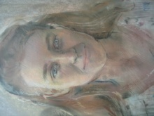

Model images
Populating the vocabulary tree/inverted index
Slide credit: D. Nister

Slide 42
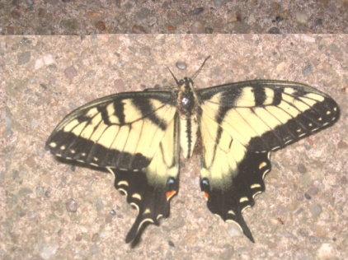
Model images
Test image
Looking up a test image
Slide credit: D. Nister
Notes:
When we then wish to query on an input image, we quantize the descriptor vectors of the input image in a similar way, and accumulate scores for the images in the database with so called term frequency inverse document frequency (tf-idf). This is effectively an entropy weighting of the information. The winner is the image in the database with the most common information with the input image.

Slide 43
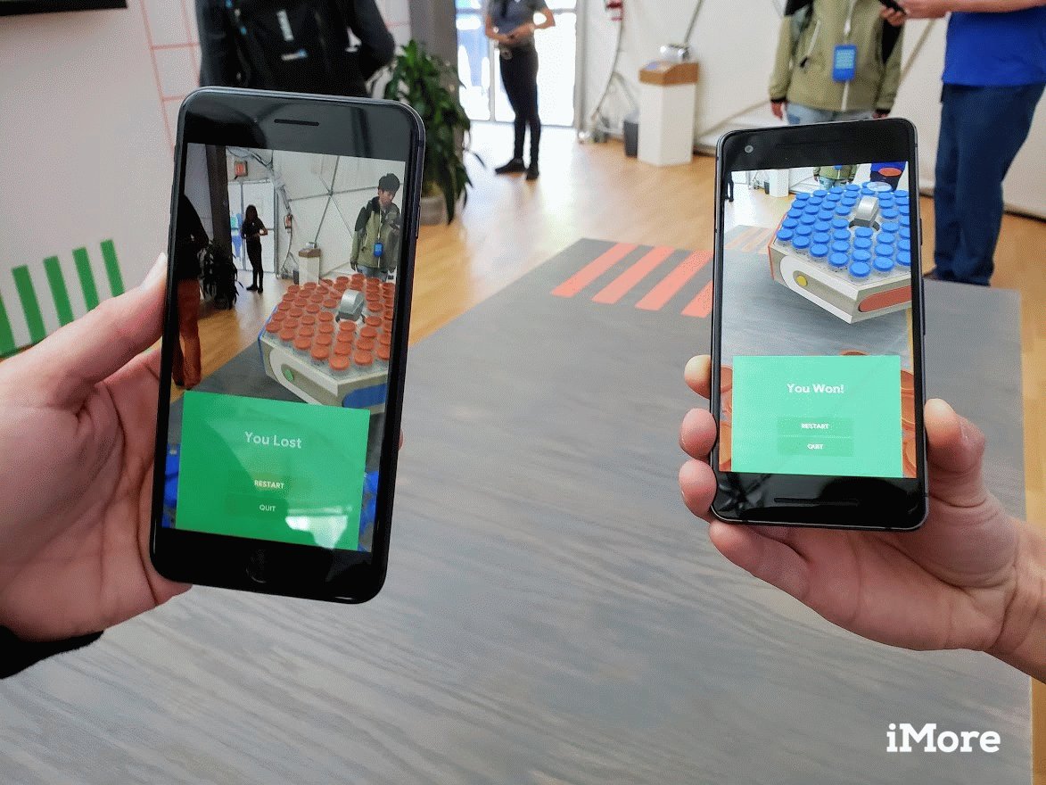
Google Cloud Anchors
Google ‘Cloud Anchors’ will help synchronize group AR experiences across iOS and Android devices
Employ Wide Baseline Matching
https://mediafocus.biz/google-cloud-anchors-will-help-synchronize-group-ar-experiences-across-ios-and-android-devices/

Slide 44


Minecraft Earth via Azure Spatial Anchors
https://www.theverge.com/2019/11/12/20961639/minecraft-earth-now-available-early-access-us-ios-android
https://youtu.be/AQEizp-VrVU
Spatial Anchors are built on Wide Baseline Matching and SfM / SLAM

Slide 45
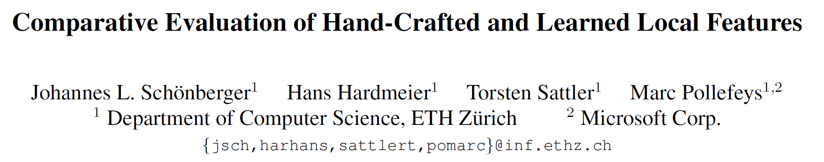
How do Hand-Crafted Features Compare with Learned Features?
CVPR 2017
“Hand-crafted features still perform on par or better than recent learned features for image-based reconstruction.
The current generation of learned descriptors shows a high variance across different datasets and applications.
The next generation of learned descriptors needs more training data.”

Slide 46

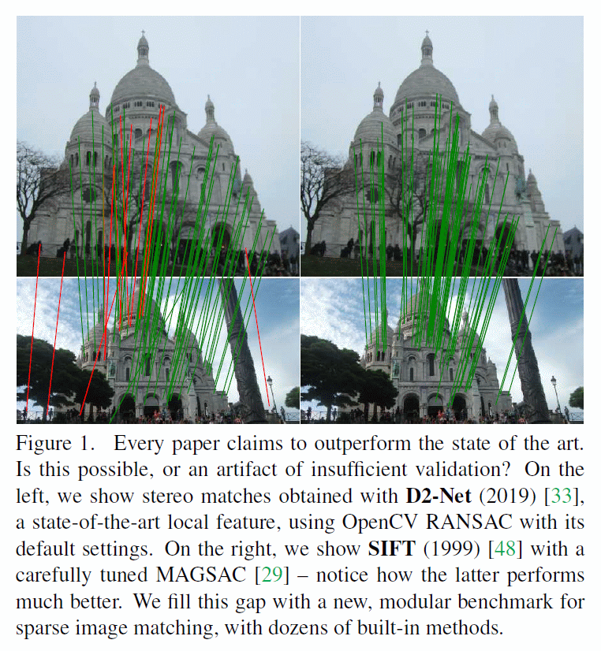
How do Hand-Crafted Features Compare with Learned Features?
Contributions
Dataset with 30k images with depth maps and ground truth poses
A modular pipeline incorporating dozens of methods for feature extraction and matching, and pose estimation
Two downstream tasks – stereo and multi-view reconstruction – evaluated with downstream and intermediate metrics
A thorough study of dozens of methods and techniques, hand-crafted and learned, and their combination, along with a procedure for hyper-parameter selection

Slide 47
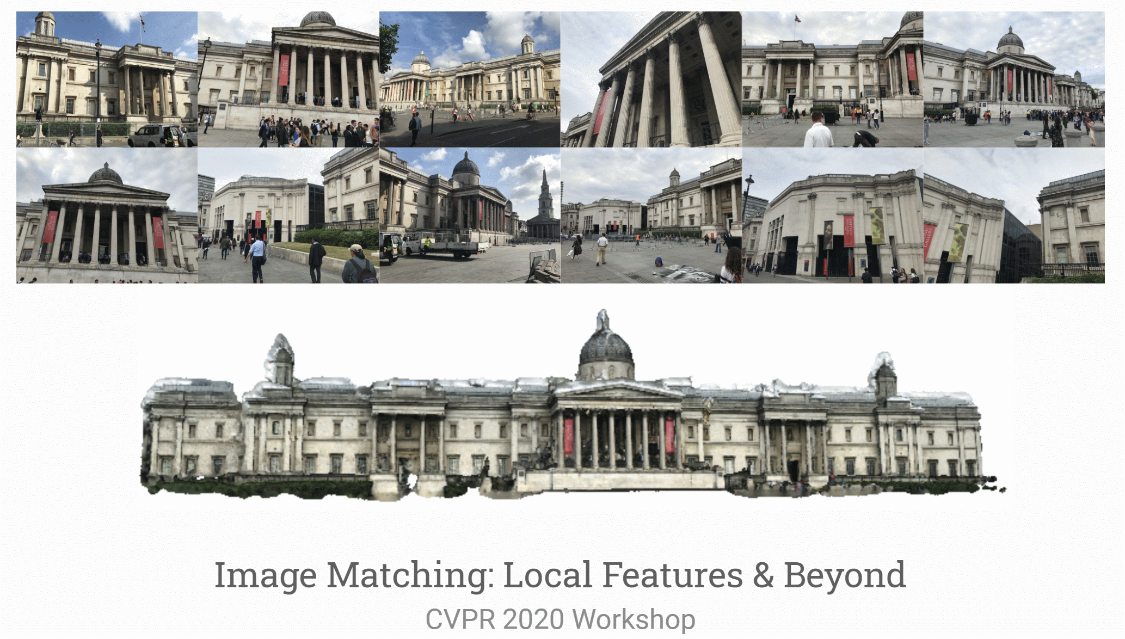
“Hot Topic”

Slide 48

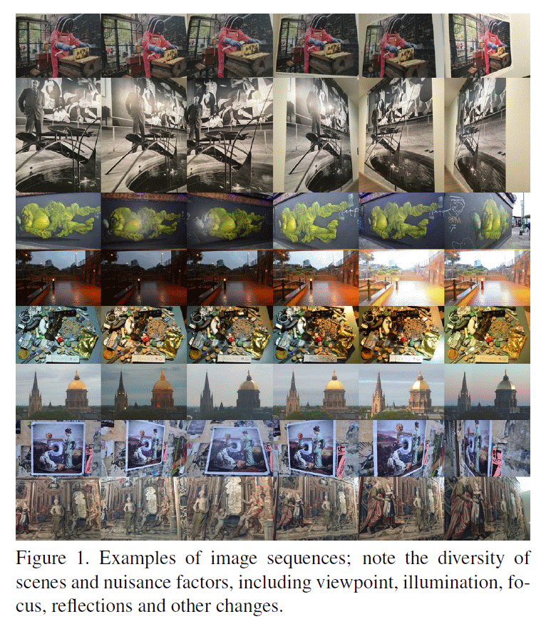
Viewpoint and Illumination Variations Dataset
https://github.com/hpatches/hpatches-dataset
Reproducible, patch-based: Descriptor evaluation should be done on patches to eliminate the detector related factors.
Diverse: Representative of many different scenes and image capturing conditions.
Real: Real data more challenging than a synthesized one due to nuisance factors that cannot be modelled in image transformations.
Large: For accurate and stable evaluation; to provide substantial training sets for learning based descriptors.
Multitask: Use cases, from matching image pairs to image retrieval.

Slide 49
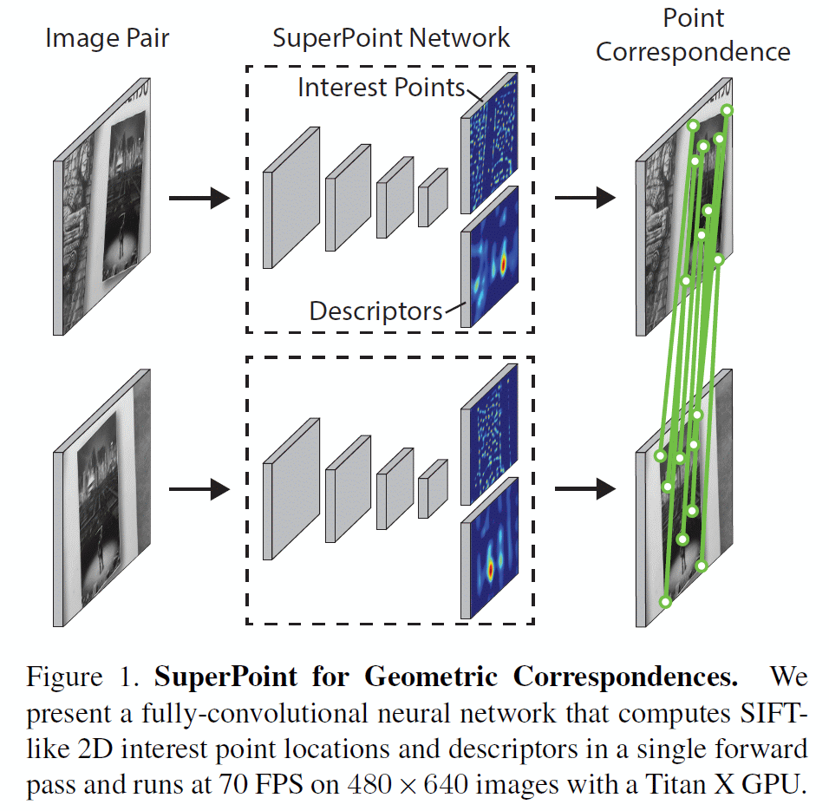
A Contemporary Example of Learned Features
SuperPoint: Self-Supervised Interest Point Detection and Description
CVPR 2018
Self-supervised framework for training interest point detectors and descriptors
Fully-convolutional model operates on full-sized images and jointly computes pixel-level interest point locations and associated descriptors in one forward pass.

Slide 50
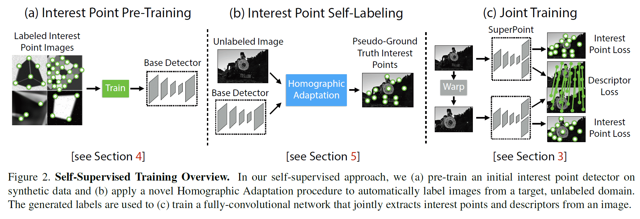
Self-Supervised Training

Slide 51

Superpoint Architecture
The interest point detector head computes Hc x Wc x 65 and outputs a tensor sized H x W.
The 65 channels correspond to local, non-overlapping 8 x8 grid regions of pixels plus an extra “no interest point” dustbin.
After a channel-wise softmax, the dustbin dimension is removed and Hc x Wc x 64 ➔ H x W reshape is performed.
The descriptor head computes Hc x Wc x D and outputs a tensor sized H x W x D.
To output a dense map of L2-normalized fixed length descriptors, first output a semi-dense grid of descriptors (e.g., one every 8 pixels).
The decoder then performs bicubic interpolation of the descriptor and then L2-normalizes to unit length.

Slide 52




Joint Geometric and Classification Loss
The interest point detector loss function Lp is a fully convolutional cross-entropy
The descriptor loss is applied to all pairs of descriptor cells, (h, w) and (h’, w’)
The homography-induced correspondence between the (h, w) cell and the (h’, w’) cell can be written as:
The descriptor loss is given by:

Slide 53


Comparative Results
SIFT performs well for sub-pixel precision homographies and has the lowest mean localization error (MLE).
SuperPoint scores strongly in descriptor-focused metrics such as nearest neighbor mAP and matching score (M. Score)

Slide 54
Topics to Cover
Longuet-Higgins Prize @ CVPR
“Object Retrieval with Large Vocabularies and Fast Spatial Matching” 2017 J Philbin et al
“Scalable Recognition with a Vocabulary Tree” 2016 D Nister
“Histograms of oriented gradients for human detection” 2015 Dalal Triggs
Helmholtz Prize (Test of Time) @ ICCV
“Recognising panoramas” 2017 M Brown D Lowe
“Object Recognition from Local Scale-Invariant Features” 2011 D Lowe

