Slide 1
Start Recording

Slide 2
3D Vision, Depth and Stereo Estimation
Harpreet S Sawhney
Microsoft / Vision & Mixed Reality
May 19th , 2020

Slide 3
Cues for 3D / Depth Perception in Our Vision System
We live, work and play in a 3D World…
…and evolved to perceive in 3D

Slide 4
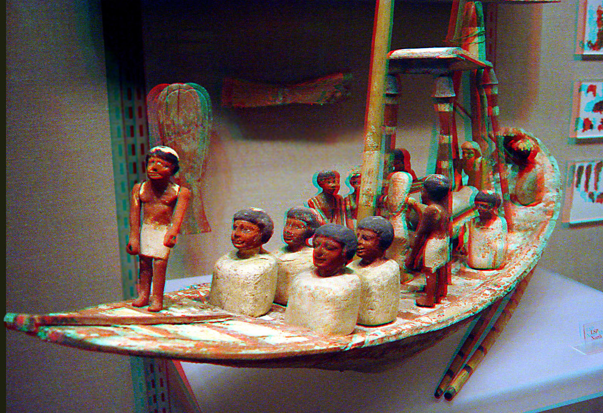
Binocular Disparities via Anaglyphs
Egyptian Ship Model rendered as an Anaglyph to give 3D perception with red-green glasses

Slide 5
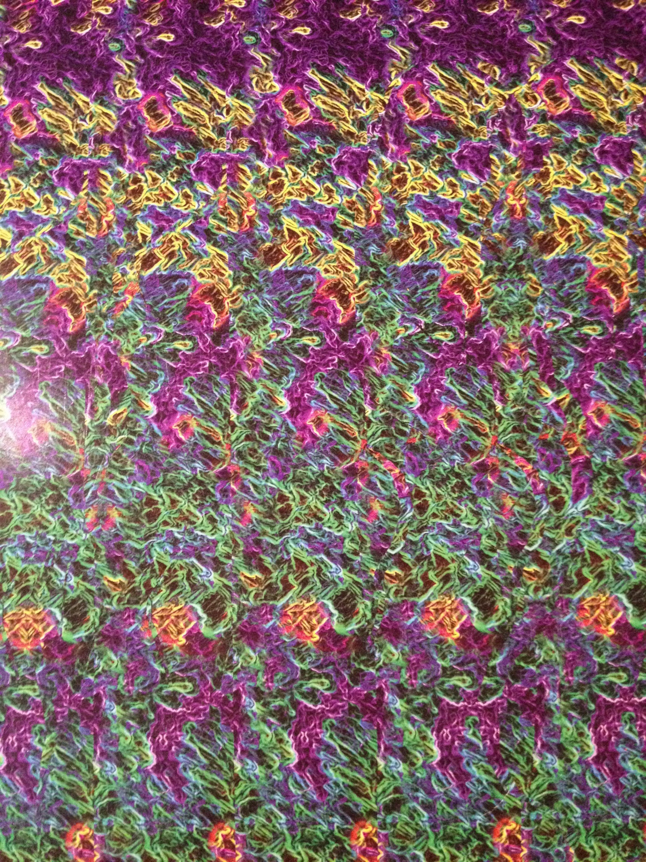

Binocular
Disparities via
Autostereograms
Thinker

Slide 6
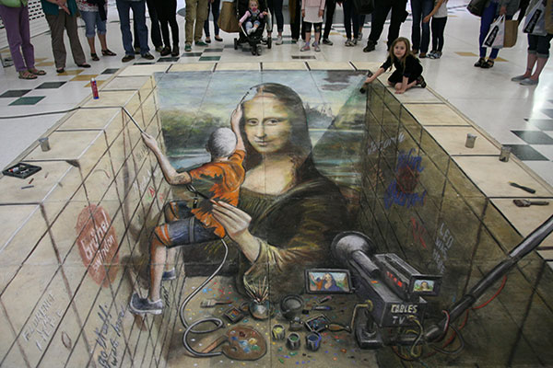
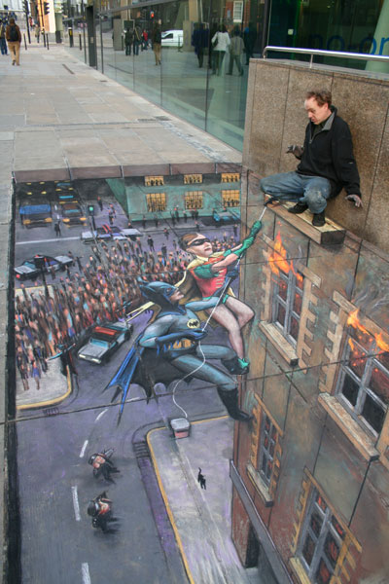
Monocular Perspective Cues: Julian Beever’s Pavement drawings
Who's Painting Who ? Historians have long wondered just how Michaelangelo managed to paint his famous Mona Lisa on the wall of the Sistine Chapel. Here a possible method is demonstrated.
Batman and Robinto the rescue. (London, UK)

Slide 7
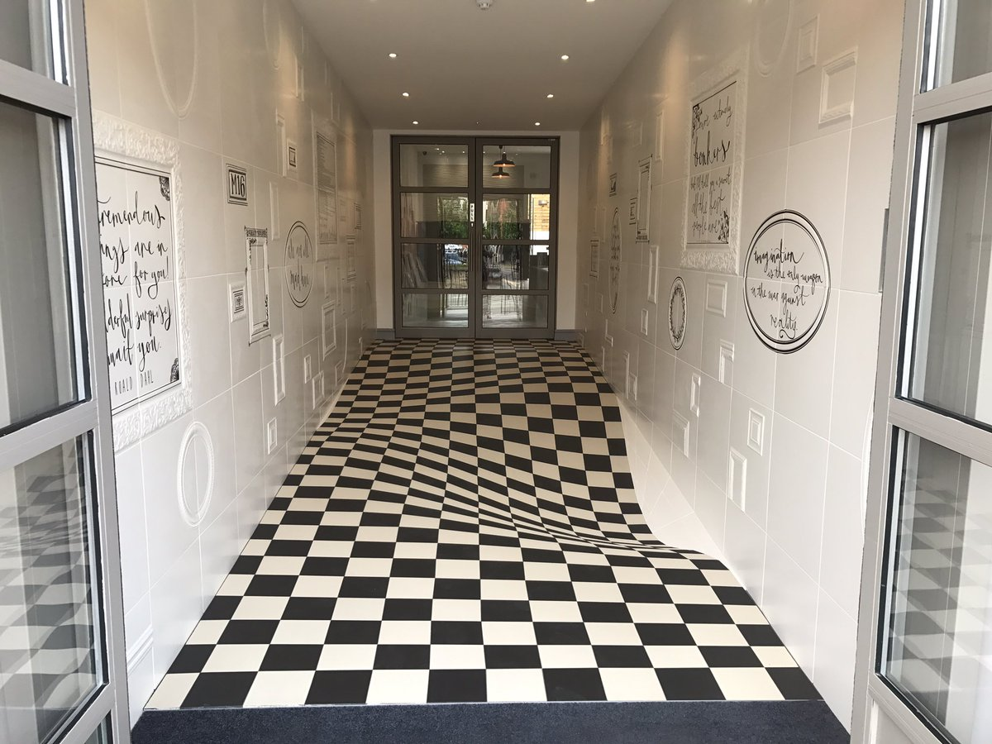
3D Visual Illusions via Texture
https://www.beautifullife.info/urban-design/10-crazy-3d-optical-illusions-will-blow-mind/

Slide 8
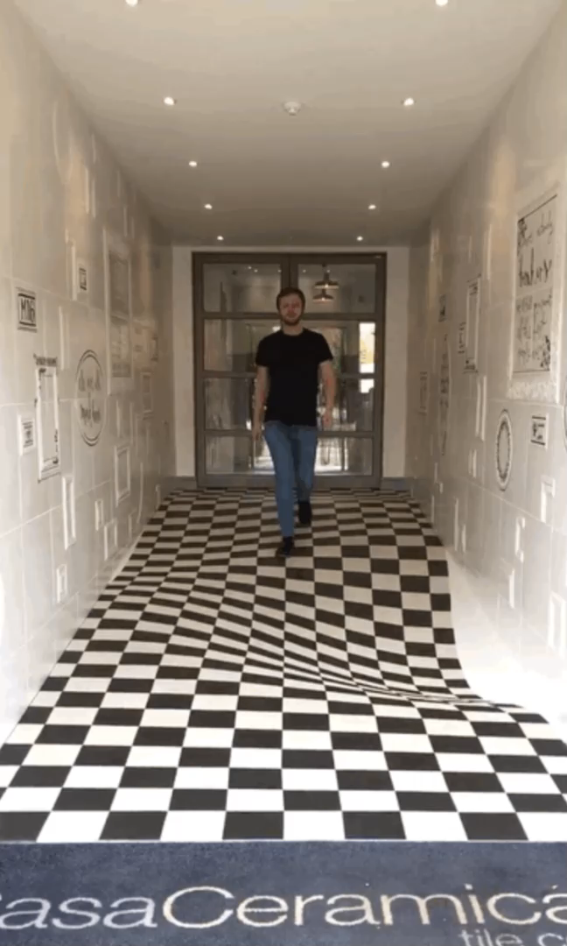
And if you do believe your eyes…
https://www.beautifullife.info/urban-design/10-crazy-3d-optical-illusions-will-blow-mind/

Slide 9
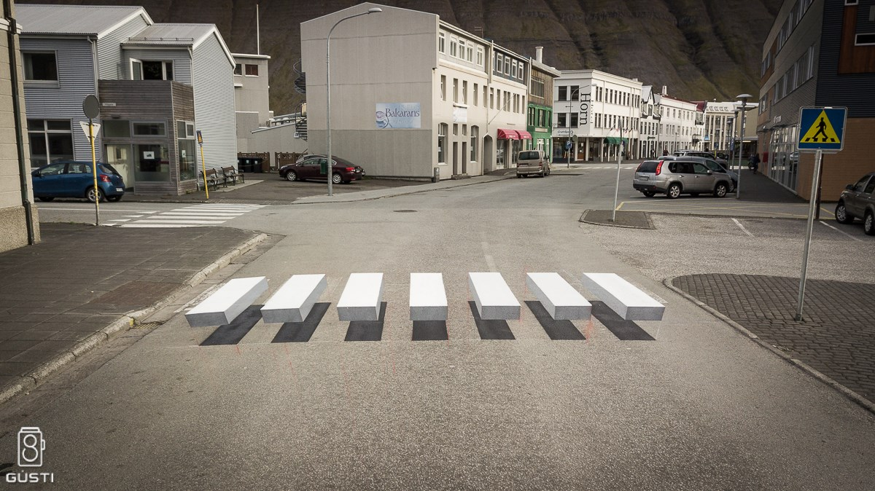
3D Perception via Perspective & Shading
https://www.beautifullife.info/urban-design/10-crazy-3d-optical-illusions-will-blow-mind/
https://youtu.be/szJbz-z7iJw

Slide 10
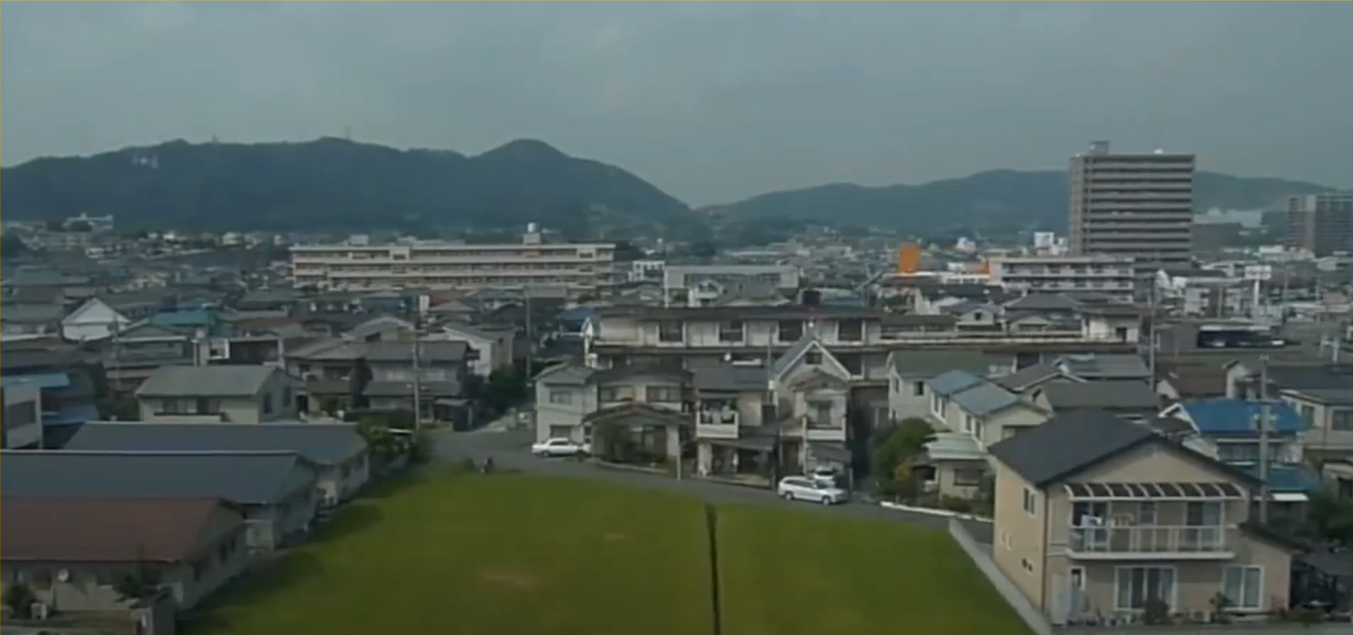
3D Perception via Motion Parallax

Slide 11
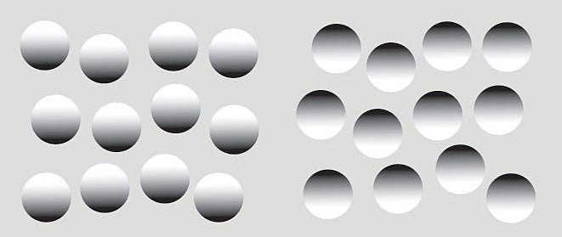
3D via Shading
3D Perception created

Slide 12
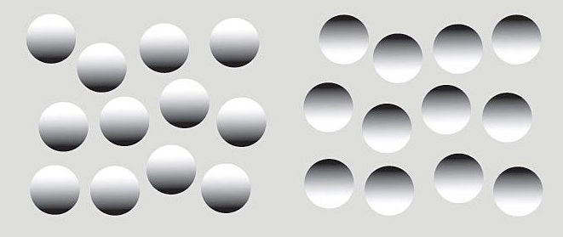
3D via Shading
3D Perception created

Slide 13
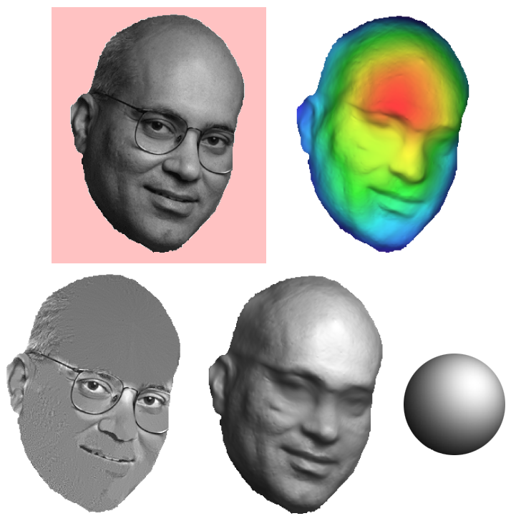
3D via Shading
Shape, Albedo and Illumination
from a
Single Image

Slide 14
Today’s Lecture
Two-view Epipolar geometry
  Relates cameras from two positions
  Takes us into the realm of Computing 3D from Images
Binocular Stereo depth estimation
  Recover depth from two images
Deep Learning for 3D Estimation
  Geometric and Photometric Constraints

Slide 15

Two View Geometry: Epipolar constraint
Via Derek Hoeim
X
X
X
x
x’
x’
x’
Epipolar Plane:
Displacement vector OO’, and the two corresponding view rays Ox and Ox’ form a plane
Correspondence Constraint between x and x’:
Potential matches for x have to lie on the corresponding line l’.
Potential matches for x’ have to lie on the corresponding line l.

Slide 16

Epipolar Geometry: Notation
Via Derek Hoeim
X
x
x’
Baseline – line connecting the two camera centers
Epipoles
= intersections of baseline with image planes
= projections of the other camera center
Epipolar Plane – plane containing baseline (1D family)

Slide 17
Epipolar Geometry: Notation
Via Derek Hoeim
X
x
x’
Baseline – line connecting the two camera centers
Epipoles
= intersections of baseline with image planes
= projections of the other camera center
Epipolar Plane – plane containing baseline (1D family)
Epipolar Lines - intersections of epipolar plane with image
planes (always come in corresponding pairs)

Slide 18


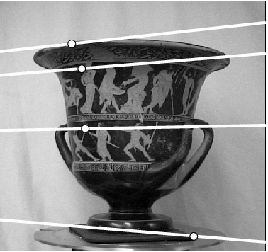
Example: Fixated / Verged “Eyes”
Via Derek Hoeim

Slide 19



Example: Cameras with no displacement in depth
Via Derek Hoeim
Epipoles at Infinity

Slide 20
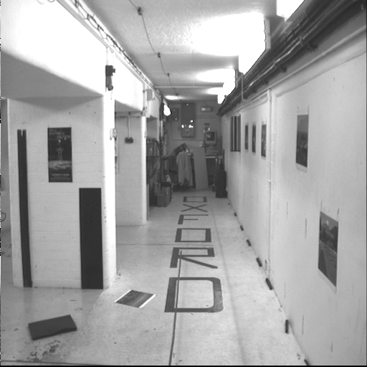
Camera Displacement in Depth: Focus of Expansion / Contraction
Via Derek Hoeim

Slide 21
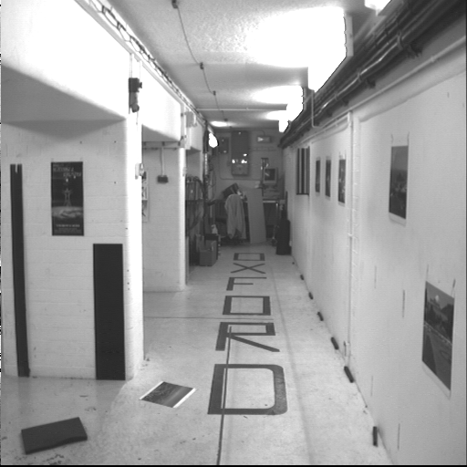
Camera Displacement in Depth: Focus of Expansion / Contraction
Via Derek Hoeim
Displacement is perpendicular to the image plane
Epipole is the “focus of expansion” and the principal point

Slide 22
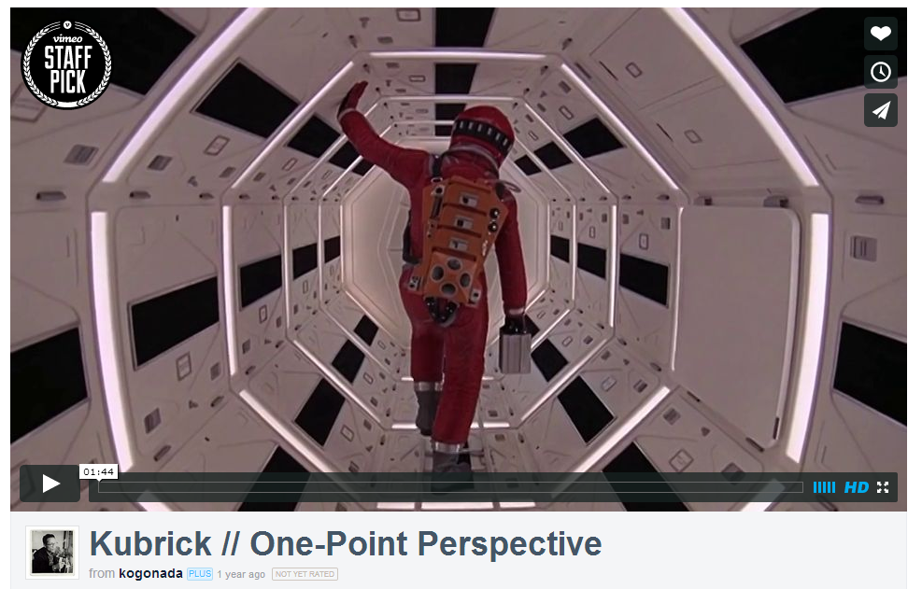
Motion perpendicular to image plane
Via Svetlana L.
http://vimeo.com/48425421

Slide 23
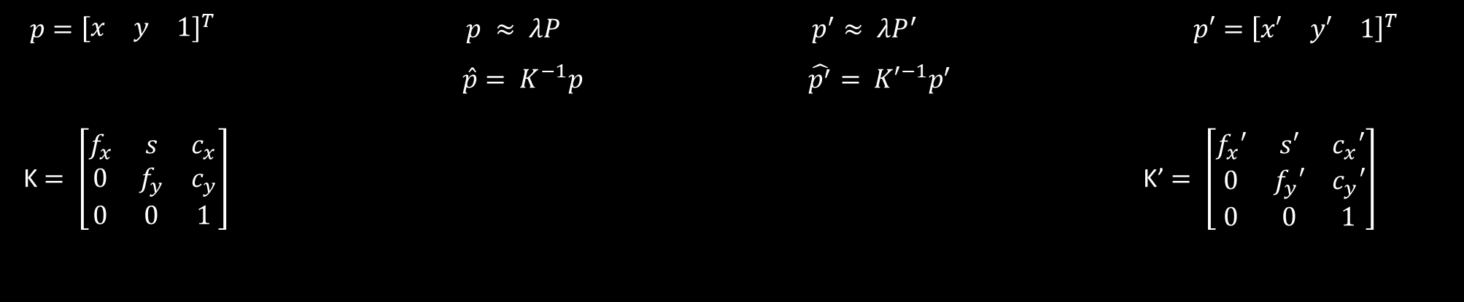



Epipolar Geometry: Calibrated Cameras
Via Derek Hoeim
P
P’
3D Scene Points
in the two Camera
Coordinate Systems
Y
Y’
X
X’
Z
Z’
$p={\left[\begin{matrix}x & y & 1\end{matrix}\right]}^{T}$ $p ≈ λP$ $p^{′}≈ λP^{′}$ $p′={\left[\begin{matrix}x′ & y′ & 1\end{matrix}\right]}^{T}$
$\hat{p}= K^{−1}p$ $\hat{p^{′}}= {K′}^{−1}p^{′}$
K$= \left[\begin{matrix}f_{x} & s & c_{x} \\ 0 & f_{y} & c_{y} \\ 0 & 0 & 1\end{matrix}\right]$ K’$= \left[\begin{matrix}f_{x}′ & s′ & c_{x}′ \\ 0 & f_{y}′ & c_{y}′ \\ 0 & 0 & 1\end{matrix}\right]$
Homogeneous 2D
Pixel Coordinates
3D View Ray in
Homogeneous Coordinates
Intrinsic Camera Matrices

Slide 24


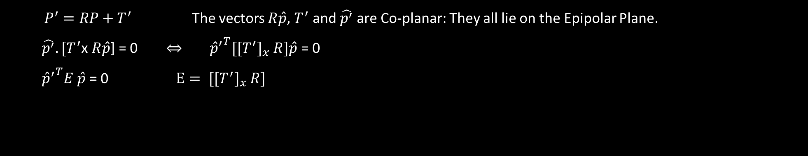


Epipolar Geometry: Calibrated Cameras
Via Derek Hoeim
P
P’
Y
Y’
X
X’
Z
Z’
$T^{′}$
$$R$$
$P^{′}=RP+T^{′}$ The vectors $R\hat{p}$, $T^{′}$ and $\hat{p^{′}}$are Co-planar: They all lie on the Epipolar Plane.
$\hat{p^{′}}.[T^{′}$x $R\hat{p}$] = 0 $⇔$ ${{\hat{p}}^{′}}^{T}[[T^{′}]_{x}$ $R]\hat{p}$ = 0
${{\hat{p}}^{′}}^{T}E \hat{p}$ = 0 $E= [[T^{′}]_{x}$ $R]$
$$a×b=\left[\begin{matrix}0 & −a_{z} & a_{y} \\ a_{z} & 0 & −a_{x} \\ −a_{y} & a_{x} & 0\end{matrix}\right]\left[\begin{matrix}b_{x} \\ b_{y} \\ b_{z}\end{matrix}\right]=[a_{×}]b$$
Recall:
Essential Matrix
(Longuet-Higgins, 1981)
Rank 2 Skew-Symmetric Matrix
Null Vector is the vector $a$

Slide 25
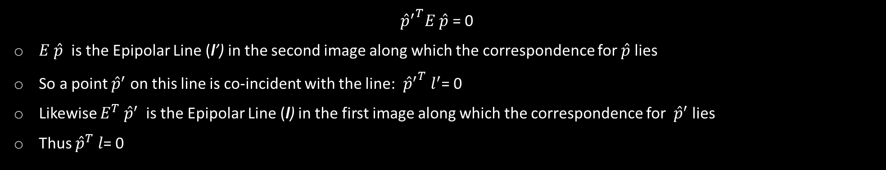

Epipolar Geometry: Properties of the E Matrix
Via Derek Hoeim
P
P’
Y
Y’
X
X’
Z
Z’
$T^{′}$
$$R$$
${{\hat{p}}^{′}}^{T}E \hat{p}$ = 0
$E \hat{p}$ is the Epipolar Line (l’) in the second image along which the correspondence for $\hat{p}$ lies
So a point ${\hat{p}}^{′}$ on this line is co-incident with the line: ${{\hat{p}}^{′}}^{T} l^{′}$= 0
Likewise $E^{T} {\hat{p}}^{′}$ is the Epipolar Line (l) in the first image along which the correspondence for ${ \hat{p}}^{′}$ lies
Thus ${\hat{p}}^{T} l$= 0

Slide 26
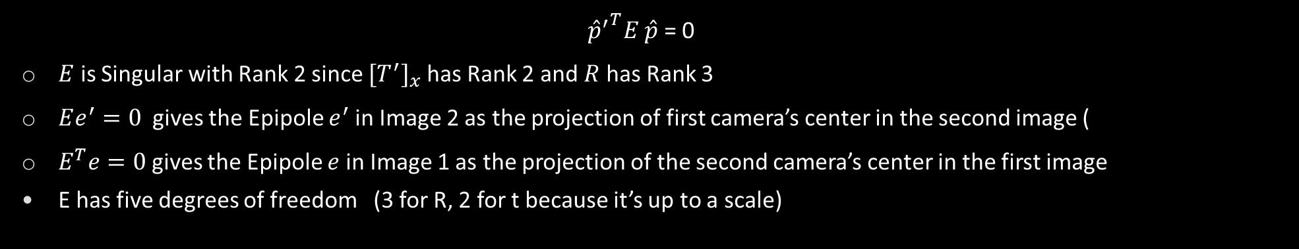
Epipolar Geometry: Properties of the E Matrix
Via Derek Hoeim
P
P’
Y
Y’
X
X’
Z
Z’
$T^{′}$
$$R$$
${{\hat{p}}^{′}}^{T}E \hat{p}$ = 0
$E$ is Singular with Rank 2 since $[T^{′}]_{x}$ has Rank 2 and $R$ has Rank 3
$Ee^{′}=0$ gives the Epipole $e^{′}$in Image 2 as the projection of first camera’s center in the second image (
$E^{T}e=0$ gives the Epipole $e$ in Image 1 as the projection of the second camera’s center in the first image
E has five degrees of freedom (3 for R, 2 for t because it’s up to a scale)

Slide 27

Epipolar Geometry: Uncalibrated Cameras
Via Derek Hoeim
P
P’
Y
Y’
X
X’
Z
Z’
$T^{′}$
$$R$$
${{\hat{p}}^{′}}^{T}E \hat{p}$ = 0 ➔ ${{p^{.}}^{′}}^{T}K^{′−T}E K^{−1}p$= 0 ➔ ${{p^{.}}^{′}}^{T}F p$ = 0
Fundamental Matrix
(Faugeras and Luong, 1992)

Slide 28
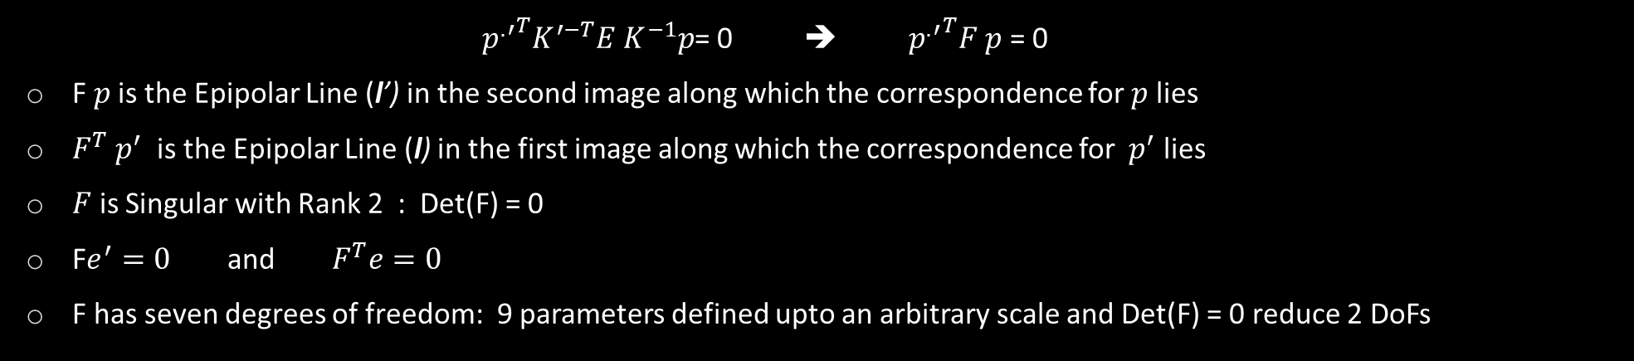
Epipolar Geometry: Properties of the F Matrix
Via Derek Hoeim
P
P’
Y
Y’
X
X’
Z
Z’
${{p^{.}}^{′}}^{T}K^{′−T}E K^{−1}p$= 0 ➔ ${{p^{.}}^{′}}^{T}F p$ = 0
F$p$is the Epipolar Line (l’) in the second image along which the correspondence for $p$ lies
$F^{T} p^{′}$ is the Epipolar Line (l) in the first image along which the correspondence for ${ p}^{′}$ lies
$F$ is Singular with Rank 2 : Det(F) = 0
F$e^{′}=0$ and $F^{T}e=0$
F has seven degrees of freedom: 9 parameters defined upto an arbitrary scale and Det(F) = 0 reduce 2 DoFs

Slide 29
Estimating the Fundamental Matrix
Via Derek Hoeim
8-point algorithm
  Least squares solution using SVD on equations from 8 pairs of correspondences
  Enforce Det(F)=0 constraint using SVD on F
7-point algorithm
  Use least squares to solve for null space (two vectors) using SVD and 7 pairs of correspondences
  Solve for linear combination of null space vectors that satisfies Det(F)=0
Minimize reprojection error
  Non-linear least squares
Note: estimation of F (or E) is degenerate for a planar scene (Homography)

Slide 30
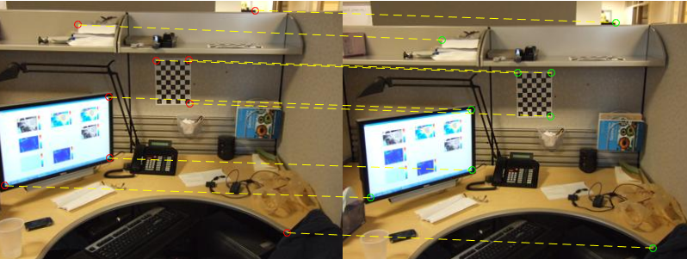
Estimating the fundamental matrix
Via Svetlana L.
Using 8 Point Correspondences

Slide 31
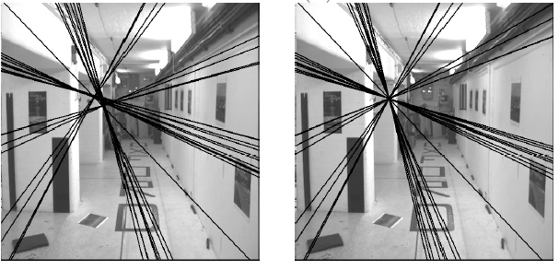



The eight-point algorithm: Each correspondence gives one equation
Via Svetlana L.
$$\left[\begin{matrix}u^{′}u & u^{′}v & u^{′} & v^{′}u & v^{′}v & v^{′} & u & v & 1\end{matrix}\right]\left[\begin{matrix}f_{11} \\ f_{12} \\ f_{13} \\ f_{21} \\ f_{22} \\ f_{23} \\ f_{31} \\ f_{32} \\ f_{33}\end{matrix}\right]=0$$
$$x=(u,v,1)^{T}, x^{′}=(u^{′},v^{′},1)$$
$$\left[\begin{matrix}u^{′} & v^{′} & 1\end{matrix}\right]\left[\begin{matrix}f_{11} & f_{12} & f_{13} \\ f_{21} & f_{22} & f_{23} \\ f_{31} & f_{32} & f_{33}\end{matrix}\right]\left[\begin{matrix}u \\ v \\ 1\end{matrix}\right]=0$$
Solve homogeneous linear system using eight or more matches
Enforce rank-2 constraint
(take SVD of F and throw out the smallest singular value)

Slide 32

Problem with eight-point algorithm
Via Svetlana L.
$$\left[\begin{matrix}u^{′}u & u^{′}v & u^{′} & v^{′}u & v^{′}v & v^{′} & u & v\end{matrix}\right]\left[\begin{matrix}f_{11} \\ f_{12} \\ f_{13} \\ f_{21} \\ f_{22} \\ f_{23} \\ f_{31} \\ f_{32}\end{matrix}\right]=−1$$
F[3][3] has been set to 1 to remove scale ambiguity

Slide 33
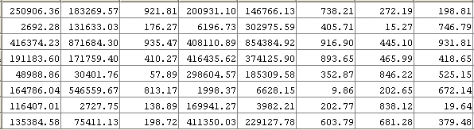

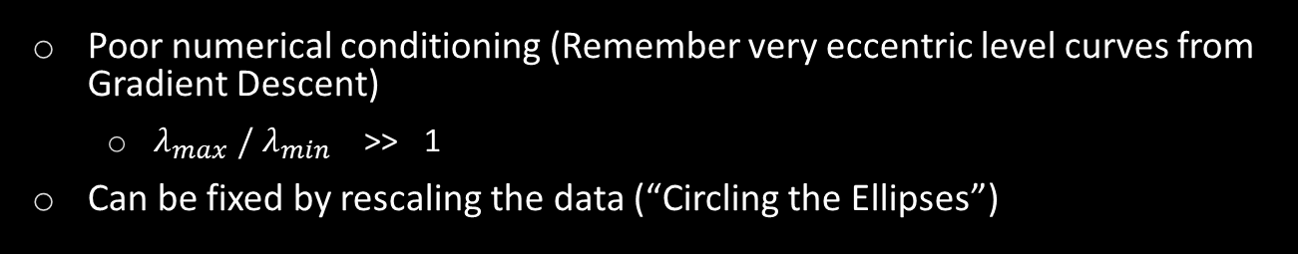
Problem with eight-point algorithm
Via Svetlana L.
$$\left[\begin{matrix}u^{′}u & u^{′}v & u^{′} & v^{′}u & v^{′}v & v^{′} & u & v\end{matrix}\right]\left[\begin{matrix}f_{11} \\ f_{12} \\ f_{13} \\ f_{21} \\ f_{22} \\ f_{23} \\ f_{31} \\ f_{32}\end{matrix}\right]=−1$$
Poor numerical conditioning (Remember very eccentric level curves from Gradient Descent)
  $λ_{max} /{ λ}_{min}$ >> 1
Can be fixed by rescaling the data (“Circling the Ellipses”)

Slide 34
The normalized eight-point algorithm
Via Svetlana L.
(Hartley, 1995)
Center the image data at the origin, and scale it so the mean squared distance between the origin and the data points is 2 pixels
Use the eight-point algorithm to compute F from the normalized points
Enforce the rank-2 constraint (for example, take SVD of F and throw out the smallest singular value)
Transform fundamental matrix back to original units: if T and T’ are the normalizing transformations in the two images, than the fundamental matrix in original coordinates is T’^{T} F T

Slide 35
Nonlinear estimation
Via Svetlana L.
Linear estimation minimizes the sum of squared algebraic distances between points x’_{i} and epipolar lines F x_{i} (or points x_{i} and epipolar lines F^{T}x’_{i}):
Nonlinear approach: minimize sum of squared geometric distances
x_{i}

Slide 36













Nonlinear estimation
Via Svetlana L.
Linear estimation minimizes the sum of squared algebraic distances between points x’_{i} and epipolar lines F x_{i} (or points x_{i} and epipolar lines F^{T}x’_{i}):
Nonlinear approach: minimize sum of squared geometric distances
x_{i}

Slide 37

Comparison of estimation algorithms
 | 8-point | Normalized 8-point | Nonlinear least squares
Av. Dist. 1 | 2.33 pixels | 0.92 pixel | 0.86 pixel
Av. Dist. 2 | 2.18 pixels | 0.85 pixel | 0.80 pixel

Slide 38
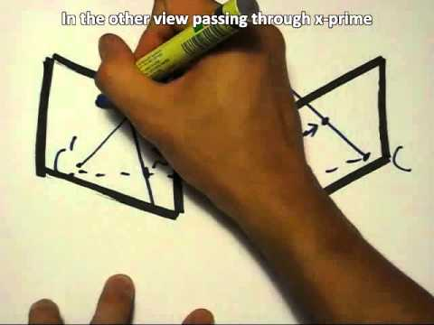
The Fundamental Matrix Song
http://danielwedge.com/fmatrix/

Slide 39


Two-View Stereo : 3D Depth from two Views
Many slides adapted from Steve Seitz

Slide 40
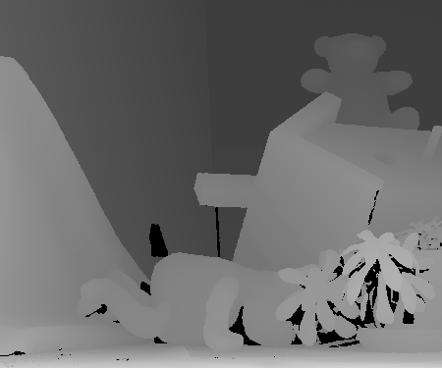
Disparity Map

Slide 41
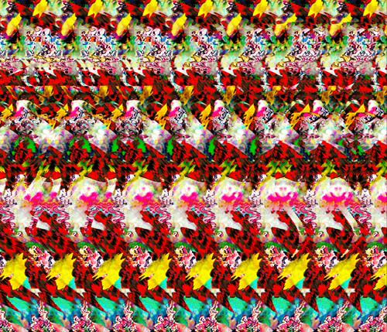
Stereograms
Humans can fuse pairs of images to get a sensation of depth
Autostereograms: www.magiceye.com

Slide 42
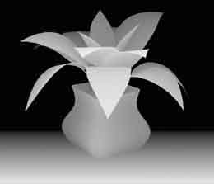
Stereograms
Humans can fuse pairs of images to get a sensation of depth
Autostereograms: www.magiceye.com

Slide 43


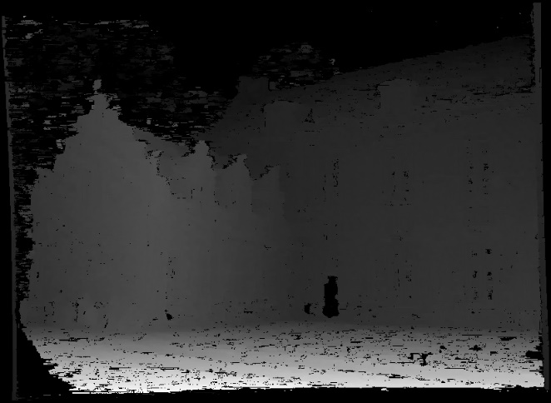
Problem formulation
Via Derek Hoeim
Given a calibrated binocular stereo pair, fuse it to produce a depth image
image 1
image 2
Dense depth map

Slide 44

Basic stereo matching algorithm
Via Derek Hoeim
For each pixel in the first image
  Find corresponding epipolar line in the right image
  Examine all pixels on the epipolar line and pick the best match
  Triangulate the matches to get depth information
Simplest case: epipolar lines are corresponding scanlines
  When does this happen?

Slide 45
Simplest Case: Parallel images
Via Derek Hoeim
Image planes of cameras are parallel to each other and to the baseline
Camera centers are at same height
Focal lengths are the same

Slide 46
Simplest Case: Parallel images
Via Derek Hoeim
Image planes of cameras are parallel to each other and to the baseline
Camera centers are at same height
Focal lengths are the same
Then epipolar lines fall along the horizontal scan lines of the images

Slide 47

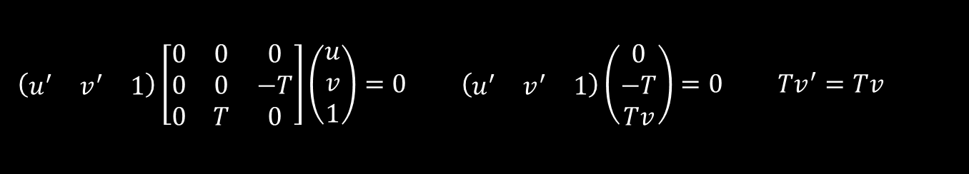
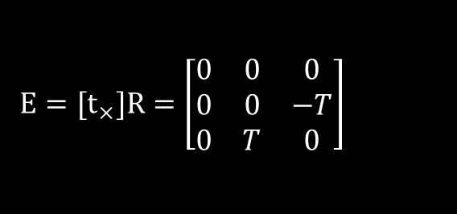
Essential matrix for parallel images
Via Derek Hoeim
Epipolar constraint:
$$x^{′T}Ex=0, E=[t_{×}]R$$
R = I t = (T, 0, 0)
x
$$E=[t_{×}]R=\left[\begin{matrix}0 & 0 & 0 \\ 0 & 0 & −T \\ 0 & T & 0\end{matrix}\right]$$
x’
t
$$\left(\begin{matrix}u^{′} & v^{′} & 1\end{matrix}\right)\left[\begin{matrix}0 & 0 & 0 \\ 0 & 0 & −T \\ 0 & T & 0\end{matrix}\right]\left(\begin{matrix}u \\ v \\ 1\end{matrix}\right)=0 \left(\begin{matrix}u^{′} & v^{′} & 1\end{matrix}\right)\left(\begin{matrix}0 \\ −T \\ Tv\end{matrix}\right)=0 Tv^{′}=Tv$$
The y-coordinates of corresponding points are the same!

Slide 48
Stereo image rectification
Via Derek Hoeim

Slide 49
Stereo image rectification
Via Derek Hoeim
Reproject image planes onto a common
plane parallel to the line between optical centers
C. Loop and Z. Zhang. Computing Rectifying Homographies for Stereo Vision. CVPR 1999

Slide 50
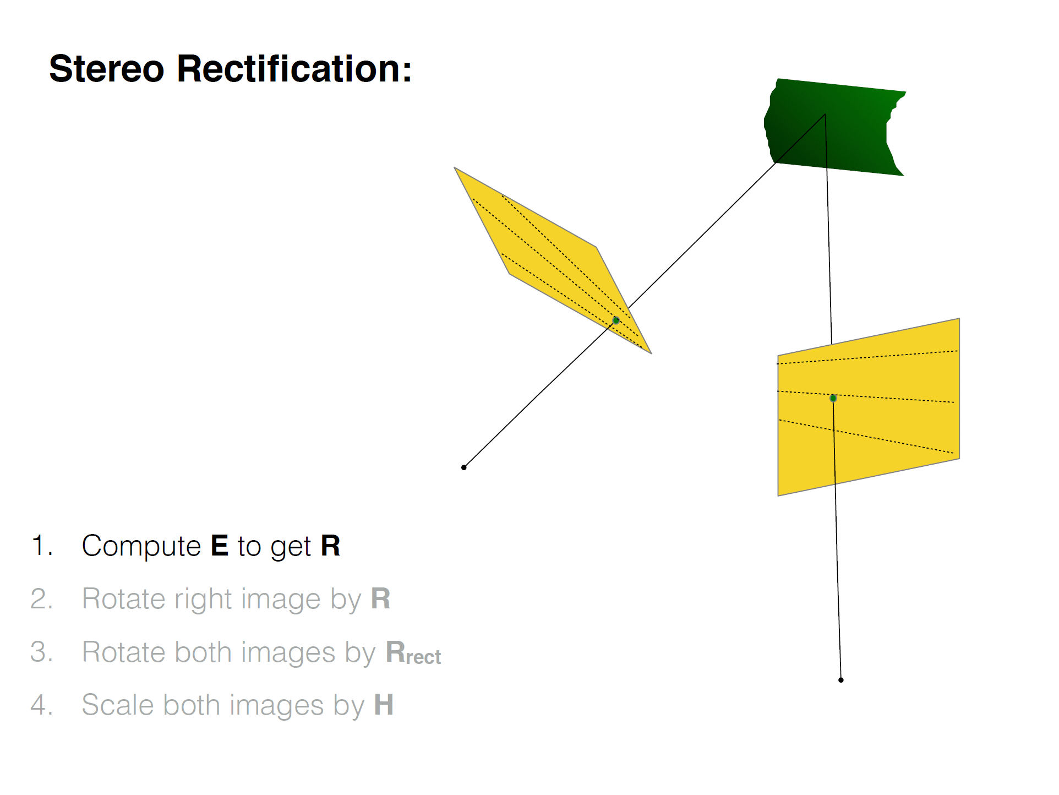

Slide 51
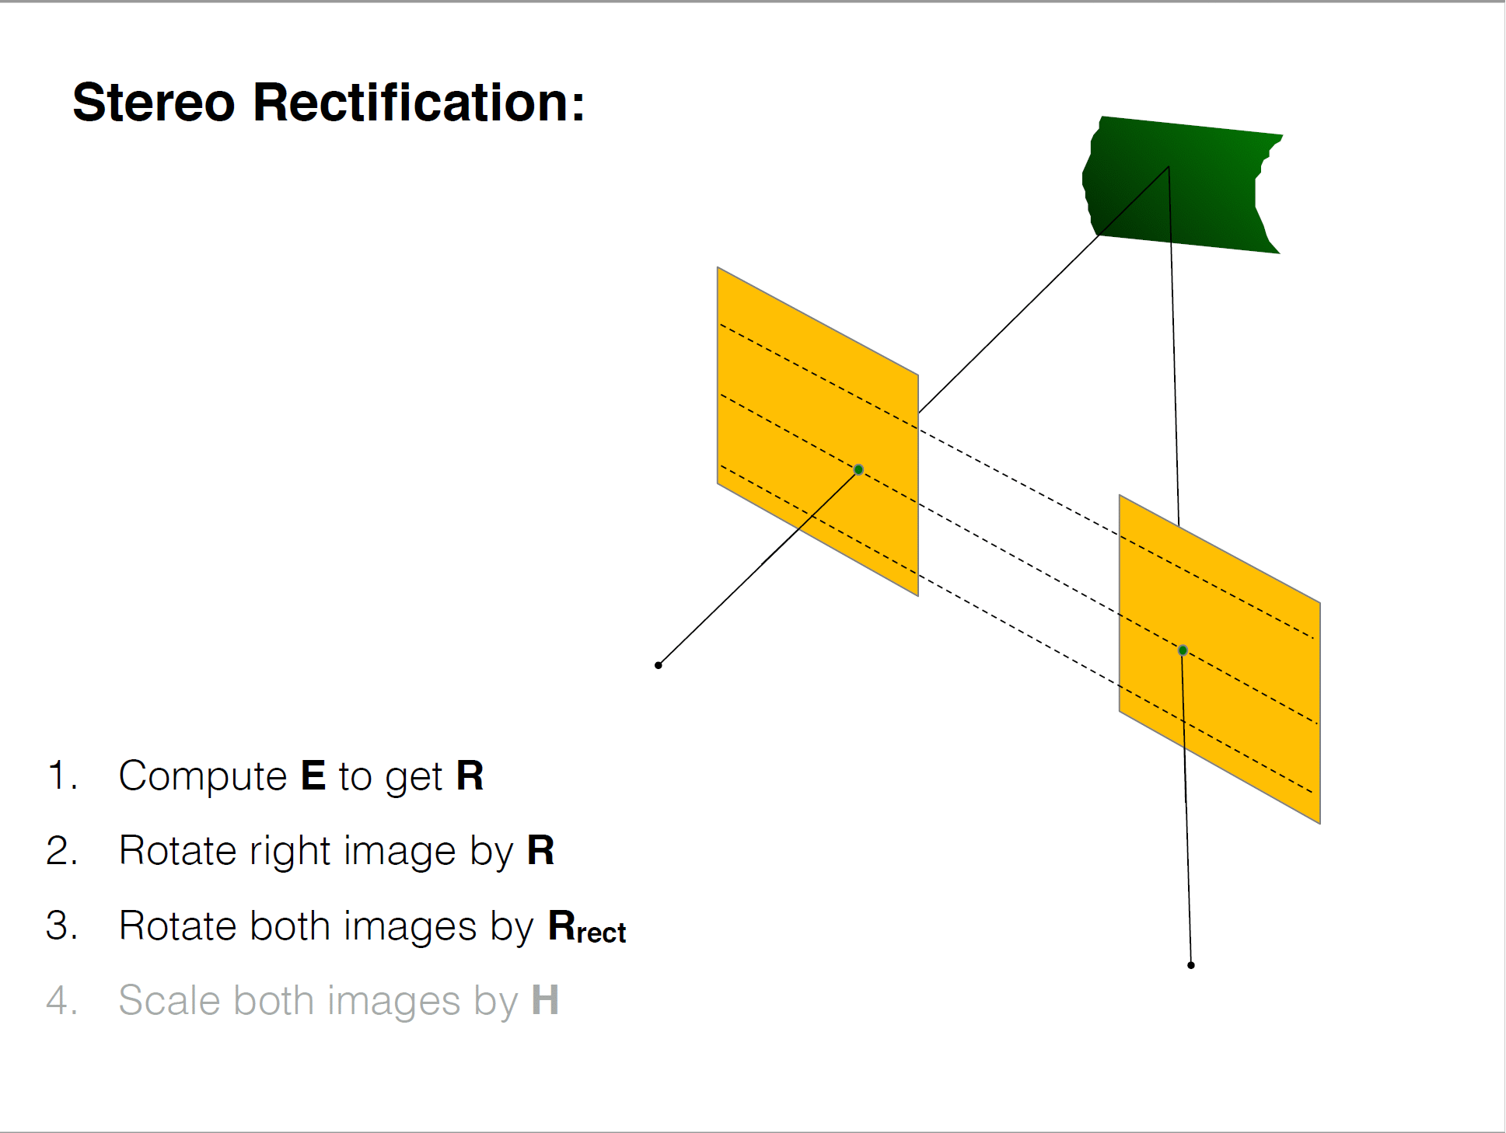

Slide 52
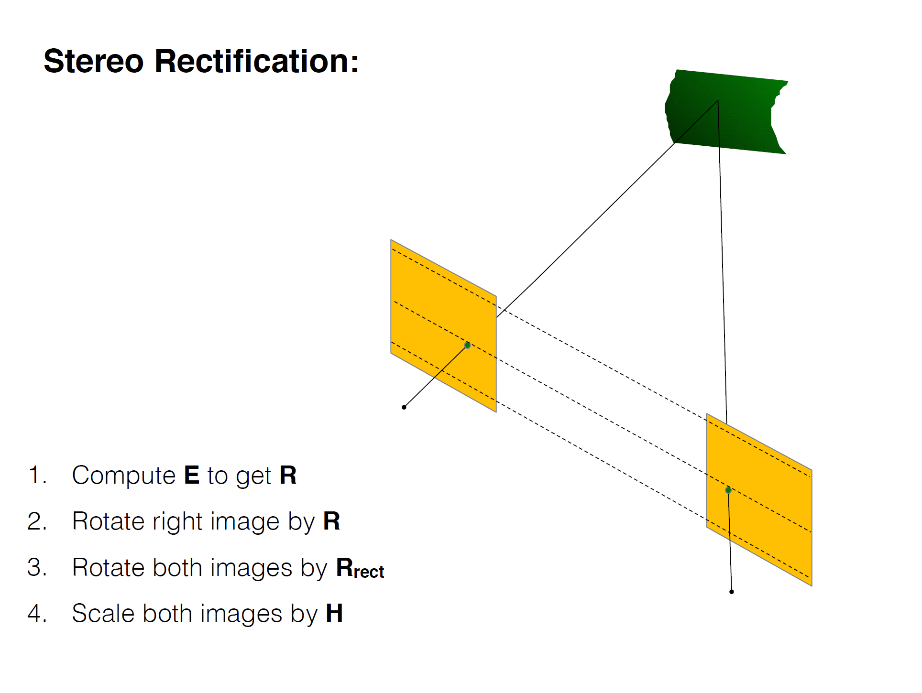

Slide 53
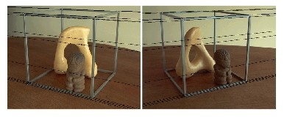
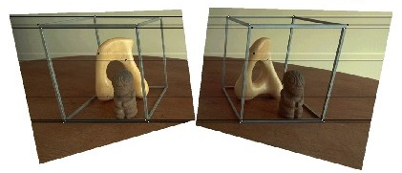
Rectification example

Slide 54
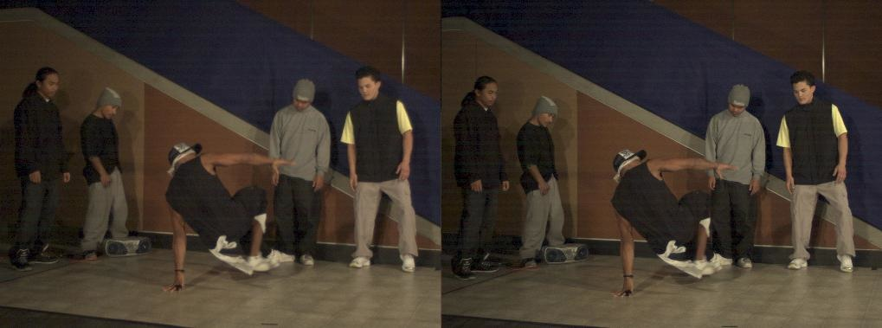
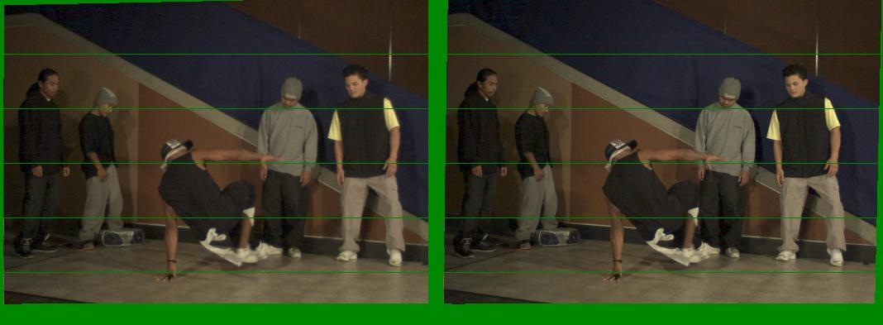
Another rectification example
Unrectified
Rectified

Slide 55
Basic stereo matching algorithm
If necessary, rectify the two stereo images to transform epipolar lines into scanlines
For each pixel in the first image
  Find corresponding epipolar line in the right image
  Examine all pixels on the epipolar line and pick the best match

Slide 56


Correspondence search
Left
Right
scanline
Matching cost
disparity
Slide a window along the right scanline and compare contents of that window with the reference window in the left image
Matching cost: SSD or normalized correlation

Slide 57
Correspondence search
Left
Right
scanline
SSD

Slide 58
Correspondence search
Left
Right
scanline
Norm. corr

Slide 59
Basic stereo matching algorithm
If necessary, rectify the two stereo images to transform epipolar lines into scanlines
For each pixel x in the first image
  Find corresponding epipolar scanline in the right image
  Examine all pixels on the scanline and pick the best match x’
  Triangulate the matches to get depth information

Slide 60
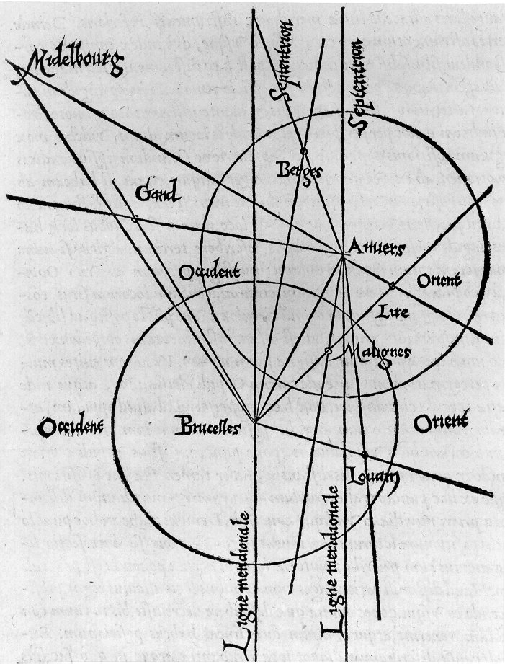
Triangulation: History
From Wikipedia: Gemma Frisius's 1533 diagram introducing the idea of triangulation into the science of surveying. Having established a baseline, e.g. the cities of Brussels and Antwerp, the location of other cities, e.g. Middelburg, Ghent etc., can be found by taking a compass direction from each end of the baseline, and plotting where the two directions cross. This was only a theoretical presentation of the concept — due to topographical restrictions, it is impossible to see Middelburg from either Brussels or Antwerp. Nevertheless, the figure soon became well known all across Europe.

Slide 61
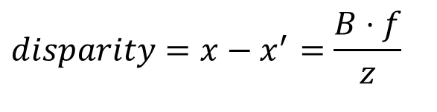
Depth from disparity
X
z
x
x’
f
B₁
B₂
f
O
Baseline
B
O’
$$disparity=x−x^{′}=\frac{B⋅f}{z}$$
Disparity is inversely proportional to depth!

Slide 62
Depth from disparity
X
z
x
x’
f
B
f
O
O’
$$disparity=x−x^{′}=\frac{B⋅f}{z}$$
B₁
B₂

Slide 63
Basic stereo matching algorithm
If necessary, rectify the two stereo images to transform epipolar lines into scanlines
For each pixel x in the first image
  Find corresponding epipolar scanline in the right image
  Examine all pixels on the scanline and pick the best match x’
  Compute disparity x–x’ and set depth(x) = B*f/(x–x’)

Slide 64


Failures of correspondence search
Textureless surfaces
Occlusions, repetition
Non-Lambertian surfaces, specularities

Slide 65


Effect of window size
W = 3
W = 20
  Smaller window
    More detail
    More noise
  Larger window
    Smoother disparity maps
    Less detail
Notes:
smaller window: more detail, more noise
bigger window: less noise, more detail

Slide 66



Results with window search
Data
Window-based matching
Ground truth

Slide 67
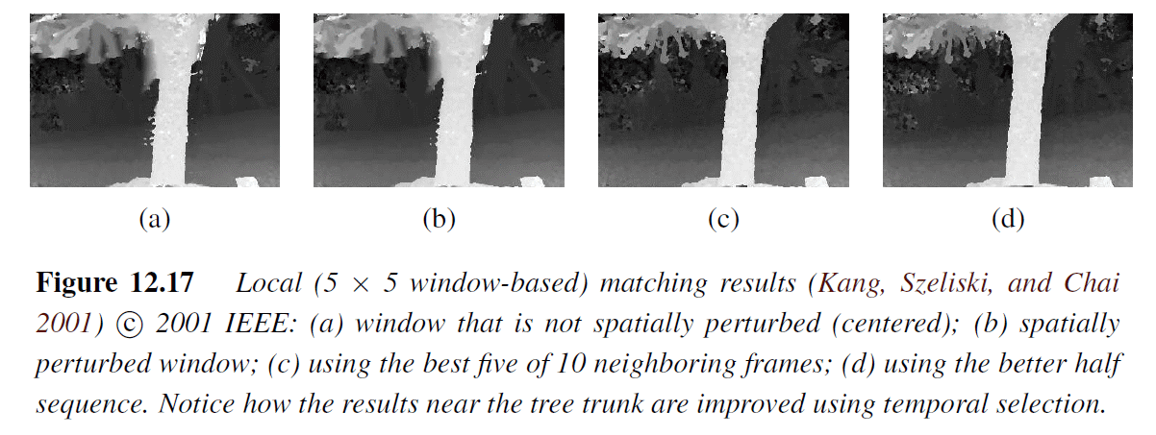
How can we improve window-based matching?
The similarity constraint is local (each reference window is matched independently)
Need to enforce non-local correspondence constraints
Spatial / Temporal Window Selection

Slide 68
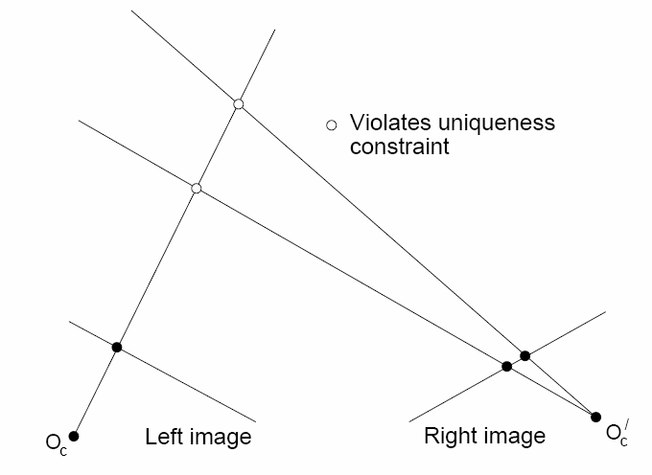
Non-local constraints
Uniqueness
  For any point in one image, there should be at most one matching point in the other image

Slide 69
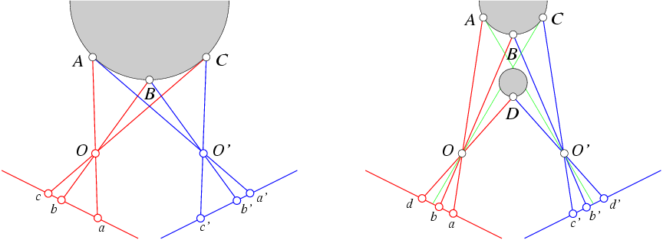
Non-local constraints
Uniqueness
  For any point in one image, there should be at most one matching point in the other image
Ordering
  Corresponding points should be in the same order in both views

Slide 70
Non-local constraints
Uniqueness
  For any point in one image, there should be at most one matching point in the other image
Ordering
  Corresponding points should be in the same order in both views
Ordering constraint doesn’t hold

Slide 71
Non-local constraints
Uniqueness
  For any point in one image, there should be at most one matching point in the other image
Ordering
  Corresponding points should be in the same order in both views
Smoothness
  We expect disparity values to change slowly (for the most part)

Slide 72
Scanline stereo
Try to coherently match pixels on the entire scanline
Different scanlines are still optimized independently
Left image
Right image

Slide 73







“Shortest paths” for scan-line stereo
Left image
$$I^{′}$$
Right image
$$I$$
$$S_{left}$$
Right
occlusion
$$C_{occl}$$
q
Left occlusion
correspondence
t
$$C_{occl}$$
$$C_{corr}$$
$$S_{right}$$
s
p
  Can be implemented with dynamic programming
  Ohta & Kanade ’85, Cox et al. ‘96
Slide credit: Y. Boykov

Slide 74
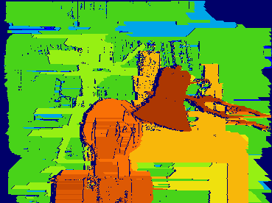
Coherent stereo on 2D grid
Scanline stereo generates streaking artifacts
Can’t use dynamic programming to find spatially coherent disparities/ correspondences on a 2D grid

Slide 75
Stereo matching as global optimization
I₁
I₂
D
W₁(i )
W₂(i+D(i ))
D(i )
data term
smoothness term
Energy functions of this form can be minimized using graph cuts
  Y. Boykov, O. Veksler, and R. Zabih, Fast Approximate Energy Minimization via Graph Cuts, PAMI 2001

Slide 76

Many of these constraints can be encoded in an energy function and solved using graph cuts
Before
Graph cuts
Ground truth
  Y. Boykov, O. Veksler, and R. Zabih, Fast Approximate Energy Minimization via Graph Cuts, PAMI 2001
    For good data set comparisons: http://www.middlebury.edu/stereo/

Slide 77
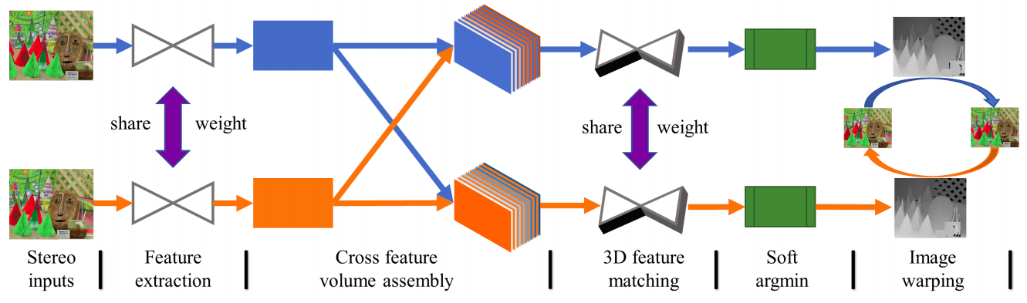
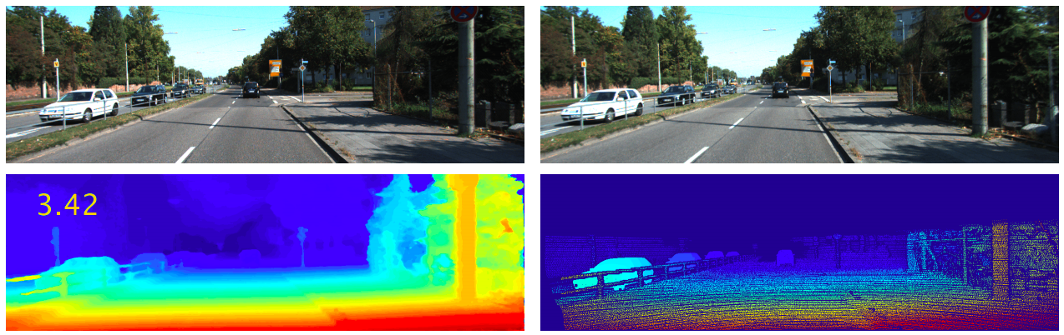
Stereo matching as a prediction problem
Y. Zhong, Y. Dai, and H. Li, Self-Supervised Learning for Stereo Matching with Self-Improving Ability, arXiv 2017

Slide 78
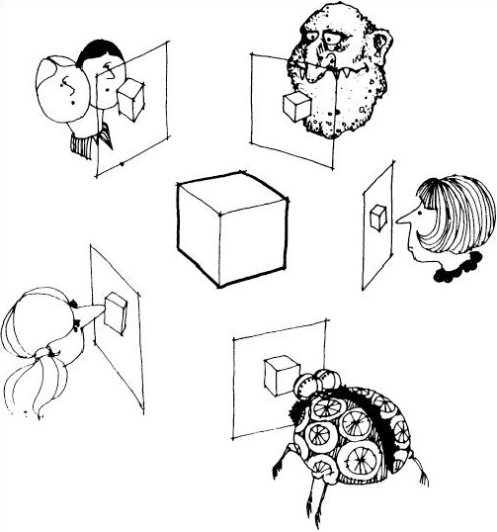
Multi-view stereo
Many slides adapted from S. Seitz, Y. Furukawa, N. Snavely

Slide 79
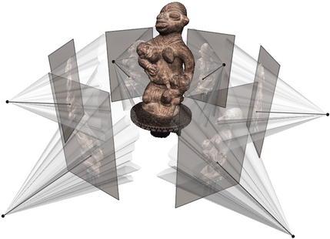
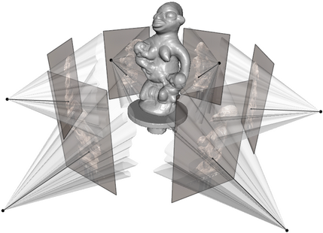
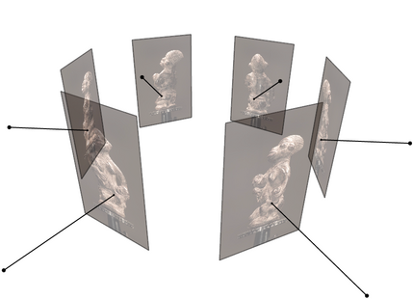
Multi-view stereo
Generic problem formulation: given several images of the same object or scene, compute a representation of its 3D shape
Source: C. Hernandez, N. Snavely

Slide 80
Multi-view stereo
Generic problem formulation: given several images of the same object or scene, compute a representation of its 3D shape
“Images of the same object or scene”
  Arbitrary number of images (from two to thousands)
  Arbitrary camera positions (special rig, camera network
  or video sequence)
  Calibration may be known or unknown
“Representation of 3D shape”
  Depth maps
  Meshes
  Point clouds
  Patch clouds
  Volumetric models
  ….

Slide 81
Why MVS?
Different points on the object’s surface will be more clearly visible in some subset of cameras
  Could have high-res closeups of some regions
  Some surfaces are foreshortened from certain views
  Some points may be occluded entirely in certain views
More measurements per point can reduce error
Source: N. Snavely

Slide 82





Source: N. Snavely

Slide 83
Source: N. Snavely

Slide 84
Estimated points contain some error.
Source: N. Snavely

Slide 85
Estimated points contain some error.
Source: N. Snavely

Slide 86
Estimated points contain some error.
Source: N. Snavely

Slide 87
Additional views reduce error.
Source: N. Snavely

Slide 88


Multiple-baseline stereo
M. Okutomi and T. Kanade, A Multiple-Baseline Stereo System, PAMI 1993

Slide 89



Multiple-baseline stereo
For each pixel in reference image, simultaneously compute matching scores w.r.t. all the other images
1/z
pixel matching score
1/z
M. Okutomi and T. Kanade, A Multiple-Baseline Stereo System, PAMI 1993

Slide 90


Multiple-baseline stereo
Use the sum of SSD scores to find the best depth
M. Okutomi and T. Kanade, A Multiple-Baseline Stereo System, PAMI 1993

Slide 91




Multiple-baseline stereo
I1
I2
I10
M. Okutomi and T. Kanade, A Multiple-Baseline Stereo System, PAMI 1993

Slide 92
Deep Learning Approaches to Stereo Depth Estimation

Slide 93

CVPR 2018
A novel semi-supervised learning approach to training a deep stereo neural network
A novel architecture containing a machine-learned argmax layer
A custom runtime that enables a smaller version of our stereo DNN to run on an embedded GPU
Competitive results are shown on the KITTI 2015 stereo dataset
Evaluate the recent progress of stereo algorithms: measure impact on accuracy of various design criteria

Slide 94

Binocular Stereo Network
Similar to traditional Global Matching methods but with Learned Features
Semi-supervised because Photometric error between left-right images is used in the Loss function

Slide 95
Binocular Stereo Network : Highlights
Feature Extraction:
  ResNet-18 working on half resolution inputs to create an H/2 x W/2 x F (=32) Tensor
Cost Volume:
  Sweep the disparity range with left-to-right and right-to-left disparity matching
  Creates H/2 x W/2 x 2F x D/2 cost volumes
Matcher:
  3D Coder/Decoder network to compute matches while sharing weights for L-R and R-L matching
  Upsampling to produce H x W x D x 1 Left and Right Tensors as the final matching costs between the two images

Slide 96
Binocular Stereo Network : Highlights
ML-Argmax:
  Do not use Soft argmax because semi-local context may not have been fully exploited by previous layers
  Sequence of 2D Convolutions with shared weights for L-R and R-L matching costs
  Produce a single value for each pixel after passing through a sigmoid
Claim that ML-Argmax is better at handling uniform or multimodal probability distributions than soft argmax.
Yields more stable convergence during training

Slide 97










Binocular Stereo Network : Loss Function
Supervised with Sparse Lidar Ground Truth + Self-supervised via L-R / R-L Photometric consistency with D-warps
Photometric Consistency:
Warp R with left disparity and L with right disparity :
Correlation between L and Warped-R and R & Warped-L :
Minimize errors between estimates and sparse Lidar data:
Left-Right disparity consistency check:
Prefer piecewise smooth disparities:

Slide 98

Improvements vis-à-vis Mono and Lidar only
%age of Outliers: Error at least 3 disparity levels or at least 5% [Lower is better]
Best results are obtained by combining Supervised Lidar Loss with Self-Supervised Photometric Loss
Photometric and LIDAR data complement each other:
  LIDAR is accurate at all depths, but its sparsity leads to blurrier results, and it misses the fine structure
  Photometric consistency allows the network to recover fine-grained surfaces but suffers from loss in accuracy as depth increases

Slide 99

Improvements vis-à-vis Mono and Lidar only
Supervised (LIDAR) : Too Smooth
Unsupervised (Photometric) : Noisy with Distance but
Preserves Thins Structures
Hybrid (Both)

Slide 100

ECCV 2018
End-to-end deep learning architecture for depth map inference from multi-view images
Framework flexibly adapts arbitrary N-view inputs using a variance-based cost metric that maps multiple features into one cost feature

Slide 101

MVSNet
Input : One reference image and several source images
Infers the depth map for the reference image.
Key insight : Differentiable homography warping operation that implicitly encodes camera geometries in the network to build the 3D cost volumes from 2D image features and enables the end-to-end training
To adapt arbitrary number of source images, variance-based metric to map multiple features into one cost feature

Slide 102

MVSNet : Components
Image Features: Extract deep features of the N input images for dense matching.
  Eight-layer 2D CNN : Outputs are N 32-channel feature maps downsized by four in each dimension vs. input images.
Cost Volume: All feature maps are warped into different fronto-parallel planes to form N feature volumes
  Warping is for the corresponding Homography between the Reference and the ith image
Cost Metric: Aggregate multiple feature volumes into one cost volume C
  V = W/4 x H/4 x D x F
Cost Volume Regularization: Multi-scale 3D CNN similar to UNet ➔ Softmaxed 1-channel probability volume

Slide 103


MVSNet : Components
Depth Map : Probability weighted sum over all hypotheses
Quality of depth: Probability sum over the four nearest depth hypotheses
Depth Map Refinement: Depth residual learning network at the end of MVSNet
Loss:

Slide 104

MVSNet : Results
Depth Refinement using Photo Consistency and L-R R-L Disparity consistency check
Depth Map Fusion

Slide 105

MVSNet : Results

Slide 106

Stereo datasets
Middlebury stereo datasets
KITTI
Synthetic data?

Slide 107


Active stereo with structured light
Project “structured” light patterns onto the object
  Simplifies the correspondence problem
  Allows us to use only one camera
camera
projector
L. Zhang, B. Curless, and S. M. Seitz. Rapid Shape Acquisition Using Color Structured Light and Multi-pass Dynamic Programming. 3DPVT 2002

Slide 108

Active stereo with structured light
L. Zhang, B. Curless, and S. M. Seitz. Rapid Shape Acquisition Using Color Structured Light and Multi-pass Dynamic Programming. 3DPVT 2002

Slide 109
Active stereo with structured light
http://en.wikipedia.org/wiki/Structured-light_3D_scanner

Slide 110


Kinect: Structured infrared light
http://bbzippo.wordpress.com/2010/11/28/kinect-in-infrared/

Slide 111


Apple TrueDepth
https://www.cnet.com/news/apple-face-id-truedepth-how-it-works/

Slide 112

Laser scanning
Digital Michelangelo Project
Levoy et al.
http://graphics.stanford.edu/projects/mich/
Optical triangulation
  Project a single stripe of laser light
  Scan it across the surface of the object
  This is a very precise version of structured light scanning
Source: S. Seitz

Slide 113

Laser scanned models
  The Digital Michelangelo Project, Levoy et al.
Source: S. Seitz

Slide 114

Laser scanned models
  The Digital Michelangelo Project, Levoy et al.
Source: S. Seitz

Slide 115

Laser scanned models
  The Digital Michelangelo Project, Levoy et al.
Source: S. Seitz

Slide 116

Laser scanned models
  The Digital Michelangelo Project, Levoy et al.
Source: S. Seitz

Slide 117

Laser scanned models
1.0 mm resolution (56 million triangles)
  The Digital Michelangelo Project, Levoy et al.
Source: S. Seitz

Slide 118

Aligning range images
A single range scan is not sufficient to describe a complex surface
Need techniques to register multiple range images
B. Curless and M. Levoy, A Volumetric Method for Building Complex Models from Range Images, SIGGRAPH 1996

Slide 119


Hybrid Stereo Camera
An IBR Approach for Synthesis of Very High Resolution Stereo Image Sequences

Slide 120

Limitations on IMAX 3D Content Creation
Live Action Content
Camera is very large.
Requires two strips of large format film.
Size of camera and cost of film limits production.
CG Content
6-14 hours rendering time per frame !
70 mm
15 perforations

Slide 121
Solution: Hybrid Stereo Camera
Digital Camera taking lens
Film Camera taking lens
Digital Camera
Camera Electronics
Film Camera and Film Magazine
Removable Disk Array

Slide 122
Hybrid Stereo Camera
... pure upsampling is not an option ...
INPUT
OUTPUT
1:16
Left Eye
(1.5K)
Right Eye
(6K)
Left Eye
(6K)
Right Eye
(6K)

Slide 123

Live Action Sequence

Slide 124


Live Action : Hybrid Input
Left
Right

Slide 125

Live Action : Hybrid Input

Slide 126
How can the Hybrid Camera be Realized ?
Render the High-Res content
into the coordinate system
of the Low-Res Frame !
t
Left Eye
?
?
Right Eye
t-2
t-1
t
t+1
t+2

Slide 127



Establishing Stereo/Motion Correspondences
A
n
a
l
y
s
I
s
Left Eye
Time t
Right Eye
Time t, t’
Synthesis

Slide 128




Synthesis vs. Up-resing : Live Action

Slide 129




Synthesis vs. Up-resing : CG Animation

Slide 131
Thanks !
This was fun!

