Slide 1
Manipulating and Understanding Images via Edges, Features and Alignment
Harpreet S Sawhney
Microsoft / Vision & Mixed Reality
May 7th and 12th , 2020

Slide 2
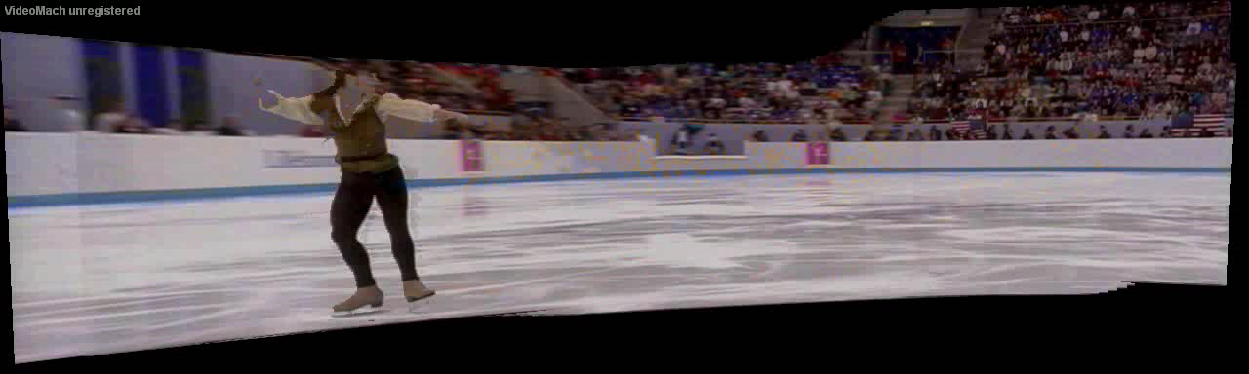
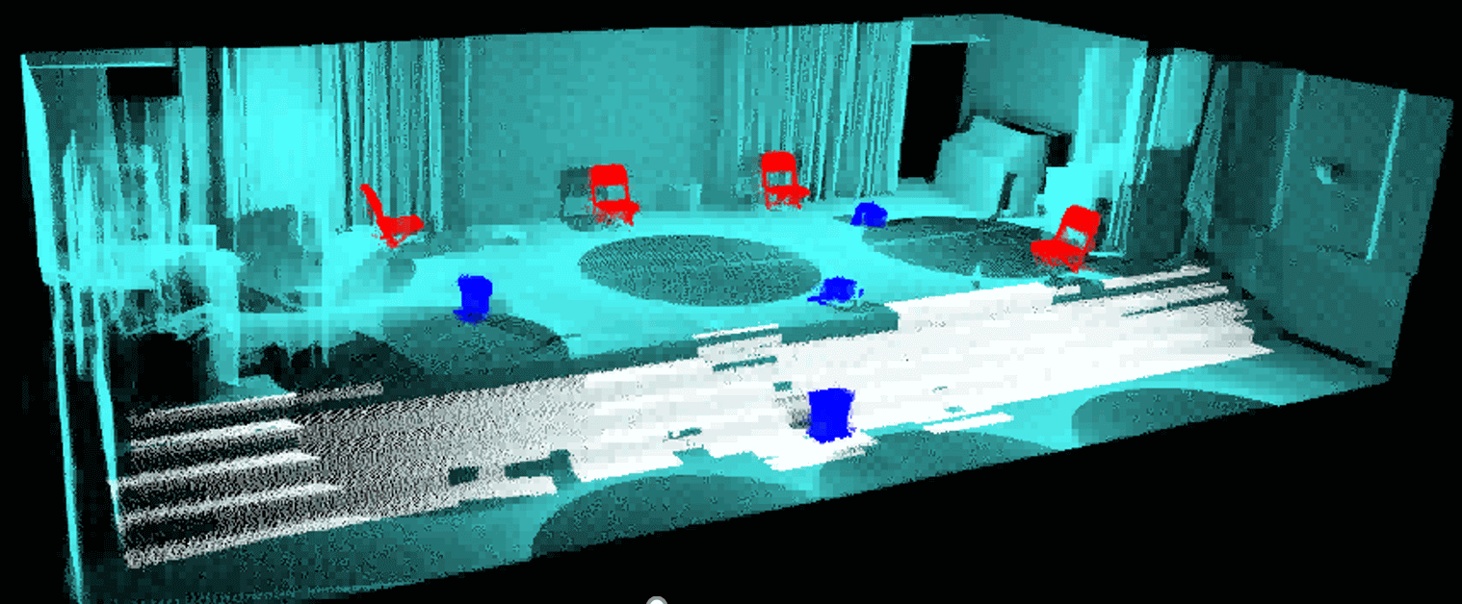
(Dynamic) Images Afford Two Types of Inferences
Inferences on scene content without object identity
Frame-to-frame motions
Foreground/background and independent object motions
3D structure / 2-2.5D layers
…
Inferences on scene content involving object identity
  Object/event recognition
  Object/scene classification
  Object/scene fingerprinting
  Extended space-time tracking
  …

Slide 3
A Bit of Historical Perspective : My Work
Dynamic Images Afford Two Types of Inferences
Analysis / Manipulation of scene content without object / scene identity
  Pixels In ➔ Pixels Out
  Stabilization, Mosaicking, 3D Structure,…
Inferences on scene content involving scene /object / event identity
  Pixels In ➔ Decisions / Labels Out
  Model-based object/event recognition
  Object/scene classification
  Object/scene fingerprinting
  Extended space-time tracking
  Multi-modal Video Analysis

Slide 4





(Dynamic) Images Afford Two Types of Inferences
Inferences on scene content without object identity
  Frame-to-frame motions
  Foreground/background and independent object motions
  3D structure / 2-2.5D layers
  …
Inferences on scene content involving object identity
  Model-based object/event recognition
  Object/scene classification
  Object/scene fingerprinting
  Extended space-time tracking
  …

Slide 5
Plan of Two Lectures : May 7th (and 12th )
Why and How of Edges in Images
Why Image / Video Alignment and Matching
A Swift Primer on Sum of Squares Optimization and Fitting
Short Range Matching with Patches
Image Transformations and Robust Fitting with RANSAC

Slide 6
Plan of Two Lectures : May 12th
Long Range Matching
  Quasi-Invariant Feature Detectors and Descriptors: SIFT, HOG
Location and Image based Object Instance Retrieval
Learned Features through Metric Learning with CNNs
Long Range Matching and Localization : Contrast between Hand-crafted and Learned Features
Take Home Lessons

Slide 7
What do edges tell us about the Physical World?

Slide 8
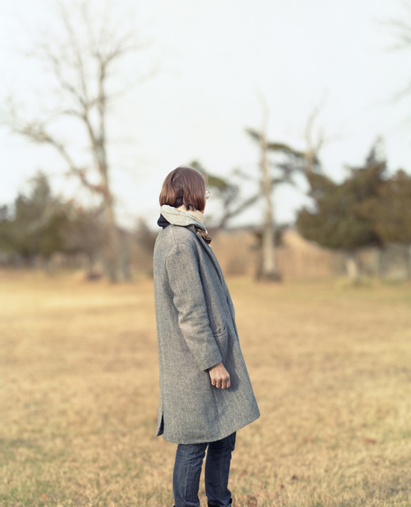
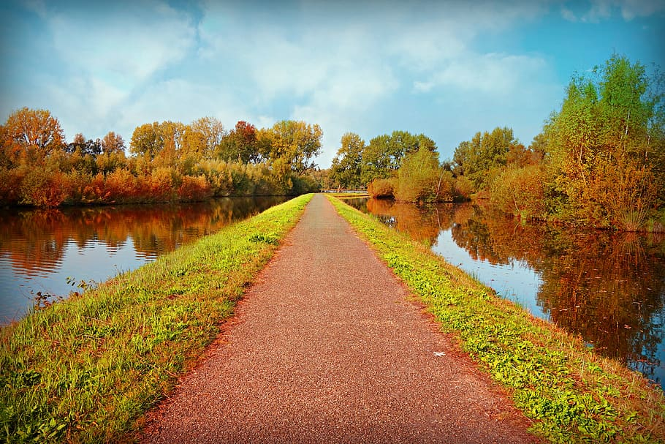
Figure-Ground
3D Perception

Slide 9


Why do we care about edges?
Extract information, recognize objects
Recover geometry and viewpoint
Vertical vanishing
point
(at infinity)
Vanishing
line
Vanishing
point
Vanishing
point

Slide 10
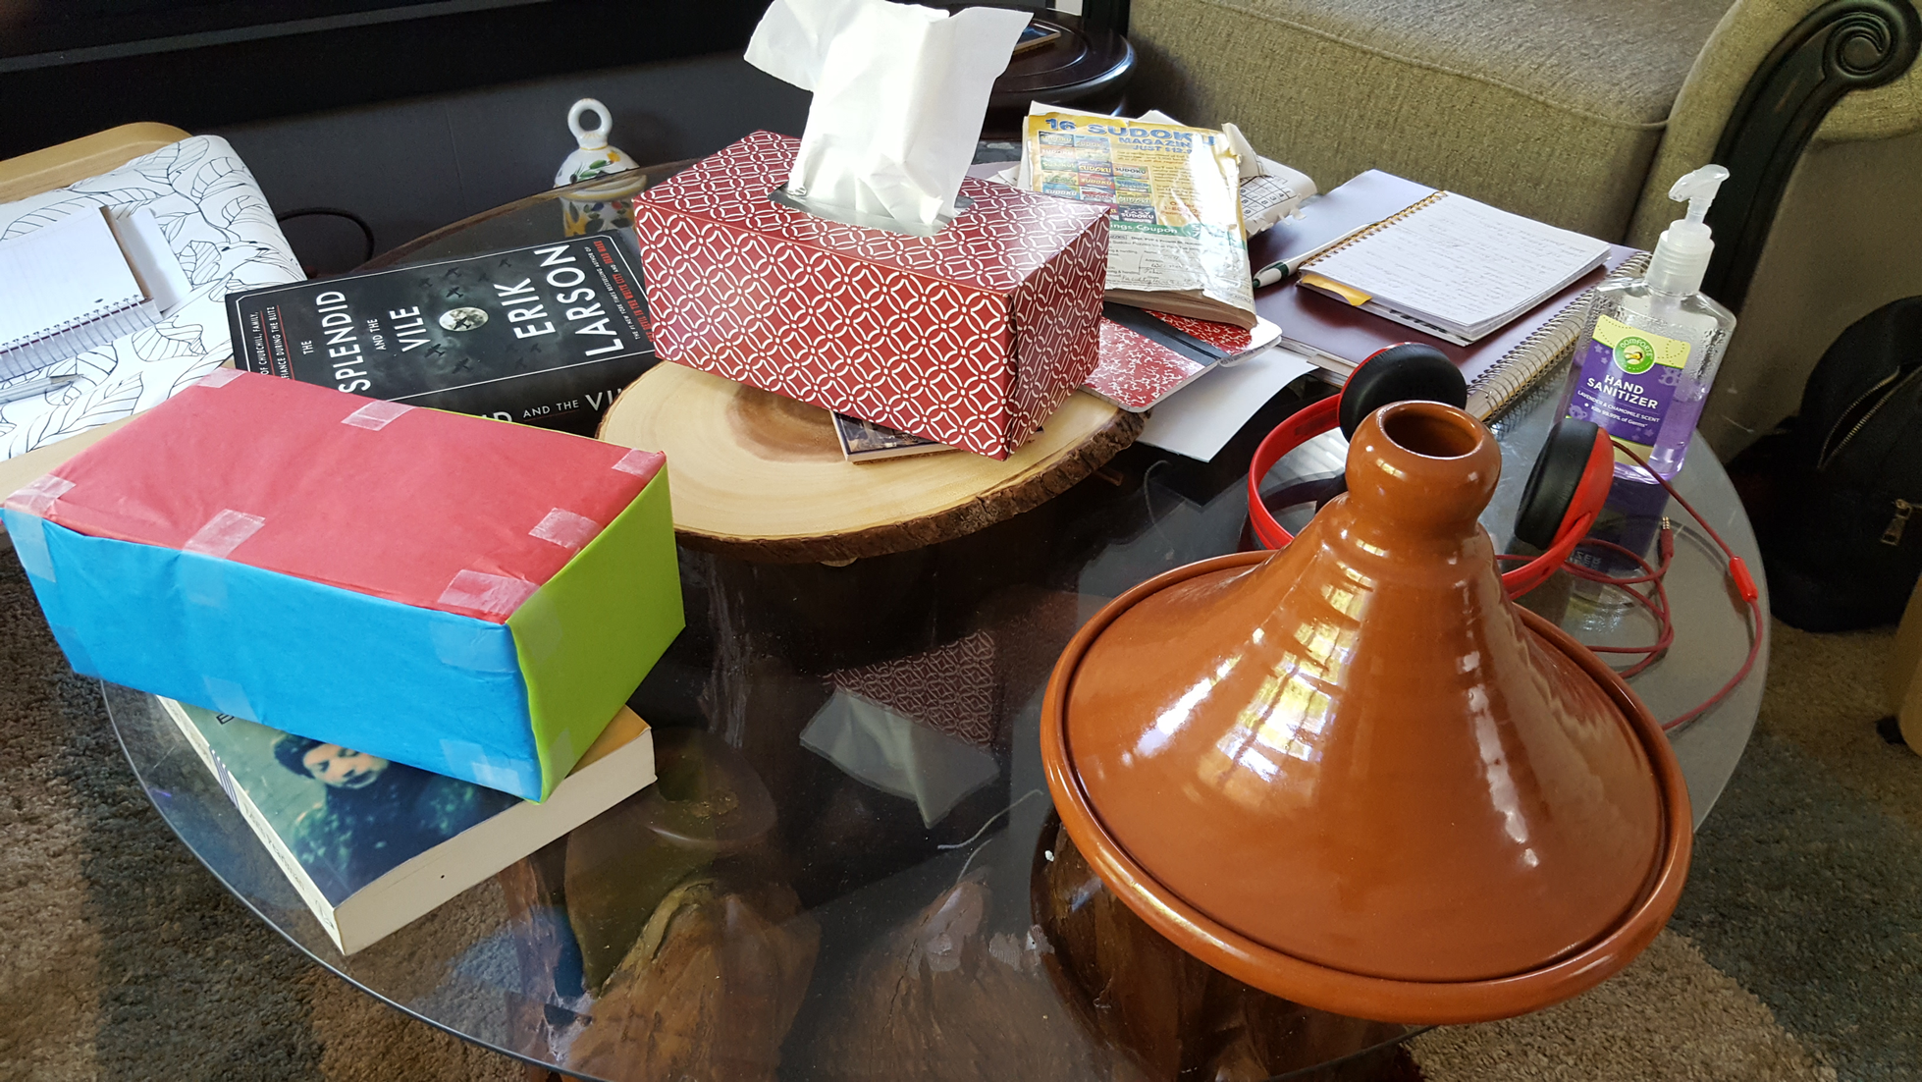
Notes:
We perceive boundaries rather than edges. Edges are historically computational entities that are correlated with various types of boundaries.

Slide 11
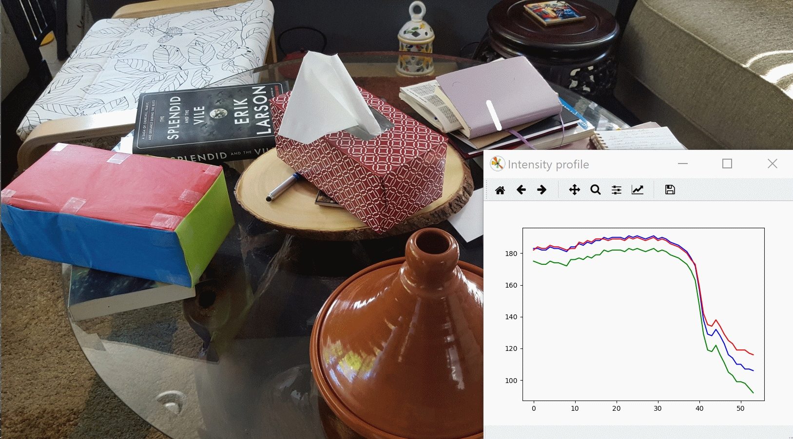
Edges have Physical / Geometric causes
Orientation Discontinuity

Slide 12

Edges have Physical / Geometric causes
Surface Albedo Changes

Slide 13
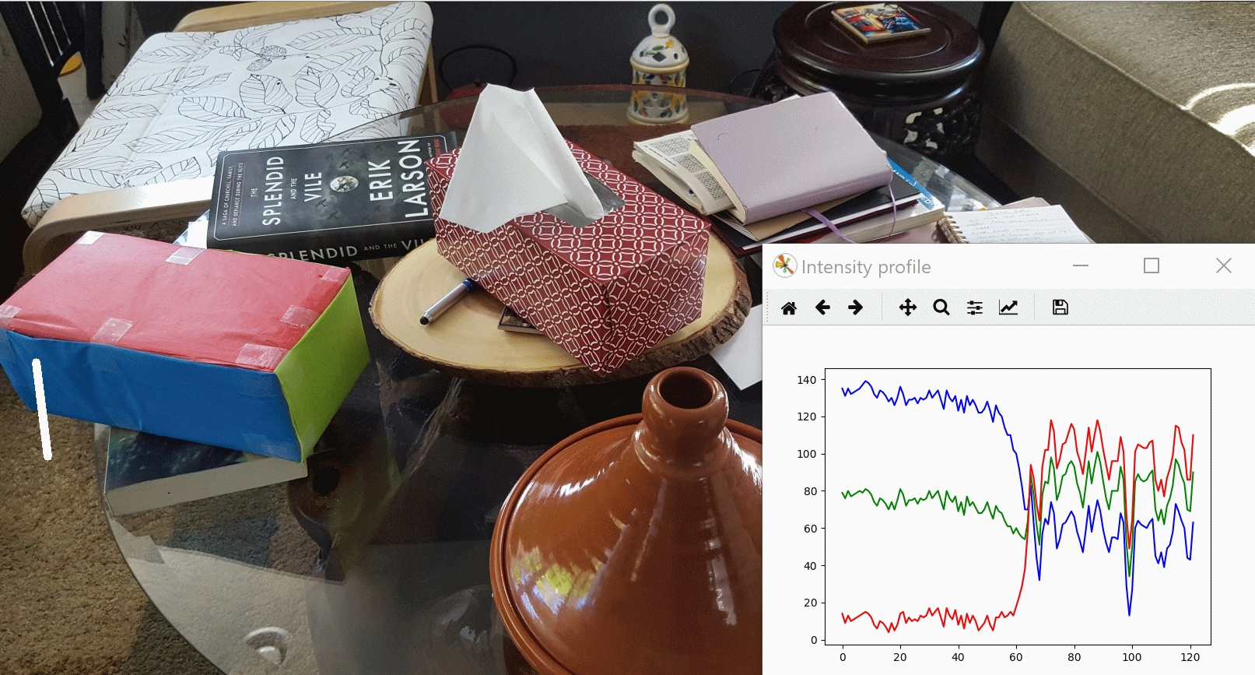
Edges have Physical / Geometric causes
Texture Change

Slide 14
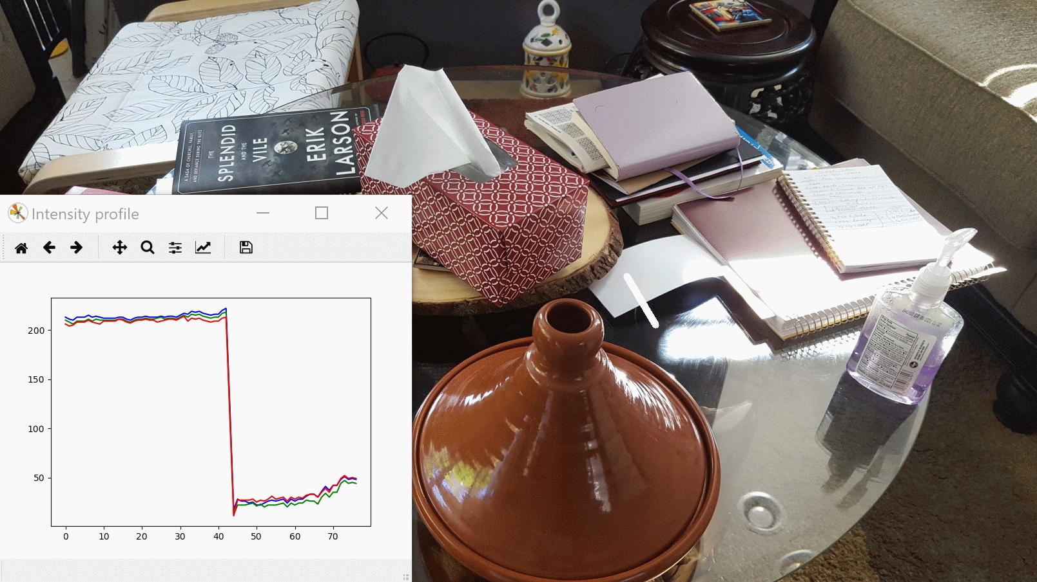
Edges have Physical / Geometric causes
Shadow Edge

Slide 15
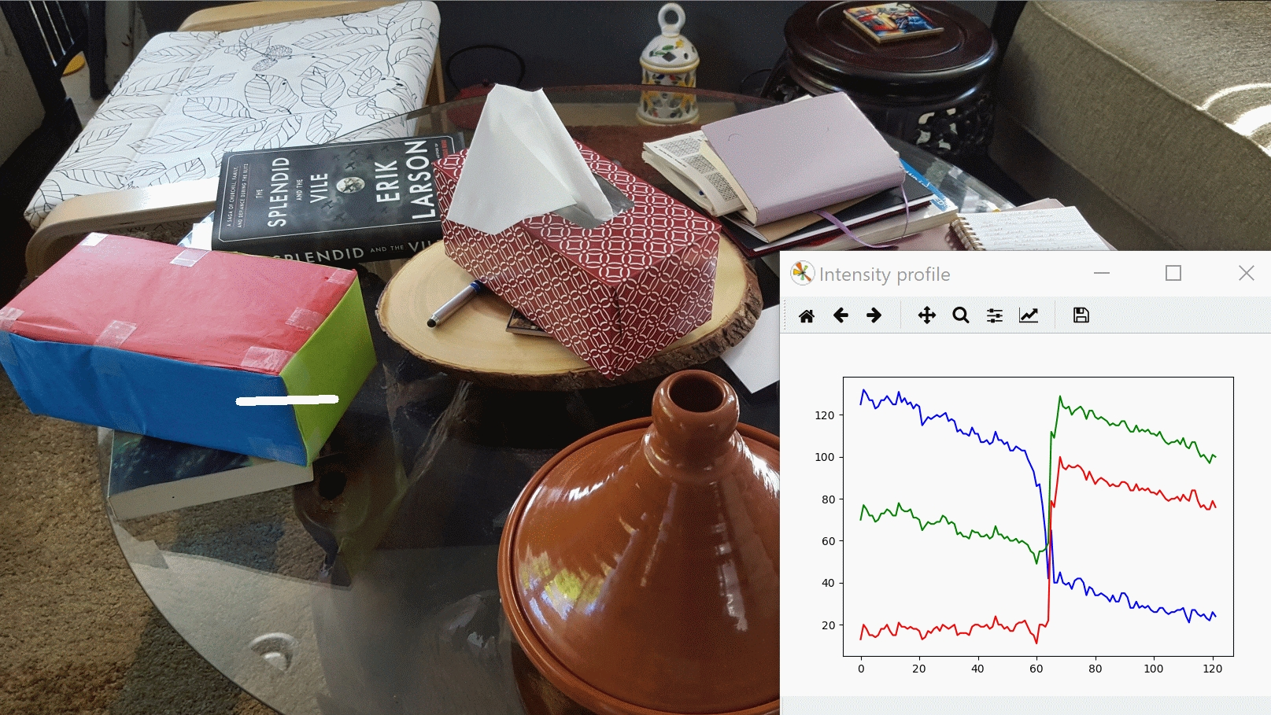
Edges have Physical / Geometric causes
Color Change

Slide 16
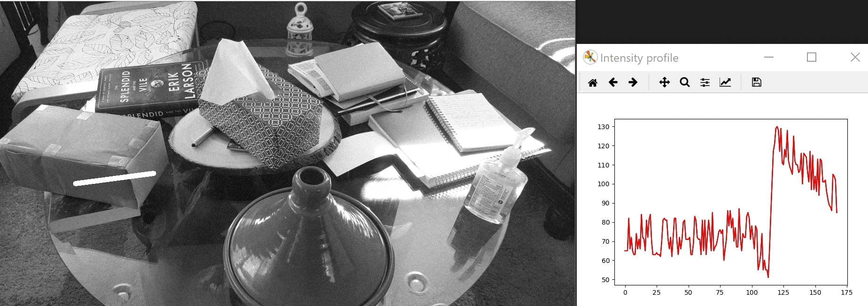
Edges have Physical / Geometric causes
Noisy Edge

Slide 17
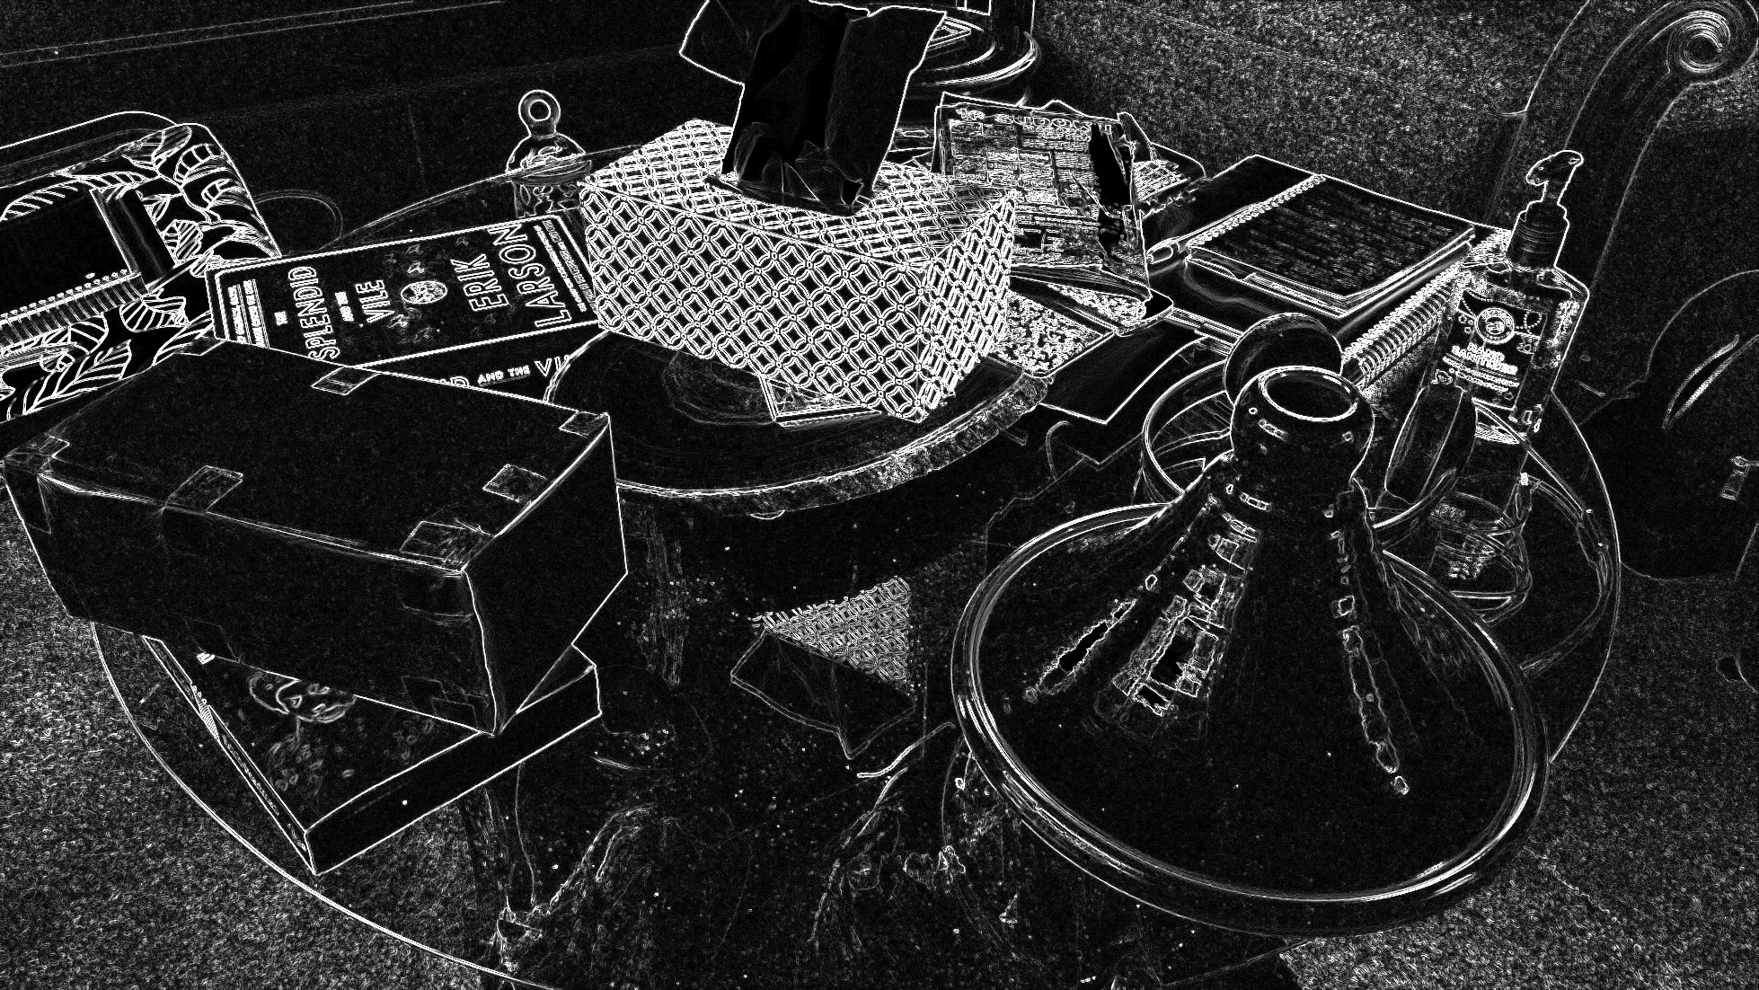

Slide 18

Origin of Edges
surface normal discontinuity
depth discontinuity
surface color discontinuity
illumination discontinuity
Edges are caused by a variety of factors
Source: Steve Seitz

Slide 19


Subjective Contours: 3D Perception / Perceptual Organization

Slide 20
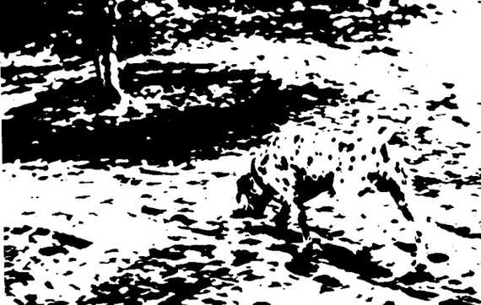
Complex Subjective “Contours”
High-Level meets Low-Level ?

Slide 21
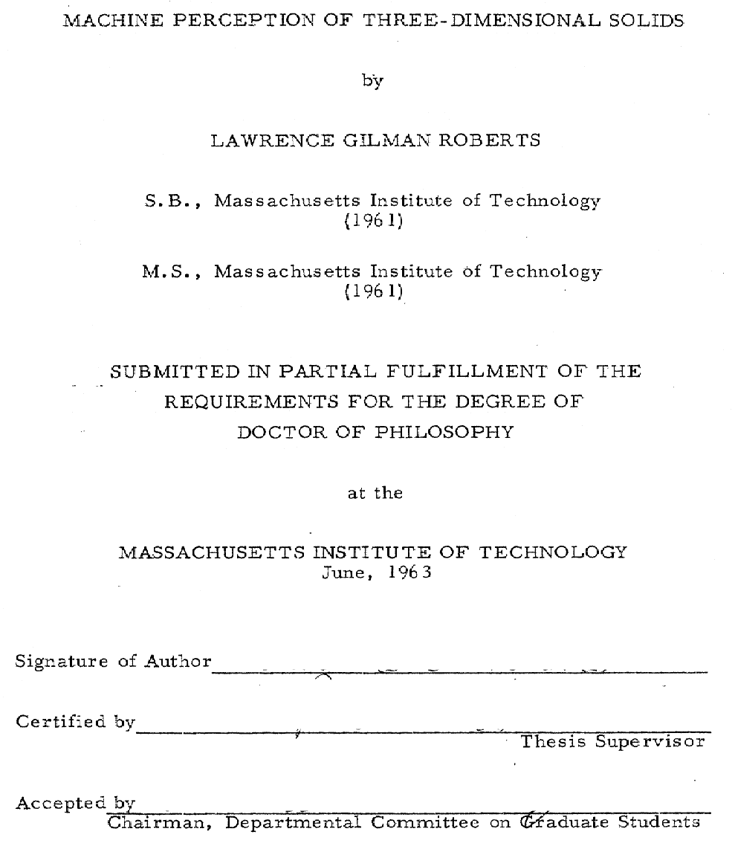
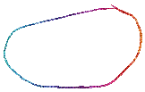
Early Work In Computer Vision: Interpretation of Line Drawings as 3D

Slide 22
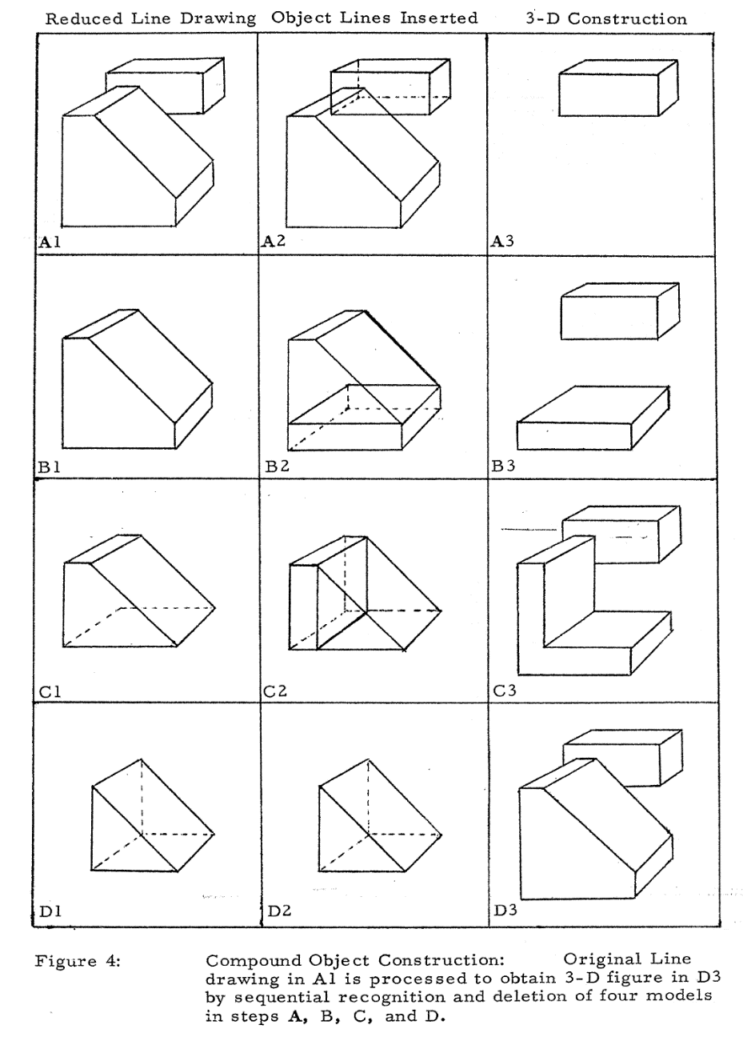






Machine Perception of 3D Solids

Slide 23
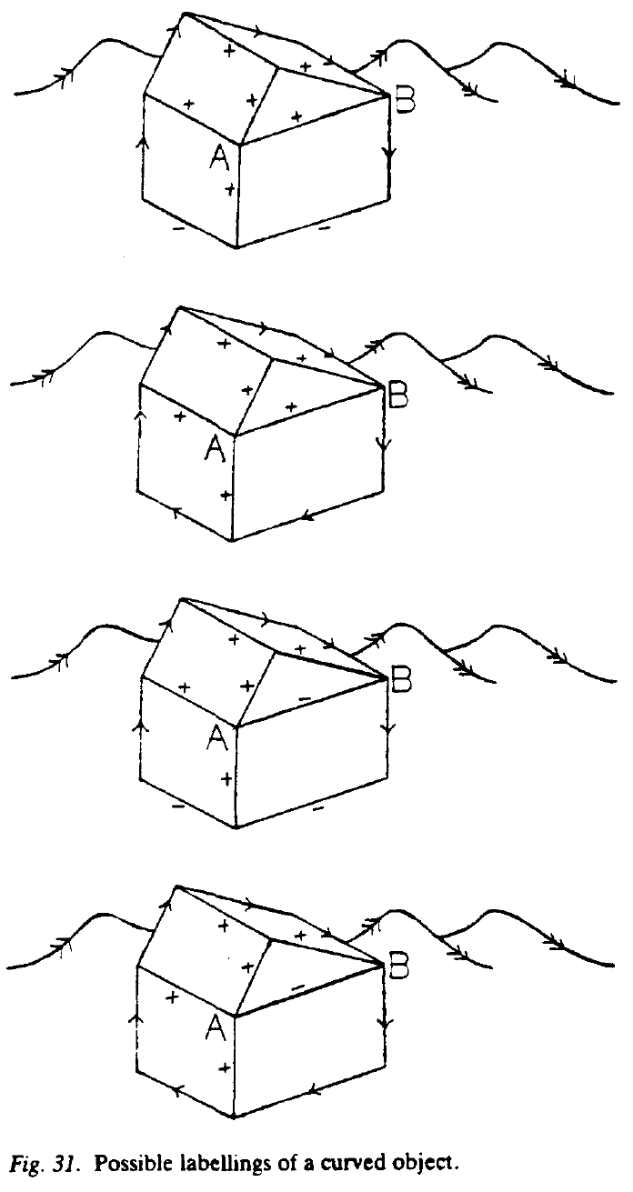
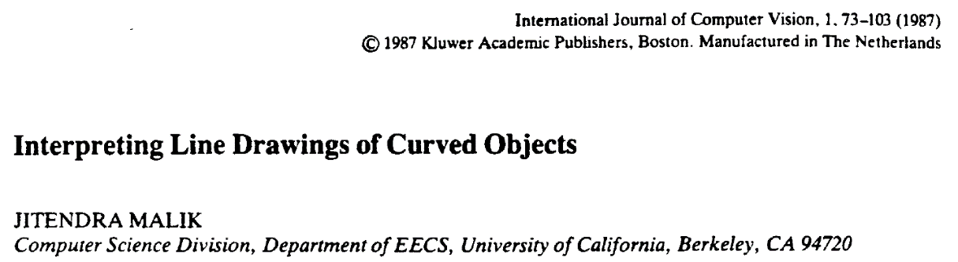
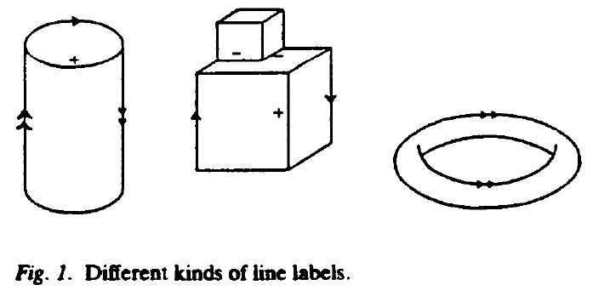
“+” label represents a convex edge
“-” label represents a concave edge
or a represents an occluding convex edge
or a represents a limb

Slide 24
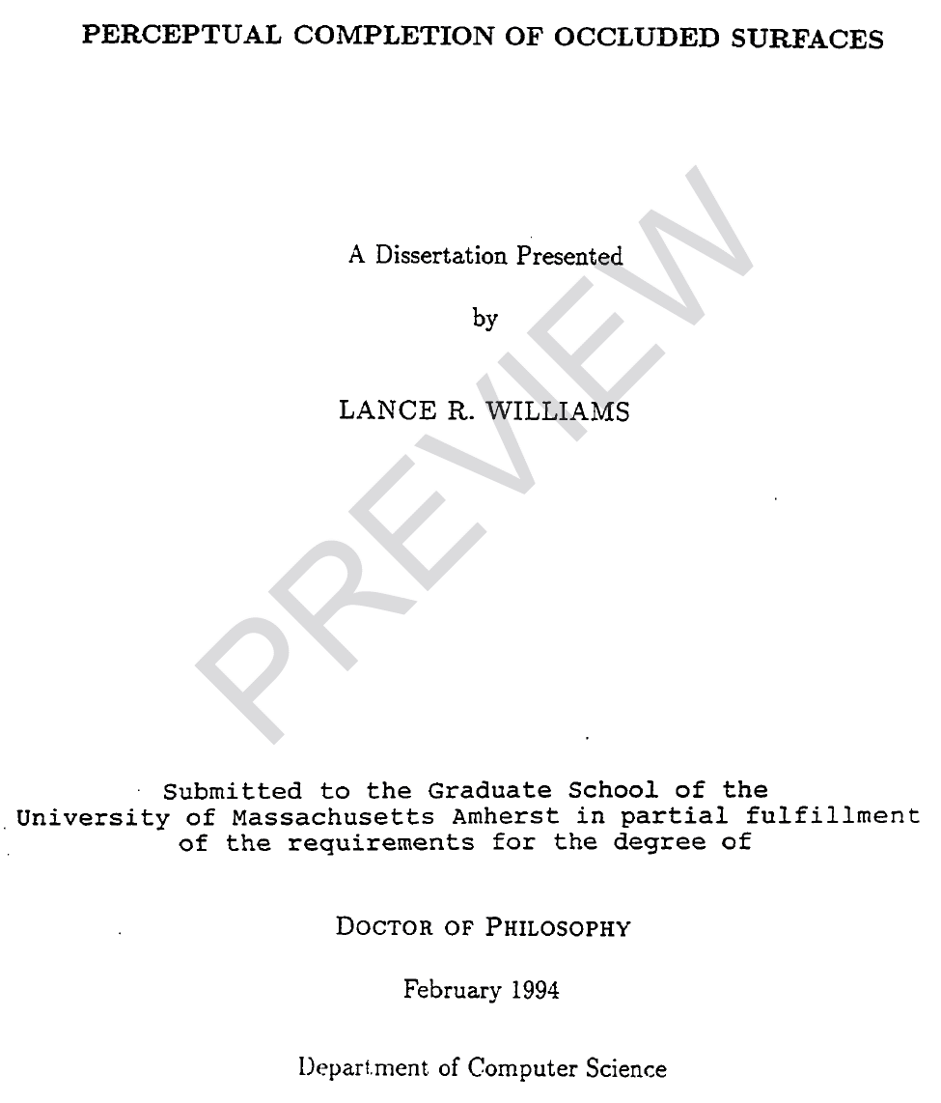
Perceptual Organization
We evolved to infer the World as 3D because you do not want to mistake a tiger in the bushes as a painting on the Wall!
Perceptual Organization makes sense the World as Figure-Ground / 3D Percepts
Perceptual Organization (Lance’s view)
Perceptual organization is the process of deriving the topological component of a representation of visible and partially occluded surfaces.
The topological component is represented using labeled knot diagrams.
Labeled knot diagrams can be derived from images through a process of figural completion.

Slide 25

Edges correspond to changes in image intensities
On a discrete pixel grid as above:

Slide 26





Computing Edges via Derivatives on a Pixel Grid: 1D Case for Simplicity
-2
-1
0
1
2
x
$$f_{x}\left(0\right)$$
-1
1
Two Approximations:
$$f_{x}\left(0\right)$$
-1
0
1

Slide 27
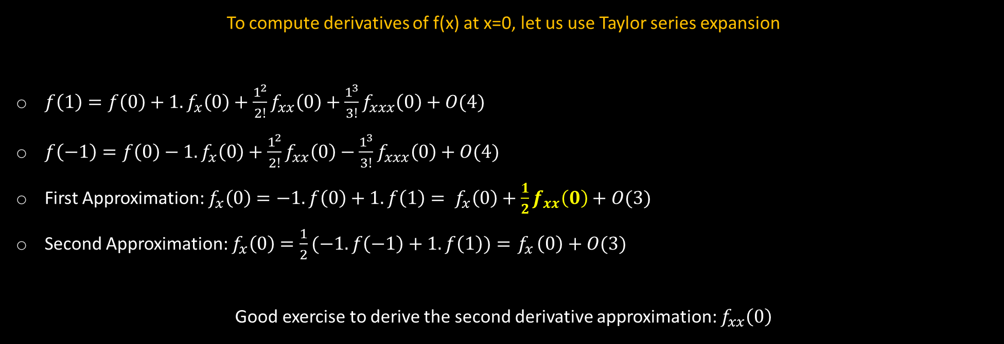
Computing Edges via Derivatives on a Pixel Grid: 1D Case for Simplicity
-2
-1
0
1
2
x
$$f_{x}\left(0\right)$$
-1
1
Two Approximations:
$$f_{x}\left(0\right)$$
-1
0
1
To compute derivatives of f(x) at x=0, let us use Taylor series expansion
$f\left(1\right)=f\left(0\right)+1.f_{x}\left(0\right)+\frac{1^{2}}{2!}f_{xx}\left(0\right)+\frac{1^{3}}{3!}f_{xxx}\left(0\right)+O(4)$
$f\left(−1\right)=f\left(0\right)−1.f_{x}\left(0\right)+\frac{1^{2}}{2!}f_{xx}\left(0\right)−\frac{1^{3}}{3!}f_{xxx}\left(0\right)+O(4)$
First Approximation: $f_{x}\left(0\right)$ $=−1.f\left(0\right)+1.f\left(1\right)= f_{x}\left(0\right)+\frac{1}{2}f_{xx}\left(0\right)+O(3)$
Second Approximation: $f_{x}\left(0\right)$ $=\frac{1}{2}(−1.f\left(−1\right)+1.f\left(1\right))={ f}_{x}\left(0\right)+O(3)$
Good exercise to derive the second derivative approximation: $f_{xx}\left(0\right)$

Slide 28
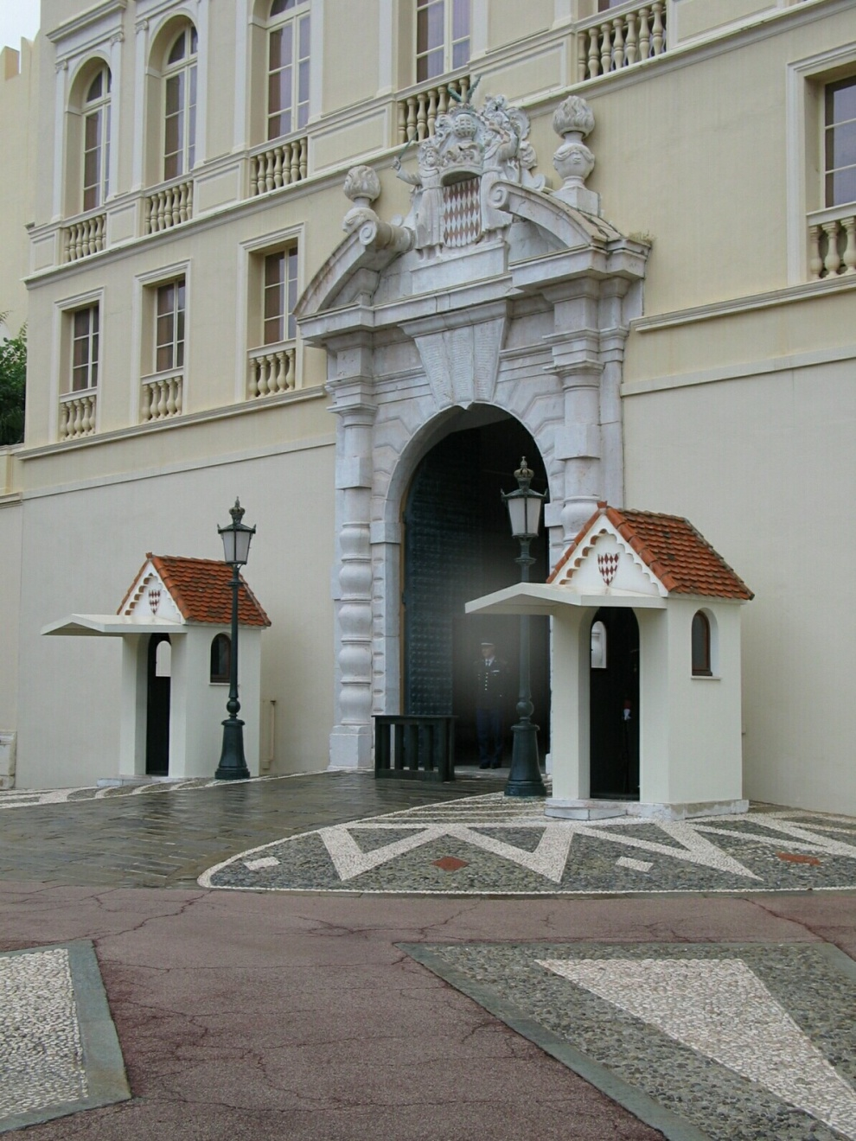
Closeup of edges
via DerekHoiem

Slide 29

Closeup of edges
via DerekHoiem

Slide 30

Closeup of edges
via DerekHoiem

Slide 31

Closeup of edges
via DerekHoiem

Slide 32

Characterizing edges
An edge is a place of rapid change in the image intensity function
intensity function
(along horizontal scanline)
image
first derivative
edges correspond to
extrema of derivative
via DerekHoiem

Slide 33
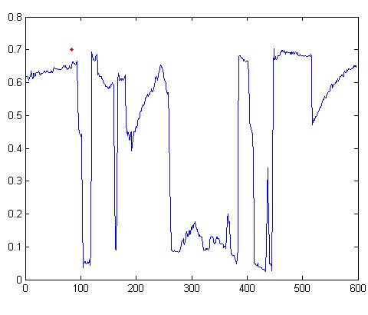

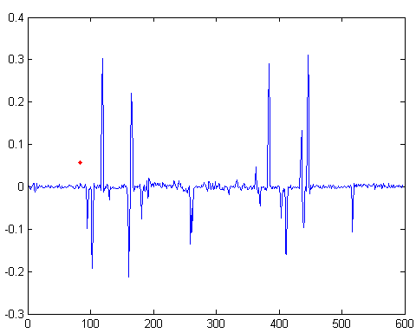
Intensity profile
Intensity
Gradient
via DerekHoiem

Slide 34
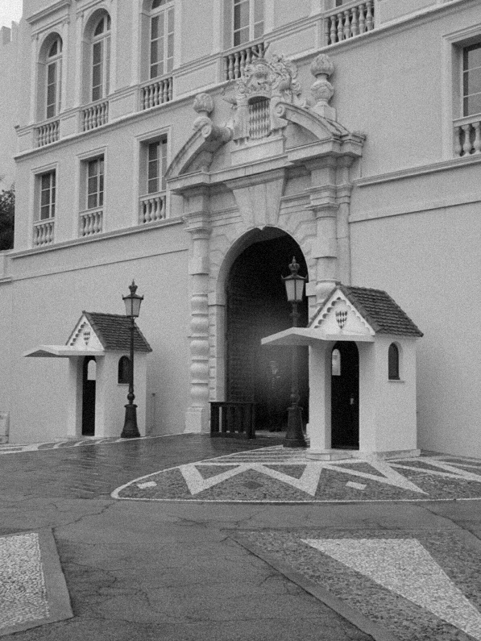
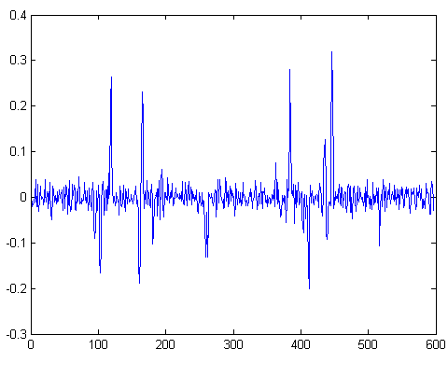
With a little Gaussian noise
Gradient
via DerekHoiem

Slide 35




Effects of noise
Consider a single row or column of the image
Plotting intensity as a function of position gives a signal
Where is the edge?
Source: S. Seitz
Notes:
How to fix?

Slide 36


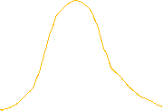














Differentiating noisy signals : Frequencey Domain Intuition

Slide 37
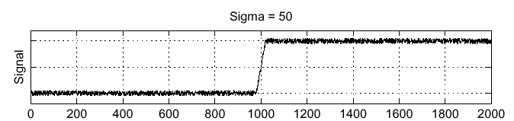
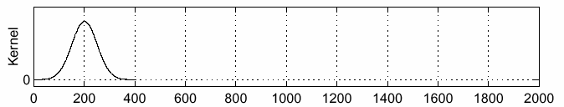
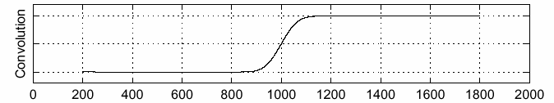
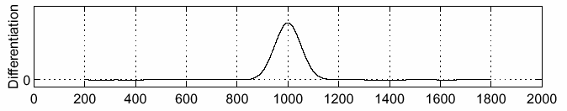
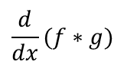

Solution: Smooth First
f
g
f * g
$$\frac{d}{dx}(f∗g)$$
$$\frac{d}{dx}(f∗g)$$
To find edges, look for peaks in
Source: S. Seitz

Slide 38
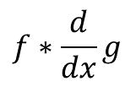




Derivative theorem of convolution
Differentiation is convolution, and convolution is associative:
This saves us one operation:
$$\frac{d}{dx}(f∗g)=f∗\frac{d}{dx}g$$
$$\frac{d}{dx}(f∗g)=f∗\frac{d}{dx}g$$
f
$$\frac{d}{dx}g$$
$$f∗\frac{d}{dx}g$$
Source: S. Seitz

Slide 39
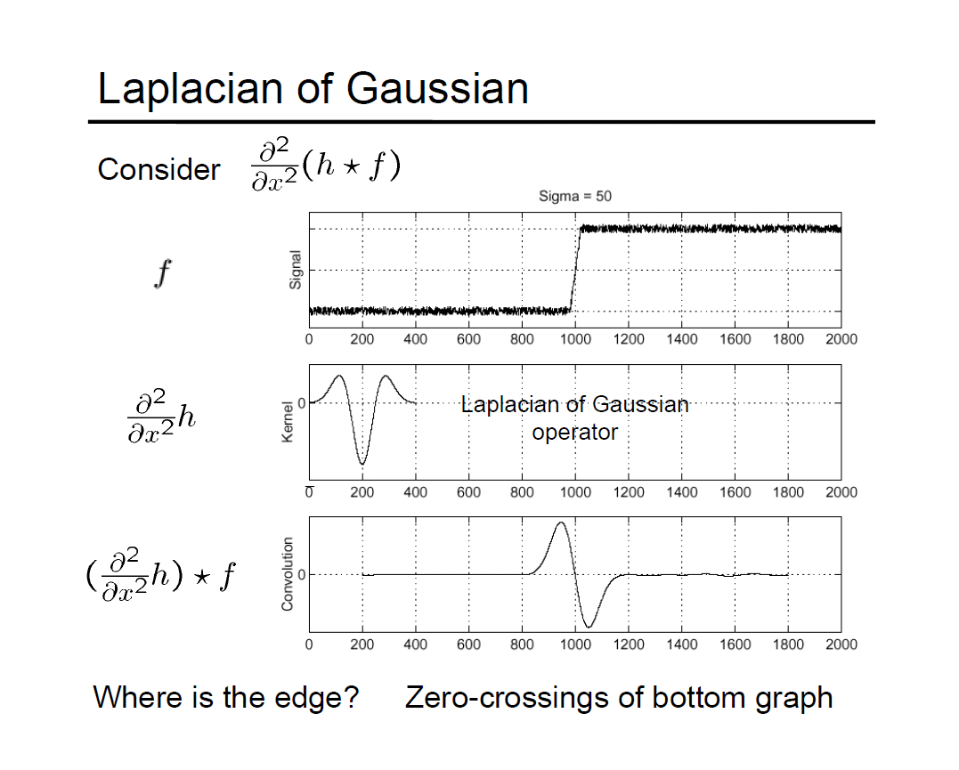
via DerekHoiem

Slide 40
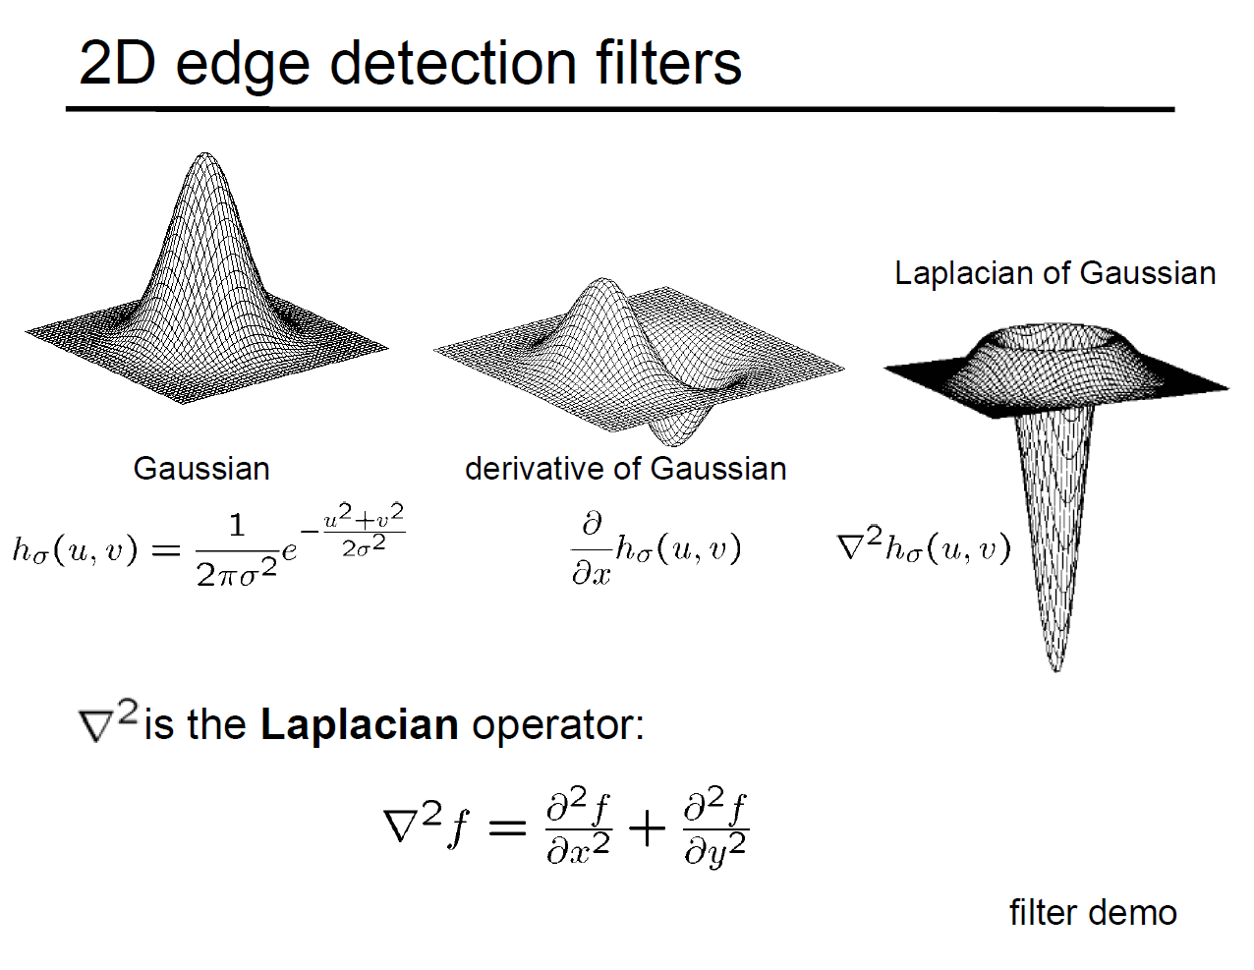
Derivative of Gaussian is a Matched Filter for a Step / Smooth Edge (Max response)
Laplacian is also a Matched Filter at appropriate scales for a bar detector (1D) and Blob detector (2D)
This property is effectively exploited by SIFT Detector
More on that later.
SMOOTHING
EXTREMA
ZERO-CROSSING
via DerekHoiem

Slide 41
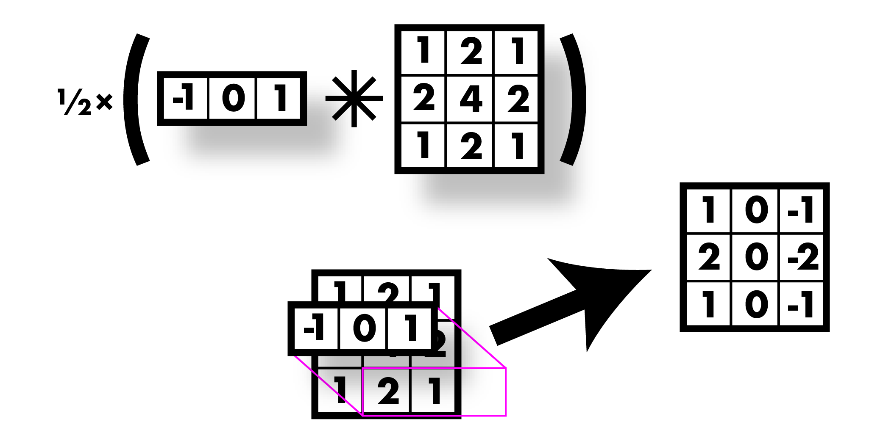

Sobel filter! Smooth & derivative
via JoeRedmon
Notes:
Instead of using a fixed Gaussian kernel, compute the kernel as a function of sigma.

Slide 42
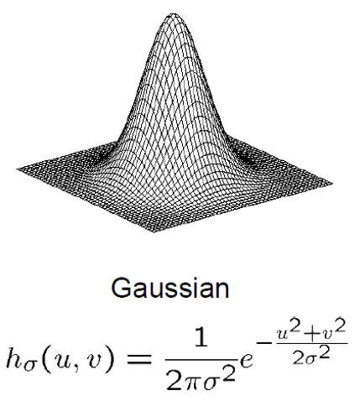
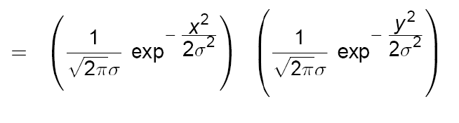
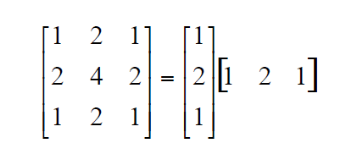
2D Gaussian is Separable…
Separable kernel
• Factors into product of two 1D Gaussians
• Discrete example:
Given an arbitrary sigma, 95% of the AUC for Gaussian is between -2*sigma and 2*sigma
99.7% of the AUC is between -3*sigma to 3*sigma
Choose one of these for your implementation
Separable kernels (M x M ) reduce the complexity of smoothing for an N x N image to O(N²M) instead of O(N² M² )
http://onlinestatbook.com/2/calculators/normal_dist.html

Slide 43
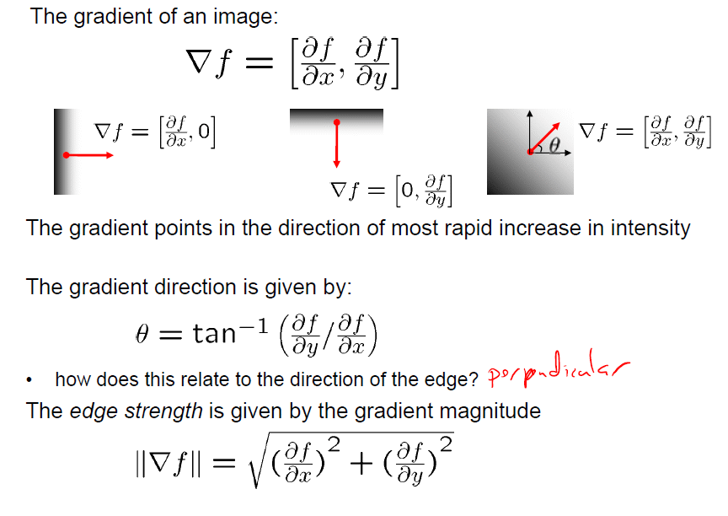
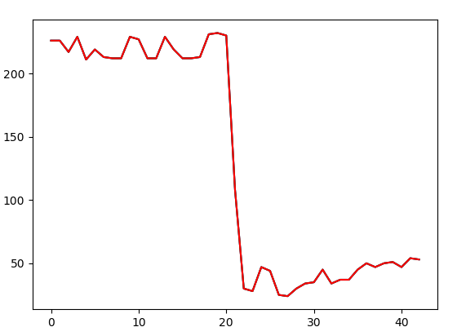
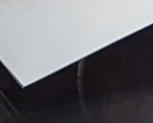
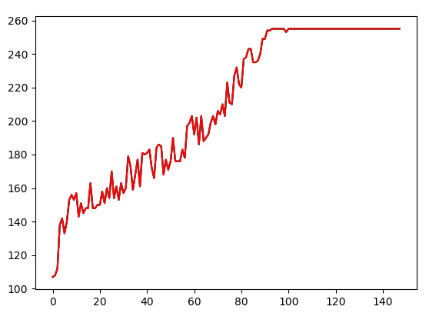
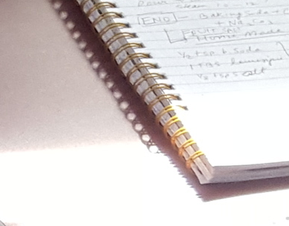
Edges in 2D Domains : Images I(x, y)
Edges have an Orientation and a Magnitude
via SteveSeitz

Slide 44
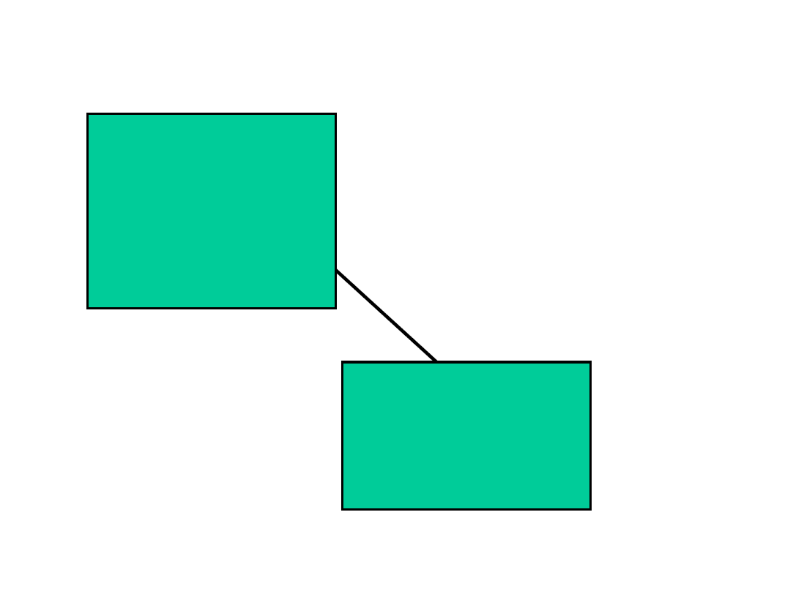

Slide 45
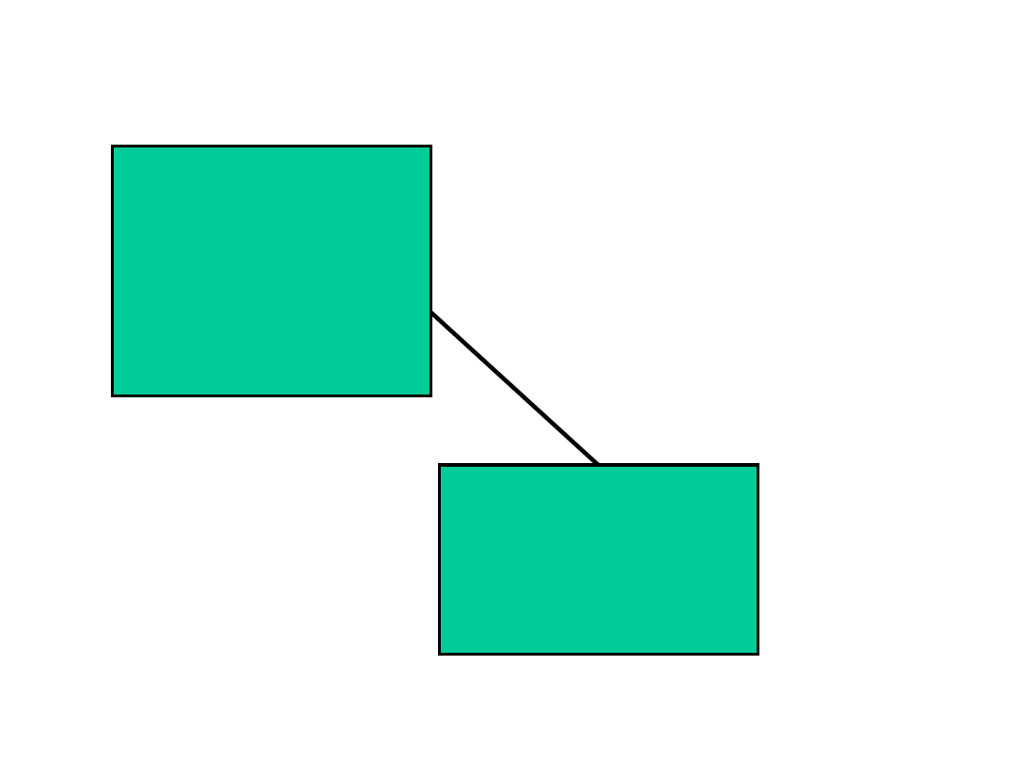

Slide 46
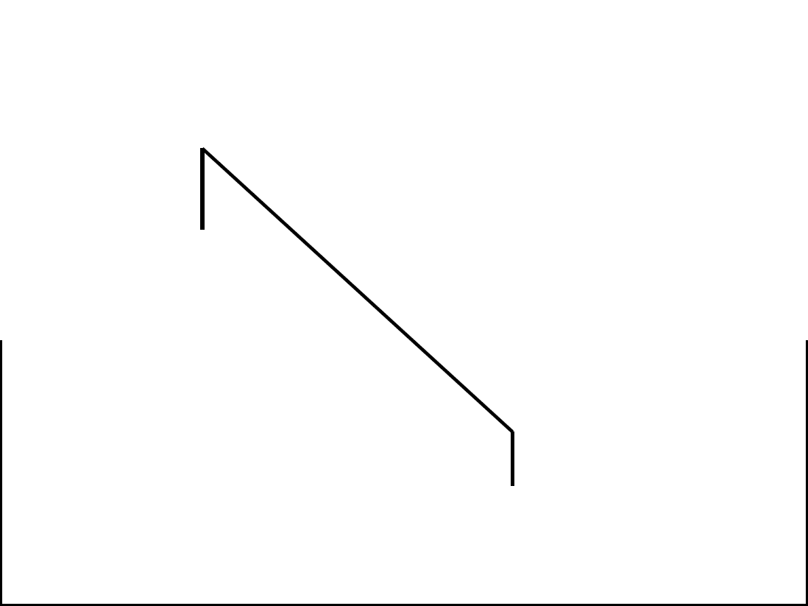

Slide 47
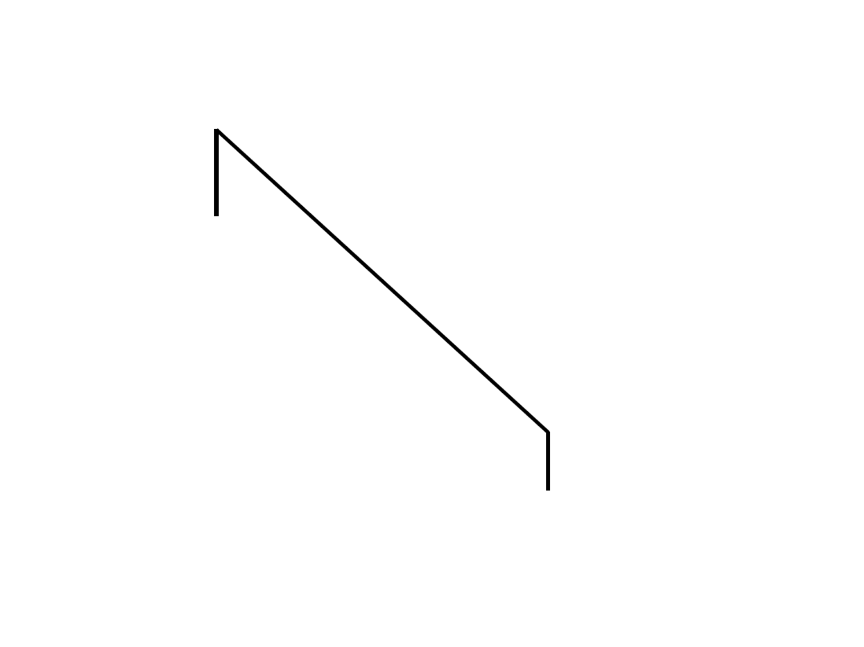

Slide 48
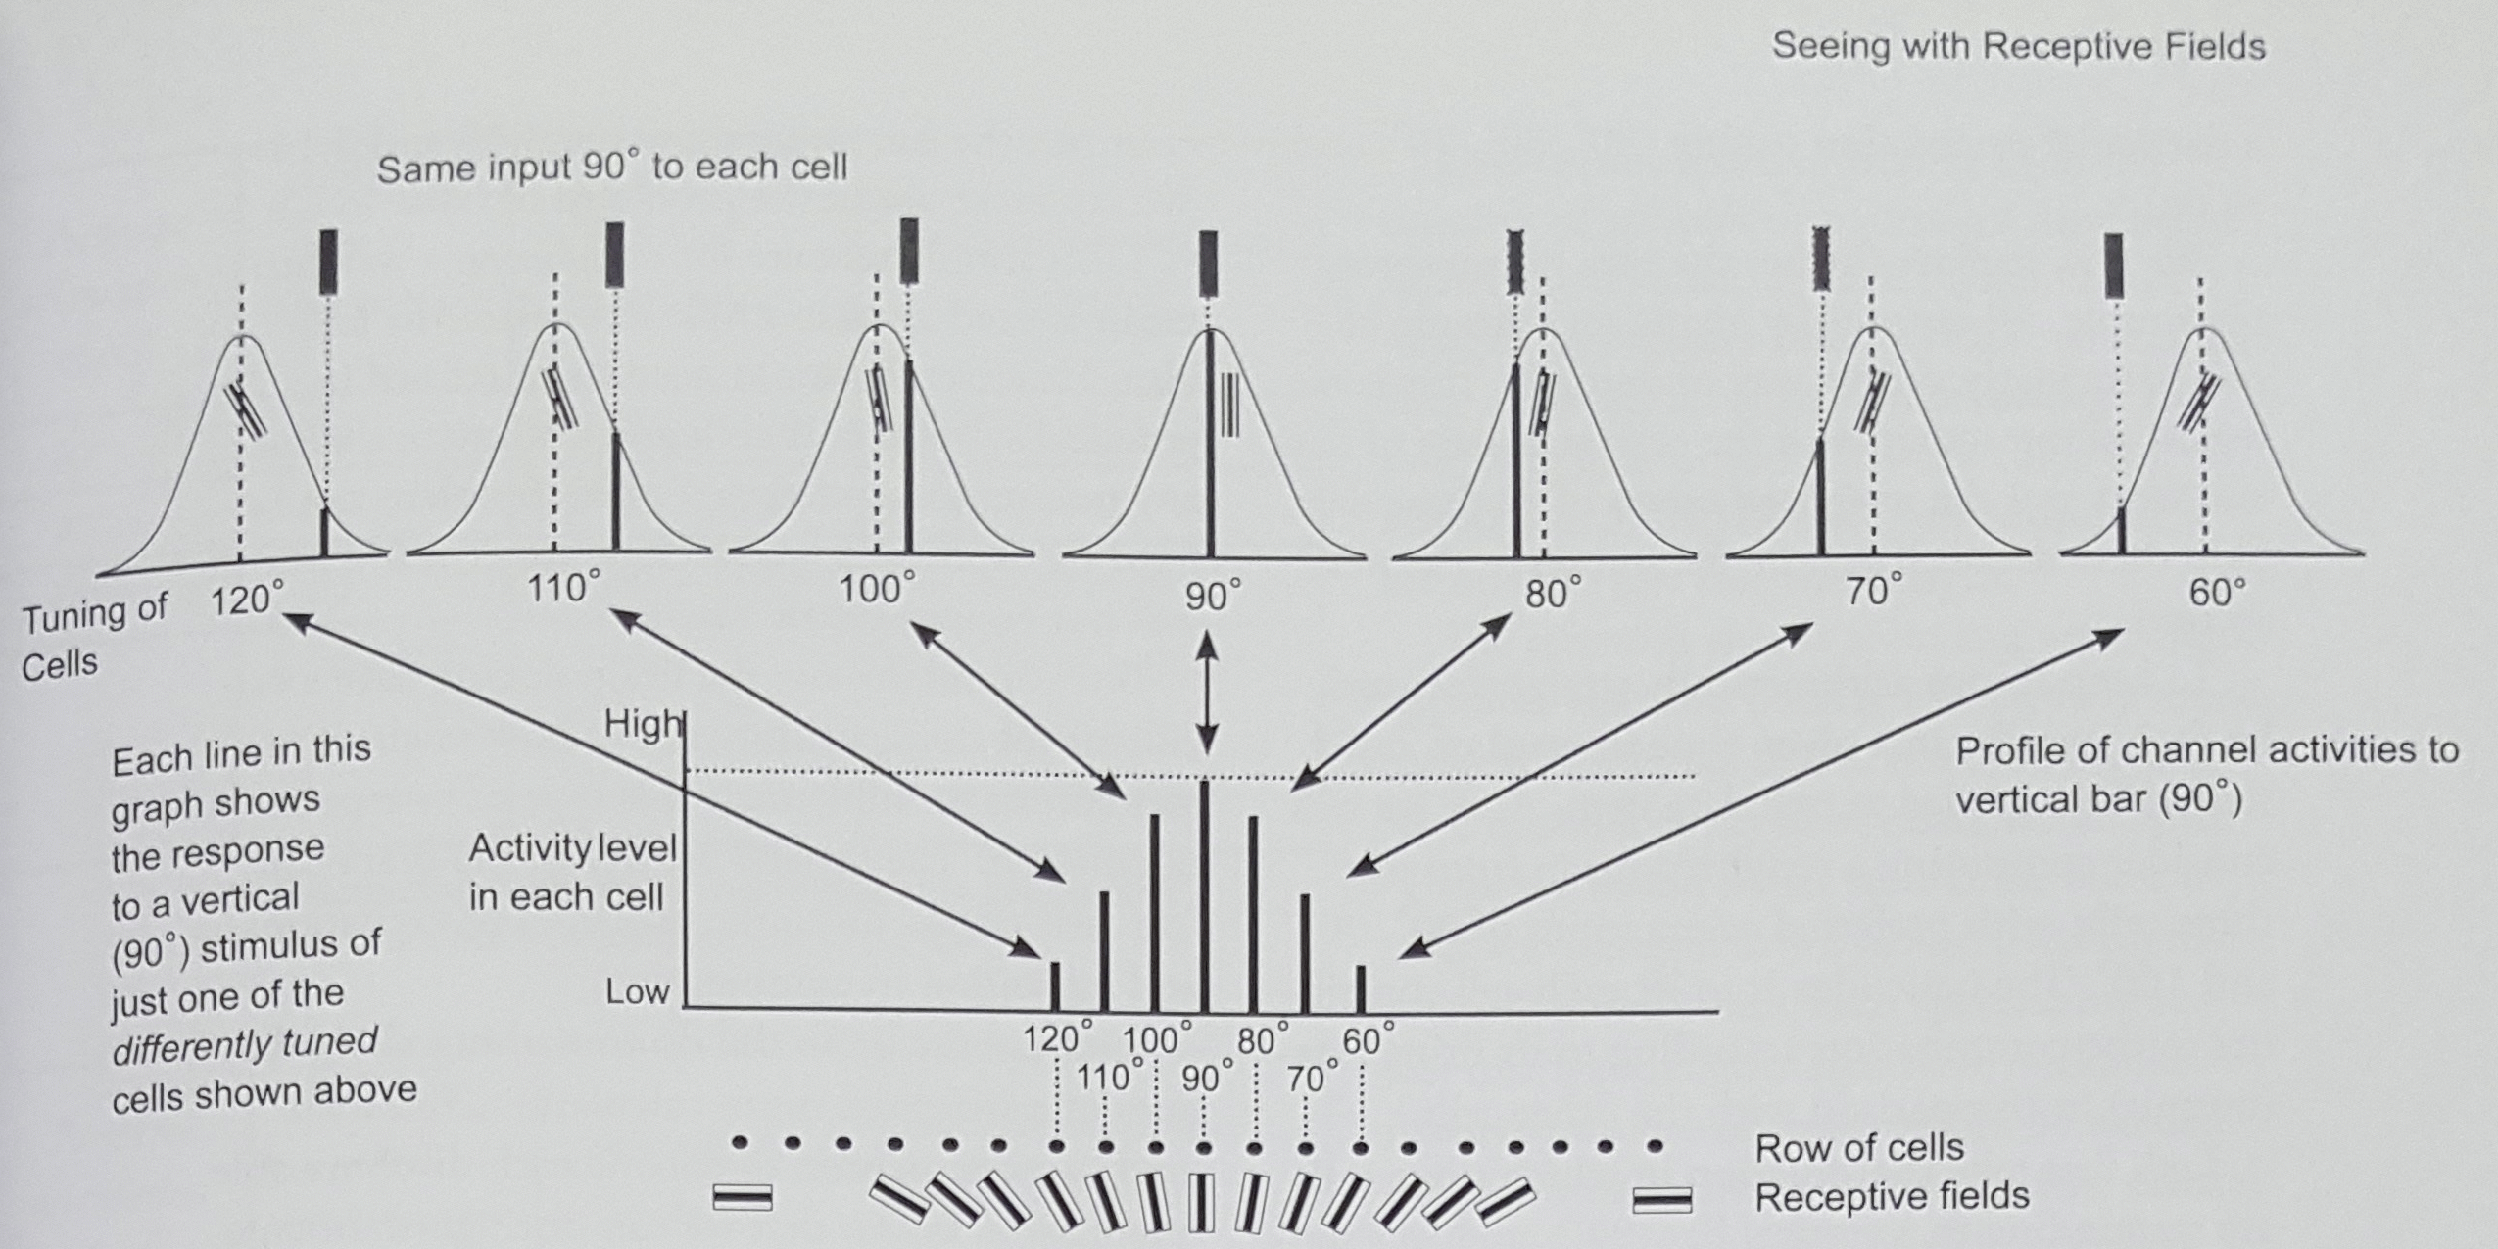
Seeing with Receptive Fields: From John Frisby
via JohnFrisby “Seeing”

Slide 49

Seeing with Receptive Fields: From John Frisby
via JohnFrisby “Seeing”
Notes:
Although individual cells are tuned to discrete orientations at 10 deg spacing the joint signature can distinguish between 90 and 92 degs.

Slide 50



Edges Occur at Different Scales

Slide 51
Edges Occur at Different Scales
This will be discussed in more details in
Wide Baseline Features and Matching (SIFT).

Slide 52


Role of Edges ?
From the time when Edge Detection was considered essential to understanding and manipulating images:
To Modern Learning to Segment, Detect Boundaries, Objects and much more…
Object-Contextual Representations for Semantic Segmentation
Yuhui Yuan, Xilin Chen, Jingdong Wang
https://arxiv.org/abs/1909.11065v2

Slide 53
Image Matching & Alignment

Slide 54



Why Align Images?
Match to create Panoramas for Single Center of Projection Images

Slide 55

Mercator projection of spherical mosaic

Slide 56


Why Align Images?
Match to create Planar Mosaics

Slide 57




Why Align Images?
“Build Rome in a Day”

Slide 58



Why Align Images?
Image / Location / Object Retrieval from a Large Database
via DavidNister

Slide 59



Matching & Alignment
Matching:
Find locations / spatial coordinates in images that correspond to the same location / direction in the World
via Feature Detectors and Feature Descriptors
Alignment:
  Use the matching locations to find Transformations for Camera Estimation and Warping
via Linear and Non-linear Optimization

Slide 60
A Swift Primer on Optimization Methods for
Linear and Non-Linear (Sum of Squares) Cost Functions

Slide 61



p₀
If f(p) is quadratic: $f\left(p\right)= \frac{1}{2}p^{T}Hp −p^{T}b+ f_{0}$
Gradient: $g\left(p\right)=Hp −b$
Steepest Descent: $p_{k+1}= p_{k}− α_{k}g_{k} g_{k}=Hp_{k} −b$ But how much do we move along g?
$$f\left(p_{k} −α_{k}g_{k}\right)= \frac{1}{2}{\left(p_{k} −α_{k}g_{k}\right)}^{T}H\left(p_{k} −α_{k}g_{k}\right) −{\left(p_{k} −α_{k}g_{k}\right)}^{T}b$$
$\frac{∂}{{∂α}_{k}}$=0 $⇒α_{k}= \frac{{g_{k}}^{T}g_{k}}{g_{k}Hg_{k}}$
Rate of convergence governed by: ${\left(\frac{r −1}{r+1}\right)}^{2 } r= \frac{λ_{max}}{λ_{min}}$

Slide 62

Observations
Gradient Descent “looks” at the cost function VERY LOCALLY.
r = 1 => Single step convergence
r >> 1 => Very slow convergence
Line search does not let the descent overshoot.
  Too expensive in Backprop for CNNs because of millions of parameters
  So learning rate used as a hyperparameter that is “globally” set and varied a bit
CAN WE DO BETTER?

Slide 63


Quadratic Cost Functions
Model the 2nd order variation (CURVATURE) in addition to the Gradient
Convex second order cost functions have a unique global minimum
f(p) is convex quadratic: $f\left(p\right)= \frac{1}{2}p^{T}Hp −p^{T}b+ f_{0}$ H is Positive Definite (Concave Upwards)
$$∇f\left(p\right)=Hp −b Setting ∇f\left(p\right)=0 ⇒ p_{opt}= H^{−1}b$$
$p_{opt}$ is a Global minimum : f(p) >= f($p_{opt}$)
By modeling the globally convex function we obtain minimum solution in a single step!

Slide 64


Optimization of General Cost Functions
We can model local quadratic behavior and apply descent type methods to general cost functions
Only local minima can be found
For local descent to happen the function needs to be PD (positive definite)
Let us see why

Slide 65


Optimization of General Cost Functions
At any point $p_{k}$ use quadratic approximation to define a descent direction: $δp=−H{\left(p_{k}\right)}^{−1} ∇f\left(p_{k}\right)$
For generality define a descent direction as: $p_{k+1}=p_{k} −α_{k}M_{k}g_{k}$
${f(p}_{k+1})={f(p}_{k}) −α_{k}{g_{k}}^{T}M_{k}g_{k}$ => For this to do descent ${g_{k}}^{T}M_{k}g_{k}$ > 0 (Positive Definite)
$M_{k}=I$ guarantees PD but is gradient descent that converges linearly.
$M_{k}=H{\left(p_{k}\right)}^{−1}$ has quadratic convergence but not guaranteed to be PD.

Slide 66

Optimization of General Cost Functions
$M_{k}=I$ guarantees PD but is gradient descent that converges linearly.
$M_{k}=H{\left(p_{k}\right)}^{−1}$ has quadratic convergence but not guaranteed to be PD.
By melding both aspects: $M_{k}= {\left[ε_{k}I+H\left(p_{k}\right)\right]}^{−1}$
$ε_{k}$ >> 1 is Steepest Descent. $ε_{k}$ = 0 is Second Order method such as Newton’s method.
Special case for Sum of Squares problems (like in Vision) called Levenberg-Marquardt method.
If descent possible use current $M_{k}$ otherwise scale up $ε_{k}$.
Close to the solution decrease $ε_{k}$ towards zero to approximate second order descent.

Slide 67

Special Common Case : Sum of Squares Cost Functions
$Y_{i}= A_{i} X+ η$ $η \sim N\left(0, Λ_{i}\right)$ $Y_{i }$ is a vector of measurements corrupted by noise. X is the unknown.
Assuming independence of measurements $Y_{i}$, the negative log likelihoods of the measurements given X is:
$Σ_{i} {(Y_{i}−A_{i}X)}^{T}{Λ_{i}}^{−1}(Y_{i}− A_{i} X)$ = $Σ_{i} {(Y_{i}}^{T}{Λ_{i}}^{−1}Y_{ i}−2{Y_{i}}^{T}A_{i}X+ X^{T}A_{i}^{T}{Λ_{i}}^{−1}A_{i} X)$
To find the optimal X we take the derivative w.r.t. X and set it to zero:
$\frac{∂}{∂X}= 2 \left[Σ_{i}A_{i}^{T}{Λ_{i}}^{−1}A_{i}\right]X −2$ $\left[Σ_{i}A_{i}^{T}Y_{i}\right]$ = 0
$X= {\left[Σ_{i}A_{i}^{T}{Λ_{i}}^{−1}A_{i}\right]}^{−1}$ $\left[Σ_{i}A_{i}^{T}Y_{i}\right]$
Solvable in Closed form. For large systems iterative methods are used.

Slide 68





Special Case : Least squares line fitting
Data: (x₁, y₁), …, (x_{n}, y_{n})
Line equation: y_{i} = m x_{i} + b
Find (m, b) to minimize
y=mx+b
(x_{i}, y_{i})
$$E=\sum_{i=1}^{n}{(y_{i}−mx_{i}−b)^{2}}$$
$$E=\sum_{i=1}^{n}{{\left(\left[\begin{matrix}x_{i} & 1\end{matrix}\right]\left[\begin{matrix}m \\ b\end{matrix}\right]−y_{i}\right)}^{2}}={\left\|\left[\begin{matrix}x_{1} & 1 \\ ⋮ & ⋮ \\ x_{n} & 1\end{matrix}\right]\left[\begin{matrix}m \\ b\end{matrix}\right]−\left[\begin{matrix}y_{1} \\ ⋮ \\ y_{n}\end{matrix}\right]\right\|}^{2}={\left\|Ap−y\right\|}^{2} \\ =y^{T}y−2(Ap)^{T}y+(Ap)^{T}(Ap)$$
$$\frac{dE}{dp}=2A^{T}Ap−2A^{T}y=0$$
$$A^{T}Ap=A^{T}y⇒p={\left(A^{T}A\right)}^{−1}A^{T}y$$
Modified from S. Lazebnik
Notes:
X is assumed noise free. Y is the measurement.

Slide 69
Special Case : Least squares line fitting
Data: (x₁, y₁), …, (x_{n}, y_{n})
Line equation: y_{i} = m x_{i} + b
Find (m, b) to minimize
y=mx+b
(x_{i}, y_{i})
$$E=\sum_{i=1}^{n}{(y_{i}−mx_{i}−b)^{2}}$$
$$E=\sum_{i=1}^{n}{{\left(\left[\begin{matrix}x_{i} & 1\end{matrix}\right]\left[\begin{matrix}m \\ b\end{matrix}\right]−y_{i}\right)}^{2}}={\left\|\left[\begin{matrix}x_{1} & 1 \\ ⋮ & ⋮ \\ x_{n} & 1\end{matrix}\right]\left[\begin{matrix}m \\ b\end{matrix}\right]−\left[\begin{matrix}y_{1} \\ ⋮ \\ y_{n}\end{matrix}\right]\right\|}^{2}={\left\|Ap−y\right\|}^{2} \\ =y^{T}y−2(Ap)^{T}y+(Ap)^{T}(Ap)$$
Caveat:
Errors are in y’s and not in x’s.
Say x is time for example.
$$\frac{dE}{dp}=2A^{T}Ap−2A^{T}y=0$$
$$A^{T}Ap=A^{T}y⇒p={\left(A^{T}A\right)}^{−1}A^{T}y$$
Modified from S. Lazebnik

Slide 70


Line Fitting with Realistic Error Model
$$\hat{N}$$
Typically errors are in all the measured quantities: x and y here
A proper error measure to optimize is normal distance of measured points to a best fit line
Line: $n^{T}p=d$
$\min_{n, d}{\sum_{i}{\left\|n^{T}p_{i}−d\right\|}}$² = $n^{T}\left[\sum_{ i}{p_{i} p_{i}^{T}}\right]n−2 d$ $p_{i}^{T} n+ d^{2}$
$\frac{∂}{∂d}=0 ⇒ d= p_{0}^{T} n$ where $p_{0}$ is the centroid of all the points
$\frac{∂}{∂n}=0 ⇒ \overline{S}n= λn n^{T}n=1$ Non-trivial solution is the Null space vector of $\overline{S}$
Eigenvector with the smaller (~ 0) eigenvalue
d
S

Slide 71







Total least squares
Slide modified from S. Lazebnik
Find (a, b, c) to minimize the sum of squared perpendicular distances
ax+by+c=0
To be Modified
Unit normal: N=(a, b)
$$E=\sum_{i=1}^{n}{(ax_{i}+by_{i}+c)^{2}}$$
(x_{i}, y_{i})
$$E=\sum_{i=1}^{n}{(ax_{i}+by_{i}−d)^{2}}$$
$$\frac{∂E}{∂c}=\sum_{i=1}^{n}{2(ax_{i}+by_{i}+c)}=0$$
$$c=−\frac{a}{n}\sum_{i=1}^{n}{x_{i}−\frac{b}{n}}\sum_{i=1}^{n}{y_{i}}=−a\bar{x}−b\bar{y}$$
$$E=\sum_{i=1}^{n}{(a(x_{i}−\bar{x})+b(y_{i}−\bar{y}))^{2}}={\left\|\left[\begin{matrix}x_{1}−\bar{x} & y_{1}−\bar{y} \\ ⋮ & ⋮ \\ x_{n}−\bar{x} & y_{n}−\bar{y}\end{matrix}\right]\left[\begin{matrix}a \\ b\end{matrix}\right]\right\|}^{2}=p^{T}A^{T}Ap$$
$$\operatorname{minimize}{p^{T}}A^{T}Ap s.t. p^{T}p=1 ⇒ \operatorname{minimize}{\frac{p^{T}A^{T}Ap}{p^{T}p}}$$
Solution is eigenvector corresponding to smallest eigenvalue of A^{T}A
See details on Raleigh Quotient: http://en.wikipedia.org/wiki/Rayleigh_quotient

Slide 72

Special Common Case : Sum of Squares Cost Functions
$Y_{i}= A_{i} X+ η$ $η \sim N\left(0, Λ_{i}\right)$ $Y_{i }$ is a vector of measurements corrupted by noise. X is the unknown.
Assuming independence of measurements $Y_{i}$, the negative log likelihoods of the measurements given X is:
$Σ_{i} {(Y_{i}−A_{i}X)}^{T}{Λ_{i}}^{−1}(Y_{i}− A_{i} X)$ = $Σ_{i} {(Y_{i}}^{T}{Λ_{i}}^{−1}Y_{ i}−2{Y_{i}}^{T}A_{i}X+ X^{T}A_{i}^{T}{Λ_{i}}^{−1}A_{i} X)$
To find the optimal X we take the derivative w.r.t. X and set it to zero:
$\frac{∂}{∂X}= 2 \left[Σ_{i}A_{i}^{T}{Λ_{i}}^{−1}A_{i}\right]X −2$ $\left[Σ_{i}A_{i}^{T}Y_{i}\right]$ = 0
$X= {\left[Σ_{i}A_{i}^{T}{Λ_{i}}^{−1}A_{i}\right]}^{−1}$ $\left[Σ_{i}A_{i}^{T}Y_{i}\right]$
Solvable in Closed form. For large systems iterative methods are used.

Slide 73
Panorama Homework
Finding keypoints in an image
  // Calculate corners and descriptors
  vector<Descriptor> ad = harris_corner_detector(a, sigma, thresh, window, nms, corner_method);
  vector<Descriptor> bd = harris_corner_detector(b, sigma, thresh, window, nms, corner_method);
Describing those key points,
Matching them to those points in another image,
  vector<Match> m = match_descriptors(ad, bd);
Computing the transform from one image to the other, and
  // Run RANSAC to find the homography
  Matrix Hba = RANSAC(m, inlier_thresh, iters, cutoff);
Stitching them
  return combine_images(a, b, Hba, acoeff);

Slide 74
Panorama Homework (Details)
Harris corner detection
  Calculate image derivatives Ix and Iy.
  Calculate measures IxIx, IyIy, and IxIy.
  Calculate structure matrix components as weighted sum of nearby measures.
  Calculate Harris "cornerness" as estimate of 2nd eigenvalue: det(S)/tr(S)
  Alternatively (Optionally) find the exact 2nd eigenvalue
  Run non-max suppression on response map
  Compute the structure matrix
    Fill in `Image structure_matrix(const Image& im2, float sigma)` in `harris_image.cpp`.
    This will perform the first 3 steps of the algorithm: calculating derivatives, the corresponding measures,
    and the weighted sum of nearby derivative information.
    This weighted sum can be easily computed with a Gaussian blur.
    For gradients use the Sobel filters (slightly smoothed versions of the regular -101 filter).
    It is true that we don't have to do that but please for this exercise do it, so it can match the output provided.

Slide 75
Why is Fitting and Features Important for Image Matching?
Find 2D / 3D Transformations
Create Panoramas
Fit to what : Coordinates defined by Features
Features have two Components:
Feature Detector
Feature Descriptor

Slide 76

Two Types of Matching Problems
SHORT BASELINE
Limited change in viewpoint & illumination
Typically Videos / Image Sequences
Very similar looking images
WIDE BASELINE
Larger changes in viewpoint & illumination
Jumble of frames
“Distant” in time:
  Retrieve Locations, Objects, “THINGS”, Images, …
Video Example

Slide 77




Two Types of Matching Problems
SHORT BASELINE
Limited change in viewpoint & illumination
Typically Videos / Image Sequences
Very similar looking images
WIDE BASELINE
Larger changes in viewpoint & illumination
Jumble of frames
“Distant” in time:
  Retrieve Locations, Objects, “THINGS”, Images, …
Video Example

Slide 78





Features
Detector / Keypoints: Discrete “distinctive” locations in the image.
Descriptors: Raw / Filtered Representations of Patches around the Keypoints
Learned
Detectors
&
Descriptors
Intensity
Patch
Filtered
Patch
Quasi-invariant Feature
SIFT

Slide 79

Where would you define good features?
via JoeRedmon

Slide 80
How can we find unique patches?
via JoeRedmon
Sky: bad
  Very little variation
  Could match any other sky

Slide 81

How can we find unique patches?
Sky: bad
  Very little variation
  Could match any other sky
Edge: ok
  Variation in one direction
  Could match other patches
  along same edge

Slide 82
How can we find unique patches?
via JoeRedmon
Sky: bad
  Very little variation
  Could match any other sky
Edge: ok
  Variation in one direction
  Could match other patches
  along same edge
Corners: good!
  Only one alignment matches

Slide 83


Making Panoramas
via JoeRedmon
Say we are stitching a panorama
Want patches in image to match to other image
Hopefully only match one spot

Slide 84
How close are two patches?
via JoeRedmon
Sum squared difference
Images I, J
Σ_{x,y} (I(x,y) - J(x,y))²

Slide 85
How can we find unique patches?
via JoeRedmon
Want a patch that is unique in the image
Can calculate distance between patch and every other patch, lot of computation
Instead, we could think about auto-correlation:
  How well does image match shifted version of itself?
Σ_{d}Σ_{x,y} (I(x,y) - I(x+d_{x},y+d_{y}))²
Measure of self-difference (how am I not myself?)

Slide 86

Self-difference
via JoeRedmon
Sky: low everywhere

Slide 87

Self-difference
via JoeRedmon
Edge: low along edge

Slide 88

Self-difference
via JoeRedmon
Corner: mostly high

Slide 89




Self-difference
via JoeRedmon
Sky: low everywhere
Edge: low along edge
Corner: mostly high

Slide 90



Characterize Self-Difference to Compute Keypoints
Compute an Auto-SSD or Auto-Correlation Surface locally at each point
$E_{SSD}\left(Δu\right)=$ Measures the sum-of-square differences as a function of $\left(Δu\right)$
With first order approximation of image patch locally, we get: $E_{SSD}\left(Δu\right)=$
$A= Σ_{i} w_{i} ∗ \left[\begin{matrix}I_{x_{i}}^{2} & I_{x_{i}} I_{y_{i}} \\ I_{x_{i}} I_{y_{i}} & I_{y_{i}}^{2}\end{matrix}\right]$
Best Practice: Compute Smoothed Gradients with derivatives of Gaussian
Eigen-structure of A captures the notion of flat or peaky self-similarity:
Structure Matrix
λ₁ and λ₂ are eigenvalues
  λ₁ and λ₂ both small: no gradient (flat
  λ₁ >> λ₂: gradient in one direction (edge)
  λ₁ and λ₂ similar: multiple gradient directions, corner

Slide 91


Harris Detector [Harris88]
via DerekHoeim
“Second moment matrix” / Structure Matrix
$$μ(σ_{I},σ_{D})=g(σ_{I})∗\left[\begin{matrix}I_{x}^{2}(σ_{D}) & I_{x}I_{y}(σ_{D}) \\ I_{x}I_{y}(σ_{D}) & I_{y}^{2}(σ_{D})\end{matrix}\right]$$
Weighted Summation can be implemented as
Gaussian Smoothing of Squared Gradient Images
Intuition: Search for local neighborhoods where the image content has two main directions (eigenvectors).

Slide 92












Harris Detector [Harris88]
via DerekHoeim
Second moment matrix
$$μ(σ_{I},σ_{D})=g(σ_{I})∗\left[\begin{matrix}I_{x}^{2}(σ_{D}) & I_{x}I_{y}(σ_{D}) \\ I_{x}I_{y}(σ_{D}) & I_{y}^{2}(σ_{D})\end{matrix}\right]$$
1. Image derivatives
I_{x}
I_{y}
(optionally, blur first)
I_{x}²
I_{y}²
I_{x}I_{y}
2. Square of derivatives
$$\begin{matrix}\det{M}=λ_{1}λ_{2} \\ \operatorname{trace}{M}=λ_{1}+λ_{2}\end{matrix}$$
3. Gaussian
filter g(σ_{I})
g(I_{x}²)
g(I_{y}²)
g(I_{x}I_{y})
4. Cornerness function – both eigenvalues are strong
$$har=\det{[}μ(σ_{I},σ_{D})]−α[\operatorname{trace}{(}μ(σ_{I},σ_{D}))^{2}]=$$
$$g(I_{x}^{2})g(I_{y}^{2})−[g(I_{x}I_{y})]^{2}−α[g(I_{x}^{2})+g(I_{y}^{2})]^{2}$$
5. Non-maxima suppression
har

Slide 93






Harris Detector: Mathematics
$$M=g(σ_{I})∗\left[\begin{matrix}I_{x}^{2}(σ_{D}) & I_{x}I_{y}(σ_{D}) \\ I_{x}I_{y}(σ_{D}) & I_{y}^{2}(σ_{D})\end{matrix}\right]$$
Want large eigenvalues, and small ratio
We know
Leads to
$$\frac{λ_{1}}{λ_{2}}<t$$
$$M= \left[\begin{matrix}m_{11} & m_{12} \\ m_{21} & m_{22}\end{matrix}\right]$$
$\begin{matrix}\begin{aligned}\det{M}=λ_{1}λ_{2} \\ \end{aligned} \\ \operatorname{trace}{M}=λ_{1}+λ_{2}\end{matrix}$
$\det{M}= m_{11}$ $m_{22}$ - $m_{12}$ $m_{21}$
$\operatorname{trace}{M}= m_{11}$ $+ m_{22}$
$$\det{M}−k⋅\text{trac}{\text{e}}^{2}(M)>t$$
(k :empirical constant, k = 0.04-0.06)
Nice brief derivation on wikipedia

Slide 94
Explanation of Harris Criterion
via DerekHoeim
From Grauman and Leibe

Slide 95


Non-Maximal Suppression (NMS)
via MIT
Harris corner responses beyond a certain threshold typically create bunched up corner pixels
Too much data to handle
Suppress responses other than MAX within an NxN neighborhood everywhere. And choose top K responses.
Alternatively use Adaptive NMS.
  For each response compute the min distance to a local MAX response
  Choose the Top K points with the largest radii

Slide 96


Harris Detector – Responses [Harris88]
via DerekHoeim
Effect: A very precise corner detector.

Slide 97

Harris Detector - Responses [Harris88]
via DerekHoeim

Slide 98

via JoeRedmon

Slide 99

via JoeRedmon

Slide 100

Ok, we found corners, now what?
via JoeRedmon
Need to match image patches to each other
Need to figure out transform between images

Slide 101
Ok, we found corners, now what?
via JoeRedmon
Need to match image patches to each other
  What is a patch? How do we look for matches? Pixels?
Need to figure out transform between images
  How can we transform images?
  How do we solve for this transformation given matches?

Slide 102


Matching patches: descriptors!
via JoeRedmon
We want a way to represent an image patch
Can be very simple, just pixels!
Finding matching patch is easy, distance metric:
  Σ_{x,y} (I(x,y) - J(x,y))²
  What problems are there with just using pixels?

Slide 103

Matching patches: descriptors!
via JoeRedmon
We want a way to represent an image patch
Can be very simple, just pixels!
Finding matching patch is easy, distance metric:
  Σ_{x,y} (I(x,y) - J(x,y))²
  What problems are there with just using pixels?

Slide 104
Short Baseline: Matching patches (descriptors!)
via JoeRedmon
We want a way to represent an image patch
Can be very simple, just pixels!
Finding matching patch is easy, L2 distance metric:
  Σ_{x,y} (I(x,y) - J(x,y))²
  What problems are there with just using pixels?
Descriptors can be more complex
  Gradient information
  How much context?
  Edges, etc. we’ll talk more about descriptors later!

Slide 105



Match Measures for matching Descriptors / Patches
$M= \sum_{p}{{\left(I\left(p\right) −J(p)\right)}^{2}}$
L2 Norm
Sensitive to outliers
Sensitive to brightness / contrast changes
$M= \sum_{p}{\left|I\left(p\right) −J(p)\right|}$
L1 Norm
Less Sensitive to outliers
Sensitive to brightness / contrast changes
$M=1 −\sum_{p}{\frac{\left(I\left(p\right) − \overline{I }\right)(J\left(p\right)− \overline{J})}{σ_{I_{p}} σ_{J_{p}}}}$
Inverse Normalized Correlation
Sensitive to outliers
Invariant to Local offset and scale changes in intensity/color

Slide 106







Match Measures for matching Descriptors / Patches
$M= \sum_{p}{{\left(I\left(p\right) −J(p)\right)}^{2}}$
L2 Norm
Sensitive to outliers
Sensitive to brightness / contrast changes
$M= \sum_{p}{\left|I\left(p\right) −J(p)\right|}$
L1 Norm
Less Sensitive to outliers
Sensitive to brightness / contrast changes
$M=1 −\sum_{p}{\frac{\left(I\left(p\right) − \overline{I }\right)(J\left(p\right)− \overline{J})}{σ_{I_{p}} σ_{J_{p}}}}$
Inverse Normalized Correlation
Sensitive to outliers
Invariant to Local offset and scale changes in intensity/color

Slide 107

Matching patches: descriptors!
via JoeRedmon
Already have our patches that are likely “unique”-ish
Loop over good patches in one image
  Find best match in other image
Find mutually best matches:
A = BestMatch(B) & B = BestMatch(A)

Slide 108

MOSAICS IN ART
…combine individual chips to create a big picture...
Part of the Byzantine mosaic floor that has been preserved in the
Church of Multiplication in Tabkha (near the Sea of Galilee).
www.rtlsoft.com/mmmosaic

Slide 109

Image Transformations : Induced by Camera Motion
3D Rotations : Pan / Tilt
Image Displacment is Independent of Depth

Slide 110

Image Transformations : Induced by Camera Motion
3D Rotations : Pan / Tilt

Slide 111

Image Transformations : Induced by Camera Motion
3D Rotations : Pan / Tilt

Slide 112
Basic Concept : Planar Mosaic Construction
2
3
4
1
Align Pairwise: 1:2, 2:3, 3:4, ...
Select a Reference Frame
Align all Images to the Reference Frame
Combine into a Single Mosaic
Virtual Camera (Pan)
Image Surface - Plane
Projection - Perspective

Slide 113






Image Transformation : Rotations
What is the mapping from image rays to the mosaic coordinates ?
Rotations/Homographies
Plane Projective Transformations
$$P^{′},P$$
$$P^{′}=RP$$
$$p_{c}^{′}≈Rp_{c}$$
$$K^{′}p^{′}≈RKp$$
Images
COP
$$p^{′}≈K^{′−1}RKp$$
$$p^{′}≈H_{∞}p$$

Slide 114

Image Transformations : Induced by Camera Motion
3D Translations : Image Displacement is a function of Depth (3D Parallax)
x
x
x
x

Slide 115

Image Transformations : Induced by Camera Motion
3D Translations : Image Displacement is a function of Depth (3D Parallax)
x
x
x
x

Slide 116

Image Transformation : Translations

Slide 117



Image Transformation : Special Cases
Planar Scene (e.g. A Whiteboard)
Plane Equation: $\frac{P^{T}N}{d}=1$
3D Camera Motion: $P^{′}=RP+T$
Imaging a Plane Under Motion leads to:
$p^{′} ≈\left(R+ \frac{T N^{T}}{d}\right) P$
$p^{′} ≈H p$
Scene at a Distance (e.g. Rainier)
$\frac{\left\|T\right\|}{Z}≪1$ ➔ Image Displacement due to T is 0
Same as the case of Rotational Motion
Image Displacements well approximated by:
$$p^{′}≈H_{∞}p$$

Slide 118


Closer Look at Homography
$p^{′} ≈H p$ $p^{′}= \left[\begin{matrix}x^{′} \\ y^{′} \\ 1\end{matrix}\right]$ $p= \left[\begin{matrix}x \\ y \\ 1\end{matrix}\right]$ are called Homogeneous coordinates.
$H=$ a 3x3 matrix relates view rays in images.
View rays are represented as homogeneous coordinates. $p ≈ λ p$ upto an arbitrary constant $λ$.
Observed 2D image coordinates are related via:
$x^{′}= \frac{p_{x}^{′}}{p_{z}^{′}}= \frac{\left(1+ h_{00}\right) x+ h_{01} y+ h_{02}}{h_{20}x+ h_{21} y+1}$ $y^{′}= \frac{p_{y}^{′}}{p_{z}^{′}}= \frac{\left(h_{10}\right)x+ {\left(1+ h_{11}\right)}_{} y+ h_{12}}{h_{20}x+ h_{21} y+1}$
Transformation is upto an arbitrary scale

Slide 119

Approximations of Homography
via JoeRedmon

Slide 120

Approximations of Homography
Translation: $\left[\begin{matrix}1 & 0 & t_{x} \\ 0 & 1 & t_{y} \\ 0 & 0 & 1\end{matrix}\right]$ Preserves Orientations, Angles, Lengths, Areas
Euclidean: $\left[\begin{matrix}cos⁡(θ) & −sin⁡(θ) & t_{x} \\ sin⁡(θ) & cos⁡(θ) & t_{y} \\ 0 & 0 & 1\end{matrix}\right]$ Preserves Angles, Lengths, Areas
Similarity: s * $\left[\begin{matrix}cos⁡(θ) & −sin⁡(θ) & t_{x} \\ sin⁡(θ) & cos⁡(θ) & t_{y} \\ 0 & 0 & 1\end{matrix}\right]$ Preserves Angles
Affine: $\left[\begin{matrix}a_{00} & a_{01} & t_{x} \\ a_{10} & a_{11} & t_{y} \\ 0 & 0 & 1\end{matrix}\right]$ Preserves Parallelism
Homography: : $\left[\begin{matrix}{(1+h}_{00}) & h_{01} & h_{02} \\ h_{10} & {(1+h}_{11}) & h_{12} \\ h_{20} & h_{21} & 1\end{matrix}\right]$ Preserves Cross-Ratios

Slide 121
Fitting Transformations to Noisy Matches
via JoeRedmon
Already have our patches that are likely “unique”-ish
Loop over good patches in one image
  Find best match in other image
Find mutually best matches:
A = BestMatch(B) & B = BestMatch(A)

Slide 122





RANSAC
(RANdom SAmple Consensus) :
Learning technique to estimate
parameters of a model by random
sampling of observed data
Fischler & Bolles in ‘81.
$$δ$$
$$π:I→\left\{P, O\right\}$$
$$\min_{π}\left|O\right|$$
Model parameters
such that:
$$f(P,β)=\left\|β−{\left(P^{T}P\right)}^{−1}P^{T}\right\|$$
$$f(P,β)<δ$$
Source: Savarese
Notes:
Let me give you an intuition of what is going on. Suppose we have the standard line fitting problem in presence of outliers.
We can formulate this problem as follows: want to find the best partition of points in inlier set and outlier set such that…
The objective consists of adjusting the parameters of a model function so as to best fit a data set.
"best" is defined by a function f that needs to be minimized.
Such that the best parameter of fitting the line give rise to a residual error lower that delta
as when the sum, S, of squared residuals

Slide 123
RANSAC
_{(RANdom SAmple Consensus) :}
Fischler & Bolles in ‘81.
Algorithm:
Sample (randomly) the number of points required to fit the model
Solve for model parameters using samples
Score by the fraction of inliers within a preset threshold of the model
Repeat 1-3 until the best model is found with high confidence
Notes:
Let me give you an intuition of what is going on. Suppose we have the standard line fitting problem in presence of outliers.
We can formulate this problem as follows: want to find the best partition of points in inlier set and outlier set such that…
The objective consists of adjusting the parameters of a model function so as to best fit a data set.
"best" is defined by a function f that needs to be minimized.
Such that the best parameter of fitting the line give rise to a residual error lower that delta
as when the sum, S, of squared residuals

Slide 124
RANSAC
Line fitting example
Algorithm:
Sample (randomly) the number of points required to fit the model (#=2)
Solve for model parameters using samples
Score by the fraction of inliers within a preset threshold of the model
Repeat 1-3 until the best model is found with high confidence
Illustration by Savarese
Notes:
Let me give you an intuition of what is going on. Suppose we have the standard line fitting problem in presence of outliers.
We can formulate this problem as follows: want to find the best partition of points in inlier set and outlier set such that…
The objective consists of adjusting the parameters of a model function so as to best fit a data set.
"best" is defined by a function f that needs to be minimized.
Such that the best parameter of fitting the line give rise to a residual error lower that delta
as when the sum, S, of squared residuals

Slide 125
RANSAC
Line fitting example
Algorithm:
Sample (randomly) the number of points required to fit the model (#=2)
Solve for model parameters using samples
Score by the fraction of inliers within a preset threshold of the model
Repeat 1-3 until the best model is found with high confidence
Notes:
Let me give you an intuition of what is going on. Suppose we have the standard line fitting problem in presence of outliers.
We can formulate this problem as follows: want to find the best partition of points in inlier set and outlier set such that…
The objective consists of adjusting the parameters of a model function so as to best fit a data set.
"best" is defined by a function f that needs to be minimized.
Such that the best parameter of fitting the line give rise to a residual error lower that delta
as when the sum, S, of squared residuals

Slide 126


RANSAC
Line fitting example
$$δ$$
$$N_{I}=6$$
Algorithm:
Sample (randomly) the number of points required to fit the model (#=2)
Solve for model parameters using samples
Score by the fraction of inliers within a preset threshold of the model
Repeat 1-3 until the best model is found with high confidence
Notes:
Let me give you an intuition of what is going on. Suppose we have the standard line fitting problem in presence of outliers.
We can formulate this problem as follows: want to find the best partition of points in inlier set and outlier set such that…
The objective consists of adjusting the parameters of a model function so as to best fit a data set.
"best" is defined by a function f that needs to be minimized.
Such that the best parameter of fitting the line give rise to a residual error lower that delta
as when the sum, S, of squared residuals

Slide 127

RANSAC
$$δ$$
$$N_{I}=14$$
Algorithm:
Sample (randomly) the number of points required to fit the model (#=2)
Solve for model parameters using samples
Score by the fraction of inliers within a preset threshold of the model
Repeat 1-3 until the best model is found with high confidence
Notes:
Let me give you an intuition of what is going on. Suppose we have the standard line fitting problem in presence of outliers.
We can formulate this problem as follows: want to find the best partition of points in inlier set and outlier set such that…
The objective consists of adjusting the parameters of a model function so as to best fit a data set.
"best" is defined by a function f that needs to be minimized.
Such that the best parameter of fitting the line give rise to a residual error lower that delta
as when the sum, S, of squared residuals

Slide 128

How to choose parameters?
Number of samples N
  Choose N so that, with probability p, at least one random sample is free from outliers (e.g. p=0.99) (outlier ratio: e )
Number of sampled points s
  Minimum number needed to fit the model
Distance threshold δ
  Choose δ so that a good point with noise is likely (e.g., prob=0.95) within threshold
  Zero-mean Gaussian noise with std. dev. σ: t²=3.84σ²
 | proportion of outliers e
s | 5% | 10% | 20% | 25% | 30% | 40% | 50%
2 | 2 | 3 | 5 | 6 | 7 | 11 | 17
3 | 3 | 4 | 7 | 9 | 11 | 19 | 35
4 | 3 | 5 | 9 | 13 | 17 | 34 | 72
5 | 4 | 6 | 12 | 17 | 26 | 57 | 146
6 | 4 | 7 | 16 | 24 | 37 | 97 | 293
7 | 4 | 8 | 20 | 33 | 54 | 163 | 588
8 | 5 | 9 | 26 | 44 | 78 | 272 | 1177
$$N=\log\left(1−p\right)/\log\left(1−{\left(1−e\right)}^{s}\right)$$
modified from M. Pollefeys

Slide 129
RANSAC
Good
Robust to outliers
Applicable for larger number of objective function parameters than Hough transform
Optimization parameters are easier to choose than Hough transform
Bad
Computational time grows quickly with fraction of outliers and number of parameters
Not as good for getting multiple fits (though one solution is to remove inliers after each fit and repeat)
Common applications
Computing a homography (e.g., image stitching)
Estimating fundamental matrix (relating two views)

Slide 130

Solving for Homography with Correspondences: Linear Least Squares
$x^{′}= \frac{p_{x}^{′}}{p_{z}^{′}}= \frac{\left(1+ h_{00}\right) x+ h_{01} y+ h_{02}}{h_{20}x+ h_{21} y+1}$ $y^{′}= \frac{p_{y}^{′}}{p_{z}^{′}}= \frac{\left(h_{10}\right)x+ {\left(1+ h_{11}\right)}_{} y+ h_{12}}{h_{20}x+ h_{21} y+1}$
Given corresponding matches in two images $\left(p, p^{′}\right)$, find the best fit H
Convert the rational equations above into linear algebraic form:
For each correspondence:
$\left[\begin{matrix}x y 1 & 0 0 0 & −{\hat{x}}^{′}x −{\hat{x}}^{′}y \\ 0 0 0 & x y 1 & −{\hat{y}}^{′}x −{\hat{y}}^{′}y\end{matrix}\right] \left[\begin{matrix}h_{00} \\ \begin{aligned}. \\ . \\ .\end{aligned} \\ h_{21}\end{matrix}\right]= \left[\begin{matrix}{\hat{x}}^{′}−x \\ {\hat{y}}^{′}−y\end{matrix}\right]$
$A_{i}^{T } h= d_{i}$
Image Displacement

Slide 131







Solving for Homography with Correspondences: Linear Least Squares
$x^{′}= \frac{p_{x}^{′}}{p_{z}^{′}}= \frac{\left(1+ h_{00}\right) x+ h_{01} y+ h_{02}}{h_{20}x+ h_{21} y+1}$ $y^{′}= \frac{p_{y}^{′}}{p_{z}^{′}}= \frac{\left(h_{10}\right)x+ {\left(1+ h_{11}\right)}_{} y+ h_{12}}{h_{20}x+ h_{21} y+1}$
Given corresponding matches in two images $\left(p, p^{′}\right)$, find the best fit H
Convert the rational equations above into linear algebraic form:
For each correspondence:
$\left[\begin{matrix}x y 1 & 0 0 0 & −{\hat{x}}^{′}x −{\hat{x}}^{′}y \\ 0 0 0 & x y 1 & −{\hat{y}}^{′}x −{\hat{y}}^{′}y\end{matrix}\right] \left[\begin{matrix}h_{00} \\ \begin{aligned}. \\ . \\ .\end{aligned} \\ h_{21}\end{matrix}\right]= \left[\begin{matrix}{\hat{x}}^{′}−x \\ {\hat{y}}^{′}−y\end{matrix}\right]$
$A_{i}^{T } h= d_{i}$
Image Displacement

Slide 132

Solving for Homography with Correspondences: Linear Least Squares
$A_{i}^{T } h= d_{i}$
$\min_{h}{\sum_{i}{{\left\|A_{i}^{T } h − d_{i}\right\|}^{2}}}$ ➔ $\min_{h} ({h^{T}\left( \sum_{i}{A_{i}} A_{i}^{T}\right)h} −2\sum_{i}{A_{i}^{T} d_{i}h})$
Setting dervivative w.r.t. h to zero gives us:
$\left( \sum_{i}{A_{i}} A_{i}^{T}\right)h= \sum_{i}{A_{i}^{T} d_{i}}$ ⬅➔ $Α h=b$ ⬅➔ $h= Α^{−1} b$
Sub-optimal since Algebraic error does not account for measurement errors in keypoints and matches
Can normalize the error with Jacobian (see Book)

Slide 133

Optimal Solution for Homography : Non-Linear Least Squares with Levenberg-Marquardt
$x^{′}= \frac{p_{x}^{′}}{p_{z}^{′}}= \frac{\left(1+ h_{00}\right) x+ h_{01} y+ h_{02}}{h_{20}x+ h_{21} y+1} y^{′}= \frac{p_{y}^{′}}{p_{z}^{′}}= \frac{\left(h_{10}\right)x+ {\left(1+ h_{11}\right)}_{} y+ h_{12}}{h_{20}x+ h_{21} y+1}$ (Non-linear in h)
$\min_{∆h}{\sum_{i}{{ \left\|f\left(p_{i}; h+ ∆h\right) − p_{i}^{′}\right\|}^{2}+ λ_{h} {\left\|∆h\right\|}^{2}}} ≈ \min_{∆h}{\sum_{i}{{ \left\|J\left(p_{i}; h\right)∆h − r_{i}\right\|}^{2}+ λ_{h} {\left\|∆h\right\|}^{2}}}$
$=\min_{∆h} {∆h}^{T} \left[\sum_{i}{J_{i}^{T} J_{i}+λ_{h} I}\right]∆h −2 {∆h}^{T} \left[\sum_{i}{J_{i}^{T}r_{i}}\right]+ \sum_{i}{{\left\|r_{i}\right\|}^{2}}$ : Computed at a current estimate h
Setting derivative w.r.t. $∆h$ to zero gives us:
$∆h= {\left[\sum_{i}{J_{i}^{T} J_{i}+λ_{h} I}\right]}^{−1}\left[\sum_{i}{J_{i}^{T}r_{i}}\right]$ $λ_{h}≫ 1$ Gradient Descent $λ_{h}$ = 0 Gauss-Newton
Far from the local optimal solution, keep $λ_{h}$ high so that descent is guaranteed.
Closer to the minimum $λ_{h}$ = 0 to get faster convergence

Slide 134
In practice:
via JoeRedmon

Slide 135

In practice:
via JoeRedmon

Slide 136

In practice:
via JoeRedmon

Slide 137

via JoeRedmon

Slide 138

In practice:
via JoeRedmon

Slide 139

In practice:
via JoeRedmon

Slide 140

What’s happening?
via JoeRedmon

Slide 141

Very bad for big panoramas!
via JoeRedmon

Slide 142

Fails :-(
via JoeRedmon

Slide 143

How do we fix it? Cylinders!
via JoeRedmon

Slide 144

Cylindrical Projection
via CMU
Mapping planar image to Cylindrical Coordinates

Slide 145

Cylindrical Re-Projection
via CMU
Developing / Reprojecting a Cylinder onto a plane to create a Planar Viewable Panorama
Try different focal lengths or use the focal length of the camera

Slide 146

Cylindrical Reprojection: Dependence on f
via CMU
Fill the panorama image to the max or use f

Slide 147

UNBLENDED MOSAIC

Slide 148
Image Merging withLaplacian Pyramids
Image 1
Image 2
1
2
Combined Seamless Image

Slide 149

VORONOI TESSELATIONS W/ L1 NORM

Slide 150
BLENDED MOSAIC

Slide 151

UNBLENDED MOSAIC

Slide 152
How does iPhone panoramic stitching work?
via DerekHoeim
Capture images at 30 fps
Stitch the central 1/8 of a selection of images
  Select which images to stitch using the accelerometer and frame-to-frame matching
  Faster and avoids radial distortion that often occurs towards corners of images
Alignment
  Initially, perform cross-correlation of small patches aided by accelerometer to find good regions for matching
  Register by matching points (KLT tracking or RANSAC with FAST (similar to SIFT) points) or correlational matching
Blending
  Linear (or similar) blending, using a face detector to avoid blurring face regions and choose good face shots (not blinking, etc)
http://www.patentlyapple.com/patently-apple/2012/11/apples-cool-iphone-5-panorama-app-revealed-in-5-patents.html

Slide 153

1D vs. 2D SCANNING
1D : The topology of frames is a ribbon or a string.
Frames overlap only with their temporal neighbors.
(A 300x332 mosaic captured by mosaicing a 1D sequence of 6 frames)
2D : The topology of frames is a 2D graph
Frames overlap with neighbors on many
sides

Slide 154


1D vs. 2D SCANNING
The 1D scan scaled by 2 to 600x692
A 2D scanned mosaic of size 600x692

Slide 155


FRAME-TO-MOSAIC VS. LOCAL-TO-GLOBAL
ALIGNMENT
Uses limited 2D spatial context
Causal commitment to parameters
cannot be corrected
Demands large overlap between
frames
Uses all the available frame-to-frame
constraints
Global solution is optimal subject to
local frame-to-frame constraints
Works even with small overlap between
frames

Slide 156
LOCAL TO GLOBAL MOSAIC ALGORITHM
Images
or
Video
Temporal
Coarse
Registration
Topology
Determination
Local
Coarse&Fine
Registration
Global
Consistency
Color
Matching/
Blending
Panoramic Visualization
Mosaic
Representation
Virtual Reality
Other Applications

Slide 157


SPECIFIC EXAMPLES : 2. SPHERICAL MOSAICS
Frame to mosaic transformation model:
Local Registration
  Coarse 2D translation & fine 2D projective alignment
Parameter Initialization
  Compute F and R’s from the 2D projective matrices
Topology :
  Initial graph topology computed with the 2D R & T estimates on a plane
  Subsequently the topology defined on a sphere
  Iterative refinement using arcs based on alignment with F and R’s
Global Alignment
$$u≈F{R_{i}}^{T}X$$
$$E_{ij}=\sum_{k}{|R_{i}F^{−1}u_{ik}−R_{j}F^{−1}u_{jk}|^{2}}$$

Slide 158
SPHERICAL MOSAICS
Video
Captures almost the complete sphere
with 380 frames

Slide 159











SPHERICAL TOPOLOGY EVOLUTION

Slide 160

SPHERICAL MOSAIC
Sarnoff Library

Slide 161
Mercator projection of spherical mosaic

Slide 162
MultiView Panoramas
Right-Eye
Panorama
Left-Eye
Panorama
360^{ο}
180^{ο}
0^{ο}
Regular Panorama

Slide 163


Stereo Panorama from Video
Stereo viewing with Red/Blue Glasses

Slide 164

Viewing Panoramic Stereo
Printed Cylindrical Surfaces
Print panorama on a cylinder
No computation needed!!!

Slide 165



DYNAMIC MOSAICS
Video Stream with
deleted moving object
Original Video
Dynamic Mosaic Video

Slide 166

SYNOPISIS MOSAICS

