Slide 1
Reconstruction
EE/CSE 576
Linda Shapiro

Slide 2
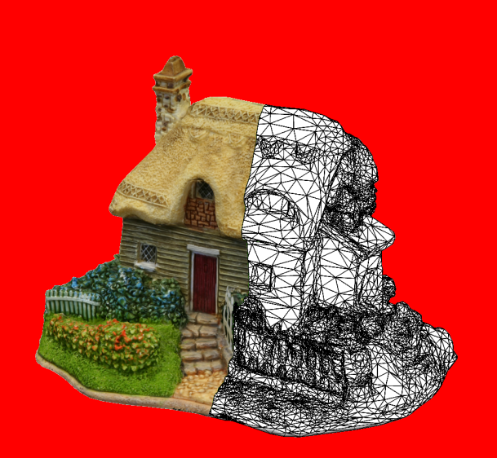
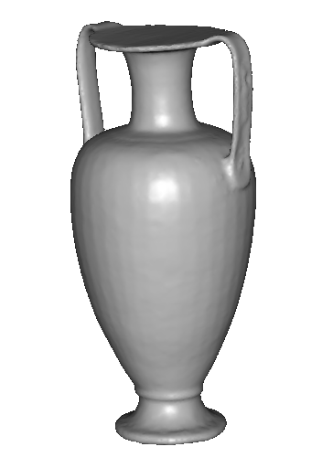
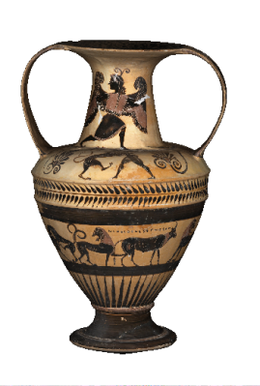
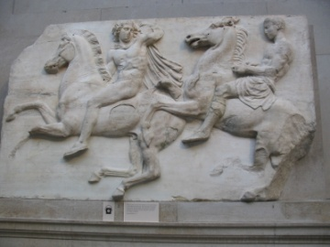
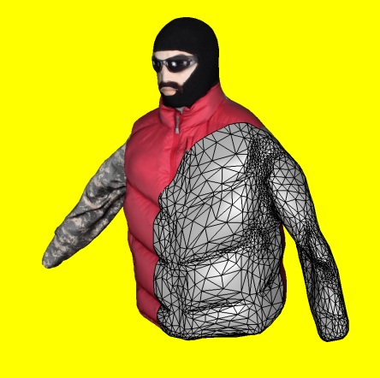
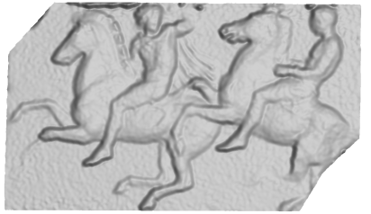
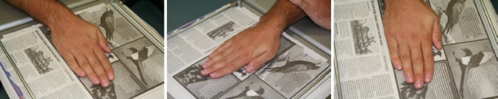
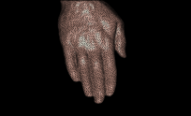
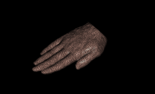
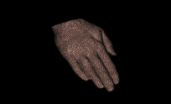
3D model
“Digital copy” of real object
Allows us to
  Inspect details of object
  Measure properties
  Reproduce in different material
Many applications
  Cultural heritage preservation
  Computer games and movies
  City modelling
  E-commerce

Slide 3
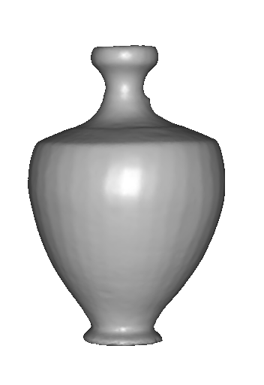
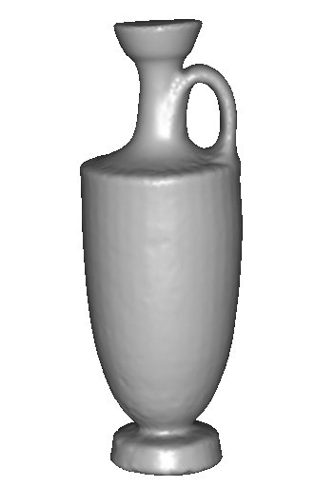
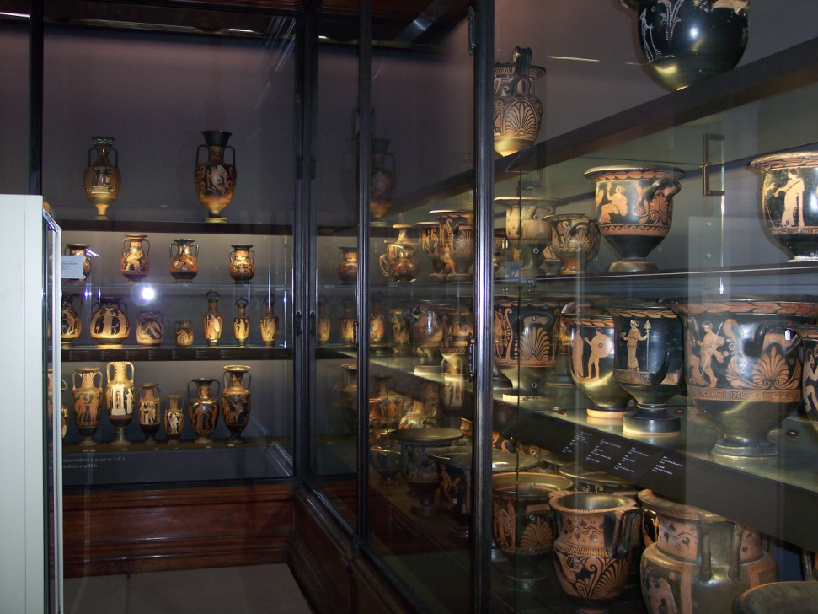
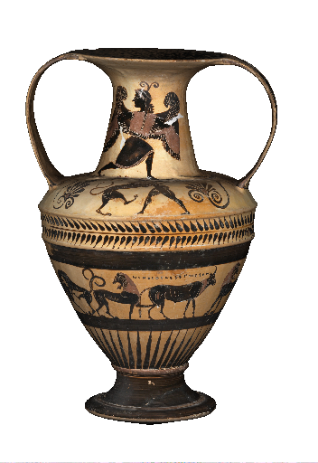
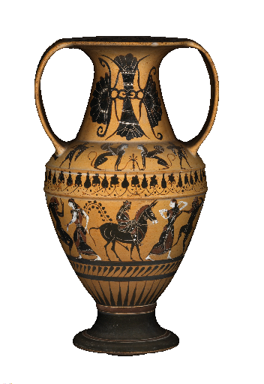
Applications: cultural heritage
SCULPTEUR European project
Notes:
To sum up,

Slide 4
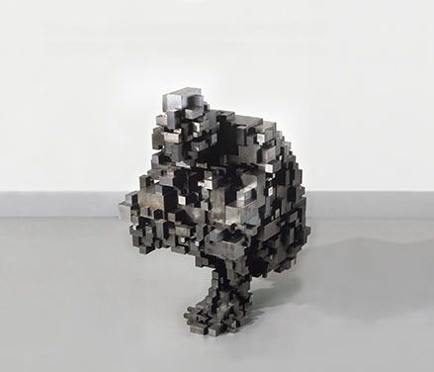
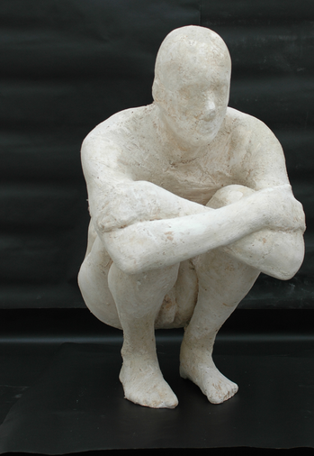
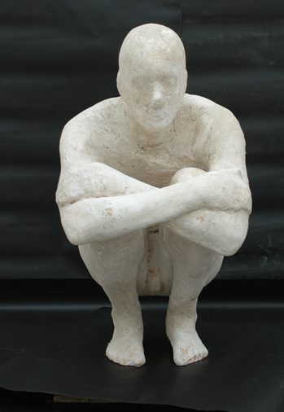
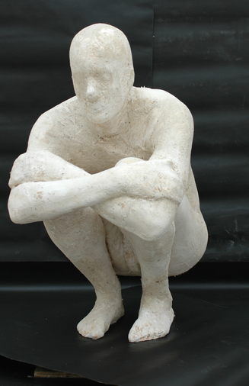
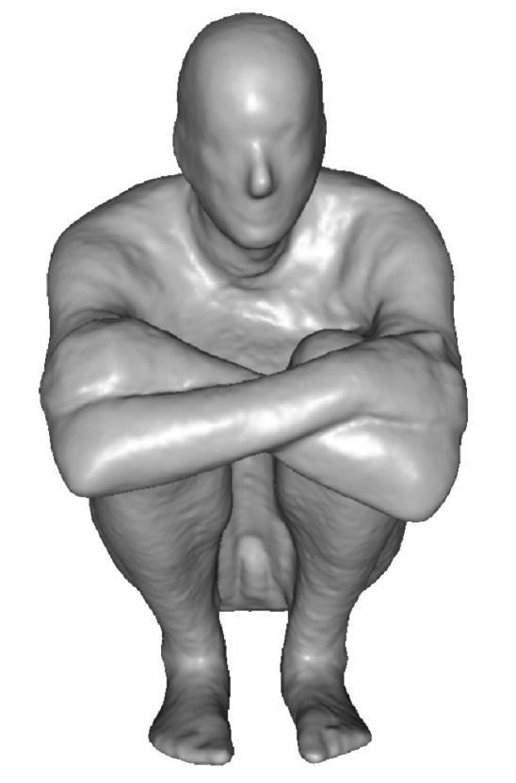
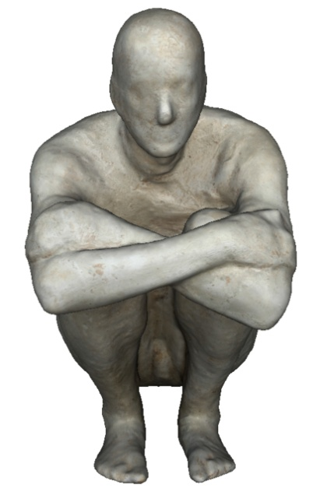
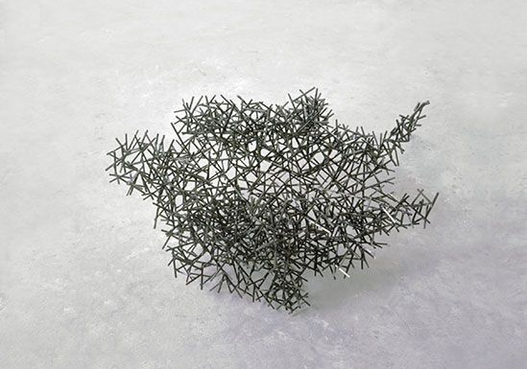
Applications: art
Block Works Precipitate III 2004
Mild steel blocks 80 x 46 x 66 cm
Domain Series Domain VIII Crouching
1999 Mild steel bar 81 x 59 x 63 cm

Slide 5
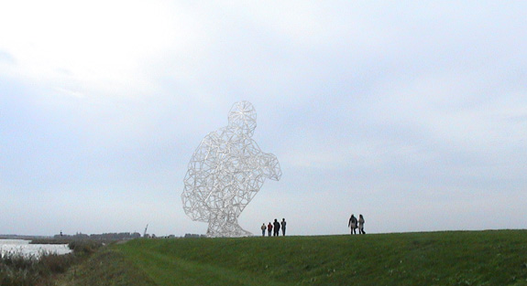
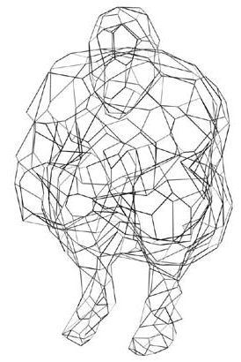
Applications: structure engineering
BODY / SPACE / FRAME, Antony Gormley, Lelystad, Holland
Notes:
To sum up,

Slide 6
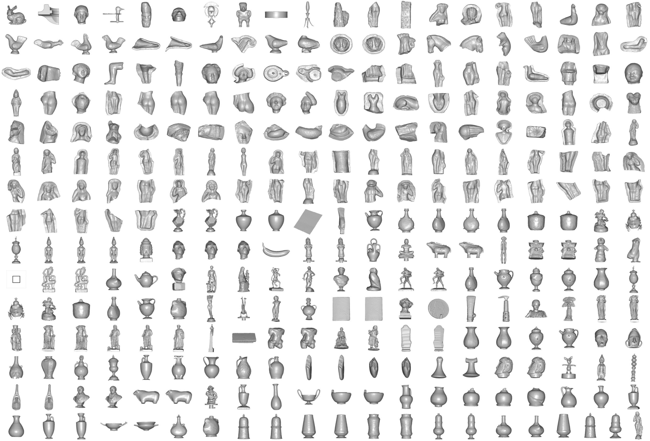
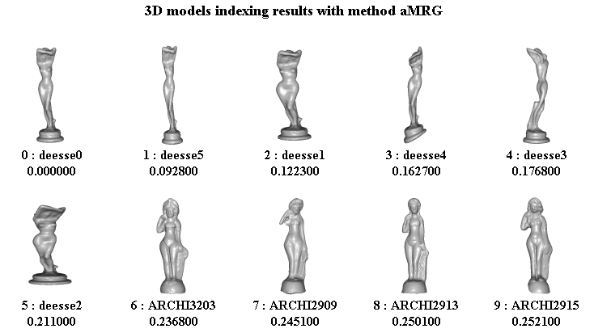
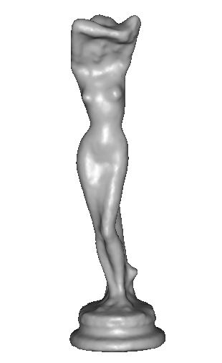
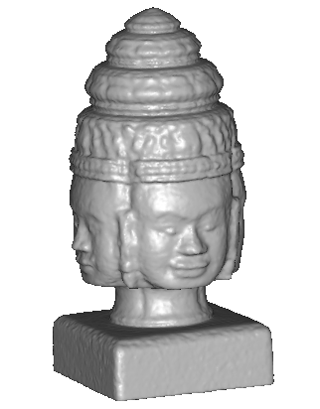
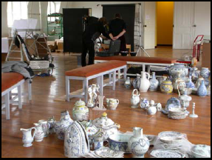
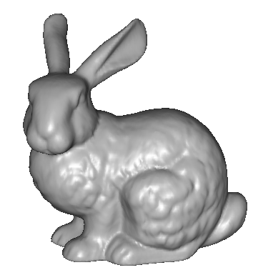
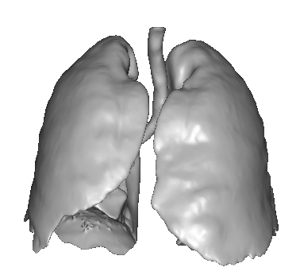
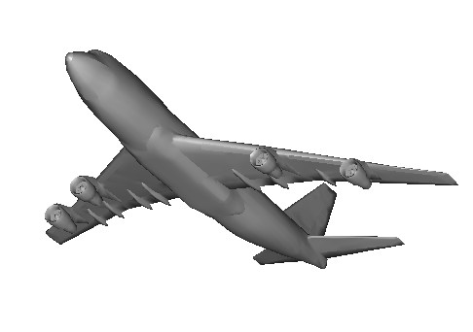
Applications: 3D indexation
? ?
? ? ?
?
? ?
?
SCULPTEUR European project
medical, industrial and cultural heritage indexation

Slide 7
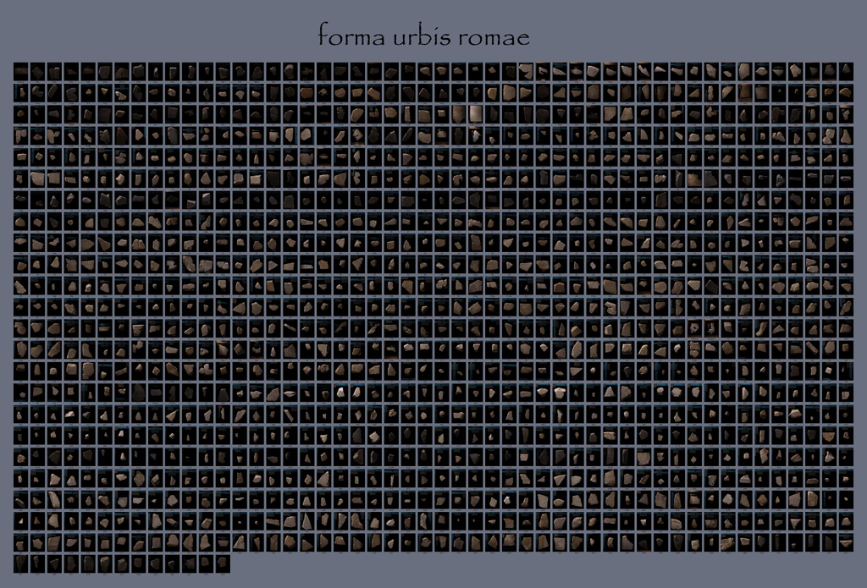
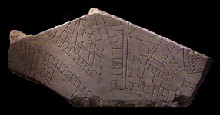
Applications: archaeology
“forma urbis romae” project
Fragments of the City: Stanford's Digital Forma Urbis Romae Project
David Koller, Jennifer Trimble, Tina Najbjerg, Natasha Gelfand, Marc Levoy
Proc. Third Williams Symposium
on Classical Architecture,
Journal of Roman Archaeology
supplement, 2006.
1186 fragments

Slide 8
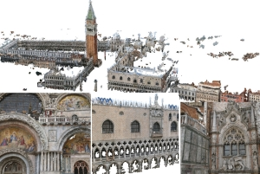
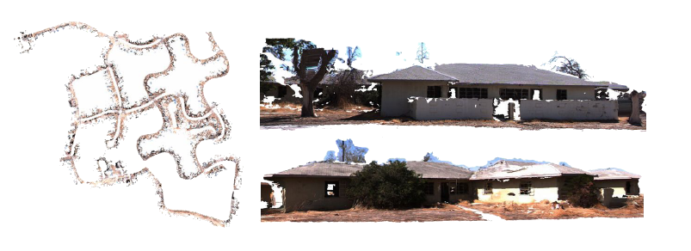
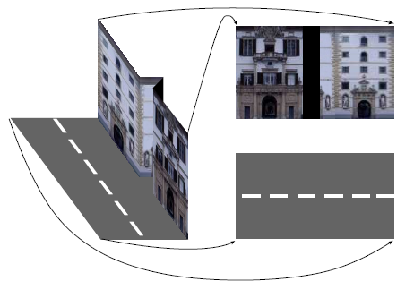

Applications: large scale modelling
[Furukawa10]
[Pollefeys08]
[Cornelis08]
[Goesele07]

Slide 9
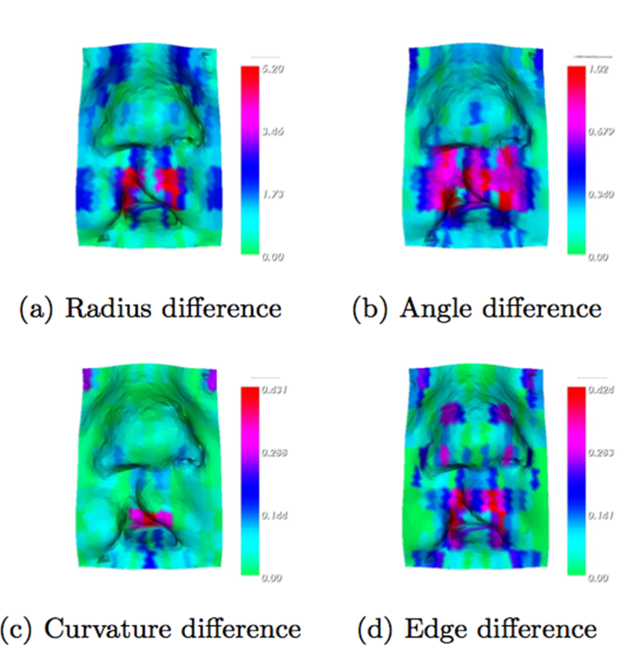
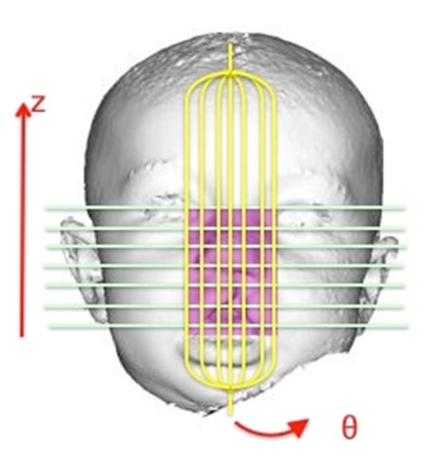
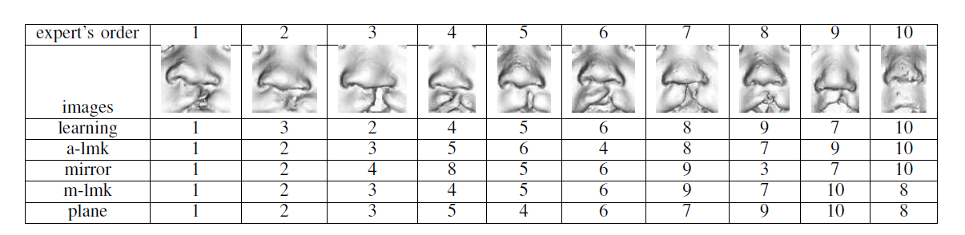
Applications: Medicine

Slide 10
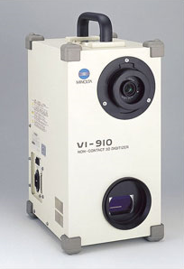
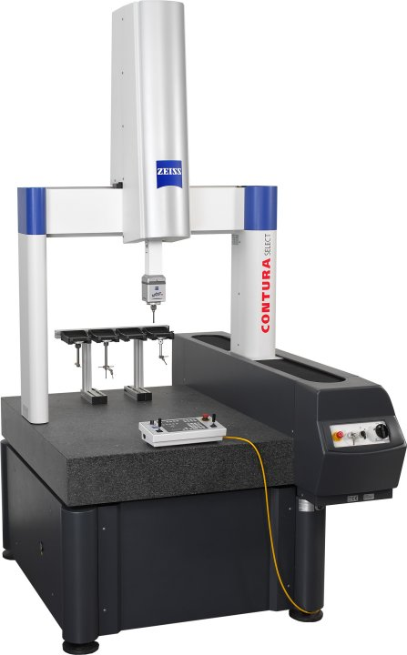

Scanning technologies
Laser scanner, coordinate measuring machine
  Very accurate
  Very Expensive
  Complicated to use
Minolta
“Michelangelo” project
Contura CMM

Slide 11
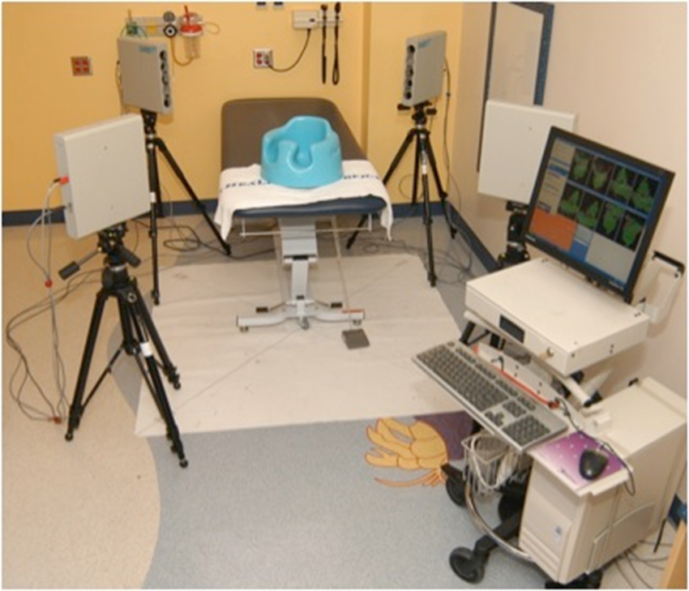
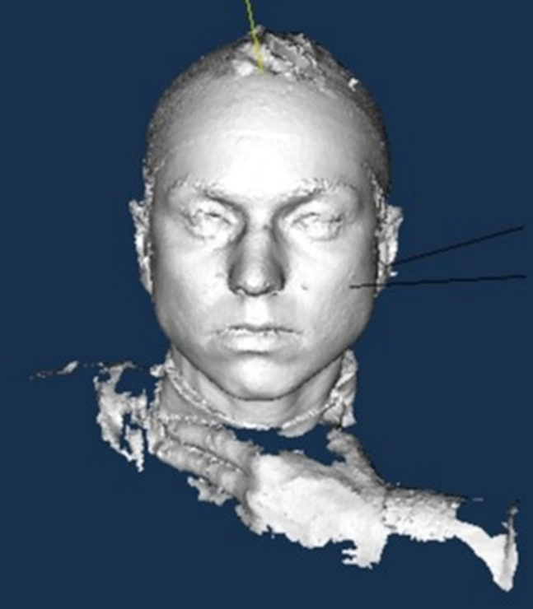
Medical Scanning System

Slide 12
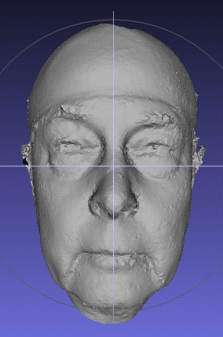
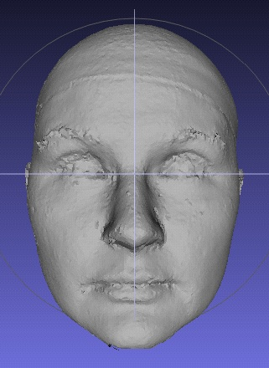
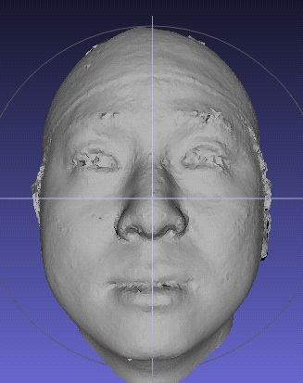
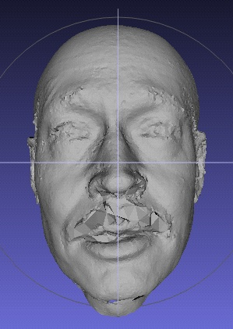
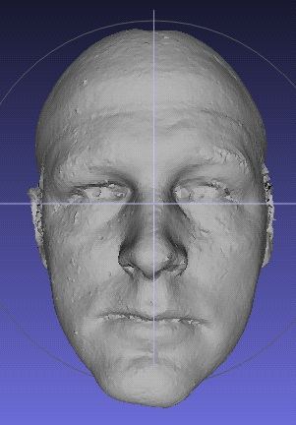
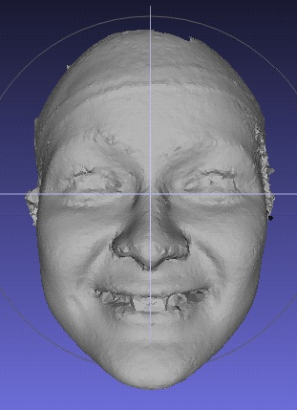


The “Us” Data Set (subset)

Slide 13


3d shape from photographs
“Estimate a 3d shape that would generate the input photographs given the same material, viewpoints and illumination”
viewpoint
?
geometry
material
illumination
image

Slide 14
Photometric Stereo
Estimate the surface normals of a given scene given multiple 2D images taken from the same viewpoint, but under different lighting conditions.
Basic photometric stereo required a Lambertian reflectance model:
I = ρ n · v
where I is pixel intensity, n is the normal, v is the lighting direction, and ρ is diffuse albedo constant, which is a reflection coefficient.

Slide 15

Basic Photometric Stereo

Slide 16

Basic Photometric Stereo

Slide 17
Basic Photometric Stereo
K light sources
Lead to K images R₁(p,q), ...,R_{K}(p,q) each from just one of the light sources being on
For any (p,q), we get K intensities I₁,...I_{K}
Leads to a set of linear equations of the form
I_{k} = ρn•v_{k}
Solving leads to a surface normal map.

Slide 18


Photometric Stereo
Inputs
3D normals

Slide 19
3d shape from photographs
Photograph based 3d reconstruction is:
  practical
  fast
  non-intrusive
  low cost
  Easily deployable outdoors
  “low” accuracy
  Results depend on material properties

Slide 20

Reconstruction
Generic problem formulation: given several images of the same object or scene, compute a representation of its 3D shape

Slide 21
Reconstruction
Generic problem formulation: given several images of the same object or scene, compute a representation of its 3D shape
“Images of the same object or scene”
  Arbitrary number of images (from two to thousands)
  Arbitrary camera positions (camera network or video sequence)
  Calibration may be initially unknown
“Representation of 3D shape”
  Depth maps
  Meshes
  Point clouds
  Patch clouds
  Volumetric models
  Layered models

Slide 22




Multiple-baseline stereo
I1
I2
I10
M. Okutomi and T. Kanade, “A Multiple-Baseline Stereo System,” IEEE Trans. on Pattern Analysis and Machine Intelligence, 15(4):353-363 (1993).

Slide 23






Reconstruction from silhouettes
Can be computed robustly
Can be computed efficiently
background
+
foreground
background
foreground
-
=

Slide 24
Reconstruction from Silhouettes
The case of binary images: a voxel is photo-consistent if it lies inside the object’s silhouette in all views
Binary Images

Slide 25
Reconstruction from Silhouettes
The case of binary images: a voxel is photo-consistent if it lies inside the object’s silhouette in all views
voxel space
Binary Images
Finding the silhouette-consistent shape (visual hull):
  Backproject each silhouette
  Intersect backprojected volumes

Slide 26





Calibrated Image Acquisition
Selected Dinosaur Images
Calibrated Turntable
360° rotation (21 images)
Selected Flower Images

Slide 27
Space Carving in General
Image 1
Image N
…...
Space Carving Algorithm
  Initialize to a volume V containing the true scene
  Choose a voxel on the outside of the volume
  Project to visible input images
  Carve if not photo-consistent (inside object’s silhouette)
  Repeat until convergence
K. N. Kutulakos and S. M. Seitz, A Theory of Shape by Space Carving, ICCV 1999

Slide 28

Our 4-camera light-striping stereo system
(now deceased)
cameras
projector
rotation
table
3D
object

Slide 29

Calibration Object
The idea is to snap
images at different
depths and get a
lot of 2D-3D point
correspondences.

Slide 30


Slide 31


Slide 32


Slide 33


Slide 34
3D space is made up of many cubes.
image plane
depth map
(u,v,d)
(
((x,y,z)
one of many cubes
in virtual 3D cube space
OUTSIDE

Slide 35


Slide 36


Slide 38


Slide 39


Slide 40


Slide 41


Slide 42


Slide 43




More: Space Carving Results: African Violet
Input Image (1 of 45)
Reconstruction
Reconstruction
Reconstruction
Source: S. Seitz

Slide 44



More: Space Carving Results: Hand
Input Image
(1 of 100)
Views of Reconstruction

Slide 45


Stereo from community photo collections
Up to now, we’ve always assumed that camera calibration is known
For photos taken from the Internet, we need structure from motion techniques to reconstruct both camera positions and 3D points. (SEE POSTED VIDEO)

Slide 46




Slide 47


Head Reconstruction from Uncalibrated Internet Photos
Input: Internet photos in different poses and expressions
Output: 3D model of the head
work of
Shu Liang

Slide 48
Recognizing Deformable Shapes
Salvador Ruiz Correa
(CSE/EE576 Computer Vision I)

Slide 49


Goal
We are interested in developing algorithms for recognizing and classifying deformable object shapes from range data.
3-D Output
Surface Mesh
3-D Laser Scanner
Range
data
Post-
processing
Input
3-D
Object
(Cloud of
3-D points)
This is a difficult problem that is relevant in several application fields.

Slide 50
















What Kind Of Deformations?
Neurocranium
Normal
Mandibles
Abnormal
Normal
Toy animals
Abnormal
3-D Faces
Shape classes: significant
amount of intra-class variability

Slide 51
Component-Based Methodology
1
Numeric
Signatures
Overcomes the limitations
of the alignment-verification
approach
define
2
Components
4
Describe
spatial
configuration
Architecture
of
Classifiers
Recognition And Classification Of
Deformable Shapes
+
3
Symbolic
Signatures

Slide 52




Assumptions
All shapes are represented as oriented surface meshes of fixed resolution.
The vertices of the meshes in the training set are in full correspondence.
Finding full correspondences : hard problem yes … but it is approachable ( use morphable models technique: Blantz and Vetter, SIGGRAPH 99; C. R. Shelton, IJCV, 2000; Allen et al., SIGGRAPH 2003).

Slide 53
Four Key Elements To Our Approach
Numeric
Signatures
1
Components
2
4
Architecture
of
Classifiers
Recognition And Classification Of
Deformable Shapes
+
Symbolic
Signatures
3

Slide 54
Numeric Signatures
Numeric
Signatures
1
Encode Local
Surface Geometry of an Object
Components
2
4
Architecture
of
Classifiers
+
Symbolic
Signatures
3

Slide 55
The Spin Image Signature
P is the selected vertex.
X is a contributing point
of the mesh.
α is the perpendicular distance from X to P’s surface normal.
β is the signed perpendicular distance from X to P’s tangent plane.
X
n
β
P
α
tangent plane at P

Slide 56
Spin Image Construction
A spin image is constructed
- about a specified oriented point o of the object surface
- with respect to a set of contributing points C, which is
controlled by maximum distance and angle from o.
It is stored as an array of accumulators S(α,β) computed via:
For each point c in C(o)
1. compute α and β for c.
2. increment S (α,β)
o

Slide 57










Numeric Signatures: Spin Images
P
3-D faces
Spin images for point P
Rich set of surface shape descriptors.
Their spatial scale can be modified to include local and non-local surface features.
Representation is robust to scene clutter and occlusions.

Slide 58
Components
Numeric
Signatures
1
define
Components
2
Equivalent Numeric Signatures:
Encode Local Geometry
of a Shape Class
4
Architecture
of
Classifiers
+
Symbolic
Signatures
3

Slide 59




How To Extract Shape Class Components?
…
Training Set
Select
Seed
Points
Compute
Numeric
Signatures
Region
Growing
Algorithm
Component
Detector
…
Grown components
around seeds

Slide 60


Component Extraction Example
Selected 8 seed
points by hand
Labeled
Surface Mesh
Region
Growing
Grow one region at the time
(get one detector
per component)
Detected
components on a
training sample

Slide 61




How To Combine Component Information?
1
…
2
2
2
1
2
2
1
2
2
1
4
3
5
6
7
8
Extracted components on test samples
Note: Numeric signatures are invariant to mirror symmetry;
our approach preserves such an invariance.

Slide 62
Symbolic Signatures
Numeric
Signatures
1
Components
2
4
Architecture
of
Classifiers
Encode Geometrical
Relationships
Among Components
+
Symbolic
Signatures
3

Slide 63

Symbolic Signature
Labeled
Surface Mesh
Symbolic
Signature at P
Critical
Point P
Encode
Geometric
Configuration
4
3
5
8
7
6
Matrix storing component
labels

Slide 64





Symbolic Signatures Are Robust
To Deformations
P
4
3
4
3
3
3
4
3
4
4
5
5
5
5
5
8
8
8
8
8
6
7
6
7
6
7
6
7
6
7
Relative position of components is stable across deformations: experimental evidence

Slide 65
Architecture of Classifiers
Numeric
Signatures
1
Learns Components
And Their
Geometric Relationships
Components
2
4
+
Architecture
of
Classifiers
Symbolic
Signatures
3

Slide 66

Proposed Architecture
Verify spatial configuration
of the components
Identify
Components
Identify
Symbolic
Signatures
Input
Class
Label
Labeled
Mesh
-1
(Abnormal)
Surface
Mesh
Two classification stages

Slide 67
Architecture Implementation
ALL our classifiers are (off-the-shelf) ν-Support Vector Machines (ν-SVMs) (Schölkopf et al., 2000 and 2001).
Component (and symbolic signature) detectors are one-class classifiers.
Component label assignment: performed with a multi-way classifier that uses pairwise classification scheme.
Gaussian kernel.

Slide 68


Experimental Validation
Recognition Tasks: 4 (T1 - T4)
Classification Tasks: 3 (T5 – T7)
No. Experiments: 5470
Rotary Table
Setup
Laser
Recognition
Classification

Slide 69

Shape Classes

Slide 70






Enlarging Training Sets Using Virtual Samples
Displacement
Vectors
Morphs
Original
Twist (5deg)
+ Taper
- Push
+ Spherify (10%)
Originals
Morphs
Push
+Twist (10 deg)
+Scale (1.2)
(14)
Global Morphing
Operators
Physical Modeling
Electrical Engineering
University of Washington

Slide 71
Task 1: Recognizing Single Objects (1)
No. Shape classes: 9.
Training set size: 400 meshes.
Testing set size: 200 meshes.
No. Experiments: 1960.
No. Component detectors:3.
No. Symbolic signature detectors: 1.
Numeric signature size: 40x40.
Symbolic signature size: 20x20.
No clutter and occlusion.

Slide 72



Task 1: Recognizing Single Objects (2)
Snowman: 93%.
Rabbit: 92%.
Dog: 89%.
Cat: 85.5%.
Cow: 92%.
Bear: 94%.
Horse: 92.7%.
Human head: 97.7%.
Human face: 76%.
Recognition rates (true positives)
(No clutter, no occlusion, complete models)

Slide 73
Tasks 2-3: Recognition In Complex Scenes (1)
No. Shape classes: 3.
Training set size: 400 meshes.
Testing set size: 200 meshes.
No. Experiments: 1200.
No. Component detectors:3.
No. Symbolic signature detectors: 1.
Numeric signature size: 40x40.
Symbolic signature size: 20x20.
T2 – low clutter and occlusion.

Slide 74
Task 2-3: Recognition in Complex Scenes (2)
Shape Class | True Positives | False Positives | True Positives | False Positives
Snowmen | 91% | 31% | 87.5% | 28%
Rabbit | 90.2% | 27.6% | 84.3% | 24%
Dog | 89.6% | 34.6% | 88.12% | 22.1%
Task 2
Task 3

Slide 75

Task 2-3: Recognition in Complex Scenes (3)

Slide 76









Task 4: Recognizing Human Heads (3)

Slide 77






Task 5: Classifying Normal vs. Abnormal Human Heads (1)
Shape Classes | Classification Accuracy %
Normal vs. Abnormal 1 | 98
Normal vs. Abnormal 2 | 100
Abnormal 1 vs. 3 | 98
Abnormal 1 vs. 4 | 97
Abnormal 1 vs. 5 | 92
Normal
Abnormal
1
2
Five Cases
3
4
5
65%-35%
50%-50%
25%-75%
(convex combinations
of Normal and Abnormal 1)
Full models

Slide 78


Task 6: Classifying Normal vs. Abnormal Human Heads In Complex Scenes(1)
Shape Classes | Classification Accuracy %
Normal vs. Abnormal 1 | 88
Range scenes – single view
Clutter < 15%
and occlusion < 50%
RR full models (no clutter and occlusion) ~ 96% (250 experiments per class)

Slide 79






Task 7: Classifying Normal vs. Abnormal Neurocranium (2)
100 Experiments
Shape Classes | Classification Accuracy %
Normal vs. Abnormal | 89
Normal
Abnormal
(sagittal synostosis )
No clutter and occlusion
Superimposed
models

Slide 80
Main Contributions (1)
A novel symbolic signature representation of deformable shapes that is robust to intra-class variability and missing information, as opposed to a numeric representation which is often tied to a specific shape.
A novel kernel function for quantifying symbolic signature similarities.

Slide 81
Main Contributions (2)
A region growing algorithm for learning shape class components.
A novel architecture of classifiers for abstracting the geometry of a shape class.
A validation of our methodology in a set of large scale recognition and classification experiments aimed at applications in scene analysis and medical diagnosis.

