Slide 1
Images and Filters
ECE/CSE 576
Linda Shapiro

Slide 2
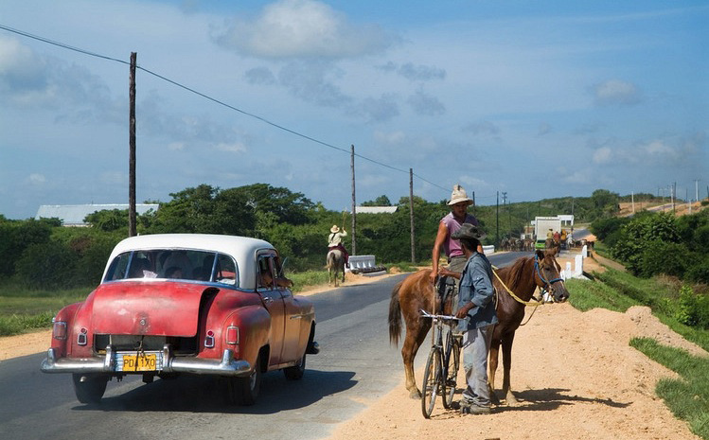
What is an image?

Slide 4
We sample the
image to get a
discrete set of
pixels with
quantized values.
2. For a gray tone
image there is one
band F(r,c), with
values usually
between 0 and
255.
3. For a color image
there are 3 bands
R(r,c), G(r,c), B(r,c)

Slide 5
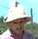
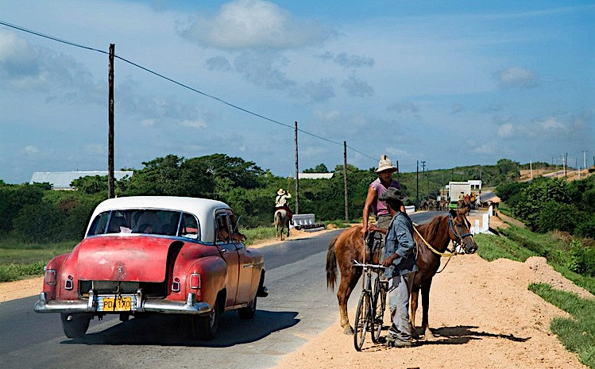
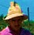
Image Operations
(functions of functions)
F( ) =

Slide 6
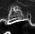


Image Operations
(functions of functions)
F( ) =

Slide 7
Image Operations
(functions of functions)
0.1
0
0.8
0.9
0.9
0.9
0.2
0.4
0.3
0.6
0
0
0.1
0.5
0.9
0.9
0.2
0.4
0.3
0.6
0
0
0.1
0.9
0.9
0.2
0.4
0.3
0.6
0
0
0.1
0.5
F( ) =

Slide 8
Image Operations
(functions of functions)
F( , ) =
Notes:
Blend two images. Control how much of each with a parameter.

Slide 9
Local image functions
F( ) =
Notes:
Ask Ali.

Slide 10

Image filtering
1
1
1
1
1
1
1
1
1
0 | 0 | 0 | 0 | 0 | 0 | 0 | 0 | 0 | 0
0 | 0 | 0 | 0 | 0 | 0 | 0 | 0 | 0 | 0
0 | 0 | 0 | 90 | 90 | 90 | 90 | 90 | 0 | 0
0 | 0 | 0 | 90 | 90 | 90 | 90 | 90 | 0 | 0
0 | 0 | 0 | 90 | 90 | 90 | 90 | 90 | 0 | 0
0 | 0 | 0 | 90 | 0 | 90 | 90 | 90 | 0 | 0
0 | 0 | 0 | 90 | 90 | 90 | 90 | 90 | 0 | 0
0 | 0 | 0 | 0 | 0 | 0 | 0 | 0 | 0 | 0
0 | 0 | 90 | 0 | 0 | 0 | 0 | 0 | 0 | 0
0 | 0 | 0 | 0 | 0 | 0 | 0 | 0 | 0 | 0
 | 0
0 | 0 | 0 | 0 | 0 | 0 | 0 | 0 | 0 | 0
0 | 0 | 0 | 0 | 0 | 0 | 0 | 0 | 0 | 0
0 | 0 | 0 | 90 | 90 | 90 | 90 | 90 | 0 | 0
0 | 0 | 0 | 90 | 90 | 90 | 90 | 90 | 0 | 0
0 | 0 | 0 | 90 | 90 | 90 | 90 | 90 | 0 | 0
0 | 0 | 0 | 90 | 0 | 90 | 90 | 90 | 0 | 0
0 | 0 | 0 | 90 | 90 | 90 | 90 | 90 | 0 | 0
0 | 0 | 0 | 0 | 0 | 0 | 0 | 0 | 0 | 0
0 | 0 | 90 | 0 | 0 | 0 | 0 | 0 | 0 | 0
0 | 0 | 0 | 0 | 0 | 0 | 0 | 0 | 0 | 0
Credit: S. Seitz

Slide 11
Image filtering
1
1
1
1
1
1
1
1
1
0 | 0 | 0 | 0 | 0 | 0 | 0 | 0 | 0 | 0
0 | 0 | 0 | 0 | 0 | 0 | 0 | 0 | 0 | 0
0 | 0 | 0 | 90 | 90 | 90 | 90 | 90 | 0 | 0
0 | 0 | 0 | 90 | 90 | 90 | 90 | 90 | 0 | 0
0 | 0 | 0 | 90 | 90 | 90 | 90 | 90 | 0 | 0
0 | 0 | 0 | 90 | 0 | 90 | 90 | 90 | 0 | 0
0 | 0 | 0 | 90 | 90 | 90 | 90 | 90 | 0 | 0
0 | 0 | 0 | 0 | 0 | 0 | 0 | 0 | 0 | 0
0 | 0 | 90 | 0 | 0 | 0 | 0 | 0 | 0 | 0
0 | 0 | 0 | 0 | 0 | 0 | 0 | 0 | 0 | 0
 | 0 | 10
0 | 0 | 0 | 0 | 0 | 0 | 0 | 0 | 0 | 0
0 | 0 | 0 | 0 | 0 | 0 | 0 | 0 | 0 | 0
0 | 0 | 0 | 90 | 90 | 90 | 90 | 90 | 0 | 0
0 | 0 | 0 | 90 | 90 | 90 | 90 | 90 | 0 | 0
0 | 0 | 0 | 90 | 90 | 90 | 90 | 90 | 0 | 0
0 | 0 | 0 | 90 | 0 | 90 | 90 | 90 | 0 | 0
0 | 0 | 0 | 90 | 90 | 90 | 90 | 90 | 0 | 0
0 | 0 | 0 | 0 | 0 | 0 | 0 | 0 | 0 | 0
0 | 0 | 90 | 0 | 0 | 0 | 0 | 0 | 0 | 0
0 | 0 | 0 | 0 | 0 | 0 | 0 | 0 | 0 | 0
Credit: S. Seitz
Notes:
ones, divide by 9

Slide 12
Image filtering
1
1
1
1
1
1
1
1
1
0 | 0 | 0 | 0 | 0 | 0 | 0 | 0 | 0 | 0
0 | 0 | 0 | 0 | 0 | 0 | 0 | 0 | 0 | 0
0 | 0 | 0 | 90 | 90 | 90 | 90 | 90 | 0 | 0
0 | 0 | 0 | 90 | 90 | 90 | 90 | 90 | 0 | 0
0 | 0 | 0 | 90 | 90 | 90 | 90 | 90 | 0 | 0
0 | 0 | 0 | 90 | 0 | 90 | 90 | 90 | 0 | 0
0 | 0 | 0 | 90 | 90 | 90 | 90 | 90 | 0 | 0
0 | 0 | 0 | 0 | 0 | 0 | 0 | 0 | 0 | 0
0 | 0 | 90 | 0 | 0 | 0 | 0 | 0 | 0 | 0
0 | 0 | 0 | 0 | 0 | 0 | 0 | 0 | 0 | 0
 | 0 | 10 | 20
0 | 0 | 0 | 0 | 0 | 0 | 0 | 0 | 0 | 0
0 | 0 | 0 | 0 | 0 | 0 | 0 | 0 | 0 | 0
0 | 0 | 0 | 90 | 90 | 90 | 90 | 90 | 0 | 0
0 | 0 | 0 | 90 | 90 | 90 | 90 | 90 | 0 | 0
0 | 0 | 0 | 90 | 90 | 90 | 90 | 90 | 0 | 0
0 | 0 | 0 | 90 | 0 | 90 | 90 | 90 | 0 | 0
0 | 0 | 0 | 90 | 90 | 90 | 90 | 90 | 0 | 0
0 | 0 | 0 | 0 | 0 | 0 | 0 | 0 | 0 | 0
0 | 0 | 90 | 0 | 0 | 0 | 0 | 0 | 0 | 0
0 | 0 | 0 | 0 | 0 | 0 | 0 | 0 | 0 | 0
Credit: S. Seitz
Notes:
ones, divide by 9

Slide 13
Image filtering
1
1
1
1
1
1
1
1
1
0 | 0 | 0 | 0 | 0 | 0 | 0 | 0 | 0 | 0
0 | 0 | 0 | 0 | 0 | 0 | 0 | 0 | 0 | 0
0 | 0 | 0 | 90 | 90 | 90 | 90 | 90 | 0 | 0
0 | 0 | 0 | 90 | 90 | 90 | 90 | 90 | 0 | 0
0 | 0 | 0 | 90 | 90 | 90 | 90 | 90 | 0 | 0
0 | 0 | 0 | 90 | 0 | 90 | 90 | 90 | 0 | 0
0 | 0 | 0 | 90 | 90 | 90 | 90 | 90 | 0 | 0
0 | 0 | 0 | 0 | 0 | 0 | 0 | 0 | 0 | 0
0 | 0 | 90 | 0 | 0 | 0 | 0 | 0 | 0 | 0
0 | 0 | 0 | 0 | 0 | 0 | 0 | 0 | 0 | 0
 | 0 | 10 | 20 | 30
0 | 0 | 0 | 0 | 0 | 0 | 0 | 0 | 0 | 0
0 | 0 | 0 | 0 | 0 | 0 | 0 | 0 | 0 | 0
0 | 0 | 0 | 90 | 90 | 90 | 90 | 90 | 0 | 0
0 | 0 | 0 | 90 | 90 | 90 | 90 | 90 | 0 | 0
0 | 0 | 0 | 90 | 90 | 90 | 90 | 90 | 0 | 0
0 | 0 | 0 | 90 | 0 | 90 | 90 | 90 | 0 | 0
0 | 0 | 0 | 90 | 90 | 90 | 90 | 90 | 0 | 0
0 | 0 | 0 | 0 | 0 | 0 | 0 | 0 | 0 | 0
0 | 0 | 90 | 0 | 0 | 0 | 0 | 0 | 0 | 0
0 | 0 | 0 | 0 | 0 | 0 | 0 | 0 | 0 | 0
Credit: S. Seitz

Slide 14
Image filtering
1
1
1
1
1
1
1
1
1
0 | 0 | 0 | 0 | 0 | 0 | 0 | 0 | 0 | 0
0 | 0 | 0 | 0 | 0 | 0 | 0 | 0 | 0 | 0
0 | 0 | 0 | 90 | 90 | 90 | 90 | 90 | 0 | 0
0 | 0 | 0 | 90 | 90 | 90 | 90 | 90 | 0 | 0
0 | 0 | 0 | 90 | 90 | 90 | 90 | 90 | 0 | 0
0 | 0 | 0 | 90 | 0 | 90 | 90 | 90 | 0 | 0
0 | 0 | 0 | 90 | 90 | 90 | 90 | 90 | 0 | 0
0 | 0 | 0 | 0 | 0 | 0 | 0 | 0 | 0 | 0
0 | 0 | 90 | 0 | 0 | 0 | 0 | 0 | 0 | 0
0 | 0 | 0 | 0 | 0 | 0 | 0 | 0 | 0 | 0
 | 0 | 10 | 20 | 30 | 30
Credit: S. Seitz

Slide 15
Image filtering
1
1
1
1
1
1
1
1
1
0 | 0 | 0 | 0 | 0 | 0 | 0 | 0 | 0 | 0
0 | 0 | 0 | 0 | 0 | 0 | 0 | 0 | 0 | 0
0 | 0 | 0 | 90 | 90 | 90 | 90 | 90 | 0 | 0
0 | 0 | 0 | 90 | 90 | 90 | 90 | 90 | 0 | 0
0 | 0 | 0 | 90 | 90 | 90 | 90 | 90 | 0 | 0
0 | 0 | 0 | 90 | 0 | 90 | 90 | 90 | 0 | 0
0 | 0 | 0 | 90 | 90 | 90 | 90 | 90 | 0 | 0
0 | 0 | 0 | 0 | 0 | 0 | 0 | 0 | 0 | 0
0 | 0 | 90 | 0 | 0 | 0 | 0 | 0 | 0 | 0
0 | 0 | 0 | 0 | 0 | 0 | 0 | 0 | 0 | 0
 | 0 | 10 | 20 | 30 | 30
?
Credit: S. Seitz

Slide 16
Image filtering
1
1
1
1
1
1
1
1
1
0 | 0 | 0 | 0 | 0 | 0 | 0 | 0 | 0 | 0
0 | 0 | 0 | 0 | 0 | 0 | 0 | 0 | 0 | 0
0 | 0 | 0 | 90 | 90 | 90 | 90 | 90 | 0 | 0
0 | 0 | 0 | 90 | 90 | 90 | 90 | 90 | 0 | 0
0 | 0 | 0 | 90 | 90 | 90 | 90 | 90 | 0 | 0
0 | 0 | 0 | 90 | 0 | 90 | 90 | 90 | 0 | 0
0 | 0 | 0 | 90 | 90 | 90 | 90 | 90 | 0 | 0
0 | 0 | 0 | 0 | 0 | 0 | 0 | 0 | 0 | 0
0 | 0 | 90 | 0 | 0 | 0 | 0 | 0 | 0 | 0
0 | 0 | 0 | 0 | 0 | 0 | 0 | 0 | 0 | 0
 | 0 | 10 | 20 | 30 | 30
 |  |  |  | 50
?
Credit: S. Seitz

Slide 17
Image filtering
1
1
1
1
1
1
1
1
1
0 | 0 | 0 | 0 | 0 | 0 | 0 | 0 | 0 | 0
0 | 0 | 0 | 0 | 0 | 0 | 0 | 0 | 0 | 0
0 | 0 | 0 | 90 | 90 | 90 | 90 | 90 | 0 | 0
0 | 0 | 0 | 90 | 90 | 90 | 90 | 90 | 0 | 0
0 | 0 | 0 | 90 | 90 | 90 | 90 | 90 | 0 | 0
0 | 0 | 0 | 90 | 0 | 90 | 90 | 90 | 0 | 0
0 | 0 | 0 | 90 | 90 | 90 | 90 | 90 | 0 | 0
0 | 0 | 0 | 0 | 0 | 0 | 0 | 0 | 0 | 0
0 | 0 | 90 | 0 | 0 | 0 | 0 | 0 | 0 | 0
0 | 0 | 0 | 0 | 0 | 0 | 0 | 0 | 0 | 0
 | 0 | 10 | 20 | 30 | 30 | 30 | 20 | 10
 | 0 | 20 | 40 | 60 | 60 | 60 | 40 | 20
 | 0 | 30 | 60 | 90 | 90 | 90 | 60 | 30
 | 0 | 30 | 50 | 80 | 80 | 90 | 60 | 30
 | 0 | 30 | 50 | 80 | 80 | 90 | 60 | 30
 | 0 | 20 | 30 | 50 | 50 | 60 | 40 | 20
 | 10 | 20 | 30 | 30 | 30 | 30 | 20 | 10
 | 10 | 10 | 10 | 0 | 0 | 0 | 0 | 0
Credit: S. Seitz

Slide 18
Box Filter
What does it do?
Replaces each pixel with an average of its neighborhood
Achieve smoothing effect (remove sharp features)
1
1
1
1
1
1
1
1
1
Slide credit: David Lowe (UBC)

Slide 19


Smoothing with box filter

Slide 20

Practice with linear filters
0
0
0
?
0
1
0
0
0
0
Original
Source: D. Lowe
Notes:
What will this do?

Slide 21
Practice with linear filters
0
0
0
0
1
0
0
0
0
Original
Filtered
(no change)
Source: D. Lowe

Slide 22
Practice with linear filters
0
0
0
?
0
0
1
0
0
0
Original
Source: D. Lowe

Slide 23
Practice with linear filters
0
0
0
0
0
1
0
0
0
Original
Shifted left
By 1 pixel
Source: D. Lowe

Slide 24
Practice with linear filters
0
0
0
-
1
1
1
?
0
2
0
1
1
1
0
0
0
1
1
1
Original
Source: D. Lowe

Slide 25

Practice with linear filters
0
0
0
-
1
1
1
0
2
0
1
1
1
0
0
0
1
1
1
Original
Sharpening filter
  Accentuates differences with local average
Source: D. Lowe

Slide 26

Sharpening
Source: D. Lowe

Slide 27


Other filters
1
0
-1
2
0
-2
1
0
-1
Sobel
Vertical Edge
(absolute value)

Slide 28

Other filters
1
2
1
0
0
0
-1
-2
-1
Sobel
Horizontal Edge
(absolute value)

Slide 29
Basic gradient filters
Horizontal Gradient
Vertical Gradient
0
0
0
0
1
0
-1
0
1
-1
0
1
0
0
0
or
0
0
0
0
-1
0
or
-1
0
1
Notes:
Is it the same? Yes.

Slide 30
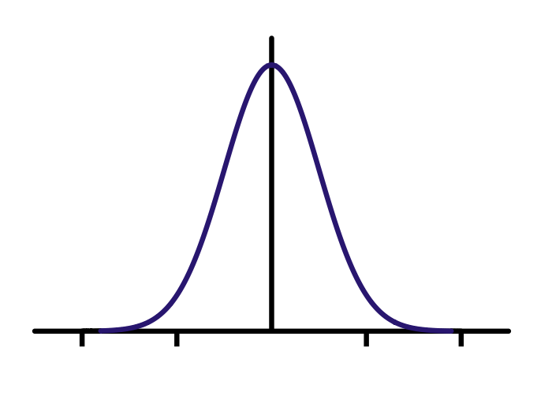

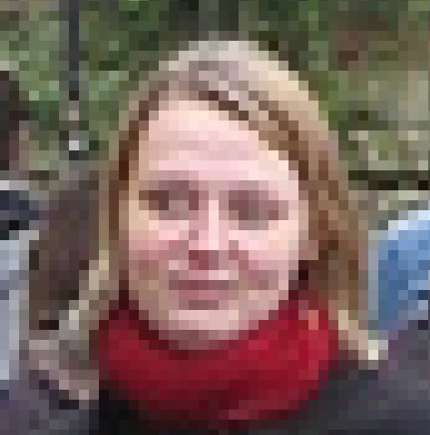


Gaussian filter
=
*
Filter h
Input image f
Output image g
Notes:
Modify

Slide 31
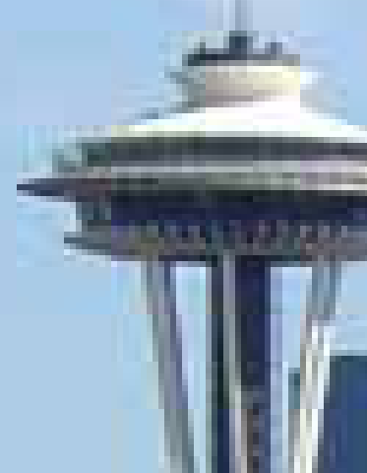
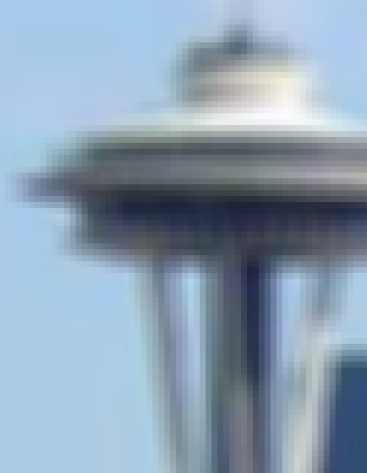

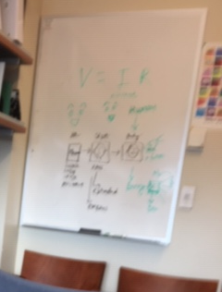


Gaussian vs. mean filters
What does real blur look like?

Slide 32

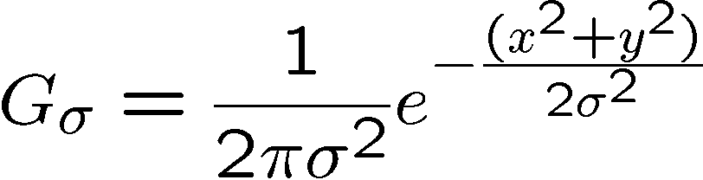
Important filter: Gaussian
Spatially-weighted average
0.003 0.013 0.022 0.013 0.003
0.013 0.059 0.097 0.059 0.013
0.022 0.097 0.159 0.097 0.022
0.013 0.059 0.097 0.059 0.013
0.003 0.013 0.022 0.013 0.003
5 x 5, σ = 1
Slide credit: Christopher Rasmussen

Slide 33

Smoothing with Gaussian filter

Slide 34
Smoothing with box filter

Slide 35
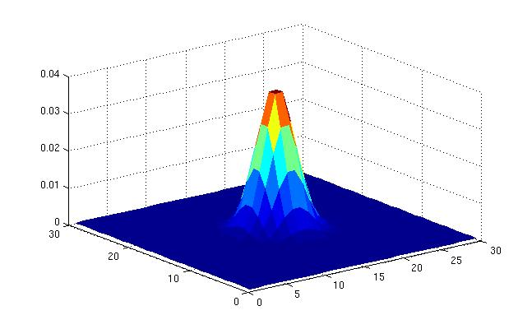
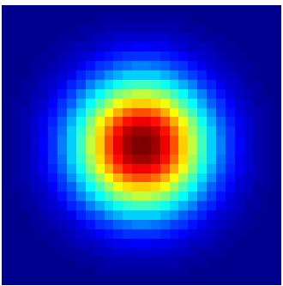
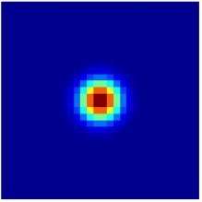
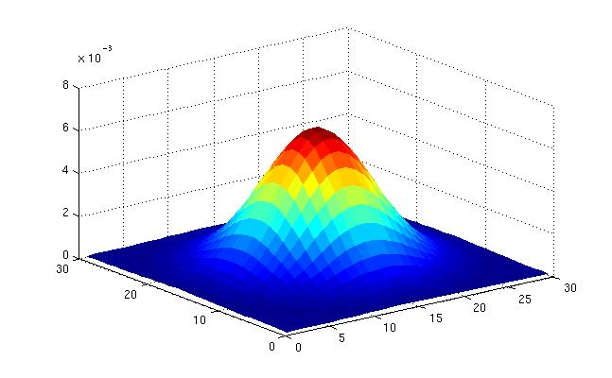
Gaussian filters
What parameters matter here?
Variance of Gaussian: determines extent of smoothing
Source: K. Grauman

Slide 36






Smoothing with a Gaussian
Parameter σ is the “scale” / “width” / “spread” of the Gaussian kernel, and controls the amount of smoothing.
…
Source: K. Grauman

Slide 37







2D edge detection filters
Laplacian of Gaussian
or LoG filter
Gaussian
x derivative of Gaussian
Often approximated by
is the Laplacian operator (sum of 2nd derivatives):
0 1 0
1 -4 1
0 1 0
Notes:
How many 2nd derivative filters are there? There are four 2nd partial derivative filters.
In practice, it’s handy to define a single 2nd derivative filter—the Laplacian

Slide 38
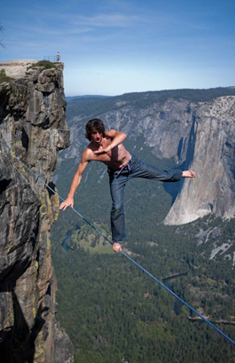
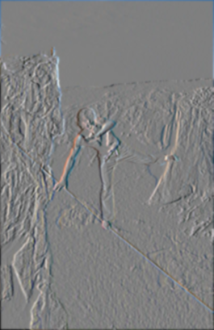
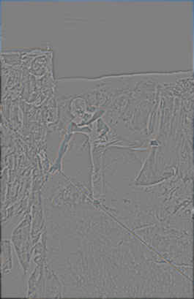
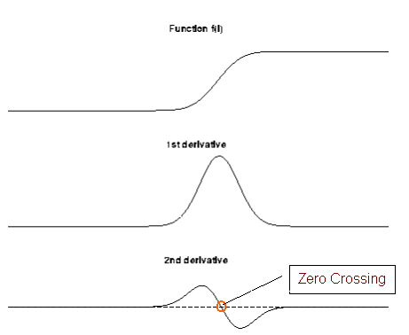
First and second derivatives
What are these good for?
Original
First Derivative x
Second Derivative x, y

Slide 39
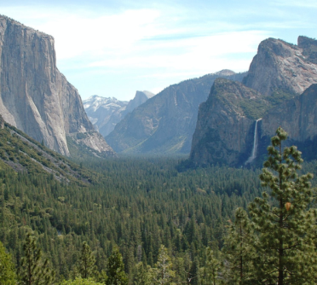
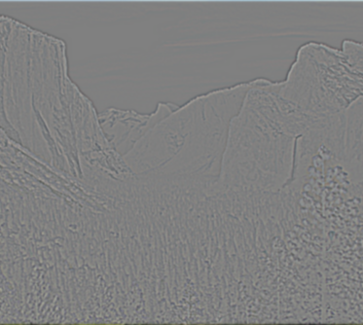
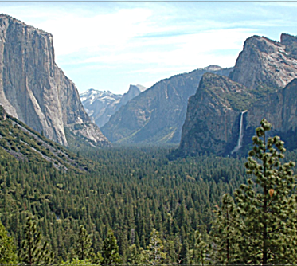
Subtracting filters
Original
Second Derivative
Sharpened

Slide 40
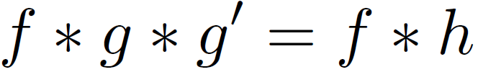


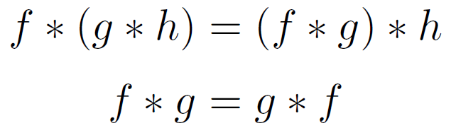
Combining filters
for some
0 | 0 | 0 | 0 | 0
0 | 0 | 0 | 0 | 0
0 | -1 | 0 | 1 | 0
0 | 0 | 0 | 0 | 0
0 | 0 | 0 | 0 | 0
=
*
0 | 0 | 0 | 0 | 0
0 | 0 | -1 | 0 | 0
0 | -1 | 4 | -1 | 0
0 | 0 | -1 | 0 | 0
0 | 0 | 0 | 0 | 0
=
*
It’s also true:

Slide 41


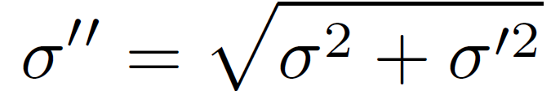
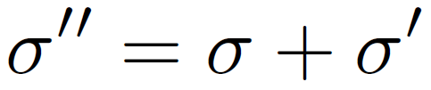
Combining Gaussian filters
=
*
?
More blur than either individually (but less than )

Slide 42

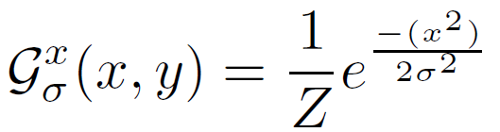
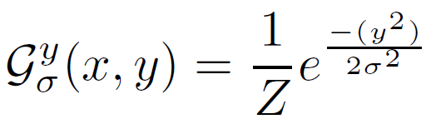
Separable filters
Compute Gaussian in horizontal direction, followed by the vertical direction.
Much faster!
=
*
Not all filters are separable. Freeman and Adelson, 1991

Slide 43
Linear vs. Non-Linear Filters
a. original image with Gaussian noise, b. Gaussian filtered, c. median filtered, d. bilateral filtered
e. original image with shot noise, f. Gaussian filtered, g. median filtered, h. bilateral filtered

Slide 44
Spatially varying filters
Some filters vary spatially.
The bilateral filter is the product of a domain kernel (Gaussian)
and a data dependent range kernel.
d(i,j,k,l) = exp[(-(i-k)²+(j-l)²)/2σ_{d}²] is the domain kernel
r(i,j,k,l) = exp[-||f(i,j)-f(k,l)||²/2σ_{r}²] is the range kernel
w(i,j,k,l) = d(i,j,k,l) * r(i,j,k,l) is their product
g(i,j) = Σ_{k,l} f(k,l) w(i,j,k,l) / Σ_{k,l} w(i,j,k,l) is the bilateral filter
from Szeliski text
Notes:
May delete.

Slide 45


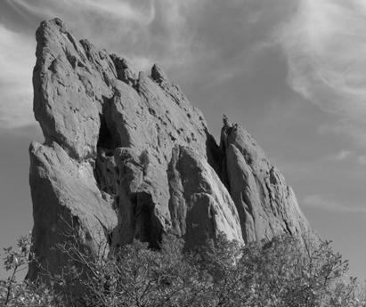
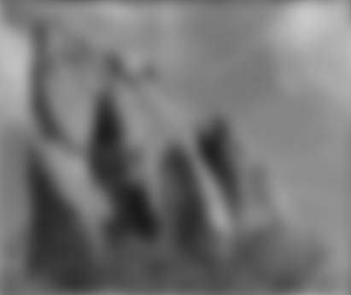


Constant blur: same kernel everywhere
*
input
output
*
*
Same Gaussian kernel everywhere.
Slides courtesy of Sylvian Paris

Slide 46

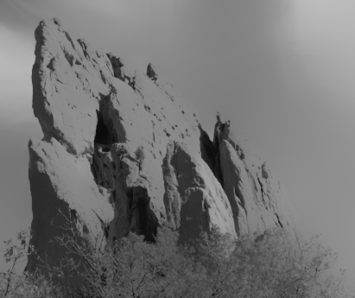


Bilateral filter: kernel depends on intensity
Maintains edges when blurring!
*
input
output
*
*
The kernel shape depends on the image content.
Slides courtesy of Sylvian Paris
Notes:
Why?

Slide 47
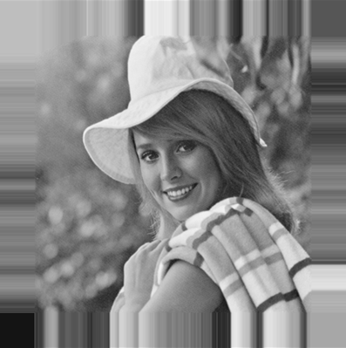
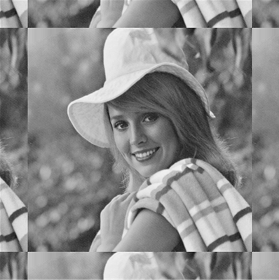
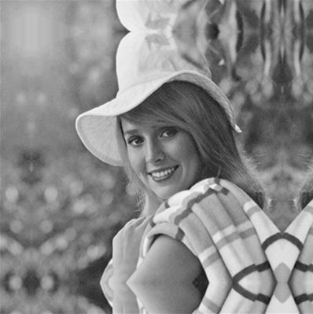
Borders
What to do about image borders:
black
fixed
periodic
reflected

Slide 48
Image Sampling
F( ) =
F( ) =

Slide 49

Image Scaling
This image is too big to
fit on the screen. How
can we reduce it?
How to generate a half-
sized version?

Slide 50



Image sub-sampling
1/8
1/4
Throw away every other row and column to create a 1/2 size image
  - called image sub-sampling

Slide 51
Image sub-sampling
1/2
1/4 (2x zoom)
1/8 (4x zoom)
Why does this look so bad?

Slide 52
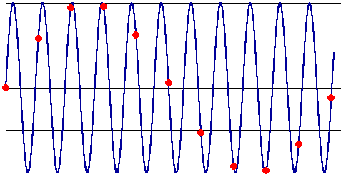
Down-sampling
Aliasing can arise when you sample a continuous signal or image
  occurs when your sampling rate is not high enough to capture the amount of detail in your image
  Can give you the wrong signal/image—an alias
  formally, the image contains structure at different scales
    called “frequencies” in the Fourier domain
  the sampling rate must be high enough to capture the highest frequency in the image

Slide 53



Subsampling with Gaussian pre-filtering
G 1/8
G 1/4
Gaussian 1/2
Solution: filter the image, then subsample
  Filter size should double for each ½ size reduction.

Slide 54
Finale
Filtering is just applying a mask to an image.
Computer vision people call the linear form of these operations “convolutions”. They are actually “correlations,” since the true convolution inverts the mask.
There are many nonlinear filters, too, such as median filters and morphological filters.
Filtering is the lowest level of image analysis and is taught heavily in image processing courses.

