Slide 1
Single-view 3D reasoning
Lecturer: Bryan Russell
UW CSE 576, May 2013
Slides borrowed from Antonio Torralba, Alyosha Efros, Antonio Criminisi, Derek Hoiem,
Steve Seitz, Stephen Palmer, Abhinav Gupta, James Coughlan, Aude Oliva, and others

Slide 2
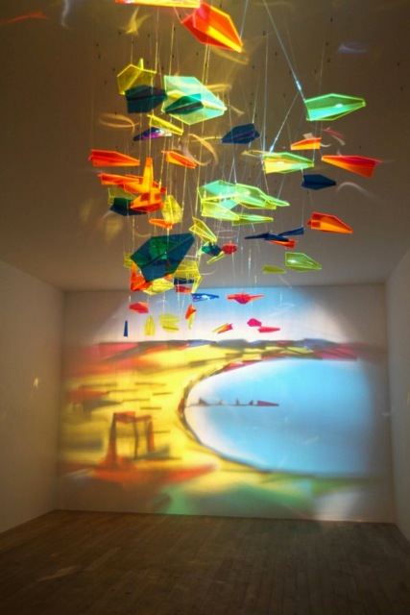

Slide 3
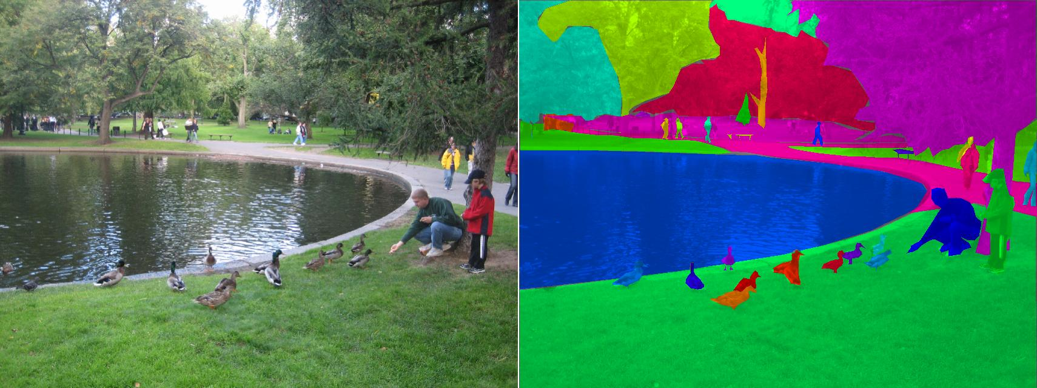

Slide 4
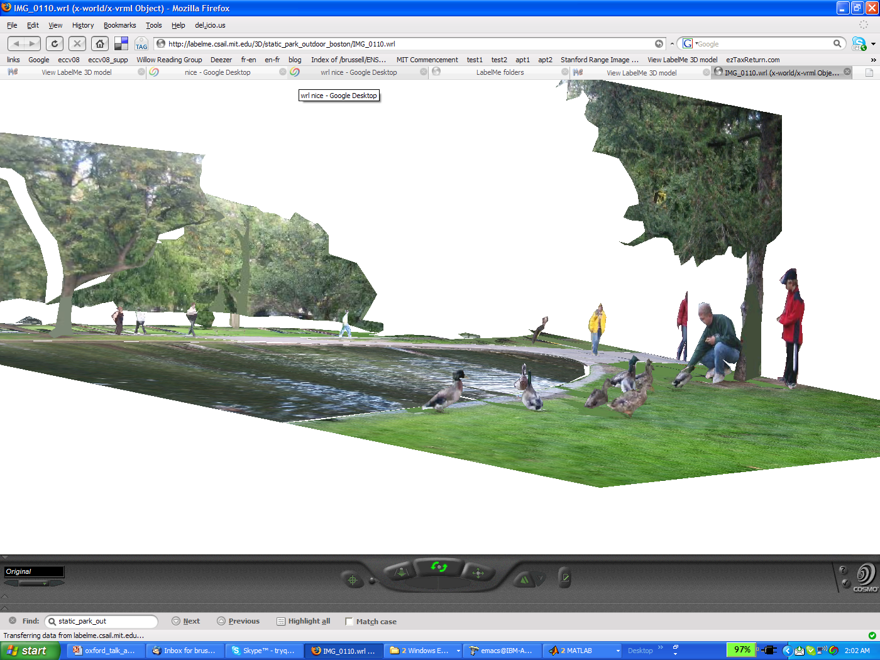
Depth Perception
The inverse problem
Slide by A. Torralba

Slide 5
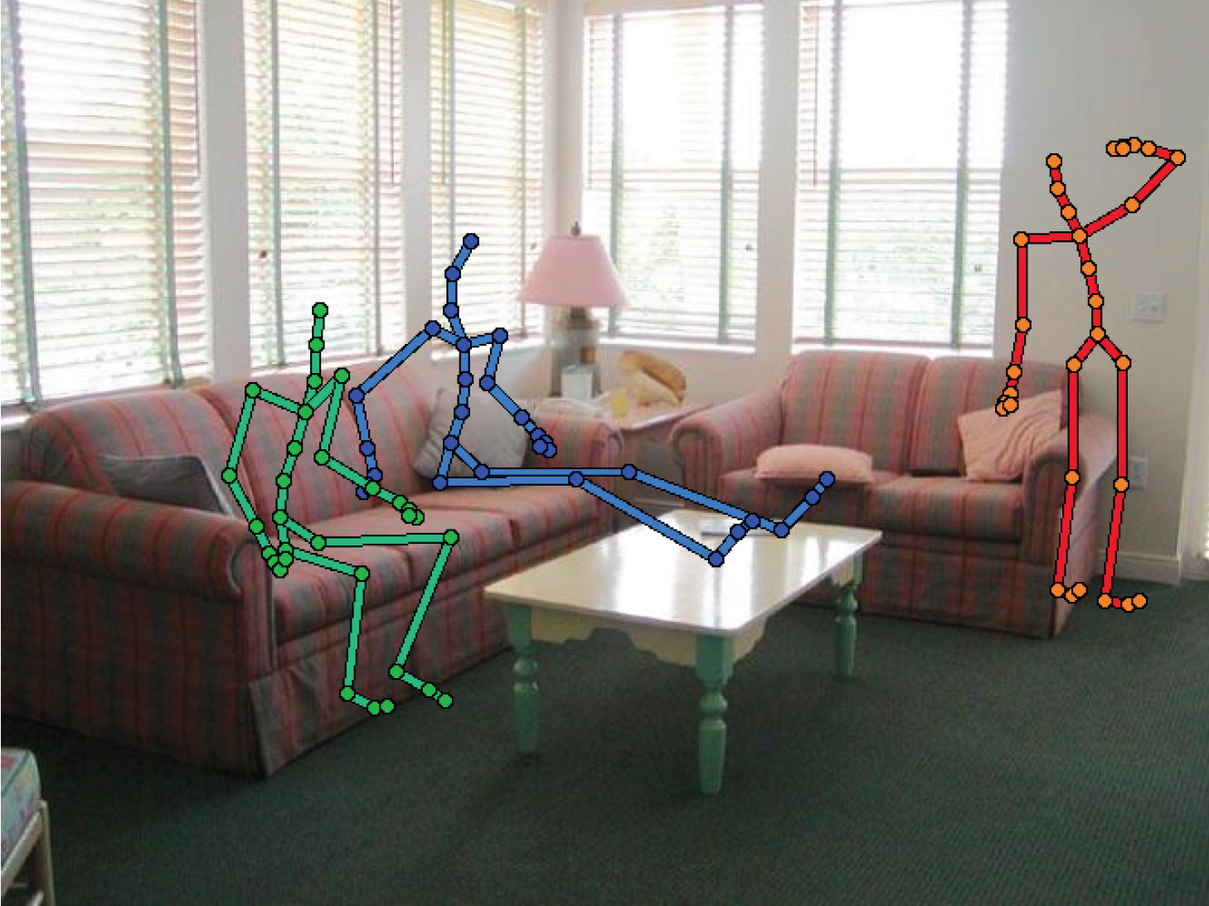
Why is depth perception important?
Information on how to navigate in an environment
Context for object detection

Slide 6
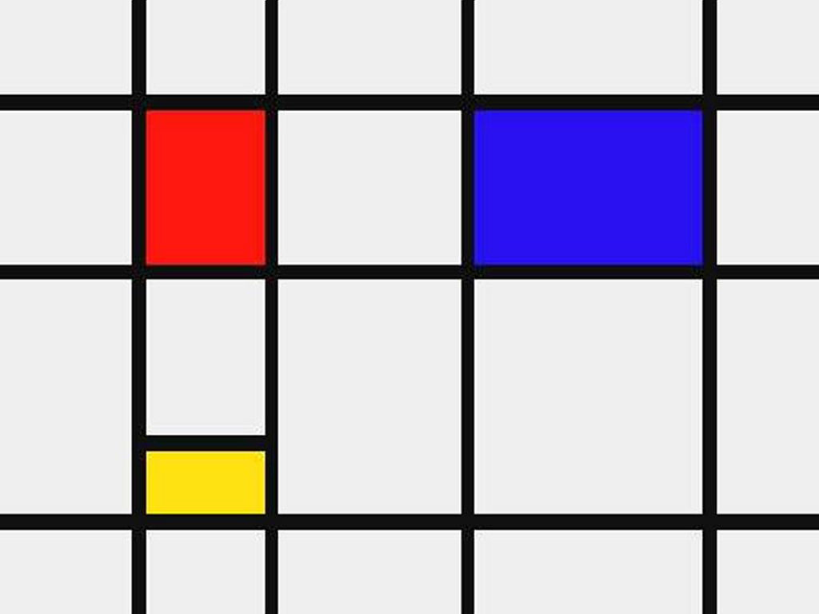
We don’t live in a 2D Mondrian world
Nearby pixels are close in 2D

Slide 7
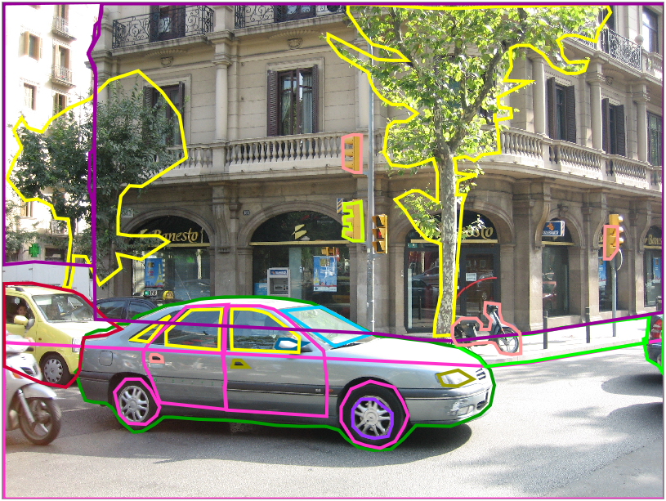
Nearby pixels in 2D can be far away in 3D
Notes:
Note the completed objects behind occlusions.

Slide 8

What are clues for recovering depth information from a single image?

Slide 9
Edge interpretation
Simple and powerful cue, but hard to make it work in practice…
Slide by A. Torralba
Notes:
Old title: Relative depth cues

Slide 10
Interposition / occlusion
Slide by A. Torralba

Slide 11
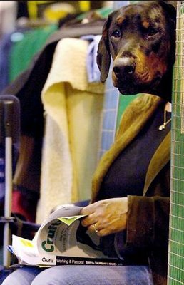

Slide 12
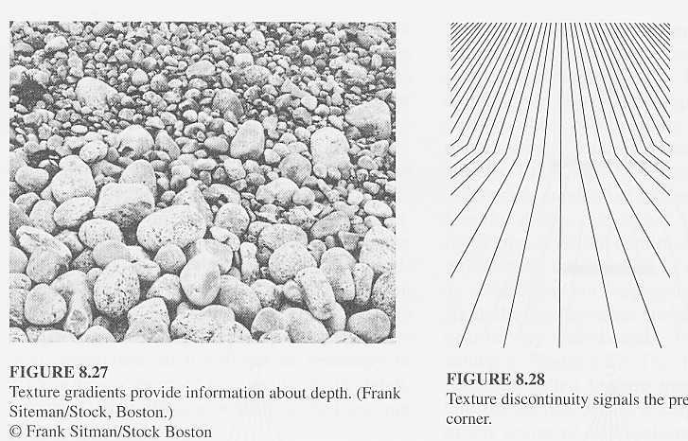
Texture Gradient
A Witkin. Recovering Surface Shape and Orientation from Texture (1981)
Slide by A. Torralba

Slide 13

Texture Gradient
Slide by A. Torralba
Shape from Texture from a Multi-Scale Perspective. Tony Lindeberg and Jonas Garding. ICCV 93

Slide 14
Shading
Based on 3 dimensional modeling of objects in light, shade and shadows.
Perception of depth through shading alone is always subject to the concave/convex inversion. The pattern shown can be perceived as stairsteps receding towards the top and lighted from above, or as an overhanging structure lighted from below.
Slide by A. Torralba

Slide 15
Shadows
Slide by Steve Marschner
http://www.cs.cornell.edu/courses/cs569/2008sp/schedule.stm

Slide 16
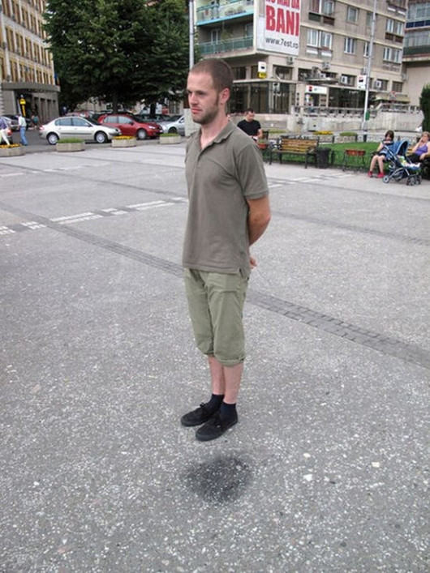

Slide 17
Atmospheric perspective
Based on the effect of air on the color and visual acuity of objects at various distances from the observer.
Consequences:
  Distant objects appear bluer
  Distant objects have lower contrast.
Slide by A. Torralba

Slide 18

Atmospheric perspective
http://encarta.msn.com/medias_761571997/Perception_(psychology).html
Slide by A. Torralba

Slide 19
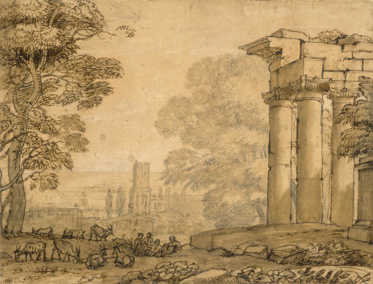
Claude Lorrain (artist)
French, 1600 - 1682
Landscape with Ruins, Pastoral Figures, and Trees, 1643/1655
Slide by A. Torralba

Slide 20
Linear Perspective
Based on the apparent convergence of parallel lines to common vanishing points with increasing distance from the observer.
(Gibson : “perspective order”)
In Gibson’s term, perspective is a characteristic of the visual field rather than the visual world. It approximates how we see (the retinal image) rather than what we see, the objects in the world.
Perspective : a representation that is specific to one individual, in one position in space and one moment in time (a powerful immediacy).
Is perspective a universal fact of the visual retinal image ? Or is perspective something that is learned ?
Simple and powerful cue, and easy to make it work in practice…
Slide by A. Torralba

Slide 21
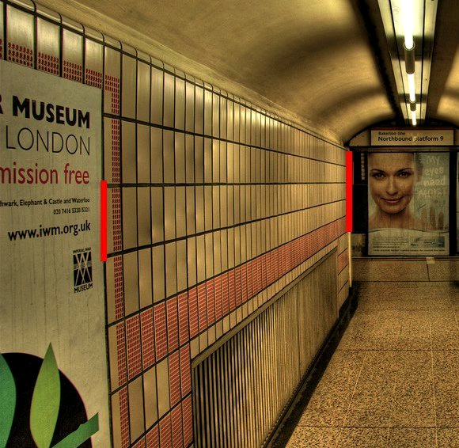
Linear Perspective
(c) 2006 Walt Anthony
Slide by A. Torralba

Slide 22
Distance from the horizon line
Based on the tendency of objects to appear nearer the horizon line with greater distance to the horizon.
Objects approach the horizon line with greater distance from the viewer. The base of a nearer column will appear lower against its background floor and further from the horizon line. Conversely, the base of a more distant column will appear higher against the same floor, and thus nearer to the horizon line.
Slide by A. Torralba

Slide 23
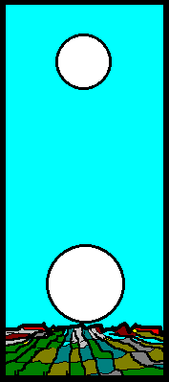
Moon illusion
Slide by A. Torralba

Slide 24
Absolute (monocular) depth cues
Are there any monocular cues that can give us absolute depth from a single image?
Slide by A. Torralba

Slide 25


Familiar size
Which “object” is closer to the camera?
How close?
Slide by A. Torralba

Slide 26
Familiar size
Apparent reduction in size of objects at a greater distance from the observer
Size perspective is thought to be conditional, requiring knowledge of the objects.
But, material textures also get smaller with distance, so possibly, no need of perceptual learning ?
Slide by A. Torralba

Slide 27
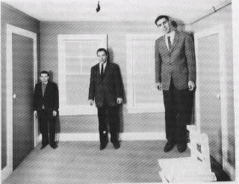
Perspective vs. familiar size
3D percept is driven by the scene, which imposes its ruling to the objects
Slide by A. Torralba

Slide 28
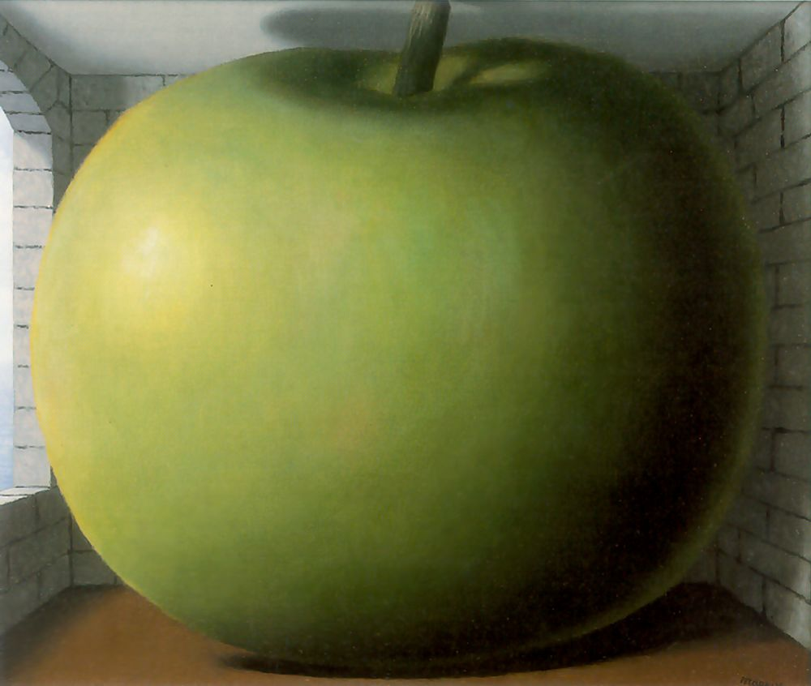
Scene vs. objects
What do you see? A big apple or a small room?
I see a big apple and a normal room
The scene seems to win again?
[The Listening Room Rene Magritte]
Slide by A. Torralba

Slide 29

Scene vs. objects
[Personal Values Rene Magritte]
Slide by A. Torralba

Slide 30
Depth Perception from Image Structure
Mean depth refers to a global measurement of the mean distance
between the observer and the main objects and structures that
compose the scene.
Stimulus ambiguity: the three cubes produce the same retinal image.
Monocular information cannot give absolute depth measurements.
Only relative depth information such as shape from shading and
junctions (occlusions) can be obtained.
Slide by A. Torralba

Slide 31
Depth Perception from Image Structure
However, nature (and man) do not build in the same way
at different scales.
d3
d2
d1
If d1>>d2>>d3 the structures of each view strongly differ. Structure provides monocular information about the scale (mean depth) of the space in front of the observer.
Slide by A. Torralba

Slide 32
Today’s class: reasoning about perspective cues via projective geometry
Notes:
How to recover depth cues in images?

Slide 33
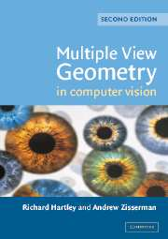
Readings
  Hartley and Zisserman textbook
  Mundy, J.L. and Zisserman, A., Geometric Invariance in Computer Vision, Appendix: Projective Geometry for Machine Vision, MIT Press, Cambridge, MA, 1992,
  (read 23.1 - 23.5, 23.10)
    available online: http://www.cs.cmu.edu/~ph/869/papers/zisser-mundy.pdf

Slide 34
Projective geometry—what’s it good for?
Uses of projective geometry
  Drawing
  Measurements
  Mathematics for projection
  Undistorting images
  Focus of expansion
  Camera pose estimation, match move
  Object recognition

Slide 35
The projective plane
Why do we need homogeneous coordinates?
  represent points at infinity, homographies, perspective projection, multi-view relationships
What is the geometric intuition?
  a point in the image is a ray in projective space
-y
(sx,sy,s)
(x,y,1)
(0,0,0)
-z
x
image plane
Each point (x,y) on the plane is represented by a ray (sx,sy,s)
all points on the ray are equivalent: (x, y, 1) ≅ (sx, sy, s)

Slide 36
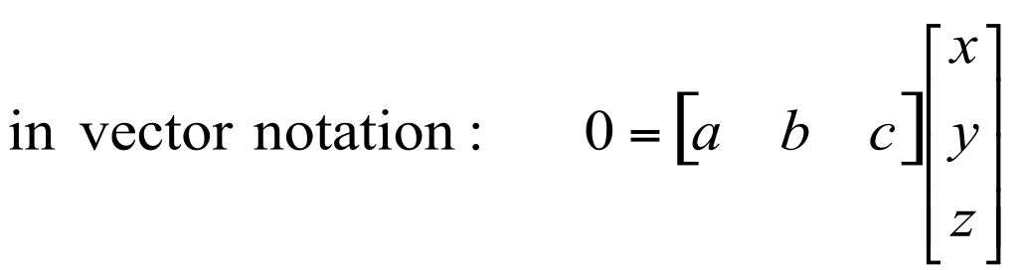
Projective lines
What does a line in the image correspond to in projective space?
A line is a plane of rays through origin
all rays (x,y,z) satisfying: ax + by + cz = 0
l
p
A line is also represented as a homogeneous 3-vector l
Notes:
Point out that l and p are orthogonal…

Slide 37
Point and line duality
  A line l is a homogeneous 3-vector = [a b c]
  It is ⊥ to every point (ray) p on the line: l p=0
p₁
p₂
l₁
p
l
l₂
What is the line l spanned by rays p₁ and p₂ ?
l is ⊥ to p₁ and p₂ ⇒ l = p₁ x p₂
l is the plane normal
What is the intersection of two lines l₁ and l₂ ?
p is ⊥ to l₁ and l₂ ⇒ p = l₁ x l₂
Points and lines are dual in projective space
given any formula, can switch the meanings of points and lines to get another formula
Notes:
What do points at infinity look like?

Slide 38
Ideal points and lines
(a,b,0)
-y
(sx,sy,0)
-y
-z
x
image plane
-z
image plane
x
Ideal point (“point at infinity”)
  p ≅ (x, y, 0) – parallel to image plane
  It has infinite image coordinates
Ideal line
l ≅ (a, b, 0) – parallel to image plane
Corresponds to a line in the image (finite coordinates)
goes through image origin (principal point)

Slide 39


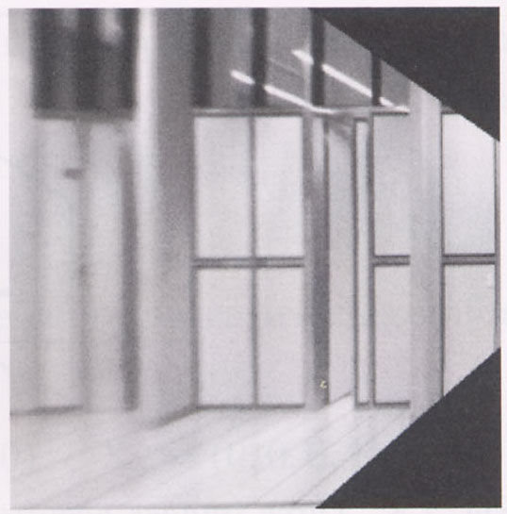
Measurements on planes
4
3
2
1
1
2
3
4
Approach: unwarp then measure
What kind of warp is this?
Notes:
homography!

Slide 40

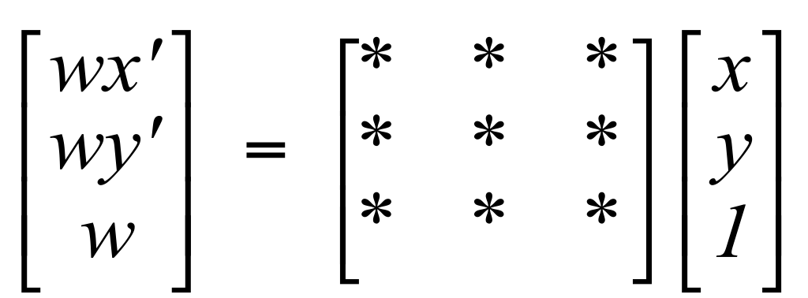

Homographies
Perspective projection of a plane
  Lots of names for this:
    homography, texture-map, colineation, planar projective map
  Modeled as a 2D warp using homogeneous coordinates
p’
H
p
To apply a homography H
Compute p’ = Hp (regular matrix multiply)
Convert p’ from homogeneous to image coordinates
divide by w (third) coordinate
Notes:
Try examples: [2 0 0; 0 2 0; 0 0 2] does what?
How to scale by 2? [2 0 0 ; 0 2 0; 0 0 1]
[1 0 10; 0 1 0; 0 0 1] shift…

Slide 41
Image rectification
p’
p
To unwarp (rectify) an image
solve for homography H given p and p’
solve equations of the form: wp’ = Hp
linear in unknowns: w and coefficients of H
H is defined up to an arbitrary scale factor
how many points are necessary to solve for H?

Slide 42




Solving for homographies

Slide 43


Solving for homographies
A
h
0
2n × 9
9
2n
Defines a least squares problem:
Since h is only defined up to scale, solve for unit vector ĥ
Solution: ĥ = eigenvector of A^{T}A with smallest eigenvalue
Works with 4 or more points

Slide 44
Vanishing points
image plane
vanishing point v
camera
center
C
line on ground plane
Vanishing point
projection of a point at infinity

Slide 45

Vanishing points
image plane
vanishing point v
camera
center
C
line on ground plane
line on ground plane
Properties
  Any two parallel lines have the same vanishing point v
  The ray from C through v is parallel to the lines
  An image may have more than one vanishing point
    in fact every pixel is a potential vanishing point
Notes:
How to determine which lines in the scene vanish at a given pixel?

Slide 46
Vanishing lines
v₁
v₂
Multiple Vanishing Points
  Any set of parallel lines on the plane define a vanishing point
  The union of all of vanishing points from lines on the same plane is the vanishing line
    For the ground plane, this is called the horizon

Slide 47
Vanishing lines
Multiple Vanishing Points
  Different planes define different vanishing lines

Slide 48
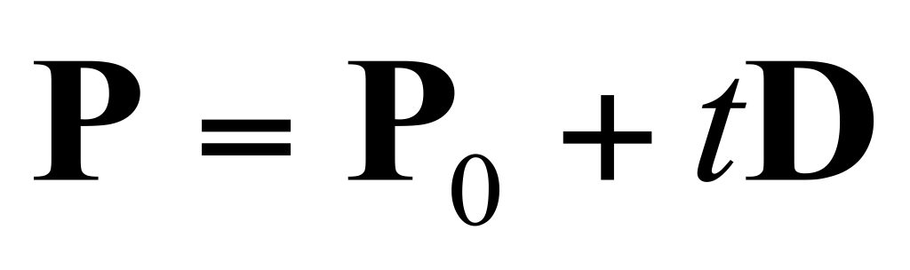
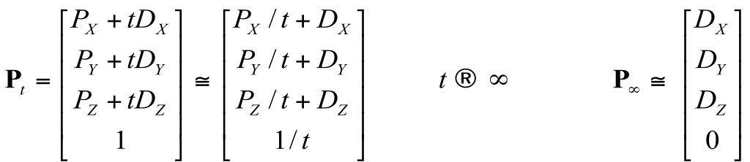

Computing vanishing points
V
P₀
D
Properties (∏ is camera projection matrix)
  P∞ is a point at infinity, v is its projection
  They depend only on line direction
  Parallel lines P₀ + tD, P₁ + tD intersect at P∞

Slide 49
Computing the horizon
C
l
ground plane
Properties
  l is intersection of horizontal plane through C with image plane
  Compute l from two sets of parallel lines on ground plane
  All points at same height as C project to l
    points higher than C project above l
  Provides way of comparing height of objects in the scene

Slide 50

Are these guys the same height?

Slide 51
Comparing heights
Vanishing
Point

Slide 52

Measuring height
5.4
5
4
3
2.8
2
1
What is the height of the camera?

Slide 53
Measuring height
5.4
5
Camera height
4
3.3
3
2.8
2
1
What is the height of the camera?

Slide 54
Computing vanishing points (from lines)
v
q₂
q₁
p₂
p₁
Intersect p₁q₁ with p₂q₂
Least squares version
Better to use more than two lines and compute the “closest” point of intersection
See notes by Bob Collins for one good way of doing this:
http://www-2.cs.cmu.edu/~ph/869/www/notes/vanishing.txt

Slide 55
Measuring height without a ruler
C
Z
ground plane
Compute Z from image measurements
Need more than vanishing points to do this

Slide 56
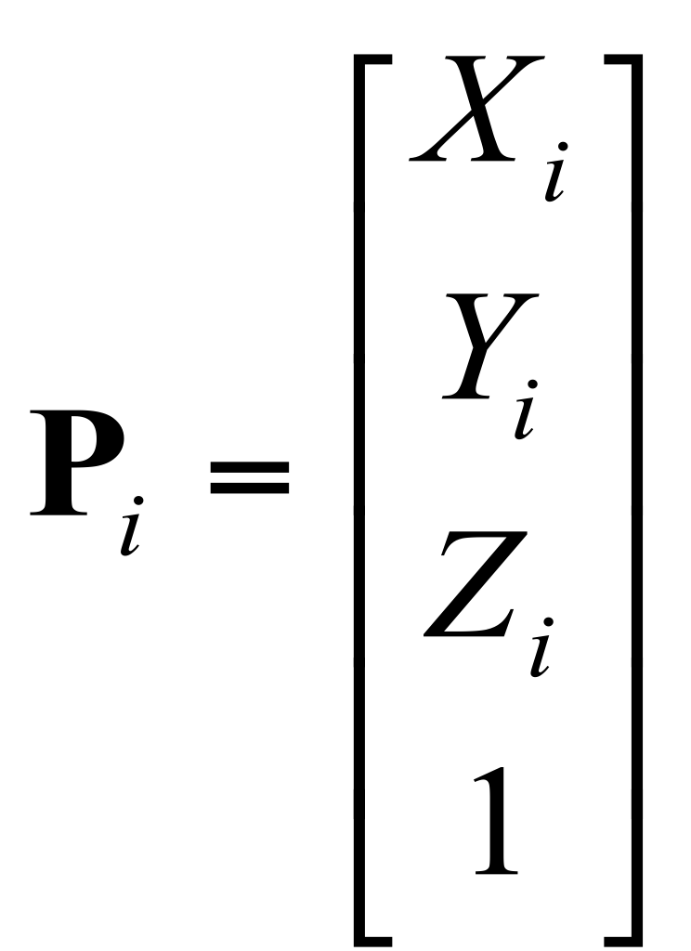
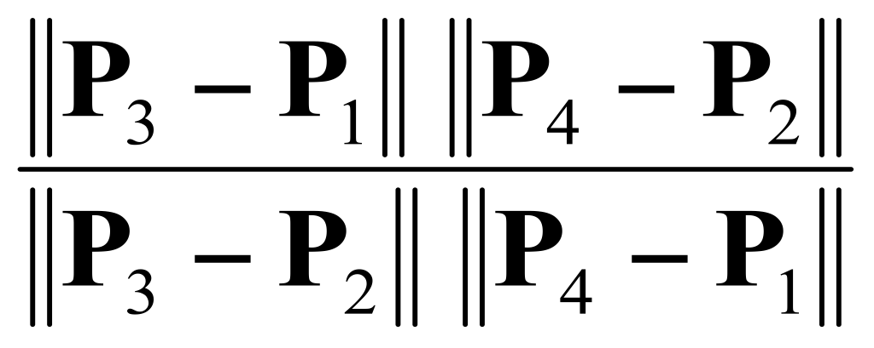
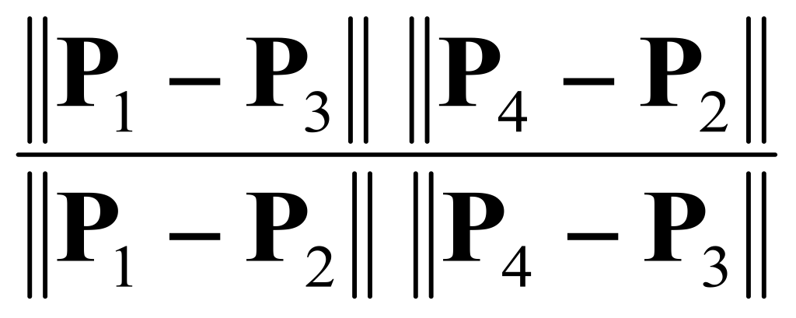
The cross ratio
A Projective Invariant
  Something that does not change under projective transformations (including perspective projection)
The cross-ratio of 4 collinear points
P₄
P₃
P₂
P₁
Can permute the point ordering
4! = 24 different orders (but only 6 distinct values)
This is the fundamental invariant of projective geometry

Slide 57
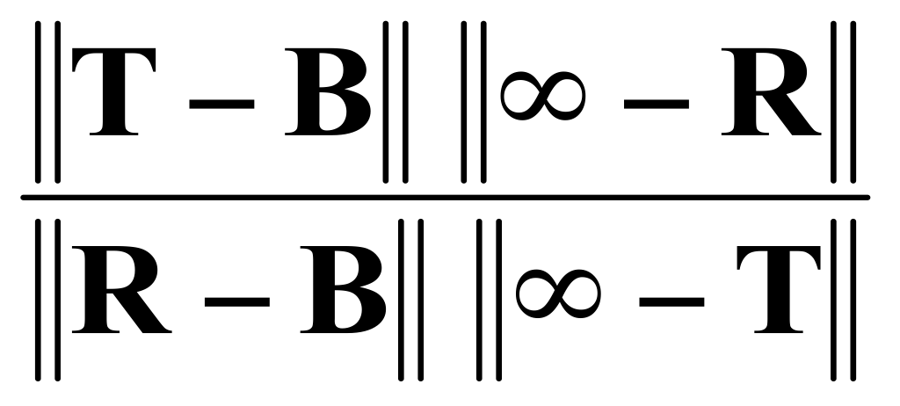
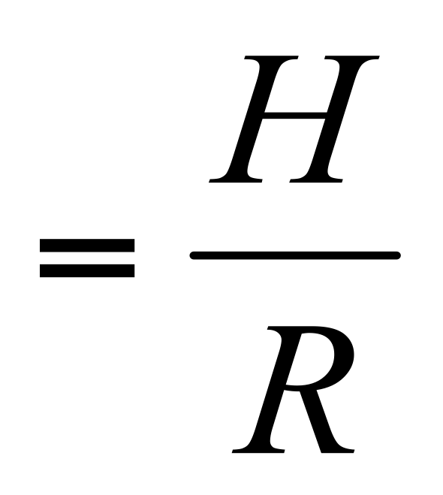
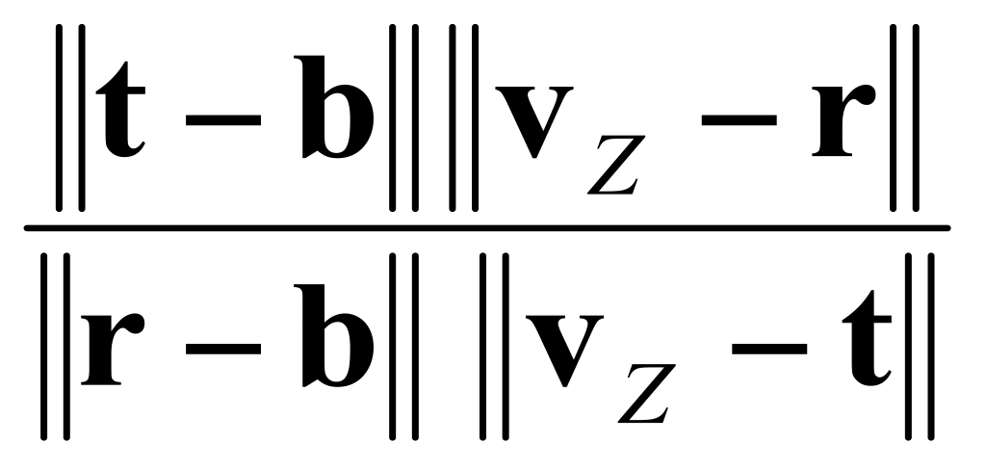
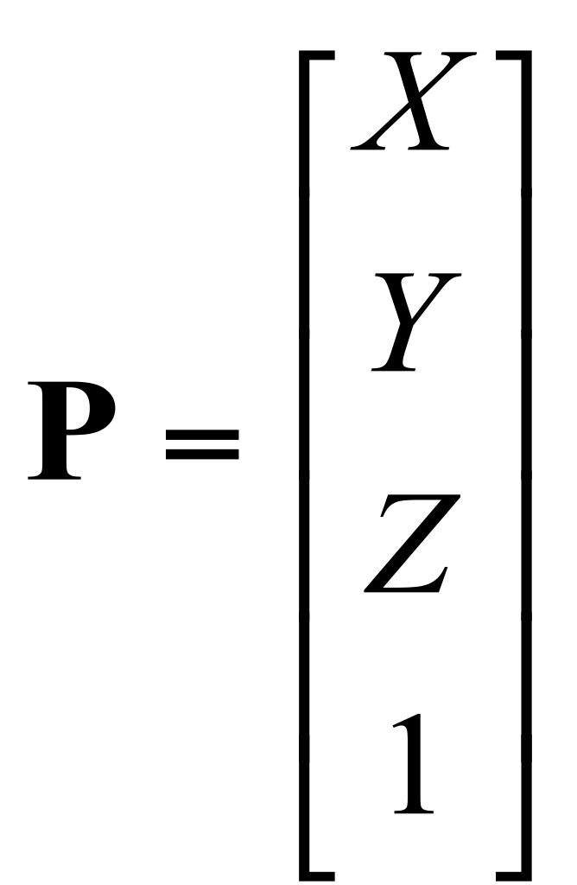
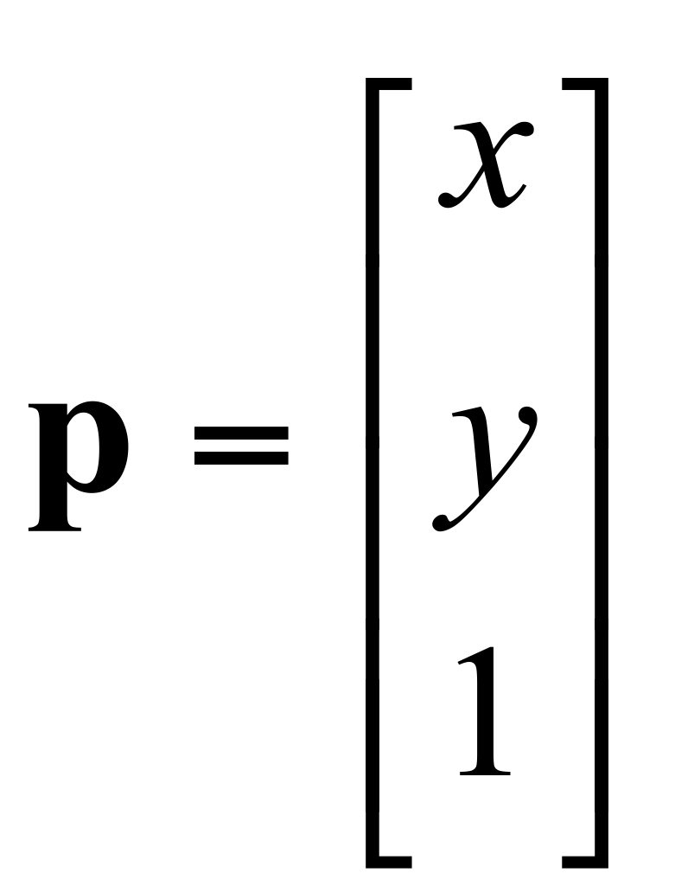
Measuring height
∞
scene cross ratio
T (top of object)
t
r
R (reference point)
C
H
b
R
image cross ratio
v_{Z}
B (bottom of object)
ground plane
scene points represented as
image points as

Slide 58


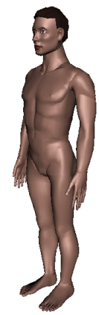
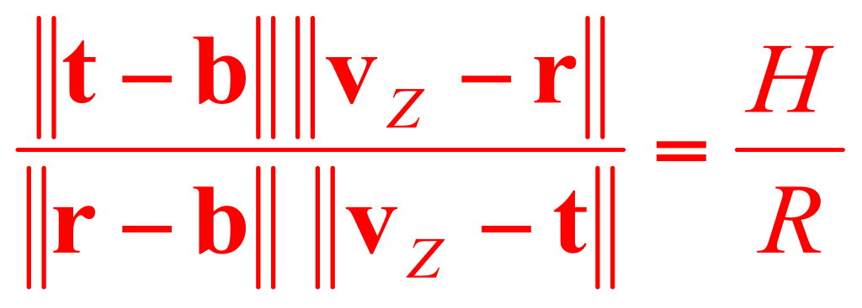
Measuring height
v_{z}
r
vanishing line (horizon)
t₀
t
v_{x}
v
v_{y}
H
R
H
b₀
b
image cross ratio

Slide 59
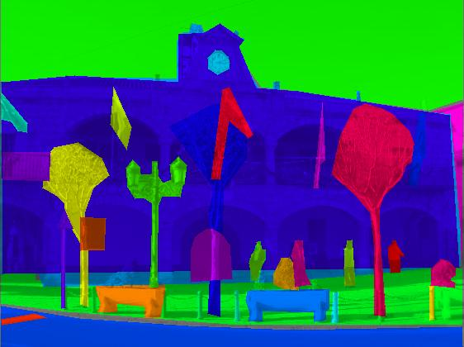
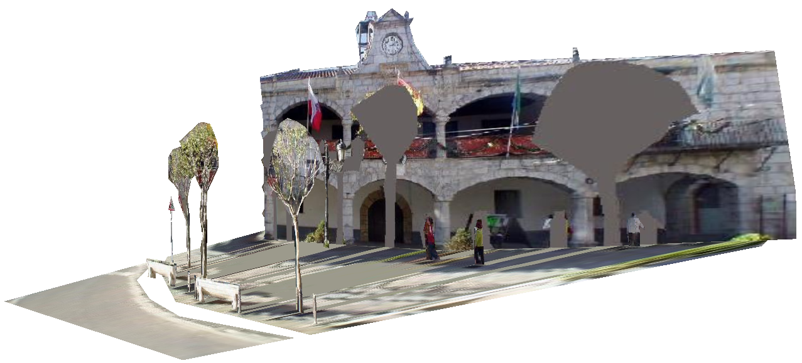
LabelMe3D: Building a database of 3D scenes from user annotations
Goal: Collect a large labeled 3D dataset in absolute coordinates over many different scene types and object categories
Object labels: tree, road, person, …
tree (4.2 meters tall)
person (1.7 meters tall)
[B.C. Russell and A. Torralba, CVPR 2009]
Notes:
59

Slide 60
Benefits of a 3D database
Can be used as a validation dataset
Techniques used to generate database can be incorporated into scene understanding system
Useful as a prior for 3D tasks (e.g. recognition, image/video pop-up)
Other creative applications (object attribute queries, studying 3D relationships between objects)

Slide 61
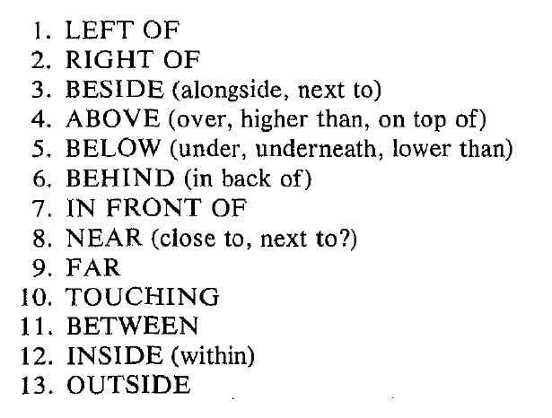
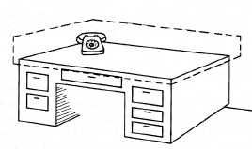
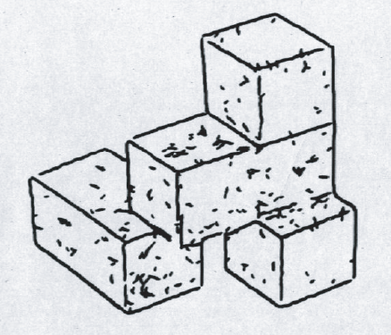
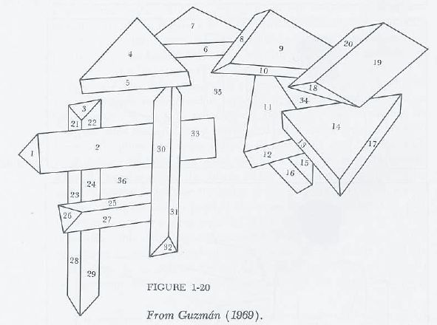
Reasoning about spatial relationships between objects
Ballard & Brown, 1982
Freeman, 1974
Guzman, 1969

Slide 62
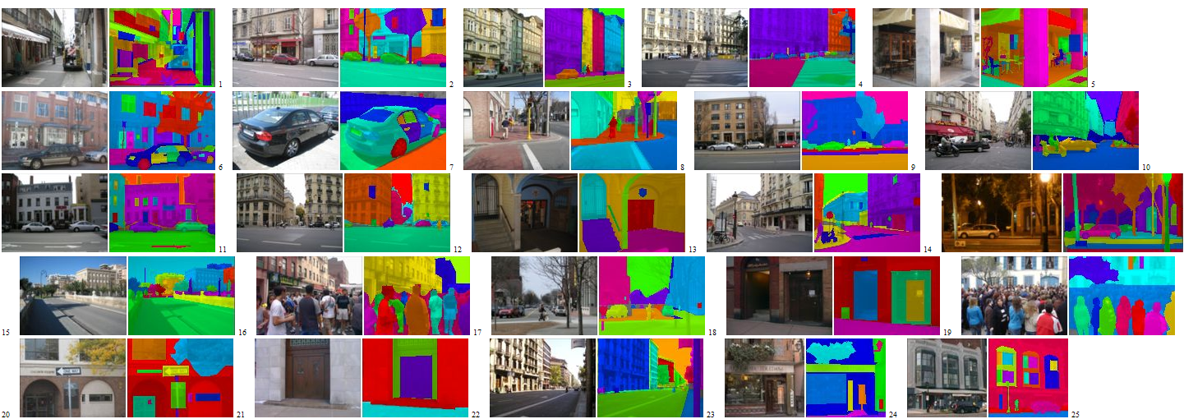
Our approach
Use object labels provided by humans to discover relationships
between objects and recover 3D scene structure
Similar to the line analysis work of the 70s, but with more data
Clowes, 1971
Barrow & Tenenbaum, 1978
Huffman, 1977
Sugihara, 1984

Slide 63
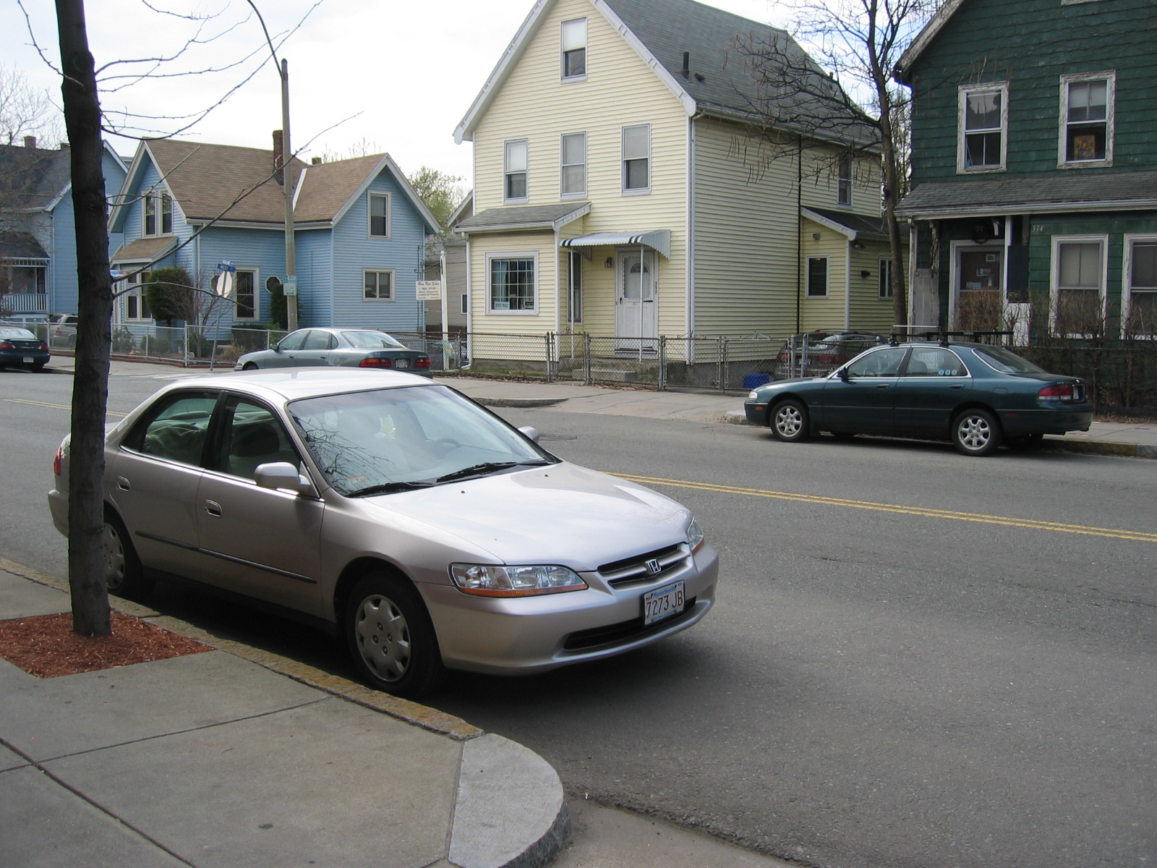


Goals of LabelMe
Build large collection of images depicting scenes and objects in their natural context
Collect detailed annotations of many objects in the scene
[B.C. Russell, A. Torralba, K.P. Murphy, W.T. Freeman, IJCV 2008]

Slide 64
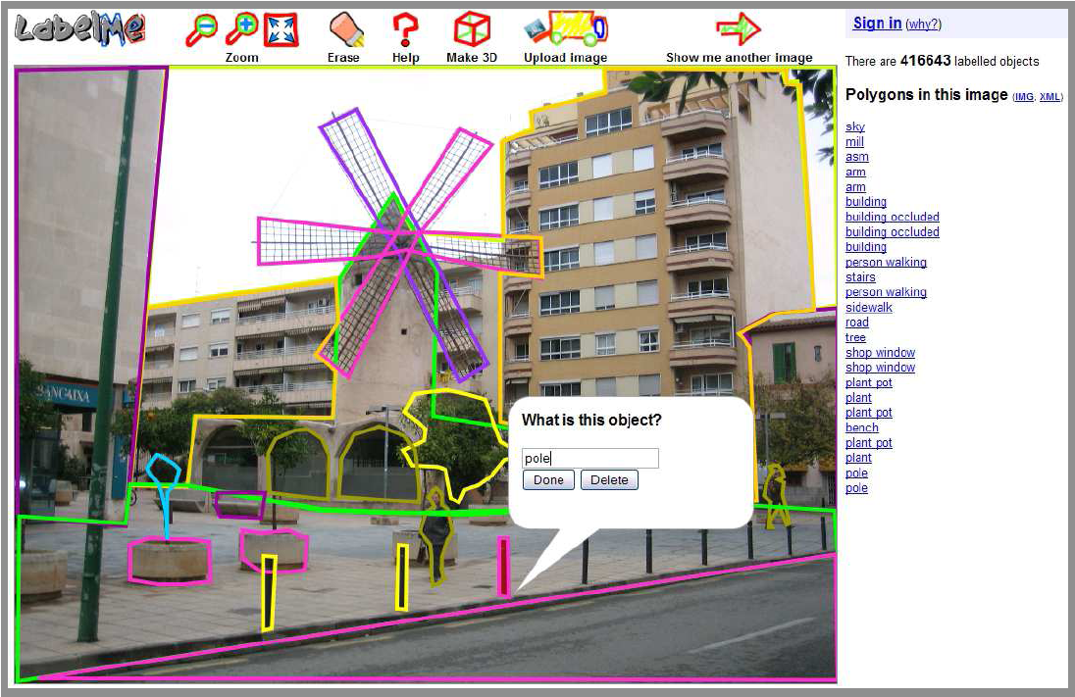
http://labelme.csail.mit.edu
Matlab toolbox and annotation tool
source code available

Slide 65
LabelMe statistics
Tool went online July 1st, 2005
201,578 images available for labeling
971,458 object annotations
72,459 images with at least one labeled object

Slide 66
Overlapping segments
(tree – building)
Transparent and
wiry objects
Key idea: analyze
overlap statistics
of labeled objects
(Car – door)
(Car – road)
Object – parts relations
Completed objects behind occlusions
Occlusion relations
Support – object relations
Notes:
Note the completed objects behind occlusions.

Slide 67
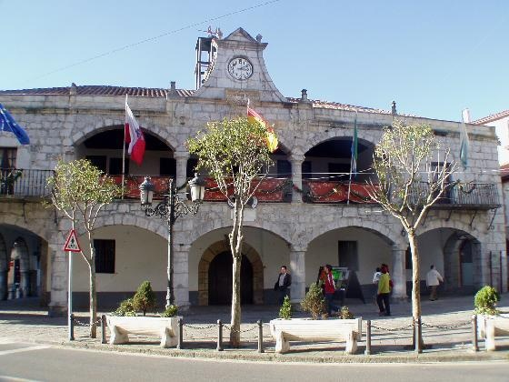
Object labels: tree, road, person, …
Notes:
67

Slide 68
Object labels: tree, road, person, …
Notes:
68

Slide 69
Object labels: tree, road, person, …
tree (4.2 meters tall)
person (1.7 meters tall)
Notes:
69

Slide 70
How to infer the geometry of a scene?

Slide 71
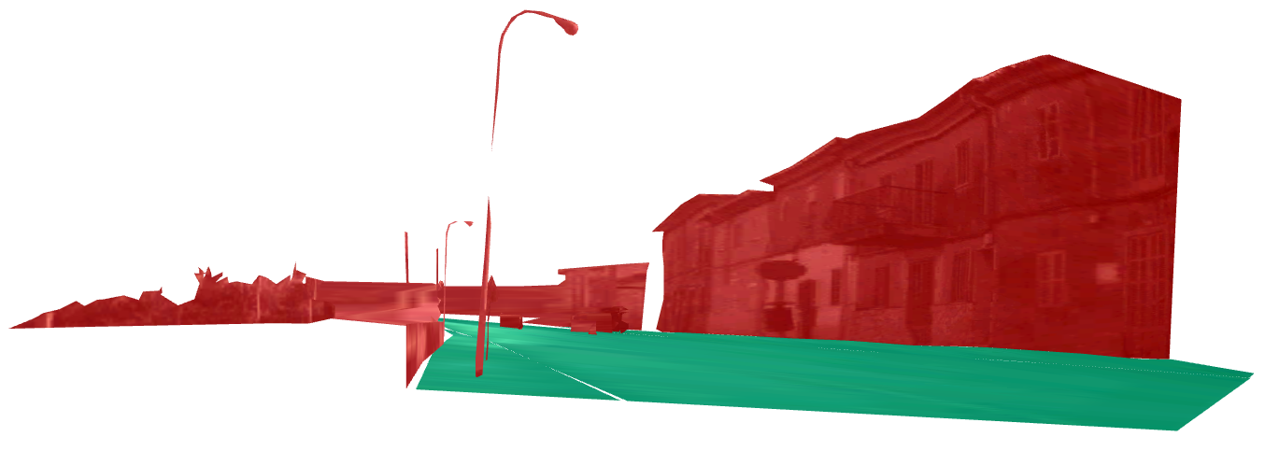
Scene layout assumptions
Assumption: objects stand on ground plane

Slide 72
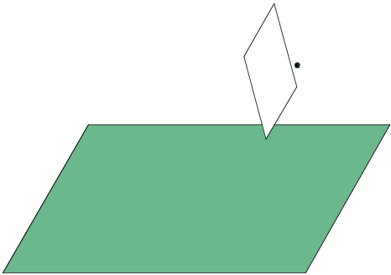
Camera and ground

Slide 73
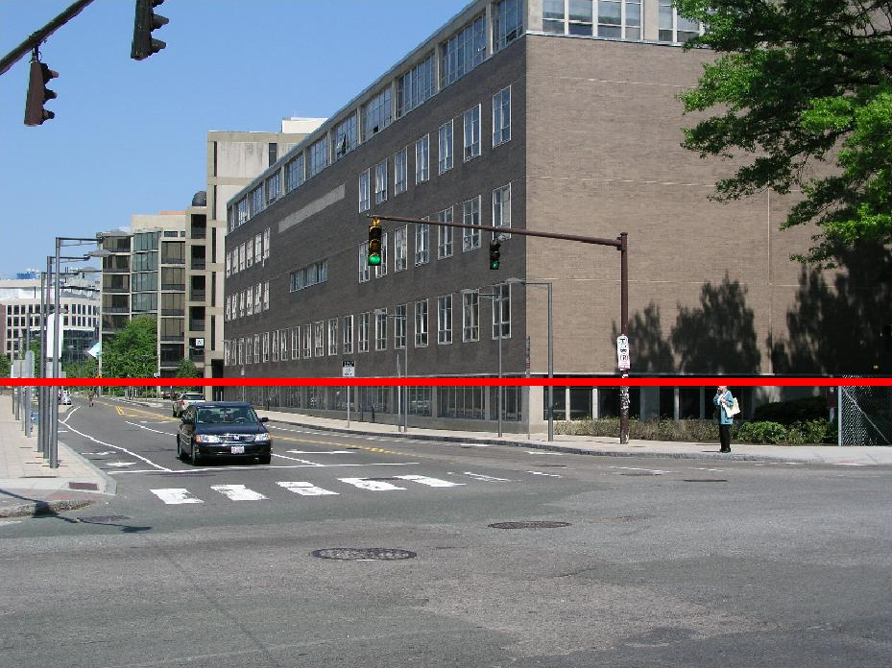
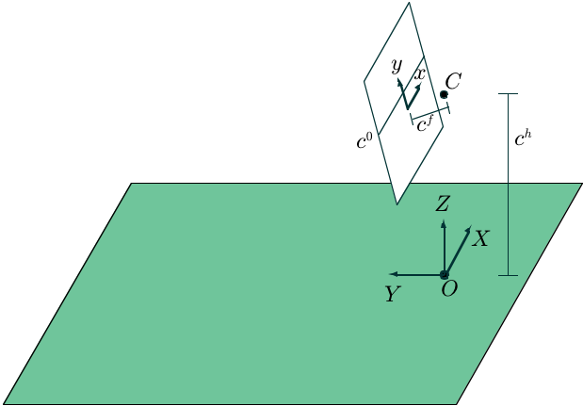
Camera and ground
Assume camera is held level with ground
Camera parameters: camera height, horizon line, focal length
Can relate ground and image planes via homography

Slide 74
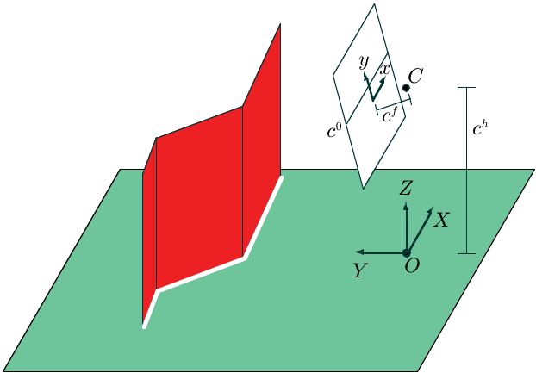
Standing objects
Standing objects represented by vertical piecewise-connected planes
3D coordinates on standing planes related to ground plane via the
contact line

Slide 75
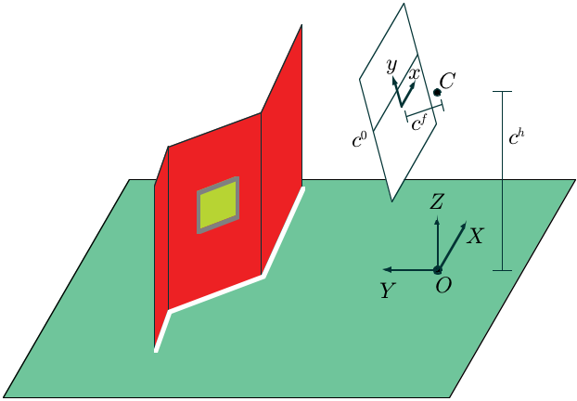
Attached objects
3D coordinates of attached objects determined by object it is attached to

Slide 76
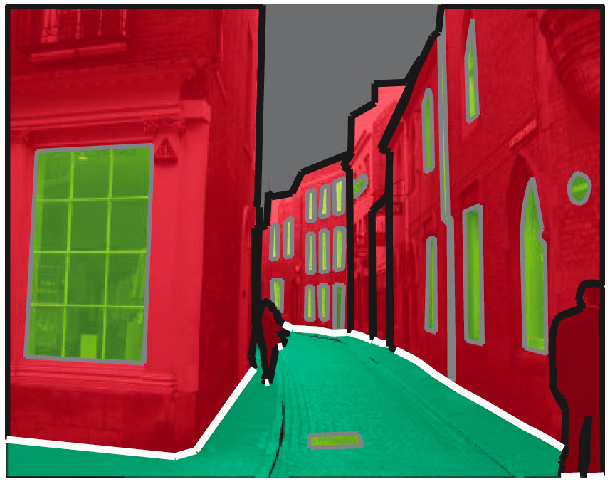
Recovering scene geometry
Polygon types
  Ground
  Standing
  Attached
Edge types
  Contact
  Attached
  Occluded
Camera parameters

Slide 77
Recovering scene geometry
Polygon types
  Ground
  Standing
  Attached
Edge types
  Contact
  Attached
  Occluded
Camera parameters

Slide 78
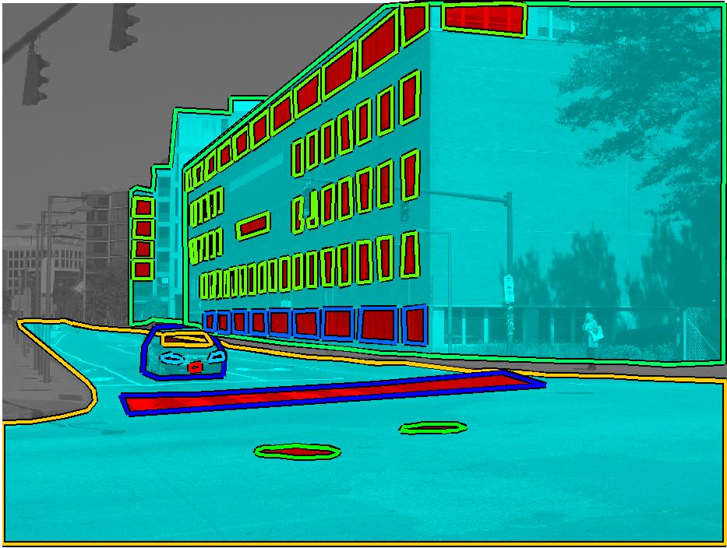
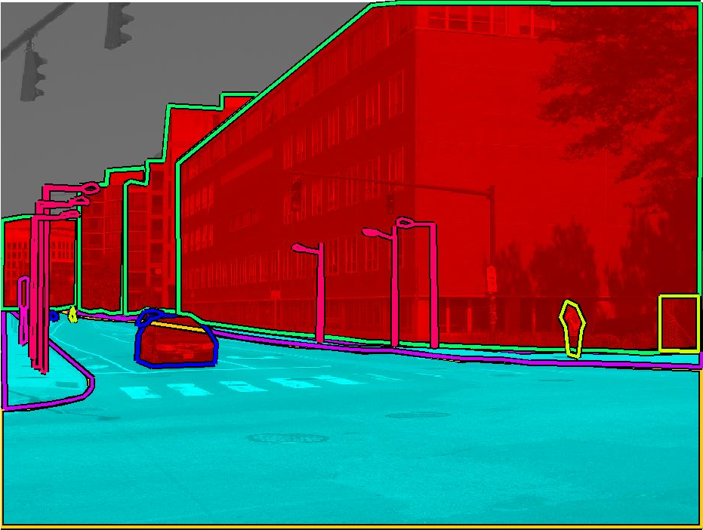
Relationships between polygons
Part-of
Attached
Standing /
Ground /
Attached
Standing
Supported-by
Ground

Slide 79
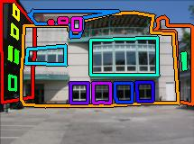







Cues for attachment relationships
1. Consistency of relationship across database
building, windows
building, person

Slide 80




Cues for attachment relationships
2. High relative overlap between
part and object
area(part object)
area(part)
3. Probability of
coincidental overlap
area(object)
area(image)
e.g. building

Slide 81
Learned/inferred attachment relationships

Slide 82
Learned/inferred attachment relationships

Slide 83
Relationships between polygons
Part-of
Attached
Standing /
Ground /
Attached
Standing
Supported-by
Ground

Slide 84
Recover support relations
Object
Support
Over entire dataset, count number of images where
bottom of object is inside support object

Slide 85

Learned/inferred support relations

Slide 86

Learned/inferred support relations

Slide 87

Learned/inferred support relations

Slide 88
Recovering scene geometry
Polygon types
  Ground
  Standing
  Attached
Edge types
  Contact
  Attached
  Occluded
Camera parameters

Slide 89

Edge types
Ground and attached
objects have attached
edges
Standing objects can
have contact or
occluding edges
Cues for
contact edges:
Orientation
Proximity to ground
Length

Slide 90
Recovering scene geometry
Polygon types
  Ground
  Standing
  Attached
Edge types
  Contact
  Attached
  Occluded
Camera parameters

Slide 91
Familiar size
Which object is closer to the camera?
How close?
Slide credit: Antonio Torralba

Slide 92




Camera parameters
Assume
  flat ground plane
  camera roll is negligible (consider pitch only)
Camera parameters: height and orientation
Slide from J-F Lalonde
Notes:
As a reminder, we need to simply estimate the camera height and pitch.
From single view metrology, we can estimate the camera height given a reference height from the ground plane in an image.
If we have two objects at different depths, then we can get the camera height and pitch.
However, we do not have such reference heights.
Let’s first start by looking at why it’s important to match the camera parameters.
Let’s consider this car. If the camera is high, then we see mostly its roof.
If the camera is lower, ...
If we assume that the ground plane is flat, ...
Then the 2 main parameters that control this behavior are the camera height and orientation.
So we propose an algorithm to AUTOMATICALLY estimate ...

Slide 93

Camera parameters
t-b
X
v-b
C
=
v
t
b
X – World object height (in meters)
C – World camera height (in meters)

Slide 94



Camera parameters
Human height distribution
1.7 +/- 0.085 m
(National Center for Health Statistics)
Car height distribution
1.5 +/- 0.19 m
(automatically learned)
Slide from J-F Lalonde
Notes:
On the other hand, we do have a rough idea of object heights.
If we use the fact that humans are roughly 1.7 meters tall, we can get an initial estimate of the camera parameters.
These in turn can help us learn height distributions for other object classes.
We can continue in this way for all of the cameras and objects.
In addition, we can reason about objects attached to standing objects with contact edges since we know the height from the ground for the bottom and top of the object.
Now say we have another class of objects, cars for example.
We iterate this process over all the images in our database which contain labeled objects.

Slide 95



Object heights
Database image
Pixel heights
Real heights
Slide from J-F Lalonde
Notes:
A nice by-product of this procedure is that, in addition to camera height and orientation, it allows us to extract the true 3-D height for each object in our database.

Slide 96
Recovered object heights
(Average, in meters)
Standing objects
Attached objects
Person | 1.65
Car | 1.46
Bicycle | 1.05
Trash | 1.24
Parking meter | 1.58
Fence | 1.89
Van | 1.89
Firehydrant | 0.87
Cone | 0.74
Wheel | 0.62
Window | 2.16
Arm | 0.72
Windshield | 0.47
Head | 0.41
Tail light | 0.34
Headlight | 0.26
License plate | 0.23
Mirror | 0.22
Notes:
Here, we show the average heights for different object classes.
On the right, we show average heights for attached objects, which previous systems could not recover.
96

Slide 97



System outputs

Slide 98



System outputs

Slide 99



System outputs

Slide 100

System outputs

Slide 101



System outputs

Slide 102



Toy example…

Slide 103




Accuracy of 3D outputs
Evaluation with range data [Saxena et al. 2007]
Relative error: 0.29
Computed over 5-70 meter range (46% of pixels)
Input image
Range scan
System output

Slide 104

How does labeling accuracy affect outputs?

Slide 105






Application: Extending database with virtual views
Randomly cropping
Virtual viewpoints
20 new views generated per image (6000 images)

Slide 106


Slide 107

Labeling 3D

Slide 108


Cut and glue!

Slide 109

3D measuring tool
Car is 13.68 meters away

