Slide 1
Activity Recognition From
Wearable Sensors
Dieter Fox
University of Washington
Department of Computer Science & Engineering

Slide 2
Acknowledgments
Joint work with
  Students: Brian Ferris, Julie Letchner, Lin Liao, Don Patterson, Alvin Raj, Amarnag Subramanya, Danny Wyatt
  UW faculty: Jeff Bilmes, Gaetano Borriello, Henry Kautz
  Intel Research Seattle: Tanzeem Choudhury, Matthai Philipose
Funded by
  NSF, DARPA, MSR, Toyota

Slide 3
Assisted Cognition Project
  U.S. by 2050: 80 million people over age 65 and
  13-16 million Alzheimer's patients
Goal: Develop technology to
  Support independent living by people with cognitive disabilities
    At home
    At work
    Throughout community
  Improve health care
    Long term monitoring of activities of daily living (ADL’s)
    Intervention before a health crisis

Slide 4
Outline
Transportation routines via Dynamic Bayes Nets
Significant places via Conditional Random Fields
Activity recognition projects
Discussion

Slide 5
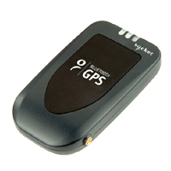
Task
[Liao-Fox-Kautz: AAAI-04, AIJ-07]
Given data stream from a wearable GPS unit
  Infer the user’s location and mode of transportation (foot, car, bus, bike, ...)
  Predict where user will go
  Detect novel behavior / user errors

Slide 6
GPS-Tracking Is NOT Trivial
Dead and semi-dead zones near buildings, trees, etc.
Sparse measurements inside vehicles, especially bus
Multi-path propagation
Inaccurate street map
…

Slide 7
Graph-based Location Estimation
Map is directed graph
Location:
  Edge e
  Distance d from start of edge
Prediction:
  Move along edges according to velocity model
Correction:
  Update estimate based on GPS reading

Slide 8
Dynamic Bayesian Network
x_{k-1}
x_{k}
Edge, velocity, position
z_{k-1}
z_{k}
GPS reading
Time k-1
Time k
Task: Estimate posterior over hidden states

Slide 9
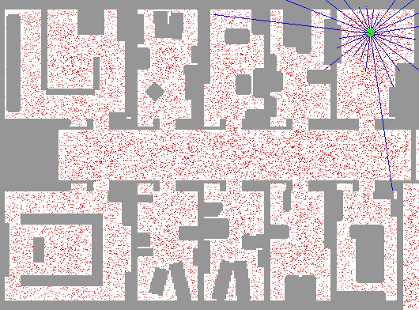
Particle Filter Based Estimation

Slide 10
Kalman Filtering on a Graph: Prediction Step
Problem: Predicted location is multi-modal
e
1
x
k-1
?
e
3
e
e
0
2
?

Slide 11
Kalman Filtering on a Graph: Correction Step
Problem: GPS reading is not on the graph
e
1
x
k
z
k
e
3
e
2

Slide 12
Kalman Filtering on a Graph: Correction Step
Problem: GPS reading is not on the graph
x
k
e
1
x
if =e
k
θ
1
z
k
e
3
e
2

Slide 13
Kalman Filtering on a Graph: Correction Step
Problem: GPS reading is not on the graph
e
1
x
k
z
x
k
k
e
3
if =e
θ
e
2
2

Slide 14
Dynamic Bayesian Network
e_{k-1}
e_{k}
Edge transition
x_{k-1}
x_{k}
Edge, velocity, position
_{k-1}
_{k}
GPS association
z_{k-1}
z_{k}
GPS reading
Time k-1
Time k
Task: Estimate posterior over all hidden states

Slide 15
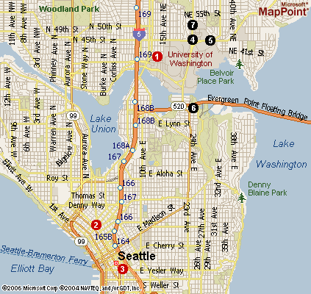
Geographic Information Systems
Street map
Source: Tiger / Line data
Bus routes / stops
Source: Metro GIS
Restaurants / Stores Source: MS MapPoint

Slide 16
Rao-Blackwellised Particle Filter
Represents posterior by sets of weighted particles:
Basic idea: Sample some variables of state space and solve other variables analytically conditioned on samples
Here: Each particle contains Kalman filter for location:
Update sets by sampling procedure (SISR)
Edge transitions, velocities, edge associations
KF for position

Slide 17
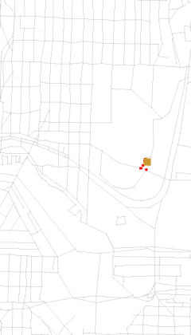
Tracking Example
GPS measurements
Particles (Kalman filters)

Slide 18
Dynamic Bayesian Network
m_{k-1}
m_{k}
Transportation mode
x_{k-1}
x_{k}
Edge, velocity, position
z_{k-1}
z_{k}
GPS reading
Time k-1
Time k
Particles:

Slide 19
Infer Mode of Transportation
Encode prior knowledge into the model
  Modes have different velocity distributions
  Buses run on bus routes
  Get on/off the bus near bus stops
  Switch to car near car location

Slide 20
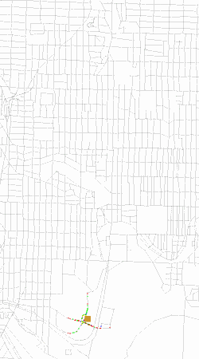
Infer Location and Transportation
Measurements
Projections
Bus mode
Car mode
Foot mode
Green
Red
Blue

Slide 21

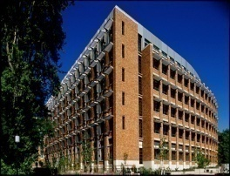


Transportation Routines
A
B
Workplace
Goal (destination):
  workplace (home, friends, restaurant, ...)
Trip segments: <start, end, transportation>
  Home to Bus stop A on Foot
  Bus stop A to Bus stop B on Bus
  Bus stop B to workplace on Foot

Slide 22
Hierarchical Model
[Liao-Fox-Kautz: AAAI-04, AIJ-07]
g_{k-1}
g_{k}
Goal
t_{k-1}
t_{k}
Trip segment
m_{k-1}
m_{k}
Transportation mode
x_{k-1}
x_{k}
Edge, velocity, position
z_{k-1}
z_{k}
GPS reading
Time k-1
Time k
[Bui-Venkatesh-West: JAIR-02]
Particles:

Slide 23
Unsupervised Model Learning
Customized model for each user
Key to goal / path prediction and error detection
Use low level model to learn variable domains
  Goals: locations where user stays for long time
  Transition points: locations with high mode transition probability
  Trip segments: connecting transition points or goals
Use full model to learn parameters
  Transition probabilities (goals, trips, edges) via EM

Slide 24
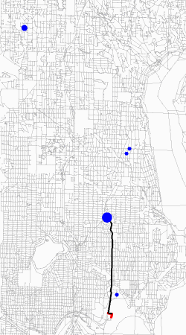
Predict Goal and Path
Predicted goal
Predicted path

Slide 25
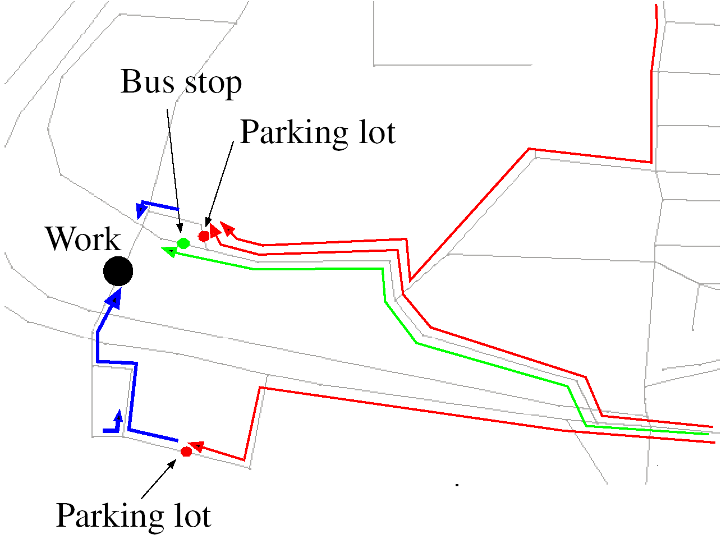
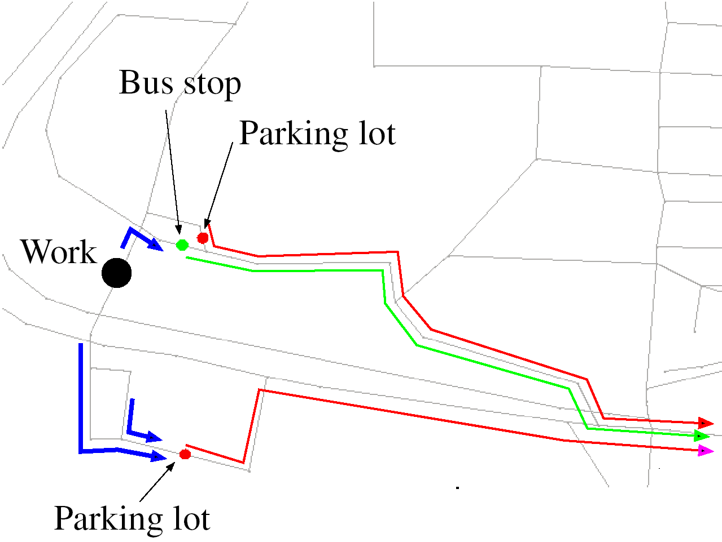
Learned Transition Parameters
Going to the workplace
Going home
High probability transitions: bus car foot

Slide 26
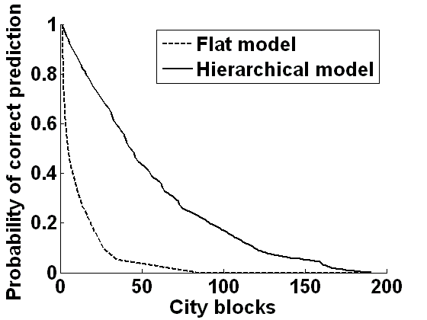
Prediction Capabilities
0.5
0.5
5
43

Slide 27
Detect Atypical Behavior and User Errors
[Patterson-Liao-etAl: Ubicomp-04]
b_{k-1}
b_{k}
Behavior mode
normal / unknown / error
g_{k-1}
g_{k}
Goal
t_{k-1}
t_{k}
Trip segment
m_{k-1}
m_{k}
Transportation mode
x_{k-1}
x_{k}
Edge, velocity, position
z_{k-1}
z_{k}
GPS reading
Time k-1
Time k

Slide 28
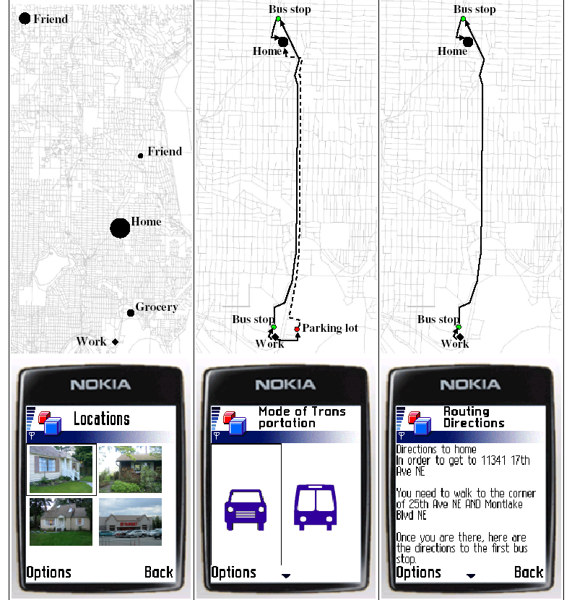
Application: Opportunity Knocks

Slide 29
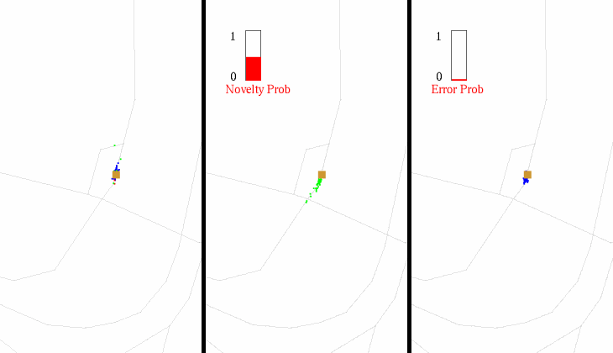
Detect User Errors
Untrained flat model Trained model Instantiated model

Slide 30
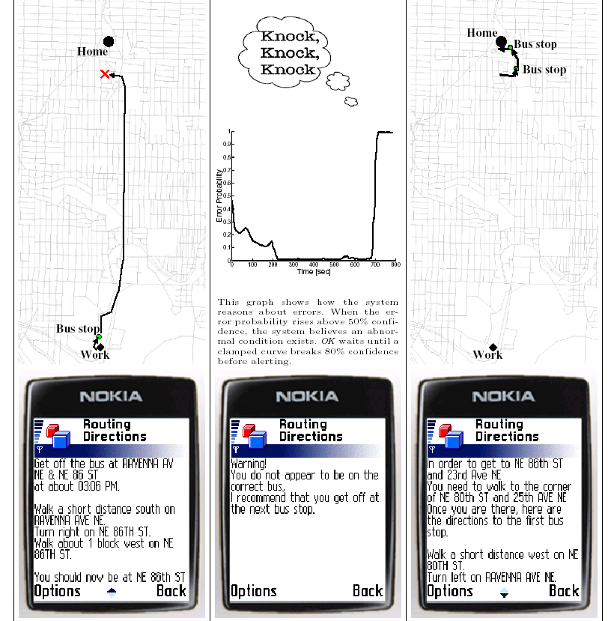
Application: Opportunity Knocks

Slide 31
Outline
Transportation routines via Dynamic Bayes Nets
Significant places via Conditional Random Fields
Activity recognition projects
Discussion

Slide 32
Place Detection and Labeling
[Liao-Fox-Kautz: NIPS-05,IJCAI-05,IJRR-07]
So far
  No distinction between different types of goals
  Model not transferable to other person
  Goals learned solely based on duration

Slide 33
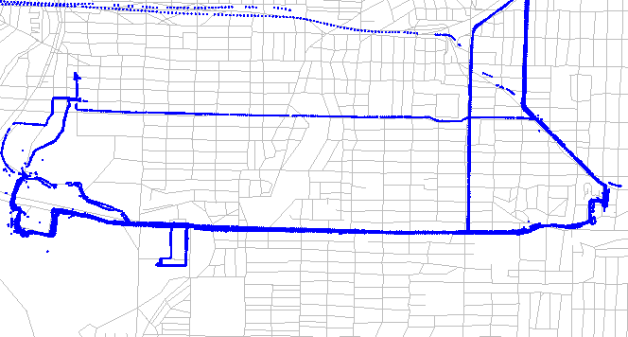
Give Semantic Meaning to Places
Friend
Restaurant
Work
Home
Bus stop
Parking
Bus stop
Store

Slide 34
Conditional Random Fields
Undirected graphical model
Introduced for labeling sequence data [Lafferty-et al: ICML-01]
No independence assumption on observations!
Trained discriminatively from labeled data
Applied successfully to
  Natural language processing [McCallum-Li: CoNLL-03], [Roth-Yih: ICML-05]
  Computer vision [Kumar-Hebert: NIPS-04], [Quattoni-Collins-Darrel: NIPS-05]
  Robotics [Limketkai-Liao-Fox: IJCAI-05], [Friedman-Pasula-Fox: IJCAI-07]

Slide 35
Conditional Random Fields
Posterior factorizes into log-linear clique potentials
Local potentials link states to observations / features
Neighborhood potentials link states to neighboring states
Hidden states x
Observations z
Notes:
Conditional Random Fields model the conditional probability p(x|z) where x is the set of hidden states (one hidden state per node), in our case, the labels to be estimated, and z is the set of observations, in our case appearance shape and appearance features extracted from laser and vision data.
In this expression, the f function is called a potential function. The index c refers to the clique of nodes which are variables of f. In this work we consider only two types of cliques which define two types of potential function:
local potentials
neighborhood potentials

Slide 36
Conditional Random Fields
Posterior factorizes into log-linear clique potentials
Local potentials link states to observations / features
Neighborhood potentials link states to neighboring states
Hidden states x
Observations z
Notes:
Conditional Random Fields model the conditional probability p(x|z) where x is the set of hidden states (one hidden state per node), in our case, the labels to be estimated, and z is the set of observations, in our case appearance shape and appearance features extracted from laser and vision data.
In this expression, the f function is called a potential function. The index c refers to the clique of nodes which are variables of f. In this work we consider only two types of cliques which define two types of potential function:
local potentials
neighborhood potentials

Slide 37
Conditional Random Fields
Posterior factorizes into log-linear clique potentials
Local potentials link states to observations / features
Neighborhood potentials link states to neighboring states
Hidden states x
Observations z
Partition function
Weights
Feature functions
Notes:
Conditional Random Fields model the conditional probability p(x|z) where x is the set of hidden states (one hidden state per node), in our case, the labels to be estimated, and z is the set of observations, in our case appearance shape and appearance features extracted from laser and vision data.
In this expression, the f function is called a potential function. The index c refers to the clique of nodes which are variables of f. In this work we consider only two types of cliques which define two types of potential function:
local potentials
neighborhood potentials

Slide 38
Parameter Learning
Conditional distribution parameterized via weights w:
Maximize conditional log-likelihood with shrinkage prior:
Maximization via stochastic / conjugate gradient, L-BFGS
Alternative: maximize pseudo log-likelihood
[Besag: 1975]

Slide 39
Inference via Belief Propagation
BP computes posteriors via local message passing
  Sum-product for posterior
  Max-product for MAP
Exact if network has no loops
Otherwise, run loopy belief propagation and hope it works
Alternatives: ICM, graph-cut, MCMC, …
....
....

Slide 40
Features for Place Labeling
Temporal pattern: duration, time of day, etc.
Geographic evidence: is there a restaurant / store / bus stop nearby?
Transition relation: adjacent activities
Spatial feature: relation between place and activity
Summation constraint: number of places labeled home or workplace

Slide 41
Hierarchical CRF Model
[Liao-Fox-Kautz: NIPS-05]
…
Activity sequence
walk, drive, ride bus,
work, visit, sleep, pickup,
get on/off bus
a₁
a₂
a₃
a₄
a₅
a_{N-2}
a_{N-1}
a_{N}
…
GPS trace

Slide 42
Hierarchical CRF Model
[Liao-Fox-Kautz: NIPS-05]
h
w
Global, soft constraints
# homes, workplaces
Significant places
home, work, bus stop,
parking lot, friend’s home
…
p₁
p₂
p₃
p_{K}
…
Activity sequence
walk, drive, ride bus,
work, visit, sleep, pickup,
get on/off bus
a₁
a₂
a₃
a₄
a₅
a_{N-2}
a_{N-1}
a_{N}
…
GPS trace
Two weeks data (> 50,000 gps points)
Inference: loopy BP (10 minutes); Learning: Pseudo-likelihood (3 minutes)

Slide 43
Generic Model Learning
Generalize from people with labeled data to others without labeled data
Relational Markov Networks to specify CRFs and parameter sharing via templates
User1
Supervised
learning
Training
data
Generic model
Other users
User2
Shared parameters
User3
[Taskar-Abbeel-Koller: UAI-02]

Slide 44
Example

Slide 45
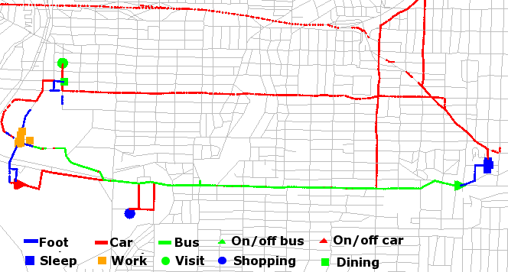
Activities

Slide 46
Places

Slide 47
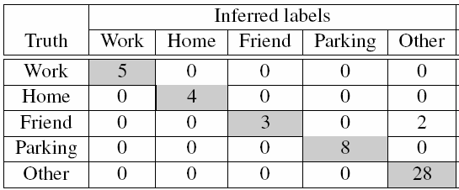
Accuracy / Confusion Matrix
Cross-validation using data from 4 persons

Slide 48
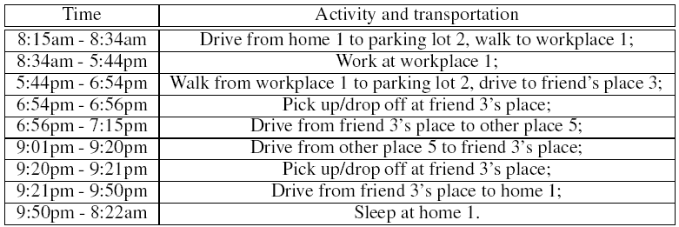
Summary of a Day

Slide 49
Outline
Transportation routines via Dynamic Bayes Nets
Significant places via Conditional Random Fields
Activity recognition projects
Discussion

Slide 50
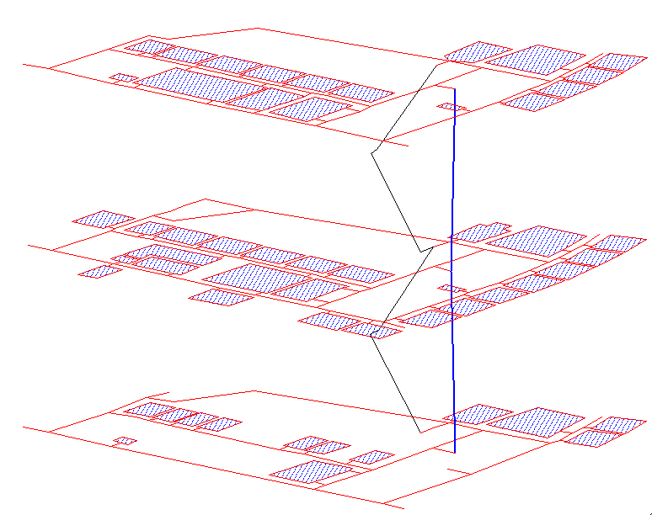
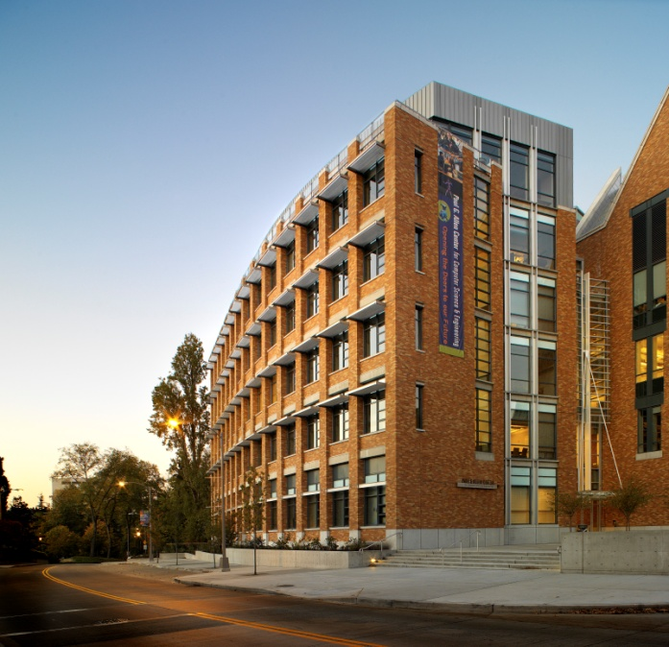
WiFi-Based Location Estimation
[Ferris-Haehnel-Fox: RSS-06]

Slide 51
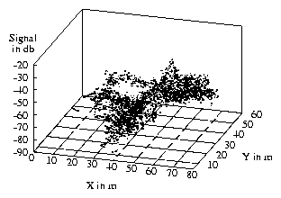
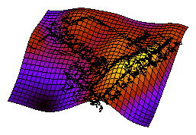
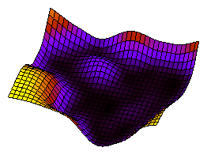
Gaussian Process Sensor Model
GP regression
  nonparametric
  smooth interpolation
  uncertainty estimates
Mean
Variance

Slide 52
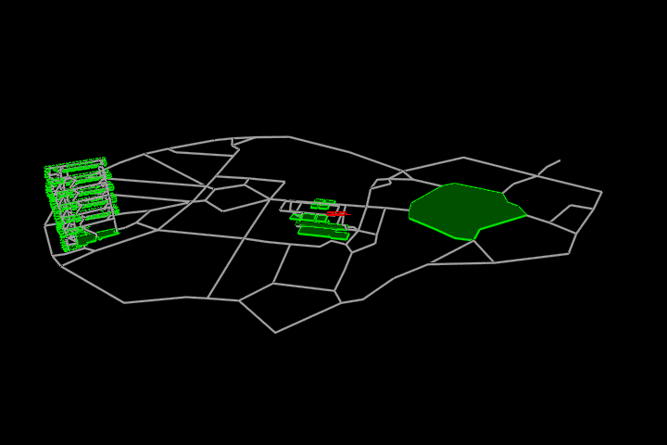
Tracking Example

Slide 53
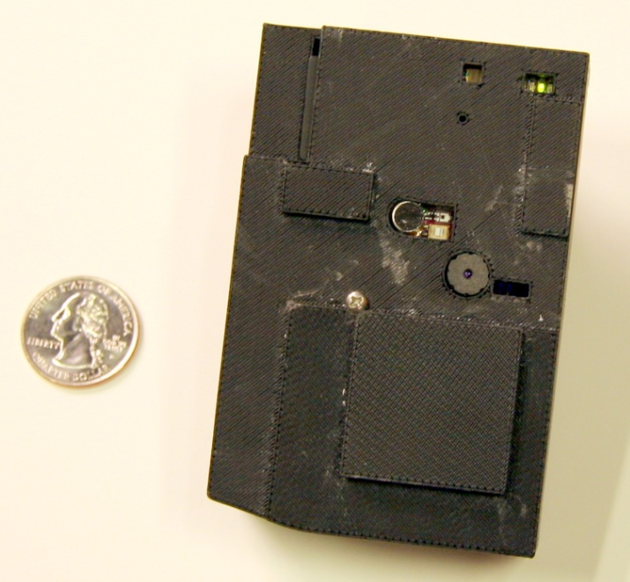
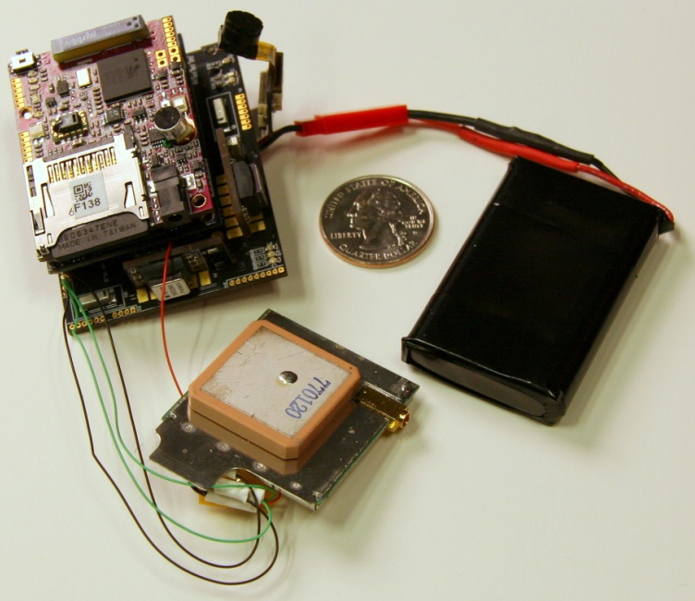
Wearable Multi-Sensor Unit
Indicator LEDs
Camera (on ribbon cable)
Battery
2 GB
SD card
Light
sensors
Microphone
Camera
iMote2 +
two sensor boards
GPS receiver
Records 4 hours of audio, images (1/sec), GPS, and sensor data (accelerometer, barometric pressure, light intensity, gyroscope, magnetometer)

Slide 54
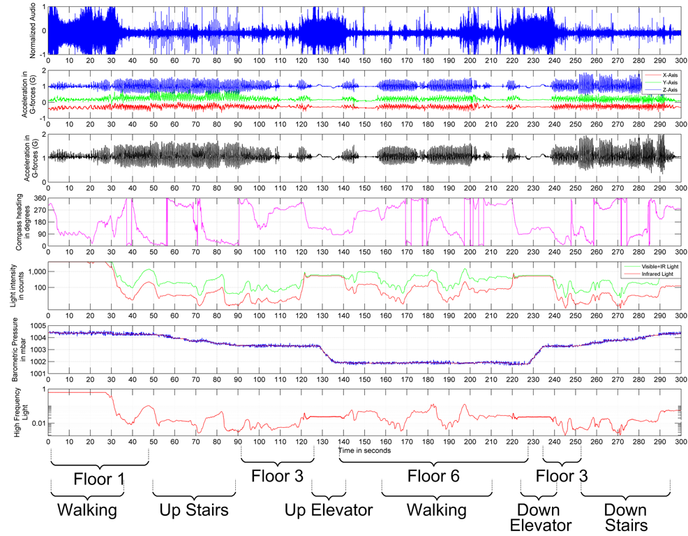
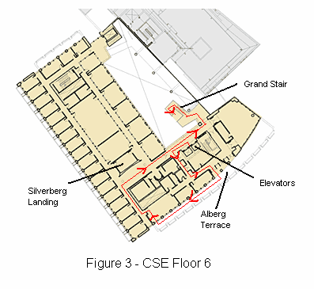
Data Stream
Courtesy of G. Borriello

Slide 55
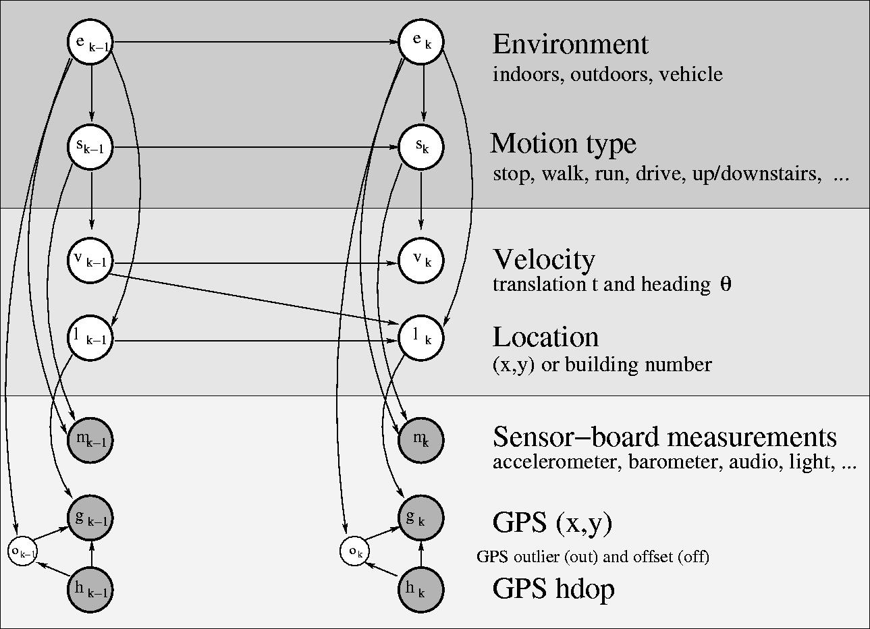
Activity Recognition Model
[Subramanya-Raj-Bilmes-Fox: UAI-06, ISRR-06]
Boosted cassifiers [Lester-Choudhury-etAl: IJCAI-05]
Virtual evidence boosting [Liao-Choudhury-Fox-Kautz: IJCAI-07]
Accuracy: 88% activities, 93% environment
Notes:
Mention that k is time.

Slide 56
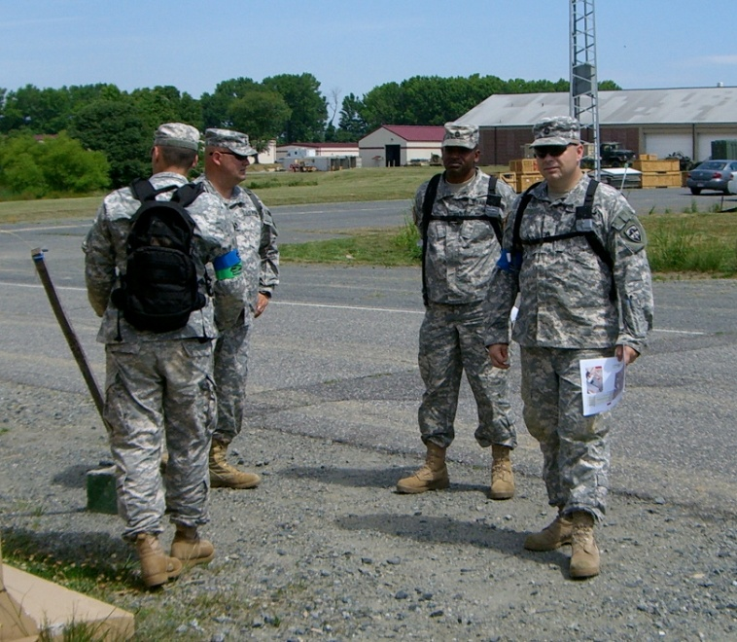
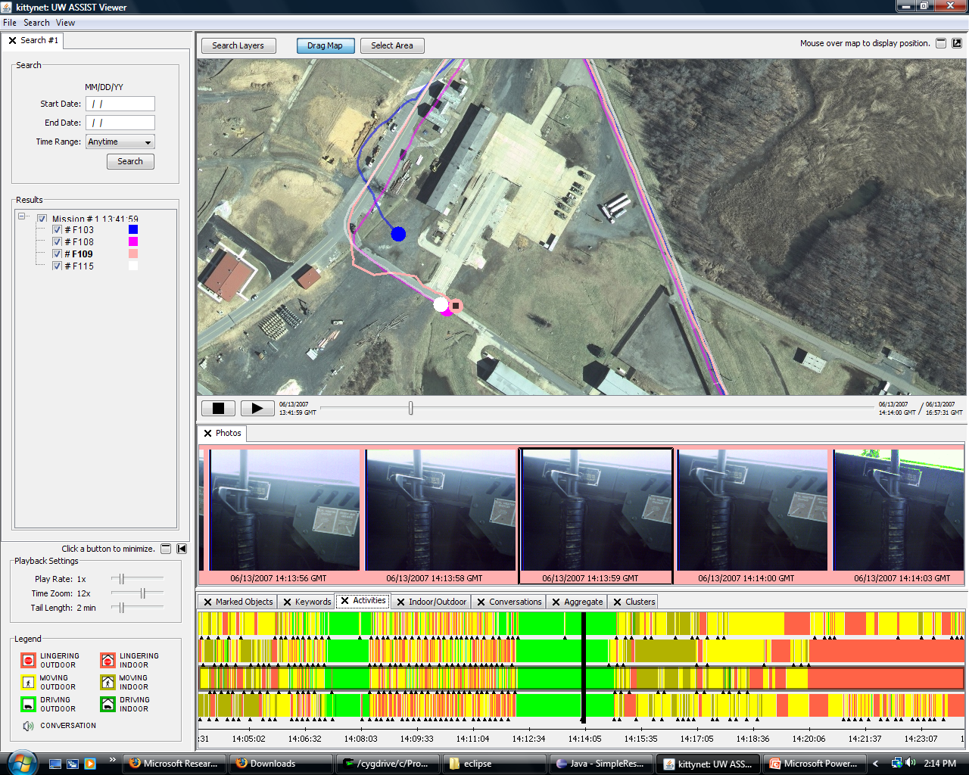
Data Visualization / Summarization
GPS traces
Image sequence
(currently in car)
Timeline of soldier activities

Slide 57
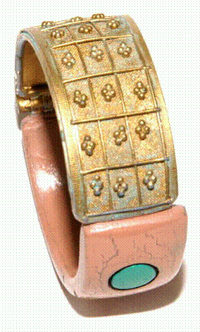

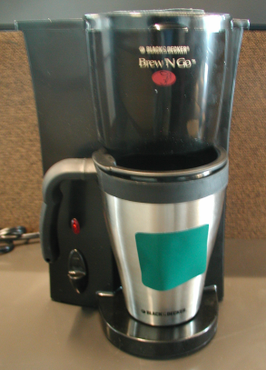
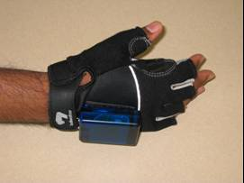
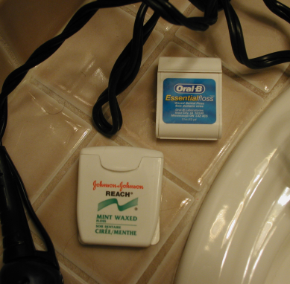
RFID Tags for In-Home Activity Recognition
[Patterson-Fox-Kautz-Philipose: ISWC-05]
[Philipose-Fishkin-etAl: Pervasive-04]

Slide 58
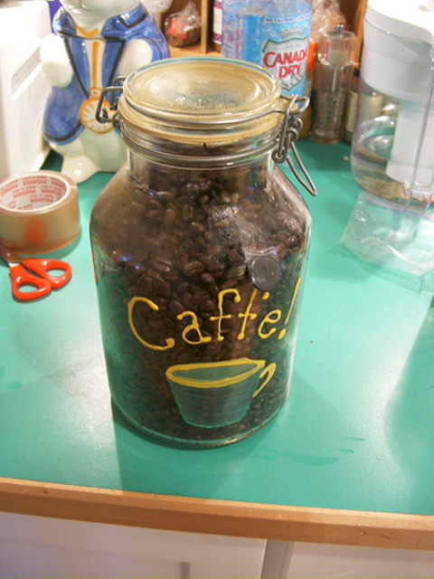
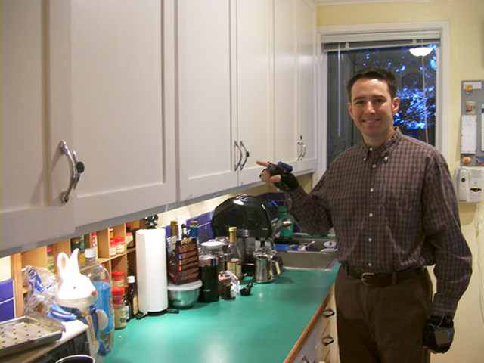
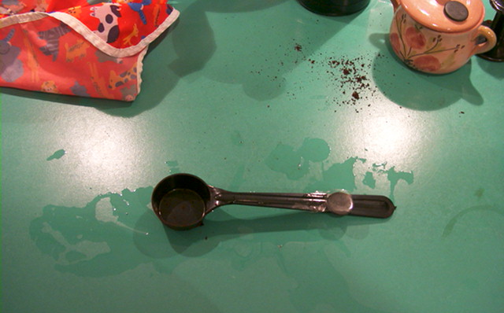
Tracking Breakfast Activities

Slide 59
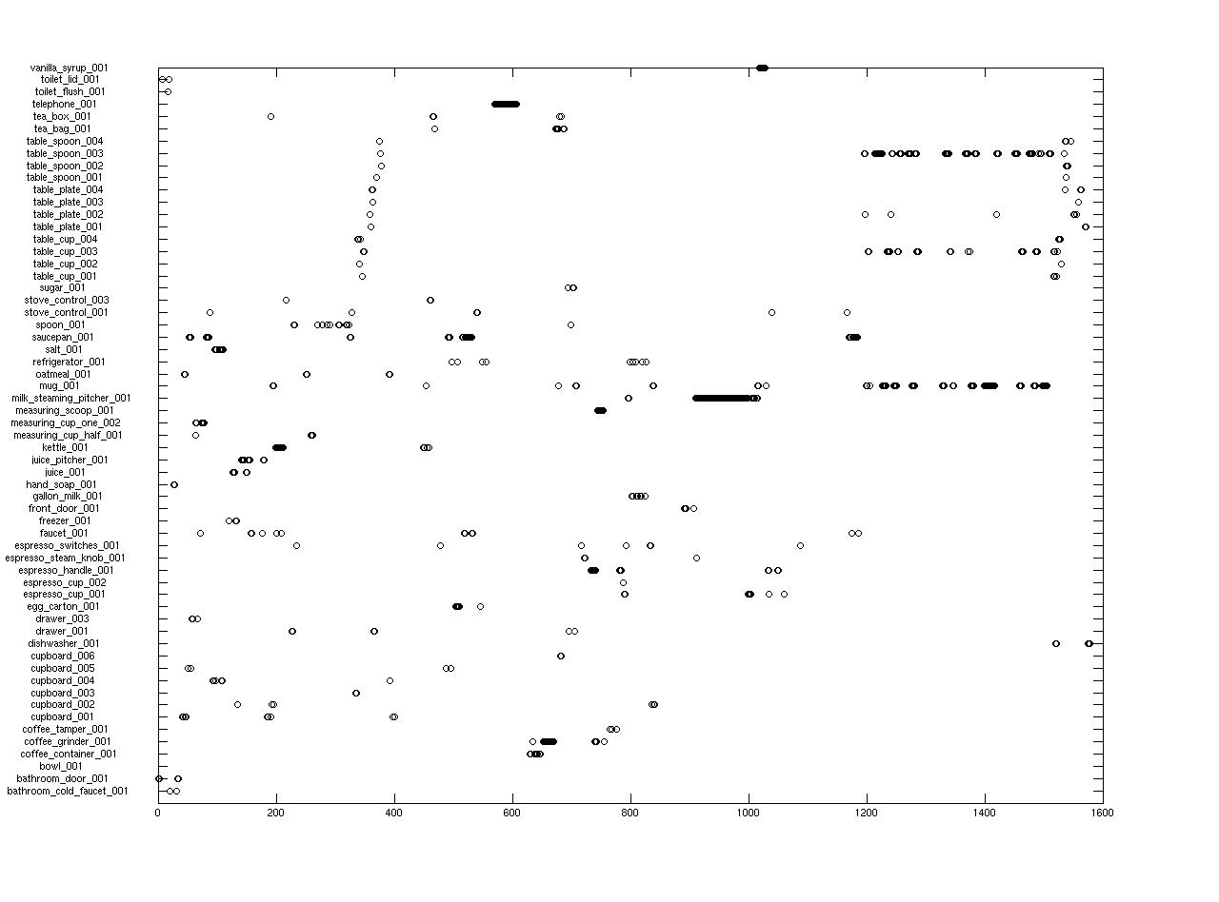
Sample RFID Sequence

Slide 60
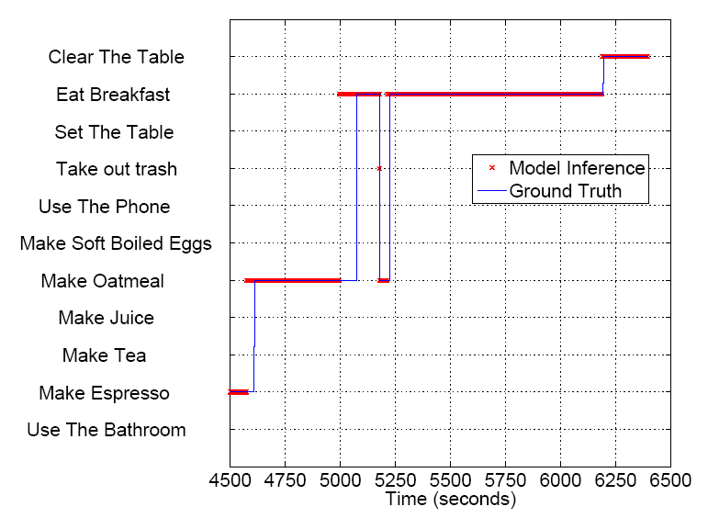
Sample Estimate
Performs object aggregation and smoothing over object types
Accuracy: 88%
SED: 6.4

Slide 61
Outline
Transportation routines via Dynamic Bayes Nets
Significant places via Conditional Random Fields
Activity recognition projects
Discussion

Slide 62
Conclusions
Graph-based representation well suited to compactly represent and learn motion patterns
Hierarchical graphical models (DBN, CRF) powerful tools for bridging gap between continuous sensor data and abstract states
Conditional Random Fields can handle high-dimensional / dependent feature vectors
Sensor-based activity recognition is an exciting research area with potentially huge impact!

