Slide 1
Paxos Made Simple

Slide 2
One-shot Paxos: solving consensus
Multipaxos: Efficient state machine replication

Slide 3
One-shot Paxos: solving consensus
Multipaxos: Efficient state machine replication

Slide 4
Consensus
Get N nodes to agree on a value
{false, true}
{1, 2, 3, ...}
{“attack at dawn”, “retreat at dawn”}

Slide 5
Let’s get pizza!
Let’s get teriyaki!
Let’s get burgers!

Slide 6
See you at burgers.
Oh, the humanity!
See you at burgers.

Slide 7
Consensus
Nodes can fail
Network is asynchronous
Notes:
So we can’t simply have a “boss”, because it might fail.
Non-receipt of a message doesn’t mean the sender didn’t send one.
Timeouts aren’t reliable for decisions.

Slide 8
Consensus
Consensus in an asynchronous environment is unsolvable [FLP1985]
FLP is about liveness
But Paxos solves it anyway
assume the network is eventually well-behaved

Slide 9
Safety
a wrong thing never happens
the system doesn’t decide a value never proposed
two nodes don’t declare different values decided
What invariants that maintain safety?
Liveness
good things eventually happen
the system doesn’t decide a value never proposed
two nodes don’t declare different values decided
What behaviors ensure liveness?

Slide 10
The Most Important Idea In Distributed Systems
The state of a distributed system is:
unsynchronized memories
in-flight network packets
At what commit point can we say that an event occurred?
Turns out this question almost always has a discrete answer. Teasing it out is how you understand the distributed behavior.
Every system behavior after that commit point should reflect the impact of that event.

Slide 11
Consensus
Everybody decides on a single value
The event is when the value was decided.
The commit point is when the value is accepted (and recorded persistently) by a quorum of acceptors.

Slide 12
3,X
3,X
3,X
3,X
3,X
3,X
3,X
3,X
3,X
3,X
3,X
1,X
3,X
1,X
1,X
3,X
3,X
3,X
3,X
3,X
4,X
3,X
4,X
2,Y
2,Y
2,Y
2,Y
2,Y
2,Y
2,Y
2,Y
2,Y
2,Y
2,Y
2,Y
4,X

Slide 13
3,X
3,X
3,X
3,X
3,X
3,X
3,X
3,X
3,X
3,X
3,X
1,X
3,X
1,X
1,X
3,X
3,X
3,X
3,X
3,X
4,X
3,X
4,X
2,Y
2,Y
2,Y
2,Y
2,Y
2,Y
2,Y
2,Y
2,Y
2,Y
2,Y
2,Y
4,X
!decided
decided(X)

Slide 14
Prepare 1?
{⊥, ⊥}
Propose 1,X?
Propose 1,X?
Prepare 2?
Propose 2,Y?
Prepare 3?
Propose 3,Y?
Propose 3,Y?
P1
{⊥, ⊥}
Prepare 3!
Accept 3,Y!
Accept 3,Y!
P2
{2:Y, 1:X, 2:Y}
P3
Prepare 1!
Accept 1,X!
Accept 1,X!
Prepare 2!
Accept 2,Y!
Decide Y
A1
2,Y
3,Y
A2
1,X
1,X
3,Y
A3
2,Y
L

Slide 15
Ballots: motivation
(Suppose f=2, N=2f+1=5)
We need a quorum for the (obvious) reason that otherwise 2/5 acceptors could accept one value, and 2/5 could accept another, and now consensus has failed.
What happens if a quorum (3/5) of acceptors accept a value, and then two of them fail? The commit point has already happened. The value won’t get lost. But how can the rest of the system learn that it has? To get liveness, we need “view change”.

Slide 16
Ballots
The key idea for liveness is that one-shot Paxos can run a sequence of ballots, all regarding the same decision.
From the outside, we know that some ballot will be the first in which the moment of decision occurred.
But from the inside, we need additional ballots to expose that decision
Key invariant: No ballot after the first decided one will mention a value other than the decided value.
So we can keep re-trying the balloting process until it works; when it does, its value reflects the one decided back at the moment

Slide 17
How to maintain the invariant
Constrain what values a leader can propose
Leader must poll acceptors, and honor any latest value observed.
If a value accepted by two acceptors is lost because both failed, that’s okay: it wasn’t decided, either.
Prepare reply: Acceptors must promise (record persistently) to never vote in an earlier ballot, so that the invariant doesn’t break by virtue of an earlier ballot getting decided retroactively.

Slide 18
P1a. An acceptor can accept a proposal numbered n iff it has not responded
to a prepare request having a number greater than n.
==>
P2c. For any v and n, if a proposal with value v and number n is issued,
then there is a set S consisting of a majority of acceptors such that
either (a) no acceptor in S has accepted any proposal numbered less
than n, or (b) v is the value of the highest-ballot-numbered proposal among all proposals numbered less than n accepted by the acceptors in S .
==>
P2b. If a proposal with value v is chosen, then every higher-numbered pro-
posal issued by any proposer has value v .
==>
P2a. If a proposal with value v is chosen, then every higher-numbered pro-
posal accepted by any acceptor has value v .
==>
P2. If a proposal with value v is chosen, then every higher-numbered pro-
posal that is chosen has value v .

Slide 19
One-shot Paxos: solving consensus
Multipaxos: Efficient state machine replication

Slide 20
Alice: deposit $20
Bob: withdraw $10
Alice: transfer $5 Bob
Alice: balance $80
Bob: denied NSF
Alice: transfer OK
Notes:
A “run” of a program can be characterized by the state machine plus its sequence of inputs.

Slide 21
Alice: deposit $20
Bob: withdraw $10
Alice: transfer $5 Bob
Alice: balance $80
Bob: denied NSF
Alice: transfer OK
Notes:
If N nodes execute the same program with the same inputs, they’ll create the same states, and generate the same output.
So let’s run our state machine on N machines with f faults, but maintain the illusion that it works flawlessly.

Slide 22
Bob: withdraw $10
proposals
Alice: deposit $20
Alice: transfer $5
Alice: transfer $5
Decide
Decide
Decide
[ , , , ...]
decided inputs
Alice: deposit $20
Bob: withdraw $10
Alice: transfer $5 Bob
Notes:
A “run” of a program can be characterized by the state machine plus its sequence of inputs.

Slide 23
Multipaxos
Decide each slot in the input sequence separately
Can execute through the prefix of decided slots

Slide 24
[ _ , _ , _ , _ , _ , _ , _ , _ , _ , _ , ...]
Prepare doesn’t depend on values
[ X , Y , W , _ , _ , _ , _ , _ , _ , _ , ...]
Prepare whole range
with one message
Leader 1 allocates, prepares these slots
[ X , Y , W , _ , _ , _ , _ , _ , _ , _ , ...]
Leader 1 commits some ops
...and then dies.
[ X , Y , W , _ , _ , Z , V , _ , _ , _ , ...]
Leader 2 allocates, prepares these slots
[ X , Y , W , ∅ , ∅ , Z , V , _ , _ , _ , ...]
Leader 2 starts committing ops
… but they can’t execute until these holes are filled!
Leader 2 backfills holes with decided values or no-ops

Slide 25
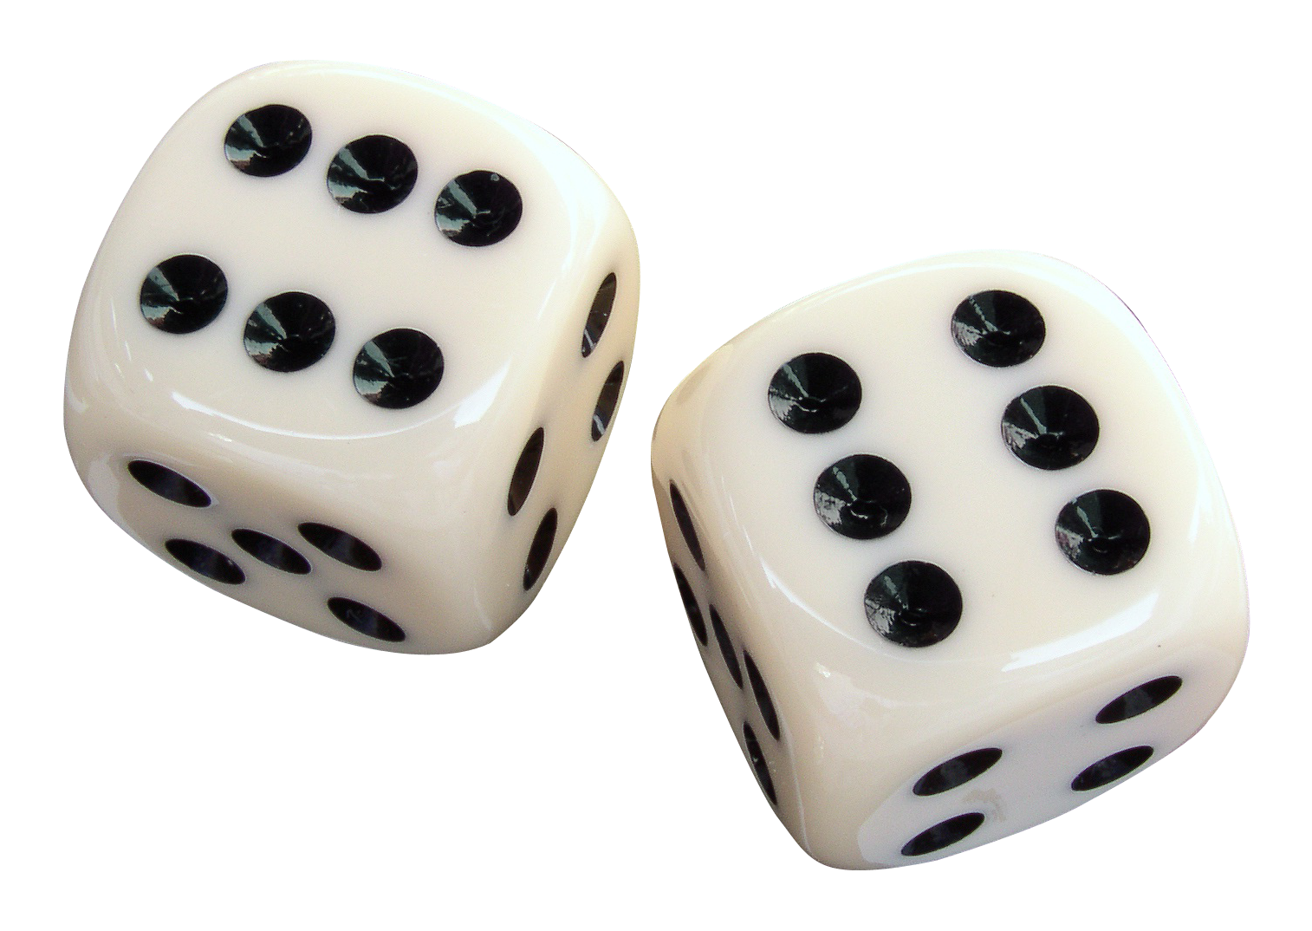
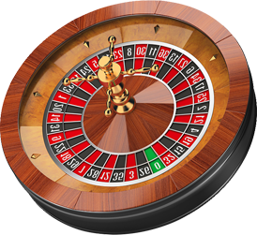
Determinism a practical challenge
Make the program deterministic
Use PRNGs with consistent seed
Can’t call the clock! Time comes from Paxos inputs.
All libraries must be deterministic
Exposed malloc pointers, exposed hash table fills
Notes:
Dice: https://pngimg.com/download/54797
Stopwatch: http://pngimg.com/download/6628
Roulette wheel: http://pngimg.com/download/48356

Slide 26
Determinism
Or, accept a nondeterministic program. Execute it once before consensus and decide on the state update.

