Slide 1
In-network computation
CSE 552
preparation for reading

Slide 2
Modern data center network topology
Each server accesses the network via a single top-of-rack switch
Single point of failure
Server-rack correspondence known to applications, so they can treat a rack as a failure domain

Slide 3
Modern data center network topology
Each network element has multiple connections to the higher layer
Network is internally
fault tolerant

Slide 4
Modern data center network topology
Fat-tree topology uses higher-bandwidth links in higher layers
...but not so much that oversubscription is impossible
Statistically, oversubscription is highly unlikely

Slide 5
Modern data center network topology
Switch buffers are large, and traffic engineering avoids congestion
Packet loss is very rare

Slide 6
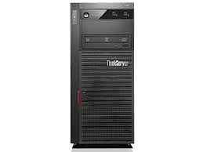
Software-defined networking (SDN)
Switches and routers have many functions: routing, traffic engineering, congestion control, virtual networking, migration support, etc.
For fault tolerance, can be a replicated state machine
Central component manages all functionality, and enacts its choices by disseminating configuration data to network elements
e.g., routing tables

Slide 7
Programmable network hardware
Switches involve complex internal processing
Some modern switches expose that capability by being programmable, e.g., in the P4 language

