Slide 1
Chain Replication lecture

Slide 2
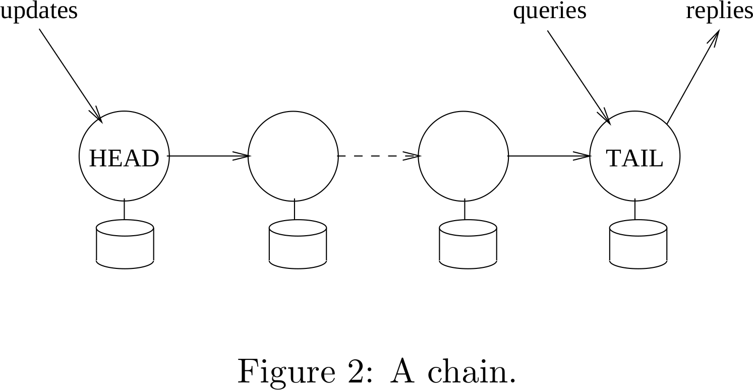

Slide 3
When is the serialization commit point of each operation?

Slide 4
behavior during failure

Slide 5
failure recovery: node removal
queries
replies

Slide 6
failure recovery: node removal
updates
old
update

Slide 7
failure recovery: node removal
update
k-1
update
k-1
update
k-1

Slide 8
failure recovery: node addition
queries
replies
TAIL

Slide 9
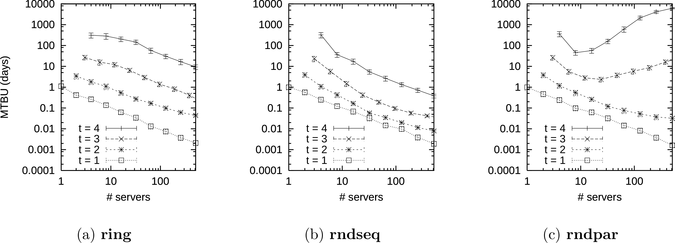

Slide 10
Chain Replication:
State machine replication with f+1 replicas

Slide 11
Look for...
...how the offered semantics compare to other approaches (Paxos, primary/backup).
...how the performance characteristics compare to other approaches.
updates, queries
healthy; under various failures

