Slide 1
CSE 552 Intro
Jay Lorch & Jon Howell

Slide 2
Class Mode
We’ll study papers, old and new
We’ll focus on correctness
Lecturers will preview papers one class ahead
Read the optional paper to get smarter
Before 9am each class day, make an insightful comment about one of the papers on the discussion thread
Lecturers will have some prepared material
Students will discuss the paper in class, moderated by lecturers

Slide 3
Discussion Expectations
Don’t discuss in class if you haven’t read the paper for that class.
Keep your comments and questions relevant to the topic.
Don’t make so many comments that other students feel excluded.
Some topics may be deferred to discussion outside class.

Slide 4
Grading
Participation in online forum and class discussions: 15%
Problem sets: 15%
Research project: 50%
Final exam: 20%

Slide 5
Research Project Criteria & Goals
Practice the art of distributed systems
design
evaluating performance
prove correct
Driver to get you to build something
this is systems
THERE WILL BE A LOT OF CODING
IT WILL NOT BE FOR THE FAINT OF HEART
Potential to publish a paper
or at least practice on your way to a systems submission
Team size 1-3
Compute resources available

Slide 6
Research Project Due Dates
April 12 | Initial one-page research project proposal
May 3 | Three-page outline of research project, including a complete introduction
May 24 | Five-page version of research project paper, including a complete discussion of related work
June 11 | Complete research paper due. 8-10 pages.
June 10 (-14) | Research project presentations, scheduled individually

Slide 7
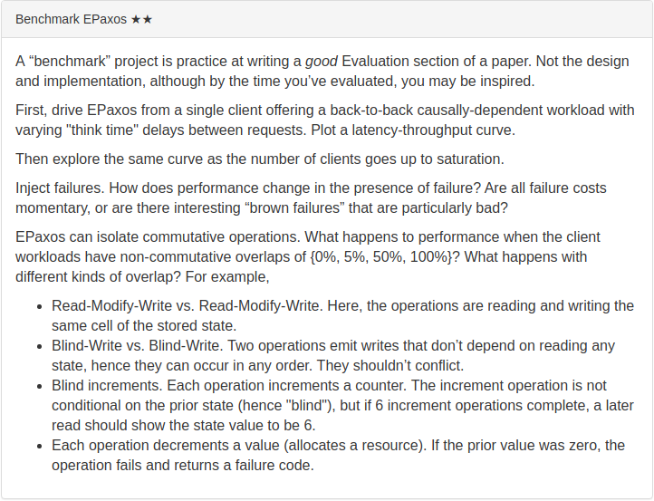

Slide 9
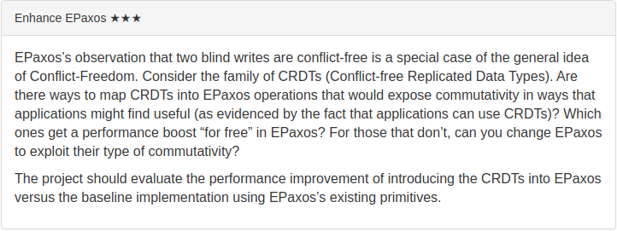

Slide 10
