Slide 1
Byzantine fault tolerance
CSE 552
preparation for reading

Slide 2
Byzantine means “acting arbitrarily”
Paxos assumes fail-stop behavior
Replicas fail only by stopping
Byzantine fault-tolerant protocols assume nothing about faulty replicas
They can do anything
Except they can’t break cryptography
Useful for modeling both active adversaries and arbitrary failures

Slide 3
Asymmetric cryptography provides secrecy
K_{private}
K_{private}
K_{pub}
K_{pub}
Secret
H%{9.v
Secret
H%{9.v

Slide 4
Symmetric cryptography also provides secrecy
K_{shared}
K_{shared}
Secret
H%{9.v
Secret
H%{9.v

Slide 5
Asymmetric cryptography provides integrity with digital signatures
K_{private}
K_{private}
K_{pub}
K_{pub}
Message

Slide 6
Symmetric cryptography provides integrity with message authentication codes (MACs)
K_{shared}
???
K_{shared}
Message
Much faster than asymmetric cryptography
Signature is meaningless to anyone else, so you can’t pass it on to others

Slide 7
Associated tech report
Tech reports have more useful material
Explanation of how MACs are used (TM-589, pp. 7–10)
Invariants of basic safety proof (TM-590, pp. 11–20)
[4] M. Castro and B. Liskov. A Correctness Proof for a Practical Byzantine-Fault-Tolerant Replication Algorithm. Technical Memo MIT/LCS/TM-590, MIT Laboratory for Computer Science, 1999.
[5] M. Castro and B. Liskov. Authenticated Byzantine Fault Tolerance Without Public-Key Cryptography. Technical Memo MIT/LCS/TM-589, MIT Laboratory for Computer Science, 1999.

Slide 8
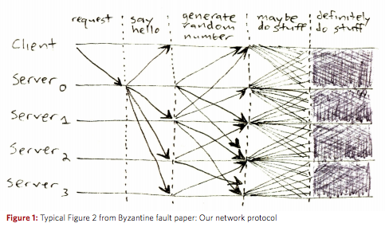
BFT protocols can be complicated
J. Mickens, The Saddest Moment, ;login, May 2013, available online at https://scholar.harvard.edu/files/mickens/files/thesaddestmoment.pdf

