Slide 1
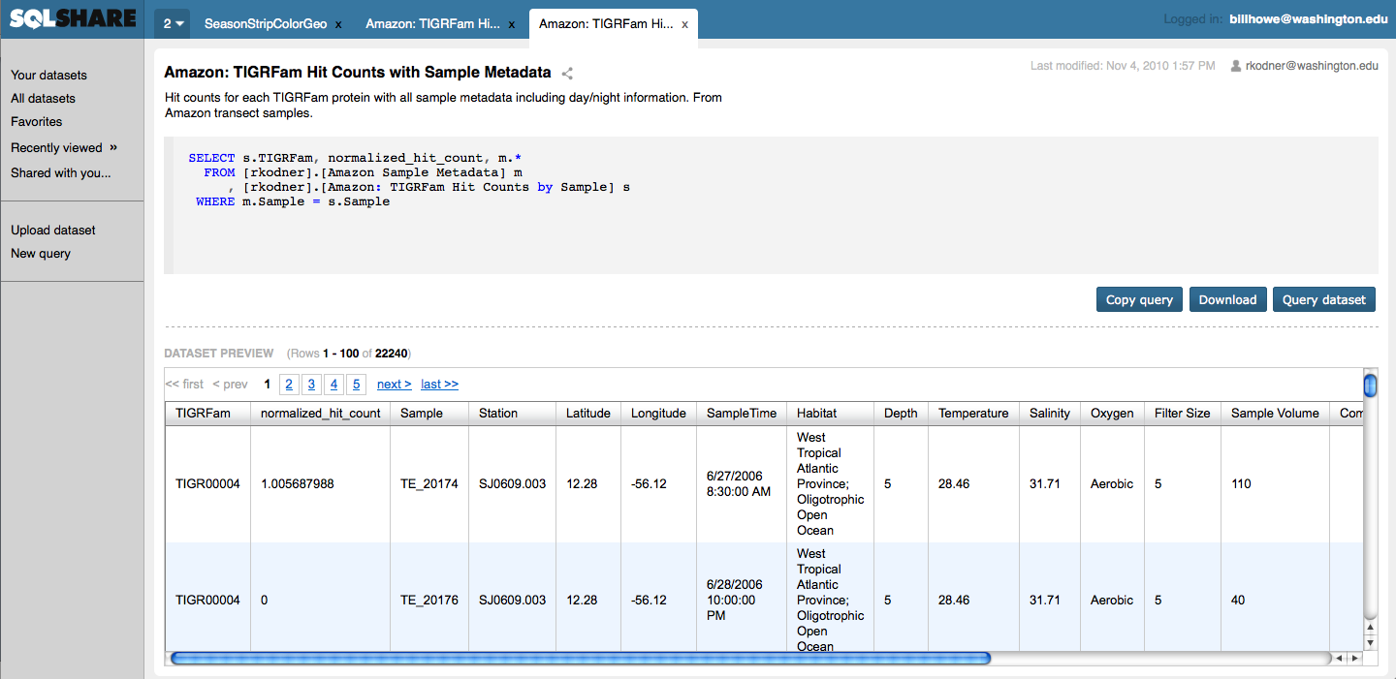
SQLShare CLI interface
(Python)
SQLShare
Python Interface
(Python)
SQLShare UI
(HTML/Javascript)
SQLShare
(Solstice, Perl, EC2)
SQLShare REST API
(C#, Web Role, Windows Azure)
SQLShare Database
(SQL Azure; SQL Server on EC2)

Slide 2
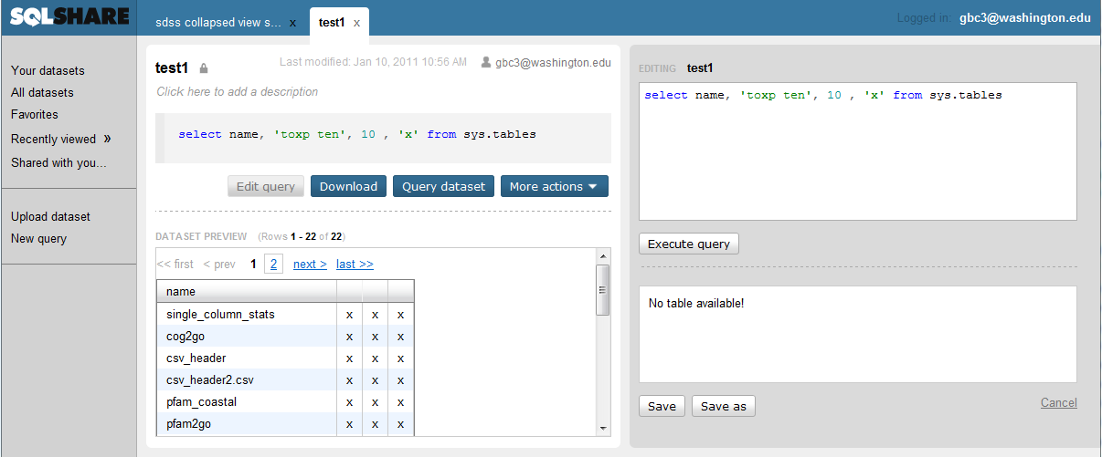
Saved as:
My employees
SQL:
SELECT * FROM Employees
SQLShare
(Solstice, Perl, EC2)
URL:
..REST/db/query/userX
JSON BODY
sql_code: SELECT * FROM Employees
description: foo
Is_public: false
REST PUT
QUERY METADATA
sql_code: SELECT * FROM..
description: foo
Is_public: false
name: My Employees
owner: userX
SQLShare REST API
(C#, Web Role, Windows Azure)
SQLShare Database
(SQL Azure)
VIEW DEFINITION
[userX].[My Employees]
Notes:
User saves a query in the UI giving a save name and some the select statement. The user may additionally provide an english description if necessary as well as whether the dataset should be public for all users.
The PERL code takes the request and wraps it in a REST ‘PUT’ request using a JSON body as the content type.
The backend server parses the request and attempts to:
Execute the query to know it is a valid SQL select statement
Create (or replace) a view in the dataspace that belongs to that user
Build a .NET object cache of the tables top 100 records for fast retrieval
If any of these steps fail, the saved query is aborted
The UI polls the REST server for the ‘cached’ 100 records to show the user after the save was successful.

Slide 3
Links
Application
http://sqlshare.escience.washington.edu
Project Page
http://escience.washington.edu/sqlshare
Subversion Repository
https://subversion.assembla.com/svn/sqlshare/

Slide 4
Get the Code
Subversion repository on Assembla
https://subversion.assembla.com/svn/sqlshare/
trunk/
client/
server/
pythonclient/

Slide 5
REST API
Partial implementations in Ruby, Python, Perl, C#
Contact me for code

Slide 6
Dev environment
Amazon Machine Image
With Apache, code, etc. all installed
Ask me if you’re interested, and I’ll launch you an instance
Patrick Michaud (pmichaud@uw.edu) for other questions

